Slide 1
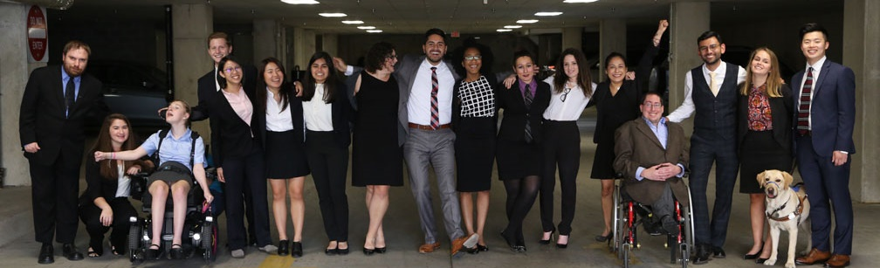

Ensuring Best Practices for Disability Inclusion
Proven Positive Messaging to Achieve
Positive Change

Slide 2
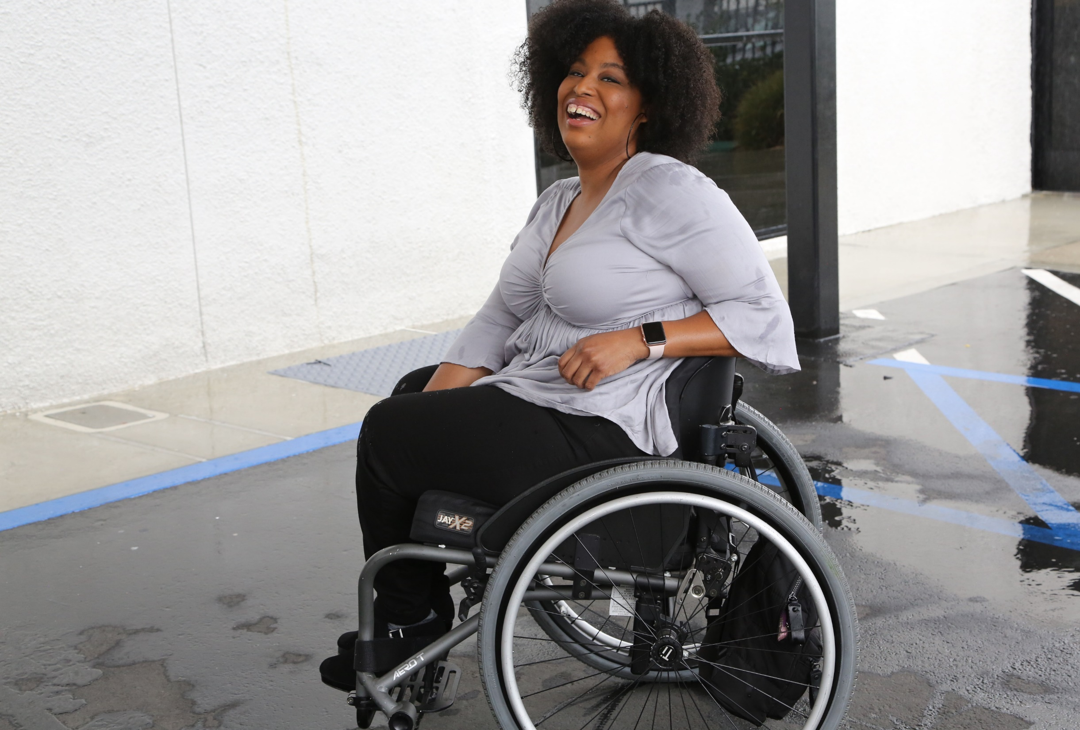

1 in 4 adults
61 million people in America have disabilities.
1-in-5
people have a disability
(physical, sensory, cognitive, mental health or other disability)

Slide 3
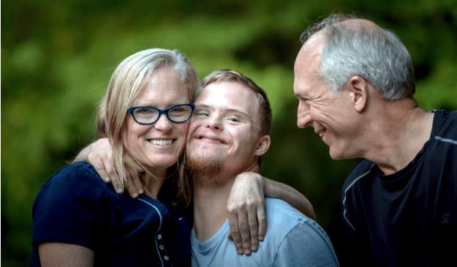
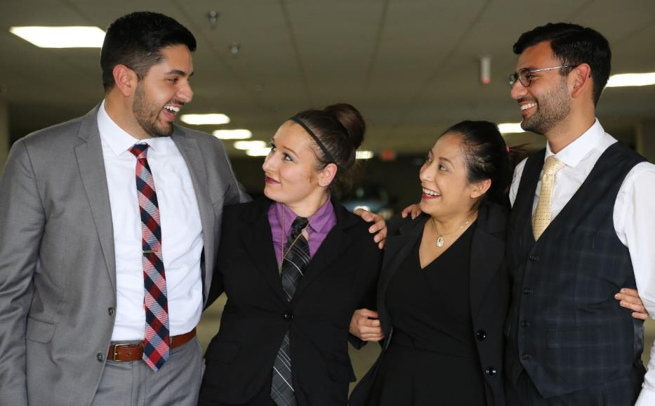
Americans are Connected to People with Disabilities
have a family member with a disability
have a close friend with a disability
48%
42%
* Source: September 2012 poll, Laszlostrategies.com

Slide 4
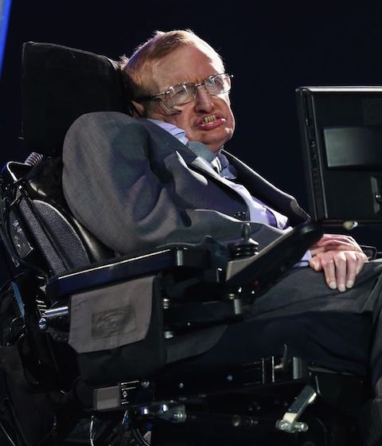
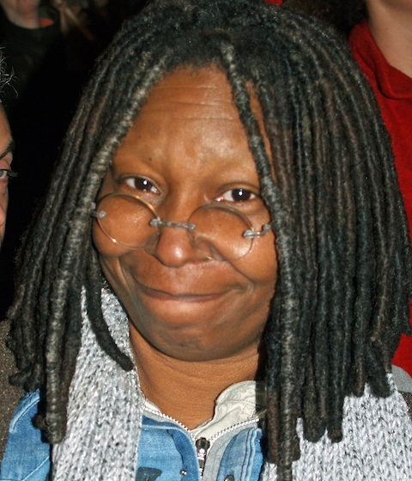


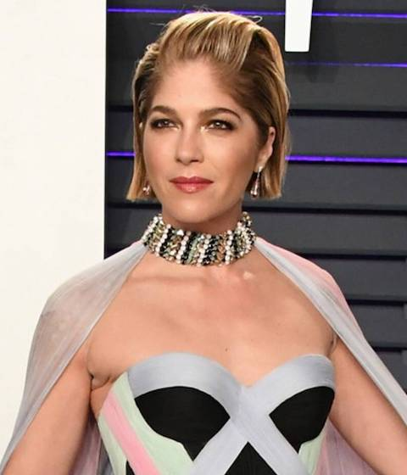
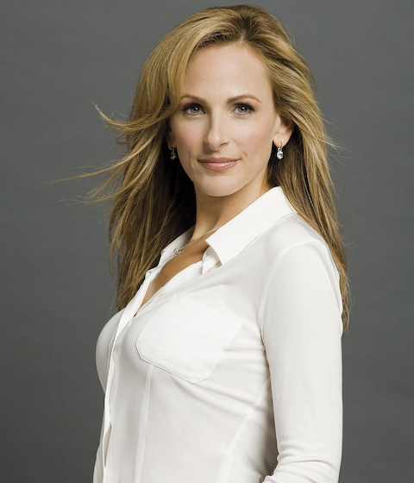

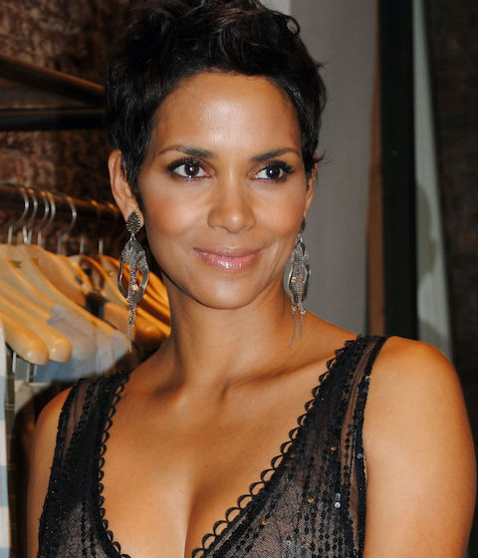
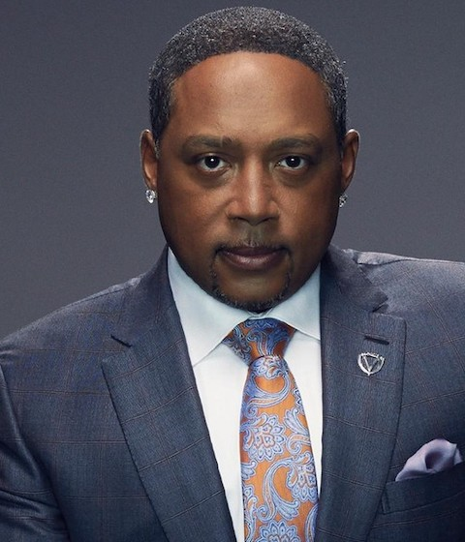
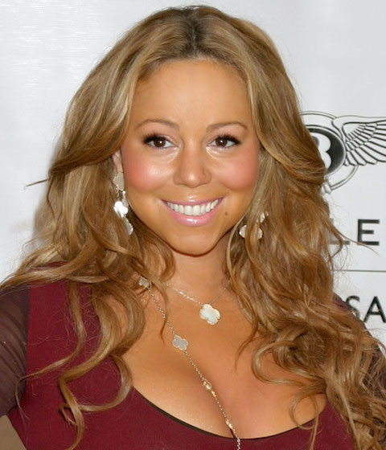
These art people with disabilities
These are people with disabilities.

Slide 5

More than 2 in 5 voters report having a disability and/or having a family member or a close friend with a disability.
Do you, a family member, or a close friend have a disability, such as a physical, mental health, sensory, learning, cognitive or other disability that impacts daily living? If yes, then please let me know which applies.

Slide 6
Employment

Slide 7
Methodology – 2020 Polling
Lake Research Partners and The Tarrance Group designed and administered this pre-election and election night survey which was conducted using professional interviewers from October 31 – November 3, 2020. The questions about voting and the demographics reached a total of 2,400 voters nationwide who voted in the 2020 elections or who were planning to vote later on Tuesday – 1,335 interviews among voters who were reached on cell phones, including 600 interviews completed by text-to-online, and 1,065 interviews among voters who were reached on landlines (margin of error +/- 2.0%). Issue questions reached a total of 1,200 voters nationwide who voted in the 2020 elections or who were planning to vote later on Tuesday (margin of error of +/-2.8%).
Telephone numbers were drawn from the TargetSmart voter file. The sample was stratified geographically based on the proportion of likely voters in each region. The data were weighted to reflect the aggregated Presidential vote as reported in the 2020 exit polls, as well as by gender, age, race, party identification, education, marital status, union household, and census region to reflect the actual proportions of the electorate.
Due to rounding some of the numbers in the presentation will not always add to 100%.

Slide 8
At least 9 in 10 voters agree that our communities are at their best when all people, including people with disabilities, have opportunities, and that people with disabilities should be at decision making tables just like everyone else
Now let me read you some statements and please tell me if you agree or disagree with each statement. [TIER ONE]
All Voters
 | Not so strongly agree
 | Strongly agree

Slide 9
The top tier of statements is strong across gender, age, educational attainment, race, and party identification. African Americans, Democrats, and Biden voters are especially likely to strongly agree.
Tell me if you agree or disagree with each statement. [TOP TIER]
% Strongly Agree | All | Men | Women | <30 | 30-39 | 40-49 | 50-64 | 65+ | Non-College | College | White | AA | Latinx | API | Dem | Ind | Rep | Voted Trump | Voted Biden
Our communities are at their best when all people, including people with disabilities, have the opportunity … | 80 | 78 | 82 | 76 | 80 | 77 | 83 | 82 | 81 | 79 | 81 | 82 | 74 | 71 | 85 | 80 | 75 | 75 | 85
People with disabilities should be at decision making tables, just like anyone else | 76 | 76 | 76 | 69 | 75 | 78 | 77 | 79 | 78 | 74 | 78 | 82 | 67 | 63 | 82 | 78 | 69 | 69 | 83
Disability issues should be included in national policies on health care | 73 | 71 | 75 | 72 | 71 | 71 | 72 | 79 | 75 | 70 | 74 | 81 | 64 | 59 | 83 | 72 | 63 | 63 | 84
Candidates and their campaigns should reach out to and include people with disabilities … | 70 | 68 | 73 | 65 | 64 | 73 | 72 | 75 | 71 | 70 | 70 | 81 | 70 | 59 | 80 | 69 | 61 | 62 | 79
America's leaders should fight stigmas and bias that limit opportunities for people with disabilities | 70 | 68 | 71 | 70 | 68 | 71 | 69 | 71 | 70 | 70 | 69 | 81 | 69 | 66 | 78 | 73 | 60 | 60 | 79

Slide 10
The top tier of statements is also strong in the disability community, especially among voters with disabilities. More than 9 in 10 older voters with disabilities and voters with disabilities in battleground states strongly agree.
Tell me if you agree or disagree with each statement. [TOP TIER]
% Strongly Agree | All Voters | PWD | Fam | Friend | All Dis. Comm. | PWD Men | PWD Women | PWD <50 | PWD 50+ | Heard Issues Biden | Heard Issues Trump | Didn’t Hear Biden | Didn’t Hear Trump | PWD BG States | Dis. Com. BG States
Our communities are at their best when all people, including people with disabilities, have the opportunity … | 80 | 91 | 85 | 84 | 87 | 91 | 91 | 86 | 95 | 88 | 81 | 83 | 73 | 92 | 87
People with disabilities should be at decision making tables, just like anyone else | 76 | 85 | 78 | 77 | 80 | 87 | 83 | 83 | 86 | 85 | 69 | 82 | 70 | 85 | 80
Disability issues should be included in national policies on health care | 73 | 84 | 80 | 77 | 81 | 86 | 82 | 84 | 84 | 86 | 66 | 83 | 61 | 88 | 84
Candidates and their campaigns should reach out to and include people with disabilities … | 70 | 81 | 77 | 63 | 76 | 83 | 79 | 76 | 85 | 83 | 66 | 77 | 61 | 79 | 75
America's leaders should fight stigmas and bias that limit opportunities for people with disabilities | 70 | 79 | 75 | 68 | 75 | 79 | 78 | 78 | 80 | 82 | 70 | 77 | 57 | 80 | 75

Slide 11
Key Findings – Election Overview
The economy and jobs and COVID-19 dominated voters’ issue concerns, with 30% saying the economy and jobs and 28% saying COVID-19 was one of the two most important issues in deciding for whom to vote. This is followed by health care (18%), dysfunction in government (16%), and racial justice (14%).
  Voters concerned with the economy and jobs overwhelmingly favored Trump (80%) over Biden (19%). Biden had similarly large margins among voters concerned with COVID-19: 82% voted for Biden compared to 18% who voted for Trump.
Among voters with disabilities, COVID-19 (24%) and the economy and jobs (22%) were the most important issues in deciding for whom to vote. 26% of the broader disability community said COVID-19 and the economy and jobs were the most important issues, too.
  Voters with disabilities who chose COVID-19 as one of the most important issues this election voted 77% for Biden and 21% for Trump. Voters in the broader disability community who chose COVID-19 voted 86% for Biden and 14% for Trump.

Slide 12
A solid majority of voters believe it is very important that candidates treat people with disabilities with dignity and respect – a core value among all voters, voters with disabilities, and the broader disability community since 2016. The simple act of treating disabled people with respect is powerful and in an election season where hundreds of races were decided by 5-points or less, courting these groups is good politics and good policy.
How important is it to you personally that candidates treat people with disabilities with dignity and respect?
^Lake Research Partners and The Tarrance Group a pre-election and election night omnibus survey November 6 through November 8, 2016, that included issue questions on behalf of RespectAbility. A total of 1,200 likely voters nationwide who voted in the 2016 elections (margin of error of +/-2.8%) were reached.
^^Lake Research Partners conducted a mixed mode survey for NDRN from August 12 – August 20th, 2019 among 1,000 adults nationwide with a disability, or who have an immediate family member or close friend with a disability.
 | Somewhat important |  | A little important
 | Very important |  | Not important at all

Slide 13
Key Findings – Candidates and Disability Issues
A solid majority of voters believe it is very important that candidates treat people with disabilities with dignity and respect (83%) – a core value among all voters, voters with disabilities, and the broader disability community since 2016.
  We see the greatest intensity of support among voters with disabilities (90%), the disability community (88%), older voters (87%), whites (85%), African Americans (86%), and Democrats (89%). There is a 13-point gap in intensity between Biden and Trump voters – 90% among Biden voters to 77% among Trump voters.
Sixty percent of voters believe it is very important that congressional and presidential campaigns address issues that are important to people with disabilities as well. Voters with disabilities (81%), including 79% of voter with disabilities in battleground states and 86% of older voters with disabilities, and African Americans (77%) are especially likely to say it is very important.

Slide 14
Years of Research Prove Efficacy of Positive and Updated Messaging
Years of research have demonstrated that support for increased employment for people with disabilities is best achieved with positive messaging. This most recent research is built on earlier message testing and shows the same core assumptions.
One caveat to consider which has been addressed in the most recent research is that the messaging no longer includes the term “American dream”. While there is still a shared core value in America that hard work should translate to success, there is also a recognition that the “American dream” is far more accessible to those who are white and privileged.

Slide 15
Methodology – 2014 Polling
This presentation is based on a bi-partisan survey conducted by the Democratic polling firm Greenberg Quinlan Rosner and the Republican polling firm North Star Opinion Research conducted in the Senate Battleground.
The survey of 1000 likely 2014 voters was conducted from September 20-24, 2014, in the Senate Battleground.
The Senate Battleground is comprised of AK, AR, CO, GA, IA, KY, LA, MI, MT, NH, NC, and WV.
Unless otherwise noted, margin of error= +/-3.10 percentage points at 95% confidence.
We reached 40 percent of our respondents by cell phone, in order to account for ever-changing demographics and trying to accurately sample the full American electorate.

Slide 16
Positive Values Make for the Strongest Message
Now I am going to read you statements people who want to make increasing levels of employment among people with disabilities more of a national priority have made. After each statement I read, please tell me if you find it to be a very convincing, somewhat convincing, not very convincing or not at all convincing reason to make increasing levels of employment among people with disabilities more of a national priority. | Total (Very Convincing) | Disability Community (Very Convincing)
Our nation was founded on the principle that anyone who works hard should be able to get ahead in life. People with disabilities deserve to be able to work to achieve the American dream, just like anyone else | 58 | 62
Companies like Walgreens, E.Y. which was formally known as Ernst and Young, AMC and others have shown that employees with disabilities are loyal, successful and help them make more money. If we find the right jobs for the right people it can and does increase the bottom line of companies | 47 | 48
People with disabilities bring unique characteristics and talents to workplaces that benefit employers and organizations. Stephen Hawking is a genius who happens to use a wheelchair. People with disabilities can work in restaurants, tend our parks, and be super talents in developing computer software. | 41 | 40
Notes:
KGW: Unique talents (Disability community): 42 => 40
Reformatted

Slide 17
Positive Values Make for the Strongest Message (2)
Now I am going to read you statements people who want to make increasing levels of employment among people with disabilities more of a national priority have made. After each statement I read, please tell me if you find it to be a very convincing, somewhat convincing, not very convincing or not at all convincing reason to make increasing levels of employment among people with disabilities more of a national priority. | Total (Very Convincing) | Disability Community (Very Convincing)
Government policies that help people with disabilities get and keep jobs are a win-win because they allow people with disabilities the dignity and financial benefits of work and also grow our economy and save taxpayer money. | 41 | 42
We cannot afford to have more than 10 million Americans who are able to work sit at home and collect benefits when they could help make America stronger. Our current system costs 350 billion dollars a year and actually discourages people from working. It is not sustainable. | 38 | 38
Progress in science, healthcare, innovation and better access to education has made Americans with disabilities more qualified than ever before. Americans with disabilities also have real abilities and want to work. Times have moved ahead - it's time for our workforce to do the same. | 32 | 34
Notes:
KGW: Win Win (Disability community) 40 => 42
Reformatted

Slide 18
Methodology - Disability Community Research
In July 2014, RespectAbilityUSA set out to examine the issue landscape and attitudes surrounding employment of people with disabilities (PwDs) in America today. We held focus groups in the Washington, D.C. area, followed by a poll of more than 3,800 PwDs, friends, families, and professionals in the disability community.
The survey was fielded November 6 – December 2, 2013 and includes 3839 respondents, 1969 of whom are people with disabilities. It is important to note that while this study is extremely extensive and has a large sample size that this poll was fielded almost exclusively online and was distributed widely via social media and by partnering organizations in the disability community. The sample therefore includes the ‘activist’ PWD community and reflects more women, more Democrats, and a more highly educated audience than one might expect within the disability community overall. Phone survey options and assistance were made available to respondents although, due to the nature of the online survey instrument, the sample likely underreports people with cognitive and intellectual disabilities among others.

Slide 19
Nearly Three-Quarters of PwDs Want Jobs and Independence Over Benefits

Slide 20
Belief in the Dignity and Importance of Work
More Than ¾ of PwD Say Job is Important to Happiness
How important is having a job to you/your friend/ family member’s happiness?
 | PWD | F/F/P/V
Extremely Important | 58% | 55%
Somewhat Important | 27% | 22%
Neutral | 10% | 14%
Not Very Important | 2% | 3%
Not Important At All | 3% | 6%

Slide 21
Attitude is Perceived as Biggest Barrier
What do you think would make the most impact in helping people with disabilities to find a job?
 | PwD Comb | F/F/P/V Comb
CHANGE IN ATTITUDES SO THAT EMPLOYERS SEE THE POSITIVE VALUE OF HIRING PEOPLE WITH DISABILITIES | 40% | 38%
MORE TRAINING FOR EMPLOYERS ON SUCCESSFULLY RECRUITING, HIRING, AND ACCOMMODATING EMPLOYEES WITH DISABILITIES | 37% | 34%
A CHANGE IN DISABILITY BENEFITS SO THAT RECIPIENTS COULD WORK WITHOUT RISKING LOSING THEM ALTOGETHER | 41% | 30%
AFTER SCHOOL BASE TRAINING AND TRANSITION SERVICES TO PREPARE PEOPLE WITH DISABILITIES FOR WORK | 20% | 29%
MORE INTERNSHIP AND EARLY WORK OPPORTUNITIES FOR YOUNG PEOPLE WITH DISABILITIES | 20% | 26%
MORE AND BETTER PROGRAMS THAT ASSIST PEOPLE WITH DISABILITIES WITH FINDING WORK | 23% | 25%
MORE GOVERNMENT INCENTIVES AND LAWS FOR COMPANIES TO HIRE PEOPLE WITH DISABILITIES | 21% | 19%

Slide 22
Emphasis on the Strength of What PwDs Can Do,
Not Complaining
 | 1st | Comb | Dem 1st | Rep 1st | Ind 1st
People with disabilities bring unique characteristics and talents to workplaces that benefit employers and staff. Stephen Hawking is a genius who happens to use a wheelchair. People with disabilities can bag groceries, tend our parks and schools, and be super talents in developing computer software. | 37% | 66% | 37% | 33% | 36%
Our nation was founded on the principles of “All Men Are Created Equal.” Fifty years after Martin Luther King, Jr. delivered his “I Have a Dream” speech, we still need to reach our civil rights goal. People, with disabilities deserve to be able to work to achieve the American dream just like anyone else. | 23% | 46% | 25% | 17% | 23%
We cannot afford to have more than 10 million Americans at home collecting benefits when they can help make America stronger. Keeping a disability unemployment compensation system that costs taxpayers $350 billion a year is financially unsustainable. Every American who can work should be encouraged ad supported to do so. | 21% | 37% | 19% | 28% | 24%
Companies like Walgreens, Bank of America and others have shown that employees with disabilities add to their company’s profitability. They are very qualified and help them make more money. If we find the right jobs for the right people it can and does increase the bottom line of companies. | 17% | 40% | 17% | 16% | 19%
Companies that have diverse employees, including people with disabilities, are more likely to get government contracts. New regulations mean that companies who hire people with disabilities will be favored in government contracts. This will help them make more money. | 3% | 9% | 3% | 3% | 2%

Slide 23
Philanthropy

Slide 24
Methodology – Philanthropy Polling
5 focus groups of people who work in philanthropy done in 2015 in partnership with the Council on Foundations
14 one-on-one interviews done in 2018 by phone with leaders of foundations/philanthropy serving organizations
Evaluation of online accessibility of 25 largest foundations and 25 largest nonprofits (done with assistance from Marcie Lipsitt) in 2018/19
Online survey of 969 people done by Buren Communications of subscribers to NonProfitTimes, Chronicle of Philanthropy and numerous PSO partners
Analysis by Meagan Buren, Amy Chapman, Jennifer Laszlo Mizrahi and others

Slide 25
Bias and lack of awareness are major barriers
Many organizations do not fully include people with disabilities. What do you think is the top reason why the inclusion of people with disabilities has not happened yet in so many organizations?

Slide 26
Disability not yet a DEI priority
Has the leadership of your organization made a specific commitment to diversity, equity, and inclusion that has been made public to management, staff, stakeholders, and the public? If yes, check all the diversity areas you specifically named:

Slide 27
People lack training on disability inclusion
In the past 2 years, in what areas have you or your organization sought out additional learning opportunities for staff and leadership around diversity, equity and inclusion? Please check all that apply.

Slide 28
Three-quarters haven’t recruited people with disabilities
Has your organization made an intentional effort to recruit individuals with disabilities for employment, interns, volunteers and/or board positions in your organization?

Slide 29
A major gap between will and skill
There are several accommodations and accessibility tools that enable people with disabilities to engage in organizations and activities. Which of the following are policies of your organization? Please check all that apply.

Slide 30
Positive messaging works
What do you think is the most compelling reason to include and increase opportunities for people with disabilities?

Slide 31
Positive Messaging Works (2)
What do you think is the most compelling reason to include and increase opportunities for people with disabilities?
Positive Messaging Works (2)
Compelling Reasons | First Choice | Second Choice | Combined
Organizations are at their best when they welcome, respect and include people of all backgrounds. This includes people with disabilities. | 44% | 28% | 72%
Problems are best solved by working with people who have experienced them first-hand and know solutions that work. Just like issues that impact people of different racial, ethnic or other backgrounds, people with disabilities should be involved in solving issues that impact them. | 24% | 27% | 51%
Our nation was founded on the principle that anyone who works hard should be able to get ahead in life. People with disabilities deserve equal opportunity to earn an income, achieve independence and be included, just like anyone else. | 18% | 22% | 40%
Companies including Microsoft, JPMC, Coca-Cola and others have seen that talented people with disabilities can bring unique experiences, innovation and determination to organizations. It is time for nonprofits and philanthropy to benefit from what people with disabilities CAN do. | 8% | 13% | 21%
Only 1 in 3 people with a disability has a job. People with disabilities are twice as likely to be poor as people without disabilities. They are disproportionally impacted by issues of school suspension and dropping out, unemployment, homelessness, abuse, incarceration and other issues. | 7% | 10% | 17%

Slide 32
Emphasize positive proven outcomes
Which one of these facts is most compelling that increasing inclusion of people with disabilities is important?

Slide 33
Emphasize Positive Proven Outcomes (2)
Which one of these facts is most compelling that increasing inclusion of people with disabilities is important?
Facts | First Choice | Second Choice | Combined
Studies show that 70% of people with disabilities want to work and that the majority of young people with disabilities can get jobs and careers when they are given the right opportunities and supports. | 37% | 29% | 66%
Most accommodations to include people with disabilities are simple, free or low cost. With new technology and best practices, more people with disabilities can be included successfully. | 30% | 27% | 57%
Fully 1 in 5 people have a disability. | 16% | 14% | 30%
Only 35% of working age people with disabilities has a job and the poverty rate of working-age people with disabilities is over twice that of persons without disabilities (29% compared to 13%). | 10% | 17% | 27%
There are more than six million children with disabilities, including more than a million black/African American and 1.5 million LatinX students with disabilities in our schools today. | 4% | 8% | 12%
32% of Federal prisoners, 40% of people in jail and the majority of women who are incarcerated have a disability. | 3% | 5% | 8%

Slide 34
Hollywood

Slide 35
Methodology - Hollywood Focus Group
RespectAbility, a nonprofit, nonpartisan organization working to fight stigmas and advance opportunities for people with disabilities, commissioned a focus group in August, 2017.
This qualitative research investigated existing perceptions of people with disabilities among entertainment decision makers and worked to identify messages and strategies to fight stigma and advance opportunities for people with disabilities in the industry.

Slide 36
Words That Work
What people see and hear impacts what they think and feel about themselves and others like them. Like ‘Will and Grace’ and ‘Modern Family’ helped to change perceptions of the LGBTQ community, an increase in positive, diverse and authentic portrayals of people with disabilities on television and film can help to end stigmas and advance opportunities for people with disabilities.
If we want to increase inclusion of people with disabilities on the screen, there are easy ways to work towards that goal and not every role must be the lead. Actors with disabilities could easily play roles that neither hide nor emphasize their disability. The doctor who uses a wheelchair, the waiter who has a prosthetic leg, the scientist who has cerebral palsy. Given that twenty percent of people have a disability it is also only natural to include people with disabilities in crowd shots.

Slide 37
Words That Don’t Work
Minorities are under attack in America. Hollywood and the creative community need to stand up to make sure our communities are welcoming, respectful, safe, and inclusive of all people. Youth of color and immigrants with disabilities are at huge risk for the school to prison pipeline. There are 750,000 people with disabilities behind bars in America today. People with disabilities of all backgrounds need to see positive role models like them on the screen. We can lead by example.

Slide 38
Religion

Slide 39
Methodology - Religion
The poll is not a random sample, as the survey was done online and lists which were emailed the survey included people involved in JerusalemU and other organizations, subscribers to the Jerusalem Post and/or Haaretz, plus reaching out via Facebook and Twitter. All individuals were encouraged to complete the survey to be entered to win $500 to go to a charity of their choosing. Young Jews were also given an opportunity to win $500.
Because early poll results showed even smaller percentages of participation from Jews with disabilities, a significant effort was made to find those Jews. Because of that effort this sample, even with extremely low participation by Jews with disabilities and their family members, it has a far larger sample than it otherwise would have.
The push to reach out to Jews with disabilities to encourage them to take the poll was broad. The New Normal, a blog for Jews who care about disability issues done through the New York Jewish Week, encouraged participation. Attendees from Jewish conferences on disability inclusion were emailed invitations to participate. Groups such at Gateways in Boston, Jewish Family Service in Houston, the Tikvah program at Ramah camp and others encouraged their participants with disabilities and their family members to fill out the survey. Parents and caretakers of people with disabilities were available to assist Jews who had intellectual disabilities in filling out the survey. Nonetheless, these programs and lists are relatively small and even the intense push did not make up the gap.
The results were less than half that of the disability rate in the census, and indeed, the people with disabilities in the sample tended to be senior citizens, thus suggesting that they might have acquired disabilities as opposed to life-long difference.

Slide 40
Which of the following is the most convincing statement on why inclusion of Jews with disabilities should be a more important priority for the Jewish community?
Answer | %
Roughly 1 out of every 5 Jews has a disability. Some are born with a disability, but for others it comes from accident, aging or illness. Chances are high that eventually everyone will at least face temporary challenges such as crutches. Whatever the reason people have a disability – Jewish institutions need a plan, skills and budgets to meet the needs of members of our community who are experiencing disabilities. | 10.7%
Through inclusion, we can understand that, though everyone is different, all people were created equal and in the image of GD, “B’tselem Elokim Bara Oto.” The Torah teaches us that some of our greatest leaders had disabilities – Moses had a speech impediment, Jacob had a limp and Isaac became blind. | 12.5%
We spend a lot of time and effort to attract and retain Jews to be engaged in Jewish life. As we do this important work, we should be mindful that there are many Jews with disabilities who already want to be involved Jewishly and are having a challenging time gaining access to our agencies, synagogues and community. | 6.9%
We are a stronger community when we live up to our values – when we are welcoming, diverse, moral and respect one another. We want our children, parents, grandparents, and other family and friends with disabilities to be able to have an equal opportunity to fully participate in our community. | 33.6%
Jewish people with disabilities and their families have the same hopes and dreams as everyone else, even if they face different challenges. We should ensure that everyone knows that their presence and participation is welcome and meaningful to us all. | 29.4%
Inclusion of people with disabilities can be as easy as giving a child a heads up before transitioning to a new activity or opening the door for a senior citizen. We can make a big difference if we start by asking people what we can do in order for them to participate fully as equal members of our community. | 6.9%

Slide 41
Capitol Hill

Slide 42
Methodology – Capitol Hill
July 2013- 1 focus group in Washington, DC of Republican Hill staffers and policy elite. These were seasoned professionals at or above the level of Legislative Director with a portfolio that includes disability issues and health care.

Slide 43
Words That Work – Capitol Hill
At RespectAbility, we deplore the actions of individuals who would game the system of disability benefits. It makes the rest of us with real disabilities and those who we care about look guilty and it makes it more difficult to have important conversations like this one about our hopes, aspirations and dreams of entering the workforce and being active, contributing members of society. I’m here to talk about how to enable more individuals to achieve the American Dream, how to get more individuals off of benefits, into jobs and actually paying taxes.
Payments to Americans with disabilities cost taxpayers approximately $450 billion a year. The trust fund for the Social Security disability insurance program could run out of money if nothing significant is changed.
The vast majority of people with disabilities say that they want to work at least part time, but our safety net programs do not encourage labor force participation and continue to punish people for working and saving money.
We cannot afford to have more than 10 million Americans at home when they can help make America stronger. Keeping a disability unemployment compensation system that costs taxpayers $450 billion a year is financially unsustainable. As a nation we cannot afford NOT to have all people with disabilities, especially young people with disabilities in the competitive workforce- at fair competitive wages. Every American who can work should be encouraged to do so.

Slide 44
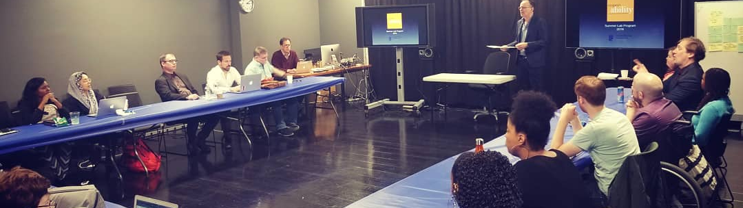
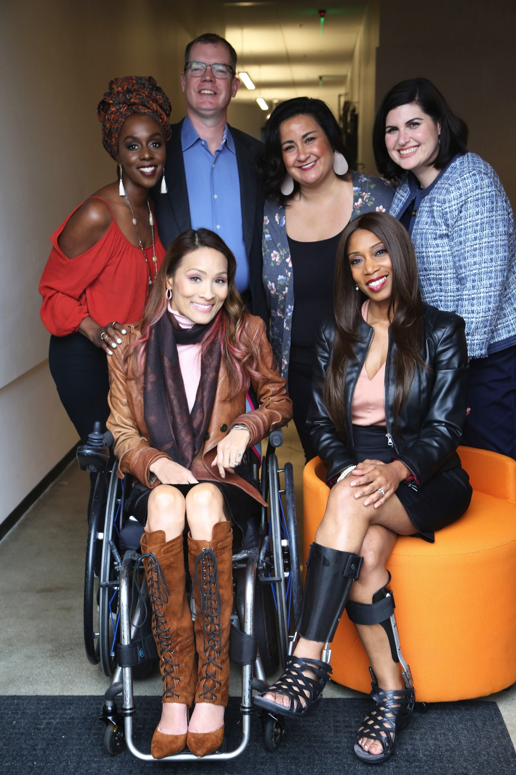
For More Information:
FOR MORE INFORMATION:
Lauren Appelbaum
www.RespectAbility.org
Cell: (202) 591-0703
LaurenA@RespectAbility.org

Slide 45
Your Key Messages
Our communities are at their best when all people, including people with disabilities, have the opportunity to get skills, jobs and succeed.
People with disabilities bring unique characteristics and talents to workplaces that benefit employers and organizations. Stephen Hawking was a genius who happened to use a wheelchair. People with disabilities can work in hospitals, hotels and excel in computer programming, software development and in many other areas of information technology and other fields.

Slide 46
Your Key Messages (2)
Companies including JPMC, Starbucks and Bank of America have shown that employees with disabilities are loyal, successful and help them become more profitable. If we find the right people for the right jobs it can increase the bottom line of all sorts of companies.
Government policies that help people with disabilities get and keep jobs are a win-win because they allow people with disabilities the dignity and financial benefits of work. Those same policies also grow our economy and save taxpayer money.

