Slide 1


Increasing Employment Opportunities for a Better Federal Service
Alison Levy, Manager
Disability Resource Center
U.S. Department of Transportation
www.transportation.gov/drc
Notes:
Questions:
What information should we bring to the table when meeting with a business for the first time?
What types of jobs do they need to fill now and in the future?
What technical knowledge is required?
What level of education, experience is needed?
The Workforce is Aging
What types of limitations are people experiencing in the office? How can VR help?
Mobility, hearing, seeing.
Is it appropriate to ask an employer have they ever worked with DVR in the past and how was there experience?
When employers post or advertise could they contact us directly?
What are your recommendation when working through complicated situation when working with a business?
Who is the best person to contact to obtain information and begin forming the professional relationship?
When it comes to business engagement what is the first thing businesses would like to know when we make contact

Slide 2

Recruitment, Hiring & Advancement
Regulation Update
Section 501 Final Rule
Requires that Federal government be a “model employer” of people with disabilities.
Affirmative Action
Advancement
Reasonable Accommodations
Personal Assistance Services
Effective January 3, 2018
Notes:
What is Section 501? Section 501 of the Rehabilitation Act is a federal civil rights law that prohibits federal agencies from discriminating against job applicants and employees based on disability, and requires agencies to engage in affirmative action for individuals with disabilities.
The rule requires each federal agency to adopt the goal of having 12% of its workforce be people with disabilities, and 2% of its workforce be people with targeted disabilities. These goals apply at both higher and lower salary levels.

Slide 3

Affirmative Action
Workforce Composition Goals
12% People with disabilities (PwD)
2% People with Targeted Disabilities (TD)
At all grade levels; including the
Senior Executive Service.
Link to list of Targeted Disabilities
Notes:
Doc can tie this back to the stats about our aging workforce and incidence of disability.
The Office of Personnel Management (OPM) has updated the list of conditions considered targeted disabilities. This change expands the number and range of targeted disabilities. New additions include: developmental disabilities, traumatic brain injuries, significant mobility impairments, and significant disfigurements. Additionally, the description of conditions such as blindness and deafness are now less restricted.
Throughout the years changes have been made to the list of conditions considered targeted. Changes have been attributed to evolving nomenclature, addition of new conditions, and the merging of individual conditions into groups.
Targeted disabilities are serious health conditions, and the employment rate of individuals with targeted disabilities has historically been low. The federal government seeks to be a leader in the employment of individuals with targeted disabilities, and to serve as a model for other employers in utilizing this talent pool.
Visit the following link for a copy of the most recent standard form 256 containing the list of targeted disabilities: https://www.opm.gov/forms/pdf_fill/sf256.pdf.

Slide 4

Advancement Requirements
Agencies must provide:
Sufficient opportunities for employees with disabilities to advance within the agency
Specialized training and mentoring programs
Notes:
Cite connection to M-10 – Learning & Development

Slide 5




Equal Access Throughout Employment
Recruitment & Hiring
Training & Advancement
Retention & Referrals
Work Inclusion & Productivity
Employment Life Cycle
Adapted from the Federal Agency Employment Strategies: A Framework for Disability Inclusion (2018 Edition)
Notes:
So we have affirmative action hiring goals and we have an aging workforce.
What does a manager need?
Maintain productivity.
Retain institutional knowledge and talent.
Recruitment & Hiring
Work Inclusion & Productivity
Training & Advancement
Retention & Referrals

Slide 6

What is Schedule A?
Non-Competitive Hiring Flexibility
No Vacancy Announcement Required
Can Promote Current Employees with Disabilities
Link to Sample Schedule A Letters
Link to ABC’s of Schedule A
Notes:
Remember our workforce composition goals?
2 and 12%
Did you know you can use Schedule A to promote current employees with disabilities.
Human Resource Policy Manual (HRPM)
Volume 1: Employment
Policy Chapter Supplement
EMP-1.26h (PWD/PWTD)
Recruitment and Appointment of Persons with Disabilities, Severe Physical Disabilities, Psychiatric Disabilities, and Intellectual Disabilities
This Supplement applies to: (1) Non-bargaining unit employees/positions; and (2) bargaining unit employees/positions, except where the applicable collective bargaining agreement contains conflicting provisions or the subject has not been negotiated.
Supplement established on: 02/29/2012
This version effective: 09/30/2015

Slide 7

Who is Eligible?
Schedule A eligible applicants must provide documentation of a disability in one of the following broad categories:
an intellectual disability;
a severe physical disability;
a psychiatric disability.
Note: The servicing HR Specialist manages the documentation.
Notes:
Now I will tell you about some resources to recruit and hire qualified individuals with disabilities.

Slide 8
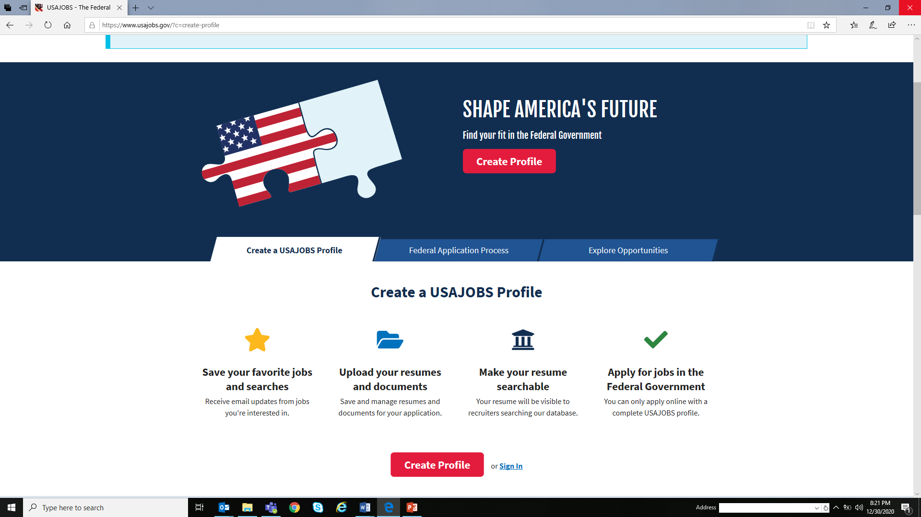
First Steps to Launching a Federal Career
Identify your job occupation series.
Identify your grade level (pay).
Obtain your Schedule A documentation.
Develop your federal resume.
Establish your www.usajobs.gov account and profile.

Slide 9

Other Paths to Federal Service:
Vocational Rehabilitation Unpaid Work Experience
Part time/full time for up to six months.
No Federal position required.
No charge to manager/office. Trainee receives stipend from State Vocational Rehabilitation (VR).
Benefits trainee and manager – Can transition to permanent employment via Schedule A.
Job coaching and training courses may be provided by VR.
Note: Trainee must be a VR client for this specific program.
Notes:
Free and no FTE is required.
Can work for 3-6 months
Can transition into permanent job using Schedule A

Slide 10

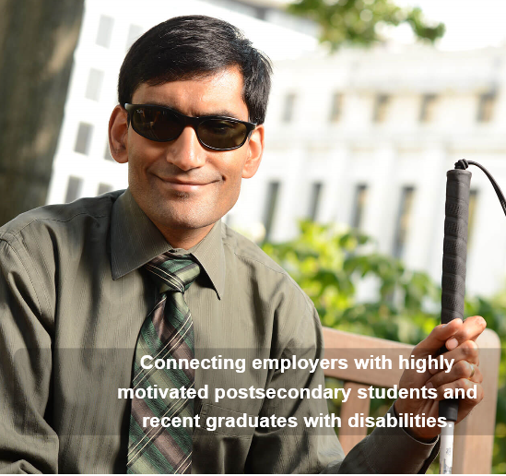
Other Paths to Federal Service:
Workforce Recruitment Program
Current students and recent graduates with disabilities (up to two years post-graduation).
Pre-screened and rated by federal recruiters.
Hiring managers can easily review and select students.
Represents a wide variety of career and employment fields.
Free accommodations provided by DoD.
Can use to recruit into permanent employment.
Visit: www.wrp.gov for more information!
Notes:
Annual database is available every December.
Pre-screened and rated by federal recruiters
Can be recruited/hired into internship and/or permanent employment.

Slide 11

Other Paths to Federal Service:
DOT Secretarial Internship Program
For Current students and recent graduates
Must apply competitively online via www.usajobs.gov announcement.
Paid Opportunities.
Challenging assignments and meaningful work.
Participate in activities, innovations, and challenges facing the transportation industry.
Approximately 10-weeks (summer) or 15-weeks (spring).
Each DOT Mode determines extensions up until the student graduates and/or is converted to a term or permanent position.
Watch USAJobs.gov in late January/Early February 2021 for a DOT SIP job announcement
to apply for summer internships.
Notes:
Paid opportunities
Require an FTE
Can transition to permanent employment using Schedule A

Slide 12
Key DOT Contacts
Supporting Managers & Employees
Selective Placement Program Managers (HR)
  Assist with recruitment, hiring and on boarding
Disability Program Managers (Civil Rights)
  Assist with reasonable accommodations and EEO matters.
DOT Disability Resource Center (DRC)
  Departmental resource that provide services, supports and reasonable accommodations from a centralized fund.
Notes:
Transition to Lisa

Slide 13





Disability Resource Center
Core Services
Recruitment, Hiring, Advancement:
Tools & Resources
Reasonable Accommodations
Consultation and Technical Assistance
Workshops, Webinars, and Outreach
Providing national support throughout the Department with centralized funding!
Notes:
Reasonable Accommodations
Needs assessments
Identify solutions
Procure technology and/or services
Interpreting Services; Personal Assistance Services; Assistive Technology, Video Relay Transcription and Real Time Captioning
Follow up and evaluation
Consultation & Technical Assistance
Employer obligations for providing reasonable accommodations as required by DOT Order 1011.1A (Procedures for Processing Reasonable Accommodation Requests)
Strategies for providing effective accommodations
Education and Outreach
How DRC processes reasonable accommodation requests
disability etiquette and effective communication
facility and program accessibility requirements
Section 508 information technology requirements, training and assessments

Slide 14
Contact Us
Disability Resource Center
U.S. Department of Transportation
Web: www.transportation.gov/drc
Email: drc@dot.gov
Photos of people with disabilities depicted on slides 3, 4, 6, 11 from this presentation are credited to photographer, Lawrence Roffee.

