Slide 1
Make our government as diverse as the American people
www.InclusiveAmerica.org
Info@InclusiveAmerica.org
@InclusiveUS

Slide 2
DISCLAIMER
Inclusive America is a 501(c)3. Attendance at this event is purely for educational and information purposes. It does not act as a promise, endorsement, or other activity in relation to any position within or on behalf of the Biden-Harris Transition or administration.

Slide 3
SEQUENCE OF ENGAGEMENT
August 2019 August 2020
August-2020 November 2020
November 2020 January 2021
January 2021 Onward
Primary Election
General Election
Transition
Administration
Closest to candidate and their team. Give time, talent, treasure.
Less close to the candidate. Given treasure, time, and talent.
Agency Review Team (aka Landing / Beachhead). About 500 people, half of whom go into government.
Hiring is sequential. USAJobs.gov. About 4,500 to 2.2m+ people.

Slide 4
TYPES OF JOBS
Political Appointee
Presidential appointments with Senate confirmation (PAS)
Presidential appointments without Senate confirmation (PA)
Non-career Senior Executive Service (NA)
Schedule C appointments (SC)
Schedule A appointments (SA)
Career
Senior Executive Service (SES)
Others
Without Compensation (WC) / Per Diem (PD)
African Development Foundation, Inter American Foundation
Corporation for National and Community Service
JFK Center for the Performing Arts, Presidio Trust
National Council on Disability, Rehabilitation Services Administration
United States-China Economic and Security Review Commission

Slide 5
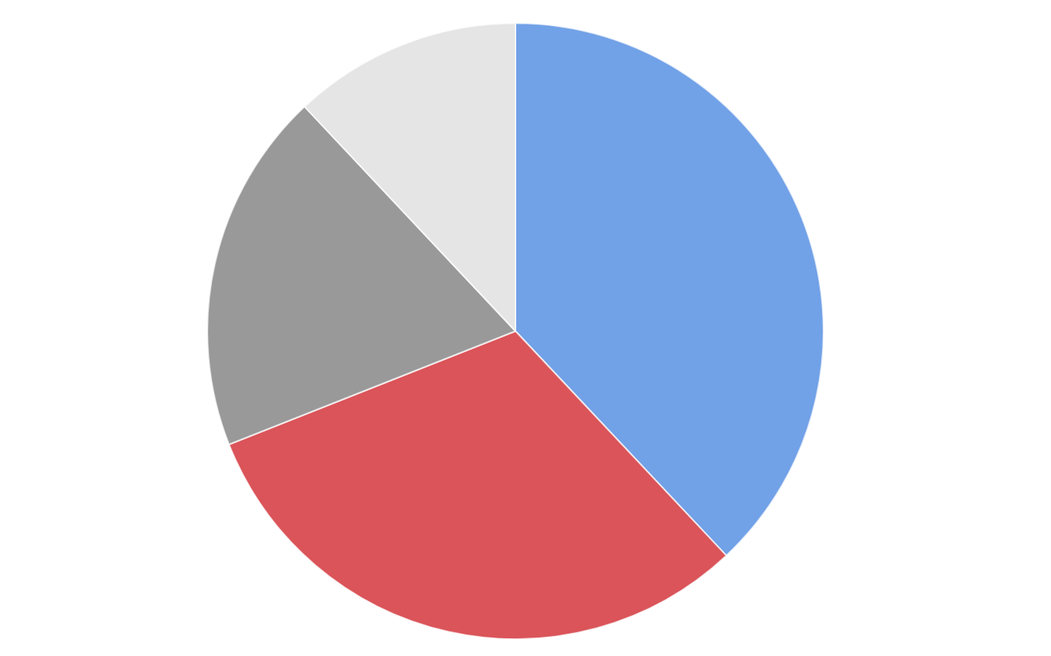
SNAPSHOT OF CURRENT PRESIDENTIAL APPOINTMENTS
The President appoints approximately 4,500 positions
Presidential Appointees who don’t need Senate Approval
12%
19%
38%
Schedule C appointments
Non-career Senior Executive Service positions
31%
Presidential Appointees who need Senate Approval

Slide 6
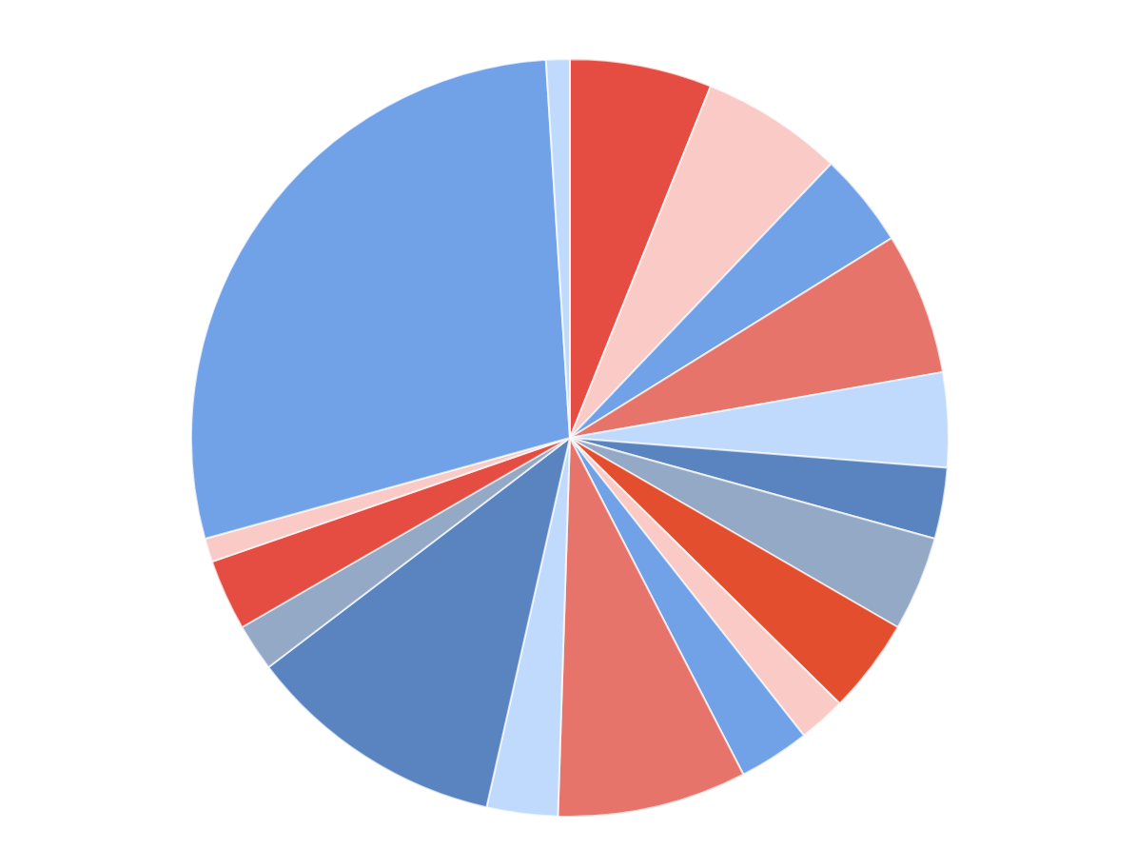
SNAPSHOT OF CURRENT PRESIDENTIAL APPOINTMENTS (2)
Legislative placements
1%
Executive Office of the President (EOP)
6%
Plum Book positions by US government entity
United States Department of Agriculture (USDA)
6%
United States Department of Commerce (DOC)
4%
Independent Agencies
28%
United States Department of Defense (DOD)
6%
United States Department of Education (ED)
4%
United States Department of Veterans Affairs (VA)
1%
United States Department of Energy (DOE)
3%
United States Department of the Treasury (Treasury)
3%
United States Department of Health and Human Services (HHS)
4%
United States Department of Transportation (DOT)
2%
United States Department of Homeland Security (DHS)
4%
United States Department of State (DOS)
11%
United States Department of Housing and Urban Development (HUD)
2%
United States Department of Labor (DOL)
3%
United States Department of the Interior (DOI)
3%
United States Department of Justice (DOJ)
8%

Slide 7
THINGS TO DO
Depending on the sequence, there are many things you can do to improve your chances.
Donate to the campaign
Draft Op-Eds in favor of the candidate
Post social media content in favor (critical content hurts)
Pay your taxes, be honest about any legal issues
Be flexible on interested positions (rigidity is discounted)
Be patient, especially for positions that include security clearance
Network: Congress, Donors, Career Servants, Other Appointees

Slide 8
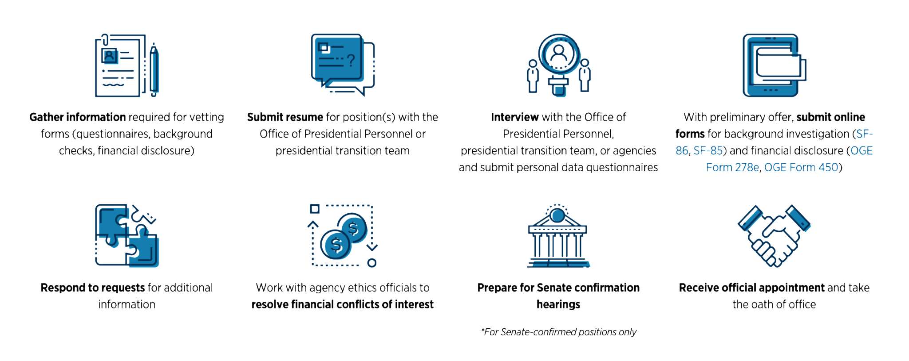
THINGS TO DO (2)
Source: Partnership for Public Service
Notes:
Mask these

Slide 9
IS A GOVERNMENT JOB RIGHT FOR ME?
Consider whether a political appointment is the right fit for their experience, expectations, and goals. Here is a helpful checklist of considerations, including
Vetting process (i.e. criminal background, use of drugs, etc.)
SF-86 / SF-85
OGE Form 27e, OGE Form 450
Ethics restrictions for political appointees
Financial, employment, or other conflicts of interest that might prevent you from serving in certain positions or may require changes to your financial portfolio (i.e. parking tickets)
Issues that may impact your ability to secure a security clearance, if required
Financial considerations
Post-employment restrictions

Slide 10
WHAT MAKES A GOOD APPOINTEE
A few characteristics of what makes a good public servant
Team player: Usually only the Principal gets the credit
Flexible: Lots of balls in the air
Patient: Hurry up and wait (vetting, political sequence)
Less/no Work-Life-Balance: Long hours
Networker: Personnel is policy, win over as many people as you can
No admin: Do you own printing, copying, scheduling, etc.

Slide 11
SALARY
Review the Office of Personnel Management website to learn more about salaries in the federal government. Salary levels will vary depending on appointment type and pay scale level. For reference:
Recent college graduates or individuals with a few years of work experience generally enter the Federal government in a GS-7 to GS-9 level
Mid-to-senior level managers are generally rated at the GS-13 to GS-15 levels
Executive leaders in senior levels of government are usually in the non-career Senior Executive Service (NC-SES)

Slide 12
ADDITIONAL RESOURCES - GENERAL
Biden-Harris Transition Team: https://BuildBackBetter.com/join-us
USA Jobs: https://www.USAjobs.gov
Plum Book: https://www.govinfo.gov/collection/plum-book
Partnership for Public Service
Ready to Serve: https://PresidentialTransition.org/ReadyToServe
Transition Lab Podcast: https://open.Spotify.com/show/1ITwoZx6eAlae1l2bNBnSt
Center on Presidential Transition: https://PresidentialTransition.org

Slide 13
ADDITIONAL RESOURCES - AFFINITY GROUPS
People with Disabilities: https://46DisabilityJobOpportunityProject.com
Black Talent Initiative: https://BlackTalentInitiative.com
Hispanic/Latinx: https://www.Proyecto20Unidos.com
Asian American Pacific Islanders: https://www.AapiProgressiveAction.com/aapi46
LGBTQ: https://VictoryInstitute.org/programs/presidential-appointments-initiative
Women: https://AppointWomen.org
Progressives: https://ProgressiveChange.Institute

Slide 14
Thank You
Make our government as diverse as the American people
www.InclusiveAmerica.org
Info@InclusiveAmerica.org
@InclusiveUS

