Slide 1
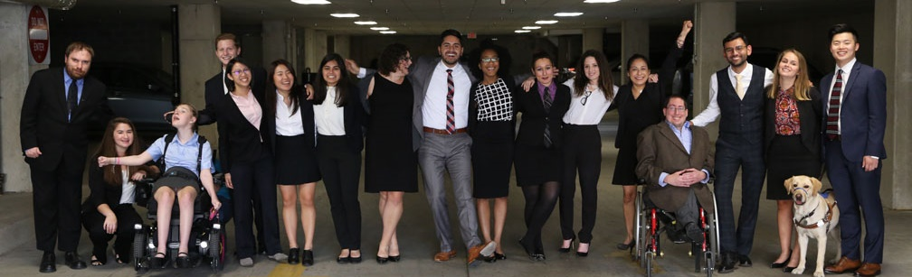

Election 2020: Candidate Outreach to Voters with Disabilities
Election 2020: Candidate Outreach to Voters with Disabilities
www.RespectAbility.org
October 15th, 2020

Slide 2
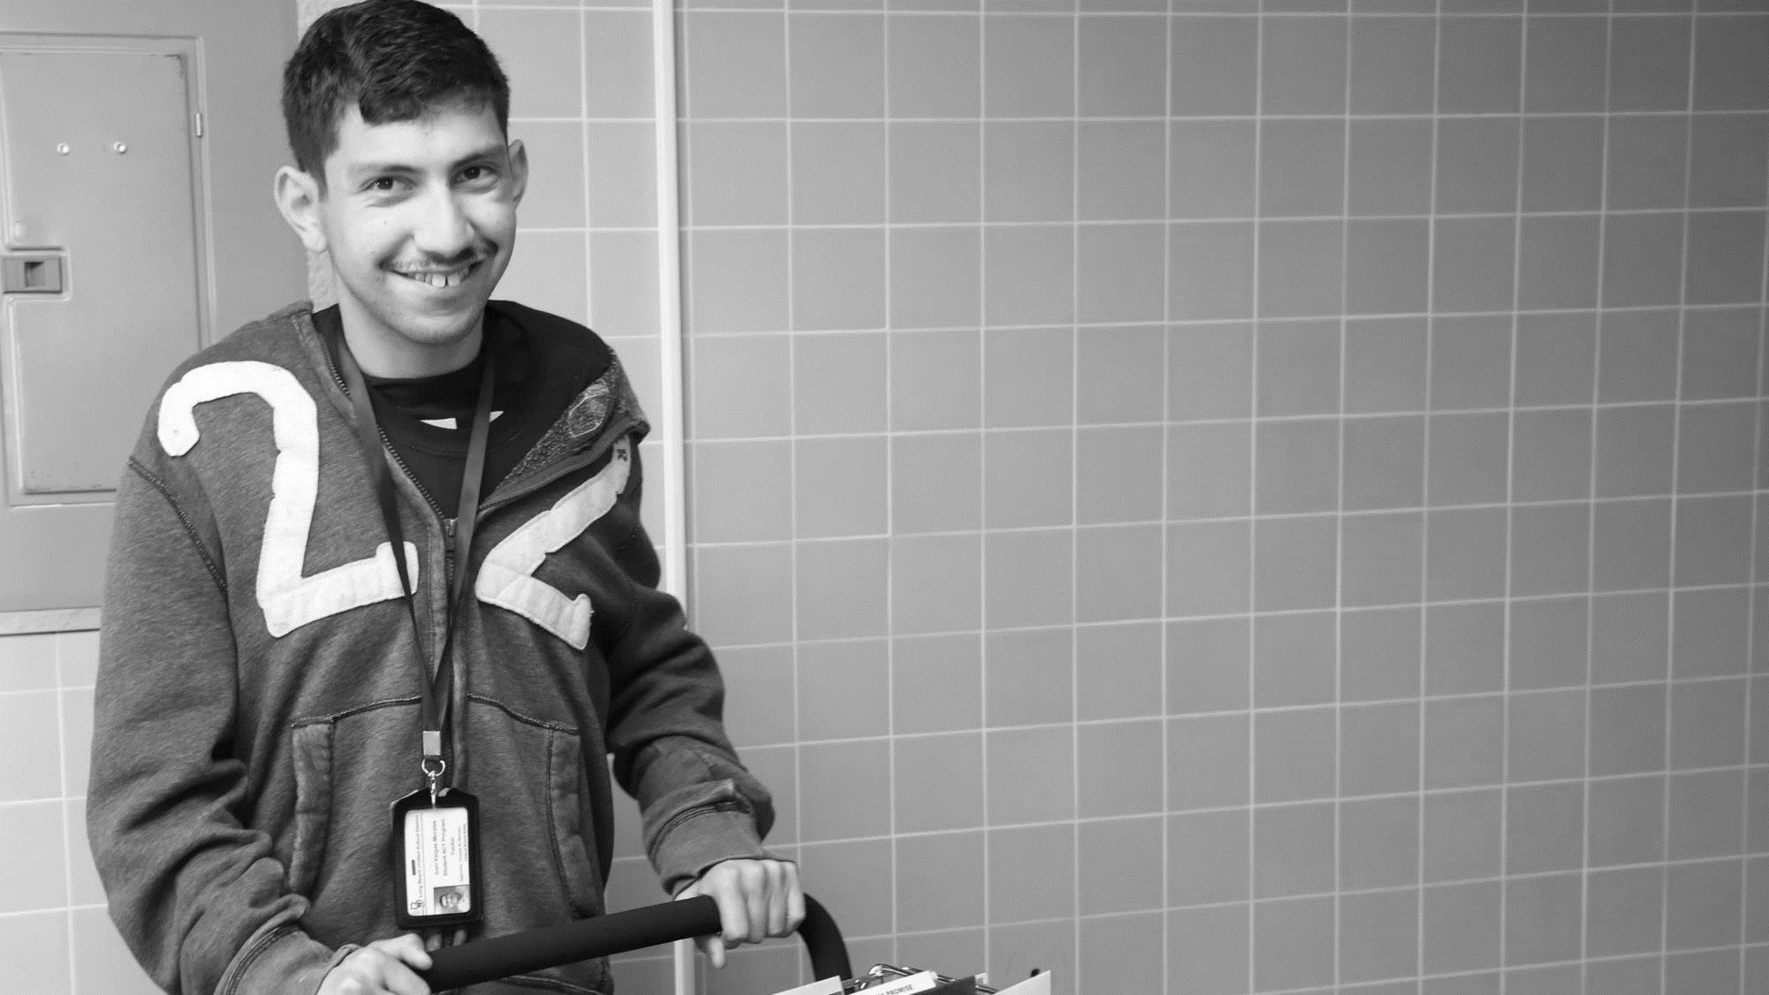
61 million people have a disability
61 Million
people in the US have a disability.*
People with disabilities
want
opportunities
Just like anyone else.
* Source: US Census

Slide 3
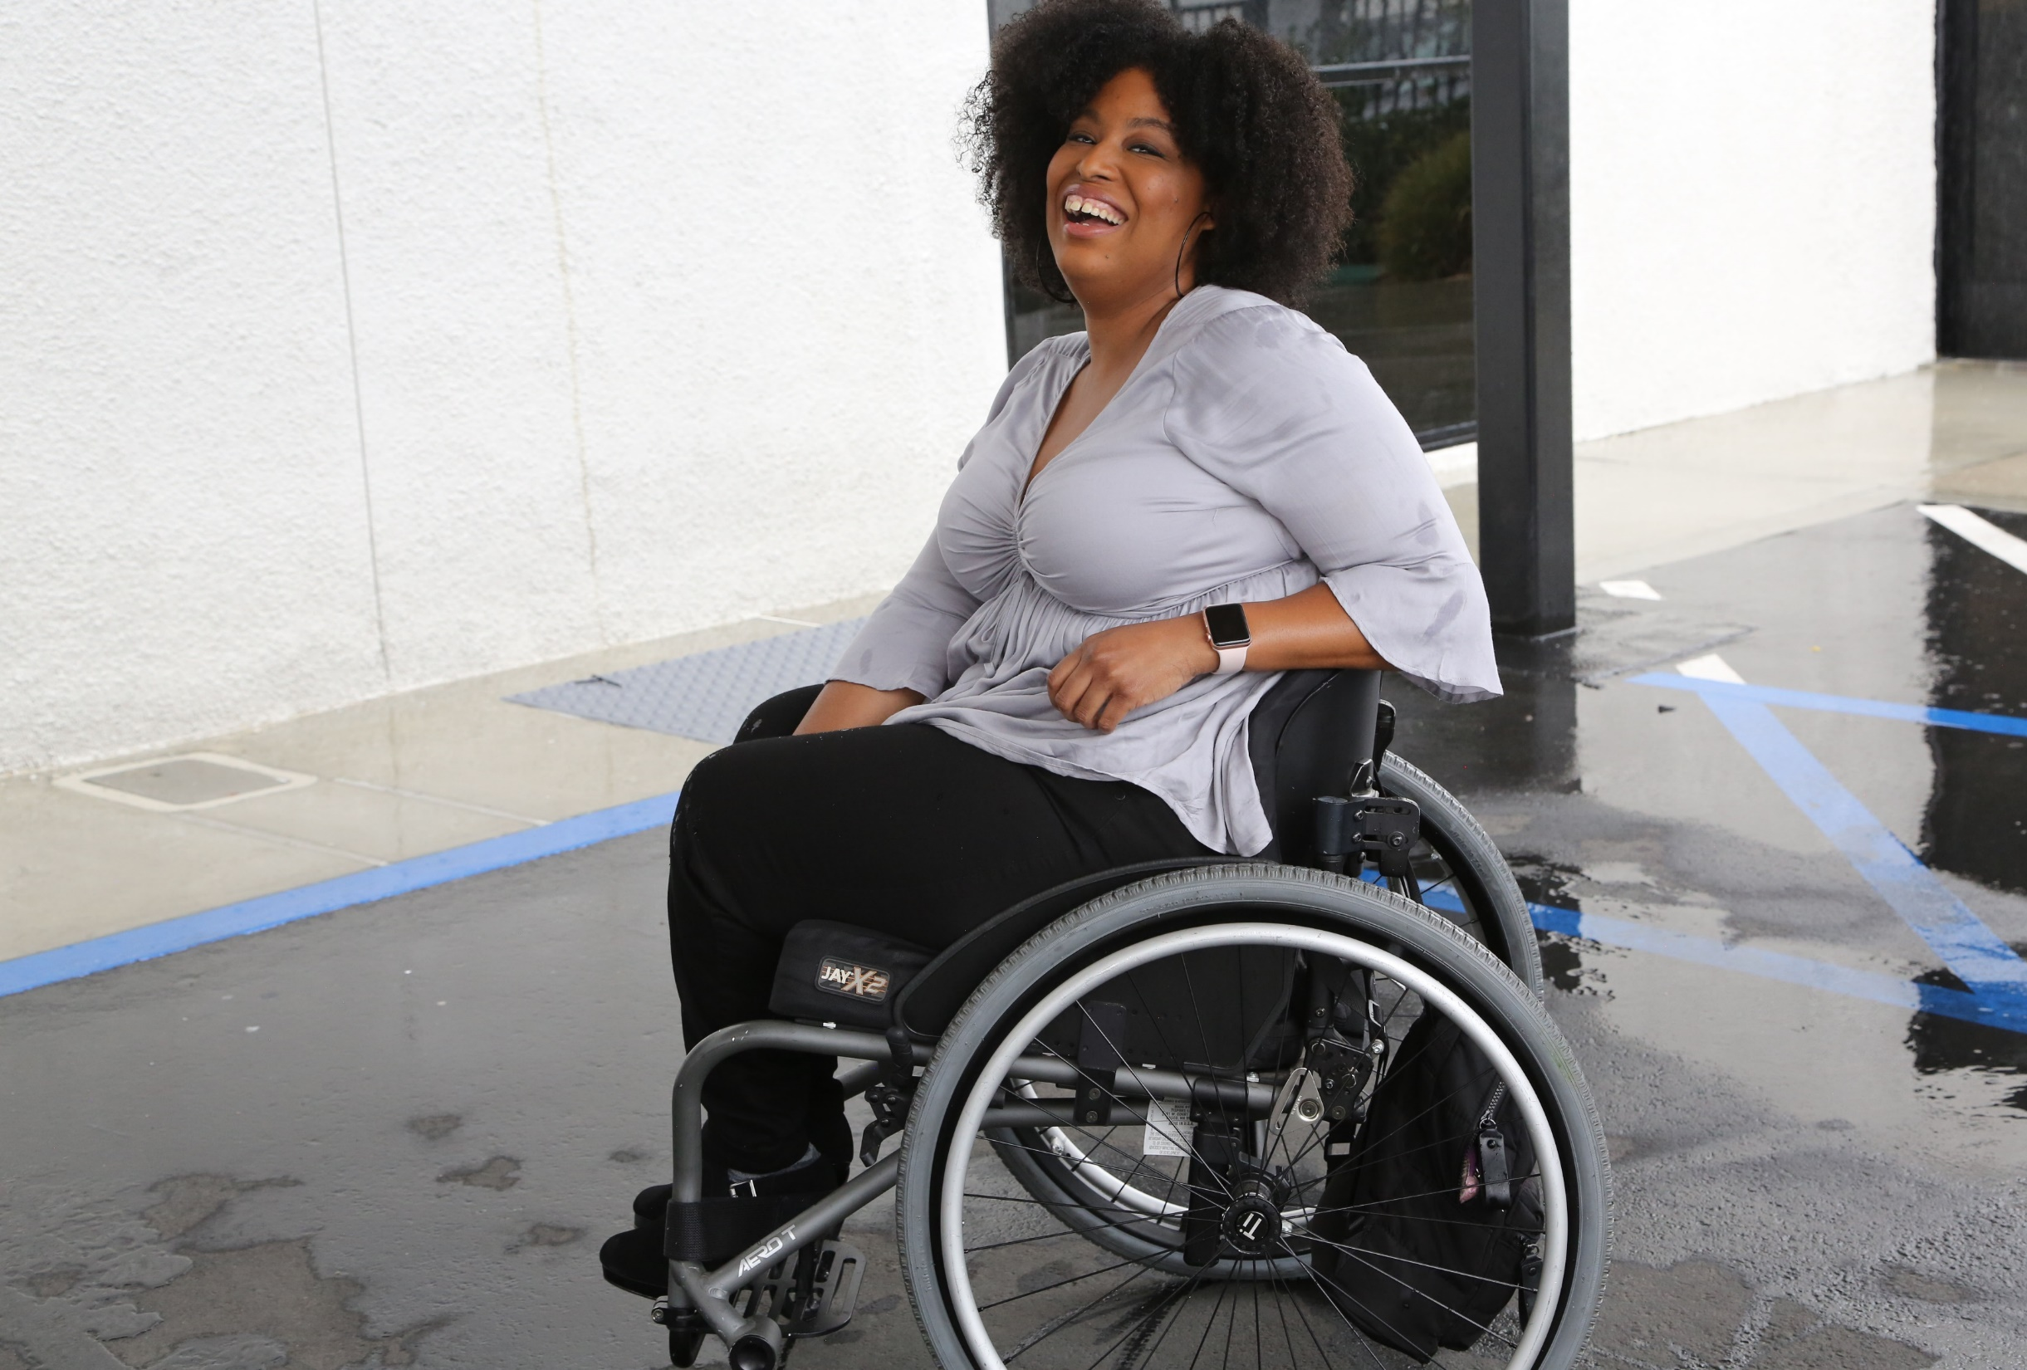

1 in 4 adults
1 in 4
adults have a disability
(physical, sensory, cognitive, mental health or other)

Slide 4
Intersectionality with All Communities
African Americans with Disabilities
Latinx People and Hispanics with Disabilities
Women with Disabilities
LGBTQ+ Individuals with Disabilities

Slide 5
Meet Today’s Speakers
Bo Harmon, President, P2P Mobile
Jack Rosen Voter, Engagement Specialist, National Disability Rights Network (NDRN)
Andrea Jennings, Commissioner, City of Pasadena Accessibility and Disability Commission and Founder, Shifting Creative Paradigms Productions
Melmira Yingst, DPAN DTV News Anchor
Moderated by Philip Kahn-Pauli, Policy and Practices Director, RespectAbility

Slide 6

Select Crosstabs of the Disability Community
Select Crosstabs of the Disability Community

Slide 7
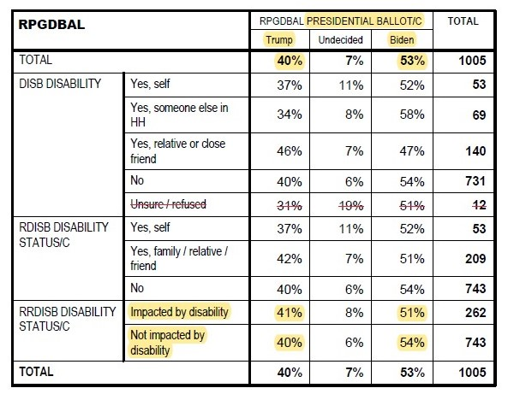
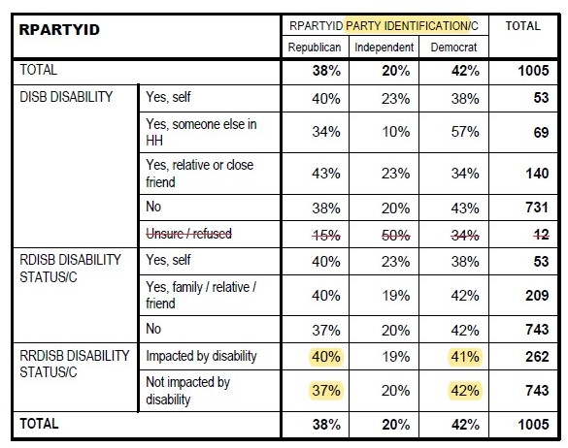
On the surface, the disability community mirrors the total population (1)
Presidential Ballot: no difference
Party ID: no difference

Slide 8
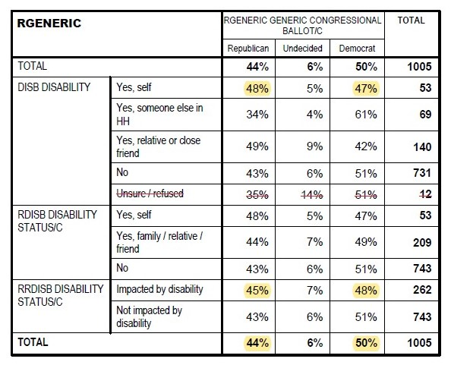
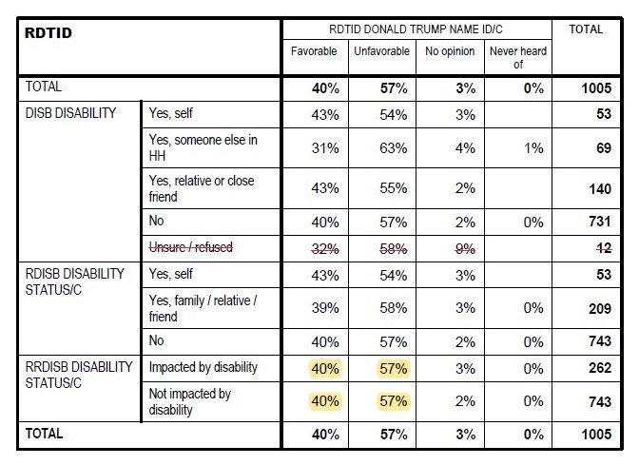
On the surface, the disability community mirrors the total population (2)
Generic Cong. Ballot: no difference
Trump Fav / Unfav: no difference

Slide 9
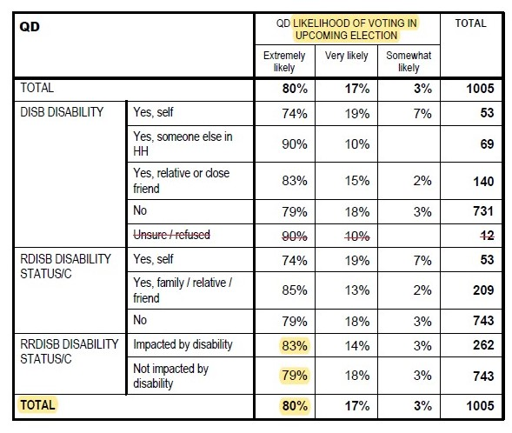
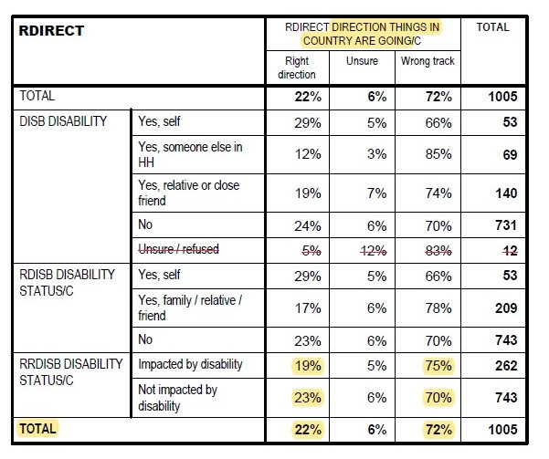
Looking Deeper (1)
Looking deeper, however, the disability community..
Is more pessimistic about the direction of the country
Is more likely to vote in 2020

Slide 10
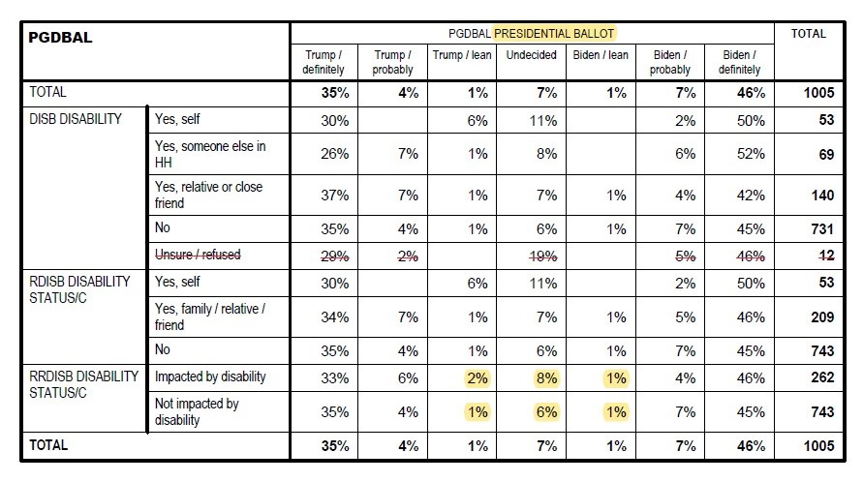
Looking Deeper (2)
Looking deeper, however, the disability community..
Is more likely to say their support is undecided or could change

Slide 11
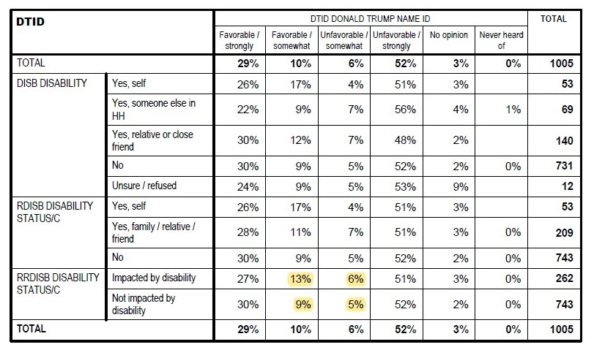
Looking Deeper (3)
Looking deeper, however, the disability community..
Is less strident in opinions of Trump

Slide 12
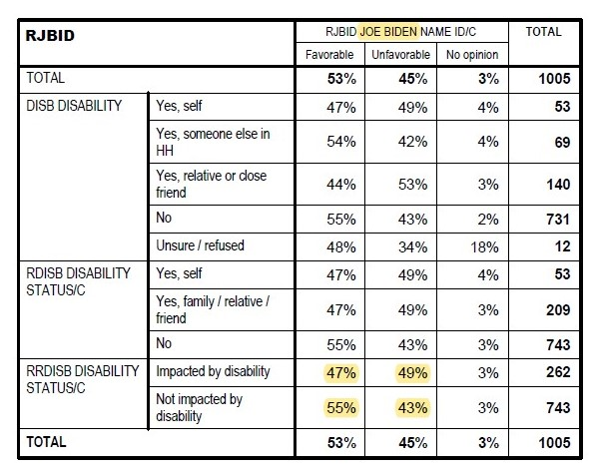
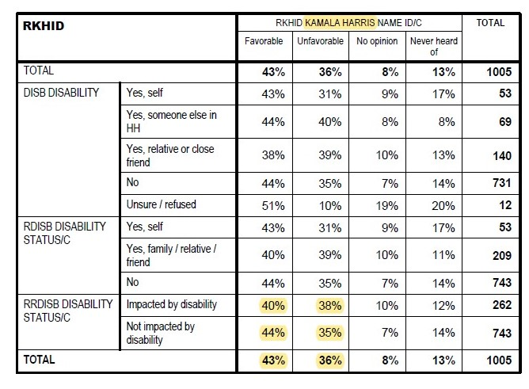
Compared to those not impacted with disability, the disability community is
Less favorable to Biden
AND less favorable to Harris

Slide 13
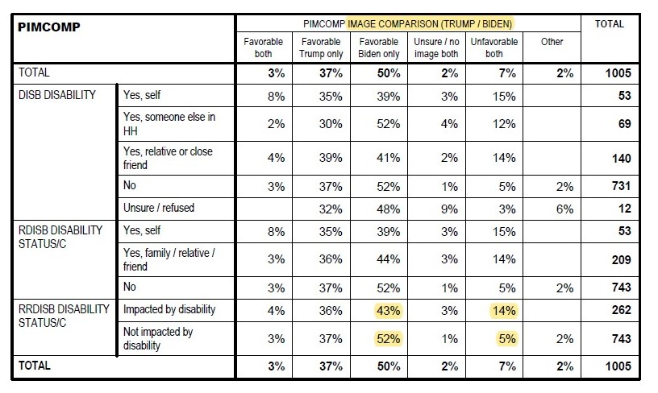
Additional “swing-iness” indicators:
14% are unfavorable to both candidates

Slide 14
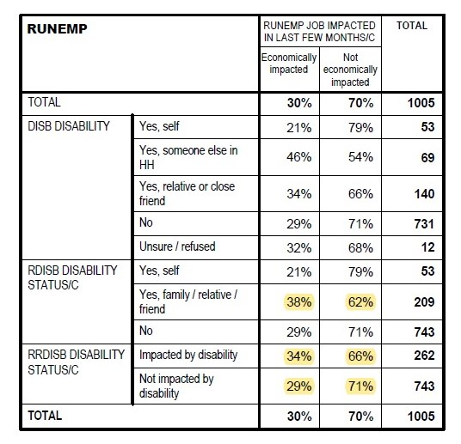
The disability community is hurting economically
5% more likely to have had a job loss in the last few months

Slide 15
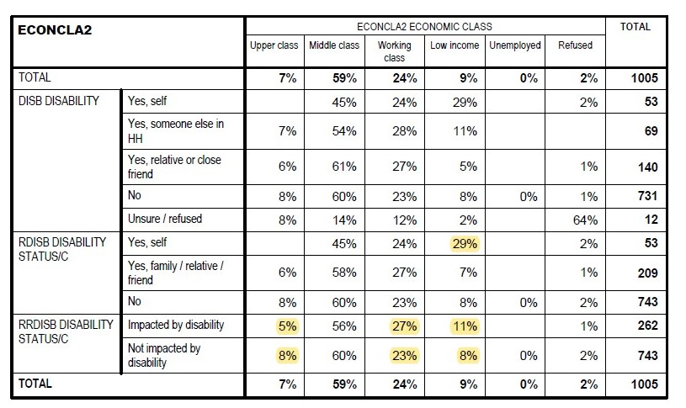
The disability community is hurting economically (2)
Over 50% of personally-disabled individuals are low-income or working class
Overall, the disability community is 7% more likely to be low-income or working class.

Slide 16
Democracy for People with Disabilities

Slide 17
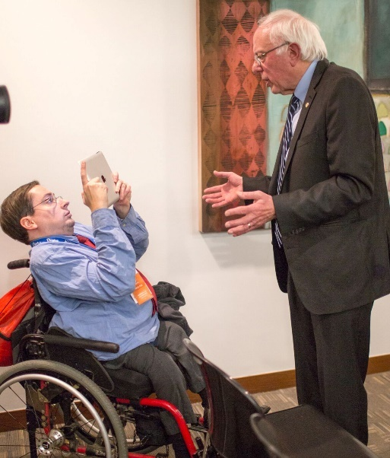
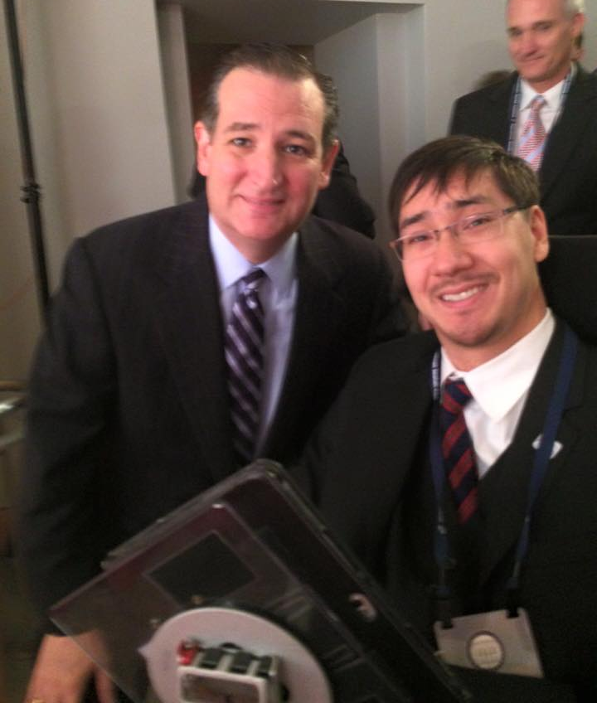
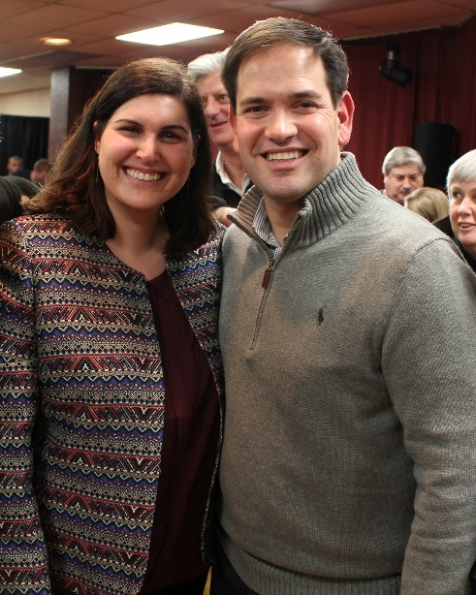
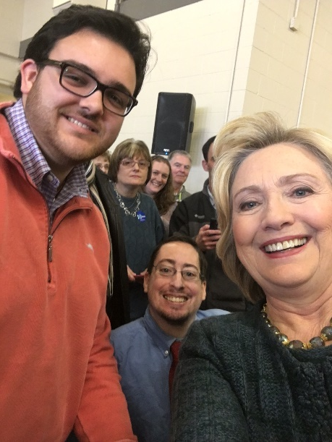
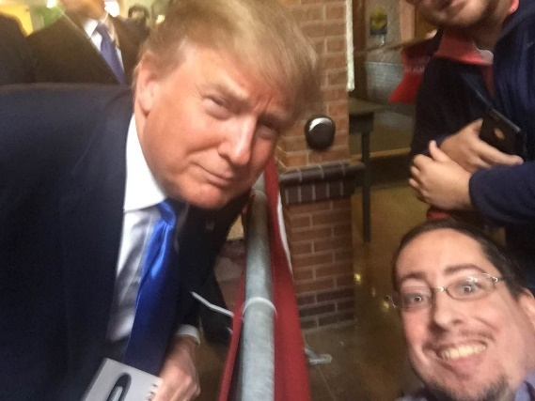
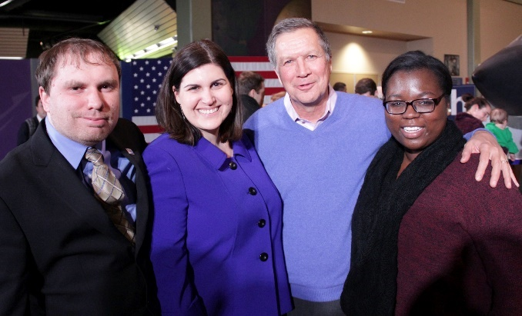
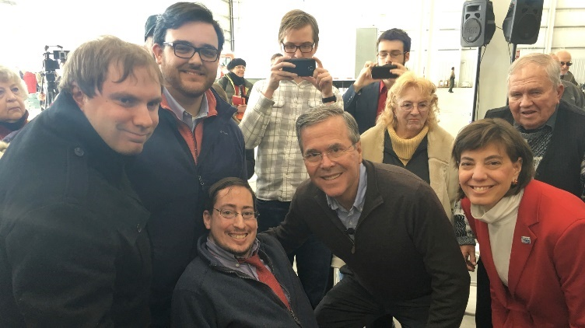
2016 Presidential Campaign Outreach
We covered all 22 presidential candidates on the issue of jobs for people with disabilities. We do not endorse any candidate.

Slide 18
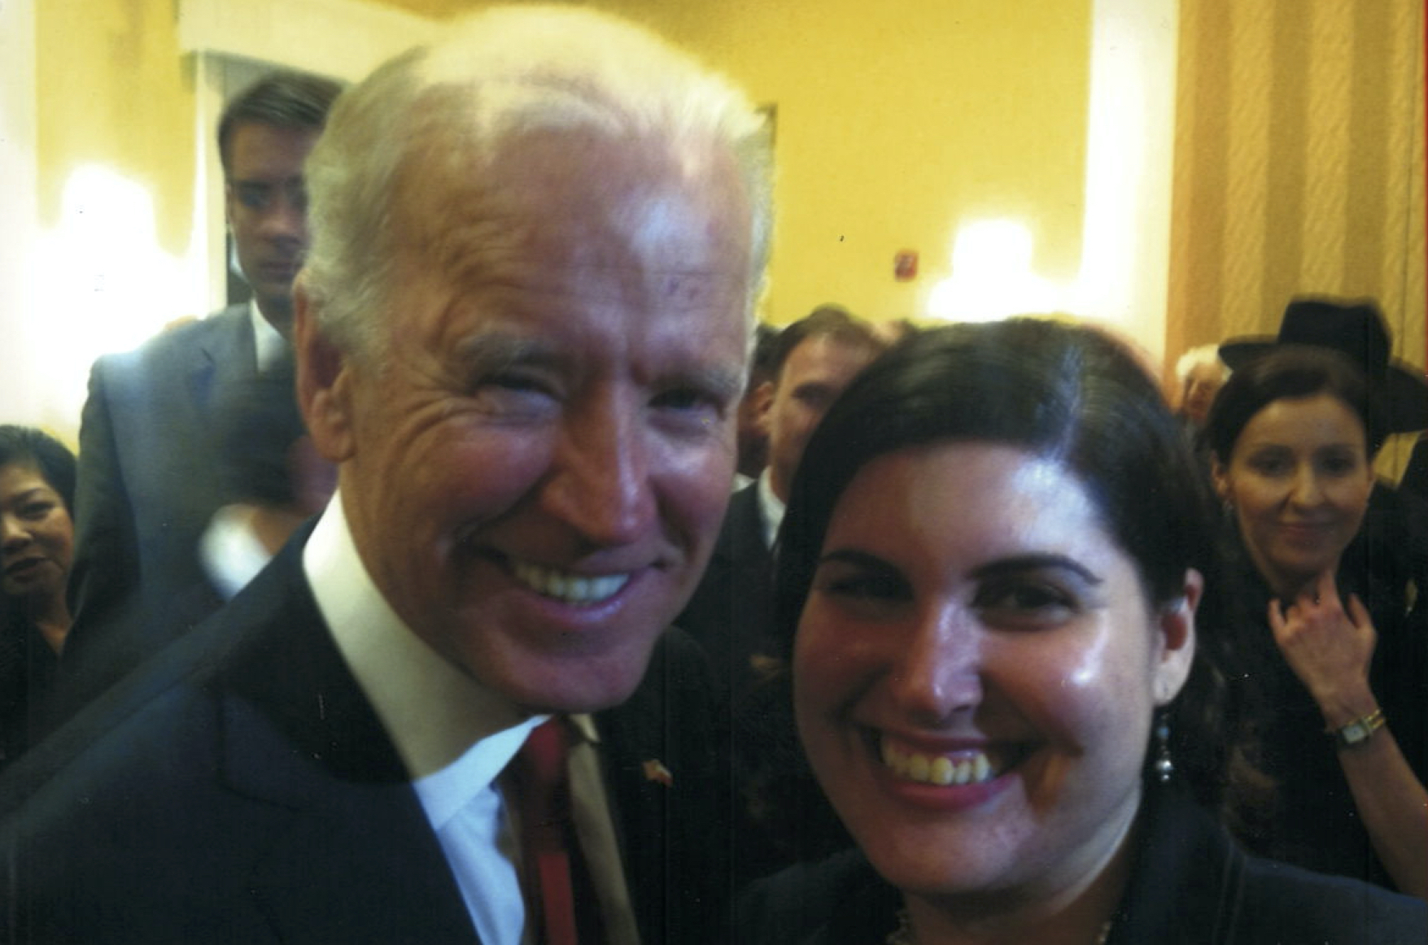
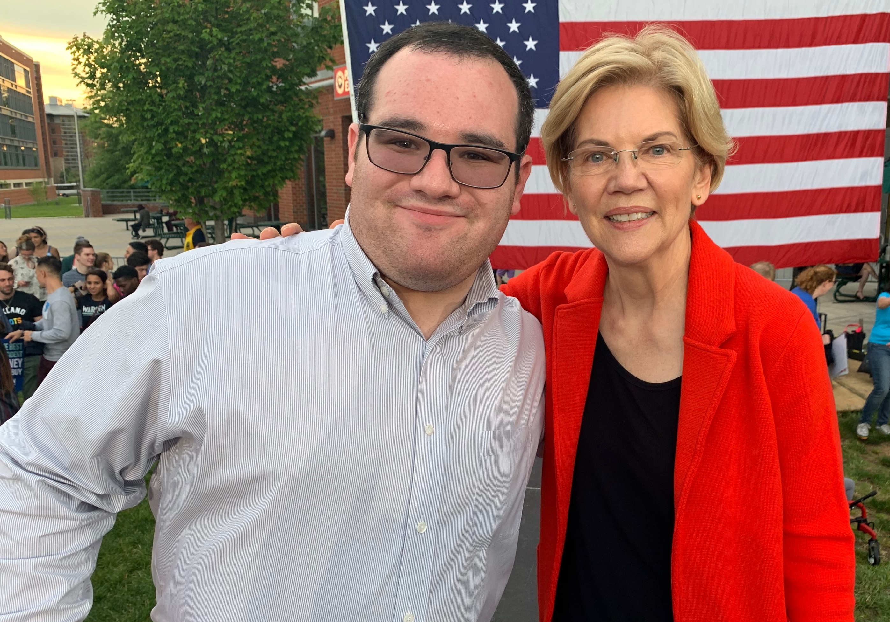
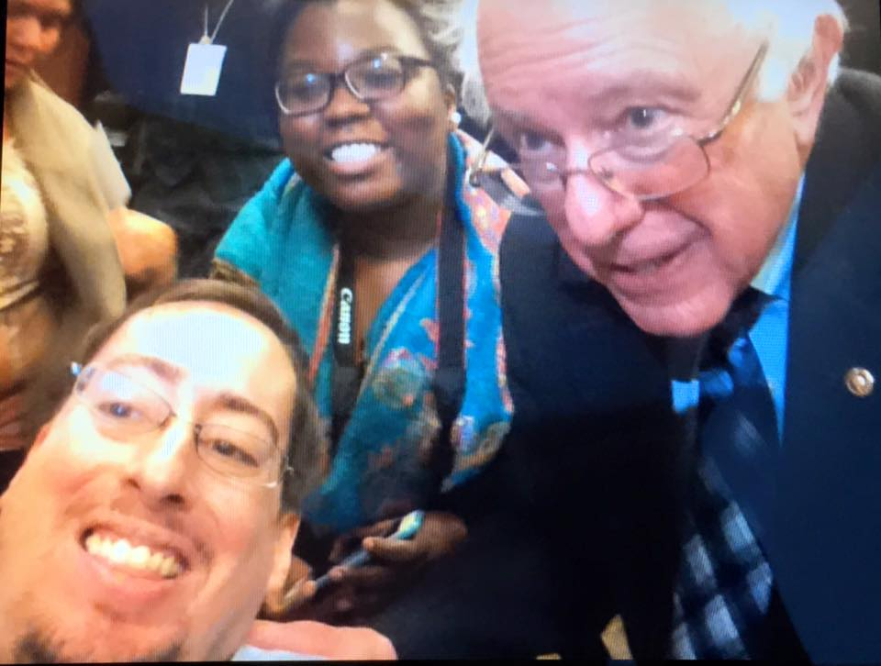
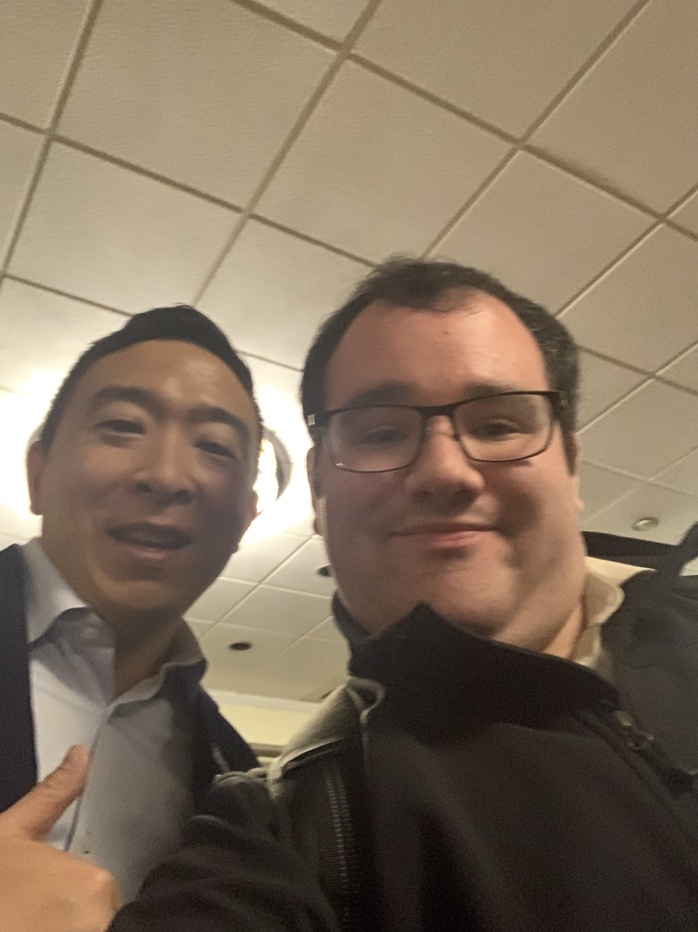
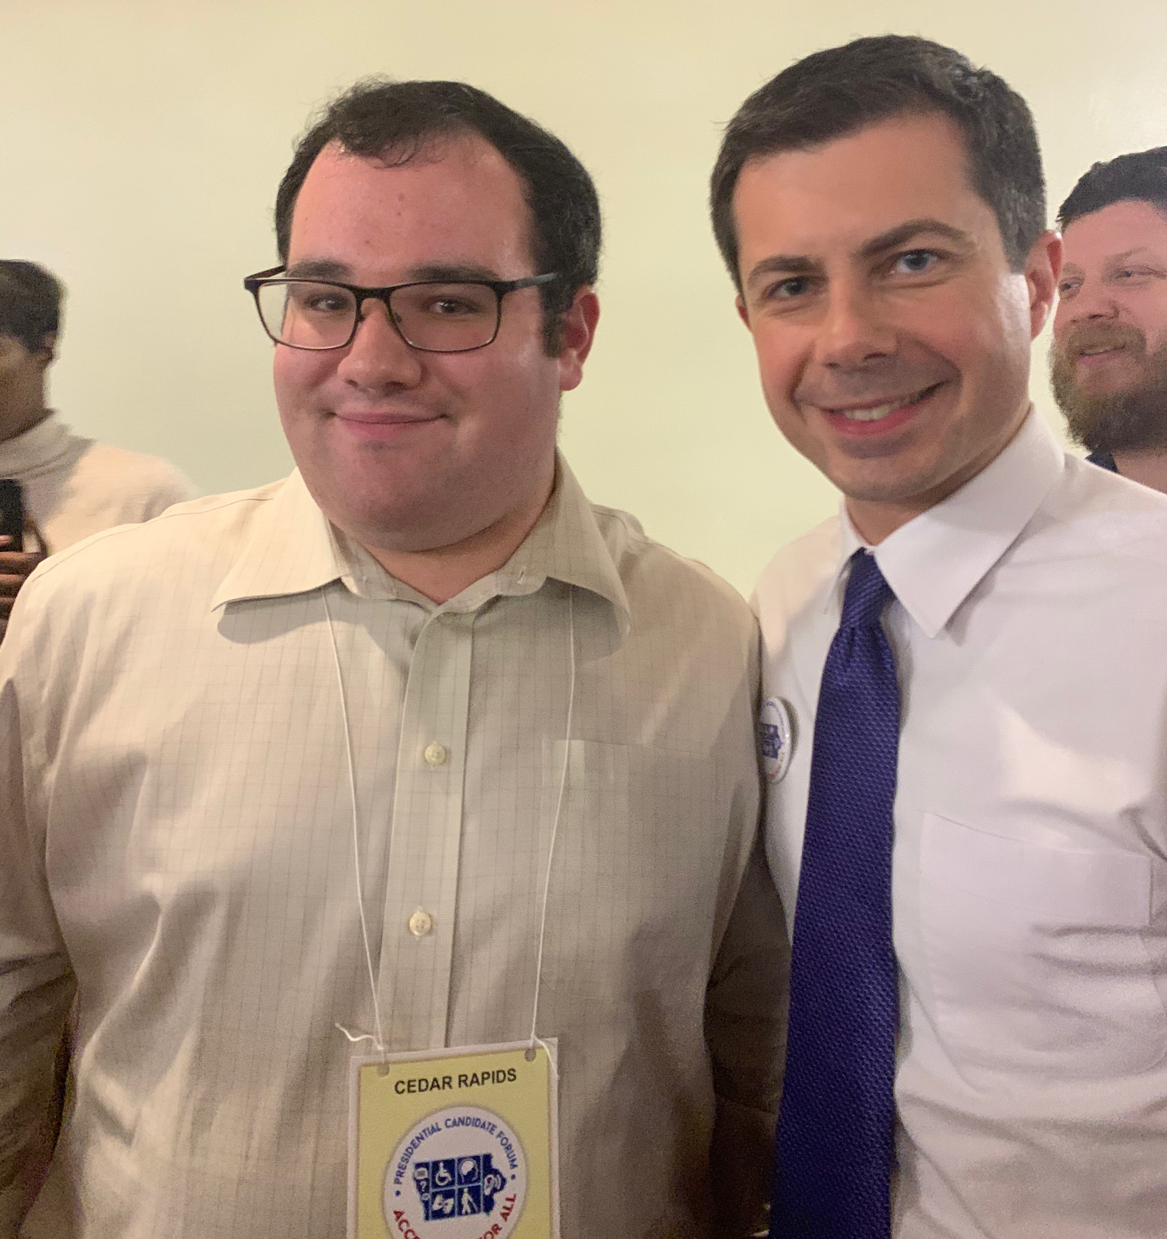
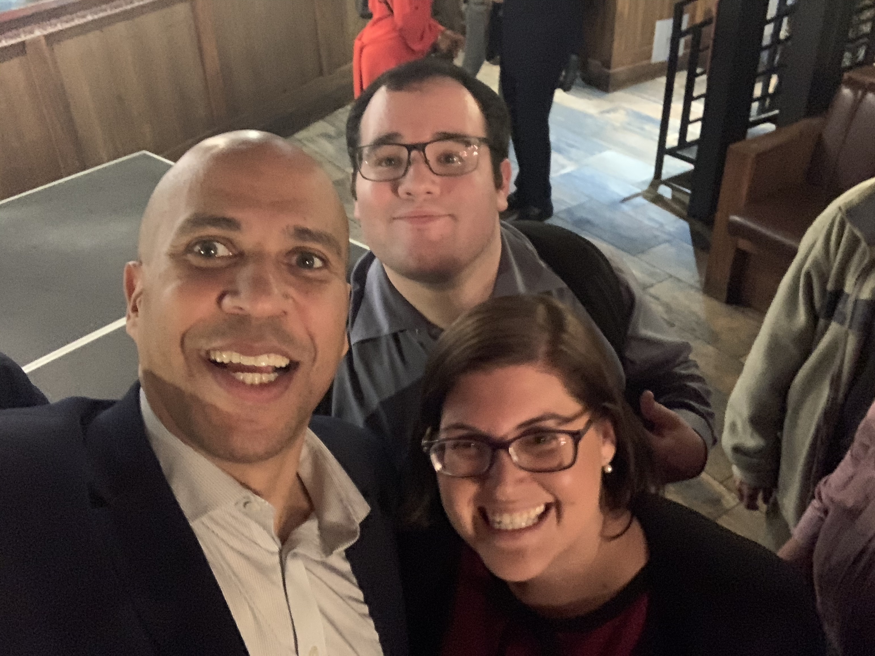
2020 Presidential Campaign Outreach
We have conducted 1:1 phone briefings with nine campaigns on accessibility issues
and begun meeting with 2020 candidates. We do not endorse any candidate.

Slide 19
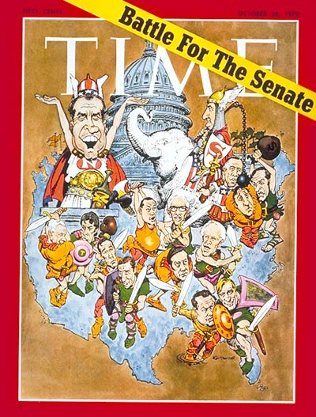
Candidate Questionnaires – 2020
Presidential Primary Campaign – As we did in 2016, we reached out to all candidates through a series of emails, phone calls and training events. Our campaign questionnaire covered 15 questions around combating stigmas, disability employment, educational attainment, immigration, police violence, independent living, Social Security, technology and veterans' issues. All answers were published, without out edits, in our online publication, http://TheRespectAbilityReport.org in the form of a voter guide.
Senate and Governor Campaign Questionnaires – As in 2016, we followed up our presidential primary coverage by shifting focus to key Governor and Senate races. We reached out to all candidate through a new, shorter, 7 part questionnaire.

Slide 20
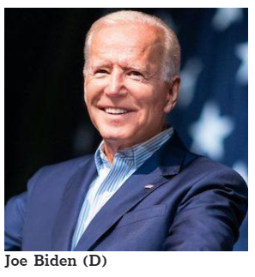
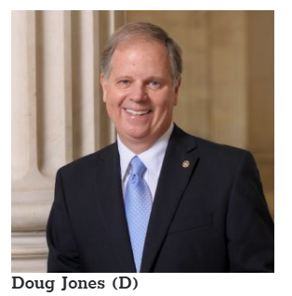
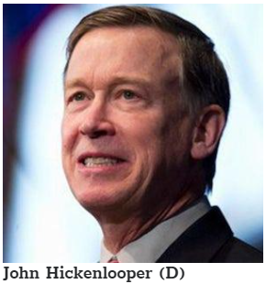
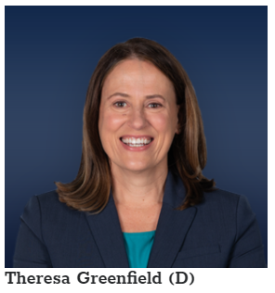
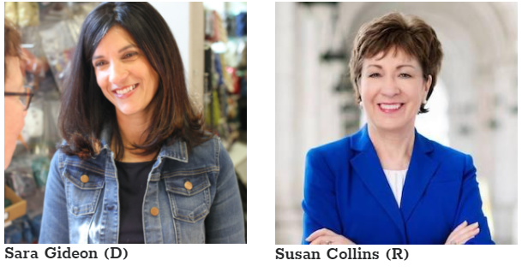
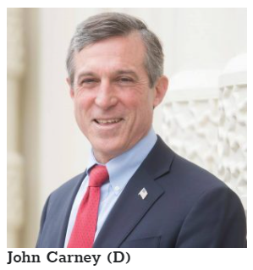
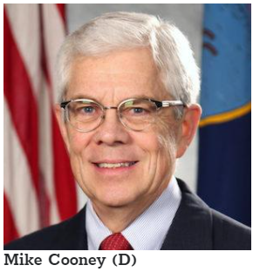
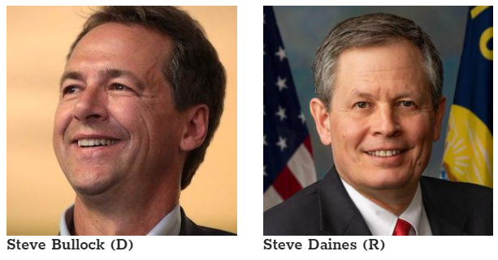
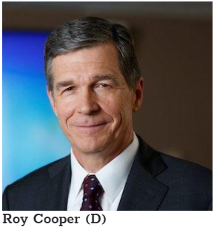
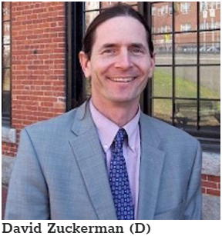
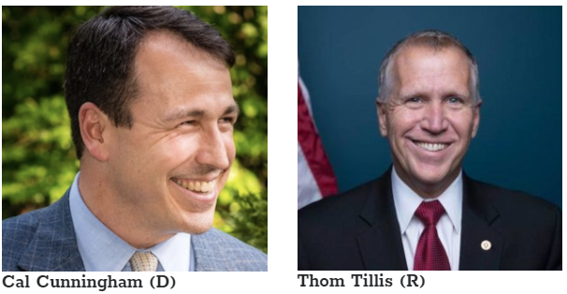
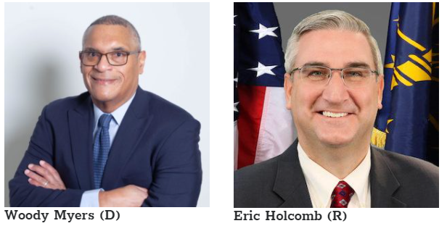
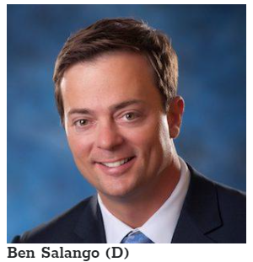
Candidate Responses – www.VoteAbility.com/

Slide 21
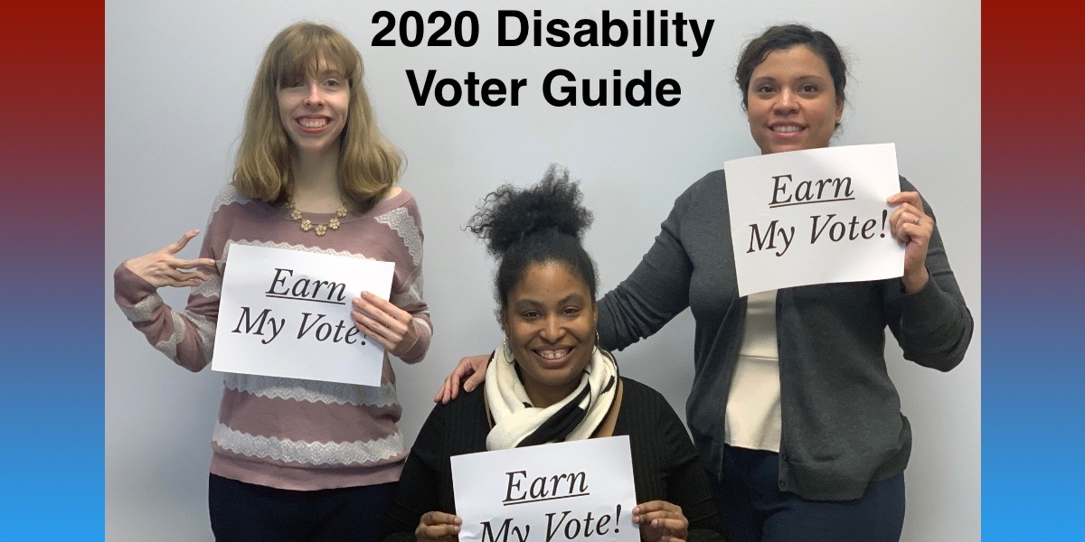
2020 State Voters Guides
Alabama
Alaska
Arizona
Arkansas
California
Colorado
Connecticut
Delaware
Florida
Georgia
Hawaii
Idaho
Illinois
Indiana
Iowa
Kansas
Kentucky
Louisiana
Maine
Maryland
Massachusetts
Michigan
Minnesota
Mississippi
Missouri
Montana
Nebraska
Nevada
New Hampshire
New Jersey
New Mexico
New York
North Carolina
North Dakota
Ohio
Oklahoma
Oregon
Pennsylvania
Rhode Island
South Carolina
South Dakota
Tennessee
Texas
Utah
Vermont
Virginia
Washington
West Virginia
Wisconsin
Wyoming
Each State Voter Guide contains:
Statistics on the size of the disability community in each state.
Data on Pre-COVID-19 economic conditions.
National/State Responses to the Questionnaire
Links to further resources.
https://therespectabilityreport.org/2020/09/22/2020-voter-guide/

Slide 22
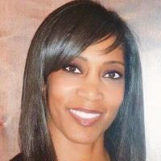
Andrea Jennings
Actress, model, public speaker, commissioner and founder of Shifting Creative Paradigms Entertainment and Productions – Leveling the Playing Field®, envisions a world where underrepresented individuals in media such as people with disabilities, will be depicted as strong leaders. She believes that the design, fashion, arts and entertainment fields are powerful arenas that can be used to influence social change by using multiple media platforms. Creating and producing inclusive and diverse content for television, film, theatre and music productions is the vision and goal of her production company.
Jennings has a Master of Music specializing in Music Business and Entertainment Industries/Law and a BA in Integrated Marketing Communications and hopes to facilitate better opportunities through developing adaptive curriculum involving music and the arts and educational events. Jennings serves as a panelist for numerous diversity and inclusion panels and is a sought-after keynote speaker for graduations and conferences. Currently, she is a guest client lecturer for a neuro-rehabilitation class at Cal State Los Angeles, serves on various advisory committees and is a commissioner advocating for accessibility and disability rights. She also trains individuals and industry professionals to “level the playing field” by teaching them creative solutions to influence social change in the arts, fashion, entertainment, medical and design arenas.
Jennings experienced a major car accident at the top of her career working for a worldwide top 5 advertising conglomerate. The accident left her with multiple and life changing injuries, affecting her ability to walk and work; however, her mother always taught her that “Adversity builds character.” After the accident, Jennnings learned how to reestablish herself in a world that was not so accessible, inclusive and accommodating with grace. She realized her purpose was to create equitable solutions for social change through her experience so that she could help others.

Slide 23
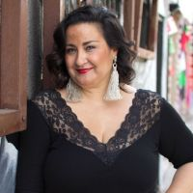
Melmira Elmira Yingst
All communities have hidden narratives, and Melmira Yingst is all about finding and bringing awareness to them, especially when they celebrate women and muxeristas. As a child in Southern California, she sought for deep connections with other people. As she grew, she realized she wanted to do something more. She ventured off to Gallaudet University to earn her Bachelor’s in Psychology, and to Arizona State University for her Master’s in Social Work. Since then, she held different positions as a social worker and school counselor in New York City and Phoenix. She currently teaches at CSUN and works at Convo as a Social Media Manager. She also is the co-founder of Alma de Muxeristas, an organization for muxeristas who are Deaf, DeafBlind, Deaf Disabled, Late-Deafened, or Hard of Hearing. Now back home in Los Angeles with her signature red lipstick (which gives her powers) and her brown Chicana self, she is ready to take on the world with Melmira, her new show.

Slide 24
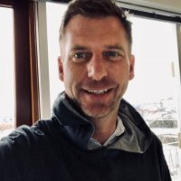
Bo Harmon
Bo Harmon enjoyed a successful career as a political campaign strategist for dozens of candidates for Governor, Senator, and President. His focus on using technology to better engage voters and innovative communications strategies helped win some of the most high-profile campaigns of the last 20 years. Harmon now uses those same strategies to help socially-conscious organizations better connect to their members, donors and the public. He has worked with NDRN for almost two years to help improve communications and advocacy between elected officials and the disability community.

Slide 25
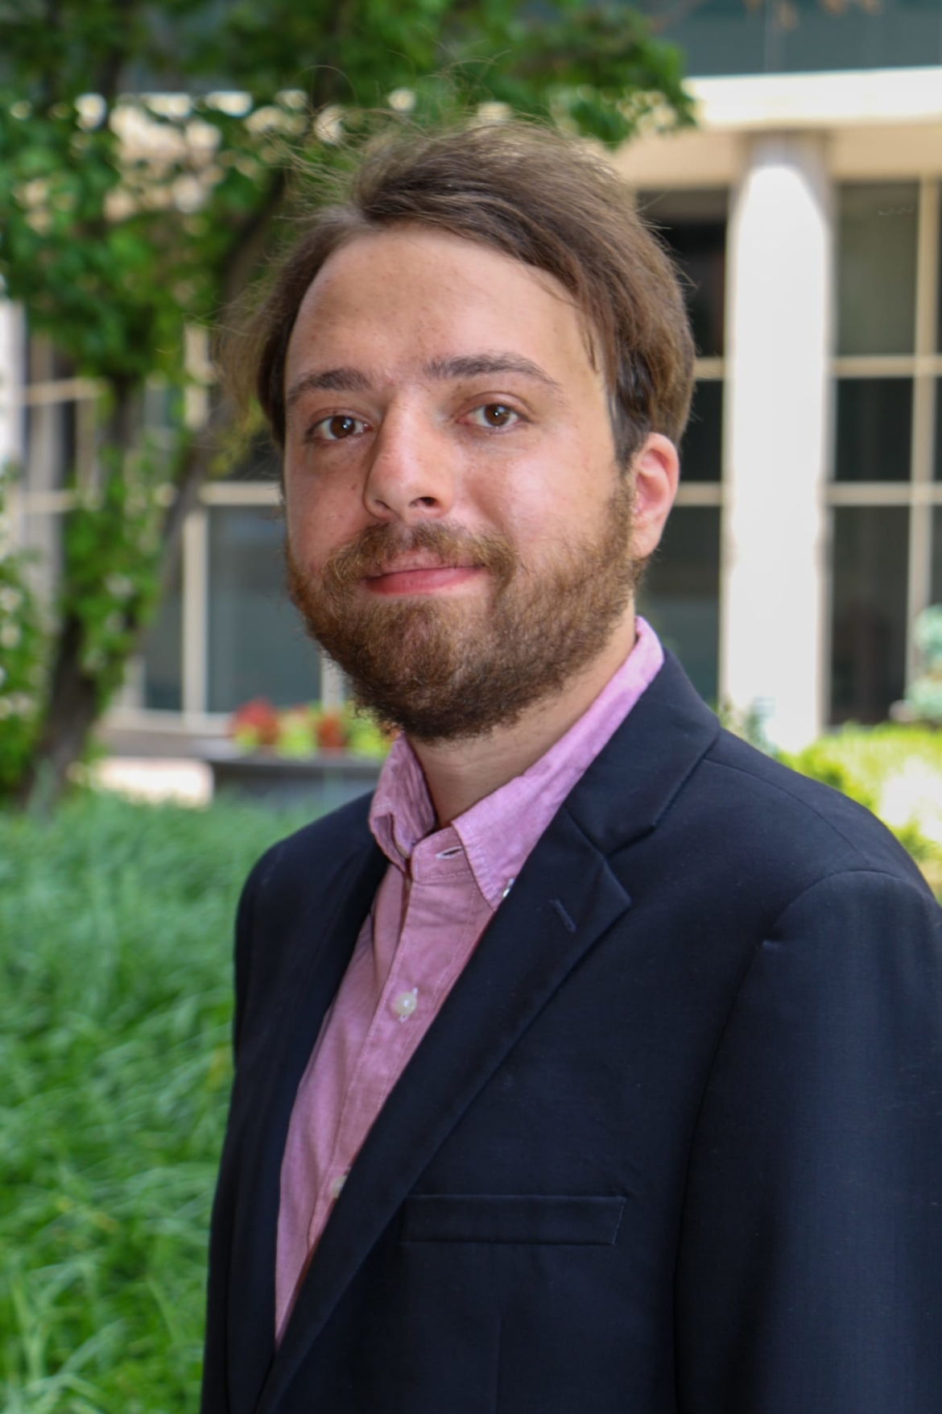
Jack Rosen
Jack Rosen develops non-partisan messaging to engage and increase participation of voters with disabilities in the electoral process. He collaborates with civil and disability rights organizations to enhance voter engagement nationally. Prior to joining NDRN in May 2020, Jack helped implement voter contact strategies for a state Senate campaign and worked as a freelance strategic communications consultant. He holds a B.A. in Government from Skidmore College and an M.A. in American Government from Georgetown University.

Slide 26
Question Time!
Questions?
Comments?
Smart Remarks?

Slide 27
Contact Us!
Jennifer Laszlo Mizrahi
President, RespectAbility
Publisher, The RespectAbility Report
Contact: JenniferM@RespectAbility.org
(202) 365-0787
Lauren Appelbaum
Vice President, Communications, RespectAbility
Managing Editor, The RespectAbility Report
Contact: LaurenA@RespectAbility.org
(202) 591-0703

Slide 28
Thank you!
THANK YOU!
Jennifer Laszlo Mizrahi
www.RespectAbility.org
Cell: (202) 365-0787
JenniferM@RespectAbility.org

