Slide 1
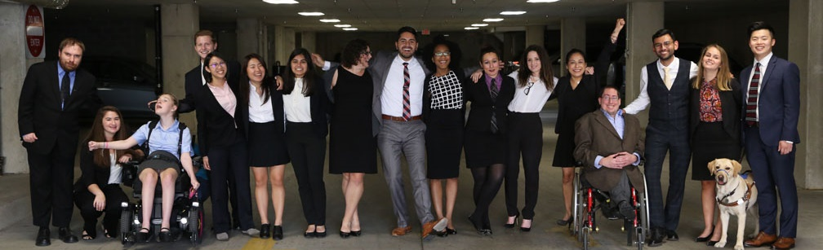


Successful Self-Employment & Entrepreneurship for People with Disabilities

Slide 2
Disability
Disability
Physical
Sensory
Cognitive
Mental Health
Other
Temporary and Permanent
Visible and Nonvisible
From Birth or Acquired Later in life
61 Million
people in the US
1 in 4
adults
Anyone can join the disability community at any point.

Slide 3
Speakers
David Mitchell, Administrator, Iowa Vocational Rehabilitation Services
Dennis Bogenrief, Iowa Self Employment Team, Iowa Vocational Rehabilitation Services
Kochell Weber-Ricklefs, Iowa Self Employment Team, Iowa Vocational Rehabilitation Services
Linda Vongxay, Iowa Self Employment Team, Iowa Vocational Rehabilitation Services
Steve Faulkner, Iowa Self Employment Team, Iowa Vocational Rehabilitation Services

Slide 4
Iowa Self Employment Program Philosophy
The Iowa Self Employment team provides quality, expert, client-centered services to Iowans with disabilities that embrace diversity, promote successful business ownership and result in self-sufficiency and economic development.
Notes:
Intro screen

Slide 5
Iowa Self Employment Program
While IVRS mainly focuses on helping job candidates (JCs) get hired by someone else, the ISE program provides technical and financial assistance to help qualified individuals with disabilities achieve self-sufficiency and work at their optimum level by starting, expanding, or purchasing a business.
Notes:
Intro screen

Slide 6
Employment First and Self Employment
What does this look like?
Who is the team?
How does this progress into a viable business?
Notes:
Intro screen

Slide 7
Watch Video at
www.facebook.com/watch/?v=2526075374348824

Slide 8
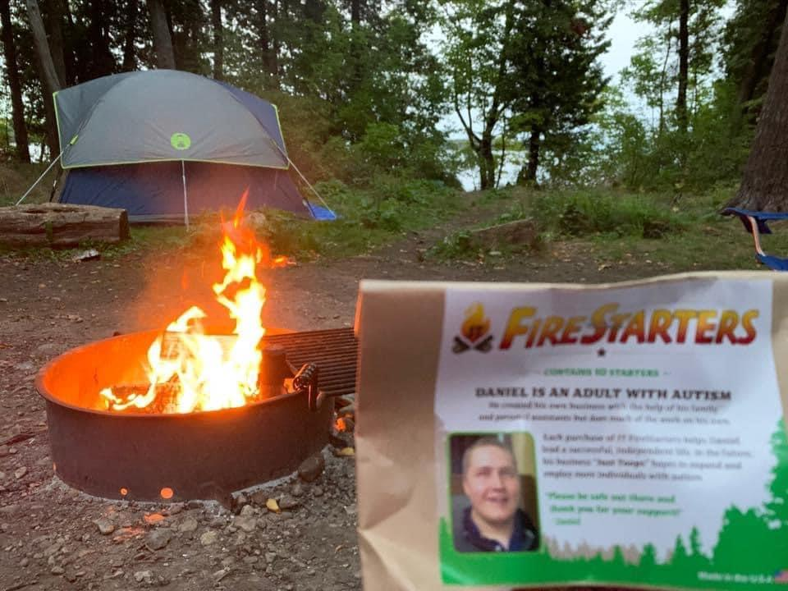
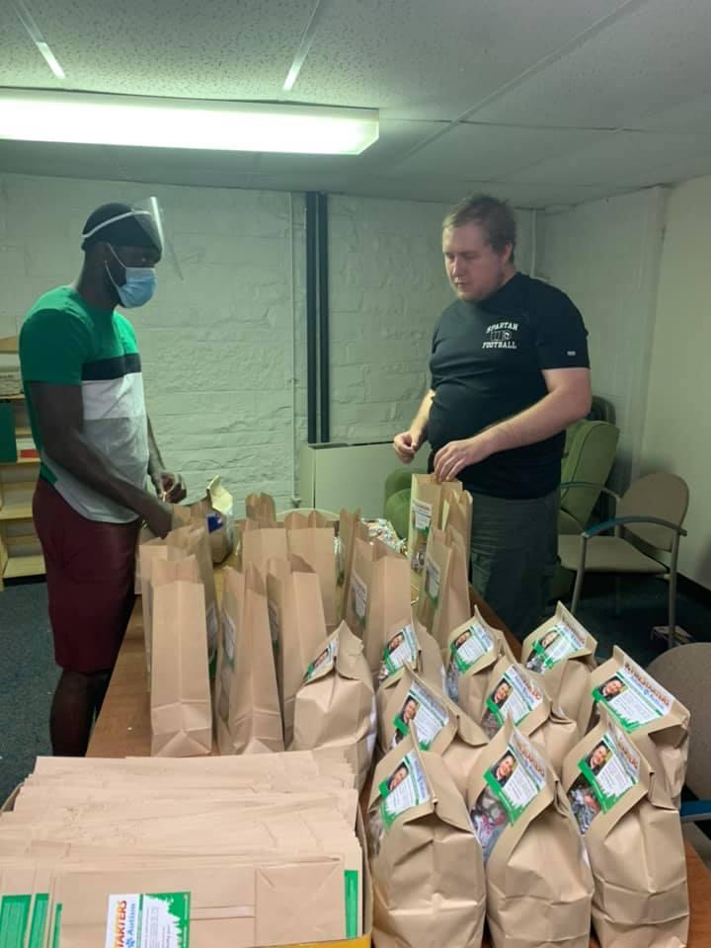
JT Firestarters
Notes:
Intro screen

Slide 9
The Process of the Program
Program Outline
  Orientation
  Initial Planning
  Benefits Planning
  Business Planning and Feasibility
  Financial and Technical Assistance
  Stabilization of the Business
Notes:
Intro screen

Slide 10
Orientation:
Exploring if self-employment is the right choice

Slide 11
Initial Planning
Planning paperwork
Team Meeting
Review of Program
Next Steps
Notes:
Intro screen

Slide 12
Benefits Planning
Notes:
Intro screen

Slide 13
Business/Feasibility
Does it make sense?
  Market
  Personal
  Business
  Financial
Notes:
Intro screen

Slide 14
Additional Resources
Internal IVRS
External
Funding Sources
Savings programs
Notes:
Intro screen

Slide 15
Implementation of Business Plan
Approvals
Funding
Continued Assistance
Notes:
Intro screen

Slide 16
Financial and Technical Assistance
Funding
Community Funding Options
Notes:
Intro screen

Slide 17
Stabilization and Monthly Reporting
Reporting
Financial Decisions
Closure of Case File
Notes:
Intro screen

Slide 18
Business Follow Up
Timeline
Assistance
As-needed
Notes:
Intro screen

Slide 19
Transition and Iowa Self Employment Program

Slide 20
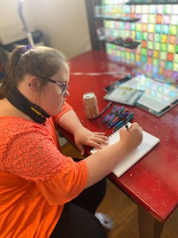
Transition and Self Employment
Faith
Notes:
Intro screen

Slide 21
Self Employment Advisory Committee
Creating a cohesive team environment

Slide 22
Virtual Services
Critical in providing quality services

Slide 23
Iowa Self Employment Statistics
Five Year Averages
  Referrals – 89
  Closures – 35
  Active Cases - 125
Current Year Statistics
  Referrals - 20
  Closures - 12
  Active Cases - 202

Slide 24
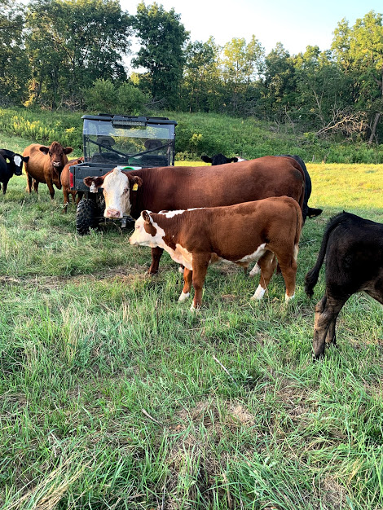
Entrepreneurs – Stacy Tjaden
Wyoming, IA
Cattle Breeder

Slide 25

Entrepreneurs – Bob Farmer
Anthon, IA
Gunsmith

Slide 26

Entrepreneurs – Jared O’Rear
Waterloo, IA
Landscaping

Slide 27

Entrepreneurs – Austin Spahn
Sioux City, IA
Cleaning Services

Slide 28
Questions?
Iowa Vocational Rehabilitation Services
Steve Faulkner, Bureau Chief
Email: steven.faulkner@iowa.gov
Phone: 641.422.1551 Ext 44546

