Slide 1

What We Do
What We Do
RespectAbility is a nonprofit, nonpartisan organization that enables people with disabilities to get the education, skills, and opportunities they need to achieve competitive, integrated employment and independence.

Slide 2
Our Mission
To fight stigmas and advance opportunities so that people with disabilities can fully participate in all aspects of community.
Mission:
1
Fight Stigmas by promoting authentic portrayals of people with disabilities.
2
Advance Opportunities by promoting best practices in education, jobs & accessibility.
3
Leadership Development to strengthen a diverse talent pipeline of people with disabilities.

Slide 3
Fight Stigmas
1
  Narrative Change in Hollywood
  Representation of People with Disabilities in News
  Facts, Studies, & Social Media
People with disabilities are viewed for what they can do – and as capable contributing members of society.

Slide 4
Positive messaging works!
Q: What do you think is the most compelling reason to include and increase opportunities for people with disabilities?
 | First Choice | Second Choice | Combined
Organizations are at their best when they welcome, respect and include people of all backgrounds. This includes people with disabilities. | 44% | 28% | 72%
Problems are best solved by working with people who have experienced them first hand and know solutions that work. Just like issues that impact people of different racial, ethnic or other backgrounds, people with disabilities should be involved in solving issues that impact them. | 24% | 27% | 51%
Our nation was founded on the principle that anyone who works hard should be able to get ahead in life. People with disabilities deserve equal opportunity to earn an income, achieve independence and be included, just like anyone else. | 18% | 22% | 40%
Companies including Microsoft, JPMC, Coca-Cola and others have seen that talented people with disabilities can bring unique experiences, innovation and determination to organizations. It is time for nonprofits and philanthropy to benefit from what people with disabilities CAN do. | 8% | 13% | 21%
Only 1 in 3 people with a disability has a job. People with disabilities are twice as likely to be poor as people without disabilities. They are disproportionally impacted by issues of school suspension and dropping out, unemployment, homelessness, abuse, incarceration and other issues. | 7% | 10% | 17%

Slide 5
Emphasize positive proven outcomes
Q: Which one of these facts is most compelling that increasing inclusion of people with disabilities is important?
 | All Respondents
32% of Federal prisoners, 40% of people in jail and the majority of women who are incarcerated have a disability. | 3%
There are more than six million children with disabilities, including more than a million black/African American and 1.5 million LatinX students with disabilities in our schools today. | 4%
Only 35% of working age people with disabilities has a job and the poverty rate of working-age people with disabilities is over twice that of persons without disabilities (29% compared to 13%). | 10%
Fully 1 in 5 people have a disability. | 16%
Most accommodations to include people with disabilities are simple, free or low cost. With new technology and best practices, more people with disabilities can be included successfully. | 30%
Studies show that 70% of people with disabilities want to work and that the majority of young people with disabilities can get jobs and careers when they are given the right opportunities and supports. | 37%

Slide 6
Advancing Opportunities
2
  Task Force of 120+ Disability Nonprofits
  Federal Task Force
  Partnership with L.A. Department on Disability
People with disabilities are hired, listened to
and part of the solution.

Slide 7
High School Graduation Rates for Students w/ & w/o Disabilities – 1990 to 2020
Source: Digest of Education Statistics 1991 to 2018 https://nces.ed.gov/programs/digest / https://nces.ed.gov/pubsearch/getpubcats.asp?sid=091#061

Slide 8
National HS Graduation Rates for Students w/ & w/o Disabilities by Race – Class of 2018
SOURCE: U.S. Department of Education, Office of Special Education Programs, Individuals with Disabilities Education Act (IDEA) Section 618 Data Products https://nces.ed.gov/programs/coe/indicator_cgg.asp

Slide 9
Employment Rates of Minority Populations
(Percentage of population) – 2008 to 2018
SOURCES: https://www.statista.com/statistics/793961/employment-among-disabled-us-adults/ https://www.bls.gov/charts/employment-situation/employment-population-ratio.htm

Slide 10
Employment Rates for Working-Age Americans w/ & w/o Disabilities, by Race – 2018
SOURCE: Annual Disability Statistics Supplement: 2019. Univ. of New Hampshire, Institute on Disability.
https://disabilitycompendium.org/sites/default/files/iod/reports/2019-annual-disability-statistics-supplement-pdfs/2019_Annual_Disability_Statistics_Supplement_ALL.pdf?ts=1580831674

Slide 11

Focus on Work in Los Angeles:
Focus on Work in Los Angeles:
RespectAbility and its Los Angeles partners collaborate, create systems change, fight stigmas and use best practices to increase education, skills, employment and independence for diverse youth with disabilities in Greater Los Angeles.

Slide 12
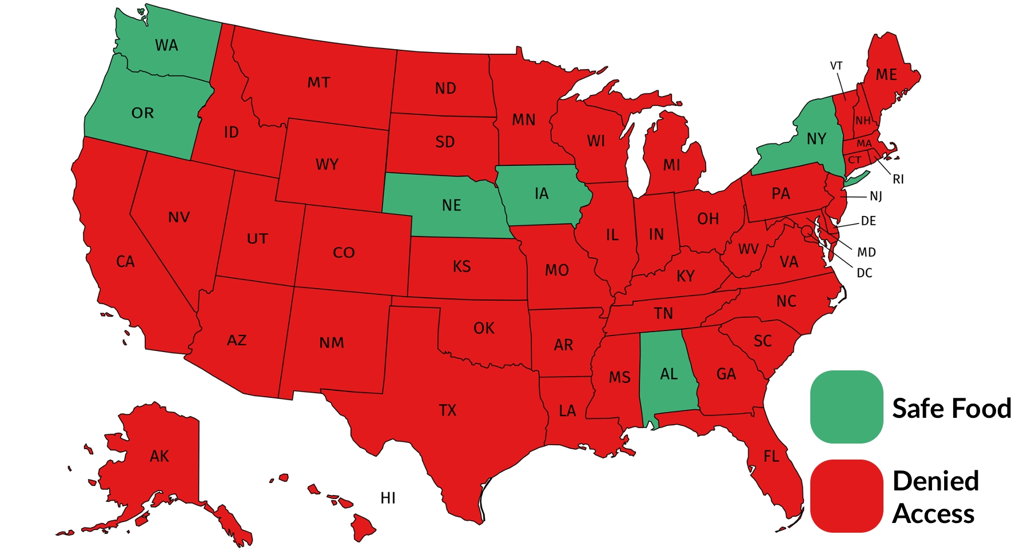
Online SNAP Pre-COVID-19: Little safe food access

Slide 13
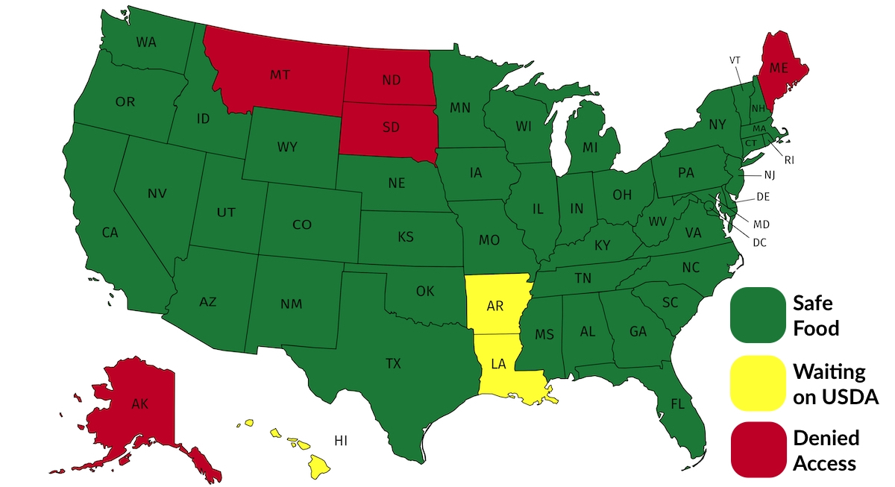
Status of Online SNAP now: 9.9 million people with disabilities have safe access to food

Slide 14
Prepare Leadership & Talent Pipeline
3
National Leadership Program
LA Lab for Entertainment Professionals
Inclusive Philanthropy
Project Moses
Women’s Disability Leadership
Diverse people with disabilities drive innovation & solutions.

Slide 15
Theory of Change
To fight stigmas and advance opportunities so that people with disabilities can fully participate in all aspects of community.
Mission
Theory of Change
Fight Implicit Bias
Advocate for Best Practices
Prepare
Leadership
Pipeline
1
2
3
Narrative Change in Hollywood
Representation of PWDs in News Media
Facts, White Papers & Social Media
Solution Center for Best Practices
Task Force of Disability Groups
National Leadership Program
Inclusive Philanthropy
Jewish Inclusion
Women’s Disability Leadership
Initiatives
PWDs drive innovation and solutions
PWDs are viewed for what they can do
PWDs are hired and heard
Outcomes

