Slide 1
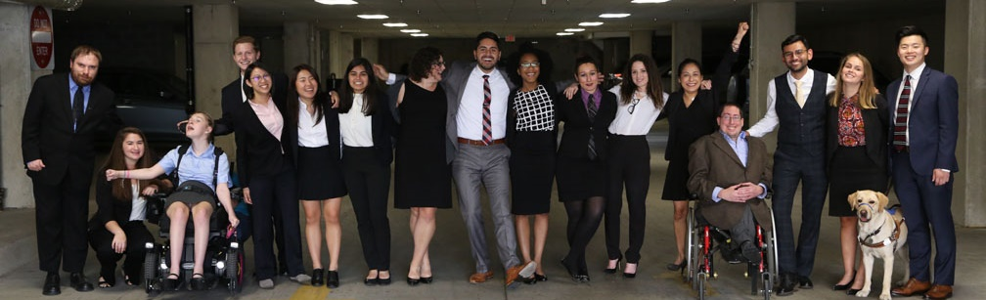

How Disability Inclusion & Equity Can Add to Your Success
Inclusion as a Jewish Value
Moderator – Matan Koch
Panelist – Aaron Kaufman
Panelist – Rabbi Lauren Tuchman

Slide 2
Partners/Co-Promoters
Avodah, B’nai David-Judea Congregation, Builders of Jewish Education: JKidLA, Congregation B’nai Amoona, Congregation B’nai Emet, Congregation Kol Ami, Congregation Or Ami, Edlavitch DCJCC, Foundation for Jewish Camp, Gateways: Access to Jewish Education, Hebrew Union College, IKAR, Institute on Theology and Disability, Jewish Federations of North America, Jewish Federation of Greater MetroWest NJ – Greater MetroWest ABLE, Jewish Los Angeles Special Needs Trust and Services, Jewish Residential Services, JQ International, JVS SoCal, Jewish Women International (JWI), Keshet, Lippman Kanfer Foundation for Living Torah, Marlene Meyerson JCC Manhattan, Matan, Moment Magazine, National Ramah Tikvah Network, Ohr HaTorah Synagogue, Reconstructing Judaism, Religious Action Center of Reform Judaism, ROSIES Foundation, Shalhevet, Shalom Institute, Stephen Wise Temple, T’ruah: The Rabbinic Call for Human Rights, The Jewish Journal, The Miracle Project, The New Normal, The Women’s Rabbinic Network, Union for Reform Judaism, USCJ, Whole Community Inclusion at Jewish Learning Venture, Yachad Los Angeles, Yeshivat Chovevei Torah Rabbinical School
This series is made possible by support from the Jewish Community Foundation of Los Angeles through a Cutting Edge Grant, The Diane & Guilford Glazer Philanthropies, The Charles & Lynn Schusterman Family Foundation, The David Berg Foundation, the Stanford and Joan Alexander Foundation, Stanley & Joyce Black Family Foundation, and The Beverly Foundation.

Slide 3
Upcoming Webinars
Tuesday, June 30, 2020 – How to Advance Disability Inclusion in Jewish Education
Tuesday, July 7, 2020 – How to Recruit, Accommodate and Promote Jewish Leaders with Disabilities for Paid Employment and Volunteer Leadership
Tuesday, July 14, 2020 – How to Ensure Accessible Events: Both Live and Virtual Across All Platforms
Tuesday, July 21, 2020 – How to Ensure a Welcoming Lexicon, Accessible Websites and Social Media and Inclusive Photos
Tuesday, August 4, 2020 – How to Create and Implement Successful Diversity, Equity and Inclusion (DEI) Initiatives – Best Practices and Must-Haves
Tuesday, August 11, 2020 – How to Ensure Legal Rights and Compliance Obligations
Sign Up at www.respectability.org/jewish-events/

Slide 4
Disability in the Jewish Community
According to the U.S. Census, fully 1-in-5 people in America has a physical, sensory, cognitive, mental health or other disability.
A landmark study by RespectAbility of more than 4000 Jewish respondents in 2018 found that more than 90 percent who responded indicated that this was a priority for them.
RespectAbility’s nonprofit survey showed that this inclusion is practiced by less than one-third of nonprofit organizations.
The studies also showed that while the will was there, the knowledge was not.
This free new series will fill that gap.

Slide 5
Speakers
Rabbi Lauren Tuchman
Speaker, Spiritual Leader, and Educator
She/Her/Hers
Aaron Kaufman
Senior Legislative Associate, The Jewish Federations of North America
He/Him/His
Matan Koch
Director of RespectAbility California and Jewish Leadership
He/Him/His

Slide 6
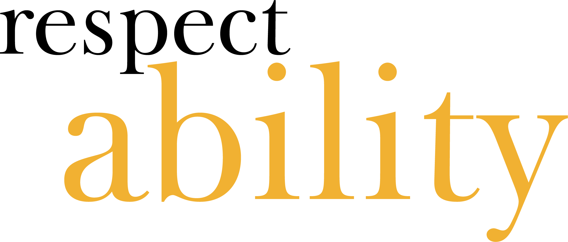
Question 1
Question:
How does your Jewishness inform your mission of disability inclusion?

Slide 7
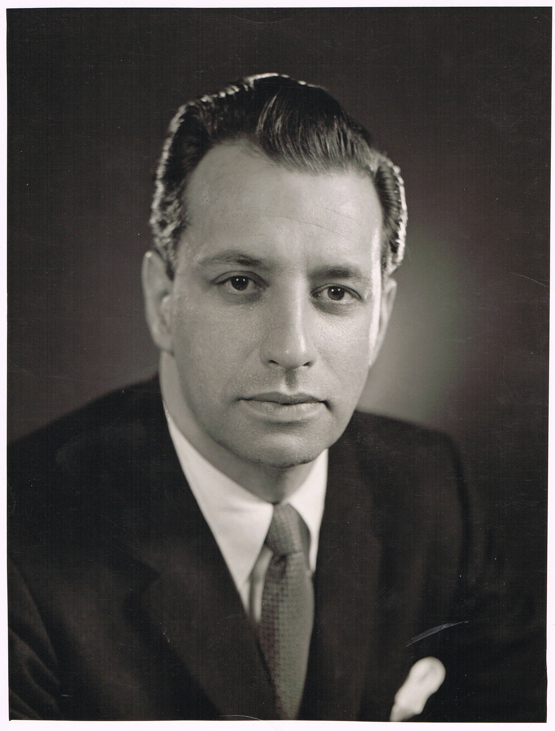
I have always had a strong Jewish connection
My grandfather, the late Rabbi Jay H. Kaufman, was the head of B'nai Brith International and a senior leader at the then Union of American Hebrew Congregations (UAHC), now Union for Reform Judaism. (URJ)
I now have the privilege to serve on the board of the URJ, and as the Secretary of the Board of the Jewish Foundation for Group Homes.

Slide 8
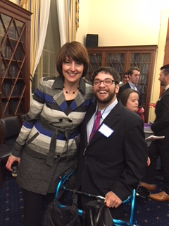
I’ve Always Had a Strong Connection to Disability Leadership
A Person with Cerebral Palsy
Was a Public Policy Specialist at the Arc of Maryland
Served on numerous disability councils and commissions

Slide 9
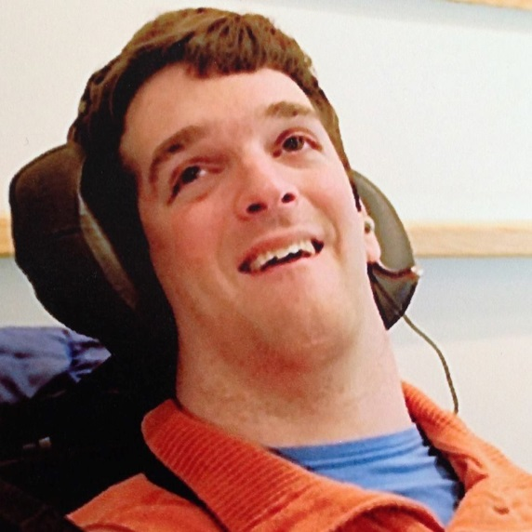
My brother and my motivation:

Slide 10
Combining Passions
Combining These Passions as the Senior Legislative Associate at The Jewish Federations of North America has Strengthened Both:
I am a stronger disability advocate because of the faith-based values that I bring to the hill
I am in a unique position to lead the Jewish world on these issues on behalf of JFNA because I fully embrace my identity as a Jewish leader, and as a person with a disability

Slide 11
Question 2
Question:
You have expressed that sometimes in your work you receive pushback that inclusion is somehow ancillary to or separate from the Jewish values of your organizational mission. How do you respond?

Slide 12
Moses was a person with a disability
My strong goal is to get people to follow up their words with actions, and to get them to do that I need them to embrace that this is a value. I start by pointing out that Moses, our greatest Jewish leader, was a person with a disability, and sometimes refer to other texts, which my friend Rabbi Tuchman will share soon.

Slide 13
My Proofs for a Jewish Value
Then I connect to the other pressing Jewish values that I know drive our organizations, especially Jewish connection, and continuity. I point out:
With the aging baby boomers, many people will be joining me in the "walker club" someday soon.
When we lose Jews with disabilities, we often lose their whole family as they choose to disengage. I personally advocate on behalf of my brother as much as myself.
Most accommodations cost nothing at all and if it cost, most accommodations cost $500 or less.

Slide 14
Overview
One of the centerpieces of modern Jewish tradition comes from our ancient text, the Babylonian Talmud
Written in modern-day Iraq in the seventh century, it surprisingly offers a lot on explicitly valuing the people we now think of as Jews with disabilities
I am going to offer you some texts that teach us some timeless values on the inclusion of Jews with disabilities, that many mistakenly believe are entirely contemporary
Hope you come away feeling that inclusion of Jews with disabilities is not new, but rather woven into our tradition.

Slide 15
Babylonian Talmud Eruvin 54B
“Having discussed the importance of reviewing one’s Torah study, the Gemara relates that Rabbi Perida had a certain student whom he would have to teach four hundred times, and only then would he learn the material, as he was incapable of understanding it otherwise. One day they requested Rabbi Perida’s presence for a mitzva matter after the lesson. Rabbi Perida taught his student four hundred times as usual, but this time the student did not successfully learn the material.”

Slide 16
Babylonian Talmud Eruvin 54B (Cont.)
Rabbi Perida said to him: What is different now that you are unable to grasp the lesson? He said to him: From the time that they said to the Master that there is a mitzva matter for which he is needed, my mind was distracted from the lesson and every moment I said: Now the Master will get up, now the Master will get up to go and perform the mitzva and he will not complete the lesson. Rabbi Perida said to him: Pay attention this time and I will teach you and know that I will not leave until you have fully mastered the lesson. He taught him again an additional four hundred times.

Slide 17
The Lessons from This Text (1)
Differentiated learning/IEP’s are talked about explicitly in the Talmud.
The rabbis of old care so much about a student that the teacher sits with them and explains the content four hundred times?
Also key to recall that when the student expresses his fear that his rabbi will leave him due to a matter of supreme importance a mitzvah matter-, the rabbi assures him that he will stay and teach the student.
Diverse learning needs have always been present. This student isn’t a burden but a joy to teach.

Slide 18
Babylonian Talmud Chagigah 5B
“The Gemara relates: Rabbi Yehuda HaNasi and Rabbi Ḥiyya were walking along the road. When they arrived at a certain city, they said: Is there a Torah scholar here whom we can go and greet? The people of the city said: There is a Torah scholar here, but he is blind. Rabbi Ḥiyya said to Rabbi Yehuda HaNasi: You sit here; do not demean your dignified status as Nasi to visit someone beneath your stature. I will go and greet him. Rabbi Yehuda HaNasi grabbed him and went with him anyway, and together they greeted the blind scholar. When they were leaving him, he said to them: You greeted one who is seen and does not see; may you be worthy to greet the One Who sees and is not seen. Rabbi Yehuda HaNasi said to Rabbi Ḥiyya: Now, if I had listened to you and not gone to greet him, you would have prevented me from receiving this blessing.”

Slide 19
The Lessons from This Text (2)
Rabbi Yehudah HaNasi was the compiler of the Mishnah, the Foundation of the Talmud.
Someone of his stature goes to greet this scholar who is considered to be by the townspeople beneath him.
Valuing all leaders, regardless of ability status is an important value. Don’t assume that just because someone has a disability, they aren’t worthy of being greeted or being visited.
The ancient rabbis understood the importance of social inclusion and recognition that blessings may be bestowed and received by all.

Slide 20
Babylonian Talmud Megillah 24B
MISHNA: A priest who has blemishes on his hands may not lift his hands to recite the Priestly Benediction. Because of his blemish, people will look at his hands, and it is prohibited to look at the hands of the priests during the Priestly Benediction. Rabbi Yehuda says: Even one whose hands were colored with satis, a blue dye, may not lift his hands to recite the Priestly Benediction because the congregation will look at him.

Slide 21
Babylonian Talmud Megillah 24B (Cont.) (An exploration of the different disabilities discussed)
GEMARA: It is taught in a baraita: The blemishes that the Sages said disqualify a priest from reciting the Priestly Benediction include any blemishes found on his face, hands, and feet, but not blemishes that are not visible to others. Rabbi Yehoshua ben Levi said: If his hands are spotted with white blotches, he may not lift his hands to recite the Priestly Benediction. The Gemara notes that this is also taught in a baraita: If a priest’s hands are spotted, he may not lift his hands to recite the Priestly Benediction. Similarly, if his hands are curved inward or bent sideways, he may not lift his hands to recite the Priestly Benediction. … Rav Huna said: A priest whose eyes constantly run with tears may not lift his hands to recite the Priestly Benediction.

Slide 22
Babylonian Talmud Megillah 24B (Cont.) (the exception)
The Gemara asks: Wasn’t there a certain priest with this condition in the neighborhood of Rav Huna, and he would spread his hands and recite the Priestly Benediction? The Gemara answers: That priest was a familiar figure in his town. Since the other residents were accustomed to seeing him, he would not draw their attention during the Priestly Benediction. This is also taught in a baraita: One whose eyes run should not lift his hands to recite the Priestly Benediction, but if he is a familiar figure in his town, he is permitted to do so.

Slide 23
Babylonian Talmud Megillah 24B (Cont.) (a second exception)
Rabbi Yoḥanan said: One who is blind in one eye may not lift his hands to recite the Priestly Benediction because people will gaze at him. The Gemara asks: Wasn’t there a certain priest who was blind in one eye in the neighborhood of Rabbi Yoḥanan, and he would lift his hands and recite the Priestly Benediction? The Gemara answers: That priest was a familiar figure in his town, and therefore he would not attract attention during the Priestly Benediction. This is also taught in a baraita: One who is blind in one eye may not lift his hands and recite the Priestly Benediction, but if he is a familiar figure in his town, he is permitted to do so.

Slide 24
Babylonian Talmud Megillah 24B (Cont.) (making it general.)
We learned in the mishna that Rabbi Yehuda said: One whose hands are colored should not lift his hands to recite the Priestly Benediction. It was taught in a baraita: If most of the townspeople are engaged in this occupation, dyeing, he is permitted to recite the Priestly Benediction, as the congregation will not pay attention to his stained hands.

Slide 25
The Lessons from This Text (4)
At first glance this text comes off as harsh, deeply hurtful, and exclusionary.
The rabbis place the onus on the people—the person does not make the priestly benediction because people will stare.
Then we start to see exceptions
  If a person is familiar in his/her town, and thus people will not be distracted, it is ok for them to make the priestly benediction.
  If a condition or situation is familiar, maybe because of the shared profession, it is okay

Slide 26
The Lessons from This Text (5)
Familiarity matters to the rabbis. Why might that be?
What obligation does this place on our community with-regard-to leaders with disabilities?

Slide 27
Questions?

Slide 28
Project Moses - Strengthening the Jewish Community Through Leadership by Jews with Disabilities
Project Moses is a new leadership program that currently is recruiting 36 new talented civic-minded Jews with disabilities to join a leadership cohort in the Los Angeles Jewish community. It is made possible by the generosity of the Jewish Community Foundation of Los Angeles and other funders. Participants will be talented people who may have mobility, vision, hearing, mental health or any other disability. We want to maximize their potential and connect them to Jewish organizations in the Los Angeles-area to truly make a difference.
Moses Leaders Will Be:
Trained
Mentored
And connected with Jewish organizations

Slide 29
RespectAbility Jewish Inclusion Fellowship
The National Leadership Program is a virtual program, ideal for people who want to gain skills and contacts while making a positive difference for people with disabilities.
For the Jewish inclusion fellowship program in particular, we’re looking for people with an absolute passion for learning and exploring about the different inclusion resources that exist, who would also enjoy research, interaction with other organizations, and deep thought about how to make information useful.
Do you know a future Jewish professional that fits the bill? Or perhaps someone who lost their job during this pandemic and wants to be helpful during their job search? Please encourage them to learn more and apply at: https://www.respectability.org/about-us/fellowship/jewish-inclusion-fellowship/

Slide 30
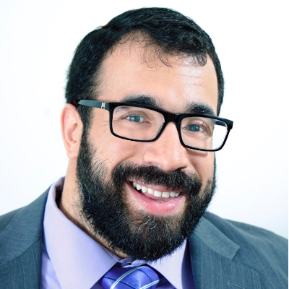
Matan Koch
Matan A. Koch is the Director of RespectAbility California and Jewish Leadership at RespectAbility, a nonprofit organization fighting stigmas and advancing opportunities for and with people with disabilities. A longtime national leader in disability advocacy and a wheelchair user himself, he leads Project Moses, RespectAbility’s Los Angeles-based Jewish leadership project, and is also on the front lines in many other areas of RespectAbility’s work, including: disability inclusion in philanthropy and nonprofits, Jewish outreach and impact, leadership, legal affairs and our continuing Los Angeles expansion.

Slide 31
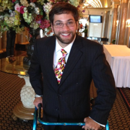
Aaron Kaufman
Aaron Kaufman joined The Jewish Federations of North America’s Washington DC office in January 2016 as a Senior Legislative Associate. He focuses on disability and poverty issues. Aaron came from the Arc Maryland where he lobbied members of the Maryland General Assembly and the Maryland Congressional delegation on issues affecting Marylanders with intellectual and developmental disabilities and their families. Having Cerebral Palsy, Aaron feels he brings a unique perspective to JFNA’s efforts on behalf of people with disabilities.

Slide 32
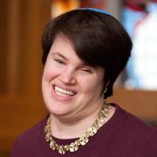
Rabbi Lauren Tuchman
Based in the Washington, D.C. area, Rabbi Lauren Tuchman is a sought-after speaker, spiritual leader and educator. Ordained by The Jewish Theological Seminary in 2018, she has taught at numerous synagogues and other Jewish venues throughout North America and was named to the Jewish Week’s 36 under 36 for her innovative leadership concerning inclusion of Jews with disabilities in all aspects of Jewish life. In 2017, she delivered an ELI Talk entitled We All Were At Sinai: The Transformative Power of Inclusive Torah.

Slide 33
See you next Tuesday, June 30 for part 2!
Want more information? Contact Matan Koch, Director of RespectAbility California & Jewish Leadership, at MatanK@RespectAbility.org

