Slide 1
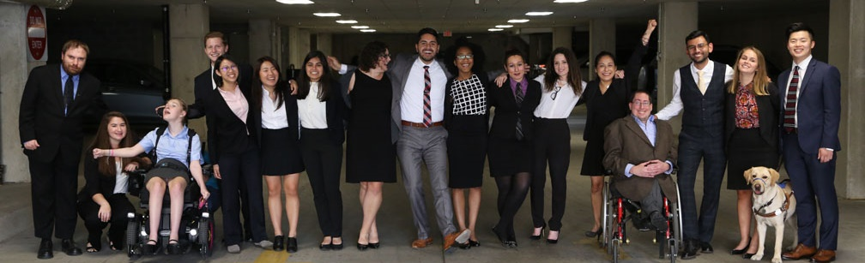

How Disability Inclusion & Equity Can Add to Your Success
“How to Advance Disability Inclusion in Jewish Education”
Speakers:
Meredith Polsky – Matan
Lianne Heller – Sulam
Debbie Niderberg – Hidden Sparks

Slide 2
Sponsors
This series is made possible by support from the Jewish Community Foundation of Los Angeles through a Cutting Edge Grant, The Diane & Guilford Glazer Philanthropies, The Charles & Lynn Schusterman Family Foundation, The David Berg Foundation, the Stanford and Joan Alexander Foundation, Stanley & Joyce Black Family Foundation, and The Beverly Foundation.

Slide 3
Co-Promoters
Avodah, B’nai David-Judea Congregation, Builders of Jewish Education: JKidLA, Congregation B’nai Amoona, Congregation B’nai Emet, Congregation Kol Ami, Congregation Or Ami, Edlavitch DCJCC, Foundation for Jewish Camp, Gateways: Access to Jewish Education, Hebrew Union College, IKAR, Institute on Theology and Disability, Jewish Federations of North America, Jewish Federation of Greater MetroWest NJ – Greater MetroWest ABLE, Jewish Los Angeles Special Needs Trust and Services, Jewish Residential Services, JQ International, JVS SoCal, Jewish Women International (JWI), Keshet, Keshet Chicago, Lippman Kanfer Foundation for Living Torah, Marlene Meyerson JCC Manhattan, Matan, Moment Magazine, National Ramah Tikvah Network, Ohr HaTorah Synagogue, Reconstructing Judaism, Religious Action Center of Reform Judaism, ROSIES Foundation, Shalhevet, Shalom Institute, Stephen Wise Temple, Temple Adat Elohim, T’ruah: The Rabbinic Call for Human Rights, The Jewish Journal, The Miracle Project, The New Normal, The Women’s Rabbinic Network, Union for Reform Judaism, USCJ, Whole Community Inclusion at Jewish Learning Venture, Yachad Los Angeles, Yeshivat Chovevei Torah Rabbinical School
RespectAbility is proud to say that our Jewish Inclusion Network now exceeds several thousand globally!

Slide 4
Upcoming Webinars
Tuesday, July 7, 2020 – How to Recruit, Accommodate and Promote Jewish Leaders with Disabilities for Paid Employment and Volunteer Leadership
Tuesday, July 14, 2020 – How to Ensure Accessible Events: Both Live and Virtual Across All Platforms
Tuesday, July 21, 2020 – How to Ensure a Welcoming Lexicon, Accessible Websites and Social Media and Inclusive Photos
Tuesday, August 4, 2020 – How to Create and Implement Successful Diversity, Equity and Inclusion (DEI) Initiatives – Best Practices and Must-Haves
Tuesday, August 11, 2020 – How to Ensure Legal Rights and Compliance Obligations
Sign Up at www.respectability.org/jewish-events/

Slide 5
Disability in the Jewish Community
According to the U.S. Census, fully 1-in-5 people in America has a physical, sensory, cognitive, mental health or other disability.
A landmark study by RespectAbility of more than 4000 Jewish respondents in 2018 found that more than 90 percent who responded indicated that this was a priority for them.
RespectAbility’s nonprofit survey showed that this inclusion is practiced by less than one-third of nonprofit organizations.
The studies also showed that while the will was there, the knowledge was not.
This free new series will fill that gap.

Slide 6
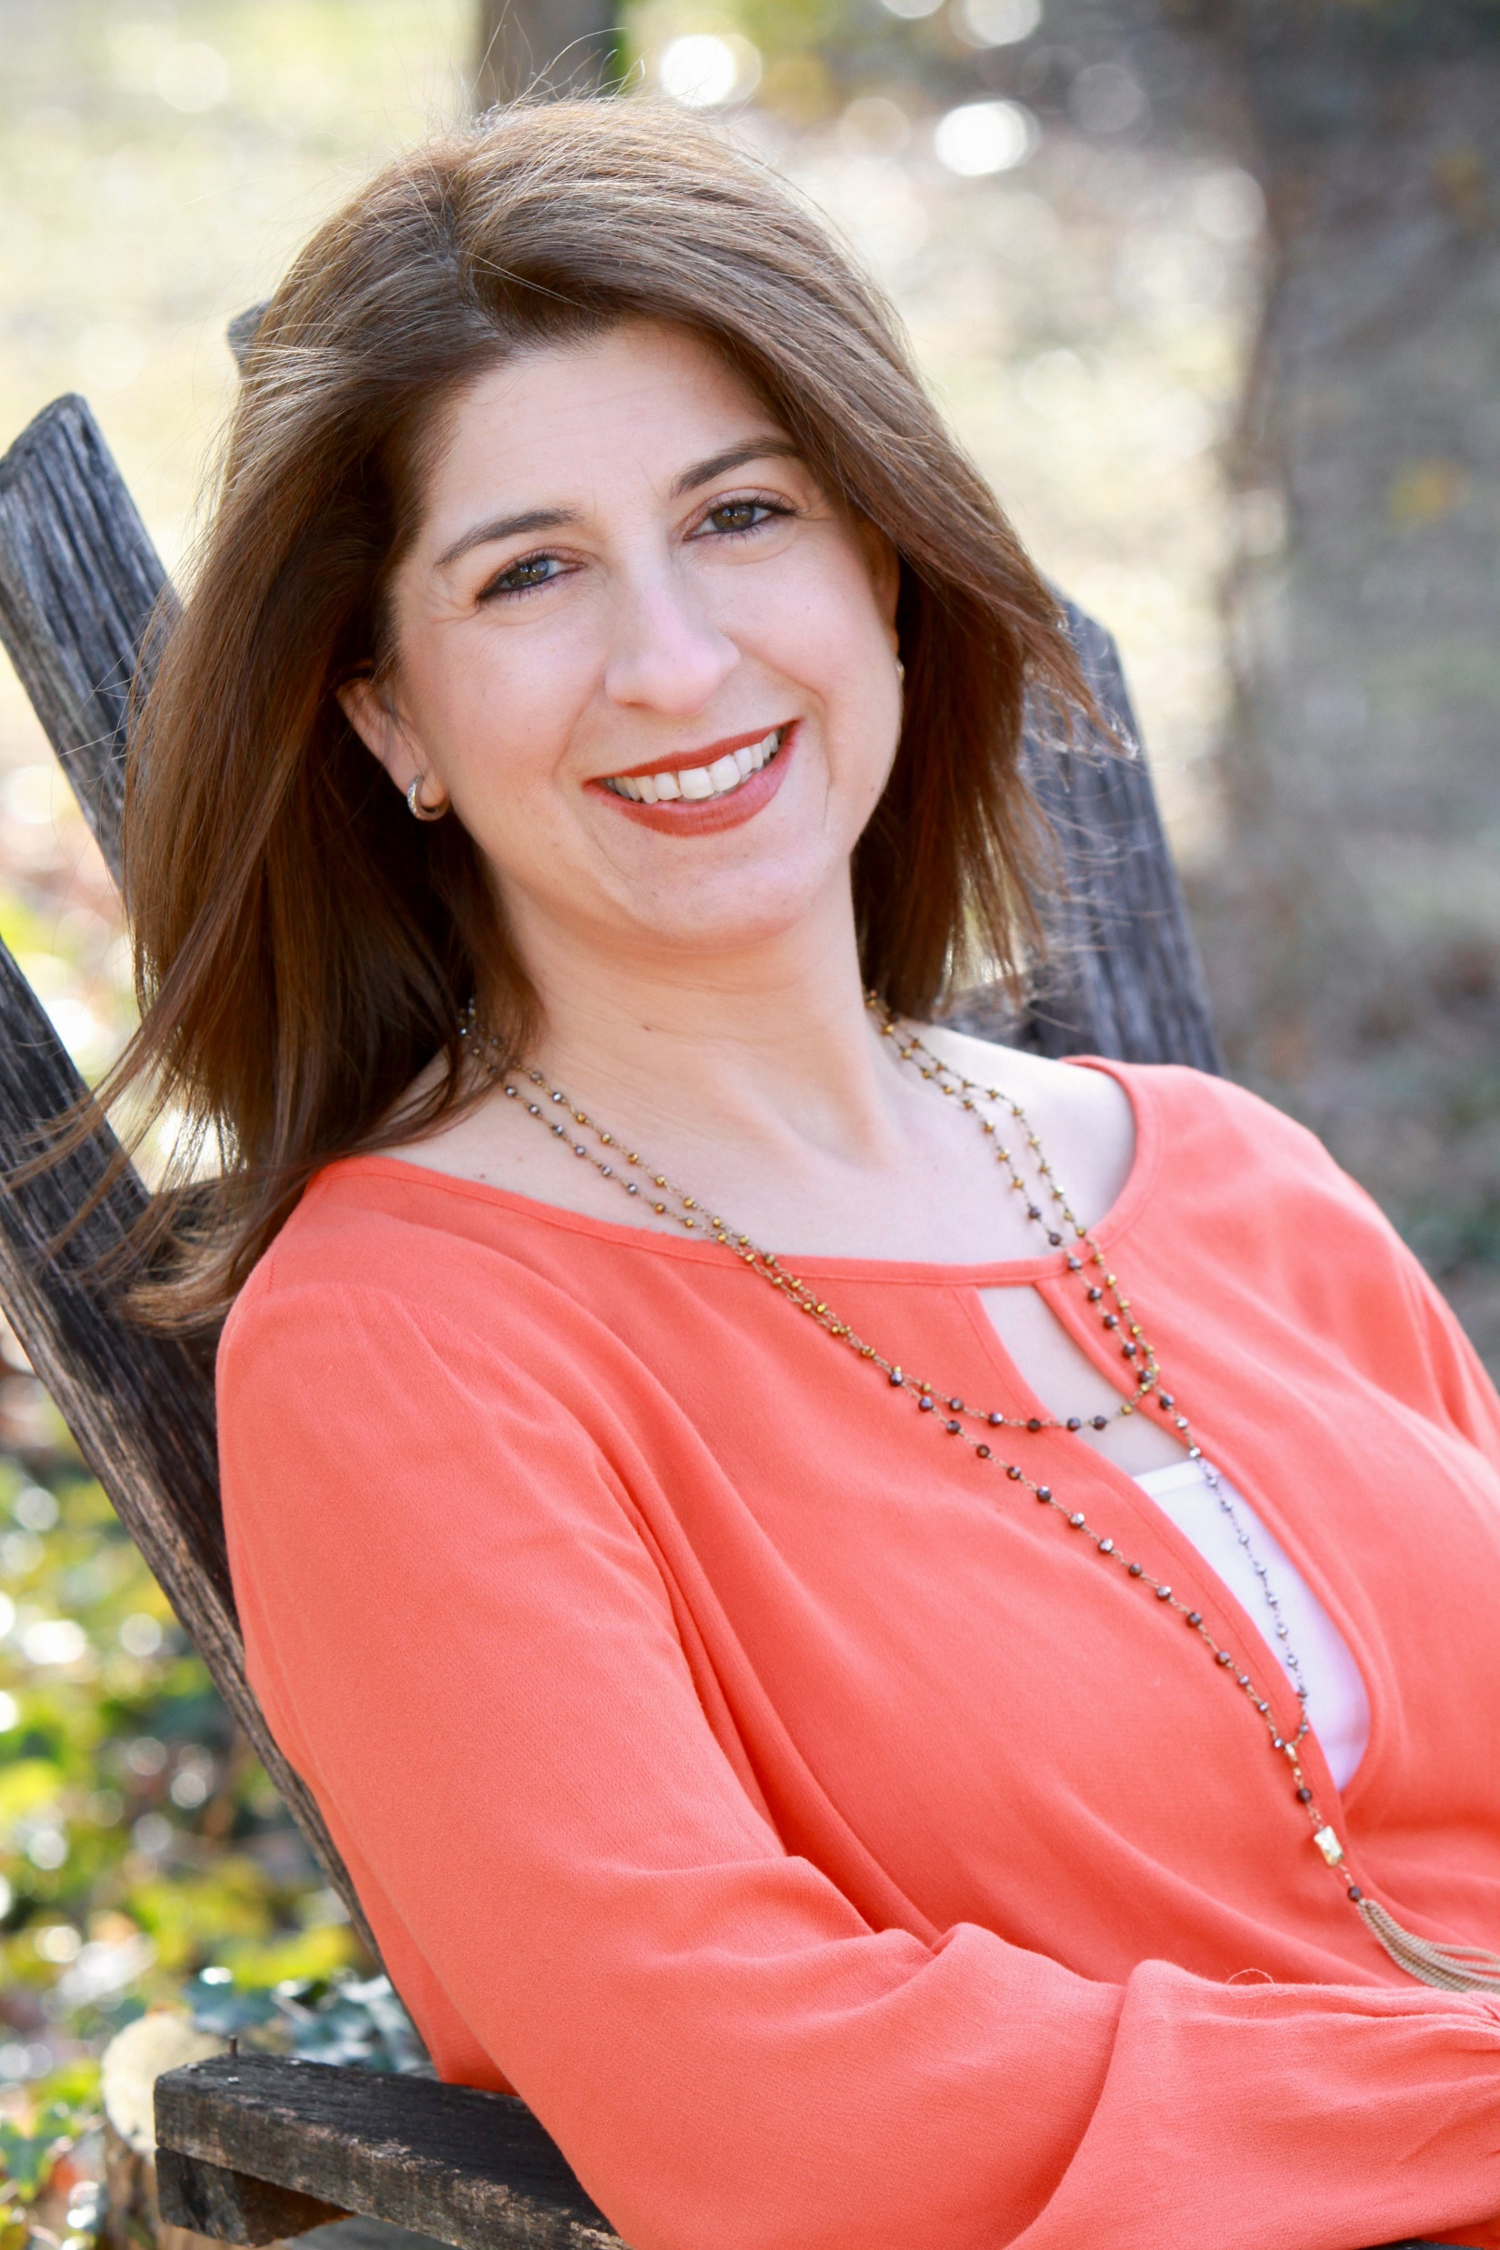
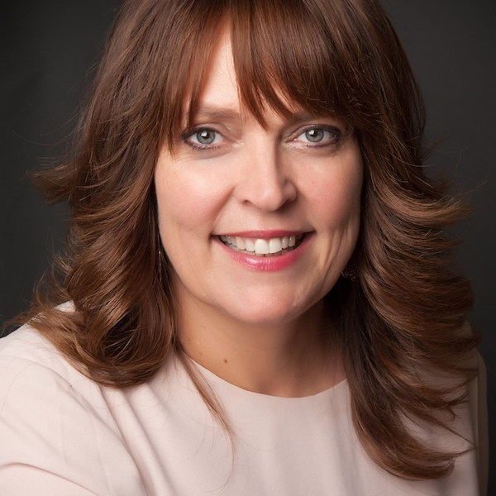
Speakers
Meredith Polsky
National Director of Institutes and Training
Matan
Lianne Heller
Executive Director
Sulam
Debbie Niderberg
Executive Director
Hidden Sparks

Slide 7

Mission Statement
MISSION STATEMENT: One in five. That’s the number of people with disabilities in the United States today. Matan enables Jewish professionals, communities and families to create and sustain inclusive settings in educational, communal and spiritual aspects of Jewish life.

Slide 8
COMMUNITY CONSULTATIONS
Matan works with communities to:
  Understand its inner workings and priorities
  Identify local expertise and resources
  Identify areas of strength and challenge when it comes to Jewish inclusion
  Serve as an independent, expert voice in bringing various local agencies to the table
  Create a report of recommendations, outlining short-term and long-term goals based on the information gathered from a cross-section of professionals and lay leaders

Slide 9
MATAN INSTITUTES
Cohorts geared towards specific groups of educators/leaders
Deep inclusion training over 10 months
Nationally and regionally based
In-person and online blended learning
1:1 Mentorship
Nationally renowned Jewish and secular trainers

Slide 10
CONVERSATION, CURRICULA, & CONSULTATION
Free webinar series
Curricular materials (JDAIM lesson plans, Teen Training, Camp Training, other resources)
Onsite and remote training sessions and consultations with teachers, directors, boards and other organizations
www.matankids.org
Meredith@matankids.org

Slide 11

Teacher Training & Coaching
To Benefit All Learners in Jewish Day Schools
Hidden Sparks is a nonprofit whose mission is to help educators and schools nurture the Hidden Spark within each student. We do this by developing and facilitating professional development programs and coaching for Jewish day school educators to deepen understanding of learning and approaches for teaching all kinds of learners, particularly those who struggle. By working with educators and coaching internal school leaders, we are committed to increasing the capacity of Jewish day schools to address the varied needs of learners so that all students thrive.

Slide 12
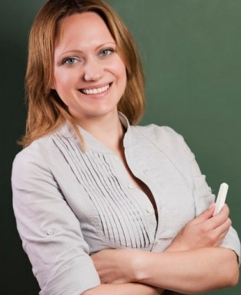
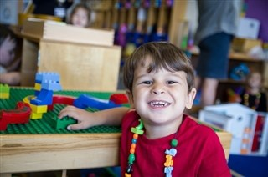
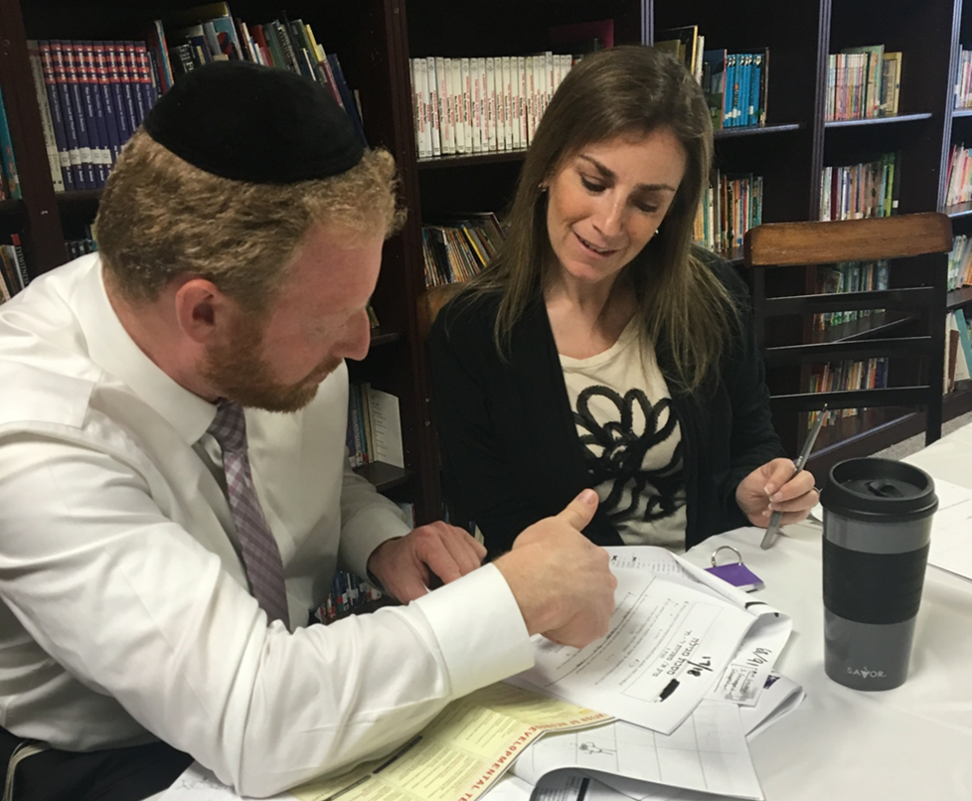
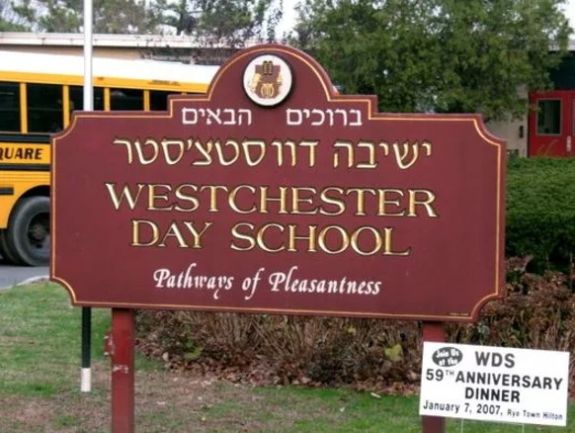
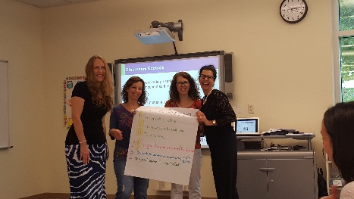
Hidden Sparks Audiences
Teacher
Student
Faculty Peer Coaches
School
Notes:
Teacher- impacting present and future; skills and mindset
Student- teachers with greater understanding and ability to help them reach their potential
School- whole school- leadership, teaching teams

Slide 13




Core Components of Our Programs
Child - whole student
Coaching model - powerful learning model
Curriculum - continuous, school based-strength based, comprehensive
Collaboration - monthly meetings- builds teams, whole child discussion
Capacity building - faculty peer coaches
Notes:
Coaching- Surgeon/ Coach on the Operating Table, New Yorker
“One 20 minute session with him gave me more to consider and work on than I’d had in the past 5 years”
Collaboration- general and Judaic, importance of seeing across disciplines, teacher team meetings, collaborative culture.
Capacity building- every program needs a capacity building plan and exit strategy.

Slide 14
Teachers and Schools Reaching Every Child

Slide 15

Contacting Hidden Sparks
For Information about special events and our ongoing programs,
Contact Hidden Sparks:
Sara Diament, Director of School Services, sara@hiddensparks.org
or
Debbie Niderberg, Executive Director, dknider@hiddensparks.org
Click Here to Watch the New Hidden Sparks Video
www.hiddensparks.org
www.facebook.com/HiddenSparks

Slide 16
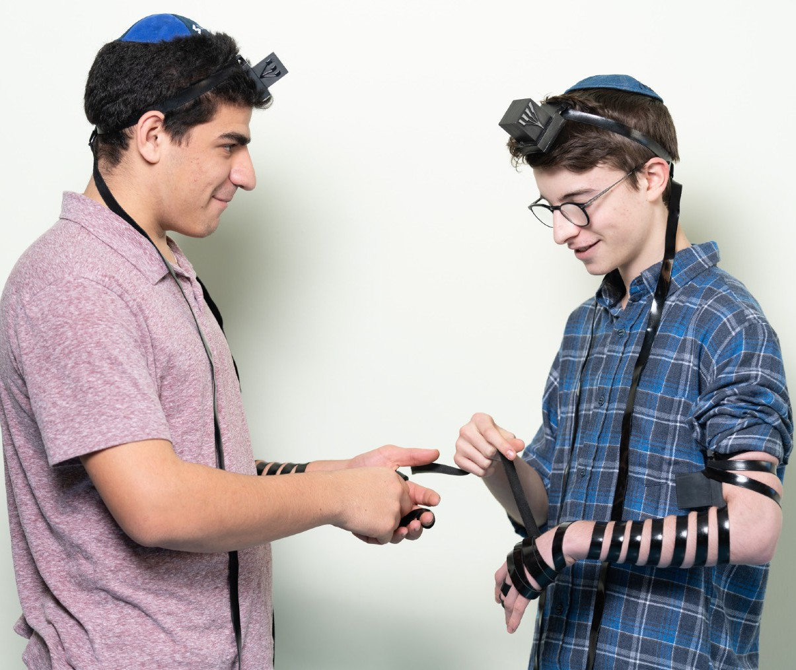
THE SULAM MISSION
Sulam, a K-12 Jewish special education inclusion program, provides high quality educational, social, and emotional support for students with disabilities, while teaching all stakeholders that
everyone belongs and can make a vital contribution to the world.

Slide 17
Sulam Vision
Sulam Vision
Sulam aspires to create an education approach where learning differences are celebrated and integrated naturally into the fabric of a school community and broader society.

Slide 18
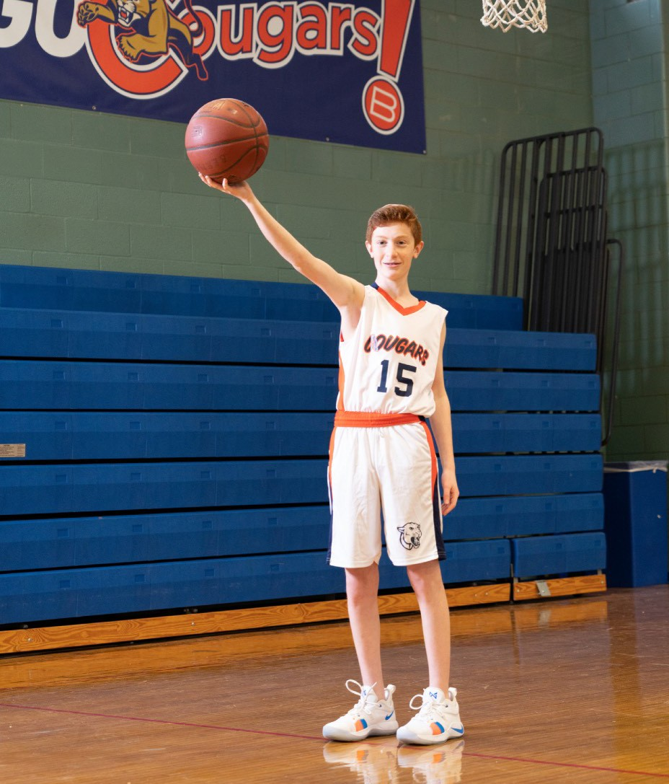
FOR MORE INFORMATION
Visit sulam.org
Hear from our students, their parents and our teachers: https://www.sulam.org/ togetherwerise and
Hear from Berman Hebrew Academy students, Sulam’s host school: https:// vimeo.com/340238655

Slide 19
Questions for the Panelists:
How did your organization come to be? What’s your story?
What are some of the questions that have come up during the life of your organization?
From the perspective of your organization, what does success look like?
What advice do you have for a community that is trying to address this population more effectively?
How has COVID-19 impacted your work or the constituents you serve?

Slide 20
Meredith Polsky
Meredith Polsky founded Matan in 2000 and serves as Matan’s National Director of Institutes and Training, as well as the part-time Developmental Support Coordinator at Temple Beth Ami Nursery School in Rockville, MD. Meredith is a nationally sought-after speaker on Jewish Special Education. She holds a Master’s degree in Special Education from Bank Street College, a Master’s degree in Clinical Social Work from Columbia University and a graduate certificate in Early Intervention from Georgetown University.

Slide 21
Lianne Heller
Lianne Heller is the Executive Director of Sulam, a special education inclusion program serving students with disabilities in K-12 in the Greater Washington area. She has worked in the field of Jewish education and special education for the past twenty-five years. After studying journalism in South Africa, where she established a publishing company and television production company, she immigrated to the US. Her focus shifted to Jewish education when she became a mother of four sons. Lianne’s work at the Montgomery County Public School Learning and Disabilities (LAD) program, as well as in the Center Programs for the Highly Gifted, inspired her to continue her studies in the field of Jewish education and leadership.

Slide 22
Debbie Niderberg
Debbie Niderberg, Executive Director, helped launch Hidden Sparks, from conceptual development to its present size and worked collaboratively to design its unique programming, and build the organization’s infrastructure and professional leadership. She is also responsible for developing new initiatives, such as Hidden Sparks Without Walls, and new programmatic and funding partnerships.

Slide 23
Questions?

Slide 24
Project Moses - Strengthening the Jewish Community Through Leadership by Jews with Disabilities
Project Moses is a new leadership program that currently is recruiting 36 new talented civic-minded Jews with disabilities to join a leadership cohort in the Los Angeles Jewish community. It is made possible by the generosity of the Jewish Community Foundation of Los Angeles and other funders. Participants will be talented people who may have mobility, vision, hearing, mental health or any other disability. We want to maximize their potential and connect them to Jewish organizations in the Los Angeles-area to truly make a difference.
Moses Leaders Will Be:
Trained
Mentored
And connected with Jewish organizations

Slide 25
RespectAbility Jewish Inclusion Fellowship
The National Leadership Program is a virtual program, ideal for people who want to gain skills and contacts while making a positive difference for people with disabilities.
For the Jewish inclusion fellowship program in particular, we’re looking for people with an absolute passion for learning and exploring about the different inclusion resources that exist, who would also enjoy research, interaction with other organizations, and deep thought about how to make information useful.
Do you know a future Jewish professional that fits the bill? Or perhaps someone who lost their job during this pandemic and wants to be helpful during their job search? Please encourage them to learn more and apply at: https://www.respectability.org/about-us/fellowship/jewish-inclusion-fellowship/

Slide 26
See you next Tuesday, July 7 for part 3!
Want more information? Contact Matan Koch, Director of RespectAbility California & Jewish Leadership, at MatanK@RespectAbility.org

