Slide 1
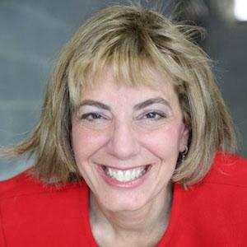


An Update on our COVID-19 Response
Jennifer Laszlo Mizrahi, President, RespectAbility
Ollie Cantos,
Board of Directors, RespectAbility
Poll Briefing: People with Disabilities & COVID-19, SNAP, Voter Access and More
Stan Greenberg,
Pollster,
Democracy Corps
Page Gardner, Founder, Voter Participation Center

Slide 2
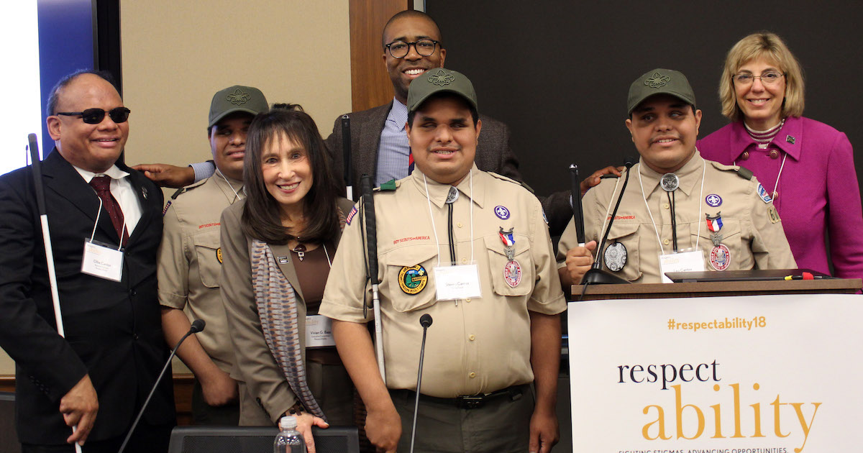
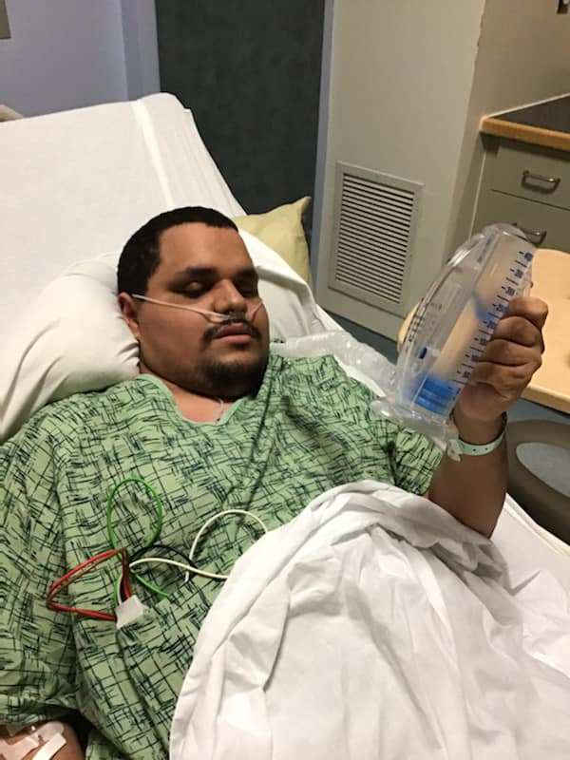
Blind Triplets Who Became Eagle Scouts Battling COVID-19
RespectAbility Release: https://www.respectability.org/2020/04/blind-triplets-covid-19/
ABC World News Tonight Story: https://www.facebook.com/watch/?v=257659705416968
NBC Washington Story: https://www.nbcwashington.com/news/local/blind-triplets-battle-coronavirus/2285691/

Slide 3


Introduction
The partisan polarization of the pandemic
CVI Pandemic battleground tracking: wave 2
April 29 to May 3, 2020

Slide 4

Definition of Battleground
Definition of Battleground
Total 16-state Presidential and Senate battleground: Arizona, Colorado, Florida, Georgia, Iowa, Nevada, New Hampshire, New Mexico, North Carolina, Maine, Michigan, Minnesota, Ohio, Pennsylvania, Virginia, Wisconsin
8 Diverse States = AZ (+5), CO (+1), FL (+2), GA (+5), NV (+1), NM (+3), NC (+3), VA (+1)
8 Blue Wall States = IA (+3), MI (+1), ME (+3), MN (+1), NH (-), OH (+3), PA (-), WI (-)
4 Regions :
Northeast (ME, NH, PA),
Midwest (IA, MI, MN, OH, WI)
South (FL, GA, NC, VA)
West (AZ, CO, NM, NV)
(Republican PVI advantage)(PVI – even)(Democratic PVI advantage)*retiring/term-limited

Slide 5
Methodology
Methodology
APRIL BATTLEGROUND WEB POLL: This large-scale web survey of 2,000 registered voters in this 16-state battleground was conducted online April 29-May 3, 2020 from a voter-file sample.
  The registered voter web survey is voter-file matched to produce a high-quality sample of real voters with the added advantage of known vote history. It is also well-suited for conducting experiments to test message strategies and executions.
WEIGHTING TO PHONE POLLS: The web poll was weighted to a rolling average of recent phone polls. The last phone poll of 1,000 registered voters in the battleground that was conducted March 9-16, 2020 from a voter-file sample. 67% of respondents were reached on cell phones. The margin of error is +/- 3.5 percentage points.
  The phone survey includes core demographic and ideological questions, including key thermometer measures, and is used to compare and apply political and cultural weights the web survey results to offset bias of online sample.
  Only with such a survey can we properly weight our web survey, which we know are often biased to be culturally liberal and more educated.
BATTLEGROUND WEB POLL, WEIGHTED TO PHONE POLL
*Unless otherwise stated, the results shown are from the Democracy Corps/CVI April & May battleground pandemic tracking surveys.
Notes:
This is a May poll – not April—CA: updated dates and also added language on weighting to the rolling average of phone polls, last one done in March.

Slide 6
Key Findings
Key Findings:
The Tea Party-Trump Republican Party was forced to lead the country’s response to the pandemic and that accelerated the polarization of the country and marginalization of the GOP — at a very high human cost.
Trump has cheered governors opening up the economy and protestors liberating their states, and the country and some Republicans fear this will prove tragic.
Republicans rally behind getting the economy started in an anti-pro-life charge against their party, but Democrats and independents are staunchly behind governors who are keeping people at home until safe.
The partisan polarization has even shaped how much they fear an immediate family member becoming seriously ill. Half of Democrats score the most worried, 8 to 10 on a 10-point scale, but only a quarter of Republicans. That explains why so many Republican political leaders have so much trouble holding the line on government control.

Slide 7
Key Findings 2
Key Findings:
The level of support for new proposals for a possible new CARES package rises to stratospheric levels. At each point in this pandemic crisis, the country becomes even more supportive of the bold options and bigger role for government.
Some of the reason why people have expressed less worry about their finances rather than health is this massive cash support that people received, so it is not surprising that 86 percent of registered voters approve of the rescue plan.
The number of voters who could now afford a sudden $500 expense jumped from two thirds to three quarters, and a remarkable 70 percent of voters received a direct payment into their bank account to deal with the crisis
Democratic leaders need to do dramatically better if they are to own the amazing rescue of average citizens and small business. Just 28 percent think the Senate and House Democrats are responsible, and 23 percent do not know.

Slide 8
Disability Community represents over one quarter of the 2020 battleground
A disability can be a physical, cognitive, sensory, mental health, chronic pain or another condition that is a barrier to everyday living. Do you, a family member, or a close friend have a disability? Please check off all that apply.

Slide 9
Anti-stay-at-home demonstrators hated by country and half GOP
Anti-stay-at-home demonstrators hated by country and half GOP
Please rate your feelings toward some people, organizations, and concepts, with one hundred meaning a VERY WARM, FAVORABLE feeling; zero meaning a VERY COLD, UNFAVORABLE feeling; and fifty meaning not particularly warm or cold.
The anti-stay-at-home demonstrators
+52
+78
+65
+20
+52
+53
+70
+59
+55
Neutral: 8
DK: 8
Neutral: 3
DK: 8
Neutral: 11
DK: 12
Neutral: 13
DK: 8
Neutral: 7
DK: 19
Neutral: 7
DK: 18
Neutral: 6
DK: 3
Neutral: 8
DK: 7
Neutral: 8
DK: 5
Notes:
No negative sign in graph—CA:fixed

Slide 10
Trump tweeting to “liberate” Democratic-run states raises serious doubts across the board; only Tea Party GOP base unfazed
Trump tweeting to “liberate” Democratic-run states raises serious doubts across the board; only Tea Party GOP base unfazed
Here are some statements that are critical of the Trump administration handling of the pandemic. Please read each one and indicate whether is raises very serious doubts, serious doubts, minor doubts, or no real doubts in your own mind about President Trump.
President Trump has tweeted "Liberate" Minnesota, Michigan and Virginia in support of demonstrators that were surrounding state capitol buildings and defying Democratic governors' stay at home orders in states hit hardest by the pandemic. Some sported assault rifles that were legal to carry openly. The president was urging people to defy his own advice on how to fight the virus and save lives
Notes:
Left adjust text in box—CA: done
Move the GOP groups to the right side.—CA: done
So, it will be party groups, then AA, Hispanic, etc. then GOP—CA: done

Slide 11
Governors opening up economy viewed warmly by only a third of country
Governors opening up economy viewed warmly by only a third of country
Please rate your feelings toward some people, organizations, and concepts, with one hundred meaning a VERY WARM, FAVORABLE feeling; zero meaning a VERY COLD, UNFAVORABLE feeling; and fifty meaning not particularly warm or cold.
The Governors who are ending stay-at-home orders to restart the economy
+20
+58
+31
+27
+50
+31
+28
+26
+9
Neutral: 14
DK: 4
Neutral: 10
DK: 4
Neutral: 13
DK: 9
Neutral: 20
DK: 5
Neutral: 13
DK: 7
Neutral: 8
DK: 11
Neutral: 14
DK: 6
Neutral: 14
DK: 6
Neutral: 19
DK: 6
Notes:
Get rid of negative sign in bar—CA: fixed

Slide 12
Almost 60 percent of country reject the way opening, including 1/3 of GOP
Almost 60 percent of country reject the way opening, including 1/3 of GOP
Which one of the following statements comes closer to your point of view, even if neither is exactly right?
1) The governors who are calling on people to stay
home and separate are doing the right thing.
2) The governors who are ending stay-at-home orders,
though keeping social distancing where possible, to
open up the economy are doing the right thing.
+18
+64
+18
+32
+48
+16
+36
+37
+18
Notes:
INSERT the graphs on open-ended reaction to Kemp—CA: done
Fill out RAE- LW done

Slide 13
When asked to share reactions to Georgia opening, comments overwhelmingly negative, and those who agree give few reasons or will still follow guidelines
When asked to share reactions to Georgia opening, comments overwhelmingly negative, and those who agree give few reasons or will still follow guidelines
Please describe your feelings when you heard that. Whatever you want to share.
OPEN END – GEORGIA OPENING
69%
Negative/
Disagree
30% Positive/Agree
Notes:
LW: done. Not sure if needed
CA: grouped together by positive/negative

Slide 14
Open-ended reaction to Georgia governor plan for reopening safely, including theaters, barbers and dine-in restaurants
Open-ended reaction to Georgia governor plan for reopening safely, including theaters, barbers and dine-in restaurants
You probably heard Georgia Governor, Brian Kemp, declared that he plans to incrementally and safely reopen sectors of the state's economy by Monday. It will include regular sanitation and social distancing. But Georgia will open theaters, bowling alleys, barbers and hair designers, and restaurant dining-in services. Please describe your feelings when you heard that. Whatever you want to share.
VERBATIM RESPONSES
“Unbelievable that a governor would make such a move when the state had not met the criteria for opening businesses. The state’s curve had not begun to flatten, and testing was not fully implemented in the state.”
“He's stupid & nobody is going to follow that.”
“Sick to my stomach that we are in a hot spot and Kemp is letting the Jennie out of the bottle.”
“I believe it is too soon. He opened up businesses that have more direct contact with people because they provide personal services. He said if the count goes up, we are prepared. We don’t have any assurance of having enough.”
“I think it's too early, but then again some businesses can't survive”
“Happiness”
Notes:
Left adjust—CA: done

Slide 15
Large majority bothered leaders willing to have a lot of older people die
Large majority bothered leaders willing to have a lot of older people die
Which one of the following statements comes closer to your point of view, even if neither is exactly right?
1) Republican leaders are right to be focused on
the economic crisis and getting people back to work.
2) I am bothered that some leaders seem willing to
have a lot more older people die.
+12
+62
+22
+50
+56
+12
+30
+24
+8
Notes:
Insert the graphs after this on reaction to TX
Fill out RAE-LW done

Slide 16
When asked to share feelings after hearing Texas Lt. Governor on seniors, most disagree and many express outrage
When asked to share feelings after hearing Texas Lt. Governor on seniors, most disagree and many express outrage
Please describe your feelings when you heard that. Whatever you want to share.
OPEN END – SACRIFICE SENIORS
67% Disagree/
Negative
Notes:
CA: grouped together by positive/negative

Slide 17
Open-ended reaction to Texas Lt. Governor statement on seniors
Open-ended reaction to Texas Lt. Governor statement on seniors
You probably heard the Texas Lieutenant Governor said that as a senior citizen, he and other seniors should be willing to take a chance on their survival in exchange for opening the economy again. Please describe your feelings when you heard that. Whatever you want to share.
VERBATIM RESPONSES
“I think it's a cruel and heartless thing to say.”
“I was shocked and appalled by the statement. He basically is saying that senior citizens are expendable, which is absolutely awful.”
“I didn't hear that, but it is shocking to think that he/she would ask seniors to lay down their lives”
“Easy to say if you are not at risk.”
“Good for him - I'm staying locked-down.”
“He can that for himself, but he doesn't have the right to make that decision for others.”
“I think we should all be responsible for our own well being. So yes agree with statement.”
“It's his choice and if he's willing to take the chance, then he should be able to do so.”
Notes:
Left adjust—ca: done

Slide 18
Even fear of losing immediate family member shaped by partisanship & world view
Even fear of losing immediate family member shaped by partisanship & world view
How fearful are you that an immidiate family member will catch COVID-19 and get seriously ill? Please rate your concern from 1 to 10.
FEAR OF FAMILY GETTING SICK (1-10 SCALE)
Notes:
Change sequence so always most Democratic to least. (CA: done)
So – moderates to Eveangelical (CA: done)
Hispanic to white (CA: done—AfAm more Democratic group, but see what you mean on this)
Circle Democrat, millennial, and Hispanic (CA: done)

Slide 19
Fear of losing immediate family member high across disability community; fear of personally getting sick particularly high among those with disability
Fear of losing immediate family member high across disability community; fear of personally getting sick particularly high among those with disability
How fearful are you that you will catch COVID-19 and get seriously ill? Please rate your concern from 1 to 10.
FEAR OF FAMILY GETTING SICK (1-10 SCALE)
Fear of Personally Getting Sick
Fear of Family Getting Sick

Slide 20
Trump’s approval falling on handling coronavirus and economy
Trump’s approval falling on handling coronavirus and economy
Do you approve or disapprove of the way Donald Trump is handling his job as President?
TRUMP APPROVAL IN PANDEMIC
March
April
May
March
April
May
March
April
May
Overall Job Approval
Notes:
Get rid of nets. (CA: done)
Shouldd be labeled – early march and late march and early May (CA: Done. Last poll fielded through April 5th, so I changed label to April)
Put an arrow going from 51 to 45 percent with 6 points—CA: done
The economy. Arrow from 55 to 51—CA: done
Create a slide – on Trump’s overall approval – We need to display the approval by party – with some kind of arrow that shows the gap.
Also show the % 10 for each party and also for Biden and Trump voters
And this is a May survey – one day in April

Slide 21
Democrats more anti-Trump than Republicans pro-Trump, and more interested in the election
Democrats more anti-Trump than Republicans pro-Trump, and more interested in the election
Do you approve or disapprove of the way Donald Trump is handling his job as President?
TRUMP APPROVAL
+84
+76
+84
+78
+83
+78
Republican
Notes:
This is pretty rough
Get rid of independents
This needs a lot of work. We used to have graphs that compared job approval intensity by party and vote.
Look back at prior elections
Use a prior graph. We had the bars closer. - with lines showing the differences.
We don’t display independents

Slide 22
Trump losing with, increasing certainty, the war on coronavirus
Trump losing with, increasing certainty, the war on coronavirus
Which one of the following statements comes closer to your point of view, even if neither is exactly right?
1) President Trump is winning the
war against the coronavirus.
2) President Trump is not winning
the war against the pandemic.
+16
+16
+74
+74
+23
+28
+54
+52
+58
+67
+22
+34
+27
+32
+24
+18
+2
+4
Total
Democrat
Independent
Republican
African
American
Hispanic
White
Unmarried
Women
White
Millennial
White
Working class
women
Notes:
Need full RAE bars and white working class-LW
After this – need the graph - which as the attack – doubts on Trump liberating state—ca: done
Fixed AfAm intensity (45 to 60)

Slide 23

Public answer: vote in safety
Public answer: vote in safety

Slide 24
A majority now want to vote from home, particularly Democrats and determined voters
A majority now want to vote from home, particularly Democrats and determined voters
Thinking about how you intend to vote in this election, do you think you will vote early at an official voting place, at home with a mail in ballot, or at the polling place on Election Day?
% VOTING FROM HOME BY MAIL
Total
Democrat
Republican
African
American
White
unmarried
Women
Millennials
White
millennials
White
working
class women
White
college
women
Notes:
Circle 58, 61, 58- LW done
Add Democrats and Republicans- LW done
Drop millennials LW-done

Slide 25
A majority say they will vote in safety from home, particularly in the disability community
A majority say they will vote in safety from home, particularly in the disability community
Thinking about how you intend to vote in this election, do you think you will vote early at an official voting place, at home with a mail in ballot, or at the polling place on Election Day?
% VOTING FROM HOME BY MAIL

Slide 26
Support for expanded Vote by mail stable and with intensity
Support for expanded Vote by mail stable and with intensity
Here are some ways people will be voting this year. For each one, please tell me whether you feel very comfortable, somewhat, not comfortable or not at all comfortable with each.
VOTING METHODS
Registered Voters in the Battleground
Most people voting in-person at polling stations
Everybody in your state being able to vote by absentee ballot, whether sick or absent or not.
Everybody in your state automatically being mailed an absentee ballot.
Everybody in your state voting with a mail ballot.
Everybody being able to put their ballots in state designated drop boxes.

Slide 27
Support for expanded Vote by mail and voting in safety especially strong among disability community
Support for expanded Vote by mail and voting in safety especially strong among disability community
Here are some ways people will be voting this year. For each one, please tell me whether you feel very comfortable, somewhat, not comfortable or not at all comfortable with each.
VOTING METHODS
Registered Voters in the Battleground
Most people voting in-person at polling stations
Everybody in your state being able to vote by absentee ballot, whether sick or absent or not.
Everybody in your state automatically being mailed an absentee ballot.
Everybody in your state voting with a mail ballot
Everybody being able to put their ballots in state designated drop boxes.

Slide 28
Half of Republicans comfortable with vote by mail, but slipping
Half of Republicans comfortable with vote by mail, but slipping
Here are some ways people will be voting this year. For each one, please tell me whether you feel very comfortable, somewhat, not comfortable or not at all comfortable with each.
VOTING METHODS
Republicans in the Battleground
Most people voting in-person at polling stations
Everybody in your state being able to vote by absentee ballot, whether sick or absent or not.
Everybody in your state automatically being mailed an absentee ballot.
Everybody in your state voting with a mail ballot.
Everybody being able to put their ballots in state designated drop boxes.

Slide 29
The government rescue: what’s next
The government rescue:
what’s next
Notes:
Need a graph with the benefits people have received.
We had a graph last time, but not here.

Slide 30
U.S. rescue plan, particularly with Republicans
U.S. rescue plan, particularly with Republicans
The U.S. Congress and President Trump have passed a two trillion dollar rescue plan and another $500 billion that greatly increases unemployment insurance, provides some families an immediate cash payment, provides help for small business and provides loans to major industries threatened with bankruptcy if they maintain employment and accept public oversight.
RESCUE PLAN APPROVAL
Notes:
Slide with benefits received after this (CA: added timeseries—which you asked for in your mark up)
Need the direct payment post important (ca: yes, will do tomorrow and include timeseries)
Drop the post card and substitute direct payment
Get rid of net LW-done
Fill out RAE LW-done

Slide 31
Stunning transfer of funds from government to households
Stunning transfer of funds from government to households
Have you or someone you know received any of the following?
TYPES OF GOVERNMENT RESPONSE
Total
Independent
RAE
WWC Women
Total
Independent
RAE
WWC Women
Total
Independent
RAE
WWC Women
A payment from the government to deal
with the crisis directly to your bank
account
A new unemployment insurance
payment.
A loan from the SBA, Small
Business Administration.
*Rising American Electorate (RAE)=African Americans, Latino/Hispanic, millennials, unmarried women. RAE+ includes white working-class women.
Notes:
Need the direct payment post important (ca: done)
Drop the post card and substitute direct payment (ca: done)

Slide 32
Remarkable number can now afford $500
Remarkable number can now afford $500
Which one of the following statements comes closer to your point of view, even if neither is exactly right?
1) I would not be able to handle a sudden
unexpected $500 expense.
2) I would be able to handle a sudden
unexpected $500 expense.
+
+31
+48
+12
+10
+12
+28
+9
+24
+2
+36
+2
+24
+6
+32
Total
African
American
Hispanic
Unmarried
Women
White
Unmarried
Women
Millennials
White
Millennials
White
Working class
women
White
College
Women
Notes:
(CA: fixed white college women number for May)
Amazing
Circle 74
Also 64, 62, 68 66 72 (ca: done)

Slide 33
But country still uncertain who is responsible for this historic rescue!
(IF APPROVE) Who do think is mainly responsible for the good things in this rescue law?
RESPONSIBLE FOR GOOD THINGS IN RESCUE LAW
May: 37%
Democrats/state and local
The Senate and House Democrats.
The Governors and Mayors
May: 39% Trump/Republicans
President Trump
The Senate and House Republicans
Not Sure
Notes:
Most recent on top (CA: done)
And survey was May (CA: done)

Slide 34
Democratic leaders have only small edge on trust to address crisis
Democratic leaders have only small edge on trust to address crisis
Which one of the following statements comes closer to your point of view, even if neither is exactly right?
When it comes to the current health care and economic
crisis, I trust more Joe Biden, Nancy Pelosi,
and congressional Democrats to address it.
When it comes to the current health care and
economic crisis, I trust more Donald Trump,
Mitch McConnell, and congressional Republicans
to address it.
+4
+6
+10
+2
+64
+70
+16
+12
+18
+20
+6
+8
+12
+8
Total
Independent
African
American
Hispanic
White
Unmarried
Women
White
Millennial
White
Working Class
Women
Notes:
Get rid of arrows –LW-done
Get rid of party and give us the full breakouts we have above –LW done
Leave independents-LW Done
Fixed white millennial for May (Total Dem from 54 to 60)

Slide 35
New Cares package - starts with food and paid leave
New Cares package - starts with food and paid leave
Congress has passed major new laws to deal with the pandemic and the economic crash and bring back small and big businesses. Please indicate whether you would favor or oppose each of the following proposals.
Purchase the crops of farmers and use trucks to transfer those to food banks in the cities.
Allowing people who use the Supplemental Nutrition Assistance Program (SNAP) to be able to order and pay for groceries and delivery online so they don't have to go into stores.
Create a government funded program of up to 12 weeks of paid family leave for anyone who can't work because of the coronavirus.
Invest $500 billion to create 12 months of employment in local and state infrastructure and construction projects
Give $500 billion to the states and cities that pay for schools, police and fire.
Notes:
Left adjusted (CA: done)
Rank order by total favor (CA: done)
More interesting if have RAE, white working class women (ca: done)
Need to have more policies – have left out child tax credit
So, need two slides

Slide 36
Employment and child tax credit also strong
Employment and child tax credit also strong
Congress has passed major new laws to deal with the pandemic and the economic crash and bring back small and big businesses. Please indicate whether you would favor or oppose each of the following proposals.
Repeal the $135 billion tax break for real estate investors and hedge fund managers put into the last economic relief package passed by Congress
The government increasing the amount of the child tax credit for all families and more for those with young children to keep millions from falling into poverty.
Add $20 billion for the relief fund for the U. S. Post Office so it doesn't go bankrupt because of the big drop off in mail
Institute a new wage guarantee where all those who lost their jobs after the state of emergency would resume receiving 100 percent of their wages and health care benefits from the employer - who would be reimbursed by the government
All without health insurance will be enrolled in Medicaid unto the end of 2020 with costs covered by the federal government
Notes:
Need to have more policies – have left out child tax credit (ca: done)
So, need two slides (CA: done)

Slide 37
Voters within the Disability Community broadly favorable toward food stamps
Voters within the Disability Community broadly favorable toward food stamps
Now, I'd like you to rate your feelings toward some people, organizations, and ideas, with one hundred meaning a VERY WARM, FAVORABLE feeling; zero meaning a VERY COLD, UNFAVORABLE feeling.
+30
+4
Person W/Disability
Non-Disability
Community

Slide 38
Disability community focused on food, paid leave and child tax credit
Disability community focused on food, paid leave and child tax credit
Congress has passed major new laws to deal with the pandemic and the economic crash and bring back small and big businesses. Please indicate whether you would favor or oppose each of the following proposals.
Purchase the crops of farmers and use trucks to transfer those to food banks in the cities.
Allowing people who use the Supplemental Nutrition Assistance Program (SNAP) to be able to order and pay for groceries and delivery online so they don't have to go into stores.
Create a government funded program of up to 12 weeks of paid family leave for anyone who can't work because of the coronavirus.
The government increasing the amount of the child tax credit for all families and more for those with young children to keep millions from falling into poverty.
Increase the maximum benefit of food stamps by 15 percent to the end of the year.

Slide 39
Presidential race at precipice
Presidential race at precipice

Slide 40
Democrats at edge of sweep in battleground, including Senate — though Biden has edged down since Sanders endorsement
Democrats at edge of sweep in battleground, including Senate — though Biden has edged down since Sanders endorsement
PRESIDENTIAL, HOUSE & SENATE BALLOTS
BATTLEGROUND
+1
+7
+5
+7
+3
+8
Displaying Senate result from Democracy Corps March & May 2020 battleground web surveys.

Slide 41
Disability Community most contested Presidential race; less in House races
Disability Community most contested Presidential race; less in House races
PRESIDENTIAL &CONGRESSIONAL BALLOTS
BATTLEGROUND
+5
+14
Displaying results from Democracy Corps May 2020 battleground phone survey.

Slide 42
Trump vote consolidates, but many more winnable voters for Biden
Trump vote consolidates, but many more winnable voters for Biden
VOTER CHOICE SCALE: BIDEN V. TRUMP
REGISTERED VOTERS IN BATTLEGROUND
Loyalist
Supporter
Conditional
Vulnerable
Winnable
In reach
Peripheral
Unreachable
Notes:
Circle around the 7 and 4—CA: done
Circle 39 and 35—CA: done

Slide 43
Biden can make most gains with white millennials, Hispanics and white unmarried women
Biden can make most gains with white millennials, Hispanics and white unmarried women
VOTER CHOICE SCALE: JOE BIDEN
Notes:
Change under 40 to millennial (CA: done)
Missing things
White millennial is 15 (CA: done)
Millennial men are 18 (CA: done)
Drop minority women millennials (CA: done)

Slide 44
Biden has not yet consolidated the non-Biden voter - and a real threat to sweep
Biden has not yet consolidated the non-Biden voter - and a real threat to sweep
2020 PRESIDENTIAL BALLOT
Registered Voters in Battleground
+94
+90
+70
+68
+65
+56
+90
+80
+61
Biden in Primary
Notes:
Actually, this would help by looking at two points at the 3 way – ignore the 2 ay (CA: done)
Display biden primary voters - March and April (CA: done)
Display Sanders primary voters – march and april - 3 way (CA: done)
Display Supported other candidates (CA: done)
March and April
Display – support for Senate and house candidates – now (not 2 points)(CA: Displayed Congressional, as we discussed on phone)
Add % 10 for each as well (CA: done)

Slide 45
Biden has modest edge on handling crisis, but Trump a strong one on getting people back to work
Biden has modest edge on handling crisis, but Trump a strong one on getting people back to work
Now you will read some issues. For each issue, please say whether you think Joe Biden or Donald Trump would do a better job with handling that issue.
+16
+12
+12
+10
+7
+8
+3
+3
+3
+3
+6
Uniting the
country
Health care
Improving
things for
the middle class
Handling a
pandemic like
the coronavirus
Immigration
The economy
Getting people
back to work

Slide 46

Contact Us
DEMOCRACY
CORPS
GREENBERG
RESEARCH
CENTER FOR VOTER INFORMATION
1440 G Street. NW
Floor 10
Washington, DC 20005
Phone: +1 202 250 3645
www.democracycorps.com
1440 G Street NW
Floor 10
Washington, DC 20005
Phone: +1 202 499 6901
www.greenbergresearch.com
1707 L Street, N.W.
Suite 300
Washington, DC 20036
Phone: +1 202 659 9570
www.centerforvoterinformation.org

Slide 47
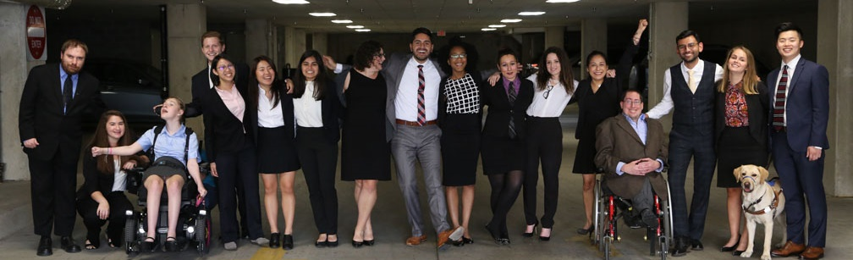
Thank you!
RespectAbility
JenniferM@RespectAbility.org
www.RespectAbility.org
Upcoming Events: www.RespectAbility.org/category/events
COVID-19 Resources:
www.RespectAbility.org/covid-19

