Slide 1
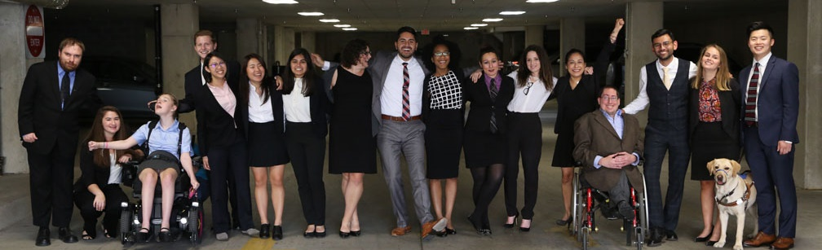

“How to Recruit, Accommodate and Promote Jewish Leaders with Disabilities”
“How to Recruit, Accommodate and Promote Jewish Leaders with Disabilities”
Speakers:
Vivian G. Bass - RespectAbility
Lee Chernotsky - ROSIES
Lori Golden – Ernst & Young, LLP

Slide 2
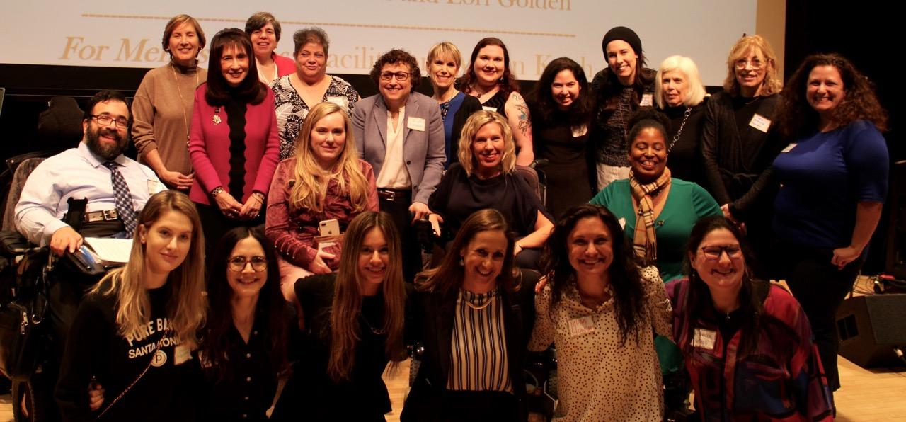
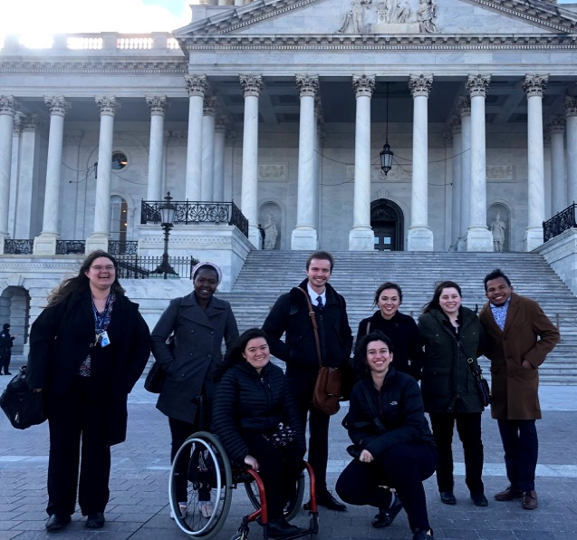
50% of RespectAbility’s team have disabilities
The majority of RespectAbility's Board of Directors, Staff and Fellows/Interns are persons with disabilities - both visible and non-visible.

Slide 3
The Mission of RespectAbility
RespectAbility is a nonprofit organization that fights stigmas and advances opportunities so people with disabilities can fully participate in all aspects of community. Led by diverse people with disabilities and allies, RespectAbility knows that people with disabilities and their families have the same hopes and dreams as everyone else.
RespectAbility is proud to say that our Jewish Inclusion Network now exceeds several thousand globally!
https://www.respectability.org/

Slide 4
Sponsors
This series is made possible by support from the Jewish Community Foundation of Los Angeles through a Cutting Edge Grant, The Diane & Guilford Glazer Philanthropies, The Charles & Lynn Schusterman Family Foundation, The David Berg Foundation, the Stanford and Joan Alexander Foundation, Stanley & Joyce Black Family Foundation, and The Beverly Foundation.

Slide 5
Co-Promoters
Avodah, B’nai David-Judea Congregation, Builders of Jewish Education: JKidLA, Congregation B’nai Amoona, Congregation B’nai Emet, Congregation Kol Ami, Congregation Or Ami, Edlavitch DCJCC, Foundation for Jewish Camp, Gateways: Access to Jewish Education, Hebrew Union College, IKAR, Institute on Theology and Disability, Jewish Federations of North America, Jewish Federation of Greater MetroWest NJ – Greater MetroWest ABLE, Jewish Los Angeles Special Needs Trust and Services, Jewish Residential Services, JQ International, JVS SoCal, Jewish Women International (JWI), Keshet, Lippman Kanfer Foundation for Living Torah, Marlene Meyerson JCC Manhattan, Matan, Moment Magazine, National Ramah Tikvah Network, Ohr HaTorah Synagogue, OurSpaceLA, Reconstructing Judaism, Religious Action Center of Reform Judaism, ROSIES Foundation, Shalhevet, Shalom Institute, Stephen Wise Temple, Temple Adat Elohim, T’ruah: The Rabbinic Call for Human Rights, The Jewish Journal, The Miracle Project, The New Normal, The Women’s Rabbinic Network, Union for Reform Judaism, USCJ, Whole Community Inclusion at Jewish Learning Venture, Yachad Los Angeles, Yeshivat Chovevei Torah Rabbinical School

Slide 6
Upcoming Webinars
Tuesday, July 14, 2020 – How to Ensure Accessible Events: Both Live and Virtual Across All Platforms
Tuesday, July 21, 2020 – How to Ensure a Welcoming Lexicon, Accessible Websites and Social Media and Inclusive Photos
Tuesday, August 4, 2020 – How to Create and Implement Successful Diversity, Equity and Inclusion (DEI) Initiatives – Best Practices and Must-Haves
Tuesday, August 11, 2020 – How to Ensure Legal Rights and Compliance Obligations
Sign Up at www.respectability.org/jewish-events/

Slide 7
Disability in the Jewish Community
According to the U.S. Census, fully 1-in-5 people in America has a physical, sensory, cognitive, mental health or other disability.
A landmark study by RespectAbility of more than 4000 Jewish respondents in 2018 found that more than 90 percent who responded indicated that this was a priority for them.
RespectAbility’s nonprofit survey showed that this inclusion is practiced by less than one-third of nonprofit organizations.
The studies also showed that while the will was there, the knowledge was not.
This free new series will fill that gap.

Slide 8
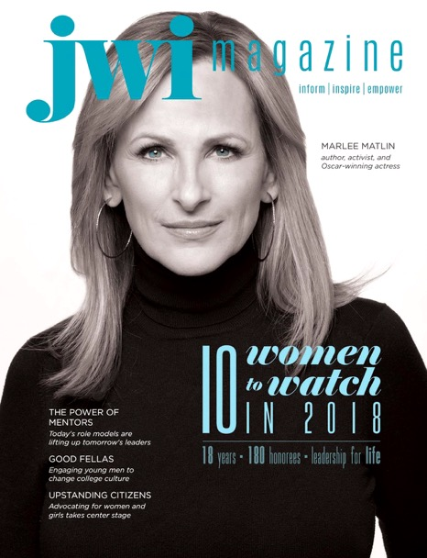
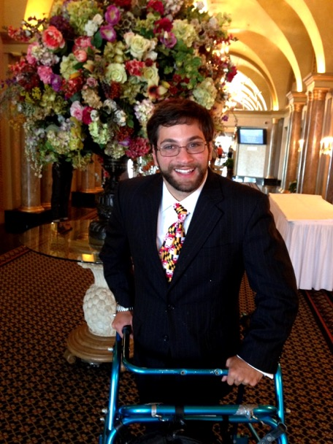
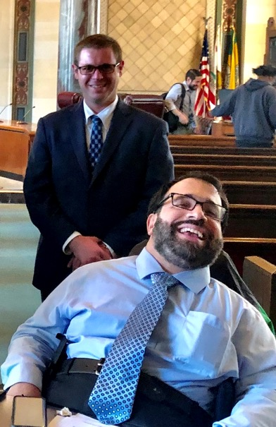
People With Disabilities Strengthening Jewish Organizations
Marlee Matlin
JWI
Aaron Kaufman
JFNA
Matan Koch and
Joshua Steinberg
RespectAbility

Slide 9
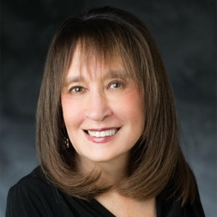
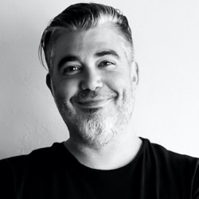
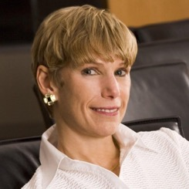
Speakers
Vivian G. Bass – Moderator
RespectAbility Co-Chair of Global Jewish Inclusion Work
CEO Emeritus, JFGH
Lee Chernotsky
Chief Encouragement Officer
ROSIES
Lori Golden
Abilities Strategy Leader
Ernst & Young, LLP

Slide 10

Vivian Bass
Vivian G. Bass of Bethesda, Maryland serves on the Executive Committee of RespectAbility's Board of Directors and as Co-Chair of its global Jewish Inclusion work. She has dedicated her career to improving the quality of life, independence, community inclusion and dignity of persons with disabilities throughout the Washington DC area, nationally and internationally. Vivian is the CEO Emeritus of JFGH (www.jfgh.org) which ultimately grew to 80 residential locations via a wide variety of service delivery models and two innovative transitional youth programs while becoming a model for more than 25 communities over five continents. Additionally, she is the Immediate Past Board Chair of Jewish Women International (JWI) (www.jwi.org), a National Board Member of Save a Child's Heart US (SACH) (www.saveachildsheartus.org) and the Board Vice Chair of CaringMatters (www.caringmatters.org) , formerly Hospice Caring, in Maryland amongst other volunteer roles. Vivian remains actively engaged with The University of Michigan where she pursued her undergraduate and graduate studies in Special Education.

Slide 11

Lori Golden
Lori Golden is EY Abilities Strategy Leader, driving efforts to build an enabling, inclusive environment for people of all abilities. She advises the firm's over 1,000 member AccessAbilities professional network, leads initiatives to enhance accessibility in EY offices, communications, meetings, trainings and technology, educate EY people on abilities issues and create new recruiting and employment models. Lori’s helped build innovative programs including WorkWell@EY on ergonomics; EY’s Neurodiversity Centers of Excellence; and We Care, helping colleagues support colleagues struggling with mental illness or substance misuse. A frequent speaker on disabilities employment issues, Lori serves on the US Department of Labor's Circle of Champions, the Disability: UN Global Roundtable, the Autism at Work Employer Roundtable, is Vice Chair of the Board of TransCen and served on the Board of Directors of the US Business Leadership Network (USBLN) and its Corporate Advisory Board. Having a lived experience with a non-visible disability, Lori is a winner of EY's Chairman's Values Award and a two-time winner of the firm’s Better Begins with You Award. She's been with Ernst & Young 22 years and is a graduate of Harvard University.

Slide 12
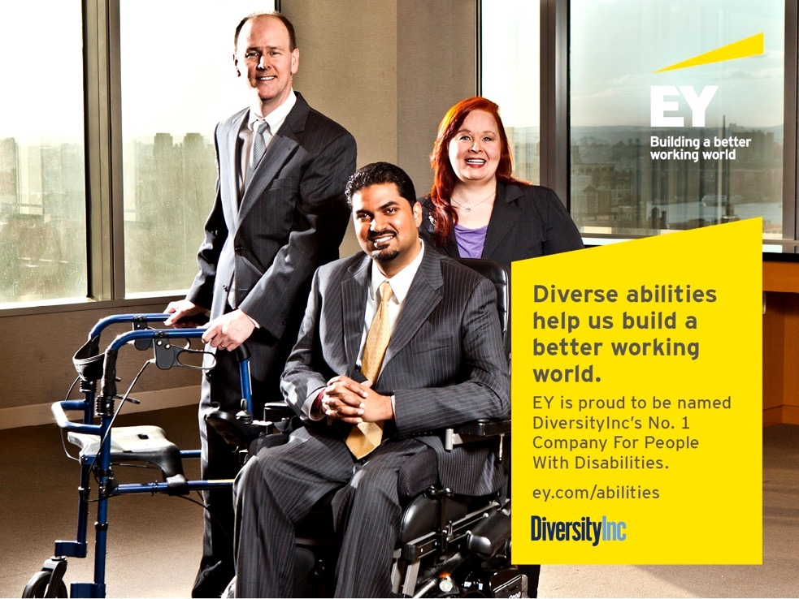
EY’s co-founder was deaf and had low vision.

Slide 13
Include and support employees with disabilities by focusing on three key areas:
Ensure recruiting reaches and works for candidates with disabilities
Signal disabilities inclusiveness in everything you do
Provide the tools, environment, and supports for people with disabilities to be successful

Slide 14
Cast a wide net; target strategically.
Ensure sources, processes, postings, sites and materials are inclusive and accessible
Train recruiters and hiring managers on etiquette, language, ADA, resources, supports
Scout disability-specific sources – job sites, career fairs, vocational rehab/community agencies, disability recruiting firms, disabilities organizations, college career/disability centers, apprenticeships/internships, training programs
Pilot, then selectively invest in relationships

Slide 15
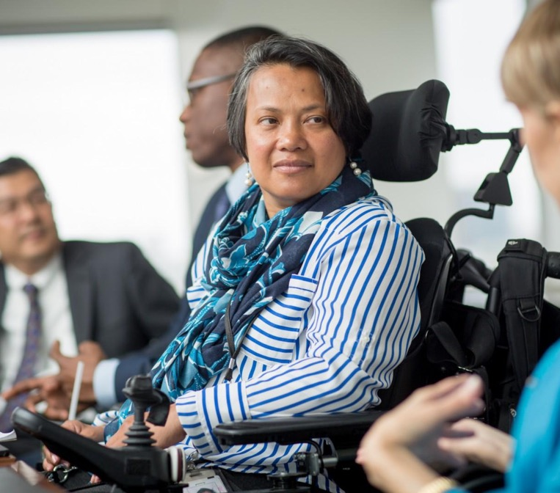
Message the commitment and highlight role models
Include photos of people with diverse abilities on sites, in materials
Include disability references in communications
Share employees with disabilities success stories
Leverage community connections, volunteer activities, ties to strategy, values, mission, etc.

Slide 16
Provide tools, supports, and an environment to enable success
Make technology and facilities accessible
Create and communicate accommodations processes
Start resource groups, peer mentoring, or development programs to build skills, relationships, and visibility
Provide organization-wide inclusiveness training
Train supervisors on non-visible disabilities, accommodations, coaching, frank and frequent feedback

Slide 17
Questions for the Panelist (1)
Given what you’ve learned at EY about sourcing and supporting people with disabilities, are there two take-aways that you would like to leave our audience with?
How do you believe the current and post-pandemic crisis will impact the Jewish and secular employment experience for persons with disabilities (as pertains to remote participation, transportation, etc.?

Slide 18

Lee Chernotsky
Lee Chernotsky is the founder & CEO (Chief Encouragement Officer) of ROSIES foundation, a 501(c)(3) organization that generates opportunities for people with diverse abilities to engage and work. He holds an MBA in nonprofit management and has been a leader in disability advocacy and education for over 20 years. Lee currently serves on the board of the Culver City Arts Business Improvement District and is a sought-after speaker on accessibility, creativity, mental health, and social enterprise across industries.

Slide 19


How [Pronoun] Spends Time?
HOW (Insert Pronoun Here) SPENDS TIME?
Notes:
This question gives you and the person you are connecting with the opportunity to share:
What is important to them…
HOW they demonstrate it…
And hopefully WHY if you both have the time… But how many times have you been stuck in that moment when someone says to you, so.. “What are you up to these days?” or what are you doing after you finish school? It can be rough - and especially during these times of uncertainty and opportunity these questions have become even more daunting for ALL of us… So what can WE do together?

Slide 20
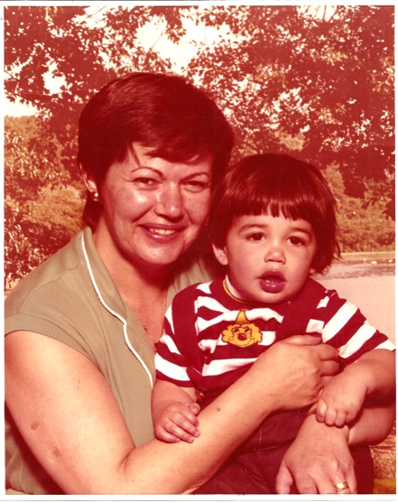
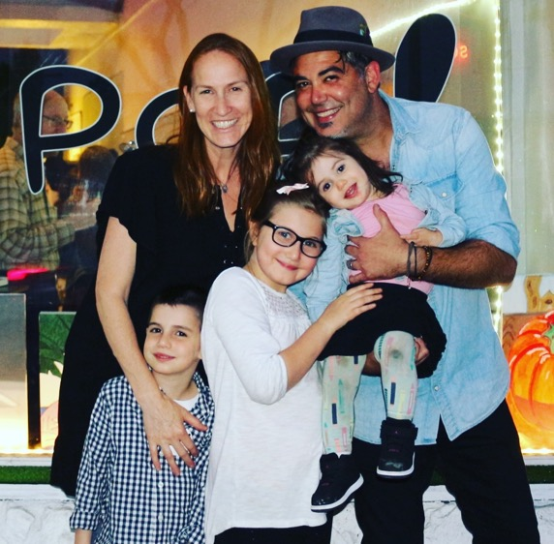
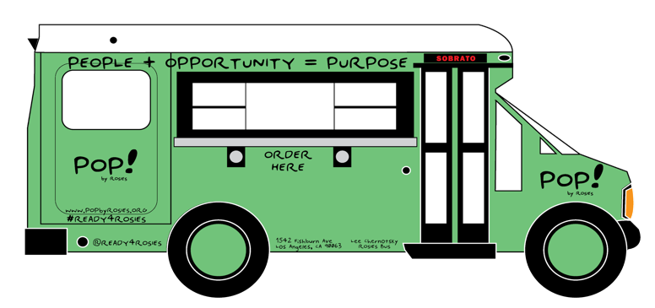

The Inspiration behind ROSIES
Notes:
ThIf someone asks me, I say my name is Lee and I spend my time giving and growing with my family and the crew at ROSIES. A platform I am grateful to be able to continue growing - because Jeffrey and Leann Sobrato gave me time to generate accessible opportunities for people with diverse abilities, like me and you, and a lot of people we ALL know to engage and work.
If we are doing it right - every day is a new adventure, and when my grandmother, Bubba Rose - who survived the holocaust because her parents fought as partisans - who also never missed an opportunity to let us know “not if, but WHEN you GIVE more than you take, there is a tomorrow!” - because she truly knew what that meant… Which is why we are in the process of repurposing the Bus to provide an accessible podcast production platform to share stories, build skills, and promote networks of people, and opportunities that promote diverse abilities with that purpose!

Slide 21
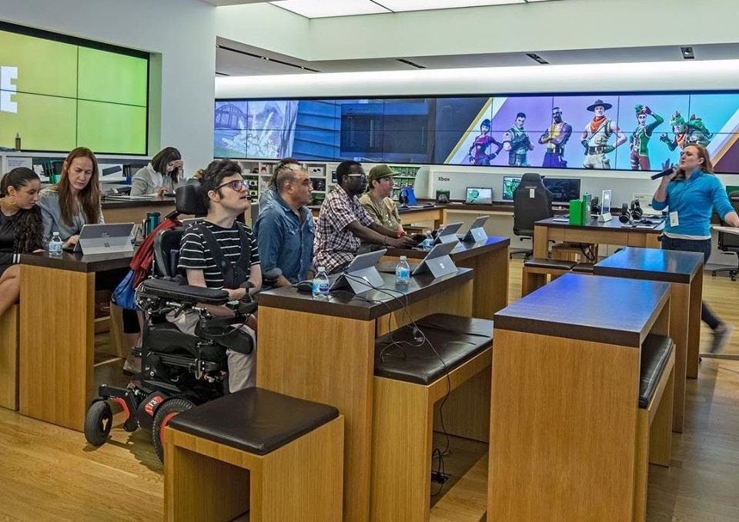

Fixed mindset vs. GROWTH mindset
FIXED mindset vs. GROWTH mindset
@
Notes:
in her book mindset: the psychology of success, Dr. Carol Dweck’s insight into why companies like Microsoft understand the disability market is valued > $1.3 trillion. (respectability.org) - resilience is somrthing that needs to be learned not only taught - the right guide and ability to adjust with what you have learned is the key to GROWTH.
Because it was at this session when Josh (pictured in front wearing glasses and a striped shirt)

Slide 22
PROmote people who...
Engage ability(ies)
Encourage initiative & opportunities
Design with diverse abilities & resources
Notes:
Ways to engage – encourage – then repeat
Legal to let everyone know they may request an accommodation for an interview or to do their job – However if you design, engage, and consistently promote a more accessible culture and the people in your communities, orgs, and local businesses…
– you may find people self disclose who you don’t expect leading to
Solutions that move everyone in the process beyond trainings & discussion around promotion – Because as we like to say at ROSIES, people are able to access the seat they need on any bus, anytime!
TODAY -

Slide 23
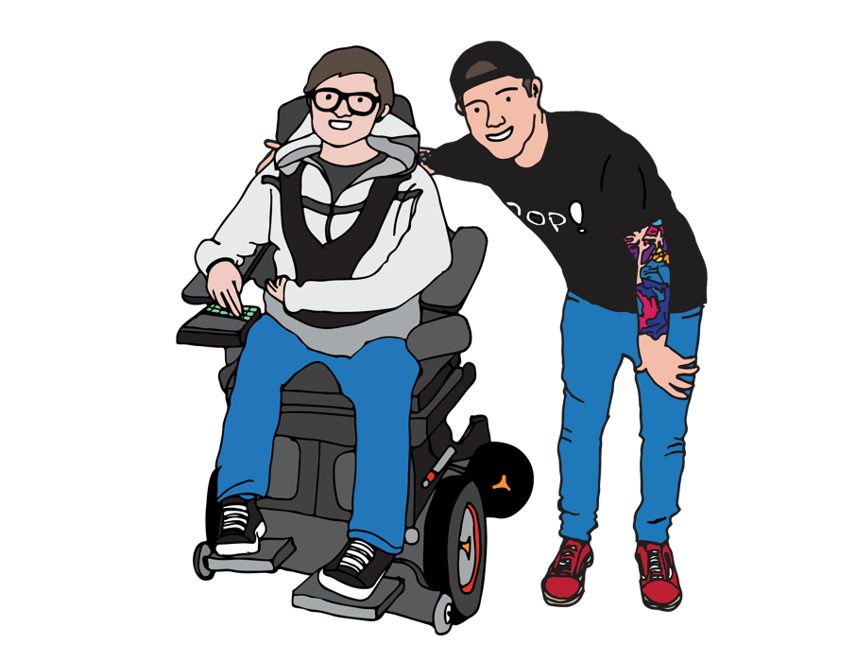
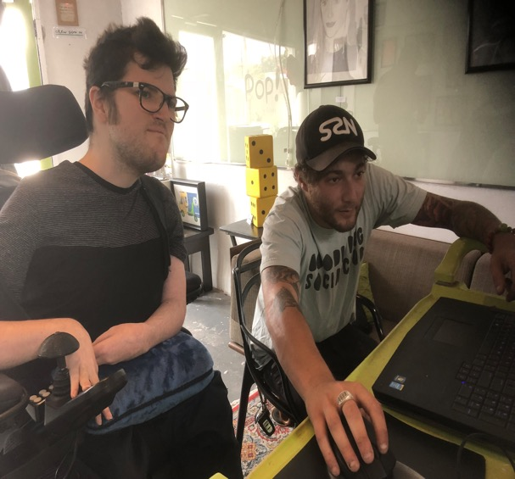
ENGAGE
“Much can we learn from our teachers, More can be learned from our colleagues, Most do we learn from our students.” -Traditional Jewish Text
Solutionaries > Revolutionaries.
Notes:
Engage the collective abilities of the community you contribute to - I say that intentionally - Nobody can reasonably expect to always be on the receiving end - we ALL need opportunities to give, especially if we don’t know how to or simply lack experience doing it.. Like any skill! Disability services offices in colleges and universities
Apprenticeships can be a great recruitment tool – BUT REMEMBER NOT JUST ENTRY LEVEL; also retain and promote
Collaborate with Leadership programs
- Respectability

Slide 24
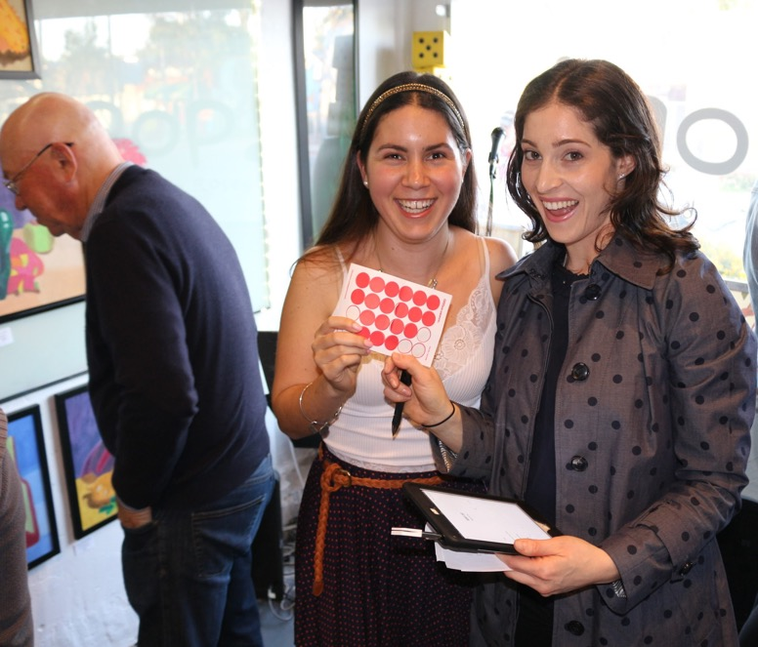
Encourage
ENCOURAGE
GIVE
Opportunities
to People
GROW
Perspective with
a Network of…
DIVERSE ABILITIES ™
^{with colleagues + allies}
Pictured: Artist/Curator Torie Zalben with artist Maya Alves at her first Gallery show @ ROSIES

Slide 25
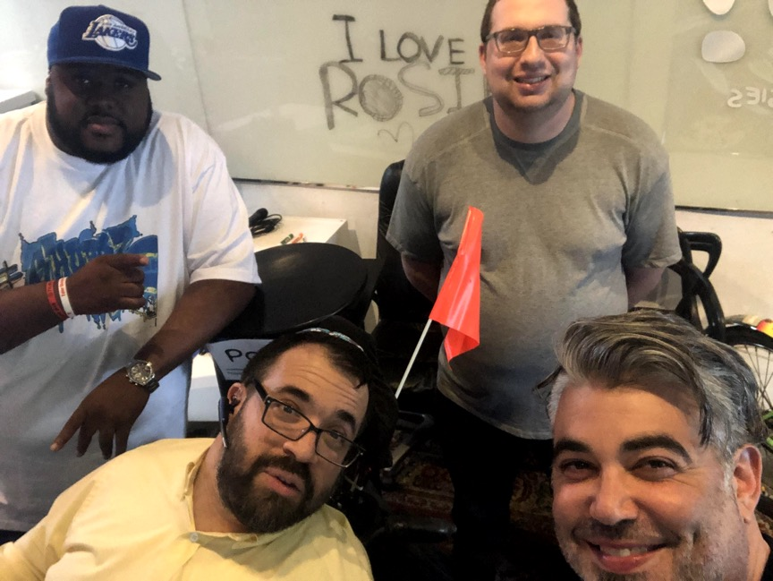


Design
DESIGN
STORY
told by the
PEOPLE
SKILLS
given to grow
PROmotion
with OPPORTUNITY to
Notes:
Drop these facts from respectability… Did you know that just 2.1 percent of scripted television characters have disabilities, compared to 25 percent of American adults having a disability?
Actors without disabilities play more than 95% of all characters with disabilities (www.respectability.org)

Slide 26

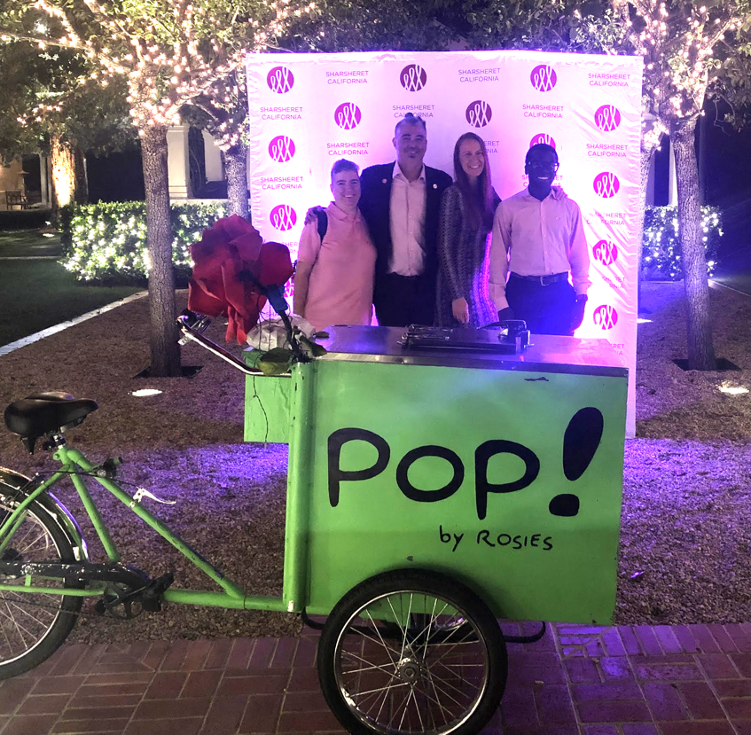


Pop Mitzva-z
MiTZV’A-Z
GIVE experiences from A - Z
Promote with Purpose...
Notes:
An example of a program you or your organization can engage with and encourage others to design with you.. and us if you find yourself in need of solutionaries...
“What bothers you?” Are you tired of hearing about terrible things happening like people’s lives and rights being attacked? Do you feel uncomfortable when you visit a nursing home and see so many people just sitting and staring into space? Here’s an opportunity Now, turn what bothers you into tikkun olam (repairing the world) and make a difference.

Slide 27

An Example
Video is of a Respectability event at the beginning of March at ROSIES in Culver City CA
Notes:
How is this an example of all 3 things you can do?
Engage: people to share resources
Encourage: participation from people beyond the “disability” community
Design: The opportunities we all need - together!

Slide 28
Questions for the Panelist (2)
Given what you’ve learned at ROSIE’S about promoting and retaining people with disabilities, are there two take-aways that you would like to leave our audience with?
How do you believe the current and post-pandemic crisis will impact the Jewish and secular employment experience for persons with disabilities (as pertains to remote participation, transportation, etc.?

Slide 29
Questions?

Slide 30
Project Moses - Strengthening the Jewish Community Through Leadership by Jews with Disabilities
Project Moses is a new leadership program that currently is recruiting 36 new talented civic-minded Jews with disabilities to join a leadership cohort in the Los Angeles Jewish community. It is made possible by the generosity of the Jewish Community Foundation of Los Angeles and other funders. Participants will be talented people who may have mobility, vision, hearing, mental health or any other disability. We want to maximize their potential and connect them to Jewish organizations in the Los Angeles-area to truly make a difference.
Moses Leaders Will Be:
Trained
Mentored
And connected with Jewish organizations

Slide 31
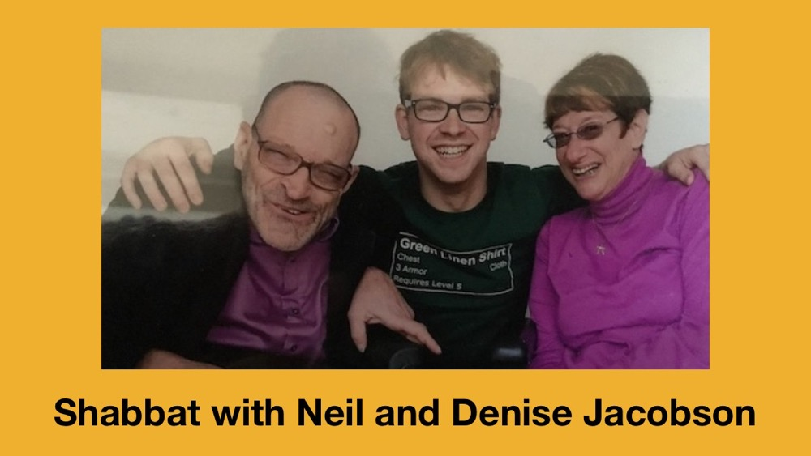
See you Friday, July 10 for Shabbat Dinner
Want more information? Contact Matan Koch, Director of RespectAbility California & Jewish Leadership, at MatanK@RespectAbility.org

Slide 32
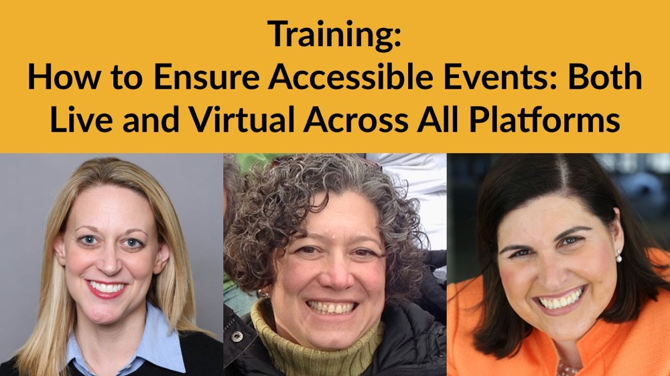
See you next Tuesday, July 14 for part 4!
Want more information? Contact Matan Koch, Director of RespectAbility California & Jewish Leadership, at MatanK@RespectAbility.org

