Slide 1
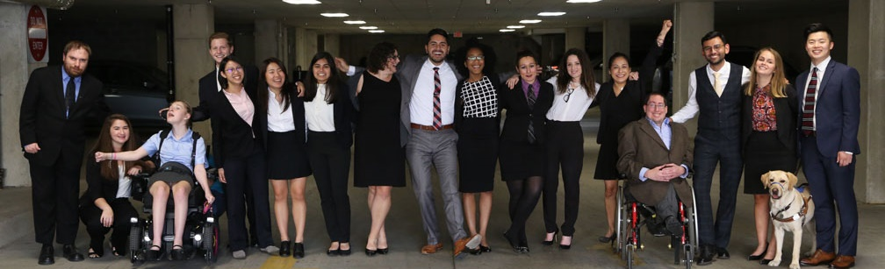

How Disability Inclusion & Equity Can Add to Your Success
How to Ensure Legal Rights and Compliance Obligations
Moderator – Matan Koch, RespectAbility
Panelist – Ariella Barker, Former RespectAbility Fellow
Panelist – Robert “Bobby” Silverstein, Principal, Powers Pyles Sutter & Verville PC
Panelist – Matthew Dietz, Esq., Litigation Director, Disability Independence Group, Inc.

Slide 2
Partners/Co-Promoters
Avodah, B’nai David-Judea Congregation, Builders of Jewish Education: JKidLA, Congregation B’nai Amoona, Congregation B’nai Emet, Congregation Kol Ami, Congregation Or Ami, Edlavitch DCJCC, Foundation for Jewish Camp, Gateways: Access to Jewish Education, Hebrew Union College, IKAR, Institute on Theology and Disability, Jewish Federations of North America, Jewish Federation of Greater MetroWest NJ – Greater MetroWest ABLE, Jewish Los Angeles Special Needs Trust and Services, Jewish Residential Services, JQ International, JVS SoCal, Jewish Women International (JWI), Keshet, Keshet: For LGBTQ Equality in Jewish Life, Lippman Kanfer Foundation for Living Torah, Marlene Meyerson JCC Manhattan, Matan, Moment Magazine, National Ramah Tikvah Network, Ohr HaTorah Synagogue, OurSpace LA, Reconstructing Judaism, Religious Action Center of Reform Judaism, ROSIES Foundation, Shalhevet, Shalom Institute, Stephen Wise Temple, T’ruah: The Rabbinic Call for Human Rights, The Jewish Journal, The Miracle Project, The New Normal, The Women’s Rabbinic Network, Union for Reform Judaism, USCJ, Whole Community Inclusion at Jewish Learning Venture, Yachad Los Angeles, Yeshivat Chovevei Torah Rabbinical School
This series is made possible by support from the Jewish Community Foundation of Los Angeles through a Cutting Edge Grant, The Diane & Guilford Glazer Philanthropies, The Charles & Lynn Schusterman Family Foundation, The David Berg Foundation, the Stanford and Joan Alexander Foundation, Stanley & Joyce Black Family Foundation, and The Beverly Foundation.

Slide 3
Disability in the Jewish Community
According to the U.S. Census, fully 1-in-5 people in America has a physical, sensory, cognitive, mental health or other disability.
A landmark study by RespectAbility of more than 4000 Jewish respondents in 2018 found that more than 90 percent who responded indicated that this was a priority for them.
RespectAbility’s nonprofit survey showed that this inclusion is practiced by less than one-third of nonprofit organizations.
The studies also showed that while the will was there, the knowledge was not.
This free new series will fill that gap.

Slide 4
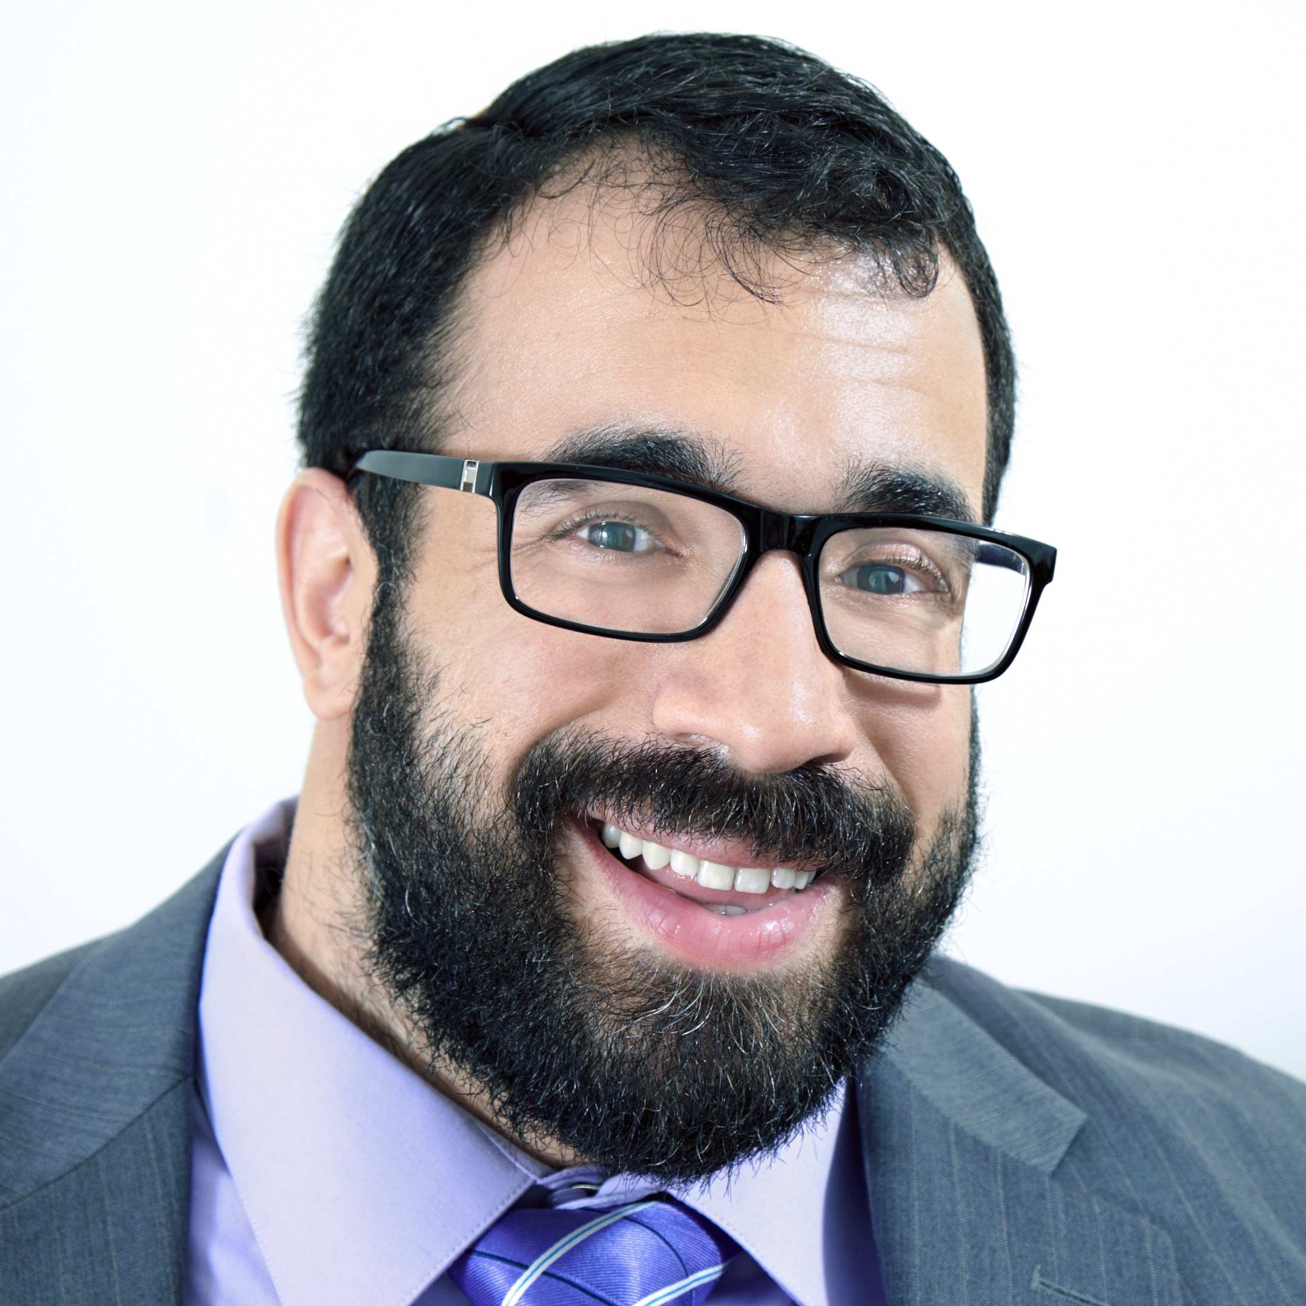
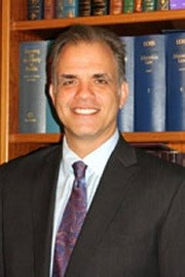
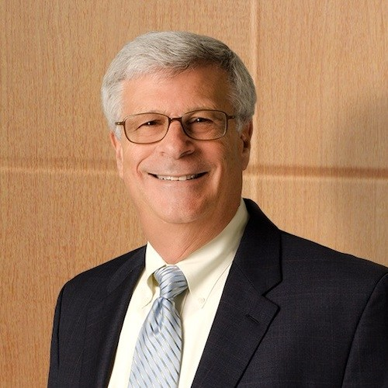

Speakers
Matan Koch – Director of RespectAbility California and Jewish Leadership
Matthew W. Dietz, Esq. – Litigation Director, Disability Independence Group, Inc.
Robert “Bobby” Silverstein
Principal, Powers Pyles Sutter & Verville PC
Ariella Barker
Former RespectAbility Fellow

Slide 5
Robert “Bobby” Silverstein
Robert “Bobby” Silverstein is a nationally-recognized attorney with over 45 years of public policy and advocacy experience. For more than a decade, he served as staff director and chief counsel for the Senate Subcommittee on Disability Policy, chaired by Senator Tom Harkin. Bobby was a behind-the-scenes architect of more than 20 disability-related bills enacted into law including the landmark Americans with Disabilities Act, the Rehabilitation Act of 1973, as amended, and the Individuals with Disabilities Education Act, as amended. Currently, Bobby is a principal in the law firm of Powers Pyles Sutter & Verville, PC. He has a federal regulatory and legislative practice in the areas of disability and civil rights. Bobby earned his B.S. in Economics, cum laude, from the Wharton School, University of Pennsylvania in 1971. He received his J.D. in 1974 from Georgetown University Law Center. Mr. Silverstein is the recipient of more than 15 national awards, including the Distinguished Services Award of the President of the United States for his work on the ADA. Bobby has been inducted into the Public Interest Hall of Fame.

Slide 6
LEGAL RIGHTS AND COMPLIANCE OBLIGATIONS
RespectAbility California
and
Jewish Leadership

Slide 7
DO JUSTICE AND
PURSUE ACTS OF LOVING-KINDNESS
July 26, 2020 marks the 30th anniversary of the ADA, the 20th century emancipation proclamation for people with disabilities.
Anniversaries are a time to celebrate, reflect, and recommit.
The ADA is a codification of the commandment to “Do Justice and Pursue Act of Loving- Kindness.”

Slide 8
DO JUSTICE
Understand the history and nature of injustice experienced by people with disabilities:
  Treated as defective, dependent, pitied in need of fixing resulting in exclusion, segregation and denial of services and supports.
  Examples: ugly laws, forced institutionalization, forced sterilization, exclusion from public accommodations, schools and other public institutions

Slide 9
DO JUSTICE (2)
Take action based on a set of values and principles:
Disability is a natural and normal aspect of the human experience that in no way diminishes a person’s right to fully participate in all aspects of society.
Fix the environment (programs, buildings, transportation, communication) by recognizing the principle of universal design i.e., design that takes into consideration the divergent functional needs of the greatest number of people.

Slide 10
DO JUSTICE (3)
Take action to achieve the goals of disability policy:
  Equal opportunity
  Full Participation
  Independent living
  Economic self-sufficiency

Slide 11
PURSUE ACTS OF LOVE AND KINDNESS
Often misconstrued when it comes to people with disabilities.
Pursuing acts of loving-kindness does NOT entail:
  Pity
  Helping without asking if help is needed; or
  Helping with a sense of superiority.
Pursuing acts of loving-kindness DOES entail:
  Treating people with dignity and respect;
  Focusing on individual’s strengths and capabilities;
  Recognizing, embracing, and celebrating differences; and
  Fostering empowerment and self-determination.

Slide 12
DEDICATION BY SENATOR TOM HARKIN
CHIEF SPONSOR OF ADA
July 13, 1990 debating final passage of the ADA on the Senate floor:
“I want to make a dedication. Across our Nation, mothers are giving birth to infants with disabilities. So, I want to dedicate the ADA to these, the next generation of children and their parents.
With the passage of the ADA, we as a society make a pledge that every child with a disability will have the opportunity to maximize his or her potential to live proud, productive, and prosperous lives in the mainstream of our society.

Slide 13
DEDICATION BY SENATOR TOM HARKIN
CHIEF SPONSOR OF THE ADA
We love you all and welcome you into the world. We look forward to becoming your friends, your neighbors, and your coworkers.
We say, whatever you decide as your goal, go for it. The doors are open and the barriers are coming down.”

Slide 14
Ariella Barker
Ariella Barker is a dual American-Israeli citizen and an attorney, policy advisor, and communications specialist. She has a BBA and JD from Emory University and an MPA from the Harvard Kennedy School, where she was a John F. Kennedy Fellow on a full merit scholarship. She has worked internationally across the public, social and private sectors, fiercely advocating for her clients and communities in the areas of employment discrimination issues, antisemitism and disability rights.

Slide 15
Ensuring Disability Rights & Legal Compliance in the Workplace
By: Ariella Z. Barker, J.D. M.P.A.
Assistant Corporation Counsel
for the City of New York

Slide 16
Title I of the Americans with Disabilities Act (“ADA”)
Federal civil rights statute; removes barriers to equal employment for individuals with disabilities who are qualified
ADA Amendments Act (ADAAA) of 2008
Prohibits covered entities from discriminating on the basis of disability, in all employment practices, and during all stages
Requires reasonable accommodation for known disability of an applicant or employee who is qualified, barring undue hardship

Slide 17
Who Must Comply with Title I of the ADA?
Covered entities:
  Private sector employers with 15 or more employees
  State and local government employers
  Employment agencies, labor unions, joint labor-management committees
Religious entities as employers; title I of the ADA does apply
Executive agencies of the U.S. Government are excluded;
Section 501 of the Rehabilitation Act

Slide 18
Who is Protected by Title I of the ADA?
Title I protects qualified individuals with disabilities
Applies to applicants and employees

Slide 19
How “Disability” is Defined Under the ADAAA
A physical or mental impairment that substantially limits one or more major life activities – “actual disability”
Has had a physical or mental impairment that substantially limited one or more major life activities at one time – “record of”
When an employment action is taken based on an
individual's impairment or perceived impairment, unless
transitory and minor – “regarded as”

Slide 20
Uncovered Conditions & Ailments
Conditions that are transitory AND minor generally not covered
(e.g., common cold, the flu, a minor broken bone)
Temporary condition lasting fewer than six months can be an actual disability if “sufficiently severe”
ADAAA predictable assessments; impairments easily found
to substantially limit a major life activity (e.g., diabetes,
blindness, HIV, epilepsy, cancer, bipolar disorder, etc.)

Slide 21
“Reasonable Accommodation”
A change or adjustment to a job or work environment that permits a qualified applicant or employee with a disability to participate in the job application process, to perform the essential functions of a job, or to enjoy equal benefits and privileges
Reasonable means “feasible” or “plausible” – possible to provide without undue hardship; don’t have to remove essential functions of the job
Undue hardship – an action requiring significant difficulty or
expense
Must be effective for the purpose

Slide 22
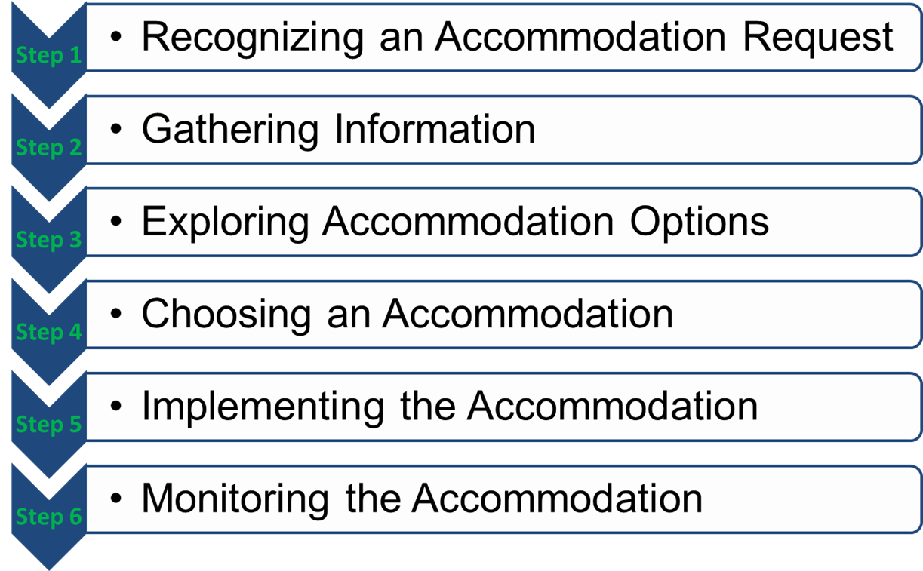
Interactive Process

Slide 23
Recognizing an Accommodation Request
An applicant or employee request for an adjustment
or change at work due to a medical impairment:
  “I’m getting carpal tunnel in my hands from typing on a standard keyboard.”
  An employee returns to work using a wheelchair and says the wheelchair will
  not fit under their desk
  “I need to work from home for the duration of the pandemic because my disability makes me at high-risk for COVID-19.”

Slide 24
Determining qualification for an accommodation?
Gather whatever information necessary to process the request, including information regarding the individual’s impairment, limitations, impact on performing job functions, and accommodations
Determine if the individual has an ADA-qualifying disability
Follow ADA disability-related inquiry rules:
  Pre-offer: Cannot inquire into an applicant’s disability or require a medical exam until a conditional job offer is made
  Post-offer: Disability-related inquiries and medical exams are permitted
  when required of all candidates for thatjob category
  Employment: Disability-related inquiries and employee medical exams
  must be "job-related and consistent with business necessity”

Slide 25
Three Types of Reasonable Accommodation:
Modifications or adjustments needed during application process
Modifications or adjustments to the workplace or the manner in which the job position is typically performed
Modifications or adjustments that enable the enjoyment of
equal benefits and privileges of employment

Slide 26
Subcategories Include:
Making existing facilities accessible and useable
Modifying policies
Restructuring a job
Modifying work schedules
Acquiring/modifying equipment
Providing a qualified reader, interpreter, job coach, etc.
Reassigning an employee to a vacant position
Granting intermittent or concurrent leave
Working remotely/at home
Allowing access for service/emotional support animal

Slide 27
Unreasonable Accommodations
Those which pose an undue hardship on the employer – significant difficulty or expense
Personal use items needed to accomplish daily activities off the job (e.g., hearing aids)
Eliminate essential job functions, lower production standards, or create new jobs as a reasonable accommodation

Slide 28
Providing an Accommodation
Document accommodation approval and/or
accommodation agreement
Implement necessary changes, purchases, arrangements
Communicate important accommodation information –
remembering confidentiality rules
  Management can (and probably should) know of employee’s disability/ accommodation and anyone who could best ensure the accommodation is provided
Do not delay implementation
Ensure effectiveness of accommodation

Slide 29
Monitor Accommodations
Why monitor accommodations?
  To maintain accommodations
  To insure effectiveness of accommodations
  To make adjustments when things aren’t working
Reasonable accommodation must enable the individual to perform essential functions/meet standards/access benefits
Can positively impact productivity and supports ADA compliance
Encourage ongoing communication
Make needed adjustments to existing accommodations

Slide 30
Thank you!
https://ariellabarker.com
Ariella@ariellabarker.com

Slide 31
Matthew Dietz, Esq.
Matthew W. Dietz, Esq., Litigation Director
Matthew W. Dietz is a founding member and current Litigation Director of Disability Independence Group. He has been practicing in the arena of civil rights litigation since 1996 and has handled hundreds of matters involving the Americans with Disabilities Act, the Fair Housing Act and other civil rights laws regarding the rights of Persons with Disabilities, and others seeking equal rights under the law on the basis of race, color, national origin, gender, age, familial status, and sexual orientation and gender identity. Mr. Dietz has been a very active writer, advocate and speaker on disability rights issues.
He is active in sections and committees in the Florida Bar, and is current chair of the Animal Law Section, past chair of the Equal Opportunities in the Law Section, and past chair of the Public Interest Law Section of the Florida Bar. He has worked to eliminate stigma and increase wellness throughout the profession, from creating puppy pits and goat yoga for the annual convention to drafting rules. In his work within the Florida Bar, Mr. Dietz drafted proposed Rule of Administrative Procedure 2.540, which provided guidelines for providing accommodations for Persons with Disabilities in Florida Courts, and is currently working on amending the rules to eliminate stigma against those applicants and members of the Bar with mental illness or histories of drug or alcohol addiction. In 2004, he was awarded the prestigious G. Kirk Haas Humanitarian Award by Florida Bar President Miles McGrane, the for his work on behalf of persons with disabilities.
Mr. Dietz represents victims of discrimination in administrative, trial and appellate proceedings, and has over three hundred reported decisions. In the past twenty years. he has worked to redefine effective communication, reasonable accommodation and expand the rights and opportunities of persons with disabilities. In 2019, Matthew Dietz was awarded the American Bar Association’s Paul G. Hearne award for performing exemplary service in furthering the rights, dignity, and access to justice for people with disabilities.

Slide 32

Discrimination Under Title III: Public Accommodations and Commercial Facilities
Matthew W. Dietz, Esq.
Disability Independence Group, Inc.
2990 S.W. 35th Ave.
Miami, FL 33133
(305) 669-2822
www.justDIGit.org

Slide 33

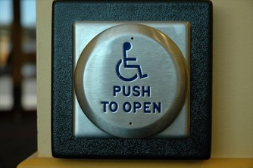
Failure to Remove Barriers
Failing to remove architectural, communication and transportation barriers.

Slide 34
Failure to Ensure Inclusion
Failing to ensure that no individual with a disability is excluded, denied services, segregated, or otherwise treated differently.

Slide 35

Eligibility Criteria
Imposing or applying eligibility criteria that screen or tend to screen individuals with disabilities from full and equal enjoyment of goods and services.

Slide 36
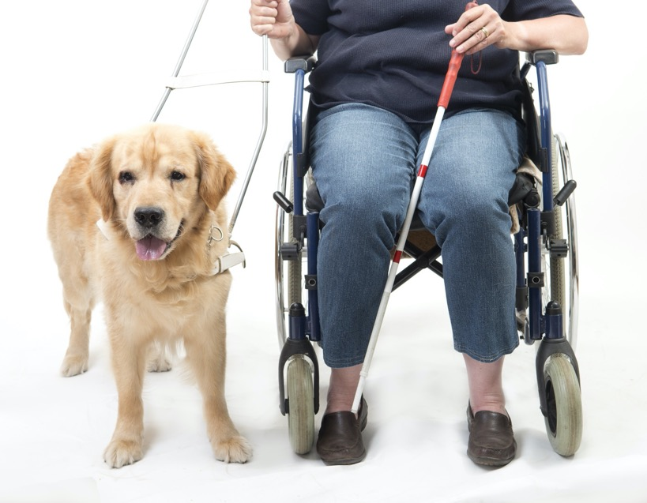

Reasonable Modifications
Failing to make reasonable accommodations in policies, practices, or procedures to allow people with disabilities full and equal of goods and services.
Notes:
Making an exception to a policy, practice or procedure

Slide 37

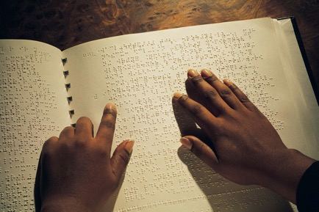
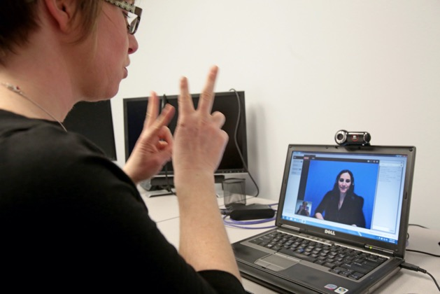

Effective Communication
Failing to provide effective communication detailing how to ensure full and equal enjoyment of goods and services.

Slide 38
Questions?

