Slide 1
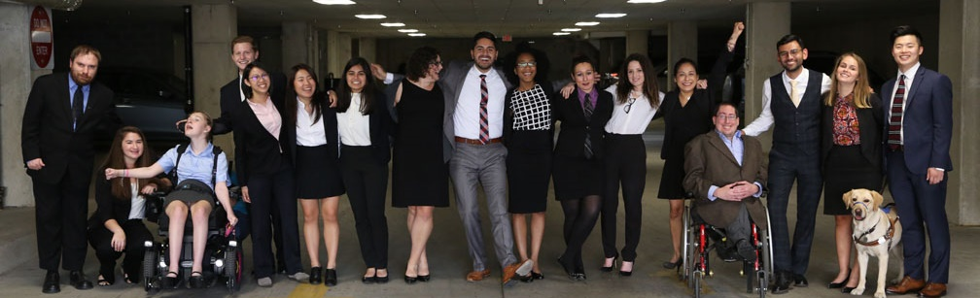

How Disability Inclusion & Equity Can Add to Your Success
How to Ensure Accessible Events
Moderator – Dori Kirshner
Panelist – Lauren Appelbaum
Panelist – Rebecca Wanatick

Slide 2
Partners/Co-Promoters
Avodah, B’nai David-Judea Congregation, Builders of Jewish Education: JKidLA, Congregation B’nai Amoona, Congregation B’nai Emet, Congregation Kol Ami, Congregation Or Ami, Edlavitch DCJCC, Foundation for Jewish Camp, Gateways: Access to Jewish Education, Hebrew Union College, IKAR, Institute on Theology and Disability, Jewish Federations of North America, Jewish Federation of Greater MetroWest NJ – Greater MetroWest ABLE, Jewish Los Angeles Special Needs Trust and Services, Jewish Residential Services, JQ International, JVS SoCal, Jewish Women International (JWI), Keshet, Lippman Kanfer Foundation for Living Torah, Marlene Meyerson JCC Manhattan, Matan, Moment Magazine, National Ramah Tikvah Network, Ohr HaTorah Synagogue, Reconstructing Judaism, Religious Action Center of Reform Judaism, ROSIES Foundation, Shalhevet, Shalom Institute, Stephen Wise Temple, T’ruah: The Rabbinic Call for Human Rights, The Jewish Journal, The Miracle Project, The New Normal, The Women’s Rabbinic Network, Union for Reform Judaism, USCJ, Whole Community Inclusion at Jewish Learning Venture, Yachad Los Angeles, Yeshivat Chovevei Torah Rabbinical School
This series is made possible by support from the Jewish Community Foundation of Los Angeles through a Cutting Edge Grant, The Diane & Guilford Glazer Philanthropies, The Charles & Lynn Schusterman Family Foundation, The David Berg Foundation, the Stanford and Joan Alexander Foundation, Stanley & Joyce Black Family Foundation, and The Beverly Foundation.

Slide 3
Upcoming Webinars
Tuesday, July 21, 2020 – How to Ensure a Welcoming Lexicon, Accessible Websites and Social Media and Inclusive Photos
Tuesday, August 4, 2020 – How to Create and Implement Successful Diversity and Inclusion Initiatives
Tuesday, August 11, 2020 – How to Ensure Legal Rights and Compliance Obligations
Sign Up: www.respectability.org/jewish-events

Slide 4
Disability in the Jewish Community
According to the U.S. Census, fully 1-in-5 people in America has a physical, sensory, cognitive, mental health or other disability.
A landmark study by RespectAbility of more than 4000 Jewish respondents in 2018 found that more than 90 percent who responded indicated that this was a priority for them.
RespectAbility’s nonprofit survey showed that this inclusion is practiced by less than one-third of nonprofit organizations.
The studies also showed that while the will was there, the knowledge was not.
This free new series will fill that gap.

Slide 5
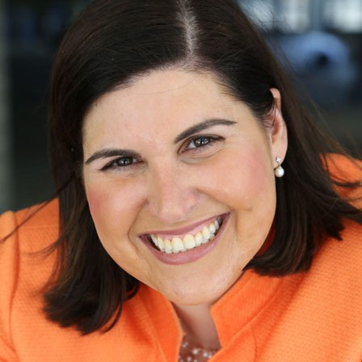
Speakers
Dori Kirshner
Executive Director, Matan
She/Her/Hers
Lauren Appelbaum
Vice President, Communications, RespectAbility
She/Her/Hers
Rebecca Wanatick
Manager of Community Inclusion, Jewish Federation of Greater MetroWest NJ
She/Her/Hers

Slide 6

Question 1
Question to Becca:
What are some of the most common accessibility challenges when planning in-person events and what are some of the solutions you’ve found to be most effective?

Slide 7

Greater MetroWest ABLE
Jewish Federation of Greater MetroWest NJ
Promote and support the collaboration & coordination of 10 partner agencies engaging with individuals with disabilities and their families
Support the development of and participation in meaningful opportunities in all aspects of Jewish communal life
Raise awareness of resources & services for individuals with disabilities & their families
Create a Jewish community made whole by the meaningful inclusion of all of its members.

Slide 8
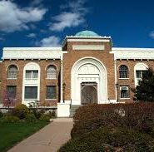
Accessible Congregations

Slide 9

When We Think About Access…
Do we think about this?

Slide 10
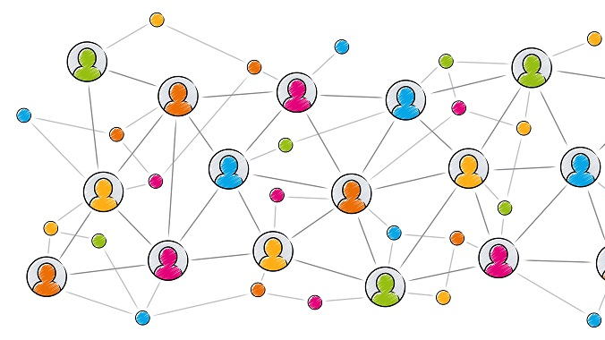
Or this?

Slide 11
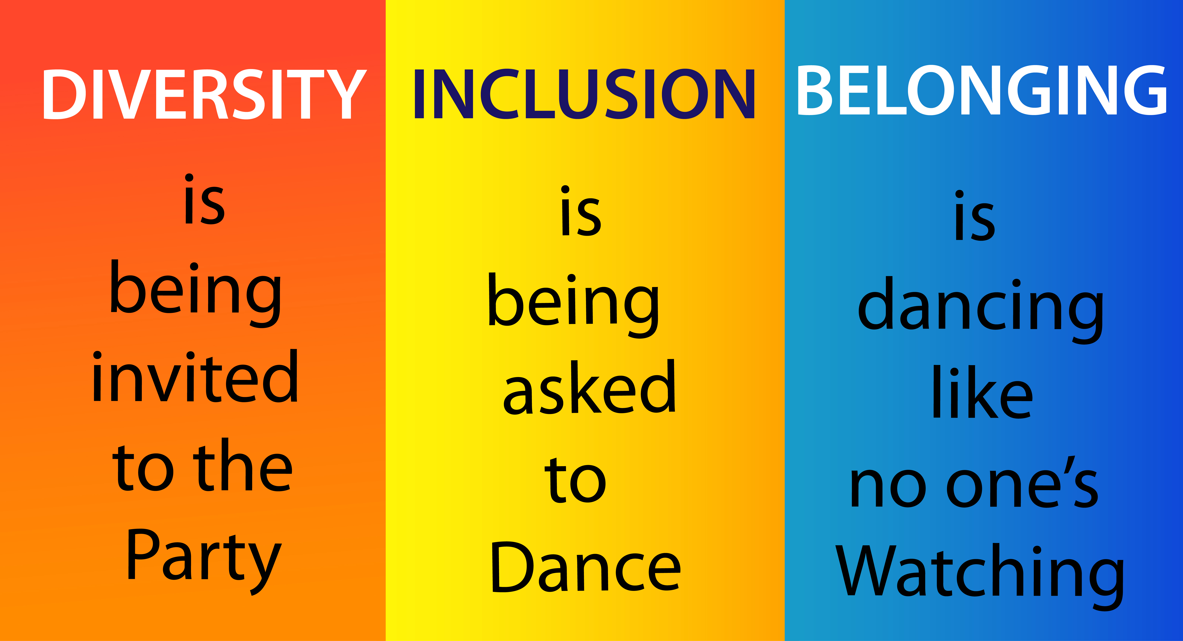
Access is more than…

Slide 12

Attending Synagogue…

Slide 13

How Inclusive Are We?
A Synagogue Self-Assessment
Architectural Accessibility
Synagogue Life: Attitudes, Practices & Policies

Slide 14
Architectural Accessibility
Parking Area/Entrance
Assistance provided when doors don’t open easily
Signage is clear
Walkways well lit & free from obstructions
Accessible parking marked clearly with symbol
Accessible entrance clearly marked
Non-worship Area
Accessible water fountain/cups
Doorways/halls clear from obstructions
Non-fragranced soaps
Accessible restrooms
Classrooms & public meeting areas provide seating that is accessible
Worship Areas
Talitot & kippot accessible
Assistive listening devices & large print siddurs visible and available
Accessible seating available
Bimah/Aron are accessible
Adequate lighting on bimah pulpits

Slide 15
Synagogue Life: Attitudes, Practices & Policies
Communication/Publicity
membership information
school & youth group materials
announcements
mission statements
Formal Education
clear educational plans
information & resources shared
curriculum teaches acceptance of difference
accommodations for b’nai mitzvah
Resources
community resources shared
inclusion committee
transportation provided to those in need
support groups offered
Awareness Training
staff & key lay leadership
ushers trained on greeting & meeting needs
disability procedures reviewed annually

Slide 16
Programming with an Inclusive Eye
Language
Building an inclusive community is a priority. Contact us and we will make every effort to meet your needs.
Space
Physically accessible
Quiet space available
Reserved seating, as needed
Timing
If appropriate, extend an invitation to individuals with disabilities to arrive early to get acclimated, participate with a smaller crowd and/or allow the crowd to grow slowly around them.
Other Accommodations
Microphone
Volunteers
Assistive listening devices, ASL interpreter and/or CART

Slide 17

Inclusion
&
Belonging

Slide 18
Question 2
Question to Lauren:
What are some of the most common accessibility challenges when planning virtual events and what are some of the solutions you’ve found to be most effective?

Slide 19
Accessibility Starts At the Beginning

Slide 20
Accessibility Is Important For All
Ensuring accessibility during the planning process of an event is important; if you are planning to post a video of the event after the fact, you may need to ensure accessibility during the actual event, even if no live participants request one. This is important for several reasons:
Twenty percent of people in the U.S. are Deaf/Hard of Hearing; that is 48 million Americans.
More than 1 million people in the U.S. are blind and more than 12 million have low vision.
More than 5 million people in the U.S. are English language learners.
While not everyone knows they have one, it is likely that more than 40 million Americans have a learning disability.

Slide 21
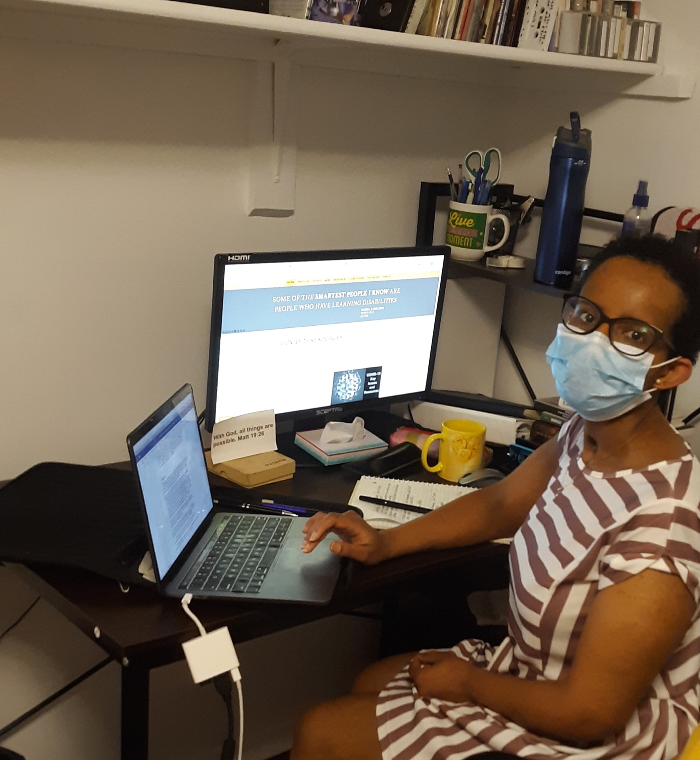
Be Intentional
It is vitally important to think through every step and every use of the event before implementing anything. After all, it always is easier to make changes during the planning stages than after the fact.

Slide 22
Before The Event: Invitations, Materials, and
Information to Share Ahead of Time

Slide 23
Invitation Format
Ensure images and logos have alt text (image descriptions) for people who are blind and use screen readers
Have a plain text version of the invite
Some systems, like Eventbrite are not accessible to people who use screen readers
Google Forms are accessible
User test – can someone using a screen reader access all fields on the form?

Slide 24
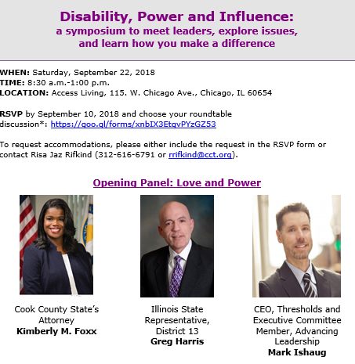
Accommodations Language
On the sign-up form, ask registrants if they need any accommodations to effectively participate in the event:
“To request accommodations, please either include the request in the RSVP form, or contact [Name of Person] at 222-222-2222 [Phone number] or xxxxxxx@yyyyyy.org [Email address]”
Be specific! List a real person!
Note: You may also choose to list accommodations you plan to offer such as CART or American Sign Language interpretation
May set a deadline of 48 hours before the event to request any accommodations

Slide 25





Information to Provide
How long the event will last and format of the event
Will participants be on video or audio for discussion or will they be more like spectators watching a presentation?
If there will be an icebreaker or questions for everyone to answer, let attendees know that ahead of time.
Encourage attendees to send questions or comments in advance (helpful to participants who may want more time to prepare their materials and to presenters to help them frame their comments)
If there will be time for live Q&A, share that information in the invitation.

Slide 26
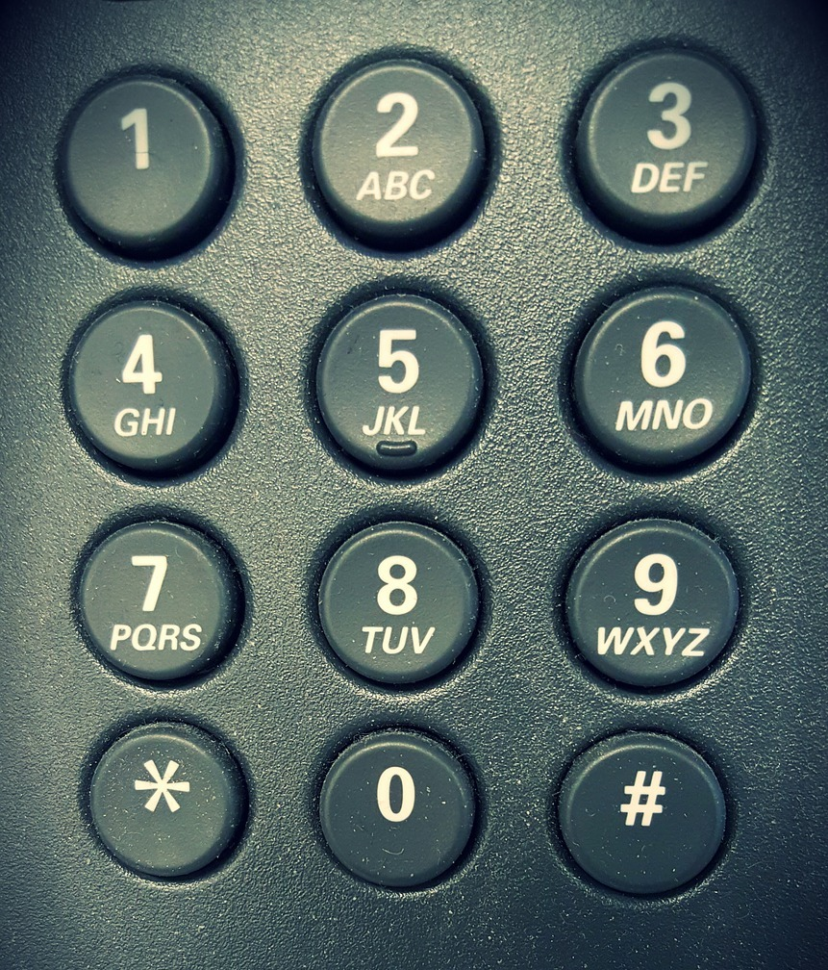
Access for All
Have accommodation for individuals who do not have access to video conferencing
Offer option for attendees to dial in by phone

Slide 27
Ensure Accessible Documents
Distribute documents or PowerPoint presentation in advance
Tips on ensuring an accessible PPT: https://support.office.com/en-us/article/make-your-powerpoint-presentations-accessible-to-people-with-disabilities-6f7772b2-2f33-4bd2-8ca7-dae3b2b3ef25
Word documents: have a text-only version for people who request one

Slide 28
During The Event:
Ensuring Everyone Can Participate Including Those Who are Blind, Have Cognitive Disabilities and/or are Nonverbal

Slide 29
Best Practices for Meetings
Each person should say their name every time they begin speaking
Any individual not speaking should be on mute and video off
Moderator manages turn-taking
For people who are nonverbal, give them an option too share thoughts if others are doing so verbally (chat box)
ASL interpreter video stays on all the time
Have 10-minute breaks every hour or so

Slide 30
Live Audio Description
Speaker should describe what is on screen (like PowerPoints or other visual aids)
NOTE: Even if you made the PPT accessible, people will not be able to use screen readers for the PPT being shown on screen – only if they are sent their own copy to use.
If video clips do not include audio description, the speaker should explain the visuals prior to showing the video
Resource on audio description: http://www.superfestfilm.com/audiodescription

Slide 31
During The Event: Live Captioning

Slide 32
Benefits of Live Captioning
People who are Deaf/Hard of Hearing
People who have Learning Disabilities
People whose first language is not English
Everyone – greatly eases the cognitive load of a video meeting or event

Slide 33
Communication Access Realtime Translation (CART)
Live transcriber – third-party captioning service
Zoom
Adobe Connect
Webex
Provide names, proper nouns and technical vocabulary for more accurate captioning

Slide 34
Automatic Speech Recognition (ASR)
Bluejeans, GoToMeeting, Microsoft Teams
Skype – limited up to 50 people, restricting captioning for larger meetings behind a paywall
Google Hangouts Meet – limited to paid G-suite customers
  Google Slides and PowerPoint – only works for individual sharing the PPT
Zoom allows for integration with Otter, speech-to-text app with high-quality ASR, but only for paid Zoom accounts
ASR will have errors

Slide 35


Third-Party Captioning in Separate Browser Window

Slide 36
During The Event: ASL Interpreters

Slide 37
Benefits of ASL Interpreters
If Deaf/Hard of Hearing individuals want to fully participate, ensure ASL interpreters for active participation
For events that involve complex subject matter, technical terms, or industry-specific terminology, viewers will find that automatic captioning, and in some cases, even live-captioning solutions, struggle to maintain a reasonable minimum level of quality and legibility for the user.
Share names of speakers and materials ahead of time so interpreters can become familiar with the materials

Slide 38
Zoom: Never Spotlight a Video During Webinars
Spotlighting a video leads to all attendees only seeing the video of the active speakers
This means that attendees are unable to view the ASL interpreter’s video
Instead, ensure gallery view
When screen sharing, ensure video gallery is set to side-by-side view so participants see the materials, individual speaking and ASL interpreter

Slide 39

Hiring a Sign Language Interpreter
Best practice to book at least two weeks prior to the event
Ensure interpreter is certified
Registry of Interpreters for the Deaf (RID) maintains a searchable directory of interpreters and their certification status: https://myaccount.rid.org/Public/Search/Member.aspx

Slide 40
After The Event:
Ensuring Accessible Videos for Websites and Social Media

Slide 41
Importance of Captions
41% of videos are incomprehensible without sound or captions.
80% of viewers react negatively to videos autoplaying with sound.
Many social media outlets autoplay videos on silent. Therefore, if you record your event and plan on sharing the video, it is crucial that you have accurate captions.

Slide 42
Subtitles vs. Captions
Subtitles only reflect what is being spoken.
Captions go a step further by also including non-spoken information including [laughter], [applause] and [music], as well as environmental sounds.
Open captions: always visible
  85% Facebook videos are watched without sound
  92% mobile users watch video with the sound off
Closed captions can be turned on/off by view on TV and social media platforms

Slide 43
YouTube
Automatic free captions similar to subtitles
Note: Speakers will not be identified, certain words will not be accurate, and there will not be any punctuation
Important: Free to edit them!
Learn more: https://support.google.com/youtube/topic/9257536?hl=en&ref_topic=9257610

Slide 44
Learn More: Ensuring Virtual Events Are Accessible for All Toolkit https://www.respectability.org/accessible-virtual-events

Slide 45

Matan Mission Statement
One in five. That’s the number of people with disabilities in the United States today. Matan enables Jewish professionals, communities and families to create and sustain inclusive settings in educational, communal and spiritual aspects of Jewish life.

Slide 46
Matan’s Methodology
Professional Development Opportunities– in-person & virtual
  Congregational Schools
  Early Childhood
  Camp,
  Day Schools
  Youth Groups
Creation of Resources – almost all are free, down-loadable
Community Consultations – Needs Assessment & Recommendations
Information and Referrals
Coaching/Mentoring

Slide 47
Best Practices that apply to both in-person and virtual events:
“Connection over Content”
Visual Schedules
Movement breaks after “bursts/bites” of learning
Smaller group size whenever possible
Share materials ahead of time
Allow fidgits/manipulatives
Communication! – especially to determine access needs
Choice – especially for relaying output/take away’s

Slide 48

Differentiation: In-Person and Online

Slide 49
Question 3
Question:
If the Jewish community could make one change today in order to ensure greater accessibility for all, what would you recommend that we do vis a vis in-person events and online/virtual experiences?

Slide 50
Useful Resources and Checklists
Ensuring Virtual Events Are Accessible for All Toolkit: https://www.respectability.org/accessible-virtual-events
Chicago Community Trust, Renewing the Commitment: An ADA Compliance Guide for Non-Profits
https://cct.org/wpcontent/uploads/2015/08/2015ADAComplianceGuideSummary.pdf
Cornell University Department of Human Resources, Accessible Meeting Checklist
https://hr.cornell.edu/sites/default/files/documents/accessible_meeting_checklist.pdf
ADA National Network, A Planning Guide for Making Temporary Events Accessible to People with Disabilities
https://adata.org/guide/planning-guide-making-temporary-events-accessible-people-disabilities
Mid-Atlantic ADA Center, Guide to Accessible Meetings, Events and Conferences – Digital
https://www.adahospitality.org/accessible-meetings-events-conferences-guide

Slide 51
Project Moses - Strengthening the Jewish Community Through Leadership by Jews with Disabilities
Project Moses is a new leadership program that currently is recruiting 36 new talented civic-minded Jews with disabilities to join a leadership cohort in the Los Angeles Jewish community. It is made possible by the generosity of the Jewish Community Foundation of Los Angeles and other funders. Participants will be talented people who may have mobility, vision, hearing, mental health or any other disability. We want to maximize their potential and connect them to Jewish organizations in the Los Angeles-area to truly make a difference.
Moses Leaders Will Be:
Trained
Mentored
And connected with Jewish organizations

Slide 52
RespectAbility Jewish Inclusion Fellowship
The National Leadership Program is a virtual program, ideal for people who want to gain skills and contacts while making a positive difference for people with disabilities.
For the Jewish inclusion fellowship program in particular, we’re looking for people with an absolute passion for learning and exploring about the different inclusion resources that exist, who would also enjoy research, interaction with other organizations, and deep thought about how to make information useful.
Do you know a future Jewish professional that fits the bill? Or perhaps someone who lost their job during this pandemic and wants to be helpful during their job search? Please encourage them to learn more and apply at: https://www.respectability.org/about-us/fellowship/jewish-inclusion-fellowship/

Slide 53
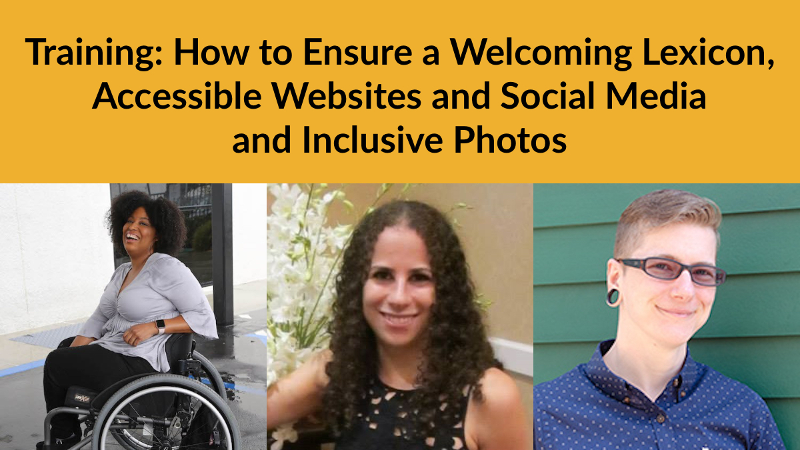
See you next Tuesday, July 21 for part 5!
Want more information? Contact Matan Koch, Director of RespectAbility California & Jewish Leadership, at MatanK@RespectAbility.org

