Slide 1
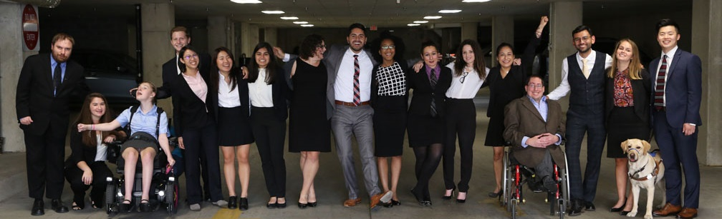

How Disability Inclusion & Equity Can Add to Your Success
How to Create and Implement Successful Diversity and Inclusion Initiatives
Moderator – Linda Burger, RespectAbility Board of Directors Treasurer and Jewish Family Services Houston
Panelist – Dorsey Massey, JCC Manhattan
Panelist – Sally Weber, Program Consultant

Slide 2
Partners/Co-Promoters
Avodah, B’nai David-Judea Congregation, Builders of Jewish Education: JKidLA, Congregation B’nai Amoona, Congregation B’nai Emet, Congregation Kol Ami, Congregation Or Ami, Edlavitch DCJCC, Foundation for Jewish Camp, Gateways: Access to Jewish Education, Hebrew Union College, IKAR, Institute on Theology and Disability, Jewish Federations of North America, Jewish Federation of Greater MetroWest NJ – Greater MetroWest ABLE, Jewish Los Angeles Special Needs Trust and Services, Jewish Residential Services, JQ International, JVS SoCal, Jewish Women International (JWI), Keshet, Keshet: For LGBTQ Equality in Jewish Life, Lippman Kanfer Foundation for Living Torah, Marlene Meyerson JCC Manhattan, Matan, Moment Magazine, National Ramah Tikvah Network, Ohr HaTorah Synagogue, OurSpace LA, Reconstructing Judaism, Religious Action Center of Reform Judaism, ROSIES Foundation, Shalhevet, Shalom Institute, Stephen Wise Temple, T’ruah: The Rabbinic Call for Human Rights, The Jewish Journal, The Miracle Project, The New Normal, The Women’s Rabbinic Network, Union for Reform Judaism, USCJ, Whole Community Inclusion at Jewish Learning Venture, Yachad Los Angeles, Yeshivat Chovevei Torah Rabbinical School
This series is made possible by support from the Jewish Community Foundation of Los Angeles through a Cutting Edge Grant, The Diane & Guilford Glazer Philanthropies, The Charles & Lynn Schusterman Family Foundation, The David Berg Foundation, the Stanford and Joan Alexander Foundation, Stanley & Joyce Black Family Foundation, and The Beverly Foundation.

Slide 3
Upcoming Webinars
Tuesday, August 11, 2020 – How to Ensure Legal Rights and Compliance Obligations
Sign Up: www.respectability.org/jewish-events

Slide 4
Disability in the Jewish Community
According to the U.S. Census, fully 1-in-5 people in America has a physical, sensory, cognitive, mental health or other disability.
A landmark study by RespectAbility of more than 4000 Jewish respondents in 2018 found that more than 90 percent who responded indicated that this was a priority for them.
RespectAbility’s nonprofit survey showed that this inclusion is practiced by less than one-third of nonprofit organizations.
The studies also showed that while the will was there, the knowledge was not.
This free new series will fill that gap.

Slide 5
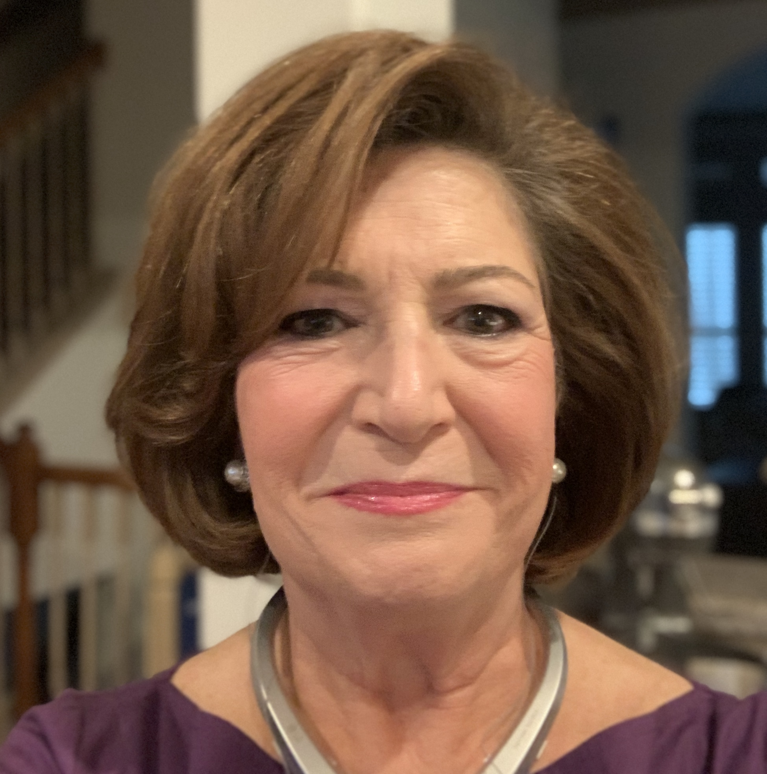
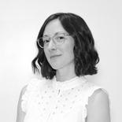
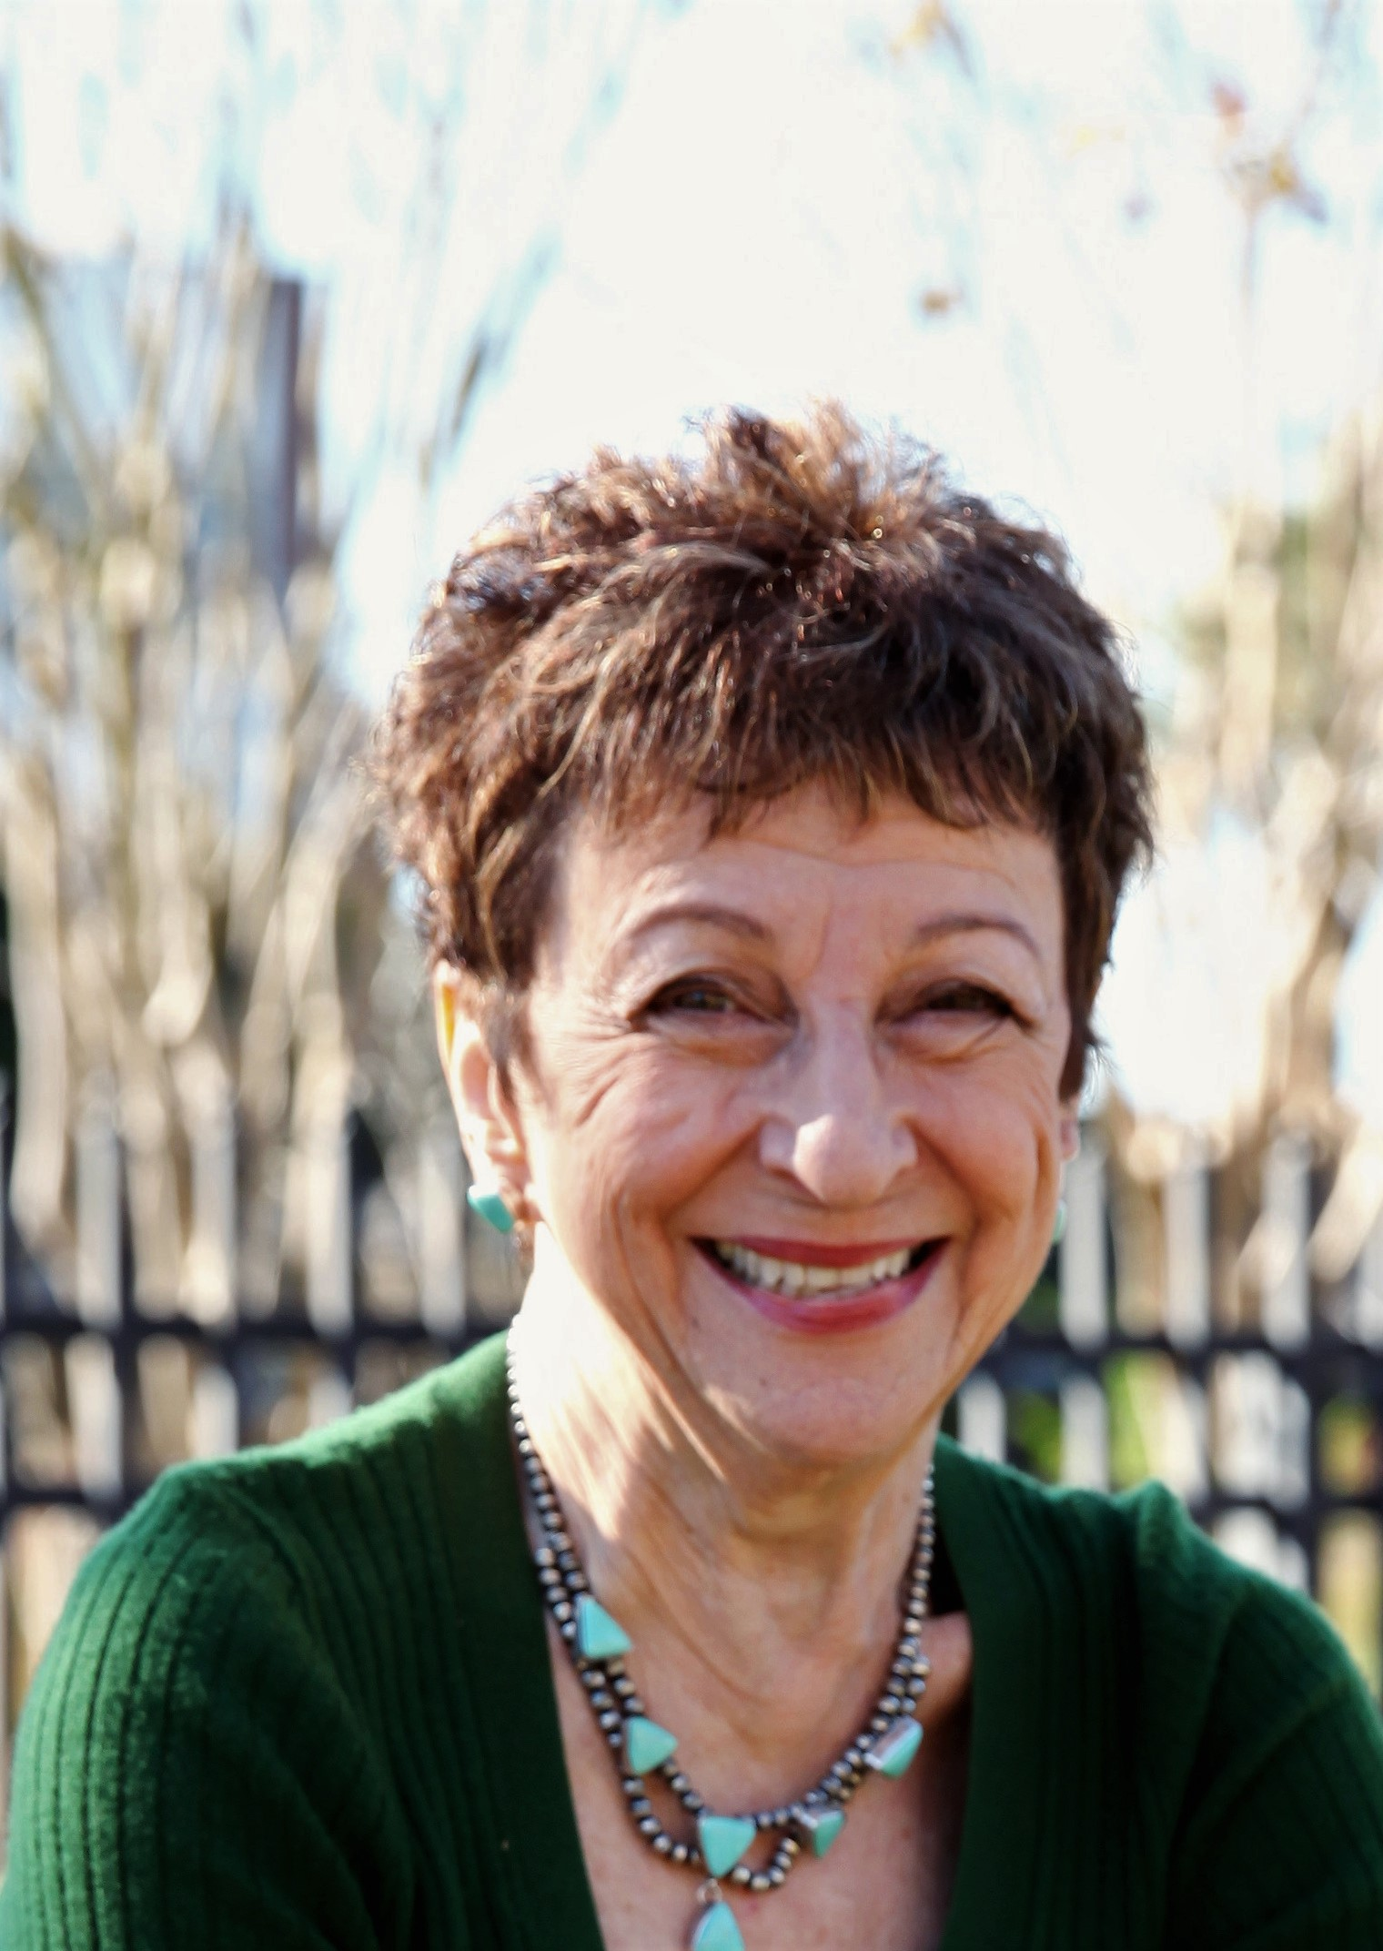
Speakers
Linda Burger
RespectAbility Board of Directors Treasurer and Jewish Family Services Houston
Dorsey Massey
JCC Manhattan
Sally Weber
Program Consultant

Slide 6
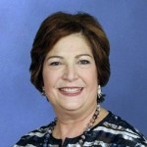
Linda L. Burger
Linda L. Burger, MSSW has devoted her professional life to leading and shaping significant social service programs, including the establishment of game-changing initiatives that focus on erasing stigmas associated with disability and mental health issues. CEO of Jewish Family Service Houston since 2005, Linda continues to transform and expand the agency’s resources and ability to respond to safety net basic needs, community emergencies and individuals who need ongoing help with counseling and other services. Burger is immediate Past Chair of the Network of Behavioral Health Providers in Houston among other board and advisory positions.

Slide 7
Dorsey Massey
Dorsey Massey, LMSW spearheads an inclusion initiative at JCC Manhattan and partners with all departments to develop, modify, and implement staff training to better support varied learning and communication styles. With a goal of ensuring that individuals are supported and connected to the community, she has created a comprehensive internship program to promote the development of graduate students’ understanding and awareness of work within the disability community. Dorsey is also currently an adjunct professor at Columbia University School of Social Work where she teaches foundation courses with a focus on diversity and disability to graduate students.

Slide 8
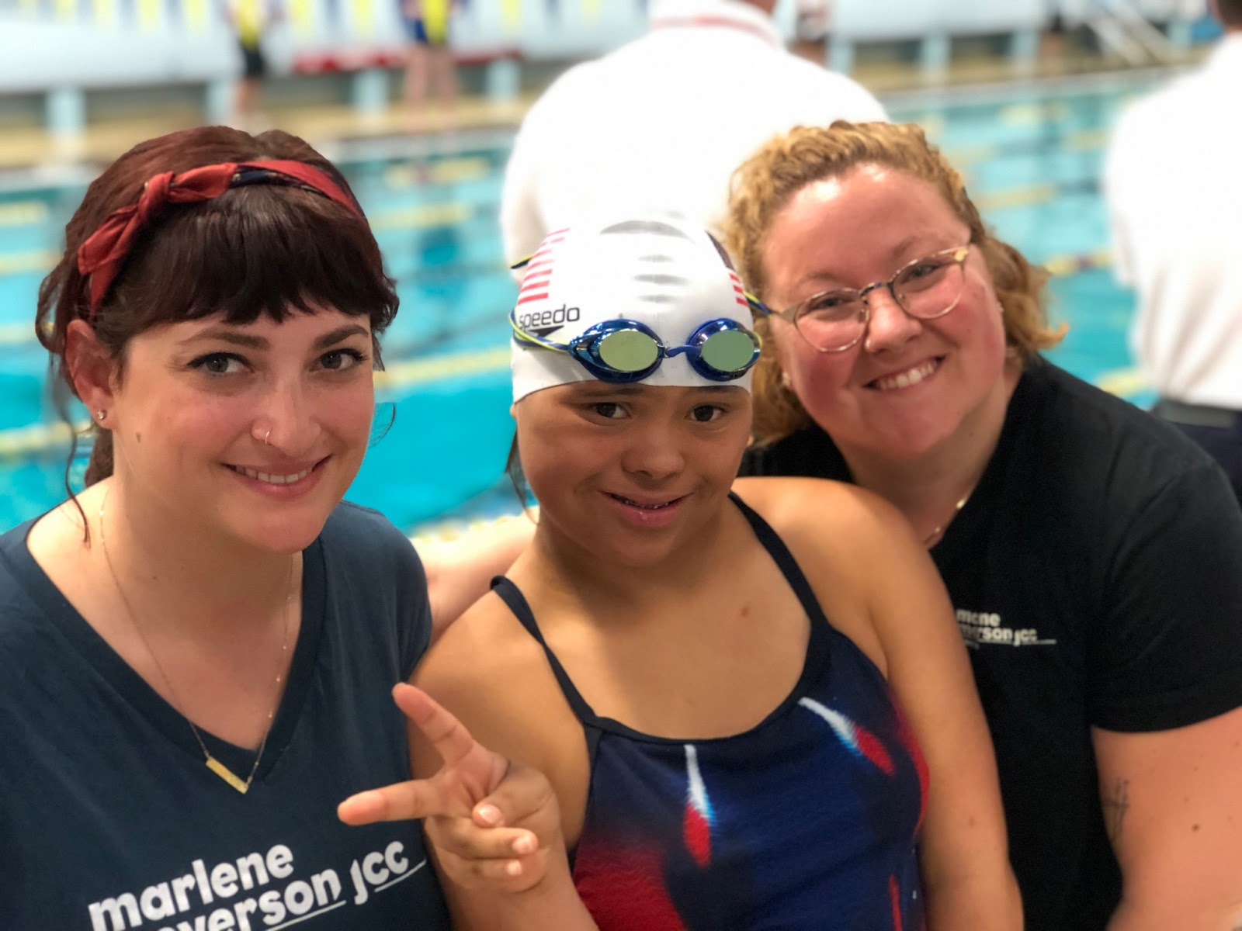
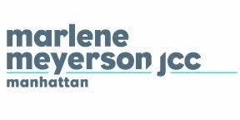
We believe in accessibility.
At the Marlene Meyerson JCC Manhattan, we strive to create an inclusive and accommodating environment for people of different backgrounds and abilities with opportunities for growth and connection.

Slide 9
Living our values
“This interpretation of difference as defect is the true root of ableist acts that cause far too many to feel marginalized, discriminated against, and ultimately devalued in this society.”
-everydayfeminism.com

Slide 10
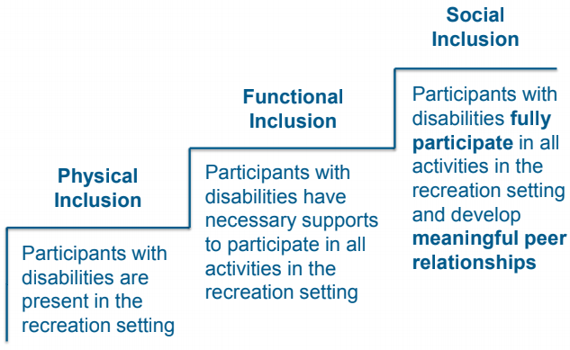
The Promise of Social Inclusion
-Schleien, et al.’s (1997) Model

Slide 11
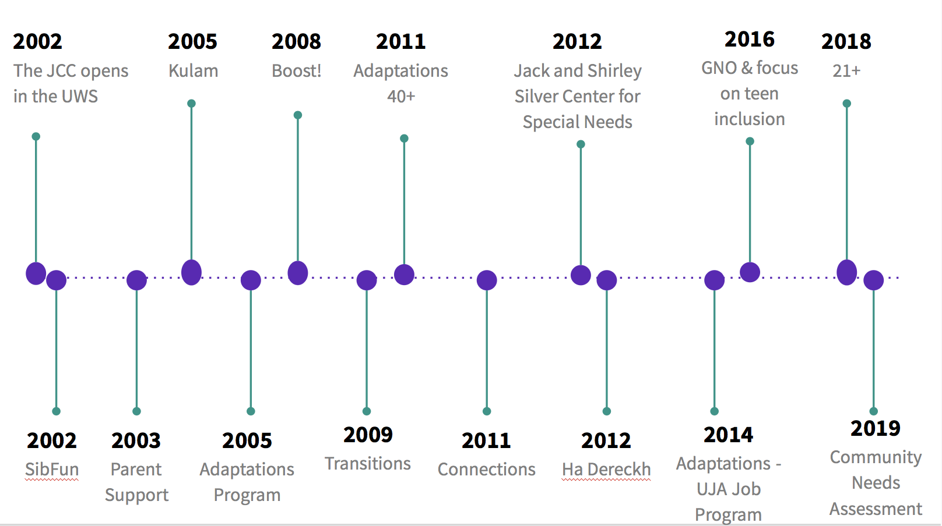
What we have been doing at MMJCC
Inclusion and Accessibility is incorporated into the core values of our organization
MMJCC has committed to building a community for individuals with disabilities
MMJCC has the support of our executive staff and leaders throughout the building to push for social change and normalization of disability
Dedicated staff development in the area of disability inclusion
Creation of DEI leadership team

Slide 12
What this could look like for you
Staff awareness and training on:
  Ableism & Privilege
  Person-first & Identity-first language
  Guiding Principles for Social Inclusion
  Inclusive Language (example from JCCA)
  MMJCC examples:
    Tips for Engagement
    Suggested Language for Challenging Behaviors
Updating job descriptions & staff manuals to promote accessibility for staff
  including social inclusion on job descriptions and annual reviews, inclusion training incorporated in on-boarding, staff accommodation requests, service animal policy, safety protocol accessibility, etc.
Updating your organization’s policies to promote constituency accessibility
  publicly marketing your building’s accessibility and accessibility features for programs, easily accessible accommodation request forms, providing information in multiple platforms, etc.
Updating your organization’s marketing.
  include individuals with disabilities- and not just for “disability programs”, ensure that your website is accessible, etc.

Slide 13
Sally Weber
Sally Weber, LCSW is the retired Senior Director of Jewish Community Programs and Special Needs Programs at Jewish Family Service of Los Angeles, where she oversaw programs targeting specific and challenging needs of the Jewish community. She was also adjunct professor of Pastoral Counseling at the Hebrew Union College-Pacific Institute of Religion School of Rabbinic Studies. Ms. Weber was co-founder of HaMercaz, the One-Stop Special Needs Resource, a program of the Jewish Federation of Los Angeles and Jewish Family Service Los Angeles and has presented extensively on issues ranging from understanding the needs of families with special needs to the importance of social and cultural inclusion in people with disabilities in Jewish communal settings. Currently a consultant, she has worked with synagogues throughout the country on developing inclusion programs within their congregations.

Slide 14
HOW TO CREATE AND IMPLEMENT SUCCESSFUL DIVERSITY AND INCLUSION PROGRAMS: a very brief overview
Sally Weber, LCSW

Slide 15
TWO CASE STUDIES: MACRO AND MICRO
TWO CASE STUDIES: MACRO AND MICRO
HAMERCAZ: An umbrella program for Jewish families with children with special needs, bringing together agencies and special needs programs throughout the city, originated as partnership between Jewish Federation Council and Jewish Family Service Los Angeles.
SYNAGOGUES: Consulting with individual synagogues in Los Angeles and Houston to create inclusion social , ritual, and educational programs

Slide 16
Similarities
SIMILARITIES:
Professional Staffing
HaMercaz: staff from the Jewish Federation and Jewish Family Service
Synagogues: outside consultant
Target populations determined by project participants:
HaMercaz: specifically targeted Jewish families with children from birth-22 where primary disability was developmental.
Synagogues: each synagogue targeted their entire congregations—adults and children—with physical, developmental or emotional disabilities

Slide 17
Coalition Building
COALITION BUILDING
HaMercaz: success was in the involvement of a broad range of agencies and programs throughout Los Angeles providing services (partners) as well as collaboration with additional programs and agencies throughout the city
  Initially all agencies and programs serving families with children with special needs were invited. As target population narrowed, some participants didn’t continue. And not all invitees chose to participate
  Inclusion of professionals, policy makers and consumers on a variety of levels
  Mission statement and target population determined by the committee of partners

Slide 18
Synagogues
Synagogues:
  Importance of top-down support, starting with rabbi(s) and Board but including all interested parties and consumers and their families
  Support needs to include invitation list created by key participants as well as general outreach
  Individual follow up with invitees essential: why they’re being invited, what value they’ll bring to the project, concerns they have

Slide 19
Key Issues - HaMercaz
KEY ISSUES:
HaMercaz:
What’s already being done and who’s doing it? What do they need to either maintain or build it?
Awareness and respect for turf issues and boundaries
If someone doesn’t want to participate, what are the barriers? Are they surmountable
If someone wants to participate but isn’t appropriate, how will that be addressed?

Slide 20
Key Issues - Synagogues
Synagogues
How do diverse participants identify their needs? What are possible differences between these groups that may be in conflict?
How do professionals, laiety and consumers identify the strengths, weaknesses, opportunities and barriers of their congregation. (SWOB) How to use this analysis for education and creating a common vision
How has this synagogue dealt with change in the past?

Slide 21
Surprises
SURPRISES
HaMercaz:
None of us were aware of exactly how much was already available in the community. Exploring this at the first meeting gave us an important building block for both what was needed and the ability to cross refer
No one expected this model to work. Too many personalities, too many turf issues. They were wrong.
Synagogues:
Through the use of story telling at our first meetings, participants were often stunned to learn of others (laity and staff) who were also dealing with issues of disabilities and challenges of inclusion within their own families. This created a common bond of empathy immediately

Slide 22
Stumbling Blocks
STUMBLING BLOCKS
HaMercaz:
Turf issues
Who’s in, who’s out and who’s decision was it?
Personality issues
Impact of change
Synagogues
Challenge of uneven buy-in: synagogues where clergy committed to the project fared much better
‘How will this change my congregation?’ Concerns about who might be brought in
Finances

Slide 23
What Tools Did We Use - HaMercaz
WHAT TOOLS DID WE USE:
Re-enforcing buy-in from the top
Needs assessments: what exists, what’s needed
SWOB
Strict accountabilty: updates, minutes, reports
Ongoing contact with committee members
HaMercaz:
Repeatedly focused on message to partners that they have something to give and something to gain
On-going acknowledgement of boundaries
Cross-referrals

Slide 24
What Tools Did We Use - Synagogues
Synagogues
Focus Groups
Working committees
Story telling both as way of introducing participants but also of creating a common bond by broadening awareness of the range of disabilities experienced by congregants and their families.
Continually updating congregation about work of the Committee

Slide 25
What Would We Look at Differently: Intersectionality
WHAT WOULD WE LOOK AT DIFFERENTLY: INTERSECTIONALITY
Who is included in the community and who, through oversight, indifference or intention, is excluded? Our proof text is the exclusion of Jews with disabilities!

Slide 26
Must Haves
MUST HAVES:
Expectations: what are the parameters of what can be done and how will you address what can’t be done. What are your realistic and unrealistic expectations of this process?
Patience: This is a process, never linear, not always easy but easier if you allow the process to develop rather than skipping steps to push for immediate results
Openness to new ideas that may not be yours: The 55/45 rule.

Slide 27
Questions?

Slide 28
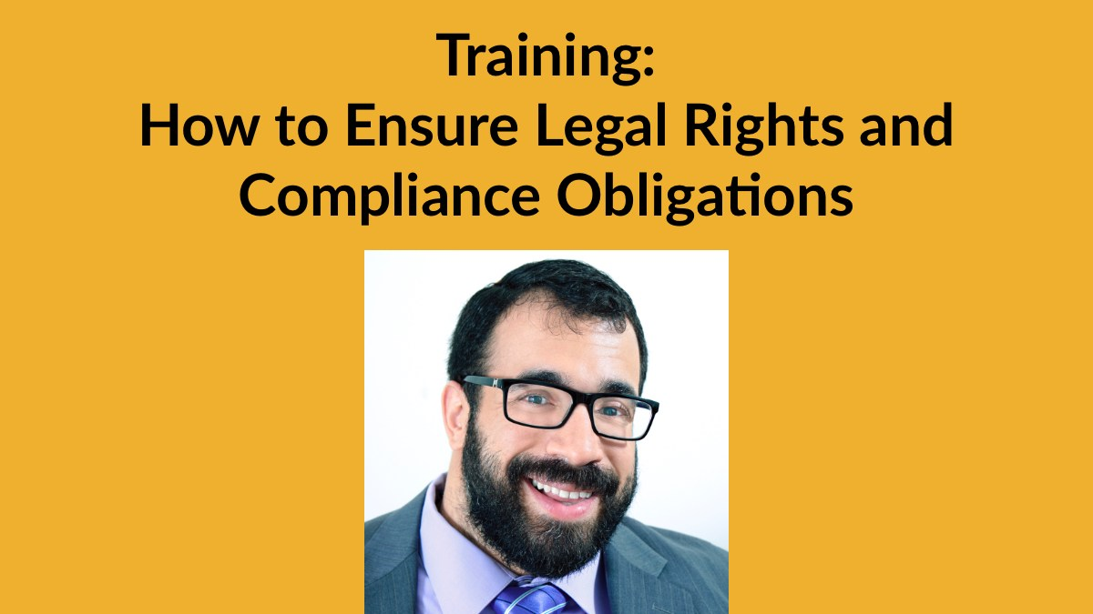
See you Tuesday, August 11 for part 7!
Want more information? Contact Matan Koch, Director of RespectAbility California & Jewish Leadership, at MatanK@RespectAbility.org

