Slide 1
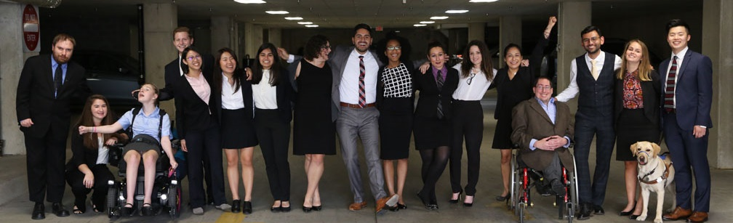

How Disability Inclusion & Equity Can Add to Your Success
How to Ensure A Welcoming Lexicon, Accessible Websites and Social Media and Inclusive Photos
Moderator – Tatiana Lee, RespectAbility
Panelist – River McMican, Keshet: For LGBTQ Equality in Jewish Life
Panelist – Sharon Rosenblatt, Accessibility Partners, LLC

Slide 2
Partners/Co-Promoters
Avodah, B’nai David-Judea Congregation, Builders of Jewish Education: JKidLA, Congregation B’nai Amoona, Congregation B’nai Emet, Congregation Kol Ami, Congregation Or Ami, Edlavitch DCJCC, Foundation for Jewish Camp, Gateways: Access to Jewish Education, Hebrew Union College, IKAR, Institute on Theology and Disability, Jewish Federations of North America, Jewish Federation of Greater MetroWest NJ – Greater MetroWest ABLE, Jewish Los Angeles Special Needs Trust and Services, Jewish Residential Services, JQ International, JVS SoCal, Jewish Women International (JWI), Keshet, Lippman Kanfer Foundation for Living Torah, Marlene Meyerson JCC Manhattan, Matan, Moment Magazine, National Ramah Tikvah Network, Ohr HaTorah Synagogue, OurSpace LA, Reconstructing Judaism, Religious Action Center of Reform Judaism, ROSIES Foundation, Shalhevet, Shalom Institute, Stephen Wise Temple, T’ruah: The Rabbinic Call for Human Rights, The Jewish Journal, The Miracle Project, The New Normal, The Women’s Rabbinic Network, Union for Reform Judaism, USCJ, Whole Community Inclusion at Jewish Learning Venture, Yachad Los Angeles, Yeshivat Chovevei Torah Rabbinical School
This series is made possible by support from the Jewish Community Foundation of Los Angeles through a Cutting Edge Grant, The Diane & Guilford Glazer Philanthropies, The Charles & Lynn Schusterman Family Foundation, The David Berg Foundation, the Stanford and Joan Alexander Foundation, Stanley & Joyce Black Family Foundation, and The Beverly Foundation.

Slide 3
Upcoming Webinars
Tuesday, August 4, 2020 – How to Create and Implement Successful Diversity and Inclusion Initiatives
Tuesday, August 11, 2020 – How to Ensure Legal Rights and Compliance Obligations
Sign Up: www.respectability.org/jewish-events

Slide 4
Disability in the Jewish Community
According to the U.S. Census, fully 1-in-5 people in America has a physical, sensory, cognitive, mental health or other disability.
A landmark study by RespectAbility of more than 4000 Jewish respondents in 2018 found that more than 90 percent who responded indicated that this was a priority for them.
RespectAbility’s nonprofit survey showed that this inclusion is practiced by less than one-third of nonprofit organizations.
The studies also showed that while the will was there, the knowledge was not.
This free new series will fill that gap.

Slide 5
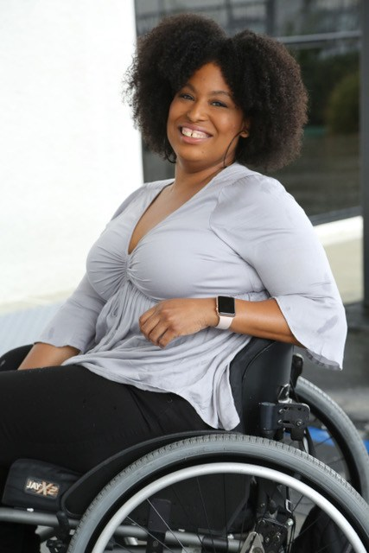
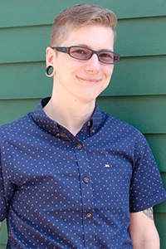
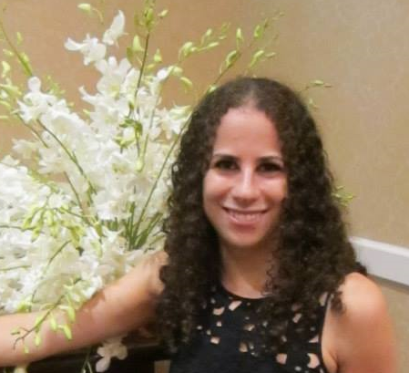
Speakers
Tatiana A. Lee
Hollywood Inclusion Associate, RespectAbility California
She/Her/Hers
River McMican
Development and Communications Project Manager, Keshet: For LGBTQ Equality in Jewish Life
They/Them/Theirs
Sharon Rosenblatt
Director of Communications, Accessibility Partners, LLC
She/Her/Hers

Slide 6
River McMican
River McMican is a design and communications professional with a focus on inclusive, accessible communications that center the LGBTQ community. They are the Development and Communications Project Manager at Keshet: For LGBTQ equality in Jewish life. River is a member of the International Association of Accessibility Professionals and serves on the Community Advisory Board of Open Door Health – Rhode Island’s only community health center dedicated to LGBTQ primary and sexual health care – where they offer guidance on accessible signage, marketing, and documentation. Previously, they worked with the President of PrideCAPA – an organization dedicated to the mental health needs of LGBTQ youth – to develop training materials for psychiatric professionals working with transgender clients. They live in East Providence, RI.

Slide 7
Communication is About Storytelling
Your audience is already diverse.
You already have people with disabilities, People of Color, LGBTQ people, interfaith families, and many other diverse viewpoints in your audience.
Inclusive storytelling explicitly welcomes people into your community.

Slide 8
Audit Your Materials
Ask:
Whose stories are you sharing?
Whose images are you showing?
Who is missing?
What assumptions are you making about your audience?
This isn’t just about ability; this is also about age, race, gender, socio-economic status, family structure, educational attainment, and religious practice.

Slide 9
Fill in the Gaps
Commit to sharing diverse experiences in your storytelling.
Actively seek out and hire people with disabilities to share their stories.
Engage your community to help you.
It might not be possible to review and revisit all of your media, so start with the materials you use the most, or that your audience is most likely to see.

Slide 10
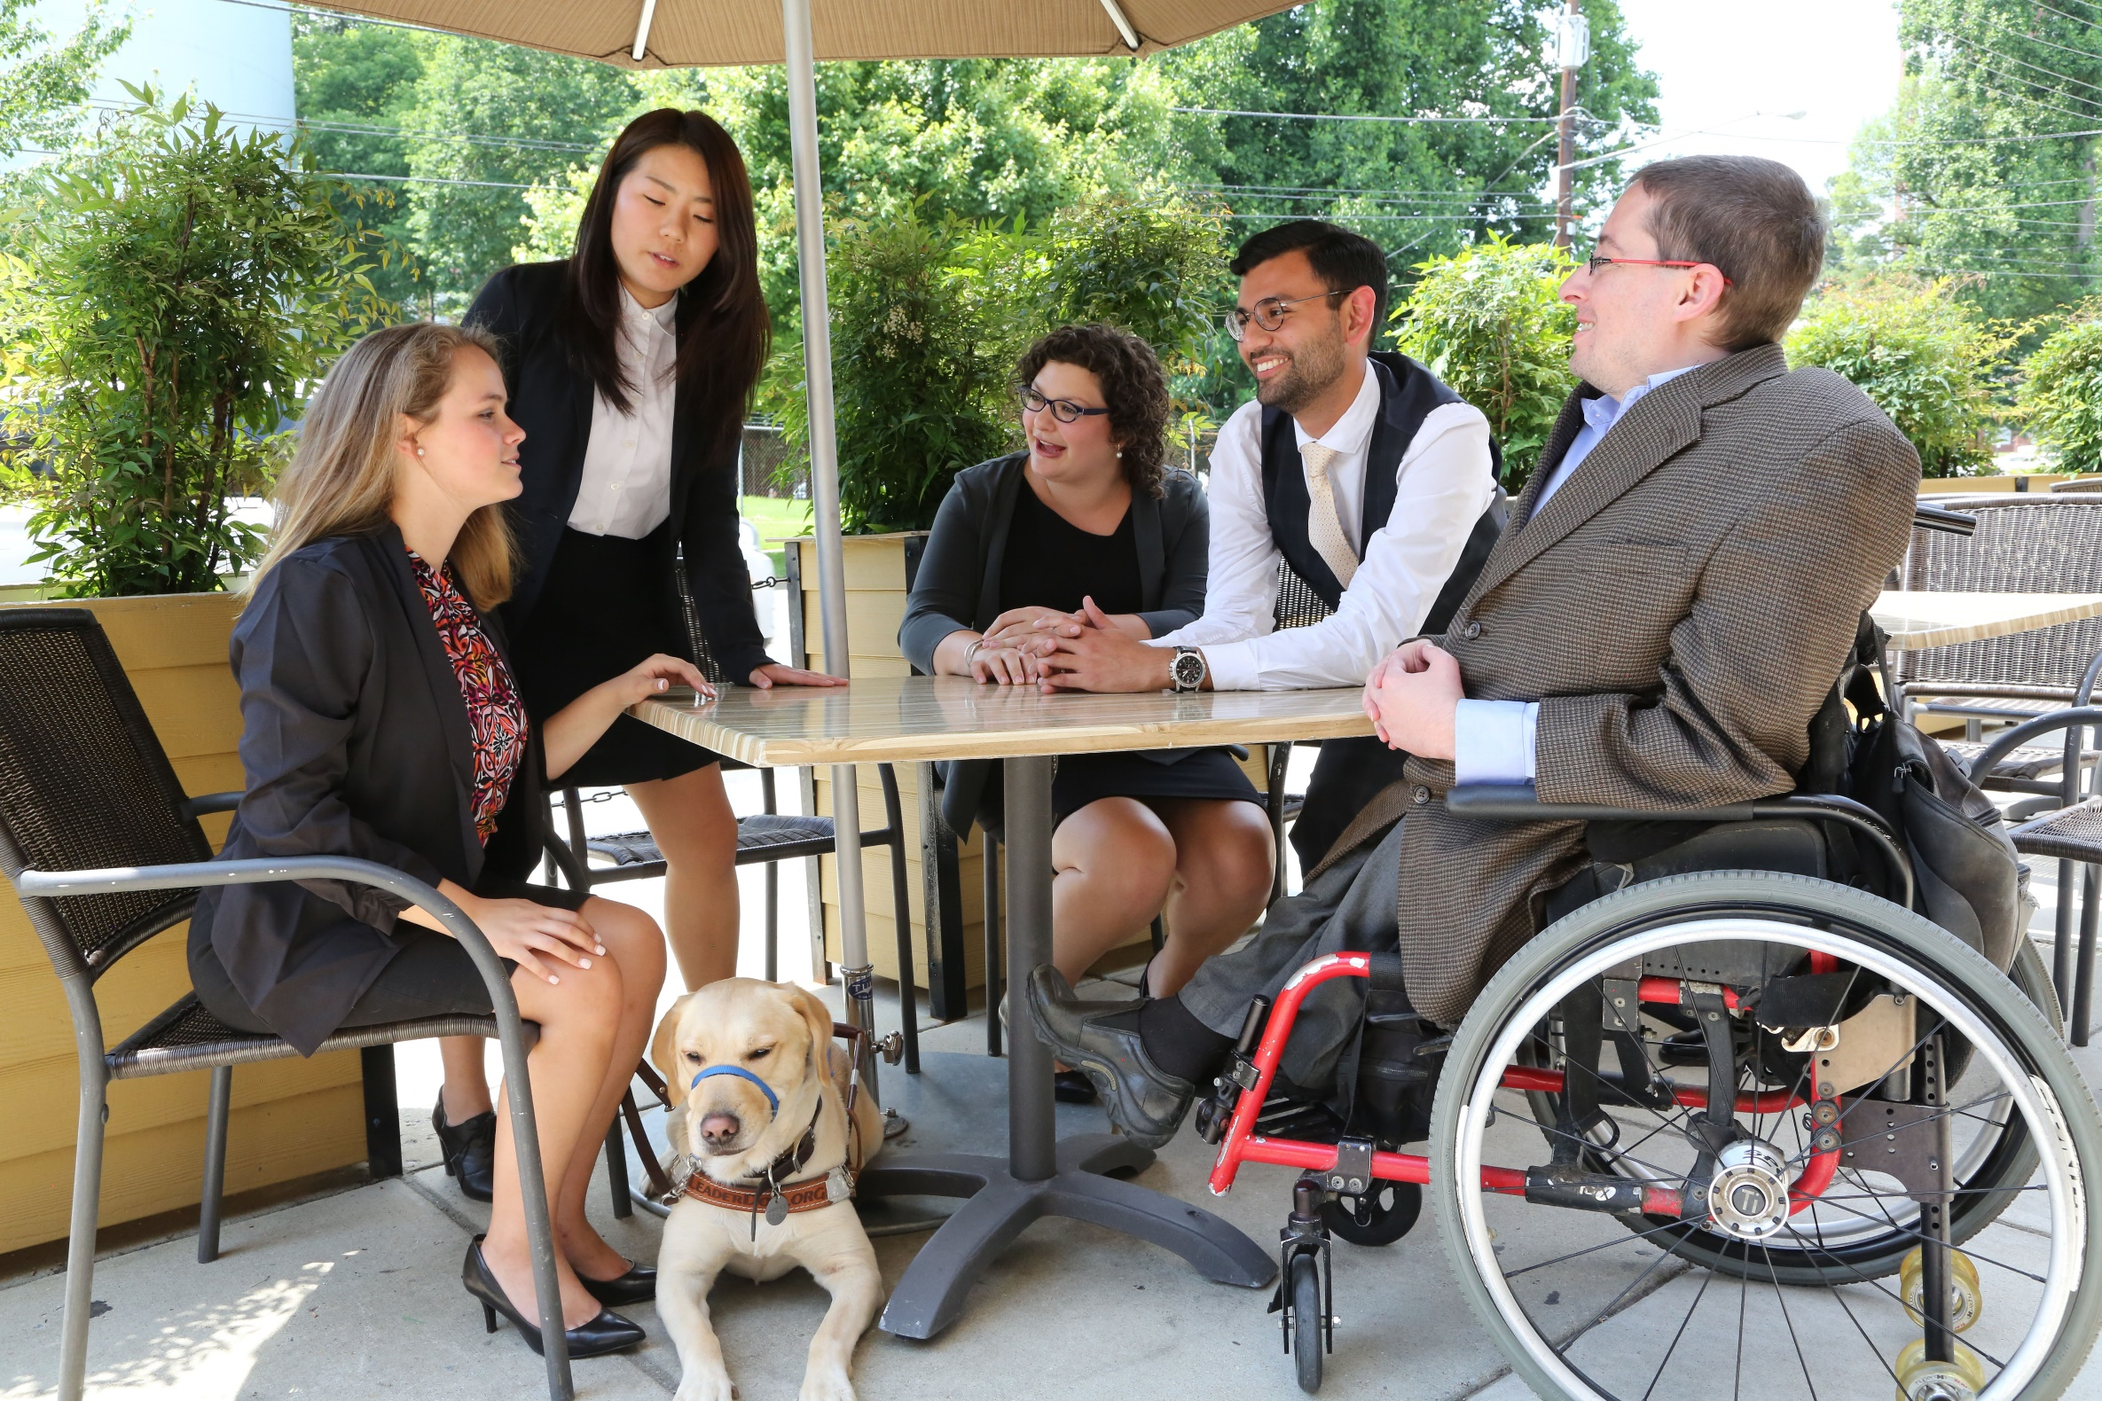
Nothing Without Us
The best way to accurately represent people with disabilities is to include us in the storytelling process!

Slide 11
Readability
Improving the readability of your materials helps everyone in your audience.
Keep messaging direct.
Keep sentences short.
Provide translation and reference for Hebrew, Yiddish, or specific terminology.

Slide 12
Talking about Disability
Say the word. “Disability” is not a bad word!
Use “nondisabled” instead of “able-bodied” or “normal.”
Don’t use euphemisms like “differently-abled” or “special needs.”
Avoid passive, victim words. Use accurate, respectful language.
  Instead of “he suffers from cerebral palsy,” use “he has cerebral palsy.”
  Instead of “confined to a wheelchair” or “wheelchair-bound,” use “wheelchair user.”
Eliminate common ableist language: Ex: Crazy
Avoid referring to “the disabled” in the same way that you would avoid referring to “the Asians,” “the Jews” or “the African-Americans.”

Slide 13
Center the Person, Not the Disability
People are complex; you cannot define a person by a single characteristic, and one person can’t represent an entire community.
Focus on their story, not on their disability, adaptive equipment, or medical history.
Don’t make assumptions, and don’t lead your audience to make assumptions.
Avoid inspiration porn. Inspiration porn uses people with disabilities to make nondisabled people feel good about themselves or to make them do something, like exercise. People with disabilities aren’t “inspirational” or “courageous” just because they have a disability.

Slide 14
People-First Language vs. Identity-First Language
People-First Language puts the emphasis on the person first; followed by a description of the disability.
Identity-First Language puts the emphasis on the disability.
Several U.S. disability groups have always used identity-first terms, specifically the culturally Deaf community and the autistic rights community.

Slide 15
Using People-First or Identity-First Language
You should generally use People-First Language.
However:
If you are talking about a specific person, ask them their preference.
If you are talking about a larger group, organization, or community, look up best practices.
Be aware of in-group language vs. out-group language.

Slide 16
Portraying Disability
Focus on the person, not on their disability.
Choose celebratory images.
Show people with disabilities participating in Jewish community life.
Use authentic images.
  Don’t use photographs of people without disabilities pretending that they have a disability.
  Don’t use generic images of pill bottles, adaptive equipment, or medical settings.
There are many different disabilities, and disability impacts people of all races, sexual orientations and gender identities, faiths and backgrounds.
People with disabilities aren’t interchangeable; don’t use an image of one person with a disability to represent all people with disabilities.
Don’t reuse the same image on all of your materials.

Slide 17
Keep It Up!
Inclusion and accessibility are ongoing tasks.
Create an inclusive communications guide and make sure your team has access to it.
https://www.respectability.org/inclusion-toolkits/etiquette-interacting-with-people-with-disabilities/
http://ncdj.org/style-guide/
Regularly revisit your materials and make improvements.

Slide 18
Sharon Rosenblatt
Sharon Rosenblatt is an accessibility professional working to improve the overall experience by a user with disabilities. With her tendency to be ‘hands on’, Sharon feels that accessibility is a right, and not a ‘nice to have’. She has been a part of the Accessibility Partners team for over ten years as the Director of Communications, and also specializes in document remediation and web compliance testing. Her efforts have enabled developers and manufacturers to see the tremendous potential that accessibility has not just for users with disabilities, but of all abilities. Sharon is also an avid runner and looks forward to her next race that gets her up at the crack of dawn. She’s been known to disregard weather forecasts as long as there is a finisher medal to be obtained.

Slide 19

Digital Accessibility
Accessibility means equal access and encompasses all disabilities
People with disabilities can:
  Perceive
  Understand
  Navigate
  Interact

Slide 20
Who Defines the Guidelines?
The World Wide Web Consortium (W3C) developed Web Accessibility Initiative (WAI)
Not a legal requirement; however, US courts are using as a global standard in lawsuits
WAI has developed the following W3C Recommendations:
  Web Content Accessibility Guidelines
  https://www.w3.org/WAI/standards-guidelines/wcag/

Slide 21
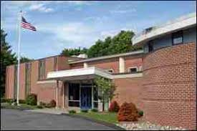
Alternative Text
Textual alternative to image content
Alternative text communicates the purpose of the graphic, not its appearance
Keep in mind how the image is used
  to convey important content
  to provide visual enhancement
  to link to other areas

Slide 22
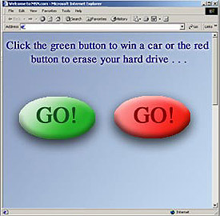
Color Usage
Color should never be the sole way to convey information
Some users with disabilities cannot distinguish colors
May lose meaning if viewed in high contrast

Slide 23
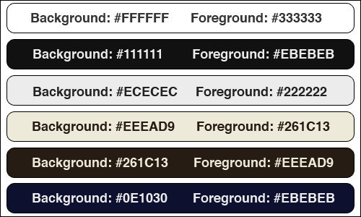
Examples of Good Color Contrast
23

Slide 24
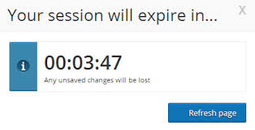
Timeouts
Timeouts are employed to track a user’s inactivity
Issues include:
  Not identified on screen
  Not long enough to complete an activity

Slide 25
Provide Descriptive Links
Proper links work with all assistive technologies
Must be accessible from the keyboard
Must be descriptive
Stay away from “click here” links
  Example: For more information, click here
  Example of a good descriptive link: WCAG 2.0

Slide 26
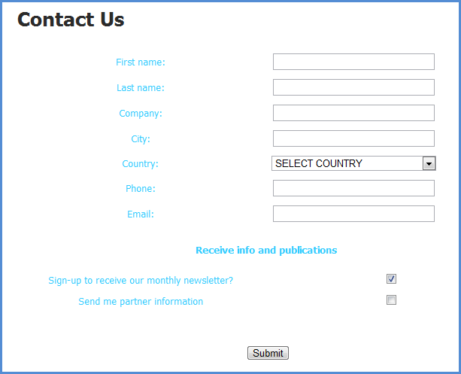
Labeled Form Fields
Matching “for” and “id” labels
ID must be unique, can’t have one label for multiple
Text labels describe the function of each form control
  <label> element used to associate text label

Slide 27
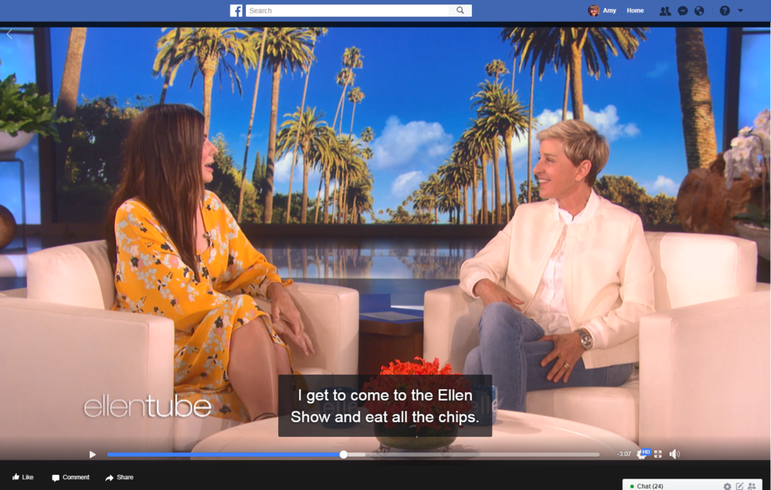
Video & Audio
Equivalent alternatives that are synchronized
Add subtitles/captions for audio and movie

Slide 28
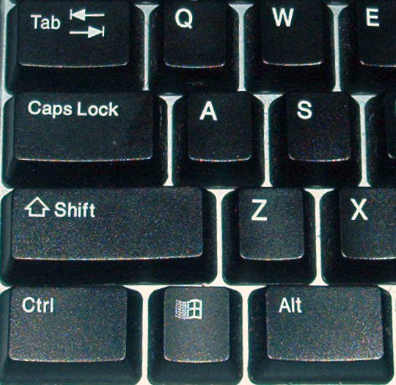
Keyboard Usage
Links, buttons, menus, form controls
Anything controllable with a mouse needs to be operable with the keyboard
Test with Tab and Enter Keys
Some items might need arrow keys such as dropdown lists, etc.

Slide 29


Contact Information
Dana Marlowe:
DMarlowe@AccessibilityPartners.com
Sharon Rosenblatt: SRosenblatt@AccessibilityPartners.com
www.AccessibilityPartners.com
301-717-7177
  www.facebook.com/AccessibilityPartners
  @Access_Partners

Slide 30
Tatiana Lee
Tatiana Lee is a Hollywood Inclusionist at RespectAbility. She was a Communications Fellow in Spring 2019, participating in the leadership program to gain better knowledge and skills to be a more effective advocate in Hollywood for disability inclusion. Now, she helps represent RespectAbility in Hollywood. Like RespectAbility, Lee has dedicated her life to fighting for inclusion of people with disabilities in all aspects of mass media. Lee learned to harness the power of social media to speak boldly about accessibility and inclusion in mass media. She became the voice behind “Accessible Hollywood,”where she highlighted her journey as an actress, model and lifestyle influencer born with Spina Bifida.

Slide 31
The Basics: Captions on Videos
Open Captions Best for Social Media
41% of videos are incomprehensible without sound or captions.
In fact, 80% of viewers react negatively to videos autoplaying with sound. So now, many social media outlets now autoplay videos on silent.
80% of people who use captions aren't Deaf or hard of hearing.
Captions help with comprehension of dialogue, clarification of terminology, concentration and engagement.

Slide 32
The Basics: Captions on Videos 2
85% of Facebook video is watched without sound
Adding captions to Facebook videos increased view time by 12%.
Facebook video posts with captions have 135% greater organic reach.
80% more people are more likely to watch an entire video when captions are available
Adding captions to YouTube led to a 7.3% increase in views.
82% of Twitter users watch video content on Twitter.
Snapchatters watch 10 billion videos a day.

Slide 33
The Basics:
Just like for websites, images on social media need to be described for individuals who cannot view them.
We will show demonstrations on
Twitter
Facebook
Instagram
YouTube

Slide 34
In Depth Tutorials
Watch the Webinar at the below link and see the next slide:
https://www.respectability.org/2020/01/webinar-premium-skills-workshop-in-social-media-accessibility/

Slide 35
Additional Resources For Captioning
Clipomatic App
Clips App by Apple
YouTube (free cc generator)
rev.com 1$/min CC 24hr turnaround

Slide 36
Questions?

Slide 37
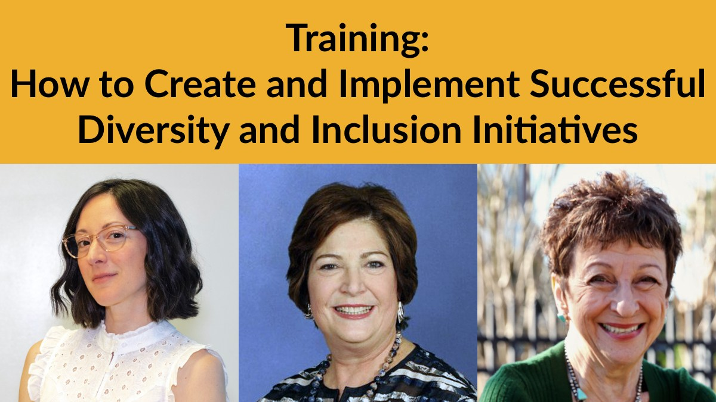
See you Tuesday, August 4 for part 6!
Want more information? Contact Matan Koch, Director of RespectAbility California & Jewish Leadership, at MatanK@RespectAbility.org

