Slide 1
Ten-Fold Decrease in Job Gains for People with Disabilities
Hope for the Best – Prepare for the Worst: Wills and Special Needs Trusts
www.RespectAbility.org
April 6th, 2020

Slide 2
Our Mission
Mission:
To fight stigmas and advance opportunities so that people with disabilities can fully participate in all aspects of community.
Meet your moderator:
Philip Kahn-Pauli, Policy and Practices Director

Slide 3
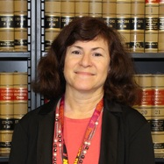
Speakers
Frederick M. Misilo is the President of The Arc of the United States and the Chair of Fletcher Tilton, PC’s Trust and Estate Department.
Michelle K. Wolf, Founding Executive Director of the Jewish Los Angeles Special Trust.
Evan Krame, Law Offices of Evan J. Krame, P.C.

Slide 4
Evan J. Krame
PLANNING FOR PEOPLE WITH DISABILITIES
Law Offices of Evan J. Krame, P.C.
11300 Rockville Pike, Suite 405
Rockville, MD 20852
(301) 468 - 3360

Slide 5
Who Is The Client?
Does the client have capacity? Is the person for whom planning is required a minor? Is that person subject to a mental or cognitive limitation such that they do not have legal capacity to make decisions?
Who are the persons closest - Next Friends, Parents, Guardians, Caretakers – who has legal authority to make decisions?

Slide 6
Public Benefits
Does the client receive, or will the client need public benefits?
What kind of benefits?
Supplemental Security Income (SSI)
Medicaid
SSDI (Disability Income).

Slide 7
Basic Documents – Part 1
While you are alive – Financial Power of Attorney
to give another person (“agent”) authority / manage and administer finances
handle legal matters / “durable” is valid even if the signer is disabled.
should be valid upon signing.
Health Care Power of Attorney
designate an “agent” for medical decisions / manage health care
useful when the signer is not capable / should be valid upon signing.
Living Will
direction in the event of extreme illness / only applies when there is no hope of recovery / directs end of life treatment / only focuses on keeping a person alive
HIPAA Release
Privacy laws limit access to medical records b/ A HIPAA release designates a representative
Needed to help implement estate plans

Slide 8
Basic Documents – Part 2
Upon Death
WILLS: a will is a list of instructions for how possessions pass upon death.
only applies to assets owned in your sole name.
does not apply to beneficiary designations
not to IRAs/401Ks. / generally not to life insurance. / generally not to annuities
generally doesn’t to apply to jointly owned assets.
A will is a list of instructions for the probate process
probate is how the Courts supervise your estate
probate begins by the filing of probate forms
probate may mean some delays in distribution
probate may safeguard against fraud
probate can cut off the claims of creditors.

Slide 9
Upon Death
NO WILL – This is called INTESTACY.
State law determines how property passes
Priority is given to a spouse and children
Provides a scheme for distributing property
If no relatives survive, ESCHEAT to the state.
if you have no assets in your sole name, you might not need a will.

Slide 10
Trusts
1. Created during life – INTER VIVOS
assets owned in trust avoid probate at death
assets can be managed if Grantor is disabled
organizes assets
can maintain privacy
can achieve some tax planning
2. Created at death – TESTAMENTARY
can serve a minor, disabled person, a surviving spouse, an addicted or alcoholic person, etc.
can protect assets from creditors, judgments, etc.
can preserve assets for generations

Slide 11
Guardianship
Guardians for adults are appointed by a court.
1. Parents of a minor are not guardians
2. Minors may need a guardian > a. Inheritance / b. recovery in a law suit
3. When a disabled minor becomes an adult.
Pitfalls of Guardianship.
1. Assets held by a guardian can mean a loss of benefits, if assets are deemed “available.”
2. Court processes can be costly.
3. Guardianships deny a person rights
4. Guardianships might not be easy to undo.
Alternatives to Guardianship
1. Trusts
2. Powers of Attorney
3. Supported decision making

Slide 12
Special Needs Trusts / Self-Funded Trusts – Part 1
Payback Trusts –
Comply with Medicaid Rules and SSI Rules. No disbursements for food or rent, or medical goods and services provided by Medicaid. Reporting to the state Medicaid agency.
Restrictions. Under Age 65. No additions after 65.
Needs court order to be established if individual is incapacitated and the trust is self-settled, and the local courts are inconsistent in this process.
Requires Trustee Selection. Is Trustee competent, compassionate, and compensated?

Slide 13
Special Needs Trusts / Self-Funded Trusts – Part 2
Pooled Trusts –
1. The trust is established and managed by a non-profit association.
2. A separate sub-account is maintained for each beneficiary of the trust, but for purposes of investment and management of funds, the trust pools these accounts.
3. Accounts in the trust are established solely for the benefit of individuals who are disabled (as defined in Section 1614(a)(3)) by the parent, grandparent, or legal guardian of such individuals, by such individuals, or by a court. And,
4. To the extent that amounts remaining in the beneficiary's account upon the death of the beneficiary are not retained by the trust, the trust pays to the state from such remaining amounts in the account an amount equal to the total amount of medical assistance paid on behalf of the beneficiary under the state plan under this title.
5. The pooled trust may also serve as trustee of a separate “third party trust.”

Slide 14
Supplemental Needs Trusts / Third Party Trusts
Funded by family, friends, etc. not from funds owned or due to the beneficiary. The Grantors establish the trust, but anyone can contribute to the trust.
Discretionary trust – the trustee has full discretion to make expenditures. This is not a support trust. There can be no mandate to make expenditures for food and shelter.
Seed trust – created during the lifetime of the Grantors.
Testamentary trust – created by will or trust upon the death of the grantor, designed to receive an inheritance
Funding – life insurance may be used to fund these trusts. Careful if making this trust the beneficiary of IRA/401K!
Beneficiaries – there can be multiple beneficiaries. Less likely to be considered an available asset by the Government and gives some flexibility in making distributions.
Trustees – choose trustees who are responsible and informed. Supplement the trust document with a life care plan. Select alternate trustees or a method to appoint successors.

Slide 15
Other Issues In Planning For Persons With Disabilities
Start this process early!
Fiduciaries - Guardians, Trustees. Who do you trust?
Hiring Counsel. Good advice, good draftsmanship, good resources. (Good trustee???)
Values, Judgment, Morals. Paternalism is outdated.
Securing a good residence is critical.

Slide 16
Resources
http://www.eparent.com/special-needs-resource-directory-2/
https://www.actec.org/assets/1/6/Douglass_Powers_of_Attorney_Survey.pdf
https://www.kramelaw.com/our-writing/
http://www.md-council.org/wp-content/uploads/2014/03/PlannGuide-v10_FINAL.pdf
https://www.specialneedsalliance.org/

Slide 17
Hope for the Best – Prepare for the Worst, Wills, Special Needs Trusts and Legacies
Frederick M. Misilo, Jr., Esq.
fmisilo@fletchertilton.com
Admitted to practice law: Massachusetts, Florida, and Rhode Island
Boston | Cape Cod | Framingham | Providence | Worcester

Slide 18
Planning
Strategic Vision for
Family Member with a Disability
Person
Centered
Plan
Trust and
Estate Plan
Financial Plan

Slide 19
Importance of a Person Centered Plan
Provides vision and guidance for Trustee decision-making;
Contains critical historical information;
If updated, it is a living document;
Identifies key people in family, social network and providers

Slide 20
Special Needs Trust and Estate Planning
Part of the family overall estate plan
Maintain government benefits, e.g. Medicaid, SSI, and other means tested benefits
Maintain standard of living
Protect assets from waste, theft and/or misuse
Ensure future decisions are made by informed and competent parties

Slide 21
The Arc Center for Future Planning
Learn what a future plan is and why it’s so important.
Build a plan, step-by-step.
Identify professionals and resources in your area to help with future planning.
See what others have done in planning for the future.
Get help for urgent needs.
https://futureplanning.thearc.org/

Slide 22
Introduction to Government Benefits and Special Needs Trusts
JLA Trust & Services Presentation
Michelle K. Wolf
April 6, 2020

Slide 23
Today’s presentation
Why you need to plan ahead
Introduction to Government Benefits
SSI and Medicaid
Purpose and use of Special Need Trusts
Pooled Special Needs Trusts (SNTs)
JLA Trust- Future Funded Accounts
CalABLE savings accounts
How SNTS and CalABLE work together

Slide 24
The number one question for parents of adult child with disabilities:
What will happen to my child after I’m gone?

Slide 25
Introduction to Government Benefits
Many government benefit programs have asset or income limits, along with disability criteria
Government benefits are only designed to get recipients to federal poverty level – in 2020, 100% for 1 person=$12,490; family of four, $25,750
Some people with more financial means may prefer not to apply for government benefits at all but may need later in life
Notes:
In Southern California, federally-established benefits don’t begin to pay for rent, food and utilities, so need to supplement from other funds, either employment, or family funds (could be insurance policies)
People with disabilities are living longer than ever—People with Down Syndrome used to die in 20s or 30s, now living to 50s and 60s, same with autism and CP

Slide 26
Key Takeaway from today
Government Benefits are not enough!

Slide 27
Need-Based vs. Entitlement Benefits
Entitlement Benefits (does not depend on income level) | Need Based Benefits (depends on income level)
Social Security (SSDI) | Supplemental Security Income (SSI)
Medicare | Medicaid (Medi-Cal in CA)
Notes:
People with disabilities often have the Needs-Based benefits side, and can also have the entitlements too and in fact, can end up enrolled in all 4 programs. Once one parent begins to draw Social security, if the adult child with a disability acquired the disability before the age of 18, thenhe/she can get SSDI, 50% of parents social security, and after parent dies, 75%. Also mention VA benefits, which can fall on both sides

Slide 28
SSDI/ Disabled Adult Child: AKA Childhood Disabled Beneficiary benefits (CDB)
A parent’s child with a disability may receive a percentage of the parents’ Social Security Retirement benefits if the child was diagnosed before age 22
Child must be over the age of 18 to receive the benefits
Payments begin when the parent retires, is disabled himself or dies
The Disabled Adult Child receives 50% of the parent’s Social Security retirement amount while the parent is alive (and the parent keeps getting 100%) and then 75% of the parent’s Social Security retirement amount after that parent passes

Slide 29
What is Supplemental Security Income - SSI?
Monthly cash benefit ($931 max) from the Social Security Administration
For adults aged 65 or older who are disabled
For the blind and disabled of any age
Must have limited income and resources (needs based)
Children with disabilities may also qualify if parents low-income
Links automatically to Medi-Cal
Notes:
And from Medi-Cal, you can get IHSS. There are other ways to qualify for Medi-cal and IHSS, but this way you avoid any share of costs and annual fee of Medi-Cal. Only need $1/month of SSI to get that automatic linkeage to Medi-Cal
If someone else pays for rent, groceries, utilities, lose one-third of federal share which is $257. $943 in 2020

Slide 30
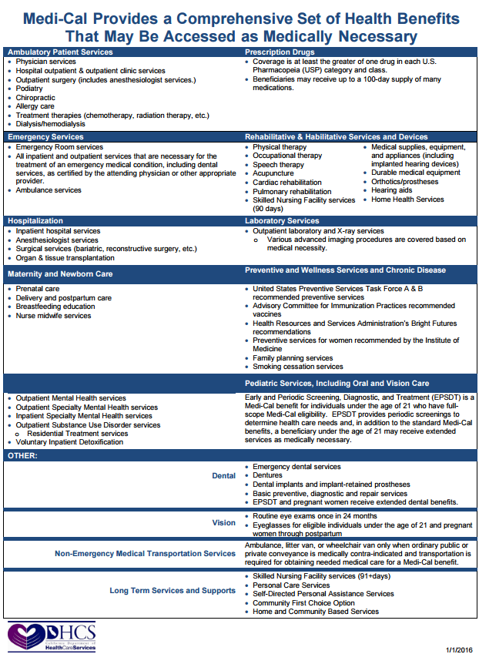
What is Medicaid?
Pays for medical care, in-home caregivers, and long term care (nursing home and some assisted living)
Durable medical equipment ( such as wheelchairs)
Hospice
Prescription medication
New requirement of managed care (HMO enrollment)
Needs-based program (low income, low assets)
Can have both Medicaid and Medicare at same time
Can have private insurance and Medicaid (secondary)

Slide 31
In-Kind Services and Maintenance (ISM)
SSI considers financial assistance for food, shelter or basic utilities to be “in-kind” income for the following categories:
Food, mortgage payments, property taxes, rent, heating fuel, gas, electricity, water, sewer and garbage removal
ISM is counted if a third-party, such as a family member, or if a special needs trust pays for these items
A penalty of one-third of the federal share of SSI will be imposed
In 2020, that amount is $261, can be $20 higher under some circumstances

Slide 32
What is a Special Needs Trust (SNTs)?
Financial instrument to assure that a person with a disability is able to either become eligible for, or able to keep eligibility for vital government benefits
Must be used primarily for the sole benefit of the beneficiary
SNTs allow the beneficiary to have the benefits of government needs-based programs, and also have the benefits of the assets (plus investment income) held in the Trust
Notes:
Can’t be used for the family, such as a sick sibling or purchasing tools for Dad to do his construction work. Could be a car driven by parents, if primary use is to transport child with a disability. If a home is purchased, parents/sibs should pay rent or at least document hours of care provided

Slide 33
What is a Pooled Special Needs Trust?
1993: Omnibus Budget Reconciliation Act – Congress authorized special needs trusts to preserve the assets of a person with a disability
Pooled Special Needs Trust (known as (d)(4)(C) SNT)
Preserves eligibility for public benefits such as Supplemental Security Income (SSI) and Medicaid
Can be created by someone over 65
Pooled special needs trusts must be operated by a nonprofit
Close to 100 Pooled SNTs around the county- Directory of pooled trusts: https://specialneedsanswers.com/pooled-trust
Notes:
LA County home to over 500,000 SSI recipients—In CA 807,945 people ages 18-64 received SSDI or SSI benefits in the year 2012.3

Slide 34
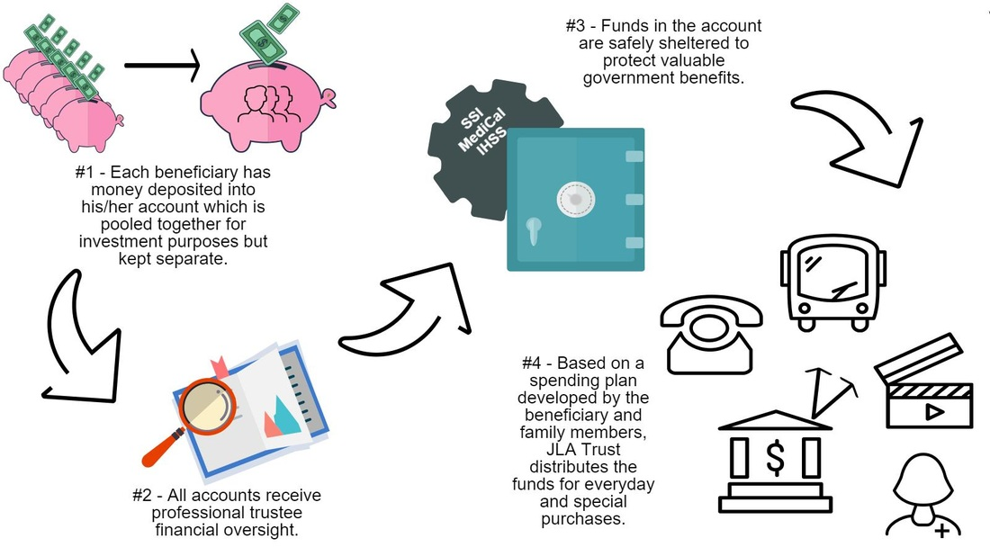
How do Pooled Special needs Trusts Work?
​
How do Pooled Special Needs Trusts work?

Slide 35
Professional Trustee vs Family Trustee
Best practice is to have a licensed professional such as a professional trustee, bank, law firm or commercial trust company
Professional trustees typically require $500,000 -$1 million minimum in assets to provide their services
Family trustees may find trusteeship to be a burden—many legal, tax and government benefits issues to deal with, plus the case management

Slide 36
Why a Pooled SNT can be a good option
Use of a Joinder Agreement as part of a Master Trust
means lower set up fees than with a private attorney
Lower minimum amount needed for professional trustee and wealth management services
Potentially higher rates of return than individual trusts
Can be created by someone over 65 for community-based care
Minimize conflicts of interest from family members/their spouses

Slide 37
JLA Trust History and Mission
We were launched in 2015 with funding from the Jewish Community Foundation of Los Angeles
Planning grants from Jewish Federation
Incubated at Bet Tzedek Legal Services
Partner with JFS, ETTA, RespectABILTY, others
Our mission is ensure that people with disabilities are able to obtain a high quality of life by leveraging the power of community to assist with financial security and peace of mind

Slide 38
New Future Funded option-3rd party
Easy and affordable way to set up a special needs trust for the future
Other family members can contribute funds or designate inheritances
Sets up a professionally managed trust
Only requires deposit of $200 into pooled money market account
$600 enrollment fee

Slide 39
Partnership with True Link
Mission-driven company that uses innovative technology to support individuals with disabilities
Accounts are held at Charles Schwab –choice of 3 portfolios- Conservative, Conservative Growth & Moderate
Request disbursements online or via phone, and can receive funds quickly via a reloadable Visa debit card
Notes:
Portfolios are currently earning between 3-5%

Slide 40
What is the new ABLE program?
In 2014, President Obama signed the Achieving a Better Life Experience Act (ABLE)
Created a tax-advantaged program for people w/disabilities to save up to $15,000/year and up to $100,000 without losing SSI or Medicaid
Not subject to Federal or CA state income taxes
Eligibility is limited to individuals who have been formally diagnosed with a disability before age 26 and either currently eligible for SSI, or receiving SSI
Funds can be spend on any qualified disability expenses—not just medical expenses. Can include basic living expenses such as housing, transportation, education and health prevention/wellness

Slide 41
More on ABLE accounts
Find your state options at https://www.ablenrc.org/
The beneficiary of the account is the account owner, and income earned by the accounts will not be taxed.
Can deposit up to $15,000 per year total, more if employed
The maximum lifetime limit is currently $100,000 before SSI or state-means tested benefits are suspended (Beneficiaries can save up to $475,000 and still receive Medicaid).

Slide 42
How ABLE accounts and SNTs can work together
Advantages to using ABLE accounts to pay for rent
Non-conserved beneficiaries can have more direct control over their ABLE funds
Can use SNT as more of a savings account with fiduciary oversight
No penalties in transferring money from a SNT to an ABLE account, and vice versa
Because ABLE accounts max at $100,000 for SSI benefits, makes sense to use SNT for ongoing medical and living expenses other than housing

Slide 43
Contact Us:
Website: www.jlatrust.org
Email: mwolf@jlatrust.org
Facebook: www.Facebook.com/JLATrust
Twitter: @JLATrust
Telephone: (310) 773-9728, ext 2
Notes:
Show enrollment packet—Joinder forms

Slide 44
Planned Giving: Your Way to have Your Charity Cont.
Your faith based organization
The Arc
RespectAbility

Slide 45
Questions? Comments? Concerns?

Slide 46
Thank you!
Contact Us:
Jennifer Laszlo Mizrahi, JenniferM@RespectAbility.org
Frederick M. Misilo, Jr., Esq. fmisilo@fletchertilton.com
Evan J. Krame, evan.krame@gmail.com
Michelle Wolf, mwolf@jlatrust.org
www.RespectAbility.org

