Slide 1
Including People with Disabilities in Nonprofits and Foundations
February 19, 2020 | Jennifer Laszlo Mizrahi, Tatiana Lee, and Matan Koch, www.RespectAbility.org

Slide 2
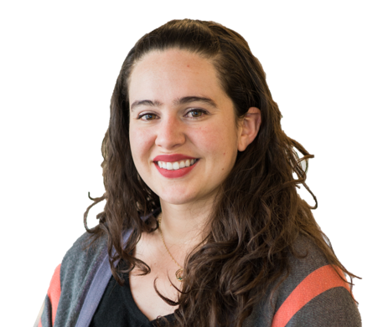
Host
Elizabeth Zevada
Program Associate,
Candid
Pronouns: she/hers
Notes:
I would now like to turn the controls over to our presenter,<Presenter’s Name>, so they can display their presentation. As they take the reins, I’d like to introduce them.

Slide 3
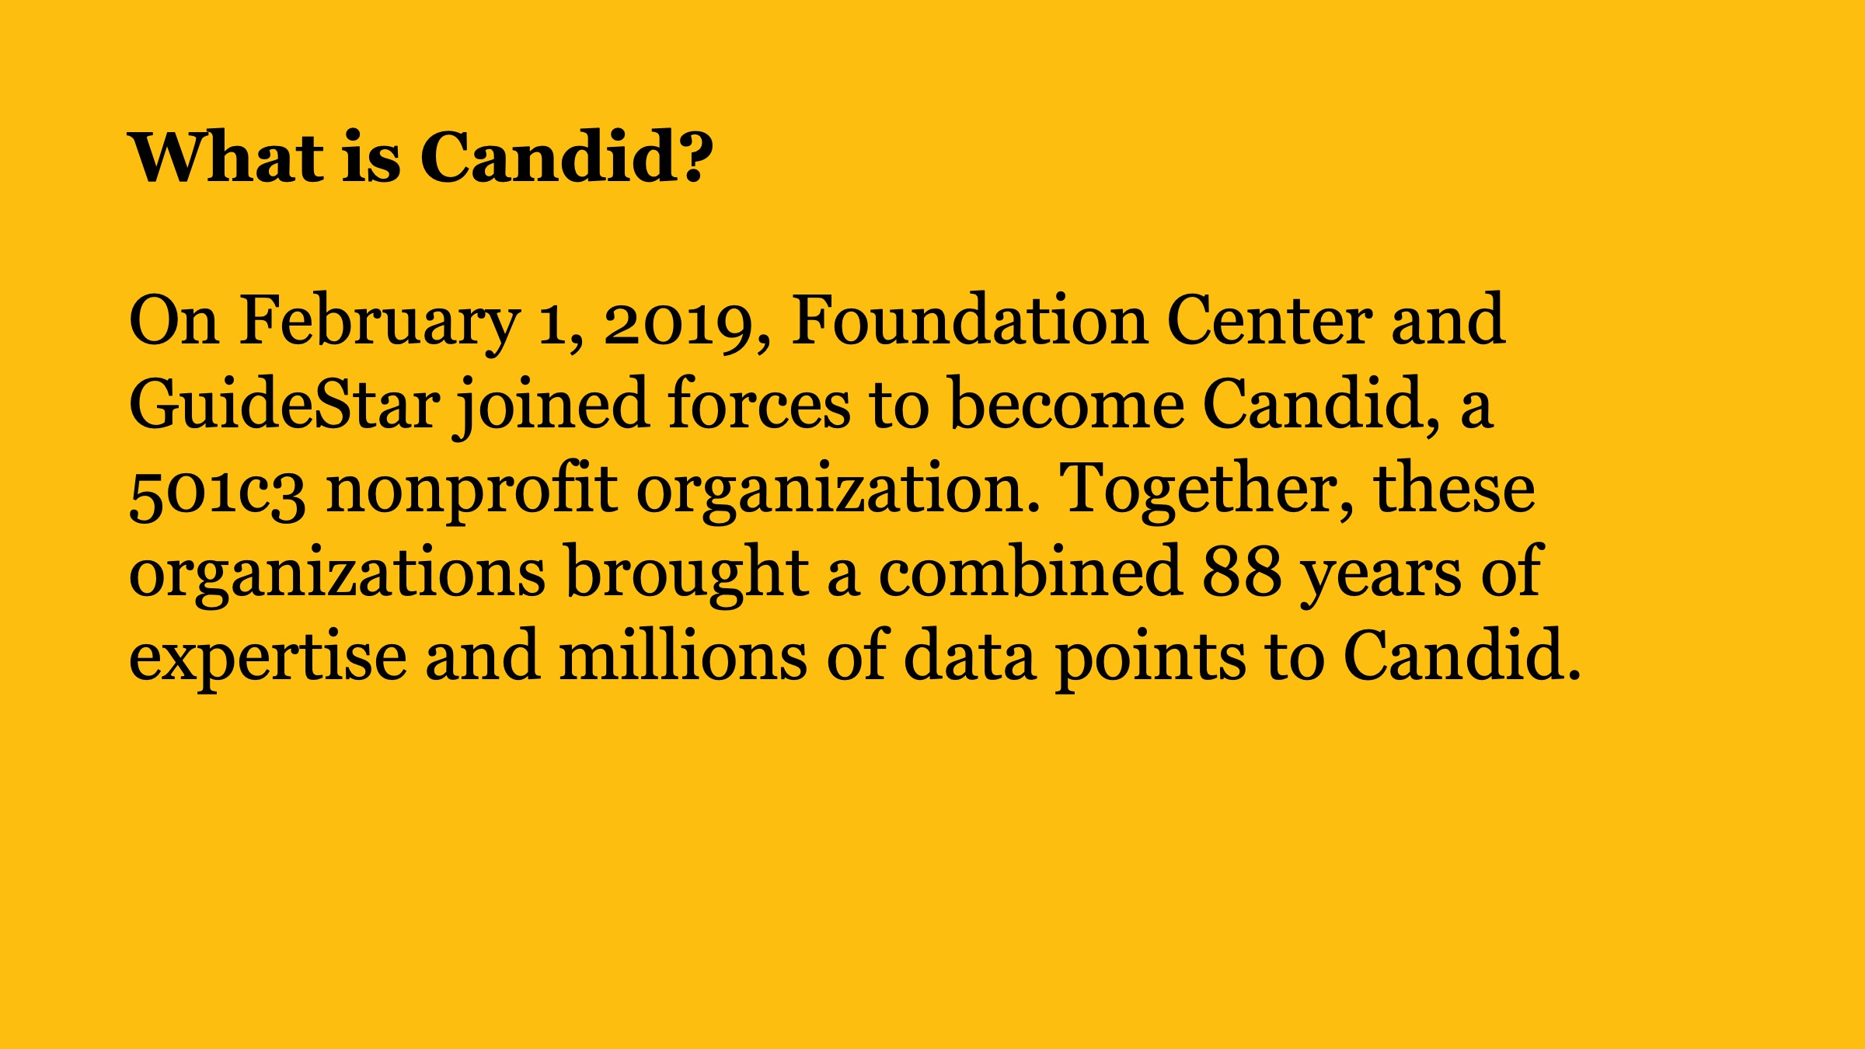
What is Candid?

Slide 4
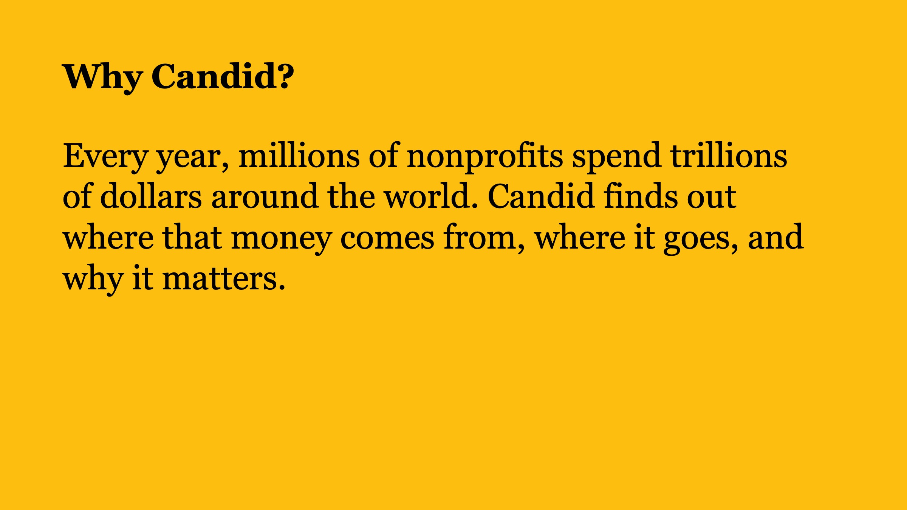
Why Candid?

Slide 5
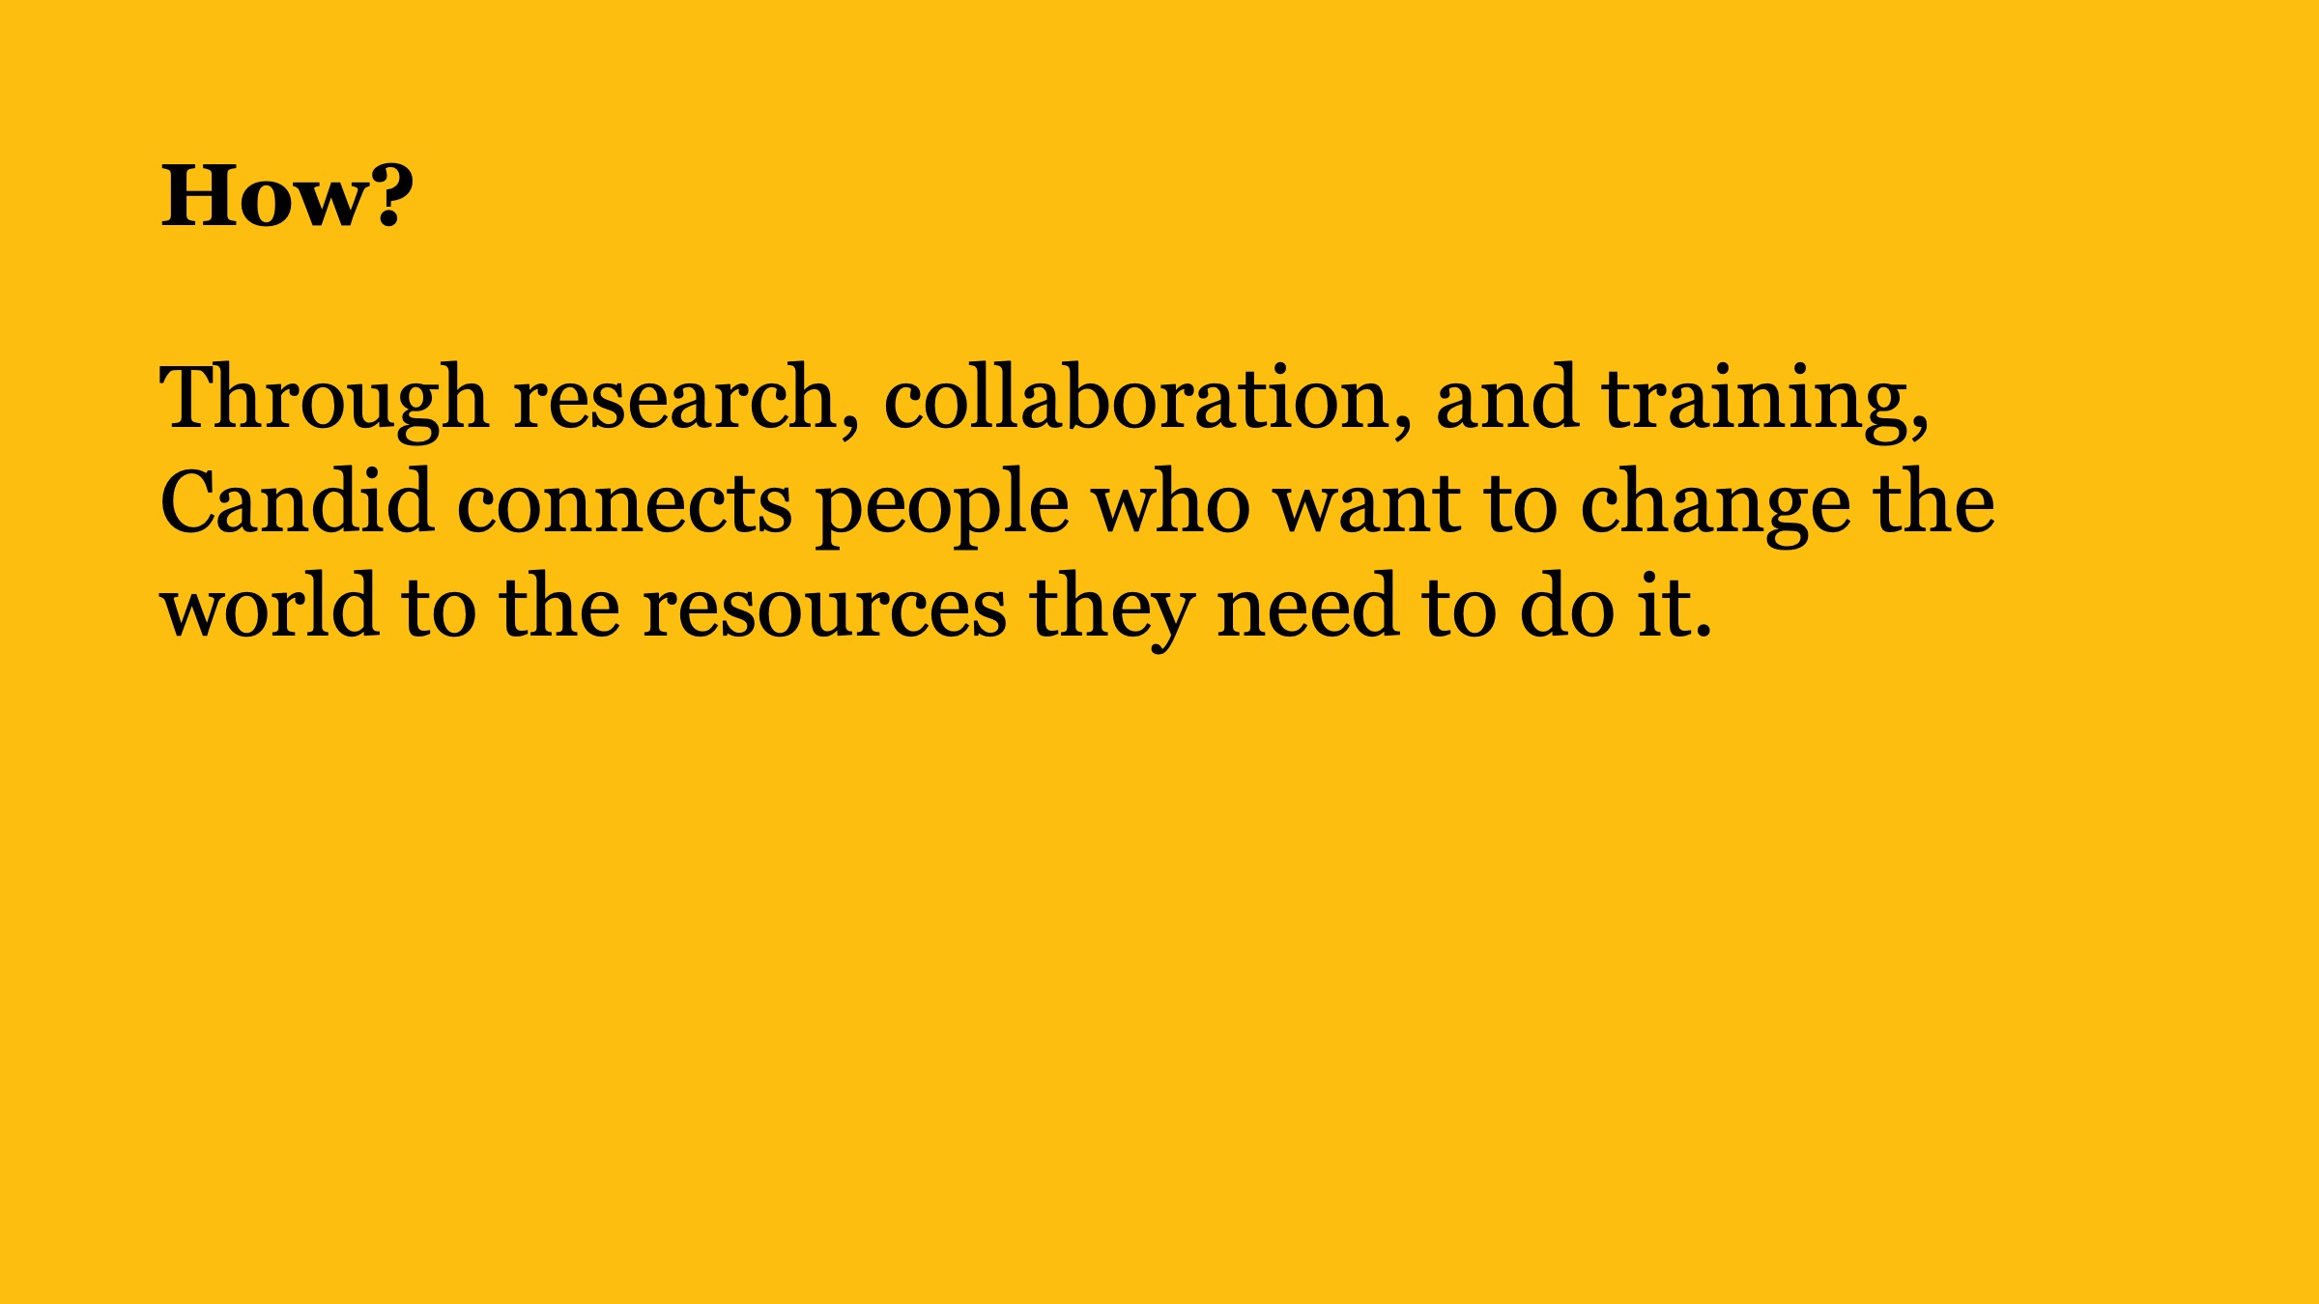
How?

Slide 6
Here are a few things you can do today:
Explore
Research nonprofits
Find funding
Verify nonprofits
Explore issues
Stay up to date
Strengthen
Improve your nonprofit
Improve your foundation
Connect
Use our data
Share
Tell your story
Notes:
With Candid you can find funding with Foundation Directory Online and Search 140,000 funders and 12 million grants, and increase your visibility with the funder community by creating or maintaining your GuideStar nonprofit profile. . You can also continue to strengthen your nonprofit by participating in GrantSpace trainings to move your fundraising skills to the next level.

Slide 7

Grantspace by Candid.
Connecting nonprofits
with the resources they need to thrive
Notes:
We will also send out a follow-up email tomorrow, which will link to a recording of this webinar and to its associated handouts.

Slide 8
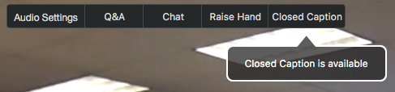
Webinar instructions
Ask a question by clicking the Q&A button
Turn on captions by clicking the Closed Caption button.
For technical assistance email training@candid.org
Notes:
[Slide] I’d also like to go over a few items so you know how to participate in today’s event. We've taken a screenshot of an example of the Attendee interface. You should see something similar on your screen. By default, you’re listening in using your computer's speaker system. If you would prefer to join over the phone, I’d also like to go over a few items so you know how to participate in today’s event. We've taken a screenshot of an example of the Attendee interface. You should see something similar on your screen. By default, you’re listening in using your computer’s audio. If you would prefer to join over the phone,
There are # handouts for today’s webinar (a .pdf version of the presentation and [insert description of additional handouts]. You can download them from the grey tab marked Handouts on the control panel.
You will have the opportunity to submit text questions by [Click] typing your questions into the Questions/Chat pane of the control panel. You may send in your questions at any time during the presentation; I will collect these and we will address them during the Q&A session at the end of today’s presentation.

Slide 9
Yes, we are recording today’s presentation.
You will receive a link to watch it and download a transcript via email next week.

Slide 10
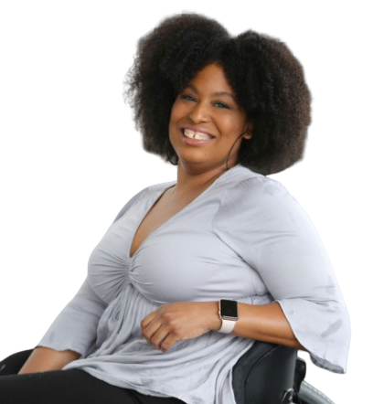
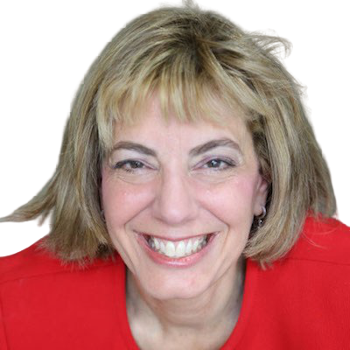
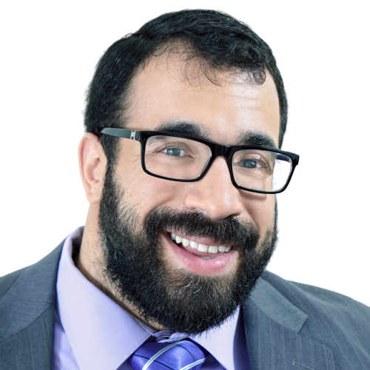
Moderator and speakers
Jennifer Laszlo
Mizrahi
President,
RespectAbility
Pronouns: she/her/hers
Tatiana Lee
Hollywood Inclusionist,
RespectAbility
Pronouns: she/her/hers
Matan Koch
Director of RespectAbility California and Jewish Leadership,
RespectAbility
Pronouns: he/him/his
Notes:
I would now like to turn the controls over to our presenter,<Presenter’s Name>, so they can display their presentation. As they take the reins, I’d like to introduce them.

Slide 11
Including the D – Disability – in Diversity
Organizations are at their best when they welcome, respect and include people of all backgrounds. This includes people with disabilities.

Slide 12
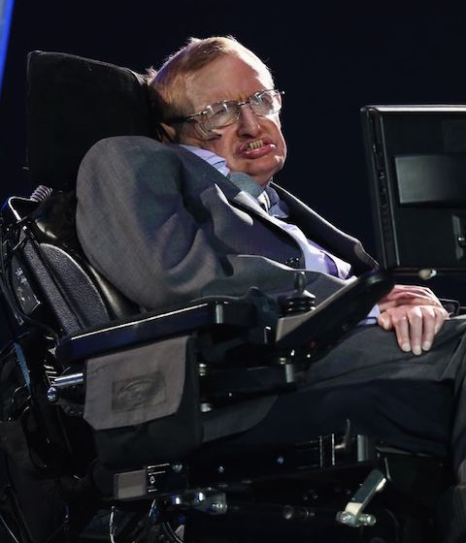
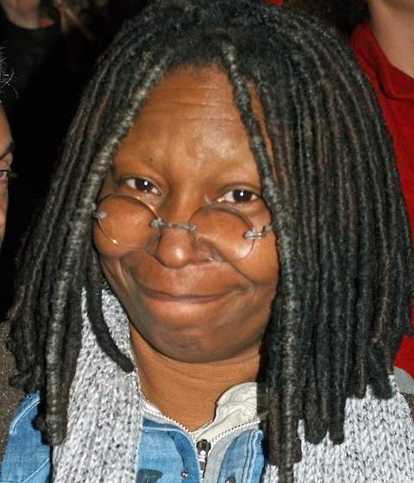
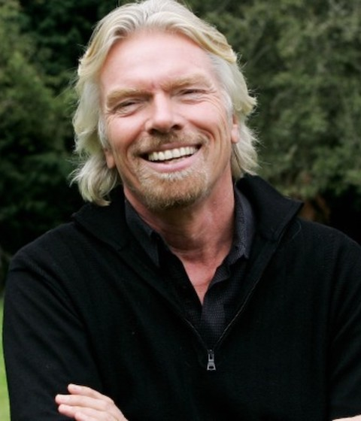

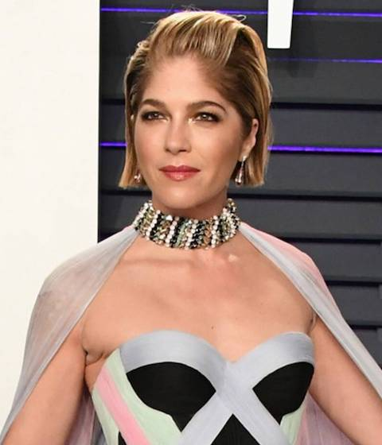
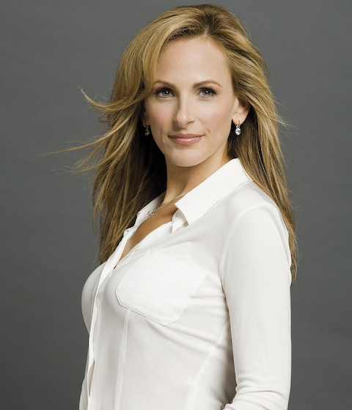

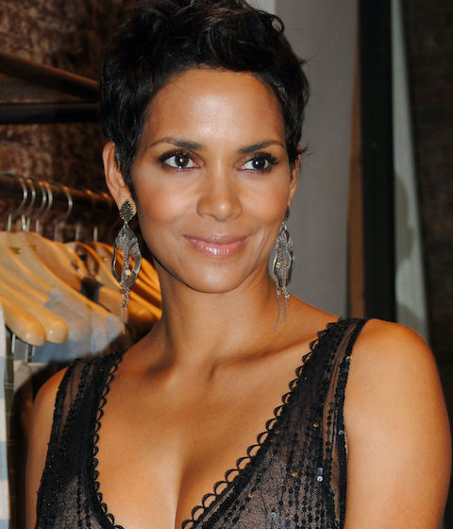
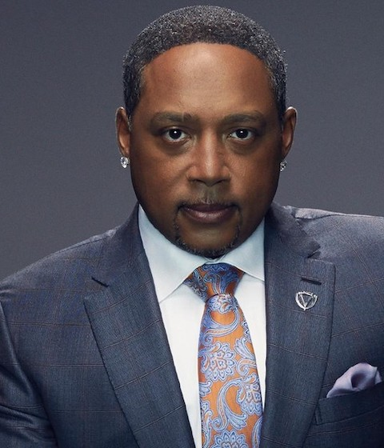
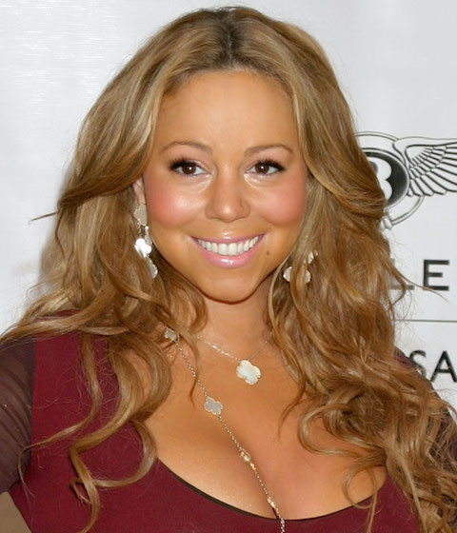
These art people with disabilities
These are people with disabilities.

Slide 13
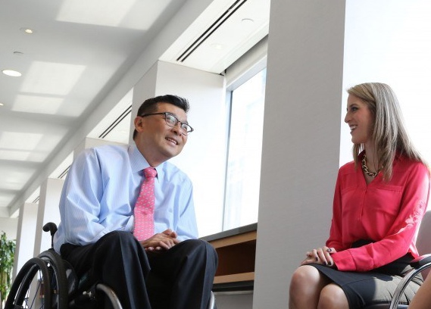
61 million people
61 Million
people in the US have a disability.*
1 in 4
adults have a disability
(physical, sensory, cognitive, mental health or other)
* Source: US Census
Notes:
I swapped stats with the next slide because these two are more related. I changed out the photo because you have a lot of group shots in this deck and I felt you needed a few different photos.

Slide 14
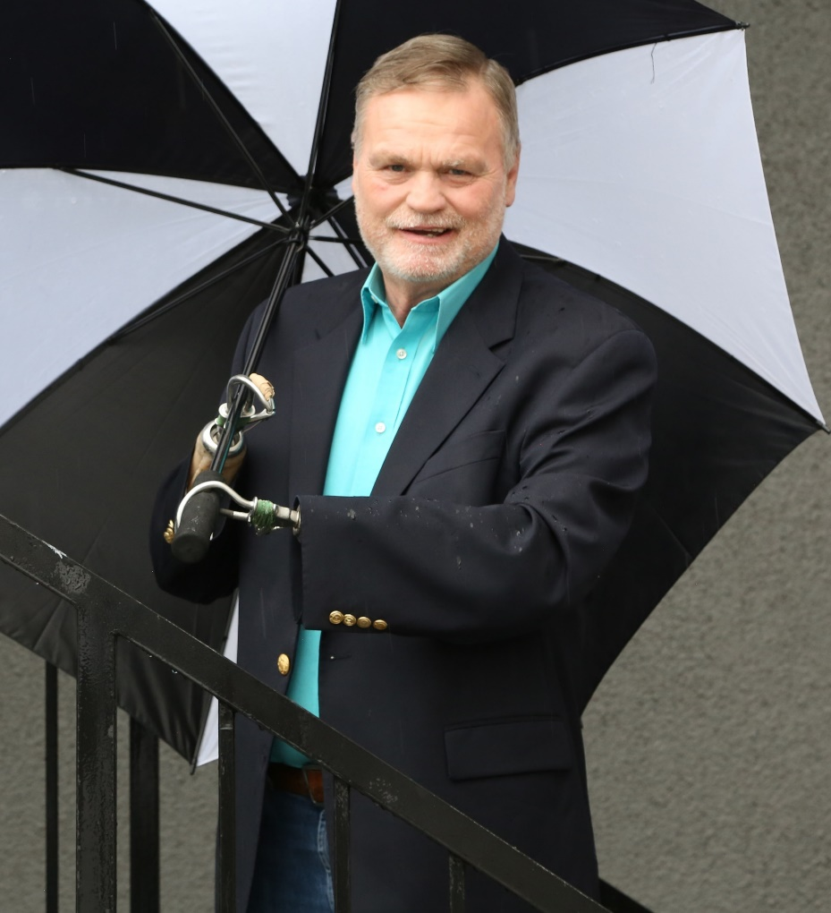
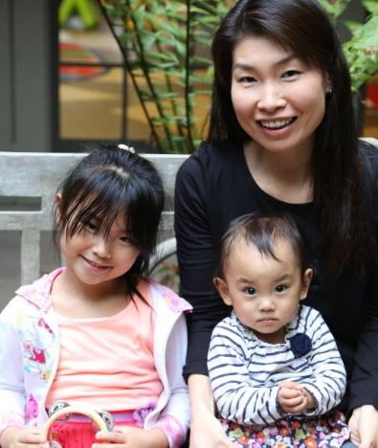
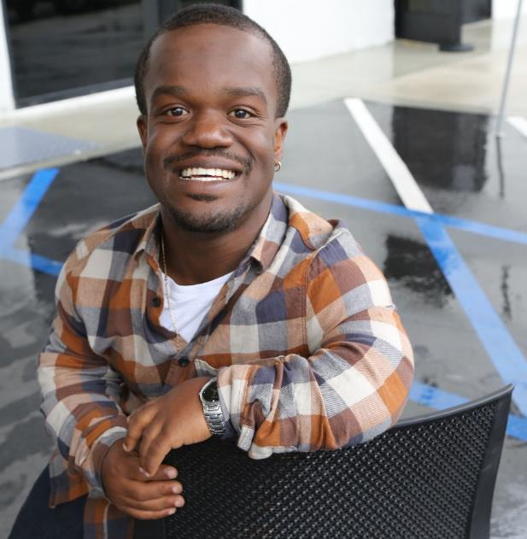
Disabilities Are….
Temporary and Permanent
Visible and Nonvisible
From Birth or Acquired Later
Anyone can join the disability community at any point.

Slide 15
Disability Impacts Everyone
Disability impacts people of all races, sexual orientations and gender identities, faiths and backgrounds.
African Americans with Disabilities
Latinx People and Hispanics with Disabilities
Women with Disabilities
LGBTQ+ Individuals with Disabilities

Slide 16
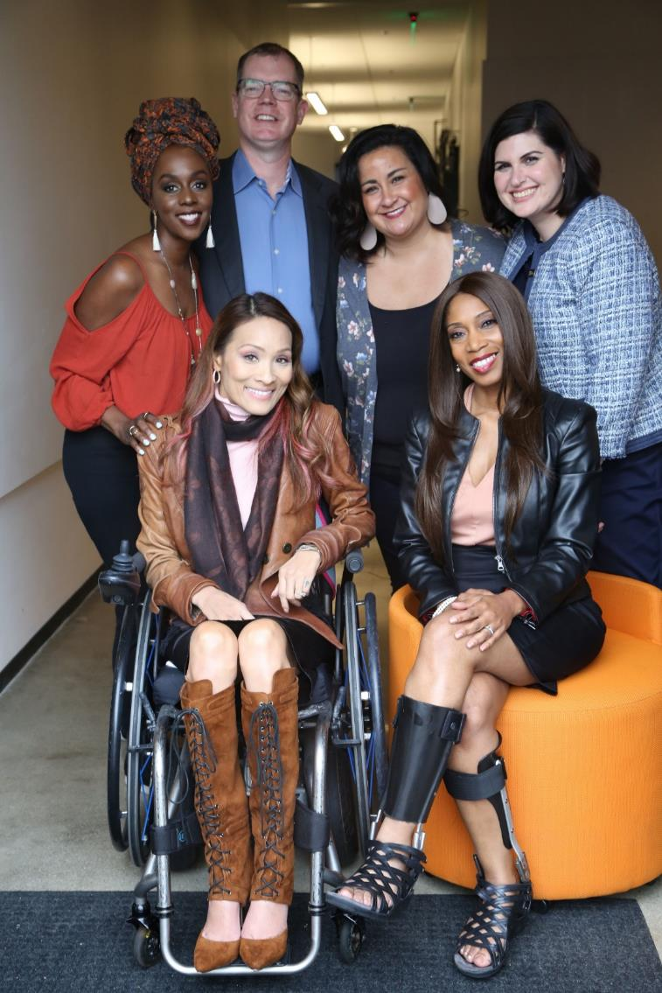

The disability community is cutting edge and innovative.
Anyone can join the disability community at any point.
People with disabilities are diverse and part of all communities.

Slide 17
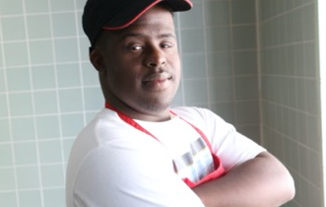
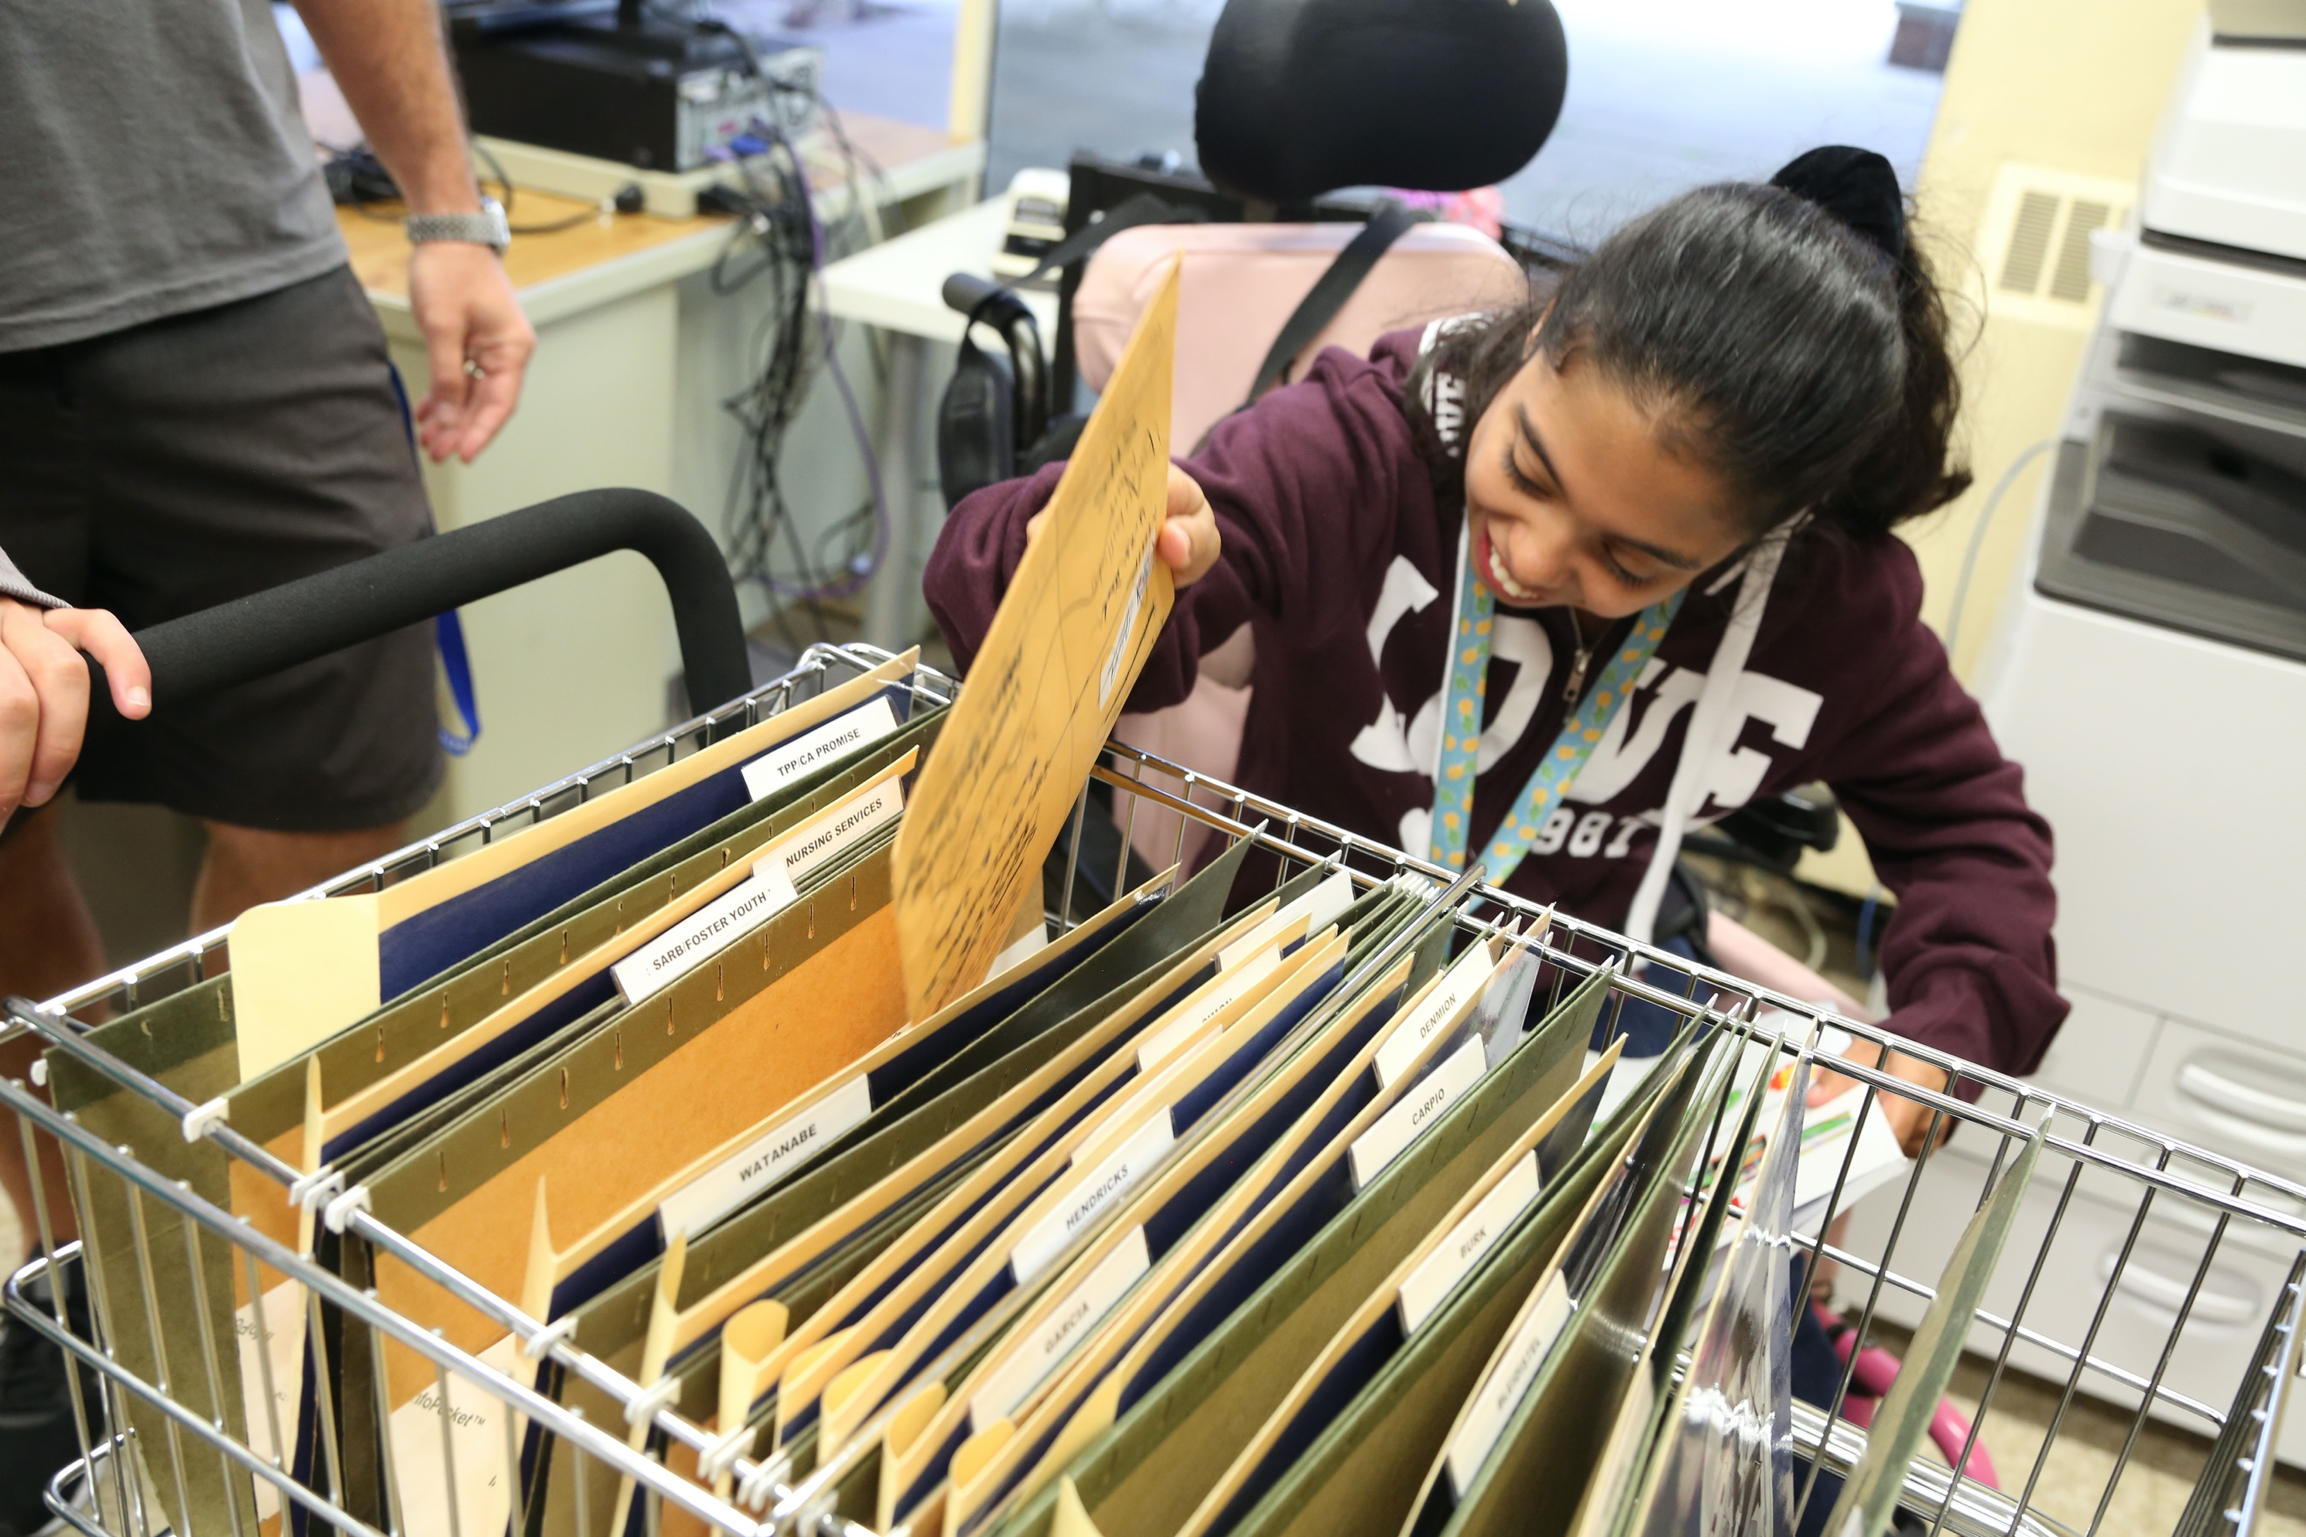
School statistics
There are 7 million students with disabilities in public schools today.
Over 52% of students with disabilities are
people of color.
Only 65% of people with disabilities finish high school.
What can be done to enable people with disabilities to succeed?

Slide 18
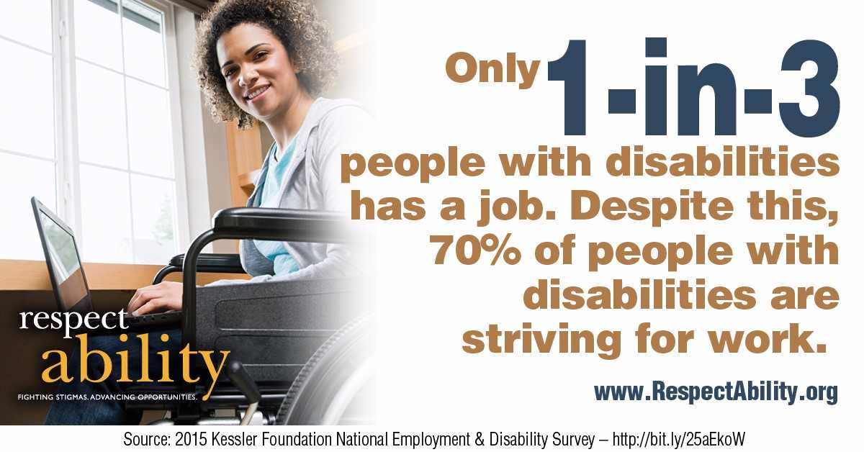
70 Percent of People with Disabilities are Striving to Work

Slide 19
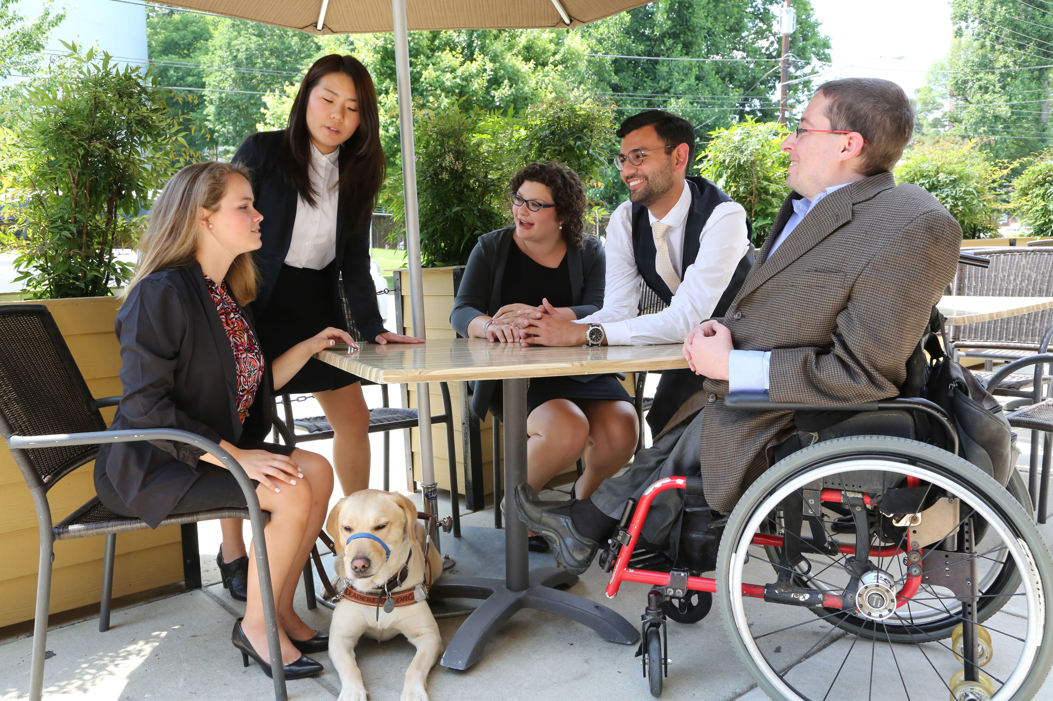
8 million ready to work
That means there are over 8 million
people with disabilities ready to strengthen your organization.

Slide 20

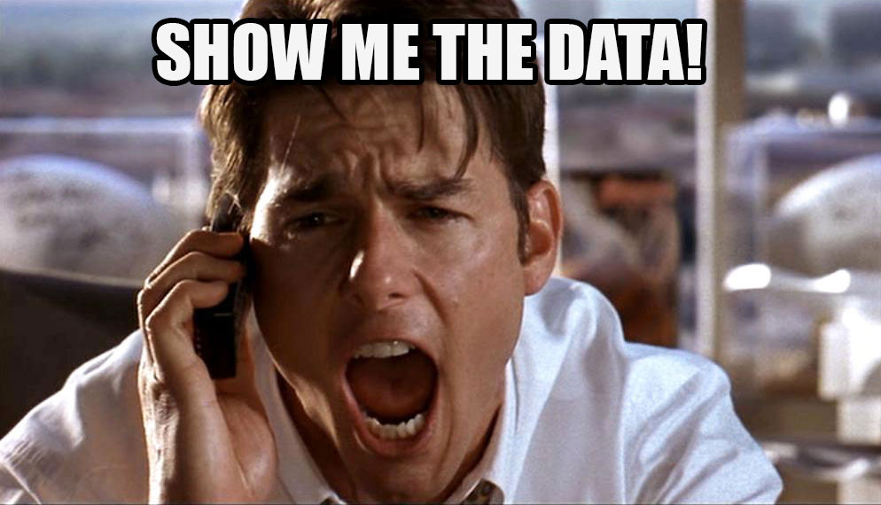
Where Can You Find Local Disability Data?
The Annual Disability Statistics Compendium, published by the Institute on Disability, collects the most up-to-date Census Bureau data on disabilities.
You can download the data, review key statistics and learn more here: disabilitycompendium.org/
You can look at local, county based data here: https://disabilitycompendium.org/county-reports
For more detailed information, go directly to the Census Bureau here: https://data.census.gov/cedsci/?intcmp=aff_cedsci_banner

Slide 21
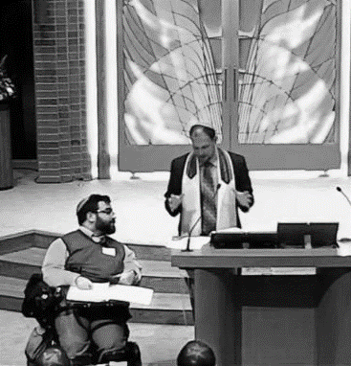

Problem Solving
Problems are best solved by people who have experienced them firsthand and know solutions that work.

Slide 22
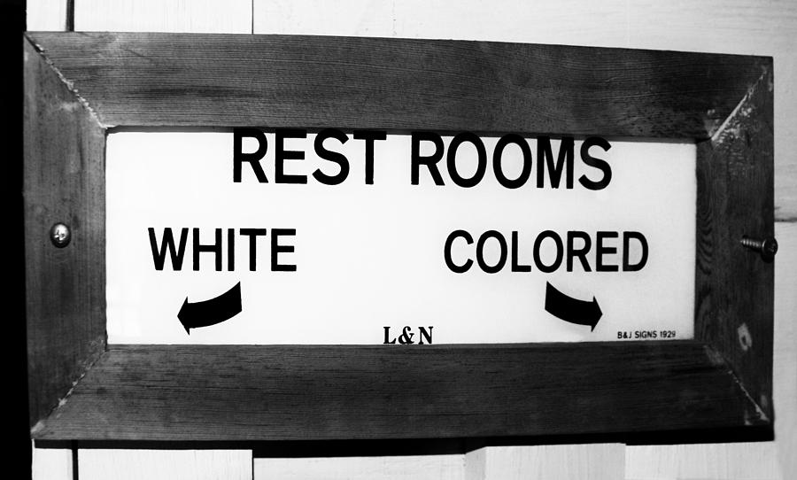

A system you would support? Hopefully not…

Slide 23
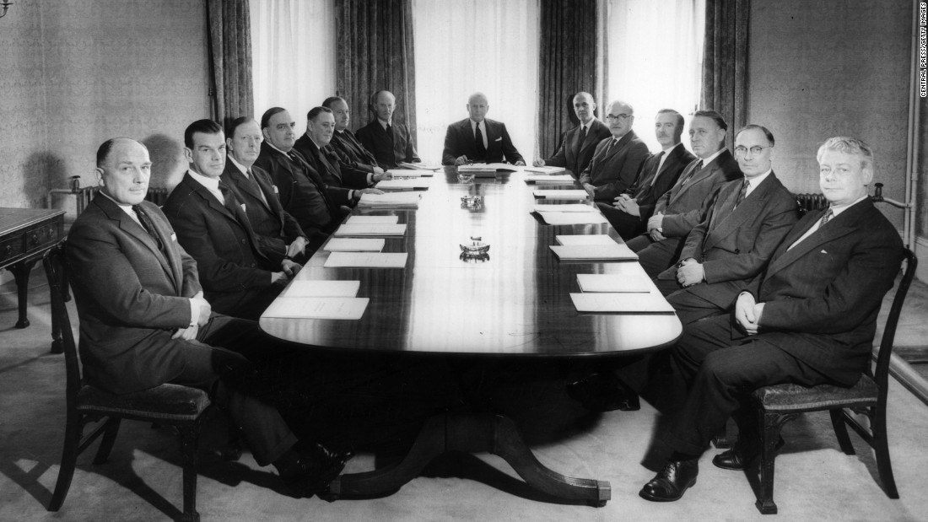
If this was the board of a non profit serving inner-city youth, would you support them? Hopefully not…

Slide 24
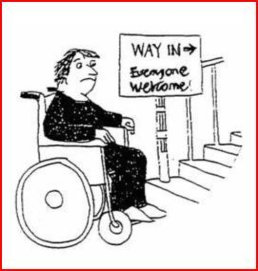
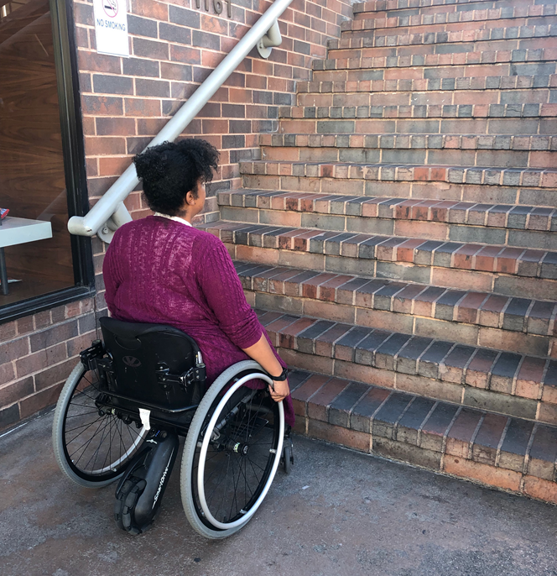
Does anyone here think they might be doing this?

Slide 25

Accenture and the Disability Inclusion Advantage
New research from Accenture reveals that companies that embrace best practices for employing people with disabilities have outperformed their peers.
Here’s the study: https://www.accenture .com/_acnmedia/pdf-89/accenture-disability-inclusion-research-report.pdf
Companies that embrace employees with disabilities clearly see the results in their bottom line.
Disability-inclusive companies have higher productivity levels and lower staff turnover rates, are twice as likely to outperform their peers in shareholder returns and create larger returns on investment.

Slide 26
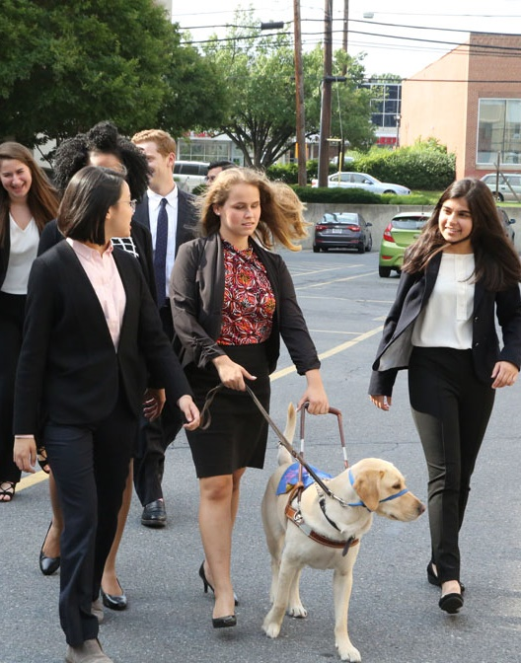
Voters & Disability www.VoteAbility.com
85% of voters find it very or somewhat important that presidential candidates have campaign events and websites that are open and accessible to people with disabilities, just like everyone else.
73% of voters are more likely to support candidates for elected office who will make ensuring that children with disabilities get the education and training they need to succeed a priority.
70% of voters are more likely to support candidates for elected office who will make expanding job and career opportunities for people with disabilities a priority, so they can succeed just like anyone else.
* The survey was completed by Democratic polling firm Greenberg Quinlan Rosner on behalf of RespectAbility of 2,000 registered voters from September 18 through September 24, 2019.
Notes:
I added the study information from Philip’s deck as a footnote. His deck had two additional stats- 28% higher revenue and double net income. I opted to just include one stat here to keep it simple. However, if you want me to add those stats or replace this one with one of those, let me know.

Slide 27
Disability in Philanthropy and Nonprofits Study
Disability in Philanthropy & Nonprofits:
A study on inclusion and exclusion of the 1-in-5 people who live with a disability and what you can do to make things better
Read the Report: www.respectability.org/inclusive-philanthropy/

Slide 28
Disability in Philanthropy & Nonprofits - Methodology
5 focus groups of people who work in philanthropy done in 2015 in partnership with the Council on Foundations
14 one-on-one interviews done in 2018 by phone with leaders of foundations/philanthropy serving organizations
Evaluation of online accessibility of 25 largest foundations and 25 largest nonprofits (done with assistance from Marcie Lipsitt) in 2018/19
Online survey of 969 people done by Buren Communications of subscribers to NonProfitTimes, Chronicle of Philanthropy and numerous PSO partners
Analysis by Meagan Buren, Amy Chapman, Jennifer Laszlo Mizrahi and others

Slide 29
A major gap between will and skill
There are several accommodations and accessibility tools that enable people with disabilities to engage in organizations and activities. Which of the following are policies of your organization? Please check all that apply.
 | %
Our events are always held in physically accessible spaces that have accessible parking spaces or transportation options for people with physical disabilities | 59%
There is a process where employees, trustees/board members and volunteers with disabilities can request and get needed accommodations if needed so that they can succeed in their roles. | 41%
Our public events enable people with disabilities to request accommodations such as sign language interpreters, live captioning or food allergy issues in the registration form. | 30%
We enable people who are blind or have low vision to be able to access our materials on the web by ensuring that our website is set up properly for screen readers. | 17%
We ensure that people who are deaf or hard of hearing can participate by ensuring that all video content has captions. | 14%
None | 16%
N/A | 10%

Slide 30
Organizations do not include enough people with disabilities
Which of the following groups in your organization include people with disabilities? Please check all that apply.
 | %
People You Serve | 66%
Staff Overall | 42%
Volunteers | 41%
Board | 24%
Professional Leadership/Management | 20%
Not Applicable | 6%
I Don’t Know | 23%

Slide 31
Donors will hold you accountable & performance metrics matter
Do you ask your members or grantees if they are representative (e.g., staff, board) of the people they serve?

Slide 32
Be sure disability is being measured in your diversity, equity and inclusion work
Is disability included in that representation?

Slide 33
Inclusion doesn’t happen by accident
Do you ask your members or grantees to intentionally include people with disabilities in their work?

Slide 34
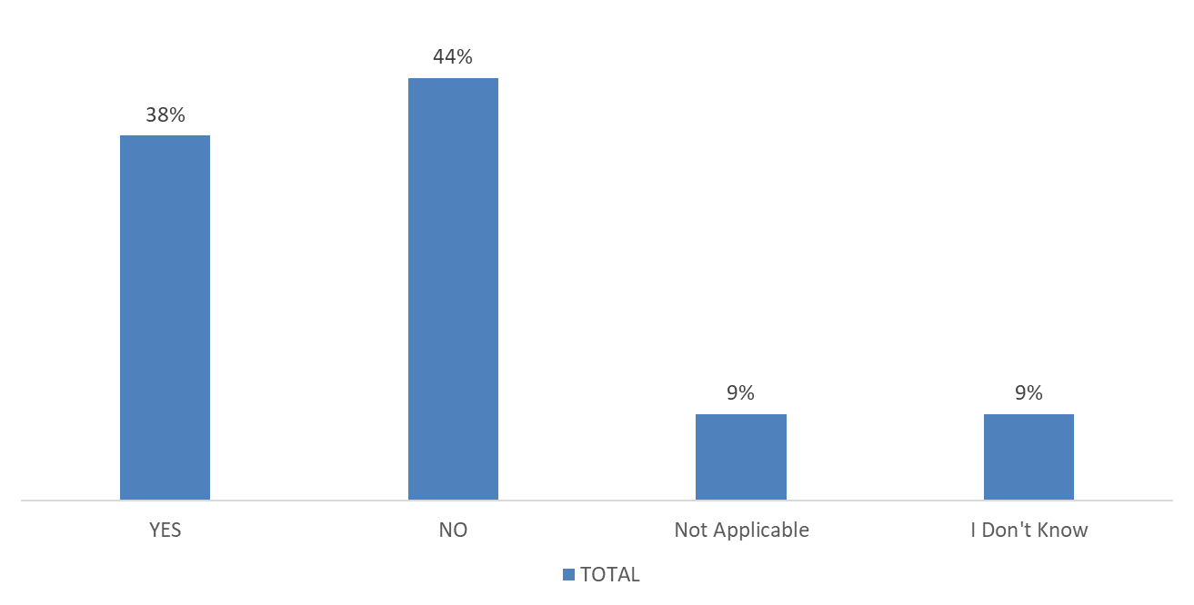
A picture is worth a thousand words
Does your organization depict people with visible disabilities (i.e. show pictures of people who use wheelchairs, white cane, have Down Syndrome etc.) in your internal or external marketing and/or advertising materials?

Slide 35

Adding the Disability Lens…
By adding the disability
lens to your existing work,
you have the opportunity
to create better outcomes
for people with and
without disabilities alike

Slide 36
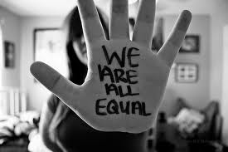
1. Commit publicly to inclusion of people with disabilities
The message that all people are of equal value and must be respected and heard fairly, must be communicated by President and Board.
REPEAT those messages over and over!

Slide 37
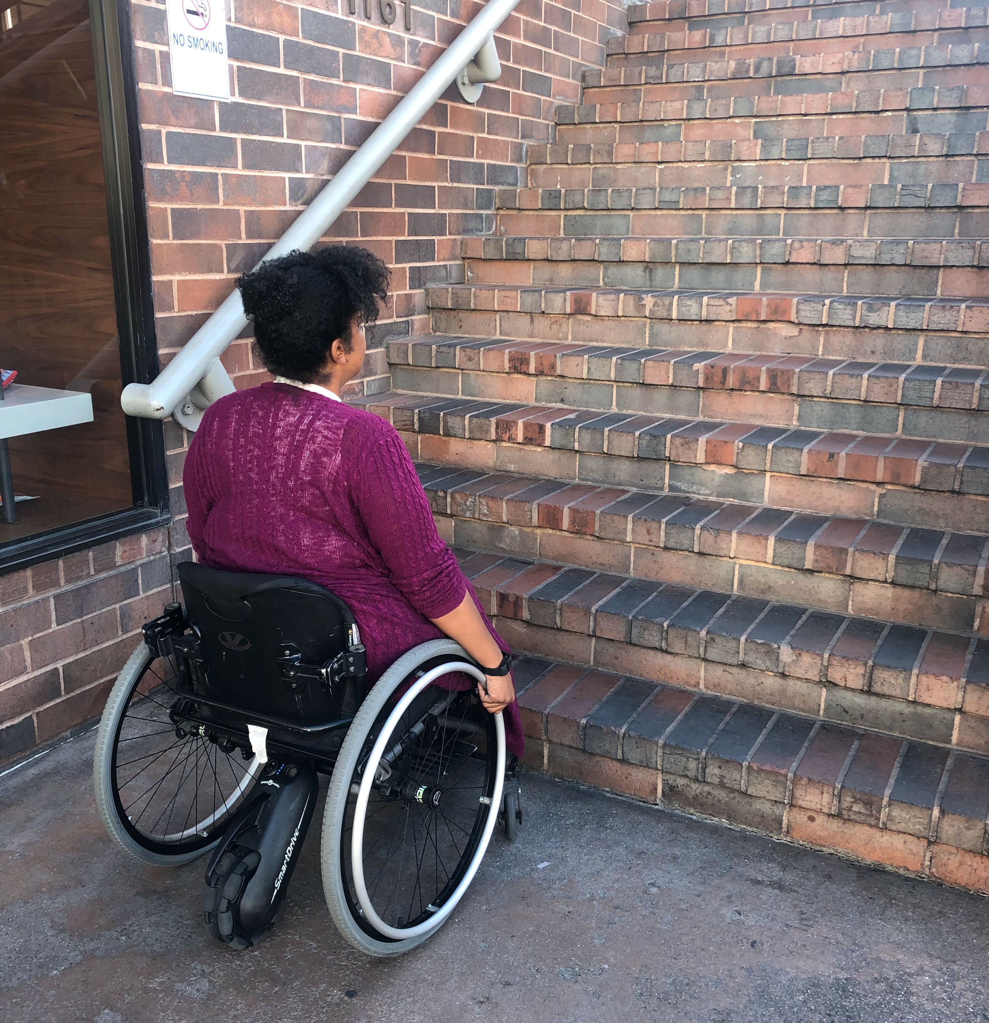
2. When people with disabilities aren’t at the table, they are on the menu
Organizations are at their best when they welcome, respect, and include people of all backgrounds. This includes people with disabilities. Indeed, problems are best solved by working with people who have experienced them first hand and know solutions that work. Just like issues that impact people of different racial, ethnic or other backgrounds, people with disabilities should be involved in solving issues that impact them.
Disability impacts people of all races, genders, and backgrounds. However, youth with multiple minority status (i.e. person of color /English language learners + disability face double discrimination) are most likely to enter the school-to-prison pipeline, become homeless and/or live in poverty. Be sure to look at intersectional issues.
  More information on our webinar - How to Recruit, Accommodate and Promote People with Disabilities for Paid Employment, Volunteer Leadership and Board Positions

Slide 38
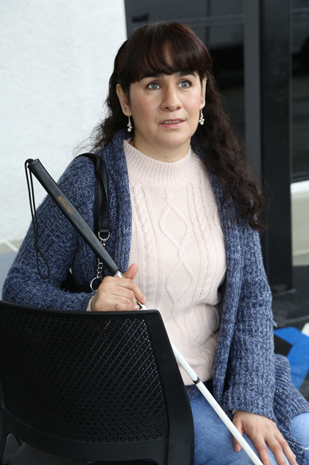
3. Foster an inclusive environment
Use “person first” language when appropriate
Have an accommodation policy
Made a conscious decision and effort to seek out and include certain demographic groups whether that was gender, race, or sexual orientation
  More information on our webinar - How to Ensure A Welcoming Lexicon and Inclusive Storytelling

Slide 39
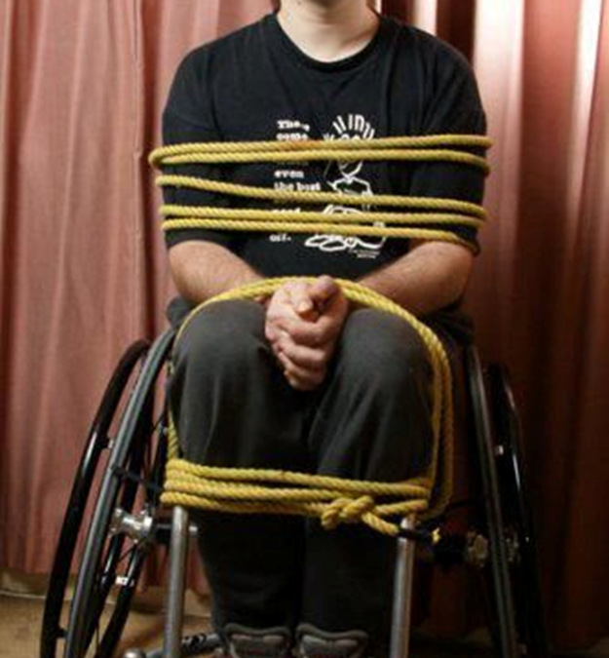
What we say makes a difference
DO SAY:
Someone uses/rides a wheelchair
DON’T SAY:
Wheelchair bound
Confined to a wheelchair
Wheelchair person
WHEN YOU DON’T KNOW WHAT TO DO/SAY, ASK!

Slide 40
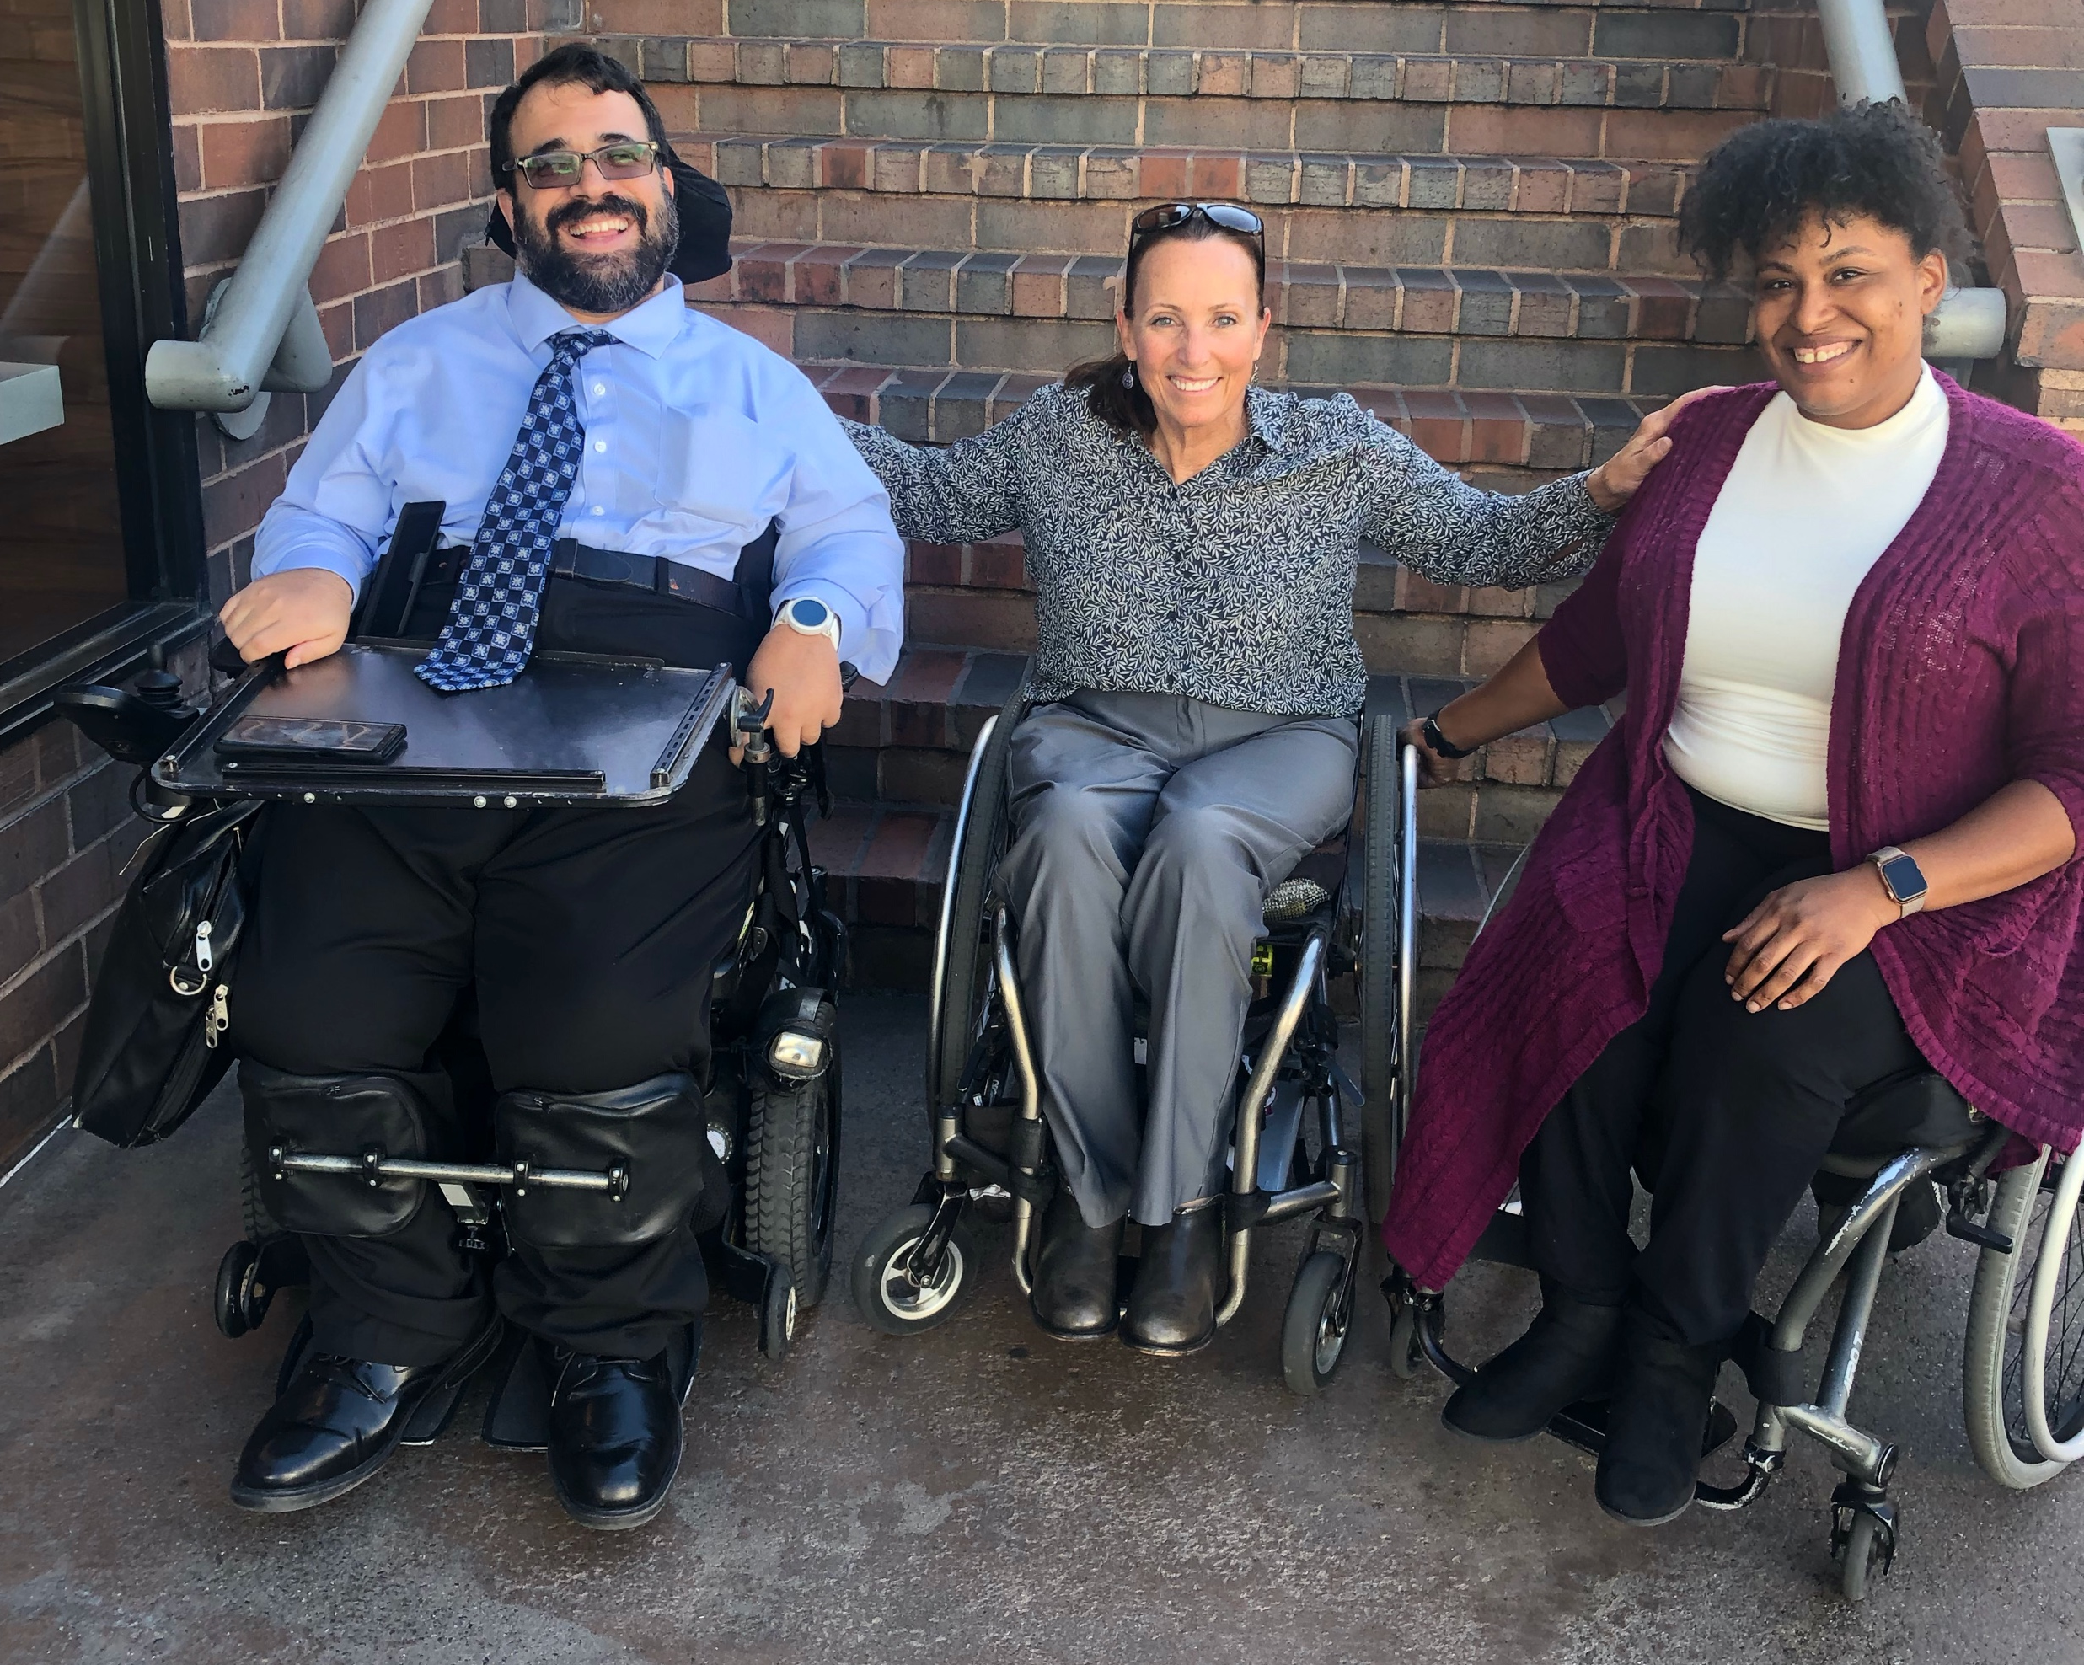
4. Work with people with disabilities
RespectAbility, Best Practices for Employers
TAPAbility, which can source talent
AskJan.org, which can problem solve inclusive employment questions for free
Diverse Managers - Philanthropy’s Next Hurdle
  More information on our webinar - How to Recruit, Accommodate and Promote People with Disabilities for Paid Employment, Volunteer Leadership and Board Positions

Slide 41


5. Have an inclusion point person or committee
Inclusion Statement and how to make requests for disability accommodations should be on your accessible website and event invites
HR Evaluation and program manager evaluation includes diversity as a performance metric
Resource on Disability Inclusion

Slide 42
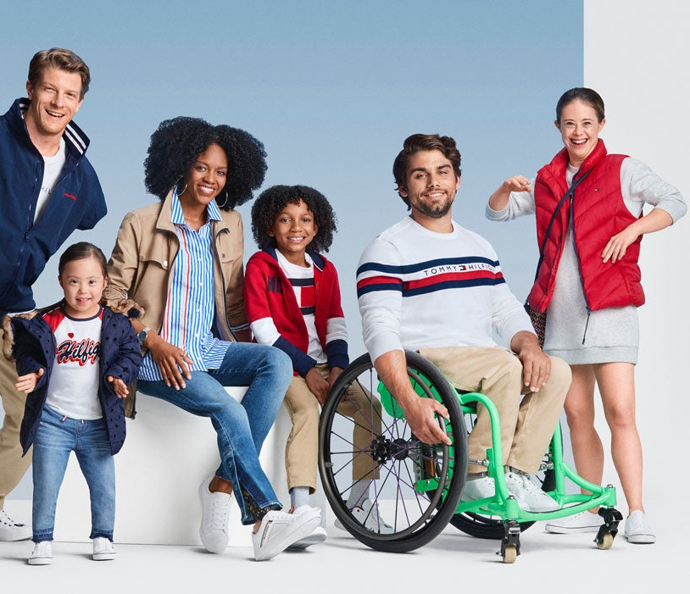
6. Include people with disabilities in your marketing
Example: Photos on website should include individuals with visible disabilities
Toolkit for Media Representation
More information on our webinars – How to Ensue Accessible Websites, Social Media and Inclusive Photos
and Premium Skills Workshop in Social Media Accessibility

Slide 43

7. Ensure website and online resources are accessible
Websites need to be set up for use by screen readers and people who need captions.
Caption videos
Make documents and presentations accessible
More information on our webinars – How to Ensue Accessible Websites, Social Media and Inclusive Photos
and Premium Skills Workshop in Social Media Accessibility

Slide 44
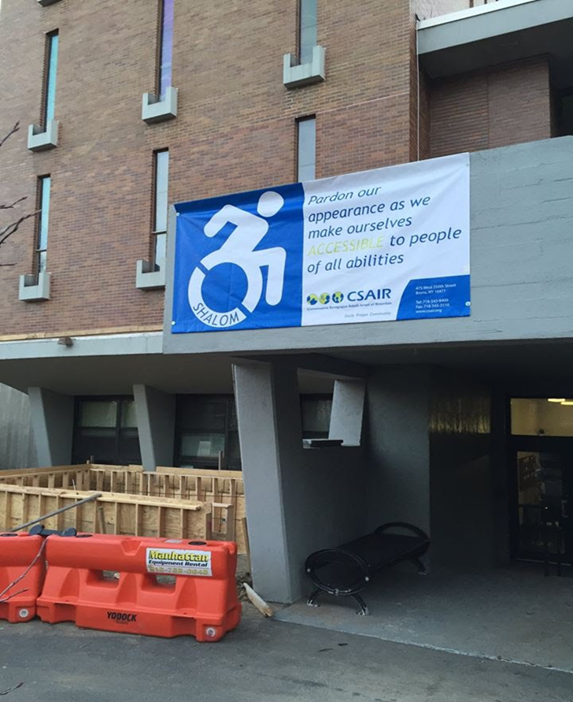
8. Ensure accessibility of office and events
Physical Accessibility
Event Checklist
All of the following must be accessible:
  Invitation/notification of event
  Facilities
  Communication
  Staff/Volunteers
  More information on our webinar -
  How to Ensure Accessible Events

Slide 45

Accessibility: ADA Accessible Resource Guide
The Chicago Community Trust
http://www.cct.org/wp-content/uploads/
2015/08/2015ADAComplianceGuide.pdf

Slide 46
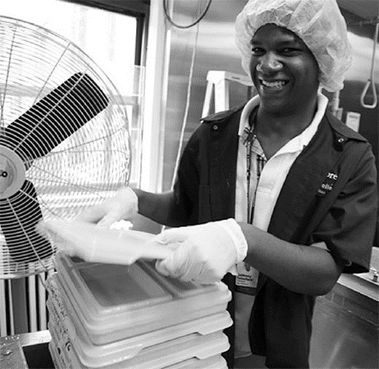
9. Use vendors who are or who hire people with disabilities
Invest in social enterprises who hire people with and without disabilities
Social Enterprise: Creating Employment Opportunities for People with Disabilities

Slide 47
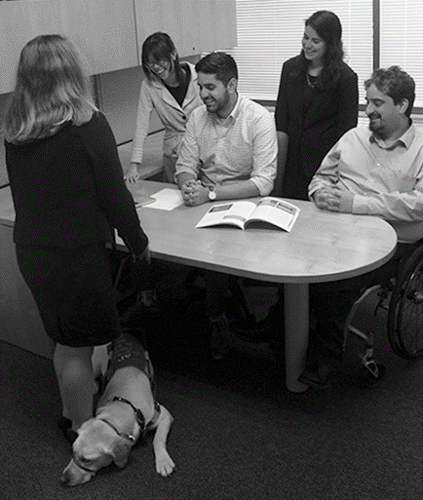
10. Promote a disability lens among grantees/members
Ask Your Grantees/Members About:
Meaningful and inclusive policies and/or programs
Public commitments on website and materials
Employing people with disabilities at all levels
Inviting people to request accommodations
Physical accessibility of office and programs
Website accessibility
Video captioning
Internal and external educational efforts

Slide 48
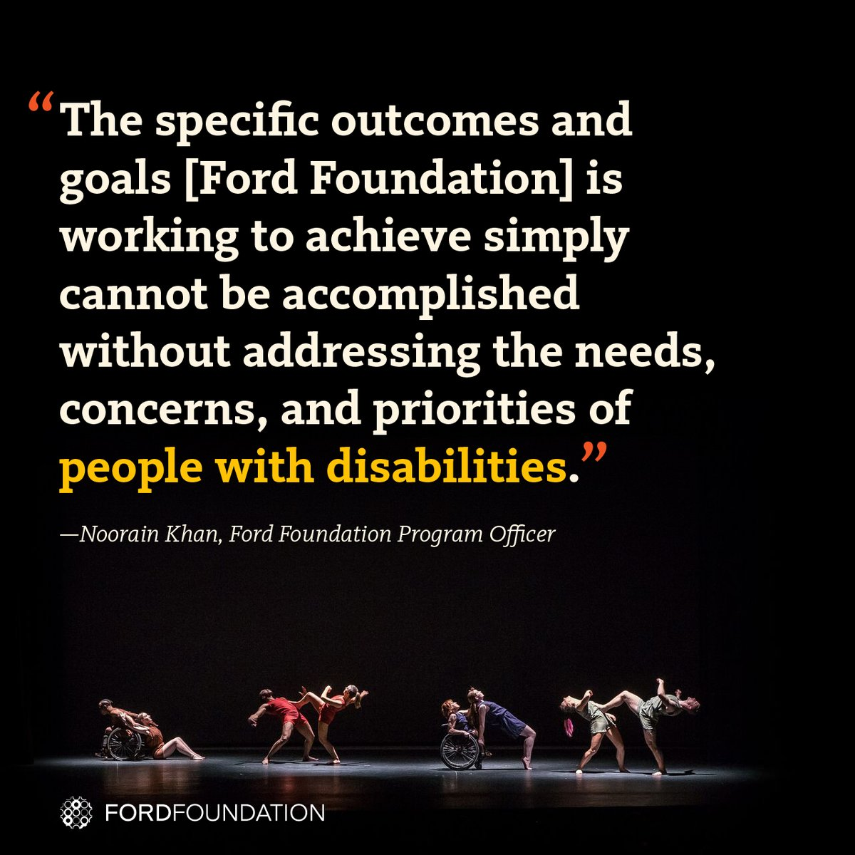
Success Stories: The Ford Foundation Includes Disability
The Ford Foundation has recently added the disability lens to their work http://bit.ly/2jOl3FL
Additionally, Ford’s CEO Darren Walker spoke extensively on why this impacts other funders as well: http://bit.ly/2nr4moJ
Here is Darren Walker’s original letter: http://bit.ly/2Bxy0Lk
This is the response of the co-authors of the Americans with Disabilities Act: http://bit.ly/2AueSyx
Darren Walker and Rich Besser (Robert Wood Johnson Foundation) on the need for disability inclusion in philanthropy: https://bit.ly/2uE8tPh

Slide 49
Today’s Take Away
Organizations are at their best when they welcome, respect and include people of all backgrounds. This includes people with disabilities.
Problems are best solved by working with people who have experienced them first-hand and know solutions that work. Just like issues that impact people of different racial, ethnic or other backgrounds, people with disabilities should be involved in solving issues that impact them.

Slide 50
Equity and Access Webinar Series
Disability 101
Disability History
How to Ensure Accessible Events
How to Recruit, Accommodate and Promote People with Disabilities for Paid Employment, Volunteer Leadership and Board Positions
How to Ensure A Welcoming Lexicon and Inclusive Storytelling
How to Ensue Accessible Websites, Social Media and Inclusive Photos
Premium Skills Workshop in Social Media Accessibility
How to Ensure Legal Rights and Compliance Obligations: Exploring the Rights of Employees and Participants, and the Obligations of Nonprofit Organizations Under the Law
Watch Recordings, Download Transcripts and PowerPoints:
https://www.respectability.org/accessibility-webinars/

Slide 51
Resources
RespectAbility’s Inclusive Philanthropy toolkit
Access information on disability inclusion, including the new Disability in Philanthropy & Nonprofits study
www.RespectAbility.org/inclusive-philanthropy
Follow us on Social Media!
Twitter: @Respect_Ability
Facebook: RespectAbilityUSA
Instagram: @RespectTheAbility
Website: www.RespectAbility.org
Intersection of Disability and Politics: www.TheRespectAbilityReport.org

