Slide 1
Accessible Events
How to Ensure Legal Rights and Compliance Obligations: Exploring the Rights of Employees and Participants, and the Obligations of Nonprofit Organizations Under the Law

Slide 2
Equity and Access Webinar Series Partners
BoardSource
The California Wellness Foundation
Catalogue for Philanthropy, Greater Washington
Center for Disaster Philanthropy
Cerebral Palsy Foundation
The Chronicle of Philanthropy
The Communications Network
The Divas With Disabilities Project
Exponent Philanthropy
Grantmakers Concerned with Immigrants and Refugees
Media Impact Funders
National Center of Disability Journalism
National Committee for Responsive Philanthropy
National Council of Nonprofits
The New York Women’s Foundation
The Unfunded List
Weingart Foundation

Slide 3
Including the D – Disability – in Diversity
Organizations are at their best when they welcome, respect and include people of all backgrounds. This includes people with disabilities.

Slide 4
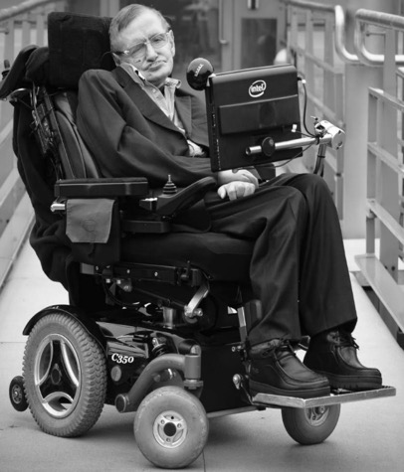
These are people with disabilities.
These are people with disabilities.

Slide 5
61 million people
61 Million
people in the U.S. have a disability.*
People with disabilities
want
opportunities
Just like anyone else.
* Source: US Census

Slide 6
1 in 4 adults
1 in 4
adults have a disability

Slide 7
Disabilities Are….
Temporary and Permanent
Visible and Nonvisible
From Birth or Acquired Later

Slide 8
Speakers
Tracie DeFreitas Lead Consultant — ADA Specialist, Job Accommodations Network She/her/hers
Moderator: Matan Koch
Director of Project Moses and General Counsel, RespectAbility
He/him/his

Slide 9
How to Ensure Legal Rights and Compliance Obligations: Exploring the Rights of Employees and Participants, and the Obligations of Nonprofit Organizations Under the Americans with Disabilities Act (ADA)

Slide 10
ADA Basics 1
What is title I of the Americans with Disabilities Act (ADA)?
Federal civil rights statute; removes barriers to equal employment for individuals with disabilities who are qualified
ADA Amendments Act (ADAAA) of 2008
Prohibits covered entities from discriminating on the basis of disability, in all employment practices, and during all stages
Requires reasonable accommodation for known disability of an applicant or employee who is qualified, barring undue hardship

Slide 11
ADA Basics 2
Who must comply with title I of the ADA?
Covered entities:
Private sector employers with 15 or more employees
State and local government employers
Employment agencies, labor unions, joint labor-management committees
Religious entities as employers; title I of the ADA does apply
Executive agencies of the U.S. Government are excluded; Section 501 of the Rehabilitation Act

Slide 12
ADA Basics 3
Who is protected by title I of the ADA?
Title I protects individuals with disabilities who are qualified
Applies to applicants and employees
Employer-employee relationship must exist – depends on whether employer controls means and manner of work performance
Qualified = Individual with a disability who meets the job’s general requirements AND can perform the essential functions of the job desired or held, with or without reasonable accommodation

Slide 13
ADA Basics 4
Did you know?
ADA prohibits discrimination based on relationship or association with an individual with a disability
Caregivers of individuals with disabilities not entitled to receive reasonable accommodation under the ADA
Not protected under title I of the ADA:
Individuals currently engaging in the illegal use of drugs
Certain sexual and behavioral disorders (e.g., pedophilia, compulsive gambling)
Homosexuality and bisexuality – not impairments

Slide 14
ADA Basics 5
How is “disability” defined under the ADAAA?
A physical or mental impairment that substantially limits one or more major life activities – “actual disability”
Has had a physical or mental impairment that substantially limited one or more major life activities at one time – “record of”
When an employment action is taken based on an individual's impairment or perceived impairment, unless transitory and minor – “regarded as”

Slide 15
ADA Basics 6
Did you know?
Conditions that are transitory AND minor generally not covered (e.g., common cold, the flu, a minor broken bone)
Temporary condition lasting fewer than six months can be an actual disability if “sufficiently severe”
ADAAA predictable assessments; impairments easily found to substantially limit a major life activity (e.g., diabetes, blindness, HIV, epilepsy, cancer, bipolar disorder, etc.)

Slide 16
ADA Basics 7
What is meant by “reasonable accommodation?”
A change or adjustment to a job or work environment that permits a qualified applicant or employee with a disability to participate in the job application process, to perform the essential functions of a job, or to enjoy equal benefits and privileges
Reasonable means “feasible” or “plausible” – possible to provide without undue hardship
Undue hardship – an action requiring significant difficulty or expense
Must be effective for the purpose

Slide 17
ADA Basics 8
Did you know?
No comprehensive list of accommodations that are “reasonable” under the ADA
Employer decides what is reasonable and has the right to choose among effective solutions
Preference of IWD should be given primary consideration
Do not have to remove essential functions, provide personal use items, lower production standards, or create new jobs as reasonable accommodation

Slide 18
The Interactive Process (IP)

Slide 19
Engaging in the IP
Know the ADA rules
Engage employees with a solution-oriented approach
Do not delay the process
Recognize what you don’t know and gather reasonable information to explore, choose, and implement effective accommodation solutions
Use the best available information and resources to make accommodation decisions
Don’t make it complicated to provide accommodations, keep employees informed, document efforts

Slide 20
Recognizing a Request 1
What is a request for accommodation?
An applicant or employee asks for an adjustment or change at work for a reason related to a medical impairment
“I'm having trouble getting to work on-time because of medication side effects.”
An employee returns to work using a wheelchair and says the wheelchair will not fit under their desk
A healthcare provider indicates an employee requires leave for medical treatment
Impairment causing a problem + work-related barrier

Slide 21
Recognizing a Request 2
Did you know?
Not required to submit a request at a particular time (e.g., upon hire) – best before performance suffers
No required process, forms for requesting RA, or timeframe for responding/implementing
Not required to assert rights under the ADA or use terms like “reasonable accommodation”
Not required to submit a request in writing – but, documented request IS recommended

Slide 22
Recognizing a Request 3
Did you know?
Generally, obligation to request RA falls on IWD
Disability disclosure is necessary to receive accommodation, when disability and/or need for accommodation are not known or obvious
Request can be made through supervisor, manager, HR – someone who can act upon request

Slide 23
Recognizing a Request 4
May ask employee to clarify what is being requested and why
Act quickly, because unnecessary delays can violate the ADA
Train management to recognize and respond to RA requests
Assign responsibility for processing RA requests
Follow a reasonable accommodation procedure
Sample Reasonable Accommodation Request Form for Employers

Slide 24
Recognizing a Request 5
What is not a request for accommodation?
Voluntary self-identification of disability (e.g., Rehabilitation Act, Section 503)
Disability disclosure absent work-related barrier or specific request
Request for the same workplace adjustments/access to benefits available to similarly situated employees (e.g., flex schedule, telework, ergonomic equipment)

Slide 25
Gathering Information 1
How can it be determined that an individual qualifies to receive accommodation?
Gather whatever information is necessary to process the request, including impairment, limitations, impact on performing job functions, and accommodations
Determine if the individual has an ADA-qualifying disability
Follow ADA disability-related inquiry rules

Slide 26
Gathering Information 2
Disability-related Inquiry Rules
Pre-offer: No non-voluntary disability-related inquiries or medical exams of applicants until after a conditional job offer is made
Post-offer: Disability-related inquiries and medical exams can be required if required for all candidates entering into the job category
Employment: Disability-related inquiries and medical exams of employees must be "job-related and consistent with business necessity”

Slide 27
Gathering Information 3
When are disability-related inquiries job-related and consistent with business necessity?
Reasonable belief, based on objective evidence, that:
performance of job functions will be/is impaired by a medical impairment;
or there is a direct threat due to a known medical impairment
Usually, after accommodation is requested, when disability and/or need for accommodation are not known or obvious
When required in positions that affect public safety
Known disability affecting performance, but no RA request

Slide 28
Gathering Information 4
Gathering disability-related information
When impairment and/or need for accommodation are known or obvious, focus on gathering information about the accommodation, not the disability
When the impairment and/or need for accommodation are not known or obvious, may request documentation that verifies:
the existence of an impairment (e.g., learning disability, seizure disorder, mental health impairment, etc.)
that the impairment affects a major life activity (e.g., reading, concentrating, interacting with others, lifting, etc.)
the impairment is substantially limiting in some way

Slide 29
Gathering Information 5
Establish coverage, but don’t get stuck in the process of determining “disability”
Definition of disability under ADAAA is to be interpreted broadly – without requiring significant analysis
Ask appropriate questions:
What is the impairment?
What are the limitations/restrictions?
How long is the impairment expected to last?
What is the expected duration of limitations/restrictions?
Will accommodation help?

Slide 30
Gathering Information 6
Resources are available!
Equal Employment Opportunity Commission (EEOC):
Disability-Related Inquiries and Medical Examinations of Employees
Reasonable Accommodation and Undue Hardship Under the ADA (q. 6)
JAN resources:
AskJAN,org, A to Z by Topic: Medical Exams and Inquiries
Sample Medical Inquiry Form in Response to an Accommodation Request
Sample Medical Inquiry Form in Response to a Request for Leave

Slide 31
Gathering Information 7
Not sure whether to ask about disability or the need for accommodation?
“Is there anything we can do to support you in performing your job duties or meeting performance standards?” or “How can we help?”
No mention of disability or accommodation = no worrying about ADA disability-related inquiry rules
Extends support, creates a safe space for disability disclosure, and often leads to engagement in the interactive process
Best practice

Slide 32
Gathering Information 8
Gather information about:
Impairment and limitations
Expected duration of impairment, limitations, and/or restrictions
Essential/marginal functions and/or standards
How limitations/restrictions affect ability to perform essential/marginal functions, and/or meet standards
Environment, equipment, tools to be used, etc.
Accommodation suggestions

Slide 33
Exploring Accommodations 1
Workplace Accommodations: Low Cost, High Impact
Cost of Accommodation
Most employers report no or low cost for accommodating employees with disabilities
Typical one-time expenditure: $500
Direct Benefits of Accommodation
Allowed company to retain a valued employee
Increased employee’s productivity
Eliminated cost of training new employee
Increased employee’s attendance

Slide 34
Exploring Accommodations 2
Three categories of reasonable accommodation:
Modifications or adjustments needed during the hiring process
Modifications or adjustments to the work environment, or to the manner or circumstances under which the position held or desired is customarily performed
Modifications or adjustments that enable the enjoyment of equal benefits and privileges of employment

Slide 35
Exploring Accommodations 3
Making existing facilities accessible and useable
Modifying policies
Restructuring a job
Modifying work schedules
Acquiring/modifying equipment
Providing a qualified reader, interpreter, job coach, etc.
Reassigning an employee to a vacant position
Granting intermittent or concurrent leave
Working remotely/at home
Allowing access for service/emotional support animal

Slide 36
Exploring Accommodations 4
Did you know?
Do not have to provide accommodations that pose an undue hardship – significant difficulty or expense
Do not have to provide personal use items needed in accomplishing daily activities both on and off the job (e.g., hearing aids)
Do not have to remove essential functions, lower production standards, or create new jobs as reasonable accommodation

Slide 37
Exploring Accommodations 5
Who can help with exploring accommodations?
Individual with the disability
Healthcare provider
Vocational rehabilitation specialist, job coach, ergonomic consultant, rehabilitation engineer, disability-related organizations, etc.
Internal subject matter experts; IT, ergonomics, safety
External accommodation/ADA resources, like JAN

Slide 38
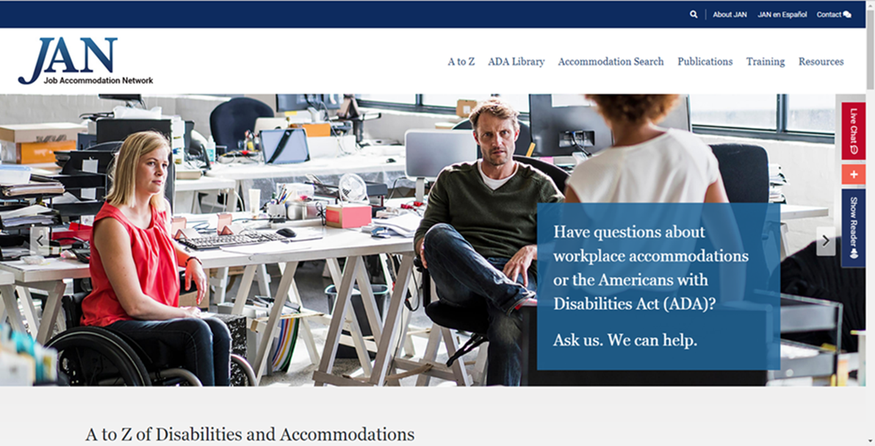
Exploring Accommodations 6
Use JAN! Visit AskJAN.org

Slide 39
Choosing Accommodations 1
Did you know?
Employer gets to choose among effective accommodation options
Employer determines what is reasonable, and what will create an undue hardship
Employer may provide trial or short-term solutions as part of the accommodation process

Slide 40
Choosing Accommodations 2
Make it uncomplicated to provide simple accommodations and give management the authority to implement
Develop a list of preapproved accommodations not requiring full RA assessment (e.g., flexible work arrangements, standing desks, ergonomic chairs)
Develop a centralized accommodation fund
Develop a task bank for return to work/modified duty accommodations

Slide 41
Implementing Accommodations 1
Document accommodation approval and/or draft an accommodation agreement
Sample Accommodation Approval Form
Approve on a trial or temporary basis
Sample Temporary/Trial Accommodation Approval Form
Implement necessary changes, purchases, arrangements
Communicate important accommodation information – but, remember ADA confidentiality rules

Slide 42
Implementing Accommodations 2
May other employees be informed that an individual is receiving accommodation?
May not disclose that an employee is receiving a reasonable accommodation – all disability-related information must be kept confidential
May inform those who are on a need-to-know basis only – this does not include co-workers
Supervisors and managers may be informed about restrictions and accommodations – but, restrict sharing medical information

Slide 43
Implementing Accommodations 3
May new managers and supervisors be informed about existing accommodations?
Yes. New management may (and probably should) be informed about existing accommodations
Avoids potential ADA risks of new management requesting disability-related information the employer already has
Facilitates a smooth transition and helps keep accommodations in-tact, and employees productive

Slide 44
Implementing Accommodations 4
Do not delay in implementing accommodations
Modify the schedule or policy, purchase equipment, provide training on equipment, schedule the service, approve leave, search for a vacant position, etc.
Make sure the accommodation will be effective
Communicate accommodation information to appropriate parties, as needed
Maintain confidentiality of all disability-related information

Slide 45
Monitoring Accommodations 1
Why monitor accommodations?
To maintain accommodations
To insure effectiveness of accommodations
To make adjustments when things aren’t working
Reasonable accommodation must enable the individual to perform essential functions/meet standards/access benefits
Can positively impact productivity and supports ADA compliance

Slide 46
Monitoring Accommodations 2
Check on effectiveness of accommodation
Encourage ongoing communication
Restrict disability-related inquiries during the monitoring stage; focus on accommodation
Maintain equipment
Make adjustments to existing accommodations when needed
Document findings and plans
Sample Form for Monitoring Accommodations

Slide 47
More information?
Contact JAN
(800) 526-7234 (V) - (877) 781-9403 (TTY)
AskJAN.org
jan@askjan.org

Slide 48
Q&A With The Speakers
Tracie DeFreitas Lead Consultant — ADA Specialist, Job Accommodations Network She/her/hers
Moderator: Matan Koch
Director of Project Moses and General Counsel, RespectAbility
He/him/his

Slide 49
Equity and Access Webinar Series Schedule
Disability 101
Disability History
How to Ensure Accessible Events
How to Recruit, Accommodate and Promote People with Disabilities for Volunteer Leadership, Board Positions and Paid Employment
How to Ensure A Welcoming Lexicon and Inclusive Storytelling
How to Ensue Accessible Websites and Social Media
Premium Skills Workshop in Social Media Accessibility
How to Ensure Legal Rights and Compliance Obligations: Exploring the Rights of Employees and Participants, and the Obligations of Nonprofit Organizations Under the Law Media
Availability Online Via Video and Transcript: https://www.respectability.org/accessibility-webinars

Slide 50
Resources and Thank You!
RespectAbility’s Inclusive Philanthropy Toolkit
Access information on disability inclusion, including the new disability in philanthropy & nonprofits study: www.RespectAbility.org/inclusive-philanthropy
Follow us on Social Media!
Twitter: @Respect_Ability
Facebook: RespectAbilityUSA
Instagram: @RespectTheAbility
www.RespectAbility.org | (202) 517-6272 | info@RespectAbility.org
Intersection of Disability and Politics: www.TheRespectAbilityReport.org

