Slide 1
Iowa Voc Rehab’s Stories of Successful Business Engagement and Disability Hiring
www.RespectAbility.org
October 22nd, 2019

Slide 2
Celebrating NDEAM – The Right Talent, Right Now

Slide 3
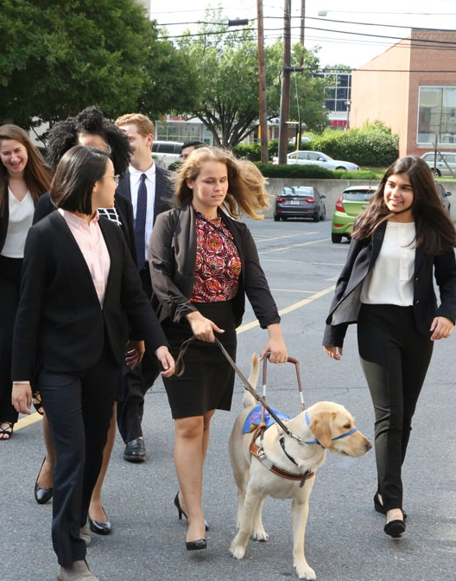
Please also join us for our last NDEAM Webinar
Webinar: Creating a Culture of Inclusion for Talented Employees with Disabilities
Date: Wednesday, October 30, 2019 Time: 1:30 p.m. ET / 12:30 p.m. CT / 11:30 a.m. MT / 10:30 a.m. PT Duration: 1 hour 30 minutes
RSVP: https://secure.confertel.net/tsRegisterD.asp?course=6269080
Speakers: Philip Kahn-Pauli, Policy and Practices Director, RespectAbility

Slide 4
Upcoming Equity Webinars!
Disability discrimination is rampant and is happening every day – despite the fact that people want to do the right thing and that most of the ways to include people with disabilities in your important work are actually free. It’s all about getting the skills to do it right. RespectAbility’s upcoming series of free webinars will give you and your teams step-by-step guidance, as well as provide resources and contacts to help foundations and nonprofits on their journey. Join for one or all! Each webinar will include live captioning. Accessible PPTs can be sent to participants ahead of time for use with screen readers.

Slide 5
Equity Series Schedule
Schedule of Webinars
Nov. 6, 2019: Disability 101
Nov. 13, 2019: Disability History
Nov. 20, 2019: How to Ensure Accessible Events
Dec. 4, 2019: How to Recruit, Accommodate and Promote People with Disabilities for Paid Employment, Volunteer Leadership and Board Positions
Dec. 11, 2019: How to Ensure A Welcoming Lexicon and Inclusive Storytelling
Jan. 7, 2020: How to Ensue Accessible Websites, Social Media and Inclusive Photos
Jan. 9, 2020: Premium Skills Workshop in Social Media Accessibility
Jan. 15, 2020: How to Ensure Legal Rights and Compliance Obligations: Exploring the Rights of Employees and Participants, and the Obligations of Nonprofit Organizations Under the Law
Learn More and RSVP Here: https://www.respectability.org/accessibility-webinars/

Slide 6
THANK YOU!
Jennifer Laszlo Mizrahi
www.RespectAbility.org
Cell: (202) 365-0787
JenniferM@RespectAbility.org

