Slide 1
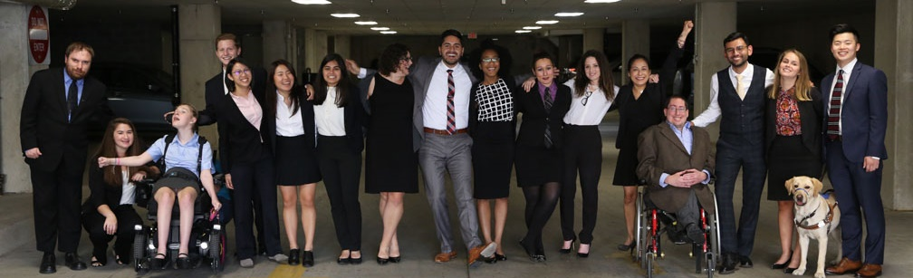

How Disability Inclusion & Equity Can Add to Your Success
How Disability Inclusion & Equity Can Add to Your Success
An online session for philanthropists, nonprofits, employers, social justice activists and diversity professionals
www.RespectAbility.org

Slide 2
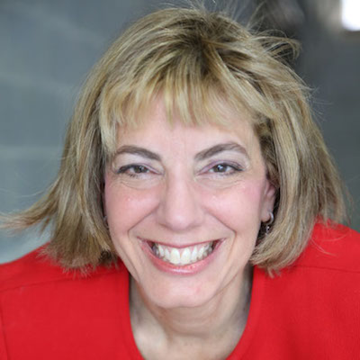
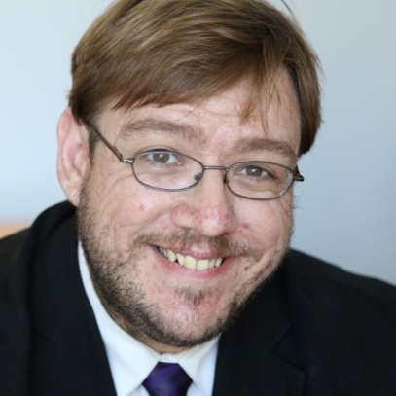
Meet Jennifer and Philip of www.RespectAbility.org
Jennifer Laszlo Mizrahi
President
JenniferM@RespectAbility.org
She/Her/Hers
Philip Kahn-Pauli
Policy and Practices Director
PhilipP@RespectAbility.org
He/Him/His

Slide 3
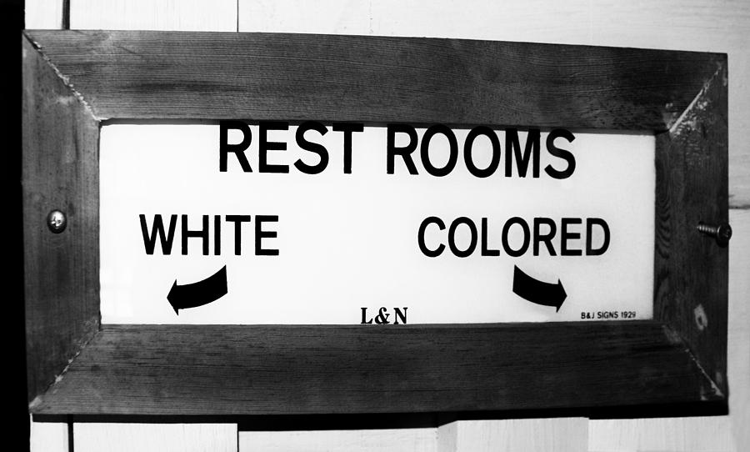

A system you would support? Hopefully not…

Slide 4
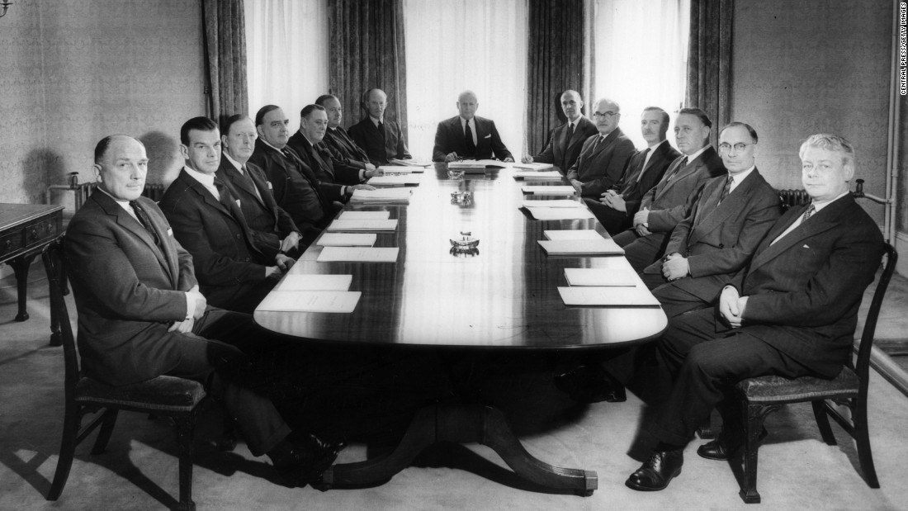
If this was the board of a non profit serving inner-city youth, would you support them? Hopefully not…

Slide 5
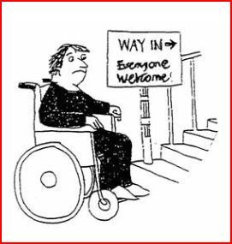
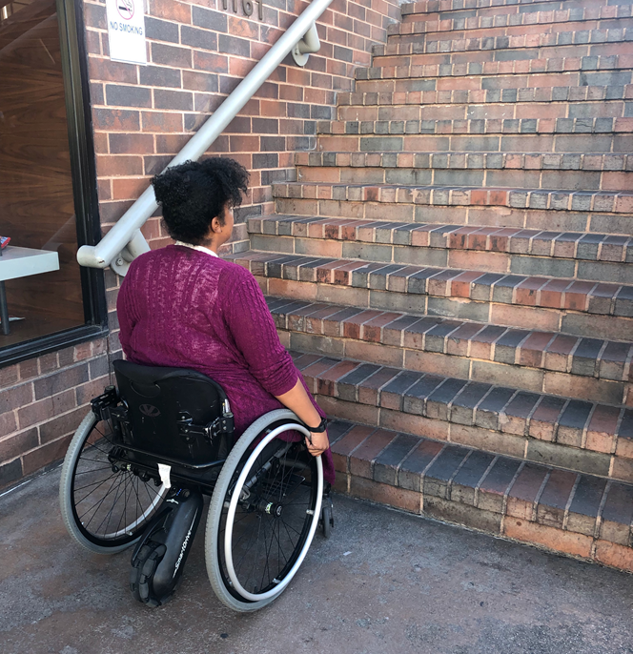
Does anyone here think they might be doing this?

Slide 6
Including the D – Disability – in Diversity
Organizations are at their best when they welcome, respect and include people of all backgrounds. This includes people with disabilities.

Slide 7
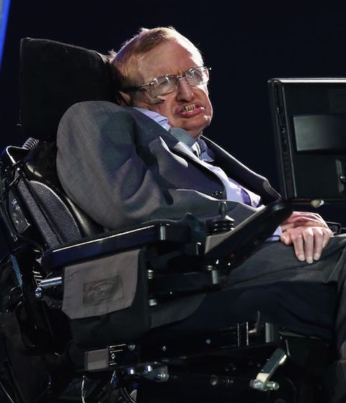
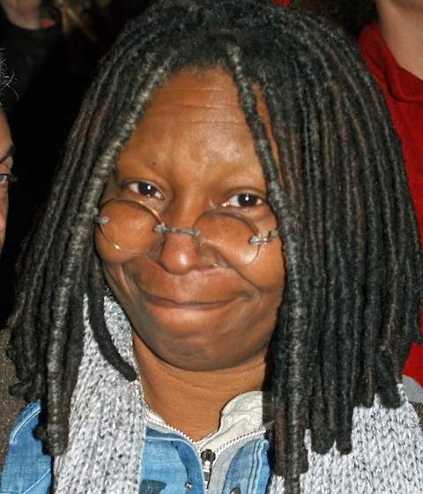



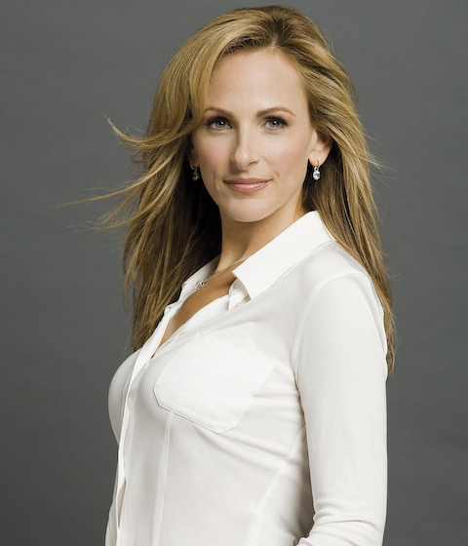

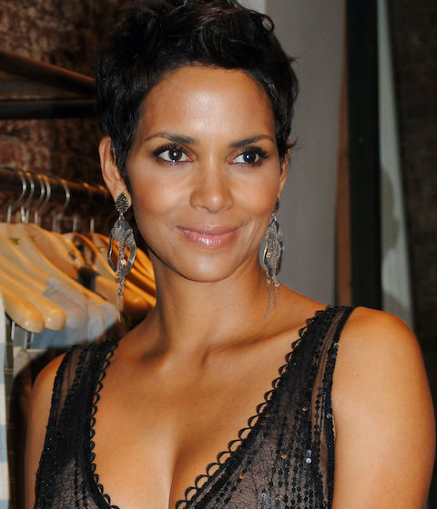
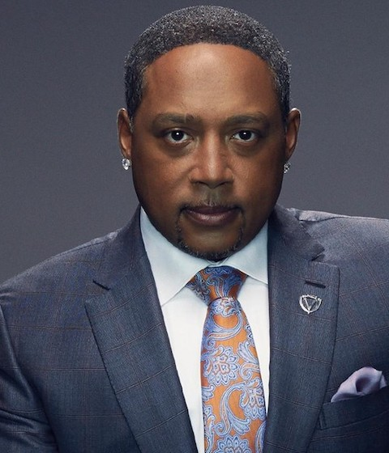

These art people with disabilities
These are people with disabilities.

Slide 8
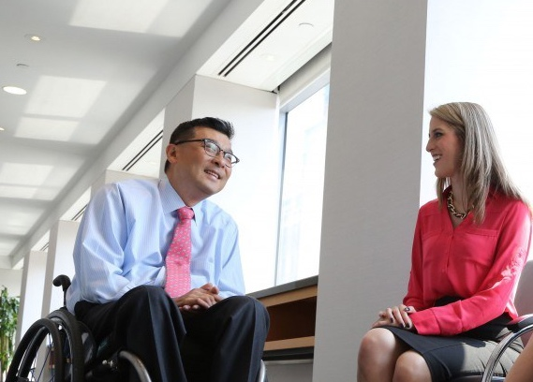
61 million people
61 Million
people in the US have a disability.*
1 in 4
adults have a disability
(physical, sensory, cognitive, mental health or other)
Notes:
I swapped stats with the next slide because these two are more related. I changed out the photo because you have a lot of group shots in this deck and I felt you needed a few different photos.

Slide 9
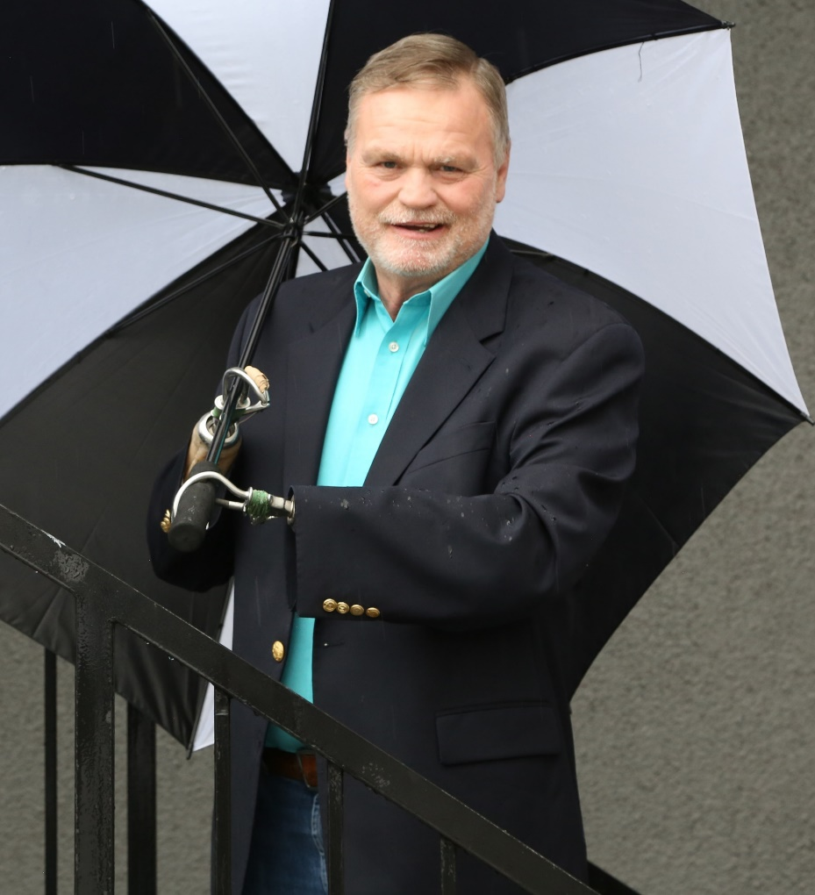
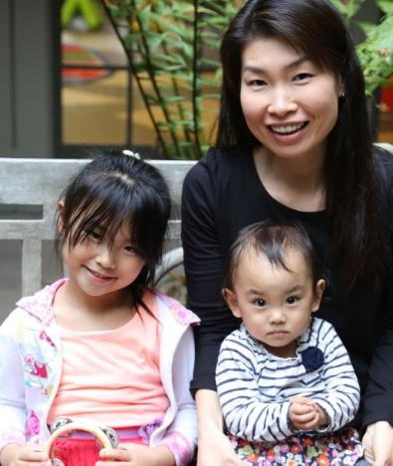
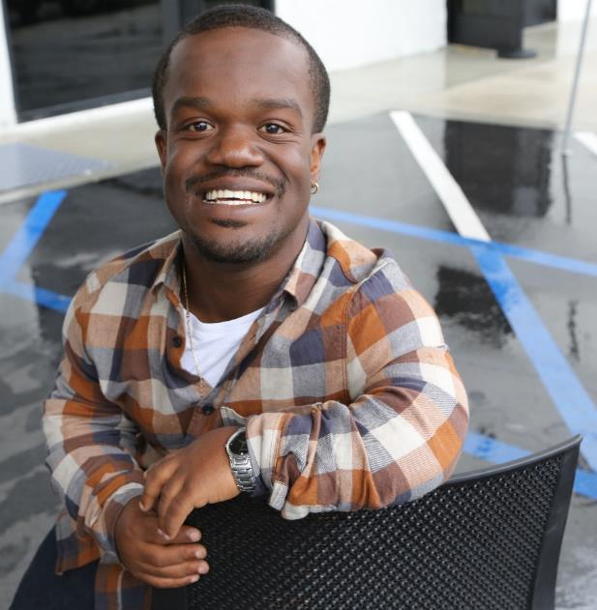
Disabilities Are….
Temporary and Permanent
Visible and Nonvisible
From Birth or Acquired Later
Anyone can join the disability community at any point.

Slide 10
Disability Impacts Everyone
Disability impacts people of all races, sexual orientations and gender identities, faiths and backgrounds.
African Americans with Disabilities
Latinx People and Hispanics with Disabilities
Women with Disabilities
LGBTQ+ Individuals with Disabilities

Slide 11
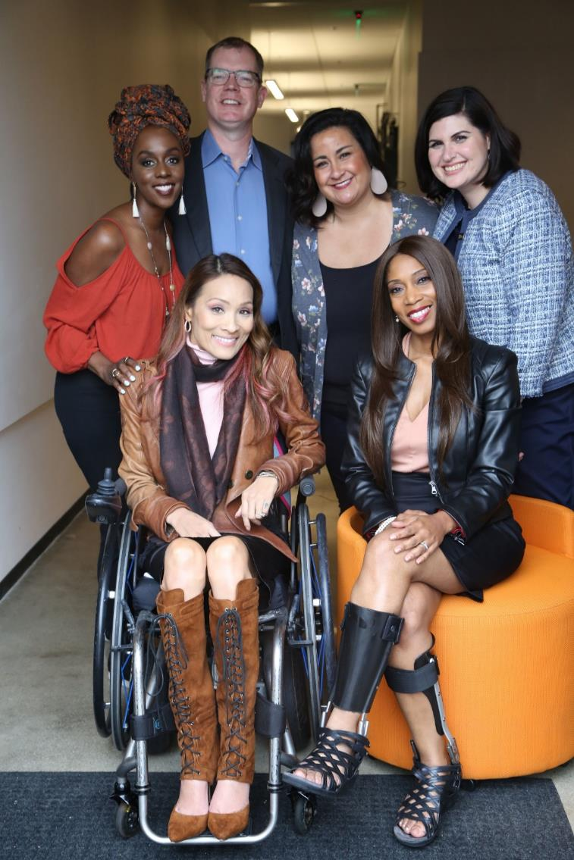

Anyone can join the disability community at any point.
The disability community is cutting edge and innovative.
People with disabilities are diverse and part of all communities.

Slide 12
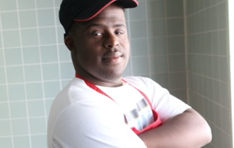
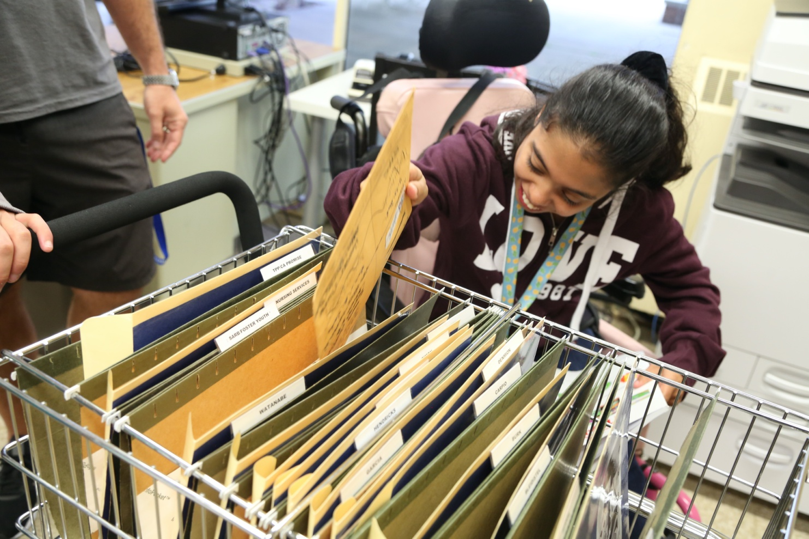
School statistics
There are 7 million students with disabilities in public schools today.
Over 52% of students with disabilities are
people of color.
Only 65% of people with disabilities finish high school.
What can be done to enable people with disabilities to succeed?

Slide 13
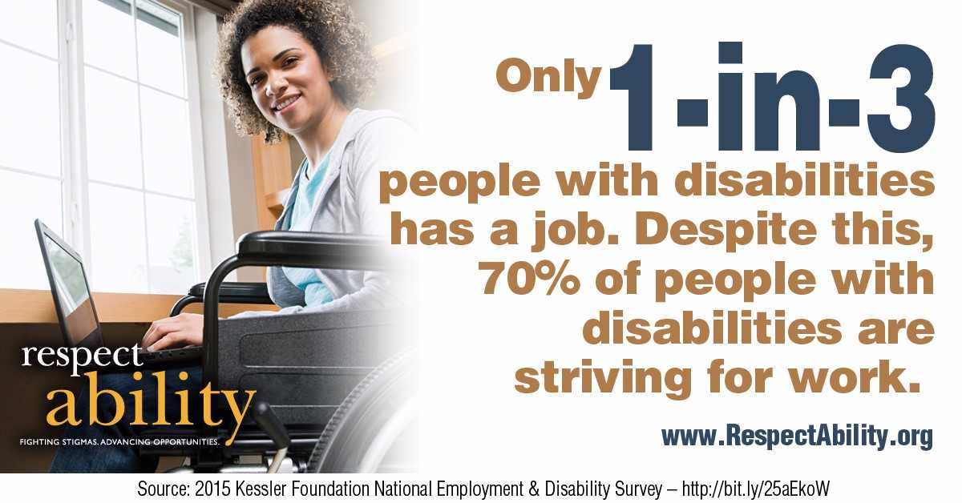
70 Percent of People with Disabilities are Striving to Work

Slide 14
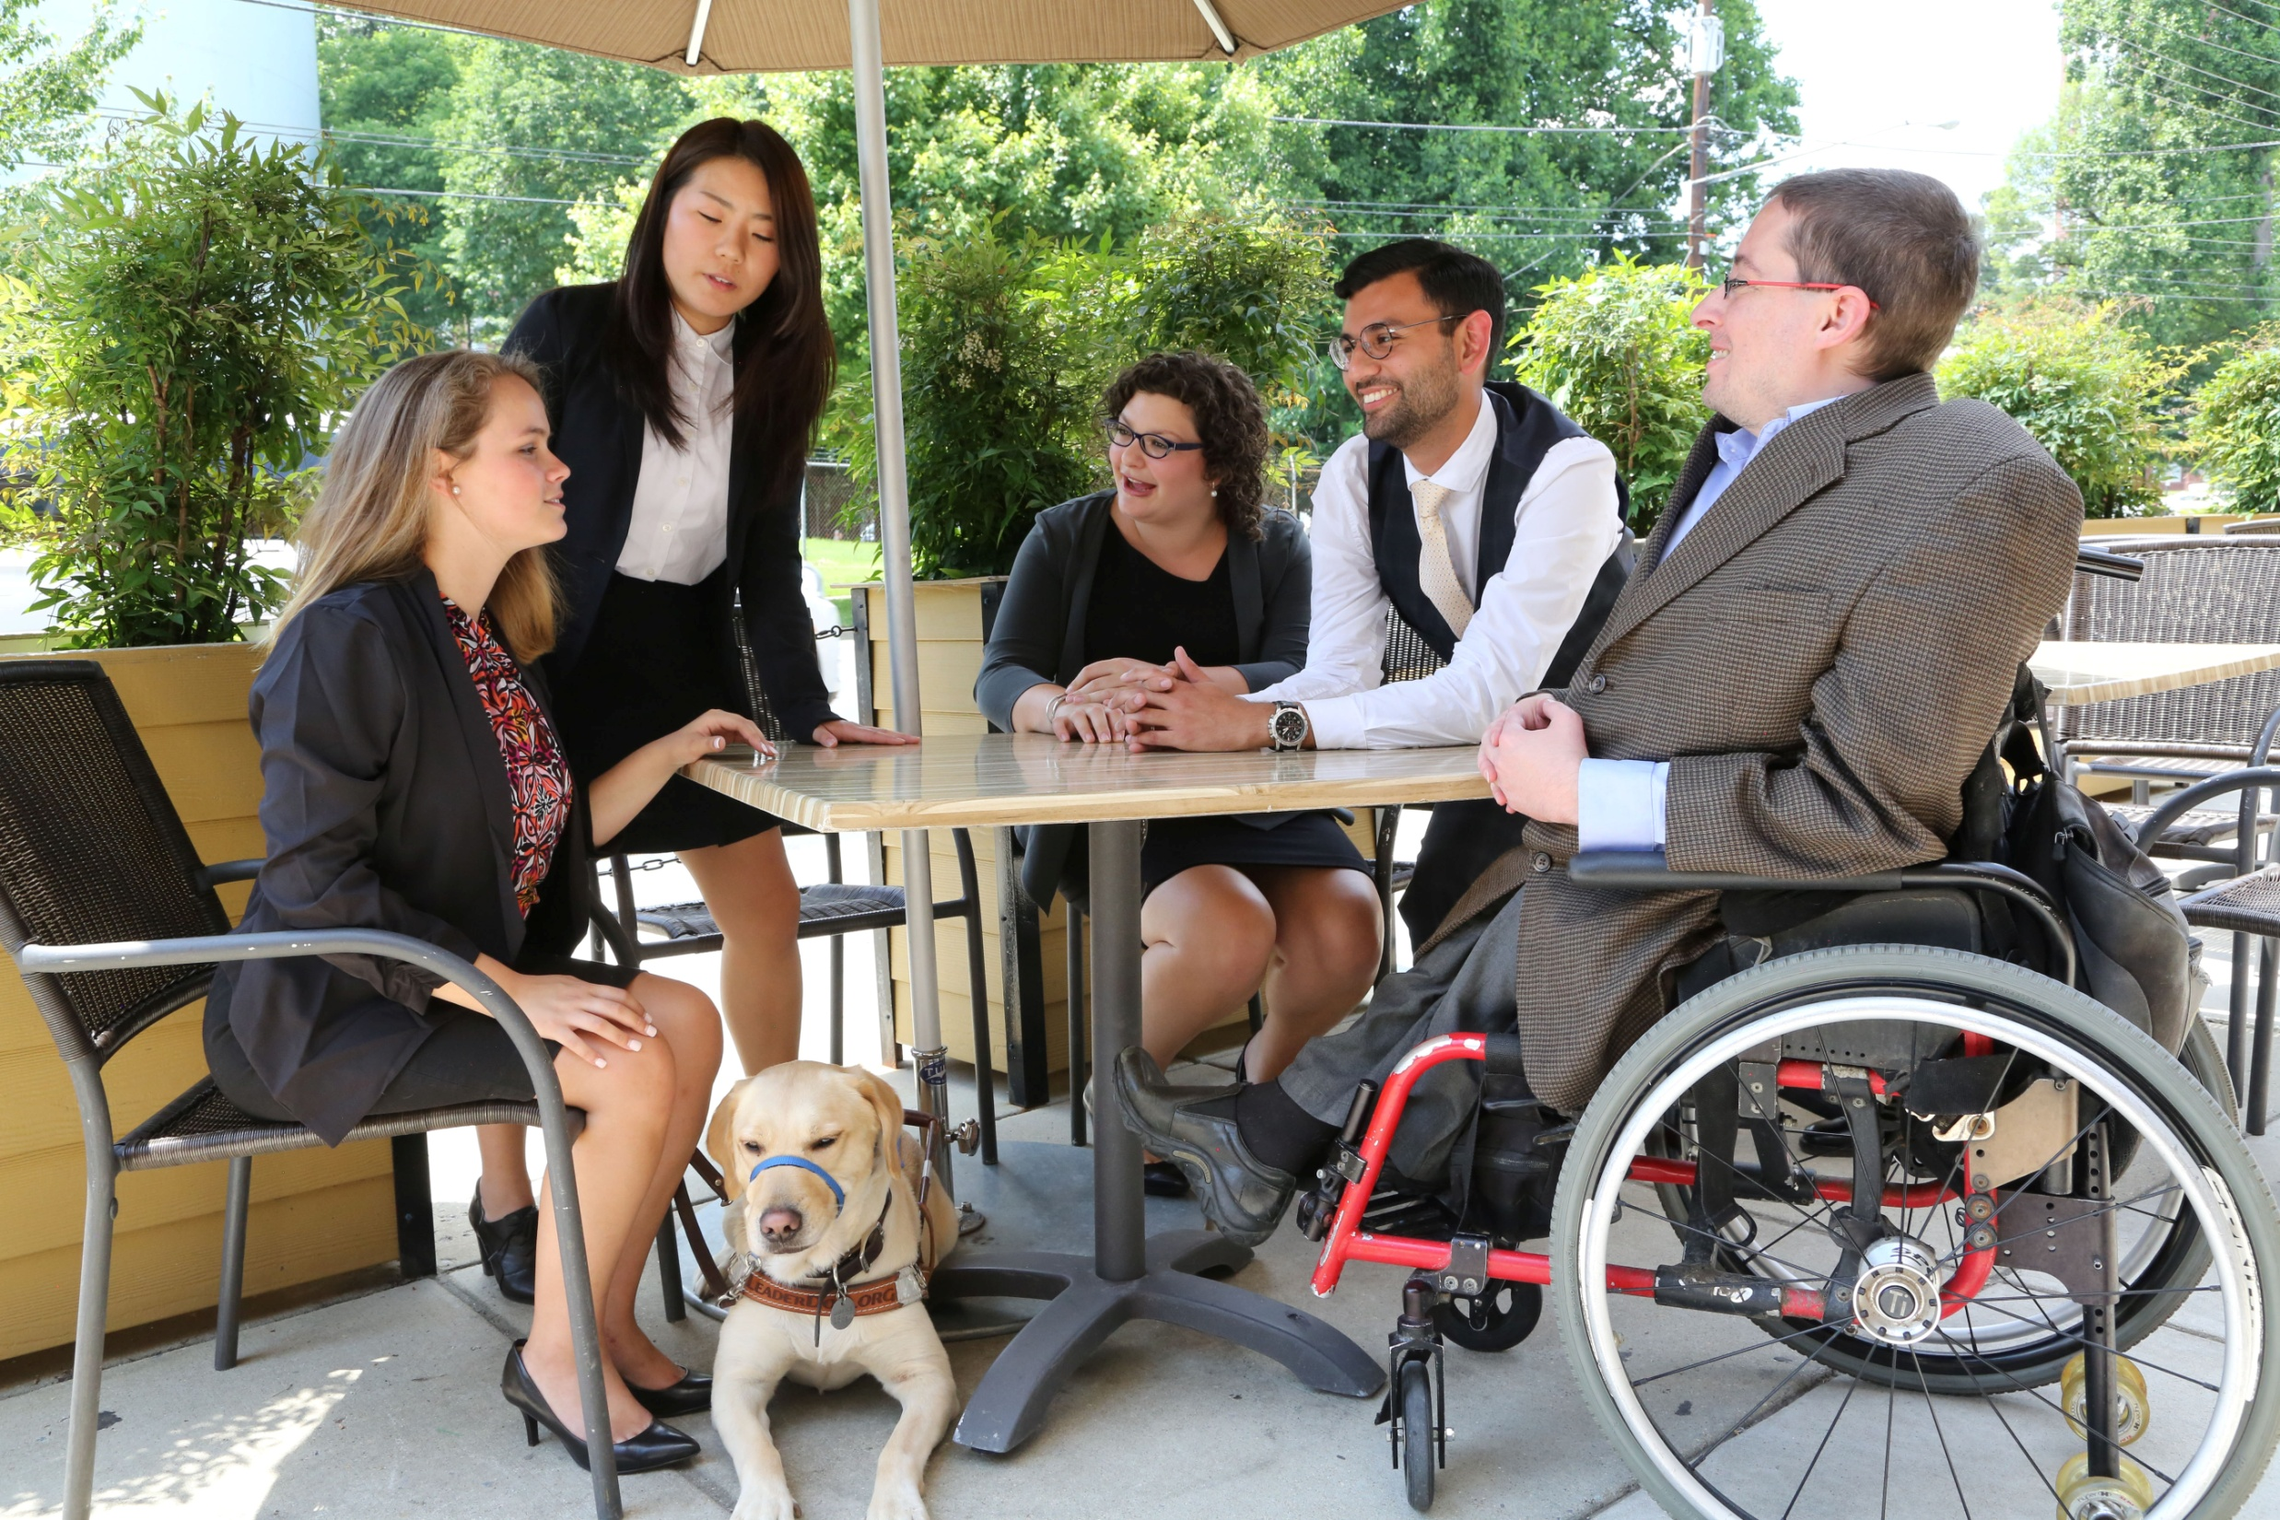
8 million ready to work
That means there are over 8 million
people with disabilities ready to strengthen your organization.

Slide 15


Where Can You Find Local Disability Data?
The Annual Disability Statistics Compendium, published by the Institute on Disability, collects the most up-to-date Census Bureau data on disabilities.
You can download the data, review key statistics and learn more here: disabilitycompendium.org/
You can look at local, county based data here: https://disabilitycompendium.org/county-reports
For more detailed information, go directly to the Census Bureau here: https://data.census.gov/cedsci/?intcmp=aff_cedsci_banner

Slide 16
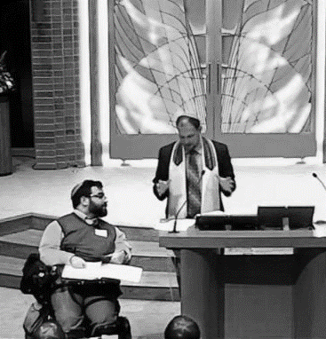

Problem Solving
Problems are best solved by people who have experienced them firsthand and know solutions that work.

Slide 17
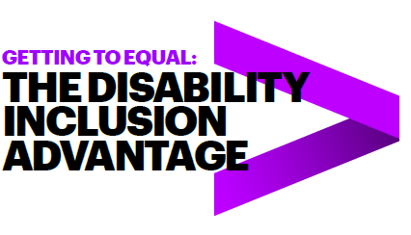
Accenture and the Disability Inclusion Advantage
New research from Accenture reveals that companies that embrace best practices for employing people with disabilities have outperformed their peers.
Here’s the study: https://www.accenture .com/_acnmedia/pdf-89/accenture-disability-inclusion-research-report.pdf
Companies that embrace employees with disabilities clearly see the results in their bottom line.
Disability-inclusive companies have higher productivity levels and lower staff turnover rates, are twice as likely to outperform their peers in shareholder returns and create larger returns on investment.

Slide 18
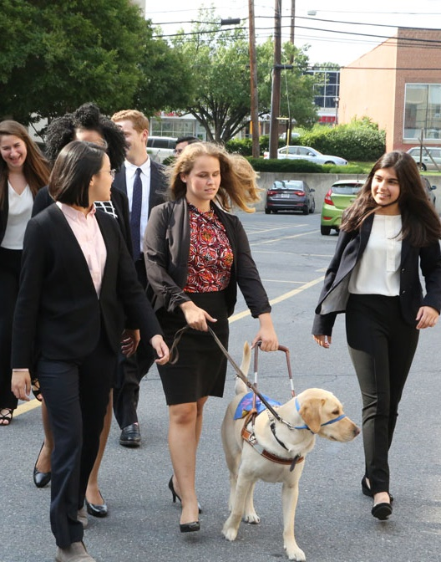
Voters & Disability www.VoteAbility.com
85% of voters find it very or somewhat important that presidential candidates have campaign events and websites that are open and accessible to people with disabilities, just like everyone else.
73% of voters are more likely to support candidates for elected office who will make ensuring that children with disabilities get the education and training they need to succeed a priority.
70% of voters are more likely to support candidates for elected office who will make expanding job and career opportunities for people with disabilities a priority, so they can succeed just like anyone else.
* The survey was completed by Democratic polling firm Greenberg Quinlan Rosner on behalf of RespectAbility of 2,000 registered voters from September 18 through September 24, 2019.
Notes:
I added the study information from Philip’s deck as a footnote. His deck had two additional stats- 28% higher revenue and double net income. I opted to just include one stat here to keep it simple. However, if you want me to add those stats or replace this one with one of those, let me know.

Slide 19
Disability in Philanthropy and Nonprofits Study
Disability in Philanthropy & Nonprofits:
A study on inclusion and exclusion of the 1-in-5 people who live with a disability and what you can do to make things better
Read the Report: www.respectability.org/inclusive-philanthropy/

Slide 20
Disability in Philanthropy & Nonprofits - Methodology
5 focus groups of people who work in philanthropy done in 2015 in partnership with the Council on Foundations
14 one-on-one interviews done in 2018 by phone with leaders of foundations/philanthropy serving organizations
Evaluation of online accessibility of 25 largest foundations and 25 largest nonprofits (done with assistance from Marcie Lipsitt) in 2018/19
Online survey of 969 people done by Buren Communications of subscribers to NonProfitTimes, Chronicle of Philanthropy and numerous PSO partners
Analysis by Meagan Buren, Amy Chapman, Jennifer Laszlo Mizrahi and others

Slide 21
A major gap between will and skill
There are several accommodations and accessibility tools that enable people with disabilities to engage in organizations and activities. Which of the following are policies of your organization? Please check all that apply.
 | %
Our events are always held in physically accessible spaces that have accessible parking spaces or transportation options for people with physical disabilities | 59%
There is a process where employees, trustees/board members and volunteers with disabilities can request and get needed accommodations if needed so that they can succeed in their roles. | 41%
Our public events enable people with disabilities to request accommodations such as sign language interpreters, live captioning or food allergy issues in the registration form. | 30%
We enable people who are blind or have low vision to be able to access our materials on the web by ensuring that our website is set up properly for screen readers. | 17%
We ensure that people who are deaf or hard of hearing can participate by ensuring that all video content has captions. | 14%
None | 16%
N/A | 10%

Slide 22
Organizations do not include enough people with disabilities
Which of the following groups in your organization include people with disabilities? Please check all that apply.
 | %
People You Serve | 66%
Staff Overall | 42%
Volunteers | 41%
Board | 24%
Professional Leadership/Management | 20%
Not Applicable | 6%
I Don’t Know | 23%

Slide 23
Donors will hold you accountable & performance metrics matter
Do you ask your members or grantees if they are representative (e.g., staff, board) of the people they serve?

Slide 24
Be sure disability is being measured in your diversity, equity and inclusion work
Is disability included in that representation?

Slide 25
Inclusion doesn’t happen by accident
Do you ask your members or grantees to intentionally include people with disabilities in their work?

Slide 26
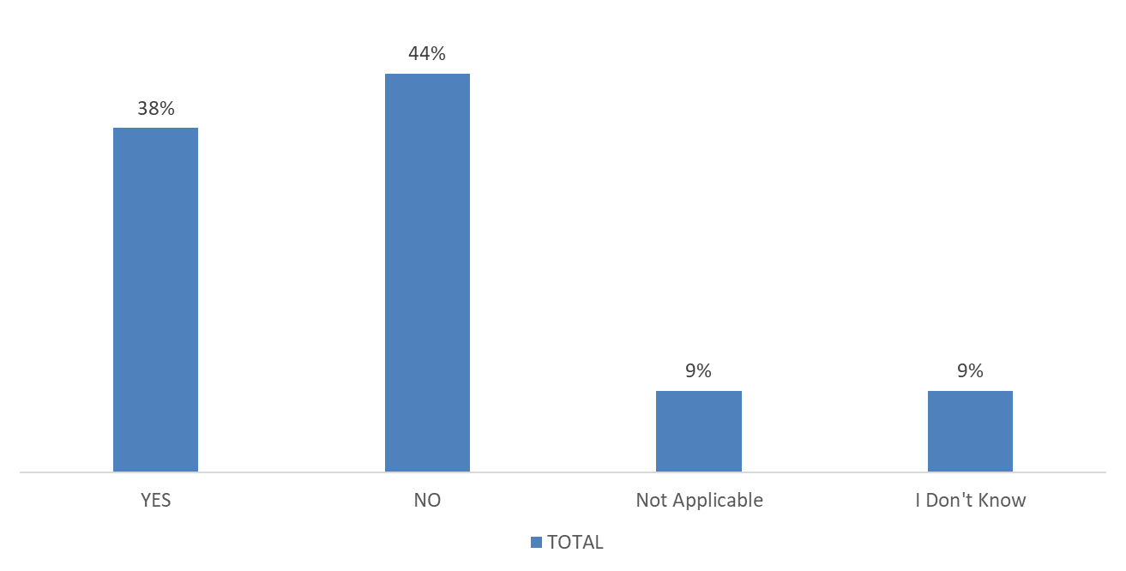
A picture is worth a thousand words
Does your organization depict people with visible disabilities (i.e. show pictures of people who use wheelchairs, white cane, have Down Syndrome etc.) in your internal or external marketing and/or advertising materials?

Slide 27

Adding the Disability Lens…
By adding the disability
lens to your existing work,
you have the opportunity
to create better outcomes
for people with and
without disabilities alike

Slide 28
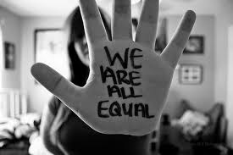
1. Commit publicly to inclusion of people with disabilities
The message that all people are of equal value and must be respected and heard fairly, must be communicated by President and Board.
REPEAT those messages over and over!

Slide 29
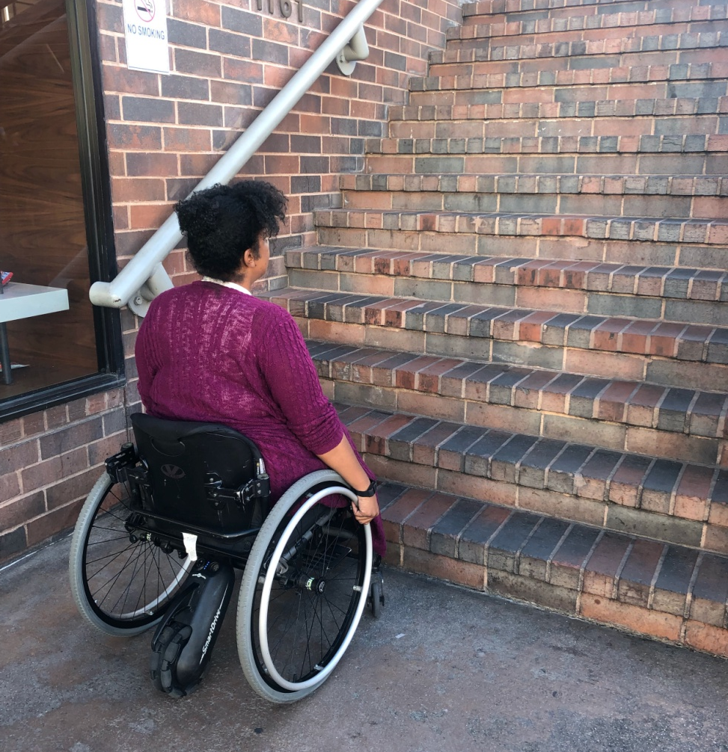
2. When people with disabilities aren’t at the table, they are on the menu
Organizations are at their best when they welcome, respect, and include people of all backgrounds. This includes people with disabilities. Indeed, problems are best solved by working with people who have experienced them first hand and know solutions that work. Just like issues that impact people of different racial, ethnic or other backgrounds, people with disabilities should be involved in solving issues that impact them.
Disability impacts people of all races, genders, and backgrounds. However, youth with multiple minority status (i.e. person of color /English language learners + disability face double discrimination) are most likely to enter the school-to-prison pipeline, become homeless and/or live in poverty. Be sure to look at intersectional issues.
  More information on our webinar - How to Recruit, Accommodate and Promote People with Disabilities for Paid Employment, Volunteer Leadership and Board Positions

Slide 30
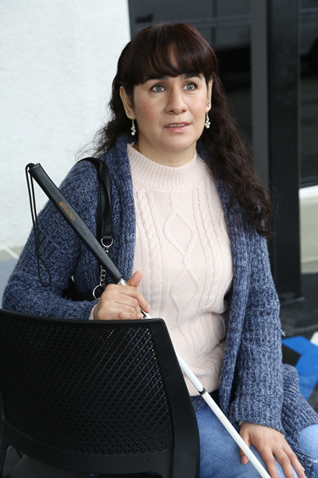
3. Foster an inclusive environment
Use “person first” language when appropriate
Have an accommodation policy
Made a conscious decision and effort to seek out and include certain demographic groups whether that was gender, race, or sexual orientation
  More information on our webinar - How to Ensure A Welcoming Lexicon and Inclusive Storytelling

Slide 31
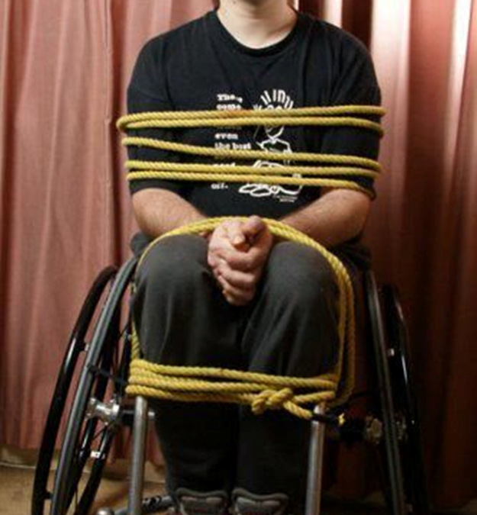
What we say makes a difference
DO SAY:
Someone uses/rides a wheelchair
DON’T SAY:
Wheelchair bound
Confined to a wheelchair
Wheelchair person
WHEN YOU DON’T KNOW WHAT TO DO/SAY, ASK!

Slide 32
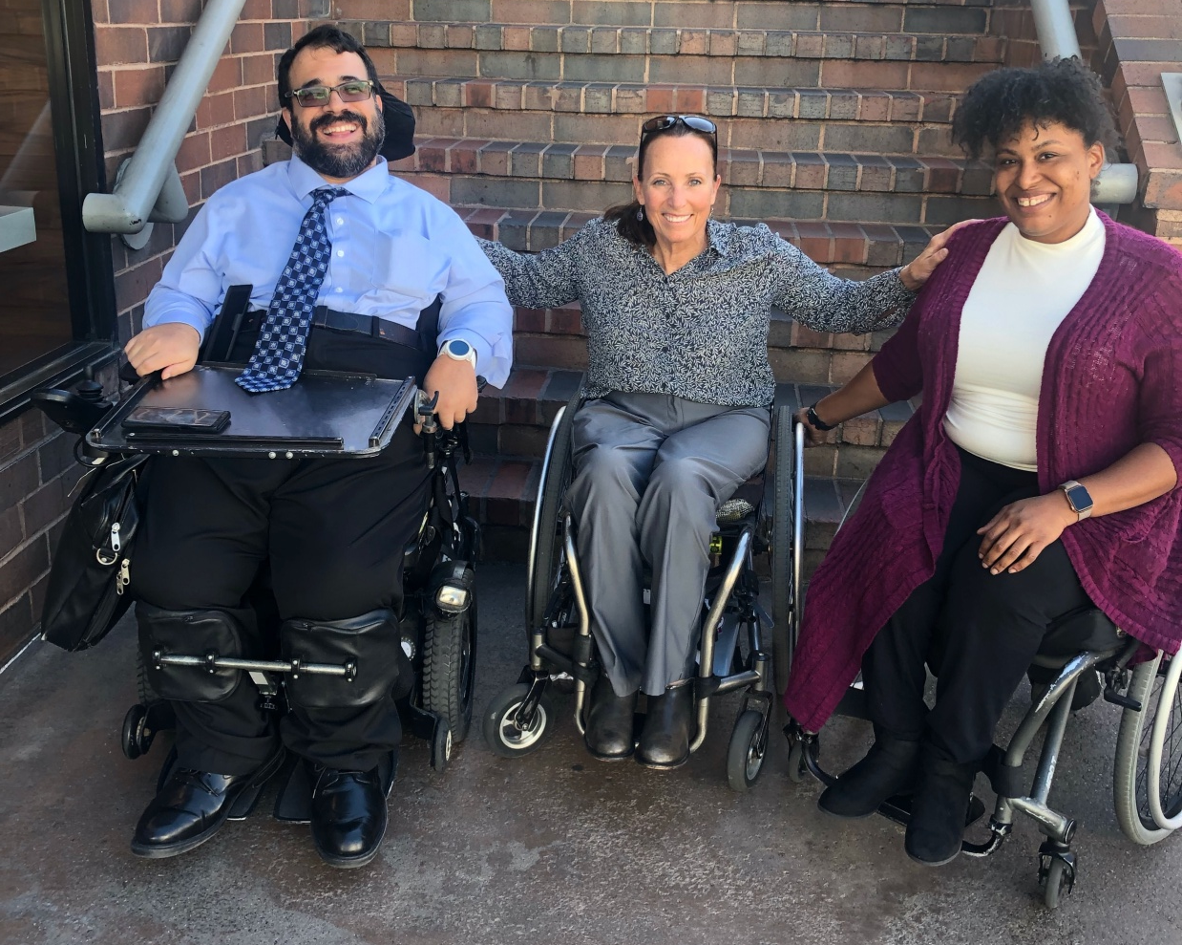
4. Work with people with disabilities
RespectAbility, Best Practices for Employers
TAPAbility, which can source talent
AskJan.org, which can problem solve inclusive employment questions for free
Diverse Managers - Philanthropy’s Next Hurdle
  More information on our webinar - How to Recruit, Accommodate and Promote People with Disabilities for Paid Employment, Volunteer Leadership and Board Positions

Slide 33
The Case for Hiring PWDs
Companies That Embrace the Talents of People with Disabilities Are More Profitable and Productive, With Better Shareholder Return
People with Disabilities Represent a High-Quality Source of Talent at a Time When the Pressure on the Talent Pipeline Is at a Premium
Increasing Disability Hiring Will Lower Turnover and the Associated Turnover Costs

Slide 34


5. Have an inclusion point person or committee
Inclusion Statement and how to make requests for disability accommodations should be on your accessible website and event invites
HR Evaluation and program manager evaluation includes diversity as a performance metric
Resource on Disability Inclusion

Slide 35

6. Include people with disabilities in your marketing
Example: Photos on website should include individuals with visible disabilities
Toolkit for Media Representation
More information on our webinars – How to Ensue Accessible Websites, Social Media and Inclusive Photos
and Premium Skills Workshop in Social Media Accessibility

Slide 36

7. Ensure website and online resources are accessible
Websites need to be set up for use by screen readers and people who need captions.
Caption videos
Make documents and presentations accessible
More information on our webinars – How to Ensue Accessible Websites, Social Media and Inclusive Photos
and Premium Skills Workshop in Social Media Accessibility

Slide 37
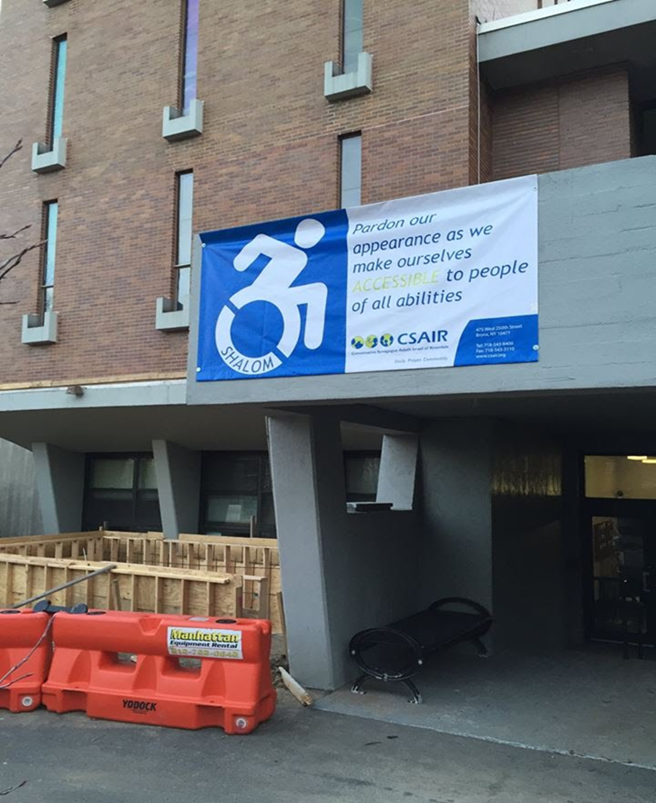
8. Ensure accessibility of office and events
Physical Accessibility
Event Checklist
All of the following must be accessible:
  Invitation/notification of event
  Facilities
  Communication
  Staff/Volunteers
  More information on our webinar -
  How to Ensure Accessible Events

Slide 38
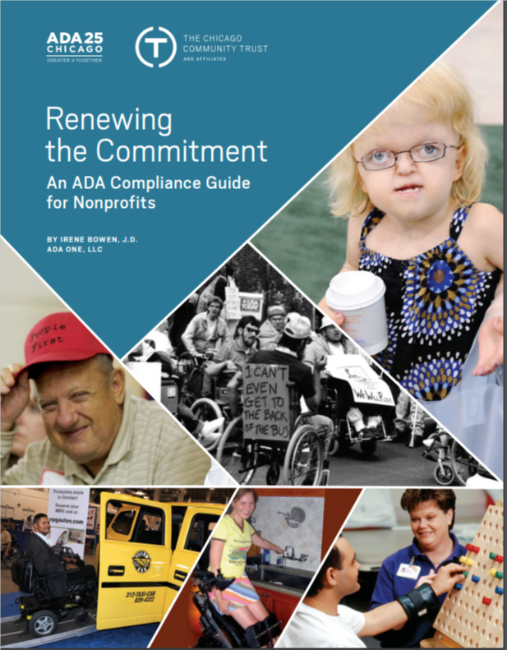
Accessibility: ADA Accessible Resource Guide
The Chicago Community Trust
http://www.cct.org/wp-content/uploads/
2015/08/2015ADAComplianceGuide.pdf

Slide 39
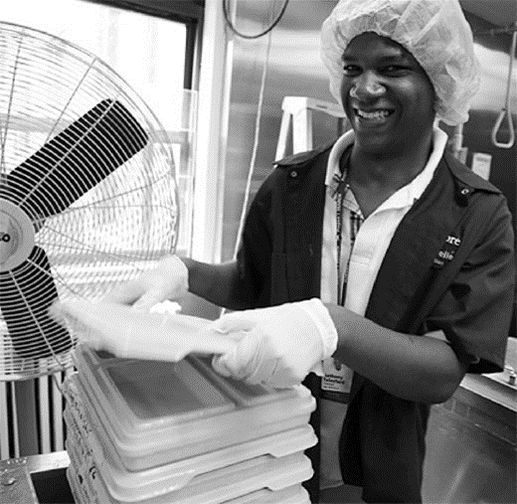
9. Use vendors who are or who hire people with disabilities
Invest in social enterprises who hire people with and without disabilities
Social Enterprise: Creating Employment Opportunities for People with Disabilities

Slide 40
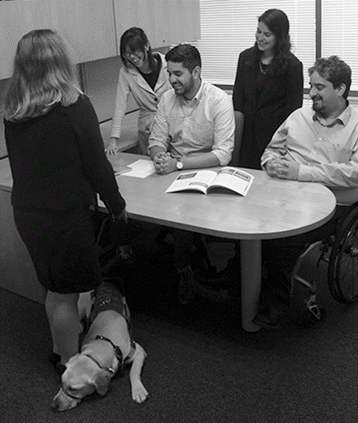
10. Promote a disability lens among grantees/members
Ask Your Grantees/Members About:
Meaningful and inclusive policies and/or programs
Public commitments on website and materials
Employing people with disabilities at all levels
Inviting people to request accommodations
Physical accessibility of office and programs
Website accessibility
Video captioning
Internal and external educational efforts

Slide 41
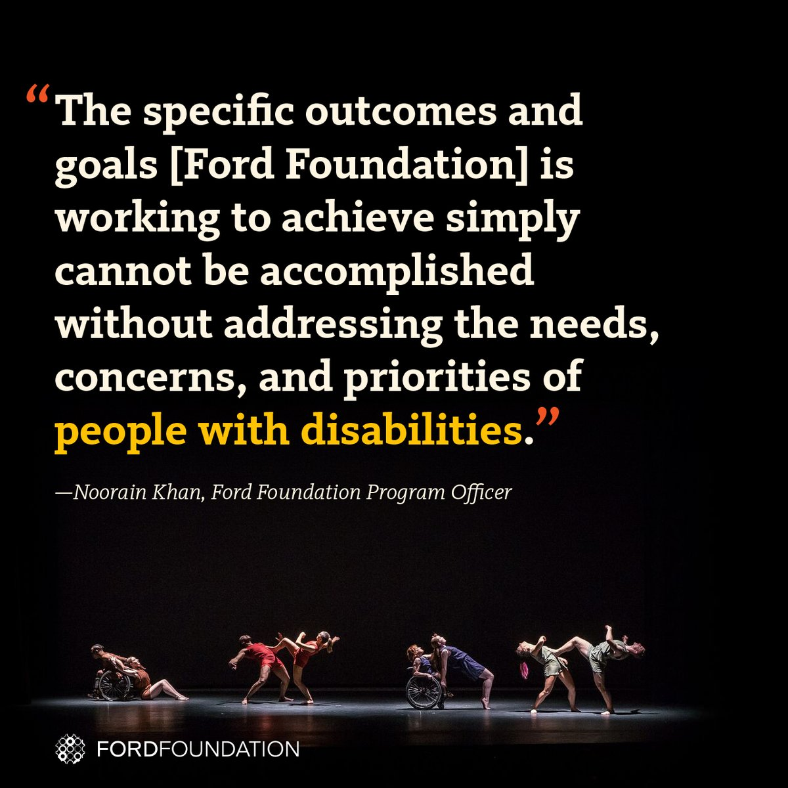
Success Stories: The Ford Foundation Includes Disability
The Ford Foundation has recently added the disability lens to their work http://bit.ly/2jOl3FL
Additionally, Ford’s CEO Darren Walker spoke extensively on why this impacts other funders as well: http://bit.ly/2nr4moJ
Here is Darren Walker’s original letter: http://bit.ly/2Bxy0Lk
This is the response of the co-authors of the Americans with Disabilities Act: http://bit.ly/2AueSyx
Darren Walker and Rich Besser (Robert Wood Johnson Foundation) on the need for disability inclusion in philanthropy: https://bit.ly/2uE8tPh

Slide 42
Today’s Take Away
Organizations are at their best when they welcome, respect and include people of all backgrounds. This includes people with disabilities.
Problems are best solved by working with people who have experienced them first-hand and know solutions that work. Just like issues that impact people of different racial, ethnic or other backgrounds, people with disabilities should be involved in solving issues that impact them.

Slide 43
Equity and Access Webinar Series
Disability 101
Disability History
How to Ensure Accessible Events
How to Recruit, Accommodate and Promote People with Disabilities for Paid Employment, Volunteer Leadership and Board Positions
How to Ensure A Welcoming Lexicon and Inclusive Storytelling
How to Ensue Accessible Websites, Social Media and Inclusive Photos
Premium Skills Workshop in Social Media Accessibility
How to Ensure Legal Rights and Compliance Obligations: Exploring the Rights of Employees and Participants, and the Obligations of Nonprofit Organizations Under the Law
Watch Recordings, Download Transcripts and PowerPoints:
https://www.respectability.org/accessibility-webinars/

Slide 44

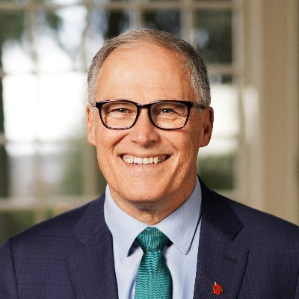
Washington State Disability Statistics
In total, there are 934,396 Washingtonians living with a disclosed disability. They represent 12.6 percent of the state’s population.
There are 478,622 working-age (18-64) Washington State residents with disabilities.
Out of that number, 195,251 have jobs.
That means Washington has a 40.8 percent disability employment rate.
The employment rate for Washingtonians without disabilities is 78.8 percent.
That means there is a 38 percentage point gap in the employment rates between people with and without disabilities.
According to that gap, Washington is ranked 20th out of the 50 states.
In 2018, a net of only 303 Washingtonians with disabilities entered the workforce.
Gov. Jay Inslee D-WA

Slide 45
Washington State Disability Demographics
Among working-age Washingtonians with disabilities:
  There are 231,152 working-age women with disabilities in WA.
  There are 48,720 working-age Latinx people with disabilities in WA.
  There are 20,784 working-age African Americans with disabilities in WA.
  There are 20,441 working-age Asian Americans with disabilities in WA.
In terms of employment:
  38.2 percent of working-age women with disabilities have jobs in WA.
  45.7 percent of working-age Latinx people with disabilities have jobs in WA.
  41 percent of working-age African Americans with disabilities have jobs in WA.
  45.9 percent of working-age Asian Americans with disabilities have jobs in WA.

Slide 46
Washington State Education Statistics (1)
In total, there are 130,488 students with disabilities in Washington’s public schools.
  47,606 have learning disabilities
  14,363 have Autism / 22 are deaf-blind / 8,431 have a developmental delay
  5,324 have emotional disturbance / 1,005 have hearing issues / 5,011 have I/DD
  2,946 have multiple disabilities / 27,249 have health impairments
  17,431 have speech issues / 310 have a TBI
  419 have visual impairments

Slide 47
Washington State Education Statistics (2)
In 2018, only 62 percent of WA students with disabilities graduated with a high school degree.
  In the class of 2018, there were 13,379 students with disabilities total, 2,904 dropped out, 5,880 graduated with a HS diploma, 23 aged out, and 288 received a certificate of completion.
14.8 percent of PK-12 students in Seattle are students with disabilities.
  14 percent of white students are students with disabilities
  18 percent of African American students are students with disabilities
  27 percent of Native American students are students with disabilities
  20 percent of Hispanic students are students with disabilities
  10 percent of Asian American students are students with disabilities.

Slide 48

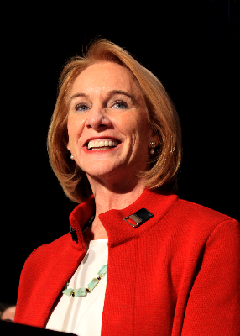
Seattle (King Co.) Disability Statistics
There are 205,142 Seattle residents with disabilities. That puts them at 9.5 percent of the city’s population.
In total, there are 105,908 working-age (18 to 64) Seattle residents with disabilities. Out of that number, only 47,777 have jobs.
Seattle’s disability employment rate is 45.1 percent.
The employment rate for Seattle residents without disabilities is 80.1 percent.
That puts the gap in the city’s employment rate between people with and without disabilities at 35.
24.6 percent of Seattle’s residents with disabilities lives in poverty.
Mayor
Jenny Durkan
(D)

Slide 49
Resources
RespectAbility’s Inclusive Philanthropy toolkit
Access information on disability inclusion, including the new Disability in Philanthropy & Nonprofits study
www.RespectAbility.org/inclusive-philanthropy
Follow us on Social Media!
Twitter: @Respect_Ability
Facebook: RespectAbilityUSA
Instagram: @RespectTheAbility
Website: www.RespectAbility.org
Intersection of Disability and Politics: www.TheRespectAbilityReport.org

Slide 50
Questions?

