Slide 1
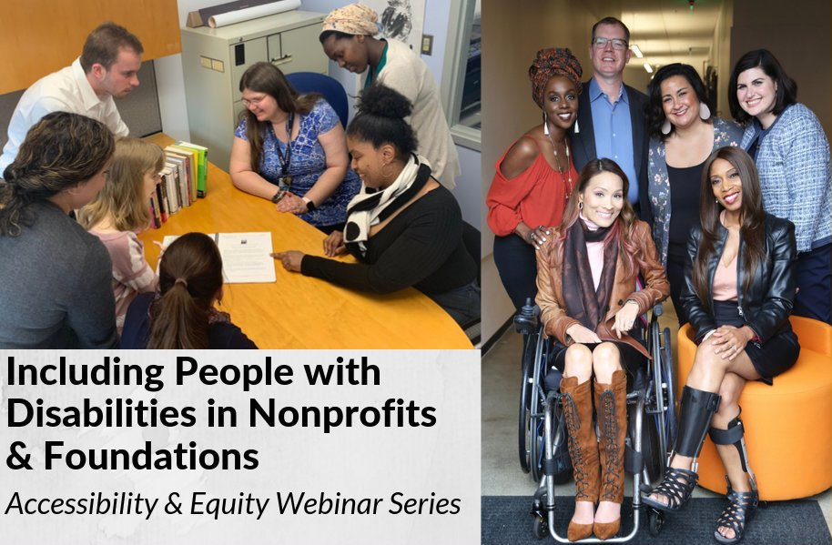
Accessible Events
Inclusive & Accessible Events

Slide 2
Equity and Access Webinar Series Partners
BoardSource
The California Wellness Foundation
Catalogue for Philanthropy, Greater Washington
Center for Disaster Philanthropy
Cerebral Palsy Foundation
The Chronicle of Philanthropy
The Communications Network
The Divas With Disabilities Project
Exponent Philanthropy
Grantmakers Concerned with Immigrants and Refugees
Media Impact Funders
National Center of Disability Journalism
National Committee for Responsive Philanthropy
National Council of Nonprofits
The New York Women’s Foundation
The Unfunded List
Weingart Foundation

Slide 3
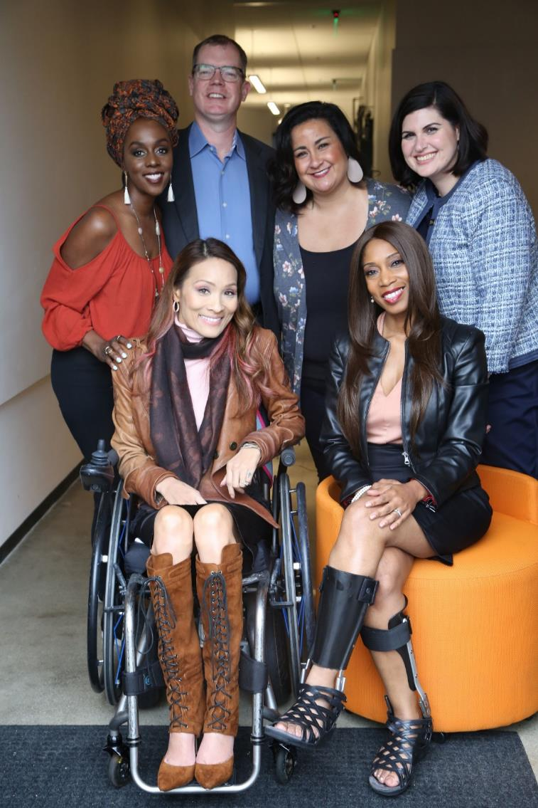
Including the D – Disability – in Diversity
Organizations are at their best when they welcome, respect and include people of all backgrounds. This includes people with disabilities.

Slide 4
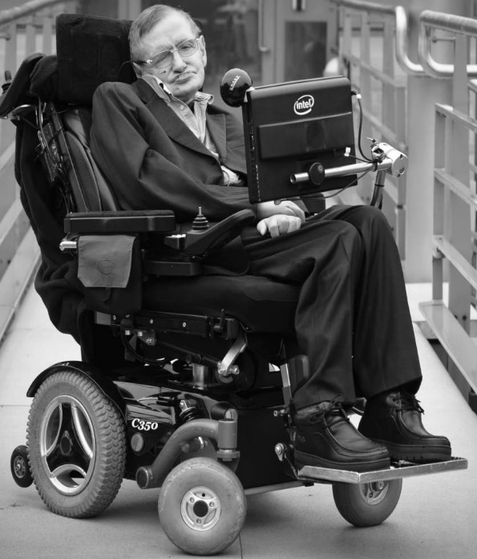
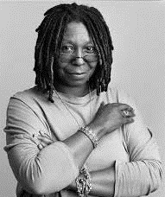
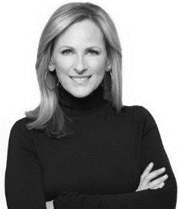
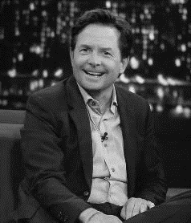
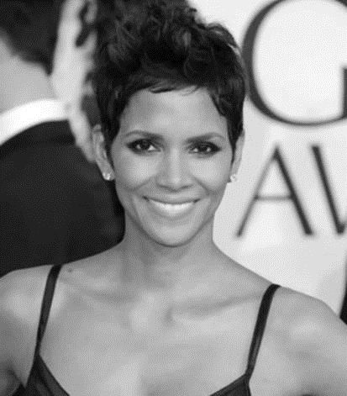
These are people with disabilities.
These are people with disabilities.

Slide 5
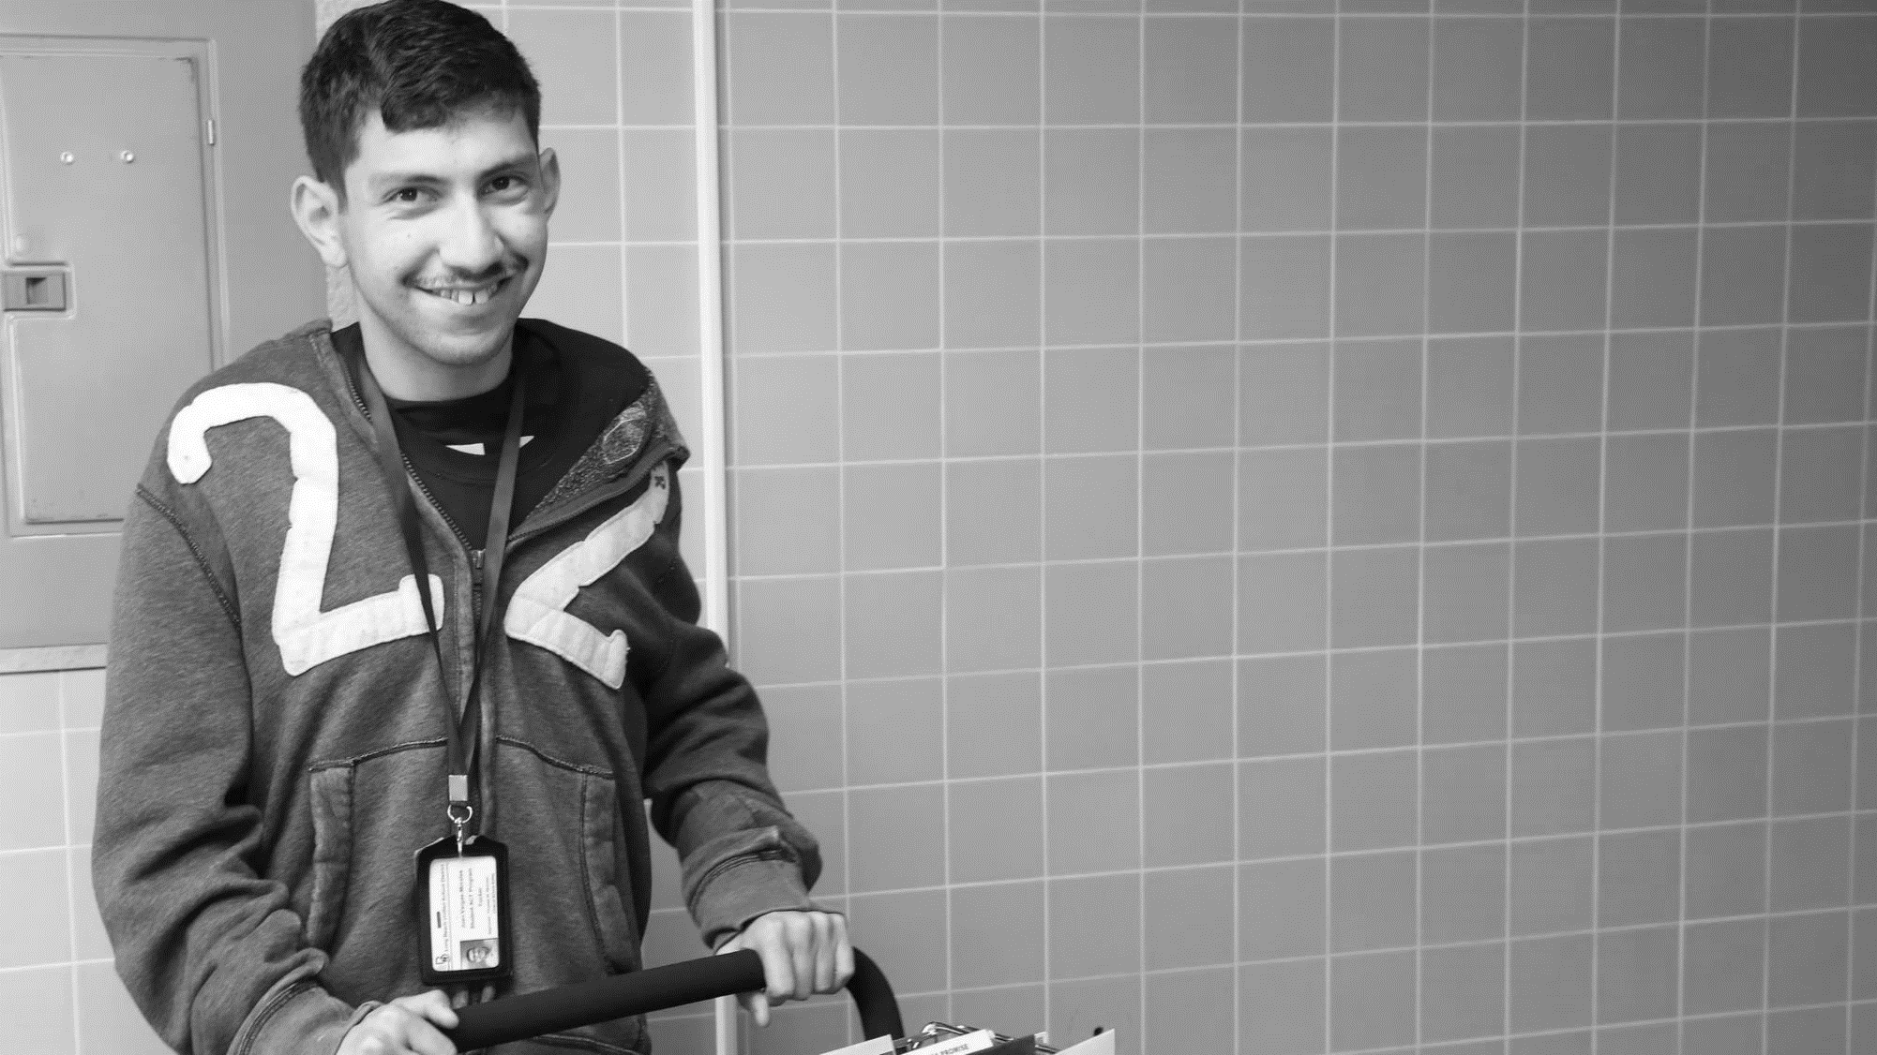
61 million people
61 Million
people in the U.S. have a disability.*
People with disabilities
want
opportunities
Just like anyone else.
* Source: US Census

Slide 6
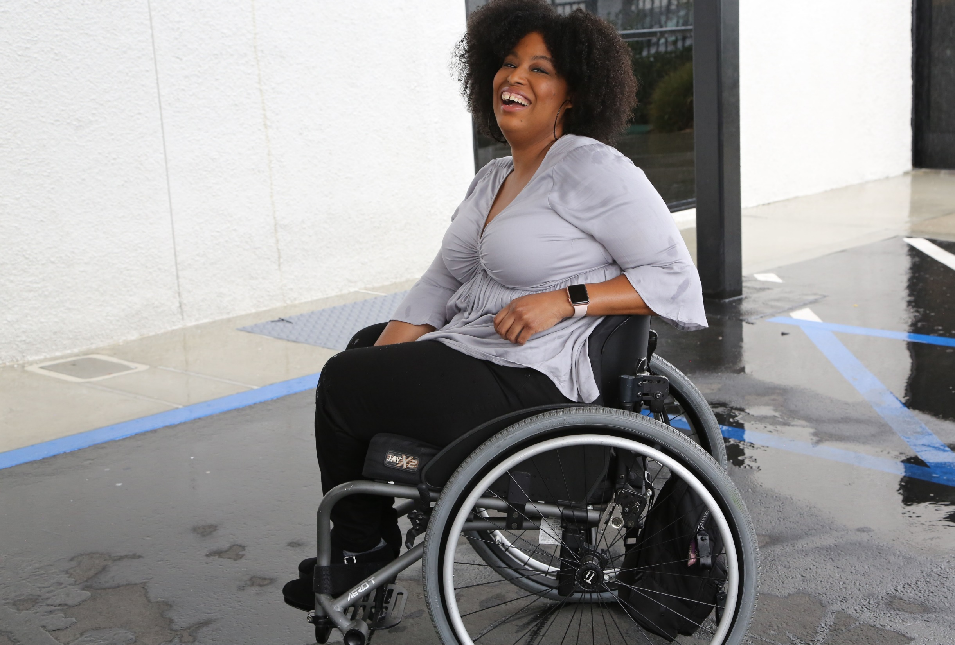
1 in 4 adults
1 in 4
adults have a disability

Slide 7
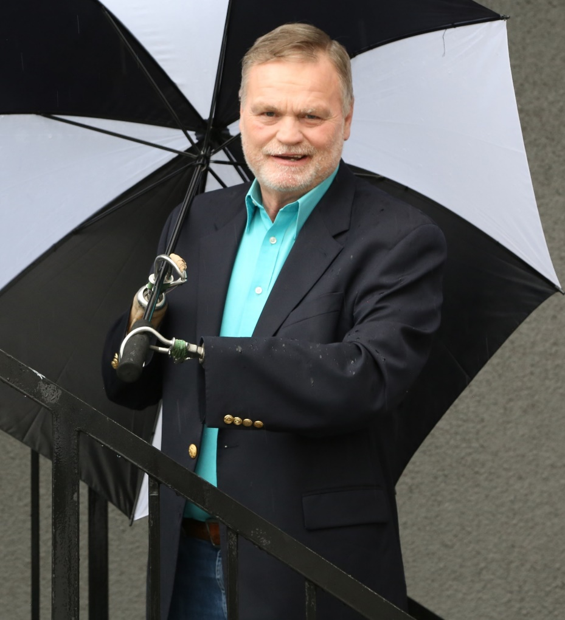
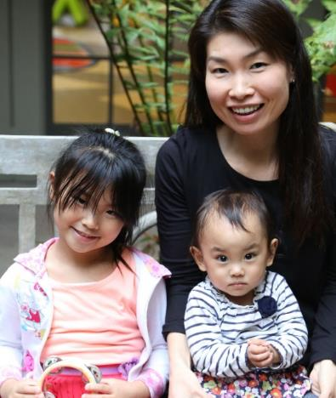
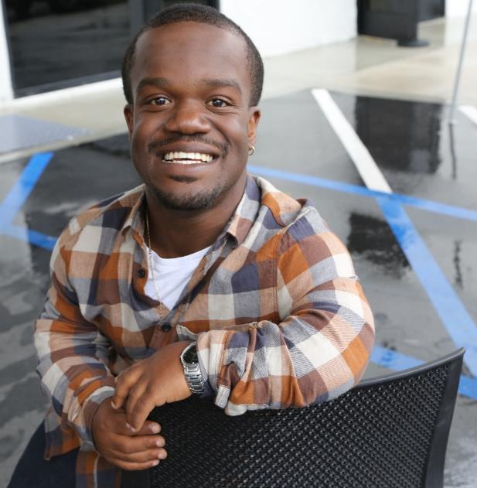
Disabilities Are….
Temporary and Permanent
Visible and Invisible
From Birth or Acquired Later

Slide 8
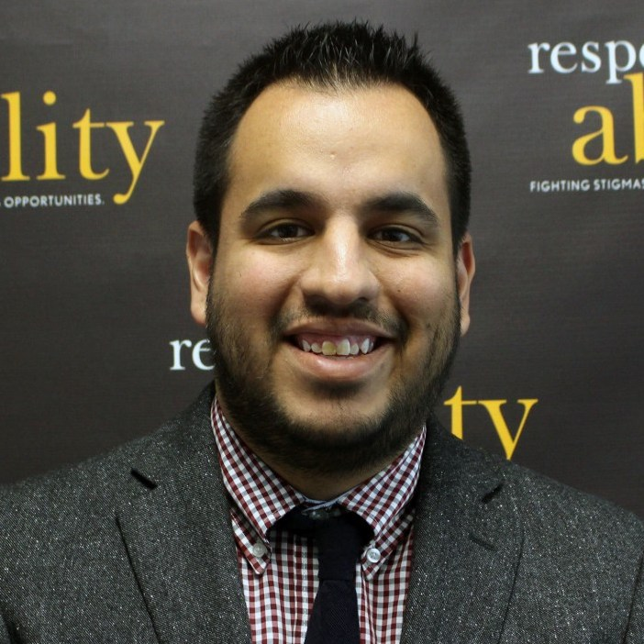
Speakers
Emily Harris Principal, Harris Strategies, LLC
Founding Executive Director, ADA 25 Advancing Leadership
Dr. Victor Santiago Pineda
Senior Advisor, RespectAbility
President, World Enabled
President, Global Alliance for Accessible Technology and Environments
Moderator: Franklin Anderson
Manager of Inclusive Philanthropy and Development, RespectAbility

Slide 9
Accessibility Starts Before the Event
Notes:
There’s a lot more than this but this is how to get started today

Slide 10
Where to Start?
Start Today!
Section 3 checklist and other resources
Accessibility is key to planning
Incorporate accessibility in all materials
Notes:
Today’s presentation will cover basic information – there are many on line resources to help. Our agenda:
Invitations and materials to share in advance
Venue selection and set up
Useful Resources
We will answer your questions

Slide 11
Invitations, Materials, and Information to Share Ahead of Time

Slide 12
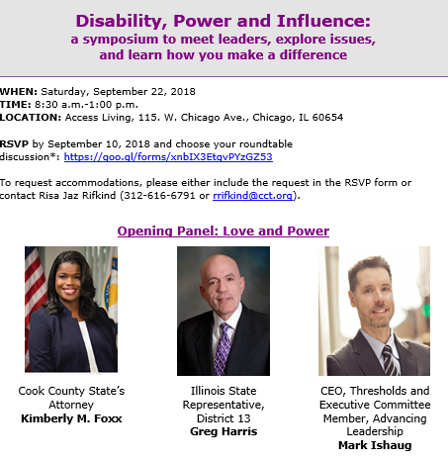
Before the Event
Big Picture
Invitation and Registration
Materials
Print
Electronic
Notes:
INVITATIONS
LANGUAGE
• As a standard practice, all of our event invitations include how someone may request an accommodation. For example, “To request accommodations please contact NAME at EMAIL or NUMBER.” Providing a name reassures attendees that their questions will be received by a human and not by an automated system. The reason for a phone number and email is to allow the greatest flexibility for means of communication, as preferences vary.
• Registration – choose and accessible platform like google form
For our electronic invitation, we change the default time allocation for the RSVP form from five minutes to at least one hour.
PRINT
• Stay away from colors that can be hard to decipher and instead opt for colors that are high contrast.
• Make sure text is in a sans serif-type font and the font size is at least 12 pt. (at least 18 pt. for large print materials)
• To be prepared to print large print and alternate formats of invitations and material, save all text in a plain text document.
ELECTRONIC
• We send programs and other handouts in advance to those who request in order to view them electronically (this applies for meetings too). Advance planning is important and should material change last minute, be sure to share the latest version as soon as possible.
• All invitations and event materials are screen reader accessible (this sometimes requires specific image tagging, note that some PDFs are not accessible although a consultant can be used to make them accessible).
- Know before you go email includes accessible entry and accommodations

Slide 13
Accommodations Language
“To request accommodations, please either include the request in the RSVP form, or contact [Name of Person] at 222-222-2222 [Phone number] or xxxxxxx@yyyyyy.org [Email address]”
Be specific! List a real person!
Note: You may also choose to list accommodations you plan to offer such as CART or American Sign Language interpretation

Slide 14
Invitation Format
Not all platforms are accessible
Google Forms are accessible
User test – can someone using a screen reader access all fields on the form?

Slide 15
Venue Selection and Set Up

Slide 16
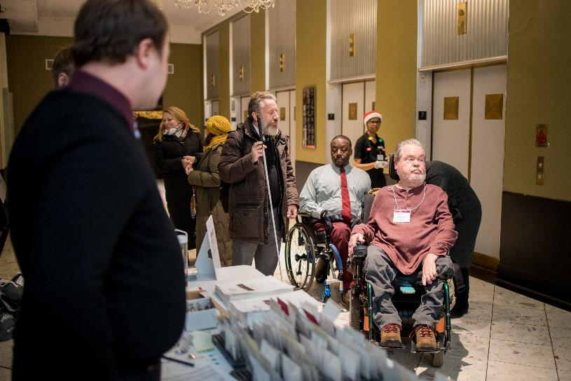
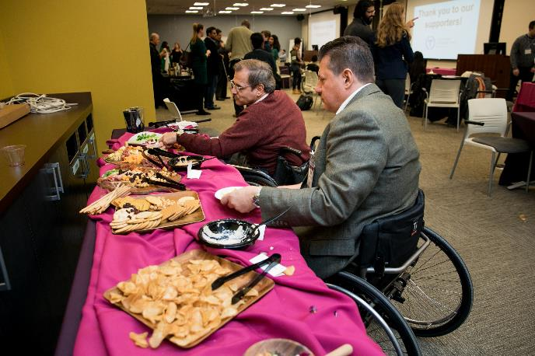
Layout: Arrival and Food
Notes:
The selection of an accessible space is critical in ensuring that our guests arrive and leave feeling welcomed.
ELEMENTS OF ACCESSIBLE VENUE
• Location should be accessible for wheelchair users and others with disabilities. Avoid stairs, steep ramps, and other physical barriers that could pose an obstacle. Accessible entrances should be in an appropriate and convenient location (for example, not through an alley or kitchen)
• The accessible entrance should be in an appropriate area not via a back area or an alley.
• Aisles between tables are wide enough for wheelchair users to navigate. Aisle should be a minimum of three feet wide when chairs are pulled out.
• The coat check and registration are accessibly located.
• Accessible bathrooms are required.
• Stage, podium, and panel should be accessible for speakers with disabilities.
• Pathways and access aisle should allow for movement throughout full space.
• Accessible seating should be available in multiple areas to achieve diverse integrated seating options.
• Warn event goers of loud noise and lights that might be flickering
Is there a quiet room?

Slide 17
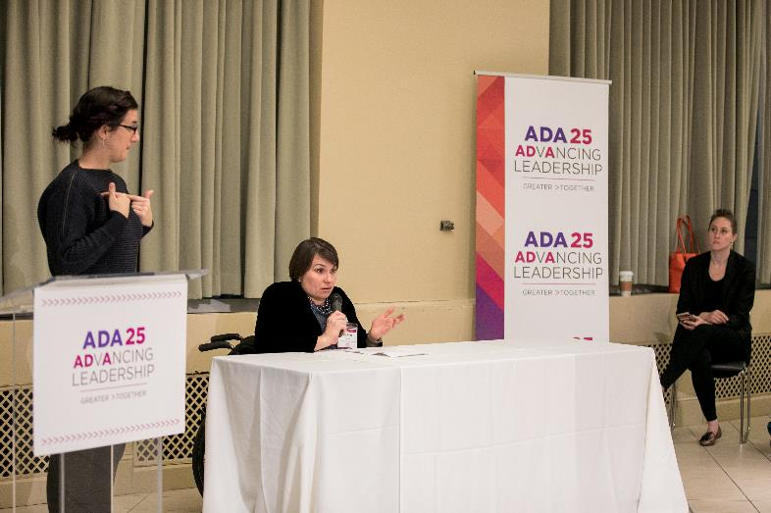
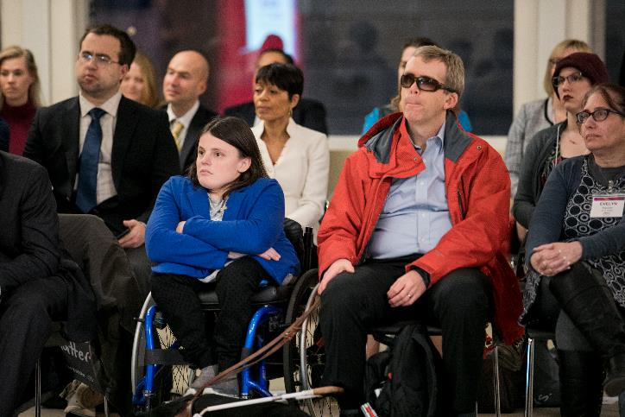
Event Experience: Speakers and Seating
Notes:
The selection of an accessible space is critical in ensuring that our guests arrive and leave feeling welcomed.
ELEMENTS OF ACCESSIBLE VENUE
• Location should be accessible for wheelchair users and others with disabilities. Avoid stairs, steep ramps, and other physical barriers that could pose an obstacle. Accessible entrances should be in an appropriate and convenient location (for example, not through an alley or kitchen)
• The accessible entrance should be in an appropriate area not via a back area or an alley.
• Aisles between tables are wide enough for wheelchair users to navigate. Aisle should be a minimum of three feet wide when chairs are pulled out.
• The coat check and registration are accessibly located.
• Accessible bathrooms are required.
• Stage, podium, and panel should be accessible for speakers with disabilities- if you can’t afford a ramp for the stage, then you can’t afford a stage
• Pathways and access aisle should allow for movement throughout full space.
• Accessible seating should be available in multiple areas to achieve diverse integrated seating options.
• Warn event goers of loud noise and lights that might be flickering
Is there a quiet room?

Slide 18
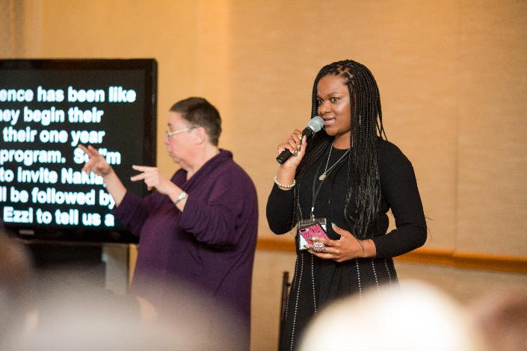
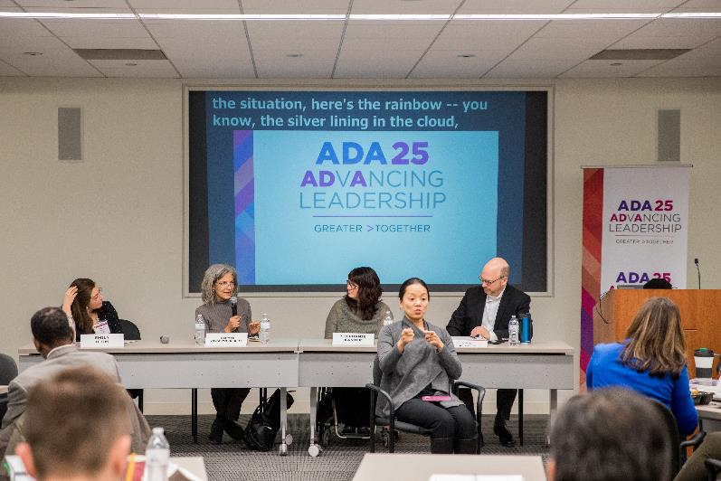
Event Experience: A/V Considerations
Notes:
ACCESSIBLE EVENT SETUP
Microphones are available in the space or have been arranged for event
Placement of CART and ASL interpreters has been planned

Slide 19
After The Event
Be sure to use feedback forms so you know how to improve for next time!

Slide 20
Useful Resources and Checklists
Chicago Community Trust, Renewing the Commitment: An ADA Compliance Guide for Non-Profits https://cct.org/wpcontent/uploads/2015/08/2015ADAComplianceGuideSummary.pdf
Cornell University Department of Human Resources, Accessible Meeting Checklist https://hr.cornell.edu/sites/default/files/documents/accessible_meeting_checklist.pdf
ADA National Network, A Planning Guide for Making Temporary Events Accessible to People with Disabilities https://adata.org/guide/planning-guide-making-temporary-events-accessible-people-disabilities
Mid-Atlantic ADA Center, Guide to Accessible Meetings, Events and Conferences – Digital https://www.adahospitality.org/accessible-meetings-events-conferences-guide

Slide 21
Next Steps
Connect with your local disability community
Hire experts – including people with disabilities
Consult Resources and Plan in ADVANCE
Start with information about how to request accommodations on all invitations
Notes:
Connect with your local disability community
Hire experts – hopefully including people with disabilities
Reach out with questions

Slide 22
Equity and Access Webinar Series Schedule
Disability 101 (available online via video and transcript)
Disability History (available online via video and transcript)
Nov. 20, 2019: How to Ensure Accessible Events
Dec. 4, 2019: How to Recruit, Accommodate and Promote People with Disabilities for Paid Employment, Volunteer Leadership and Board Positions
Dec. 11, 2019: How to Ensure A Welcoming Lexicon and Inclusive Storytelling
Jan. 7, 2020: How to Ensue Accessible Websites, Social Media and Inclusive Photos
Jan. 9, 2020: Premium Skills Workshop in Social Media Accessibility
Jan. 15, 2020: How to Ensure Legal Rights and Compliance Obligations: Exploring the Rights of Employees and Participants, and the Obligations of Nonprofit Organizations Under the Law
Learn More and RSVP Here: https://www.respectability.org/accessibility-webinars/

Slide 23
Resources and Thank You!
RespectAbility’s Inclusive Philanthropy Toolkit
Access information on disability inclusion, including the new disability in philanthropy & nonprofits study: www.RespectAbility.org/inclusive-philanthropy
Follow us on Social Media!
Twitter: @Respect_Ability
Facebook: RespectAbilityUSA
Instagram: @RespectTheAbility
www.RespectAbility.org | (202) 517-6272 | info@RespectAbility.org
Intersection of Disability and Politics: www.TheRespectAbilityReport.org

