Slide 1
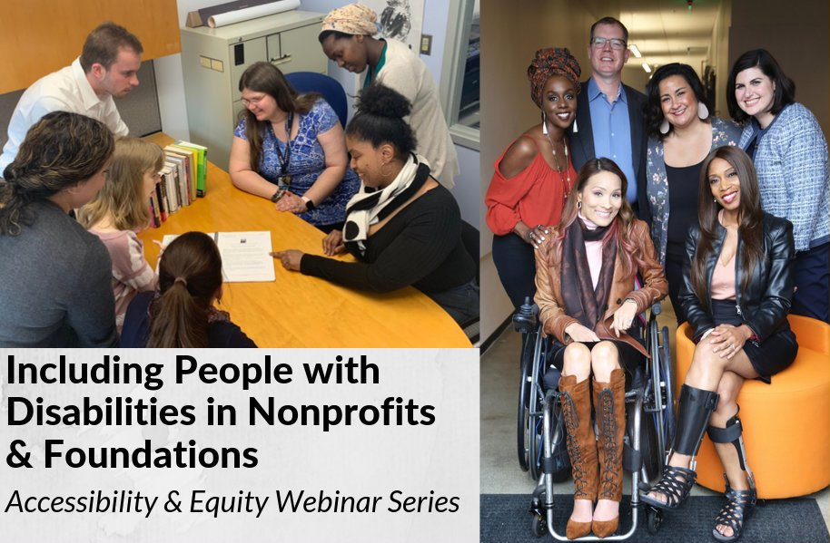
How to Recruit, Accommodate and Promote People with Disabilities Volunteer Leadership, Board Positions and Paid Employment
How to Recruit, Accommodate and Promote People with Disabilities Volunteer Leadership, Board Positions and Paid Employment

Slide 2
Equity and Access Webinar Series Partners
BoardSource
The California Wellness Foundation
Catalogue for Philanthropy, Greater Washington
Center for Disaster Philanthropy
Cerebral Palsy Foundation
The Chronicle of Philanthropy
The Communications Network
The Divas With Disabilities Project
Exponent Philanthropy
Grantmakers Concerned with Immigrants and Refugees
Media Impact Funders
National Center of Disability Journalism
National Committee for Responsive Philanthropy
National Council of Nonprofits
The New York Women’s Foundation
The Unfunded List
Weingart Foundation

Slide 3
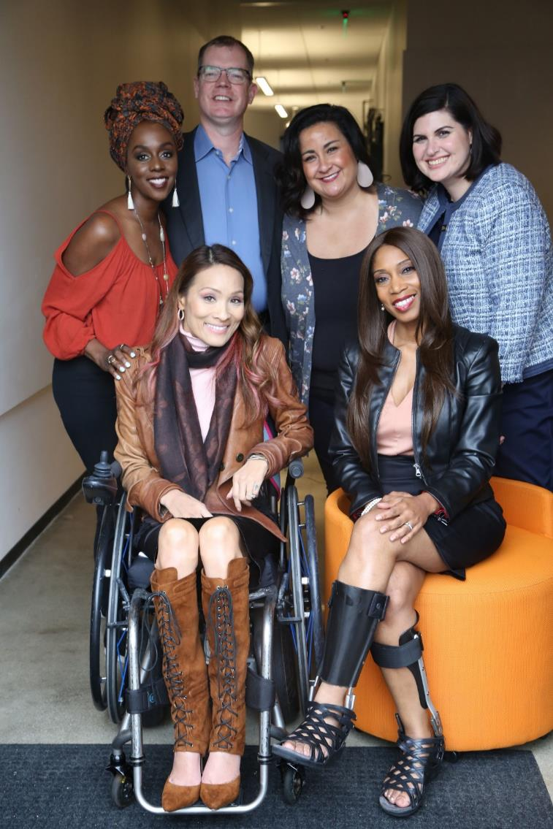
Including the D – Disability – in Diversity
Organizations are at their best when they welcome, respect and include people of all backgrounds. This includes people with disabilities.

Slide 4
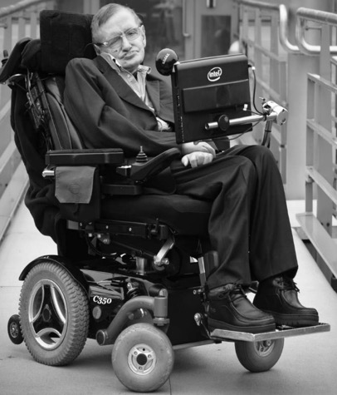
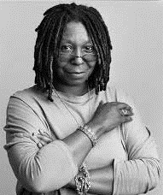
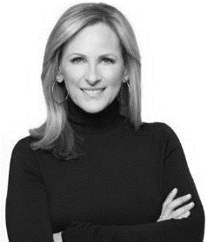
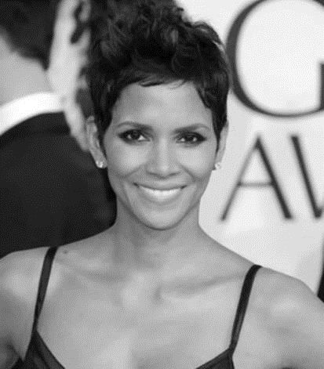
These are people with disabilities.
These are people with disabilities.

Slide 5
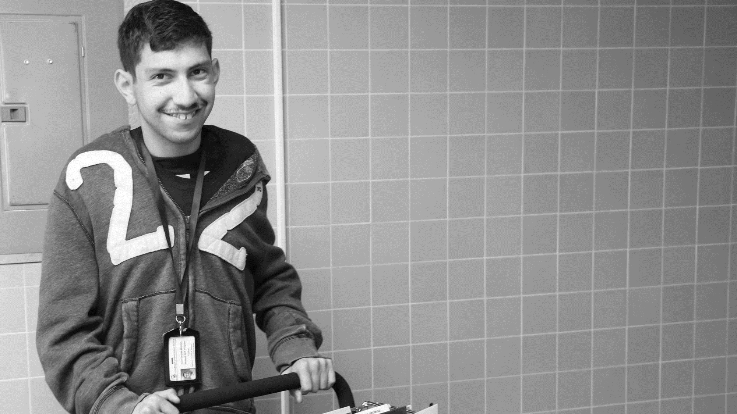
61 million people
61 Million
people in the US have a disability.*
People with disabilities
want
opportunities
Just like anyone else.
* Source: US Census

Slide 6
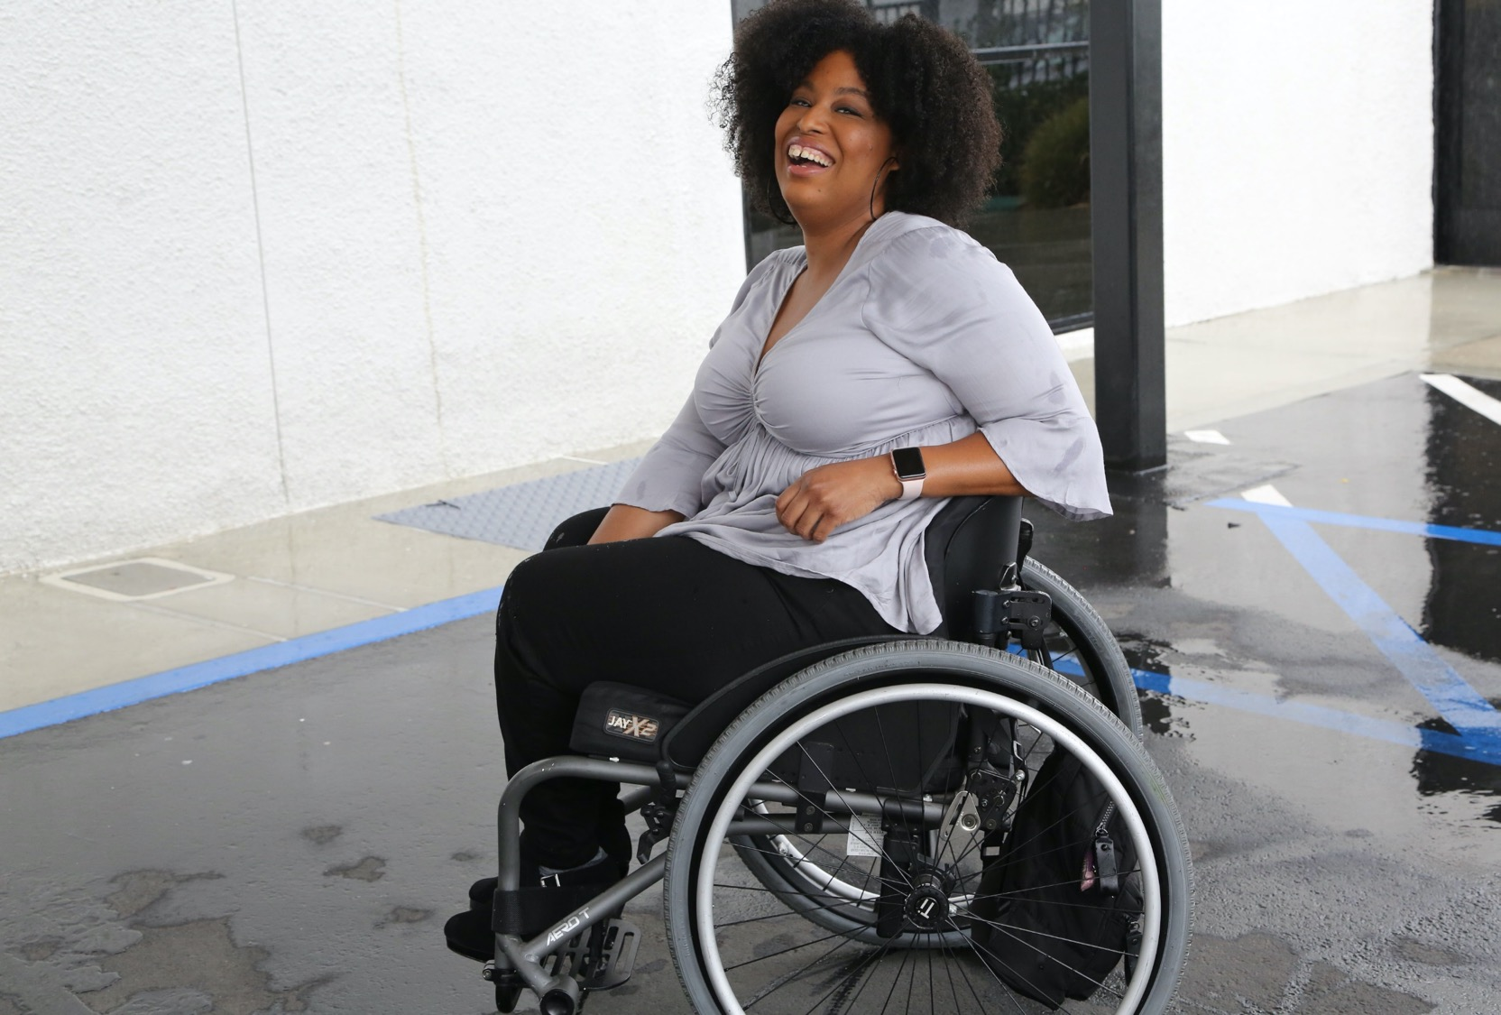
1 in 4 adults
1 in 4
adults have a disability

Slide 7
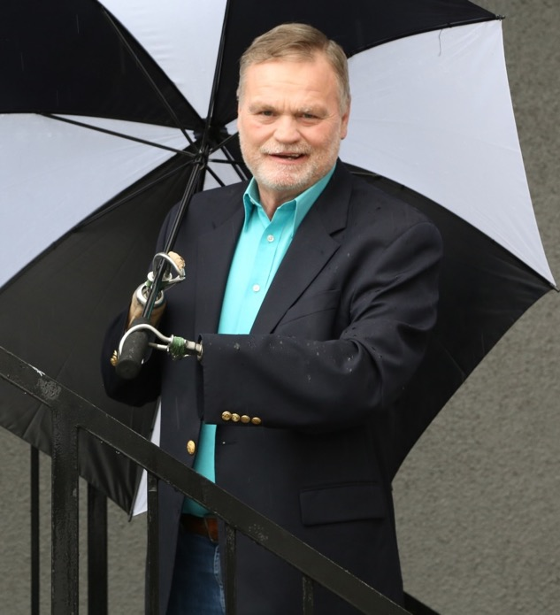
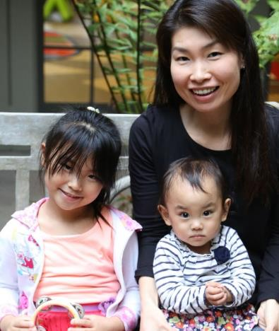
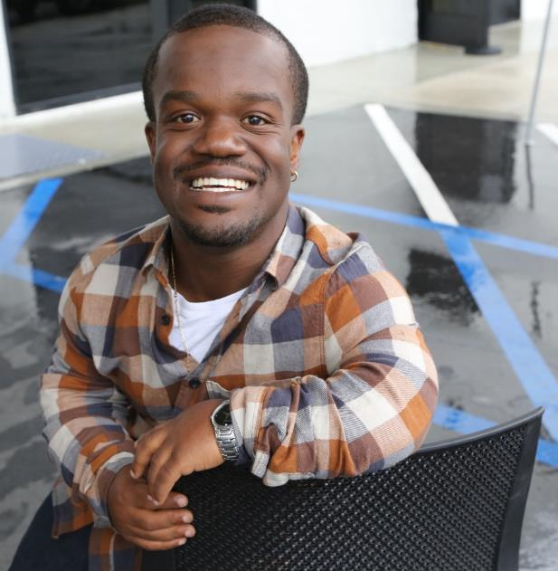
Disabilities Are….
Temporary and Permanent
Visible and Invisible
From Birth or Acquired Later

Slide 8
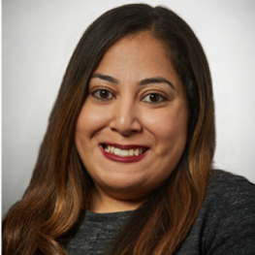
Speakers
Moderator: Randall Duchesneau
Board of Advisors, RespectAbility
Emily Harris Principal, Harris Strategies
Risa Jaz Rifkind
Director, Civic Engagement and Marketing, ADA 25 Advancing Leadership

Slide 9
Introductions
Our experience: engaging people with disabilities for volunteer roles, boards, and committees
We will address employment basics
We ARE NOT attorneys or HR experts
Notes:
EH:
You may not even know you have pwd engaged in your organization
For example – I didn’t know I had a disability until 5 years ago
Self intro
Talk about ourselves and what we do
We have experience in recruitment and working with a diverse cohort of people with disabilities who want to be civically engaged
WE ARE going to talk about what you need to know generally and ways to engage volunteers, boards, and committees
WE ARE NOT – attorneys, HR professionals experts in hiring
RR:
Talk about Advancing Leadership and your role

Slide 10
Disability inclusion at your organization
Volunteer
Opportunities for schools, summer jobs, internships, disability service providers
Leadership roles like boards and committees
Staff
Competitive integrated employment
Hire and promote
Notes:
RR:
inclusion = recruitment, hiring, retention, promotion
Volunteer opportunities could lead to a pipeline for employment– may be able to provide job coaches, etc.
Our perspective of inclusion is intentional from recruitment and outreach
We help our Members find volunteer opportunities

Slide 11
Why engage
Innovation
Increase productivity
Untapped talent pool
Know your customers
Disability lens
Notes:
RR
Like all diversity – strengthens your programs
Demonstrates your commitment
Both board and staff are important – remember to seek diversity in all sectors
Personal stories:
EH – On LFA Board as a leader representing my class, my diverse background of urban planning, economic development and disability inclusion. With my presence, the question of inclusion gets asked more frequently even if I don’t ask it.
Risa – brings a user perspective to the arts – and your leadership skills as a co-chair

Slide 12
Disability Defined
The ADA defines a person with a disability as a person who has a physical or mental impairment that substantially limits one or more major life activity. This includes people who have a record of such an impairment, even if they do not currently have a disability. It also includes individuals who do not have a disability but are regarded as having a disability.
The ADA makes it unlawful to discriminate against a person based on that person’s association with a person with a disability.
Visible, invisible, lifelong or acquired
Notes:
RR – step back
Non –attorney perspective
Give examples
Not everyone with a disability self identifies
As Emily shared before perhaps someone doesn’t think of it in that way and won’t asking for accommodations
As opposed to me…lifelong
Either way – no discrimination
Diverse perspectives are good for your organizations
Being inclusive in our language to get diversity of disability experience – visible, invisible, or acquired
Disability can change at any time

Slide 13
What is a reasonable accommodation?
Most cost < $500
Best practice to budget centrally
Guidance
Notes:
RR
Risa then Emily provide their examples of accommodations
Really think about main requirements of the job as related to duties and job description
Budget for accommodations
Keep them central – and remember to budget for board meetings, etc.

Slide 14
Accommodations and Employment Resources
Job Accommodation Network: AskJAN.org
Employer Assistance and Resource Network on Disability Inclusion (EARN)
DisabilityIN
National Organization on Disability (NOD)
Respectability
Your regional ADA Center
Your Protection and Advocacy System
Notes:
RR
These are some of the top resources
You don’t need to know it all
Ask JAN, a great resource where you can read generally but also get guidance
Protection and Advocacy Systems - your version of Equip for Equality
Regional ADA Centers

Slide 15
Disability welcoming organizations
Accessible workplace, event spaces, websites, materials
Include disability in diversity statements
Invite volunteer, board and staff candidates to request accommodations
Training
Notes:
EH
Accommodations are the heart of becoming inclusive
See previous Archived webinars and upcoming – implementing these practices will make you the kind of place pwd want to serve as staff and board
Events
Throughout the hiring process
Completing applications
Interviewing
Training
Doing the work
Train staff, board, other volunteers on diversity and inclusion
INCLUDING DISABILITY

Slide 16
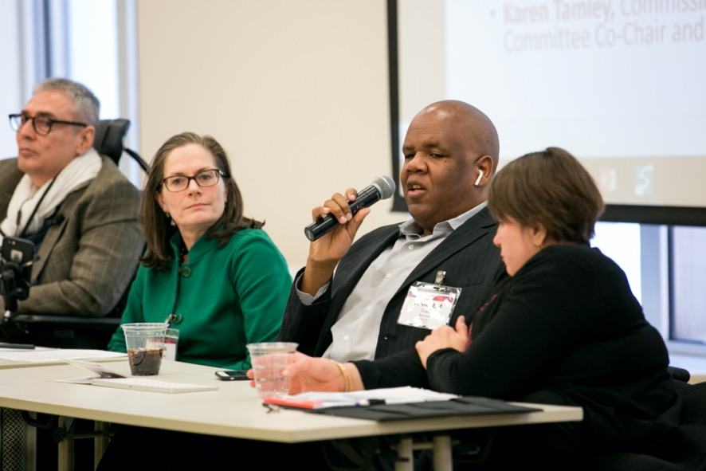
Committee and Board Members
Who are you looking for?
Time
Talent
Treasure
Perspective
Board Diversity Training
Disability is diverse
Accommodations make great meetings
Materials in advance
Microphones, captions
Accessible space
Notes:
EH:
Time and talent in addition to treasure
Why are they serving – not everyone is an advocate –
no one person represents all disabilities
STORIES – What questions people ask or perspective they bring –
Can they go on a site visit?
Are the food pantries accessible?
Do you have microphones at meetings?
But remember just because I am hard of hearing I don’t know what it’s like to use a wheelchair or have lived experience with low vision, mental or chronic illness. No one represents all disability – but the benefit is asking the questions
Many accommodations are really best practices for organizing meetings
Send materials in advance
Accessible materials and portals
Accessible space/venue
Say name which is also help for remote participation
Use microphone
Use universal design principles for meeting materials like ppt, flip charts etc
Might be specific accommodations as well

Slide 17
Qualified staff
Employees with disabilities may choose not to disclose
Focus on skills; recognize non-traditional backgrounds
Staff training: hiring managers, company culture
Notes:
EH
Remember you may have more people with disabilities already on your team than you know. They may choose to self disclose when they see it will benefit them and the organization because you are taking steps to be more inclusive. In turn, that will make them more productive, open opportunities.
Because of the low employment rate, and the interest of non-profits, many have found this path. Recognize work in the community, leadership experience in multiple contexts – at the same time not asking for any charity.
Picture:
This was an event bringing employers together with people with disabilities to talk about disability employment
PWD asked why employers didn’t ask people what they needed. Story of the water cooler – just wanted some cups.
PWD also talked about HR telling them one thing but a different experience in the actual workplace. Don’t forget to train everyone on all aspects of D&I.
Employers asked where to find qualified people.

Slide 18
Recruitment
Overcome “We can’t find…”
First steps on inclusion journey -
Find individuals ready to step into positions now
Build the Pipeline
Seek Disability Community Partnerships
Attend events
Proactive outreach
Tap public systems – rehabilitation and workforce services
Notes:
EH
– where to look – from interns, to emerging professionals, to professionals, who can meet your needs for both board and staff
- Disability service organizations
- Disability led community organizations
Workforce development staff
State Departments of Rehabilitation Services
Disability services offices in colleges and universities
Internships can be a great recruitment tool – BUT REMEMBER NOT JUST ENTRY LEVEL; also retain and promote
RR – Recruiting for Boards – and talk about your experience with recruitment this year
CILs, Arts organizations, Disability specific organizations (e.g. Hearing Loss Association of America; National Federation of the Blind (local chapters); Little People of America; etc.)
Corporate Disability Employer Resource Groups (ERGs)
Leadership programs
- Respectability
- DisabilityIN
- Advancing Leadership

Slide 19
Start now: Presentation matters
DISABILITY
Use the word
Highlight accommodations
Train hiring managers, supervisors – not just HR
Notes:
RR
Things to start right away
Unlawful to discriminate
Legal to let everyone know they may request an accommodation for an interview or to do their job
– to all – you may find people self disclose who you don’t expect
- In training of HR also include discussion around promotion
Upcoming webinars

Slide 20
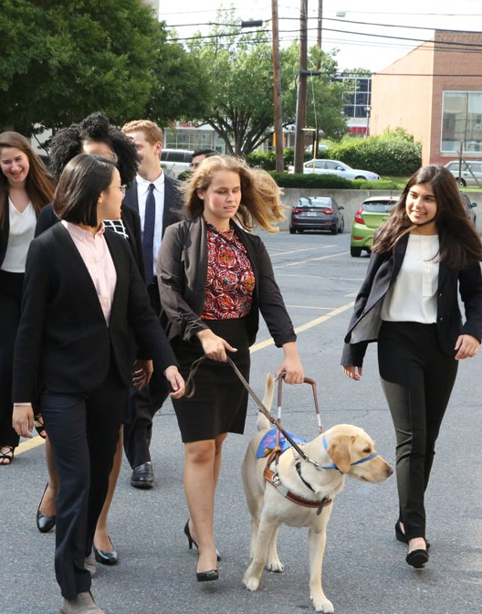
Unleash Untapped Potential
Retention and promotion are key to diversity
Bring problem-solving experience, loyalty, productivity to your organization
Accommodations and accessibility lay the groundwork for promotion and leadership
Nothing About Us Without Us!
Notes:
RR – wrap up –
It’s not just about recruitment, successful program includes promotion and leadership

Slide 21
Contact Information + Other Resources
www.RespectAbility.org | (202) 517-6272 | info@RespectAbility.org
Follow us on Social Media!
Twitter: @Respect_Ability
Facebook: RespectAbilityUSA
Instagram: @RespectTheAbility
RespectAbility’s Inclusive Philanthropy Toolkit
Access information on disability inclusion, including the new disability in philanthropy & nonprofits study: www.RespectAbility.org/inclusive-philanthropy
Learn more about ADA 25 Advancing Leadership, including contact information: www.ada25advancingleadership.org
Learn more about Harris Strategies: www.harris-strategies.com

Slide 22
Equity and Access Webinar Series Schedule
Disability 101 (available online via video, PowerPoint and transcript)
Disability History (PowerPoint online now, video available online soon)
How to Ensure Accessible Events (PowerPoint online now, video available online soon)
How to Recruit, Accommodate and Promote People with Disabilities for Paid Employment, Volunteer Leadership and Board Positions (PowerPoint online now, video available online soon)
Dec. 11, 2019: How to Ensure A Welcoming Lexicon and Inclusive Storytelling
Jan. 7, 2020: How to Ensue Accessible Websites, Social Media and Inclusive Photos
Jan. 9, 2020: Premium Skills Workshop in Social Media Accessibility
Jan. 15, 2020: How to Ensure Legal Rights and Compliance Obligations: Exploring the Rights of Employees and Participants, and the Obligations of Nonprofit Organizations Under the Law
Learn More and RSVP Here: https://www.respectability.org/accessibility-webinars/

Slide 23
Appendix – Additional Recruitment Resources
State & Local Resources that Can Help:
American Job Centers (AJCs) - These centers located in communities throughout the country offer centralized employment and training services to help people both with and without disabilities.
Centers for Independent Living (CILs) - These community-based nonprofit agencies are run by and for people with disabilities. They provide a variety of services, including those related to employment.
Disability and Veterans Community Resources Directory - Maintained by OFCCP, this directory provides a list of organizations that can assist with training, recruiting and hiring people with disabilities and veterans.
Employment Networks (ENs) - ENs are private organizations or public agencies that have agreed to provide employment and vocational services under the Ticket to Work Program.

Slide 24
Appendix - Resources
Other Resources:
Primer on Disability Inclusion
Business Strategies that Work: A Framework for Disability Inclusion
Small Business & Disability: Steps to Success
Fact Sheet on Self-Identification of Disability
ADA 25 Advancing Leadership - a Chicago region disability leadership program

