Slide 1
Disability Inclusion, Assimilation and Success – Lessons from JP Morgan Chase and Coca-Cola
www.RespectAbility.org
October 15th, 2019

Slide 2
Celebrating NDEAM – The Right Talent, Right Now

Slide 3
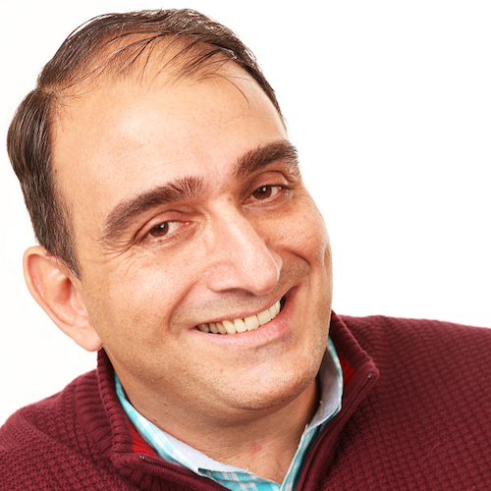
Meet Vincenzo Piscopo
Vincenzo Piscopo works as Community and Stakeholder relations director for The Coca-Cola Company where he manages the relationships with disability, veterans and Hispanic organizations as well as United Way and Hands-On Atlanta. He has worked for The Coca-Cola Company for the last 22 years in different areas of the organization: Finance, IT, Marketing and Innovation. He has a bachelor degree in Economics, an MBA from Carnegie Mellon University, a Master in Creativity from Buffalo State College and is currently working in a Master in Rehabilitation Counseling. He is the president and founder member of the This-ABILITY BRG for The Coca-Cola Company and the president and founder of the “Wheels of Happiness Foundation” where he uses his expertise to help people with motor disabilities in disadvantaged areas of the world.

Slide 4
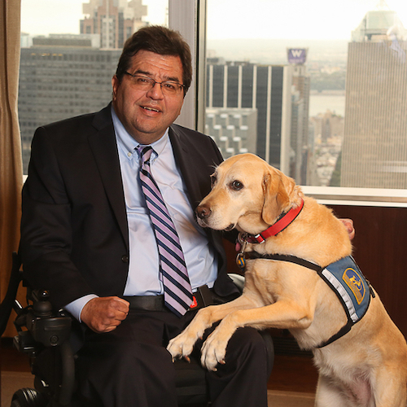
Meet Jim Sinocchi
Jim Sinocchi works closely with senior leaders across JPMorgan Chase to establish consistent standards and processes to better support employees with disabilities. The office also supports employees who care for disabled family members. Sinocchi is keenly aware of the issues and challenges facing people with disabilities as he sustained a spinal cord injury early in his business career. He has been active in creating awareness and understanding of disability inclusion through his blog, View from the Chair. He has served on the boards of Jawonio, an organization focused on the well-being and equality of people with disabilities, and the Human Rights Commission in Rockland County, NY. He is also a member of the Viscardi Center Board of Directors — a special education school in NY for severely disabled students.

Slide 5
Accenture and the Disability Inclusion Advantage
New research from Accenture, in partnership with Disability:IN and the American Association of People with Disabilities (AAPD), reveals that companies that embrace best practices for employing…have outperformed their peers.
Would you like to know more? https://www.accenture .com/_acnmedia/pdf-89/accenture-disability-inclusion-research-report.pdf
Companies that embrace employees with disabilities clearly see the results in their bottom line.
According to Accenture, disability-inclusive companies have higher productivity levels and lower staff turnover rates, are twice as likely to outperform their peers in shareholder returns and create larger returns on investment.

Slide 6
Question #1
Jim – You often talk about the 4 A’s of Disability Inclusion. What are they and why are they important?

Slide 7
Building Towards the 4 A’s – What are the 4 A’s?

Slide 8
Disability Worldwide Snapshot
One billion people, or 15% of the world’s population, experience some form of disability, and disability prevalence is higher for developing countries.
One-fifth of the estimated global total, or between 110 million and 190 million people, experience significant disabilities.
People with disabilities are more likely to experience adverse socioeconomic outcomes than persons without disabilities, such as less education, poorer health outcomes, lower levels of employment, and higher poverty rates.
People with disabilities experience barriers to full social and economic inclusion including inaccessible physical environments/transportation, the unavailability of assistive devices and technologies, non-adapted means of communication, gaps in service delivery, and discriminatory prejudice/stigmas.

Slide 9
Introduction to Jim
Introduction
A little about me …

Slide 10
Reservations and Attitudes

Slide 11
Alien Encounters

Slide 12
JPMorgan Chase: A history of support
1924
First employee to receive benefits under the disability clause of the Group Insurance plan
1993
Chemical wins The Lighthouse Inc. Employer Recognition Award for its leadership in employing and training visually impaired persons
2001
Sight-impaired Call Center employees use memory, special tools to field calls from Louisiana
2019
First bilingual ASL Chase branch (coming
1982
Blind employee finds Morgan the bank of “opportunity”
2015
Autism at Work program created
1961
Handicapped staff members fill many positions in the bank
4Q)
1989
Human Resources conducts disability awareness seminar
1998
Chase Auto Finance helps physically challenged drivers
2017
Disability Inclusion Policy Letter; “This is Me” campaign launched
1993
2018
MyAccessibility Hub, Real-time Captioning teams created; global Disability Inclusion Standards established; Employee Accessibility (EE-ally) Team created
1983
Braille computer terminal creates programming job
Equal Employment Opportunity Policy
2003
Ohio Item Processing facility wins award for helping deaf employee
1952
Winthrop Aldrich, Chairman of Chase National Bank provided statement expressing belief in hiring employees with disabilities
1992
Valley Bank organizes a task force to deal with issues concerning the Americans With Disabilities Act
2016
Office of Disability Inclusion created
1985
1969
Chase backs program for injured veterans
Morgan hosts seminar on communicating and working with the hearing impaired
1993
Morgan Delaware promotes diversity awareness

Slide 13
A strategic focus: The Four A’s
Attitude
Accessibility
Accommodations
Assimilation
Create a firmwide corporate environment with the right business strategy and “attitude” to recruit, hire, retain and advance the careers of people with disabilities.
Establish firmwide policies and strategies that ensure reasonable “accessibility” standards are maintained for employees with disabilities.
Eliminate barriers with processes and systems so candidates and employees can get the reasonable “accommodations” they require to perform their jobs.
“Assimilate” qualified people with disabilities into the firm, as well as into management and leadership positions.

Slide 14
Defining Success
“Disability inclusion is no longer about automatic doors, curb cuts, ramps, and legislation. These historic efforts were essential at the time and represented the thinking and necessary change required for people with disabilities in the 20th Century.
“Today, the new era of disability inclusion is about ‘assimilation’ — hiring professionals with disabilities into the robust culture of the firm and marketplace. Full assimilation requires a leadership team with the will, commitment and attitude to identify, train and groom professionals with disabilities for leadership positions as we do with mainstream employees.”

Slide 15
Question #2
Vincenzo – Coca-Cola is a global company and very much a journey towards greater disability inclusion. What are some key steps?

Slide 16
Question #3
Can both of you talk about business resource groups/employee resources groups? What is their role in promoting inclusion?

Slide 17
WTH is an ERG?
Definition: Increasingly, companies are establishing internal organizational structures to address the unique needs and issues of this diverse workforce. These structures, known as Employee Networks, Affinity Groups or Employee Resource Groups (ERGs), are found in 90 percent of Fortune 500 companies and are gaining additional business support throughout the country. These groups offer employees an opportunity to network, address common issues and concerns, and receive support from those who share similar backgrounds, experiences, or interests. ERGs are most effective when senior management is involved and an Executive Sponsor or Champion is assigned to lend support. Senior management participation also serves as an excellent opportunity for a CEO or other executives to be in touch with the workforce and link the group’s mission to specific business goals.

Slide 18
Question #4
What are some of the best ways to foster leadership opportunities for professionals with disabilities inside your companies?

Slide 19
Audience Questions?

Slide 20
Question #5
What are some promising practices for creating a seamless accommodation/assistive technology process?

Slide 21
Question #6
How do we harmonize disability efforts with other D&I intiatives such as promoting African-Americans, Women, or Latinx folks?

Slide 22
Question #7
How do you make disability part of the robust culture of a firm? What lessons can you draw about changing organizational culture?

Slide 23
Question #8
Vincenzo – Talk to us about the Unlabeled Campaign? What is driving this effort?

Slide 24
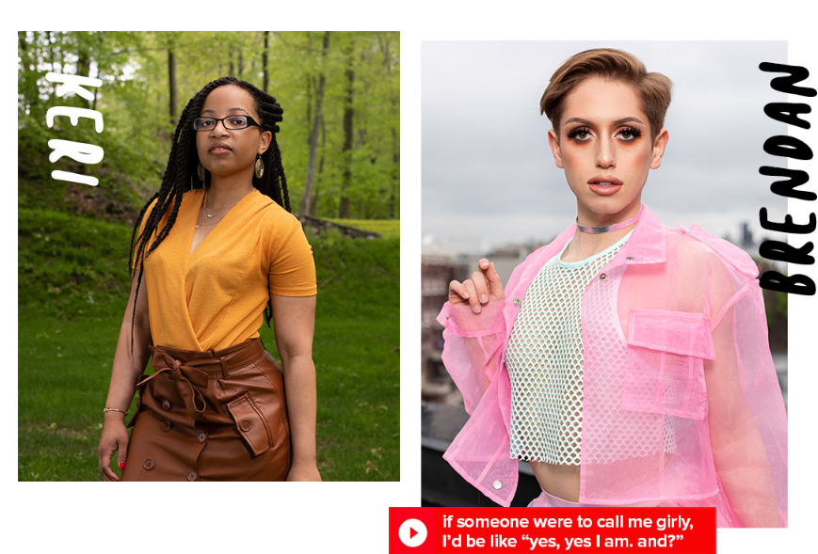
Coca-Cola’s Unlabeled Campaign

Slide 25
Foster Dialogues about Labels
question 1 – our minds are naturally geared towards the use of labels; labels and categories help us make sense of the world. however, when labels are applied to people they can be incredibly limiting and can prevent us from really seeing and understanding each other. jason described this when he said, ‘as a young black man you have 19 things that people know about you before you get to introduce yourself’. share a moment where you have labeled someone and they surprised you.
question 2 As Nauman says, ‘some labels are chains and some labels are wings’. Share an example of labels being either ‘chains’ or ‘wings’.
question 3 What is one action you can take to help create an environment at work, school, or in life where others can bring their whole selves?
Feeling inspired? Help us keep the conversation going by sharing your [unlabeled]™ experience on social using #unlabeled @dietcoke @civicdinners and continue to start new conversations with friends, family or colleagues.

Slide 26
Question #9
Let’s talk Internships. What role do internships provide in terms of recruiting, training and promoting talented PWDs?

Slide 27
Audience Questions – 2?

Slide 28
Would You Like to Know More?

Slide 29
Please Join Us for Next Week’s Webinar
Webinar: Iowa Voc Rehab’s Stories of Successful Business Engagement and Disability Hiring
Date: Tuesday, October 22, 2019 Time: 1:30 p.m. ET / 12:30 p.m. CT / 11:30 a.m. MT / 10:30 a.m. PT Duration: 1 hour 30 minutes
RSVP: https://secure.confertel.net/tsRegisterD.asp?course=6269082
Speakers: David Mitchell, CRC IVRS Administrator Michelle Krefft, Business Relations Manager, IVRS Philip Kahn-Pauli, Policy and Practices Director, RespectAbility

Slide 30
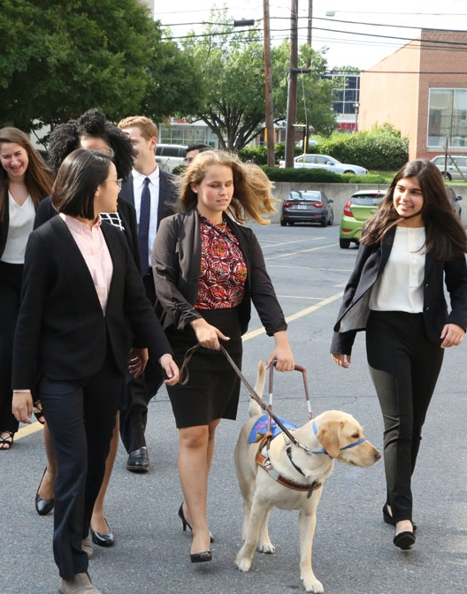
Please also join us for our last NDEAM Webinar
Webinar: Creating a Culture of Inclusion for Talented Employees with Disabilities
Date: Wednesday, October 30, 2019 Time: 1:30 p.m. ET / 12:30 p.m. CT / 11:30 a.m. MT / 10:30 a.m. PT Duration: 1 hour 30 minutes
RSVP: https://secure.confertel.net/tsRegisterD.asp?course=6269080
Speakers: Philip Kahn-Pauli, Policy and Practices Director, RespectAbility

Slide 31
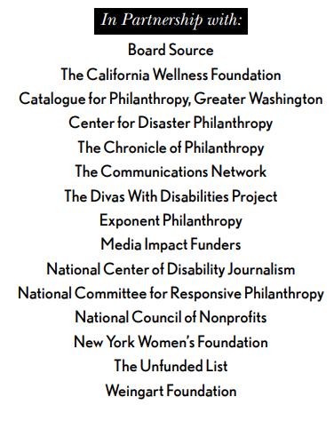
Upcoming Equity Webinars!
Disability discrimination is rampant and is happening every day – despite the fact that people want to do the right thing and that most of the ways to include people with disabilities in your important work are actually free. It’s all about getting the skills to do it right. RespectAbility’s upcoming series of free webinars will give you and your teams step-by-step guidance, as well as provide resources and contacts to help foundations and nonprofits on their journey. Join for one or all! Each webinar will include live captioning. Accessible PPTs can be sent to participants ahead of time for use with screen readers.

Slide 32
Equity Series Schedule
Schedule of Webinars
Nov. 6, 2019: Disability 101
Nov. 13, 2019: Disability History
Nov. 20, 2019: How to Ensure Accessible Events
Dec. 4, 2019: How to Recruit, Accommodate and Promote People with Disabilities for Paid Employment, Volunteer Leadership and Board Positions
Dec. 11, 2019: How to Ensure A Welcoming Lexicon and Inclusive Storytelling
Jan. 7, 2020: How to Ensue Accessible Websites, Social Media and Inclusive Photos
Jan. 9, 2020: Premium Skills Workshop in Social Media Accessibility
Jan. 15, 2020: How to Ensure Legal Rights and Compliance Obligations: Exploring the Rights of Employees and Participants, and the Obligations of Nonprofit Organizations Under the Law
Learn More and RSVP Here: https://www.respectability.org/accessibility-webinars/

Slide 33
THANK YOU!
Jennifer Laszlo Mizrahi
www.RespectAbility.org
Cell: (202) 365-0787
JenniferM@RespectAbility.org

