Slide 1
Creating a Culture of Inclusion for Talented Employees with Disabilities
Philip Kahn-Pauli
Policy and Practices Director www.RespectAbility.org
October 31st, 2019

Slide 2
Today’s Learning Objectives
#1 Participants will learn ways to utilize existing internal communication processes as a means of promoting a disability-inclusive culture in the workplace.
#2 Participants will learn how to leverage external communication tools to create interest among job seekers with disabilities.
#3 Participants will learn how to develop new and unique communication strategies, both internal and external, to promote disability inclusion.

Slide 3
Mission:
To fight stigmas and advance opportunities so that people with disabilities can fully participate in all aspects of community.

Slide 4
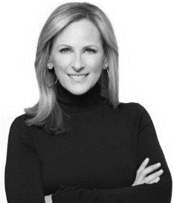
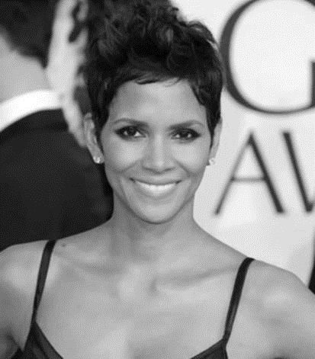
These are the faces of people with disabilities.

Slide 5
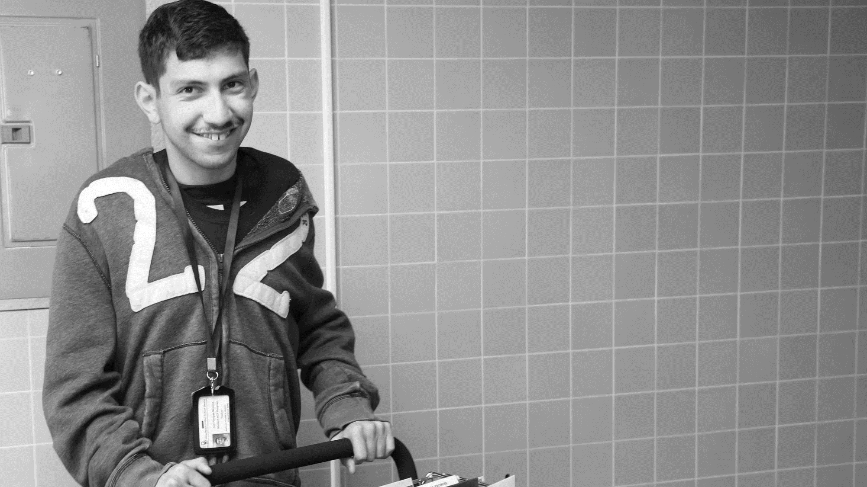
61 Million
people in the US have a disability.*
People with disabilities
want
opportunities
Just like anyone else.
* Source: US Census

Slide 6
1 in 4
adults have a disability

Slide 7
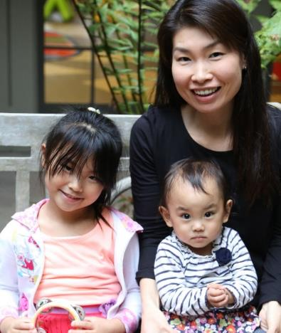
Disabilities Are….
Visible and Invisible
Born with it or Acquired
Temporary and Permanent

Slide 8
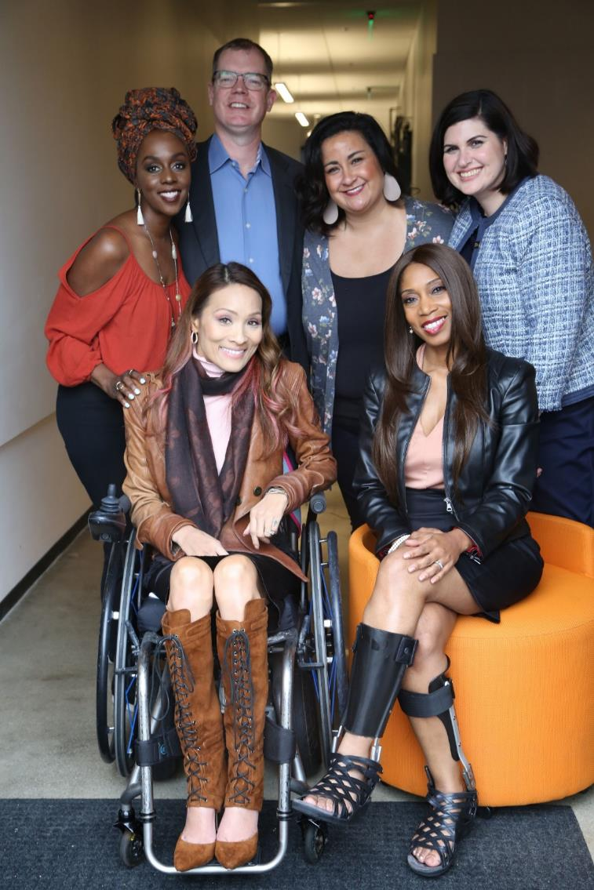
The disability community is cutting edge and innovative.
Anyone can join the disability community at any point.
People with disabilities are diverse and part of all communities.

Slide 9
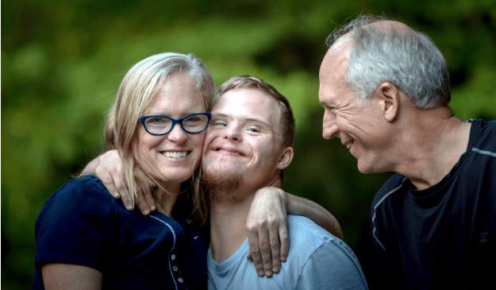
Americans with Disabilities are Connected to Communities
have a family member with a disability
have a close friend with a disability
48%
42%
* Source: September 2012 poll, Laszlostrategies.com

Slide 10
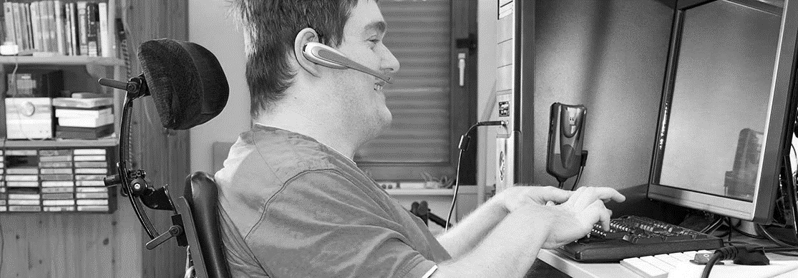
Only 65% of people with disabilities finish high school.
Only 7% of people with disabilities complete college.
Only 1 in 3 people with a disability have a job.
What can be done to ensure success for people with disabilities?

Slide 11
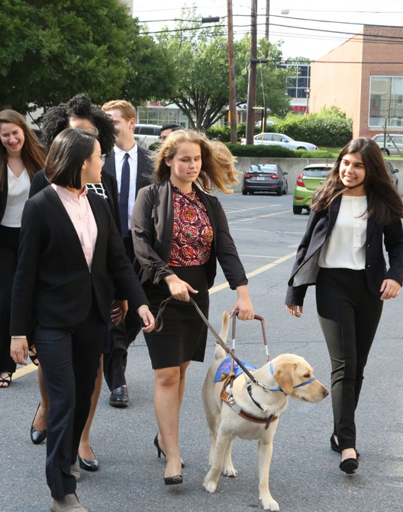
Untapped Potential
People with disabilities have problem-solving experience, as well as loyalty to their employers.
Companies that recruited and supported employees with disabilities have a 30% greater profit margin.
* Study completed by Accenture, Disability:IN and the American Association of People with Disabilities
Notes:
I added the study information from Philip’s deck as a footnote. His deck had two additional stats- 28% higher revenue and double net income. I opted to just include one stat here to keep it simple. However, if you want me to add those stats or replace this one with one of those, let me know.

Slide 12
Building Towards the 4 A’s – What are the 4 A’s?

Slide 13
Defining The 4 A’s…
Attitude – Create a firmwide corporate environment with the right business strategy and attitude to recruit, hire, retain and advance the careers of people with disabilities.
Accessibility – Establish firmwide policies and strategies that establish reasonable accessibility standards for all employees with disabilities as it pertains to technology, real estate, and work environments including meetings and conferences.

Slide 14
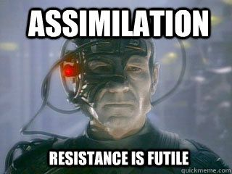
Defining The 4 A’s…Part 2
Accommodations – Continually look for ways to eliminate barriers with processes and systems that enable job candidates and employees to obtain reasonable accommodations they require to perform their essential job roles in accordance with their job functions and business goals.
Assimilation – “Assimilate” qualified people with disabilities into the firm’s culture of merit and inclusiveness, including management and leadership positions.

Slide 15
Mission:
To fight stigmas and advance opportunities for people with disabilities,
1
Internal Communications to promote a disability-inclusive culture in the workplace
2
External Communications to attract the best talent possible aka hiring PWDs
3
New Communications Strategies to promote disability inclusion

Slide 16
Internal Communications
1
CEO Leadership
Self-Identification Campaigns
Centralized Accommodations System
Employee Resource Groups
People with disabilities are viewed as capable contributing members of the firm and society at large.

Slide 17
OFCCP > Learning the Lessons of Section 503
The Office of Federal Contract Compliance Programs (OFCCP) is moving forward with an Excellence in Disability Inclusion awards program.
Program will celebrate nominated federal contractors who are the leading edge of recruiting, hiring and retaining qualified PWDs.
Source: https://bit.ly/2KhralB

Slide 18
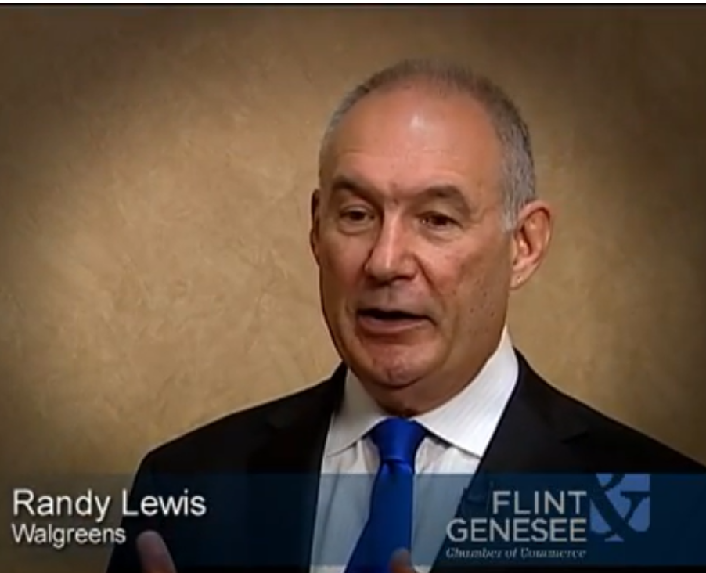
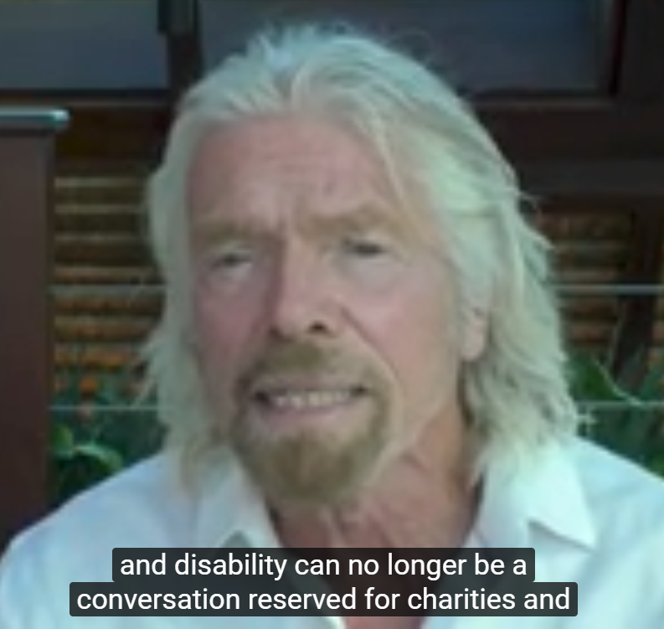
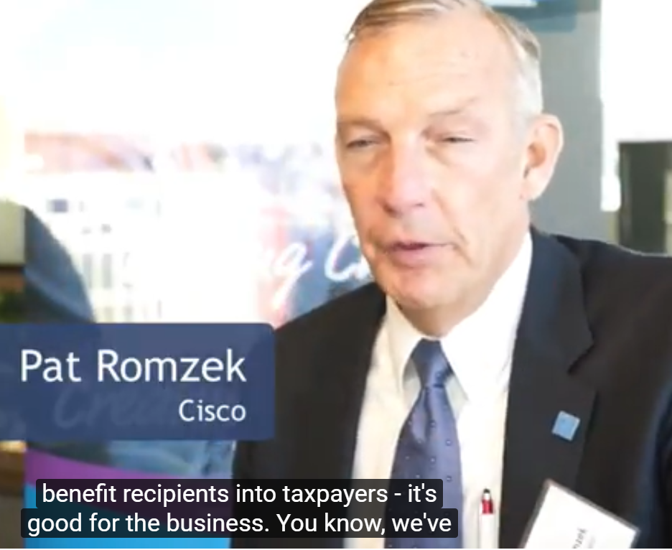
CEO Leadership
From OFCCP > CEO Leadership through Correspondence and Video – Support from senior leadership is crucial for workforce programs to be effective. Contractors are encouraged to support their Disability Inclusion programs via various forms of media releases, both internally and externally.

Slide 19
Self-Identification Campaigns
From AskEARN: While the choice to self-identify as a person with a disability is entirely up to the individual, employers are increasingly interested in fostering an environment that encourages self-identification in order to:
Increase hiring and retention of qualified individuals with disabilities to capitalize on their unique skillset, talents, experiences and perspectives. Ensure they are creating and sustaining diverse and inclusive workplaces.
Achieve compliance with federal regulations requiring affirmative action in disability hiring, such as Sections 501 and 503 of the Rehabilitation Act, which cover federal agencies and federal contractors, respectively.
Strategies for Creating an Environment that Encourages Self-Identification
On a positive note, individuals with disabilities have reported that they are more likely to self-identify if they see their employer making concerted efforts to recruit and hire individuals with disabilities
Include disability in your company’s diversity statement
Making sure disability is included in your company’s diversity statement sends a message to current employees, potential employees, and customers.

Slide 20
Learning from the Best-Northrup Grumman
https://www.diversitybestpractices.com/sites/diversitybestpractices.com/files/attachments/2017/05/kurby_slides_cracking_the_self-id_nut_-_northrop_grummans_story_-_dbp.pdf
Objectives of the New Campaign: To provide an opportunity for individuals to self-identify as LGBT, Person with a Disability, and/or Veteran.
Convey importance of self-identification by: o Answering “What’s In It For Me” to self-identify o How will the company benefit? o What will be the impact? o How will you protect my identity?
Create a communications campaign that includes videos, FAQs, website on how and why self-identify.
Next Steps for a Campaign > Feature on New Employee On-Boarding Website • Communicate Quarterly Across the Enterprise • Share at ERG Meetings • Take it Globally

Slide 21
Centralized Accommodation System
Lessons from OFCCP and Section 503:
Centralized accommodation systems are a best practice in hiring and retaining employees with disabilities.
With centralized accommodation systems, contractors can improve and streamline the accommodation process making it more efficient for employees with disabilities.
A centralized accommodation system also helps ensure that contractors have sufficient expertise and funds in place to ensure accommodations requests are being appropriately reviewed and accommodations appropriately provided throughout the company.
This is an efficient, high impact approach for contractors to better serve their employees.
Source: https://www.dol.gov/ofccp/Section503-FocusedReviews/files/Section503BestPracticesUpdated-FEDQA508c.pdf

Slide 22
The Job Accommodation Network on a CAF
Establishing a centralized accommodation fund requires:
Commitment from C-Suite or VP level is essential;
Develop a team of change agents to manage the process of developing and implementing the CAF;
Communicate to everyone involved the business case for what is being asked of them – it can be formal or informal – but everyone must know why a CAF is being instituted – communicate, communicate, communicate;
Know what accommodation tools and services will be covered
Bring consistency to your entire process;
Use technology to track your accommodation requests;
And, bring all the stakeholders into the process from the beginning.
Source: https://askjan.org/articles/Best-Practices-in-Establishing-a-Centralized-Accommodation-Fund.cfm

Slide 23
Accommodations Resources
Job Accommodation
Network: AskJAN.org
JAN is the leading source of free, expert and confidential guidance on workplace accommodations and disability employment issues.
Working toward practical solutions that benefit both employer and employee, JAN helps people with disabilities enhance their employability, and shows employers how to capitalize on the value and talent that people with disabilities add to the workplace.
Recent JAN activities and areas of focus include:
JAN Workplace Accommodation Toolkit
JAN Just-In-Time Training Modules
Workplace Accommodations: Low Cost, High Impact

Slide 24
WTH is an ERG?
Definition: Increasingly, companies are establishing internal organizational structures to address the unique needs and issues of this diverse workforce. These structures, known as Employee Networks, Affinity Groups or Employee Resource Groups (ERGs), are found in 90 percent of Fortune 500 companies and are gaining additional business support throughout the country. These groups offer employees an opportunity to network, address common issues and concerns, and receive support from those who share similar backgrounds, experiences, or interests. ERGs are most effective when senior management is involved and an Executive Sponsor or Champion is assigned to lend support. Senior management participation also serves as an excellent opportunity for a CEO or other executives to be in touch with the workforce and link the group’s mission to specific business goals.

Slide 25
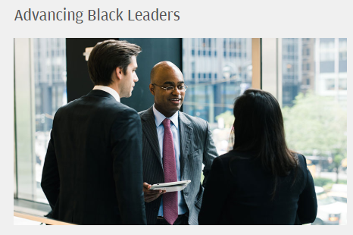
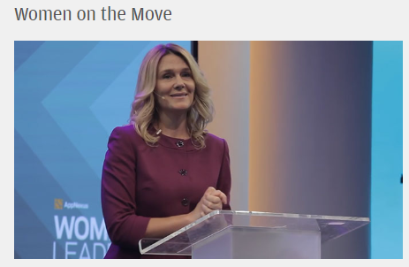
The ERG Process - Step 1-4
Getting Started:
Step 1: Start at the Top – Gain the Support of Corporate Executives
Step 2: Create Partnerships with Your Diversity Teams
Step 3: Get Employees Involved
Step 4: Develop Budget and Secure Funding
Example of Promising Practices > JP Morgan Chase: https://www.jpmorganchase.com/corporate/About-JPMC/ab-employee-programs.htm

Slide 26
The ERG Process - Steps 5-12
Implementation: Step 5: Name the Group / Step 6: Set Mission and Goal
Step 7: Design a Structure/ Step 8: Create an Innovative Business Strategy
Step 9: Overcome Challenges / Step 10: Maintain Momentum
Step 11: Leverage Relationships / Step 12: Measure Success

Slide 27
External Communications
2
Celebrating Leaders with Disabilities
Accessible Recruiting Tools
Coordinate with local Voc Rehab Agencies
People with disabilities are recruited, hired and promoted across the firm and the wider workforce.

Slide 28
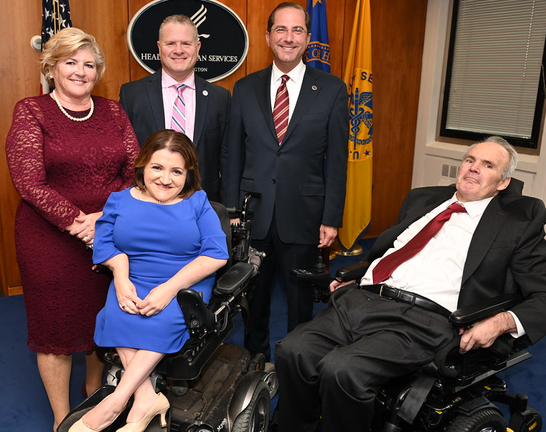
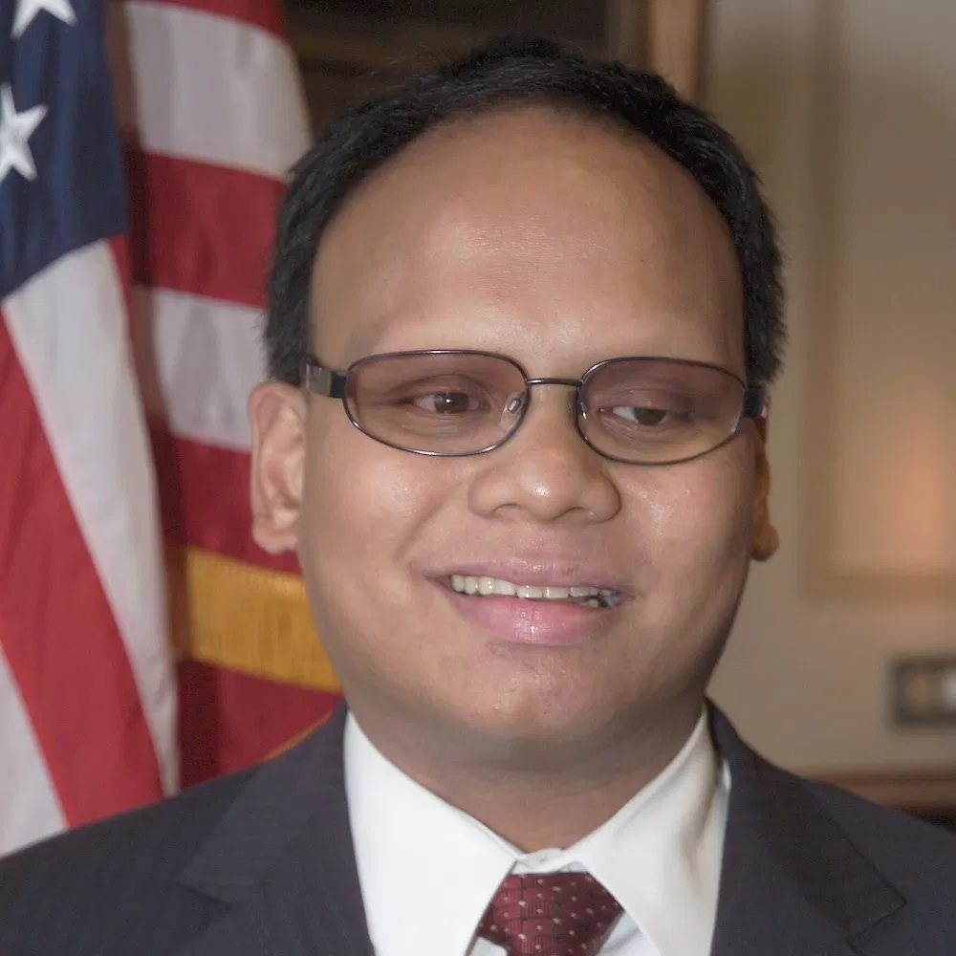
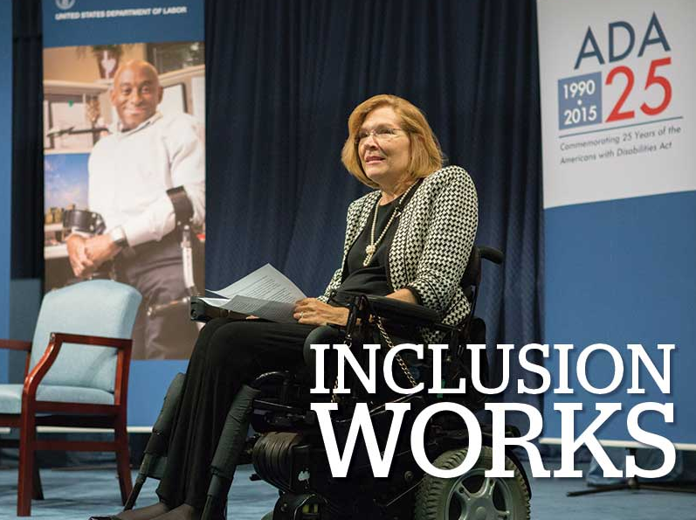
Celebrate Leaders with Disabilities
October is National Disability Employment Awareness Month.
Consider having an event to celebrate Federal employees w/ disabilities.

Slide 29
Celebrate Leaders & Programs
Find and celebrate leaders who are achieving tremendous things results for PWDs.
Consider taking public nominations for award recipients.

Slide 30
Employer Resources
(EARN) helps employers recruit, hire, retain and advance people with disabilities.
EARN also maintains a website, AskEARN.org, which provides information on: recruiting and hiring; retention and advancement; laws and regulations; creating an accessible and welcoming workplace; and federal contractor requirements.
Other Resources:
Primer on Disability Inclusion
Business Strategies that Work: A Framework for Disability Inclusion
Small Business & Disability: Steps to Success
Fact Sheet on Self-Identification of Disability
Employer Assistance and Resource Network on Disability Inclusion (EARN)

Slide 31
Right There in the Job Description
Additional elements should include:
Environmental Factors: Describe the environment an individual will encounter in performing the position. Consider the total environment, and imagine it from the perspective of a new employee. Are the lights bright or dim? Is the work area busy and noisy, or quiet and isolated? Consider such factors as air quality, and any materials that need to be handled on a regular basis. This element may be especially important for OSHA compliance.
A Comprehensive Break Down of Physical Requirements: Describe both the obvious and less-obvious physical requirements of a position. Examples of requirements might include: lifting requirements, including weight and frequency of such lifting; hours per day to be spent standing, sitting or walking; and hours per day spent typing, leaning over an assembly line, etc.
Schedule and Location: The preferred schedule and number of hours worked per week should be stated explicitly. If there is an option for flexibility, a statement to that effect could also be included. Describe whether the employee is expected to report to work in a specific location, or if telework is an option. Attendance can be considered an essential function when required to perform the job. Being clear about this requirement from the outset can help prevent difficult conversations in the future.
http://www.askearn.org/topics/recruitment-hiring/job-descriptions/
A detailed job description is the cornerstone of many human resources objectives.
A well-crafted job description can be useful in attracting and retaining qualified employees with disabilities, and should contain detail beyond what is included in a vacancy announcement.
A job description that covers more than just basic information can be a useful tool throughout the employment process.

Slide 32
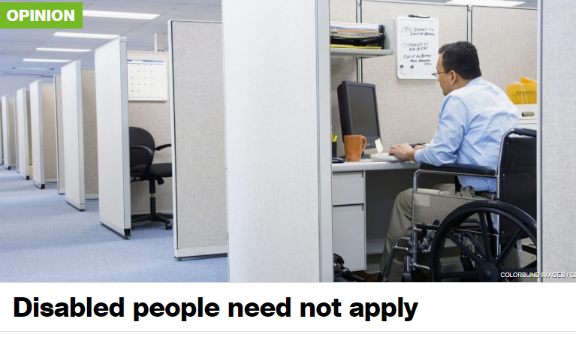
From the Desk of David M. Perry @lollardfish
Go to your favorite job site and search for ‘25 pounds.’ You’ll be shocked at how many non-manual-labor jobs have lifting requirements.
Unintentional discrimination is still discrimination.
Boilerplate clauses keep disabled people from even applying for jobs. “Requirement creep,” likely put in place by HR professionals eager to avoid trouble, exacerbates discrimination and could, if someone had the time and money, lead to legal trouble.

Slide 33
Help Wanted!
When a job posting includes information about access, accommodations, and flexibility, it can be a signal to applicants that the workplace values disabled candidates—which is the first step toward trusting that they also will value their disabled employees.
https://qz.com/1569134/how-to-write-inclusive-job-descriptions-for-people-with-disabilities/

Slide 34
“Where can I find job candidates with disabilities?”
Many employers say that one of the greatest barriers they face in hiring people with disabilities, is that they have trouble finding candidates. That’s where effective outreach and recruitment strategies come in. State & Local Resources that Can Help:
American Job Centers (AJCs) - These centers located in communities throughout the country offer centralized employment and training services to help people both with and without disabilities.
Centers for Independent Living (CILs) – These community-based nonprofit agencies are run by and for people with disabilities. They provide a variety of services, including those related to employment.
Disability and Veterans Community Resources Directory – Maintained by OFCCP, this directory provides a list of organizations that can assist with training, recruiting and hiring people with disabilities and veterans.
Employment Networks (ENs) – ENs are private organizations or public agencies that have agreed to provide employment and vocational services under the Ticket to Work Program.

Slide 35
Coordinate with local Voc Rehab Agencies
Many employers tell us that one of the greatest barriers they face in hiring people with disabilities, including veterans with disabilities, is that they have trouble finding qualified candidates. That’s where effective outreach and recruitment strategies come in.
Working with state and local service providers, such as vocational rehabilitation agencies, American Job Centers, Centers for Independent Living (CILs) and other community-based organizations, is key to helping you find qualified candidates with disabilities.

Slide 36
For Example: Leverage the Expertise of CSAVR
Council of State Administrators of Vocational Rehabilitation (CSAVR) CSAVR is a network comprised of the 80 Directors that manage the VR programs in every state, Washington, D.C., and U.S. territories. CSAVR coordinates the following resources:
National Employment Team (NET): The NET is a national team of VR Business Consultants that provide direct access to employment-ready candidates in the public VR system, and support disability employment specialists in providing services to these candidates. Designed in collaboration with business partners and supported by VR leadership, the NET provides business customers in every state, Washington, D.C., and U.S. territories with a range of services — from basic disability training for staff, to pre-employment support, to building a talent pipeline, to retention services, to diversity and compliance strategies, to a range of technical support.
Talent Acquisition Portal (TAP): TAP is an online system which includes both a national pool of Vocational Rehabilitation candidates looking for employment and a job posting system for businesses looking to hire people with disabilities. TAP also supports Virtual Job Fairs that include candidates with disabilities from across the U.S.

Slide 37
Positive Messaging Works
Q 10. What do you think is the most compelling reason to include and increase opportunities for people with disabilities? | All Respondents
Organizations are at their best when they welcome, respect and include people of all backgrounds. This includes people with disabilities. | 44%
Problems are best solved by working with people who have experienced them first hand and know solutions that work. Just like issues that impact people of different racial, ethnic or other backgrounds, people with disabilities should be involved in solving issues that impact them. | 24%
Our nation was founded on the principle that anyone who works hard should be able to get ahead in life. People with disabilities deserve equal opportunity to earn an income, achieve independence and be included, just like anyone else. | 18%
Companies including Microsoft, JPMC, Coca-Cola and others have seen that talented people with disabilities can bring unique experiences, innovation and determination to organizations. It is time for nonprofits and philanthropy to benefit from what people with disabilities CAN do. | 8%
Only 1 in 3 people with a disability has a job. People with disabilities are twice as likely to be poor as people without disabilities. They are disproportionally impacted by issues of school suspension and dropping out, unemployment, homelessness, abuse, incarceration and other issues. | 7%

Slide 38
Strong Response to Disability Employment
Now I am going to read you statements from people who want political and business leaders to make employment for people with disabilities a national priority. After each statement I read, please tell me if you find it to be a very convincing, somewhat convincing, not very convincing or not at all convincing reason to make increasing levels of employment among people with disabilities more of a national priority.
Our nation was founded on the principle that anyone who works hard should be able to get ahead in life. People with disabilities deserve the opportunity to earn an income and achieve independence, just like anyone else
People with disabilities bring unique characteristics and talents to workplaces that benefit employers and organizations. Stephen Hawking is a genius who happens to use a wheelchair. People with disabilities can work in hospitals, hotels, be super talents in developing computer software and in many other fields
r
Companies including Amazon, Starbucks, Pepsi and others have shown that employees with disabilities are loyal, successful and help them make more money. If we find the right jobs for the right people it can and does increase the bottom line of companies

Slide 39
New Communications Strategies
3
Learn from the Trailblazers – Poses Workplace Initiative
Identify and Change Processes – Microsoft’s Lesson
Unlabeled by Coca-Cola
Leading the Way at JP Morgan Chase
Diverse people with disabilities drive innovation & solutions in the firm and the world beyond.

Slide 40
Learn from the Trailblazers – Benefits of Inclusion
Inclusion Works
Increased talent pool
90% perform on par or better
48% greater tenure
40% less absenteeism
$225B Market Opportunity
Employees
Managers report no difference in working with those with disabilities
Managers report improved culture
Policy changes or work adjustments are good for everyone
Culture/ Climate

Slide 41
Obstacles and Frameworks
Obstacles
Framework
Become a catalyst for the employment of people with disabilities by creating a high volume of jobs in a relatively short period of time by using a variety of models
Companies
Low demand for hiring people with disabilities
Few case studies of hiring at volume
Little knowledge of how to find, recruit, hire or retain
Few disability inclusion consultants
Disability/Workforce Agencies
Little understanding of business needs
Little benefit to jobseekers from large-scale workforce development programs
National: Company readiness through one-to-one or cohort
Local: Networks of businesses, government, nonprofit agencies
Funders
Low interest from foundations on disability employment
Field-Building: Increased numbers of consultants and funders

Slide 42
Connecting National/Local Strategies
National Strategy
Field-Building
We support major corporations to implement largescale disability hiring programs.
We collaborate across the field to share knowledge, increase resources, and amplify impact. We build capacity and expertise in the field to activate a new generation of leaders in disability inclusion.
Local Strategy
We support local communities to collaborate and employ people with disabilities locally.

Slide 43
Focus on Delivery and Initial Scale
3
Horizon 3
Deliver and scale
2
Horizon 2
Learn and thrive
1
Horizon 1
Set foundation
Q4 2015– Q1 2016
Q2 2016 – Q3 2016
Q4 2016 -
Q4 2017
Establish national & cluster inclusion programs
Establish a number of field-building programs
Strengthen business case for hiring people with disabilities
Grow program and codify learnings
Publish case studies and learnings
Encourage other employers and communities to scale

Slide 44
Bringing It All Together > Action and Learning
Action
Transform HR practices (certifications, employee referrals, etc.)
Establish model companies
Build on current communities
Improve technology for job seekers
DIY
Guide
Company
Cohorts
Learning
Increase knowledge of the pipeline
Increase knowledge of policy levers

Slide 45
Would You Like to Know More?

Slide 46
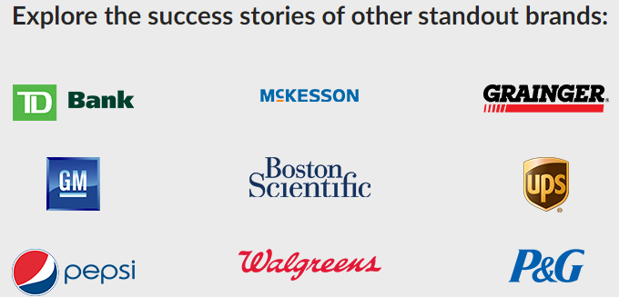
Poses Family Foundation – Workplace Initiative
The Workplace Initiative was founded as a national network of foundations, companies, nonprofits and government agencies that worked to remove barriers to successful careers for people with disabilities. Started in 2012, the agency was spearheaded by a team of experts in disability inclusion at the Poses Family Foundation (PFF), a New York City–based philanthropic foundation founded by Nancy and Fred Poses.
https://workplaceinitiative.org/wp-content/uploads/2017/02/Disability-Employment-and-Inclusion_Your-Guide-to-Success.pdf

Slide 47
The National Organization on Disability (NOD)
Challenge: Many employers are struggling to advance disability workplace inclusion and, at a time when talent attraction is a top business priority. It’s imperative to develop a disability inclusion baseline to measure adoption of best practices.
Actions: The Disability Employment Tracker™, NOD’s confidential, corporate self-assessment, allows employers to benchmark their disability inclusion practices against other leading companies.
Employers receive a free Scorecard measuring six inclusion aspects: Climate & Culture; Talent Sourcing; People Practices; Workplace & Technology; Strategy & Metrics; and Veterans Employment.

Slide 48
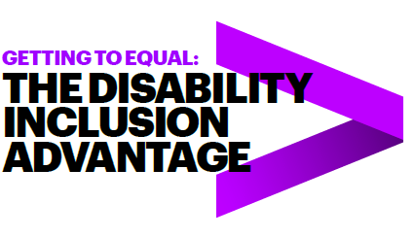
Accenture and the Disability Inclusion Advantage
New research from Accenture, in partnership with Disability:IN and the American Association of People with Disabilities (AAPD), reveals that companies that embrace best practices for employing…have outperformed their peers.
Would you like to know more? https://www.accenture .com/_acnmedia/pdf-89/accenture-disability-inclusion-research-report.pdf
Companies that embrace employees with disabilities clearly see the results in their bottom line.
According to Accenture, disability-inclusive companies have higher productivity levels and lower staff turnover rates, are twice as likely to outperform their peers in shareholder returns and create larger returns on investment.

Slide 49
Identify and Change Process – Microsoft’s Lesson
At Microsoft, managers realized that people with autism weren’t getting hired despite clearly having the required knowledge and intellect.
As Jenny Lay-Flurrie, the company’s chief accessibility officer, told us, “We discovered that the problem was the interview process, so we did away with that process entirely for candidates with autism.” Microsoft instead began working with a local autism-support organization
to bring in candidates for a different type of evaluation process. The assessment program involved a series of exercises designed to test teamwork and technical skills; it also provided real-time training.
This way of thinking also applies to people development and training processes. Even small changes in standard training programs can make a big differenc

Slide 50
Coca-Cola’s Unlabeled Campaign

Slide 51
Foster Dialogues about Labels
question 1 – our minds are naturally geared towards the use of labels; labels and categories help us make sense of the world. however, when labels are applied to people they can be incredibly limiting and can prevent us from really seeing and understanding each other. jason described this when he said, ‘as a young black man you have 19 things that people know about you before you get to introduce yourself’. share a moment where you have labeled someone and they surprised you.
question 2 As Nauman says, ‘some labels are chains and some labels are wings’. Share an example of labels being either ‘chains’ or ‘wings’.
question 3 What is one action you can take to help create an environment at work, school, or in life where others can bring their whole selves?
Feeling inspired? Help us keep the conversation going by sharing your [unlabeled]™ experience on social using #unlabeled @dietcoke @civicdinners and continue to start new conversations with friends, family or colleagues.

Slide 52
Leading the Way at JP Morgan Chase

Slide 53
Remember the Four A’s

Slide 54
What did we learn today?
#1 Participants learned ways to utilize existing internal communication processes as a means of promoting a disability-inclusive culture in the workplace.
#2 Participants learned how to leverage external communication tools to create interest among job seekers with disabilities.
#3 Participants learned how to develop new and unique communication strategies, both internal and external, to promote disability inclusion.

Slide 55
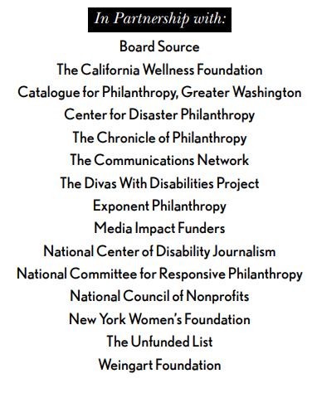
Upcoming Equity Webinars!
Disability discrimination is rampant and is happening every day – despite the fact that people want to do the right thing and that most of the ways to include people with disabilities in your important work are actually free. It’s all about getting the skills to do it right. RespectAbility’s upcoming series of free webinars will give you and your teams step-by-step guidance, as well as provide resources and contacts to help foundations and nonprofits on their journey. Join for one or all! Each webinar will include live captioning. Accessible PPTs can be sent to participants ahead of time for use with screen readers.

Slide 56
Equity Series Schedule
Schedule of Webinars
Nov. 6, 2019: Disability 101
Nov. 13, 2019: Disability History
Nov. 20, 2019: How to Ensure Accessible Events
Dec. 4, 2019: How to Recruit, Accommodate and Promote People with Disabilities for Paid Employment, Volunteer Leadership and Board Positions
Dec. 11, 2019: How to Ensure A Welcoming Lexicon and Inclusive Storytelling
Jan. 7, 2020: How to Ensue Accessible Websites, Social Media and Inclusive Photos
Jan. 9, 2020: Premium Skills Workshop in Social Media Accessibility
Jan. 15, 2020: How to Ensure Legal Rights and Compliance Obligations: Exploring the Rights of Employees and Participants, and the Obligations of Nonprofit Organizations Under the Law
Learn More and RSVP Here: https://www.respectability.org/accessibility-webinars/

Slide 57
THANK YOU!
Jennifer Laszlo Mizrahi
www.RespectAbility.org
Cell: (202) 365-0787
JenniferM@RespectAbility.org

