Slide 1
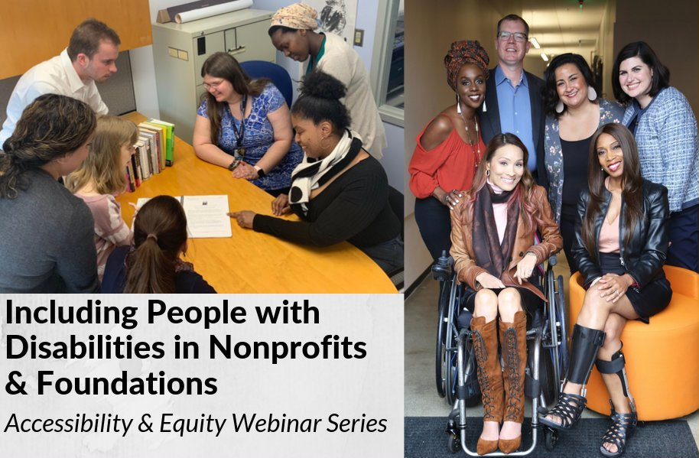
Disability 101
Premium Skills Workshop in Social Media Accessibility

Slide 2
Equity and Access Webinar Series Partners
BoardSource
The California Wellness Foundation
Catalogue for Philanthropy, Greater Washington
Center for Disaster Philanthropy
Cerebral Palsy Foundation
The Chronicle of Philanthropy
The Communications Network
The Divas With Disabilities Project
Exponent Philanthropy
Grantmakers Concerned with Immigrants and Refugees
Media Impact Funders
National Center of Disability Journalism
National Committee for Responsive Philanthropy
National Council of Nonprofits
The New York Women’s Foundation
The Unfunded List
Weingart Foundation

Slide 3
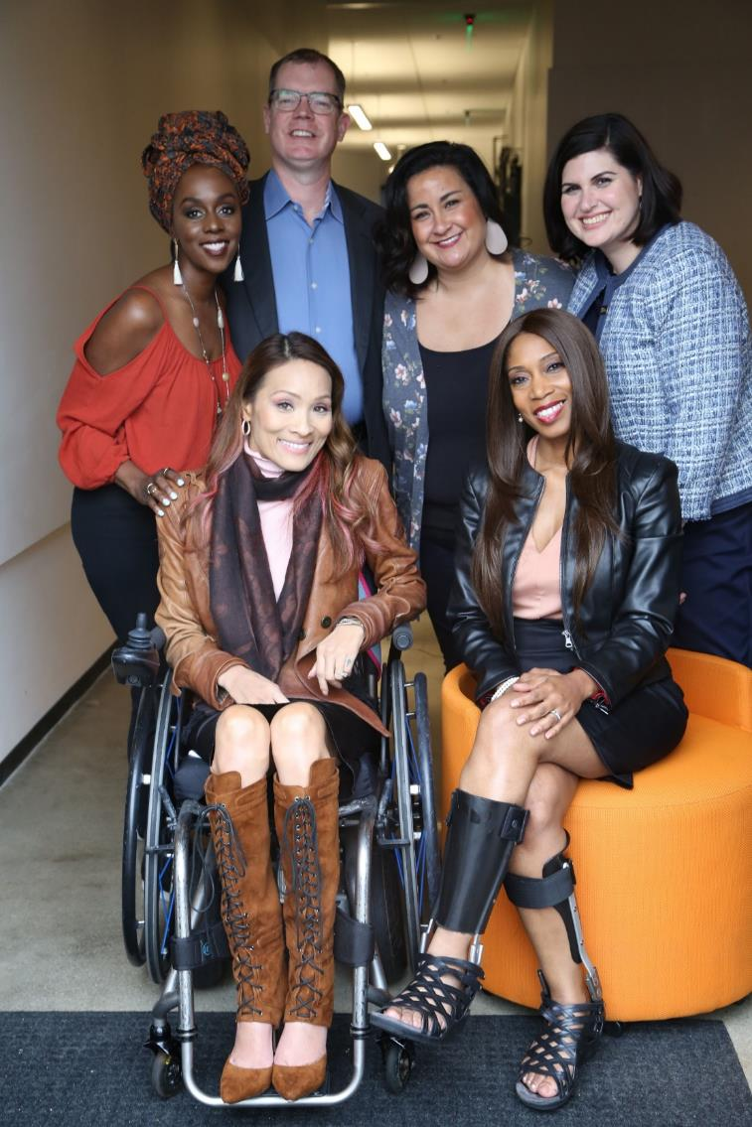
Including the D – Disability – in Diversity
Organizations are at their best when they welcome, respect and include people of all backgrounds. This includes people with disabilities.

Slide 4
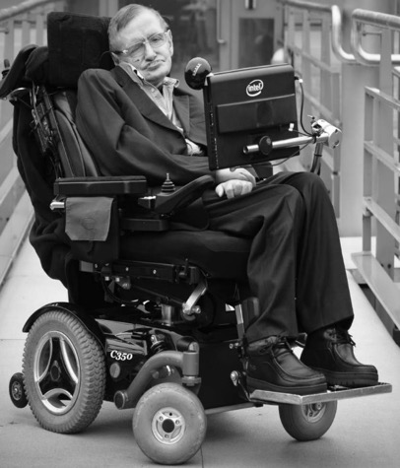
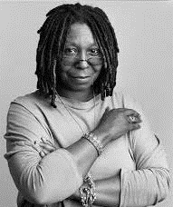
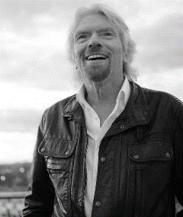
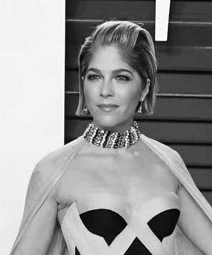
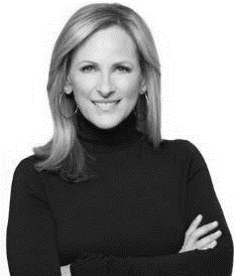
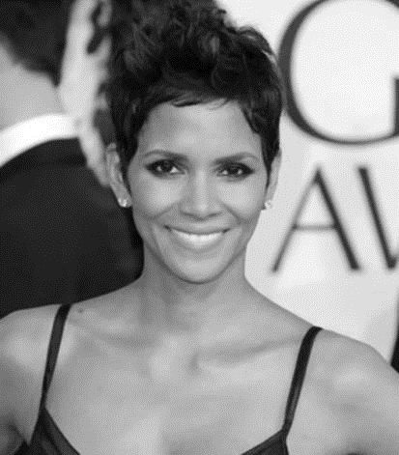
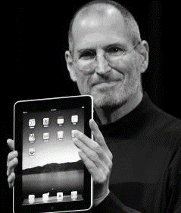
These are people with disabilities.
These are people with disabilities.

Slide 5
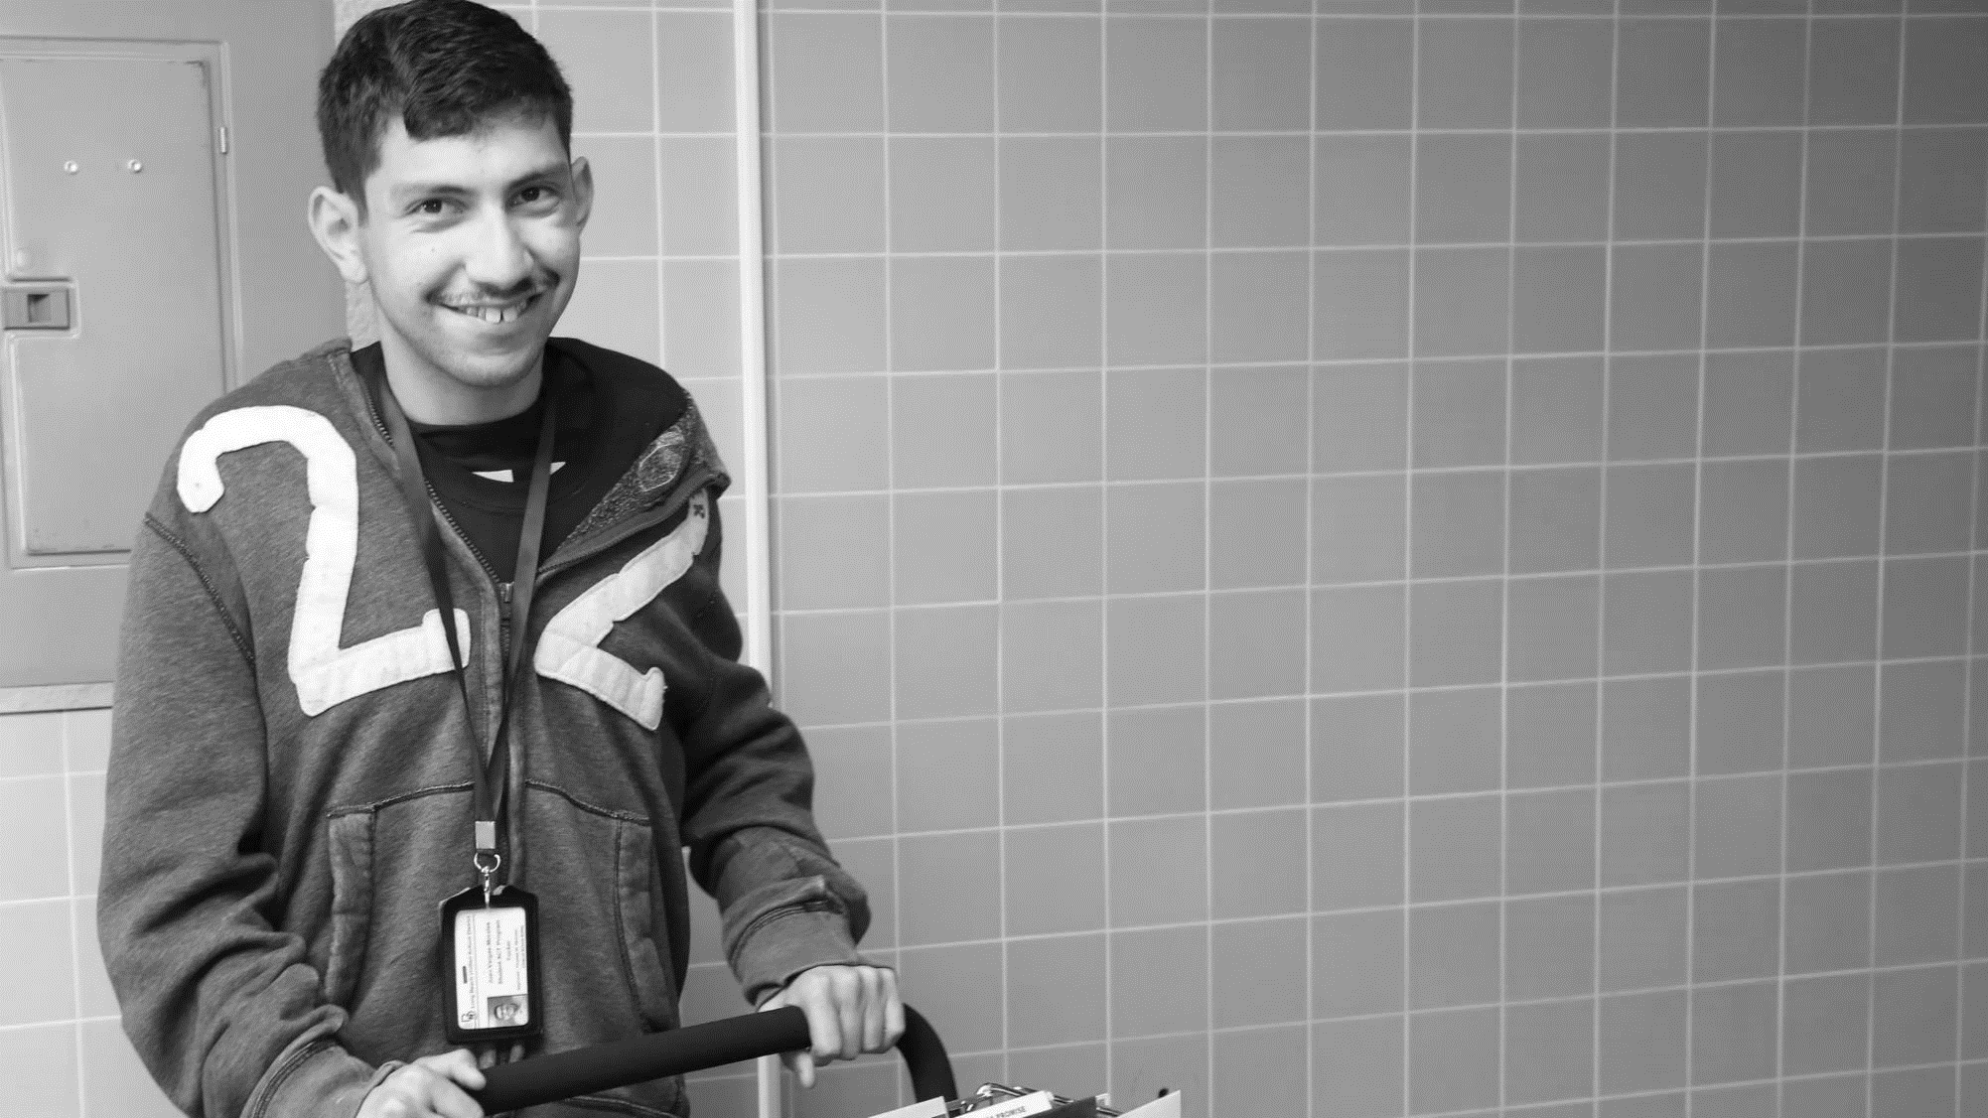
61 million people
61 Million
people in the US have a disability.*
People with disabilities
want
opportunities
Just like anyone else.
* Source: US Census

Slide 6
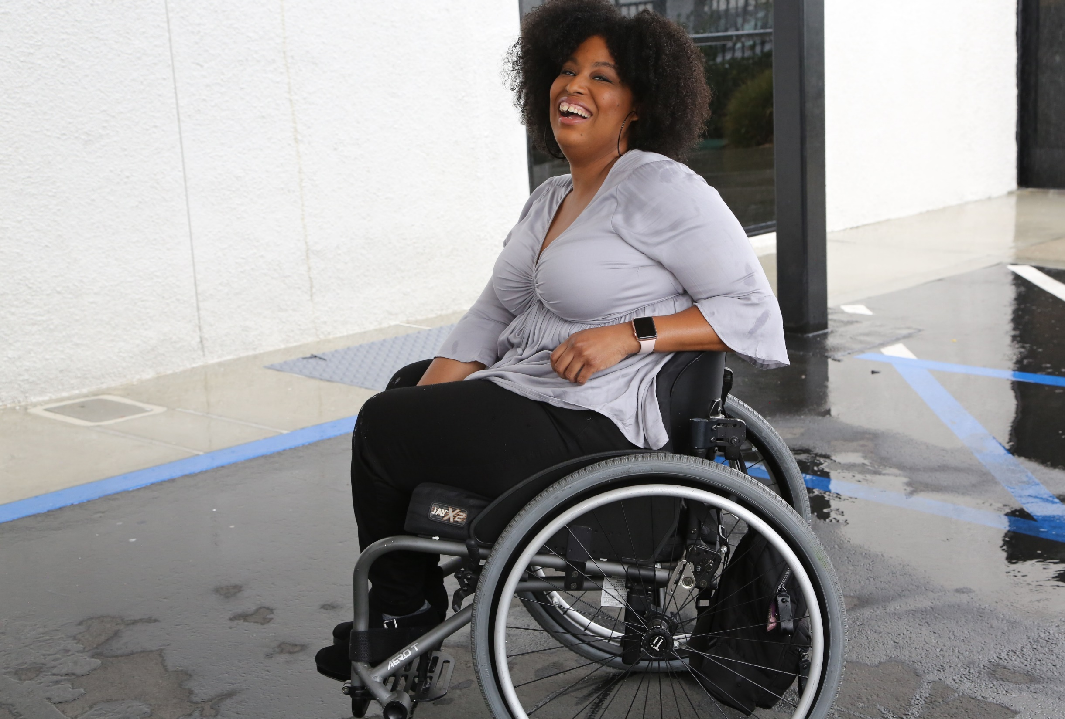
1 in 4 adults
1 in 4
adults have a disability

Slide 7
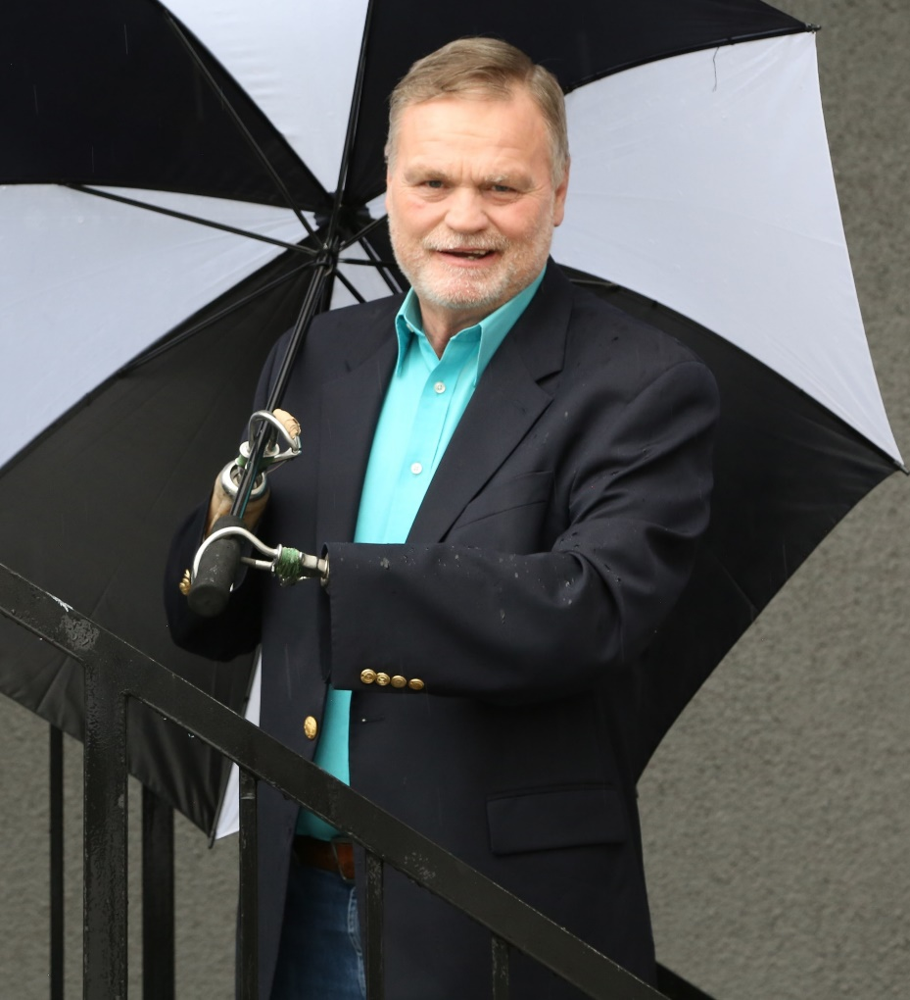
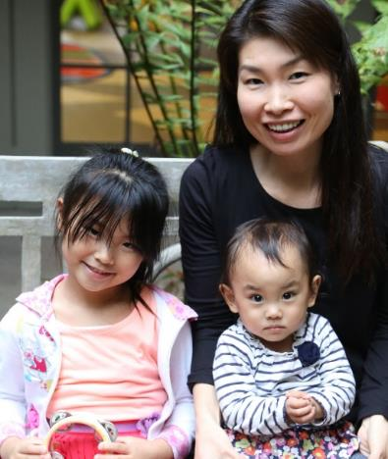
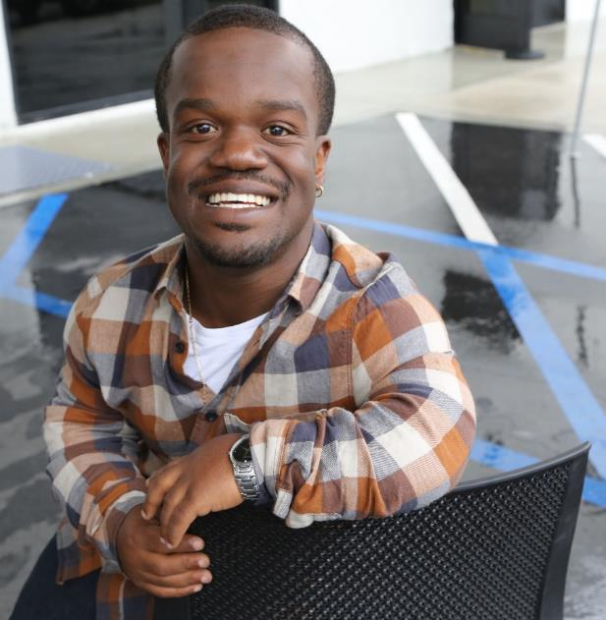
Disabilities Are….
Temporary and Permanent
Visible and Nonvisible
From Birth or Acquired Later

Slide 8
The Basics: Captions on Videos
Open Captions Best for Social Media
41% of videos are incomprehensible without sound or captions.
In fact, 80% of viewers react negatively to videos autoplaying with sound. So now, many social media outlets now autoplay videos on silent.
80% of people who use captions aren't Deaf or hard of hearing.
Captions help with comprehension of dialogue, clarification of terminology, concentration and engagement.

Slide 9
The Basics: Captions on Videos 2
85% of Facebook video is watched without sound
Adding captions to Facebook videos increased view time by 12%.
Facebook video posts with captions have 135% greater organic reach.
80% more people are more likely to watch an entire video when captions are available
Adding captions to YouTube led to a 7.3% increase in views.
82% of Twitter users watch video content on Twitter.
Snapchatters watch 10 billion videos a day.

Slide 10
The Basics: Alt Text for Images
Just like for websites, images on social media need to be described for individuals who cannot view them.

Slide 11
Instagram Alt-Text Demo

Slide 12
Live Demo

Slide 13
Resources for Alt-Text
Twitter How-To: https://help.twitter.com/en/using-twitter/picture-descriptions
Facebook How-To: https://www.facebook.com/help/214124458607871
Instagram How-To: https://help.instagram.com/503708446705527
Best Practices: https://blog.hubspot.com/marketing/image-alt-text

Slide 14
Resources for Captioning
YouTube How-To: https://support.google.com/youtube/answer/2734796?hl=en
Clipomatic App
Clips App by Apple
rev.com - $1/min, 24 hour turnaround

Slide 15
Q&A

Slide 16
Equity and Access Webinar Series Schedule
Disability 101 (available online via video and transcript)
Disability History (available online via video and transcript)
How to Ensure Accessible Events (available online via video and transcript)
How to Recruit, Accommodate and Promote People with Disabilities for Paid Employment, Volunteer Leadership and Board Positions (available online via video and transcript)
How to Ensure A Welcoming Lexicon and Inclusive Storytelling (available online via video and transcript)
How to Ensue Accessible Websites, Social Media and Inclusive Photos (coming soon online)
Premium Skills Workshop in Social Media Accessibility (coming soon online)
Jan. 15, 2020: How to Ensure Legal Rights and Compliance Obligations: Exploring the Rights of Employees and Participants, and the Obligations of Nonprofit Organizations Under the Law
Learn More and RSVP Here: https://www.respectability.org/accessibility-webinars/

Slide 17
Resources and Thank You!
RespectAbility’s Inclusive Philanthropy Toolkit
Access information on disability inclusion, including the new disability in philanthropy & nonprofits study: www.RespectAbility.org/inclusive-philanthropy
Follow us on Social Media!
Twitter: @Respect_Ability
Facebook: RespectAbilityUSA
Instagram: @RespectTheAbility
www.RespectAbility.org | (202) 517-6272 | info@RespectAbility.org
Intersection of Disability and Politics: www.TheRespectAbilityReport.org

