Slide 1
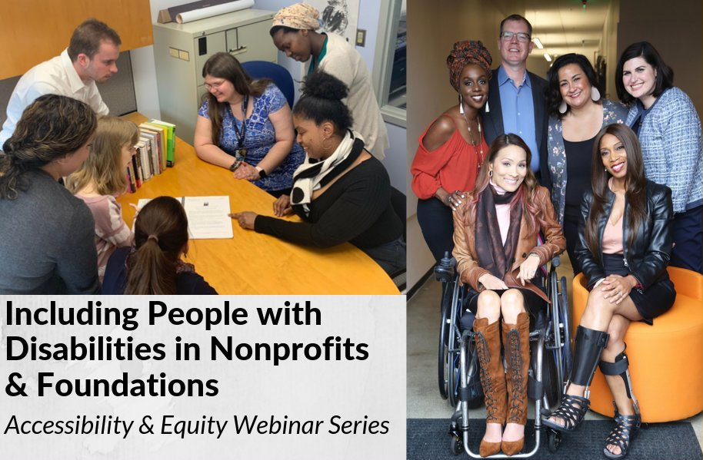
Accessible Events
How to Ensure A Welcoming Lexicon and Inclusive Storytelling

Slide 2
Equity and Access Webinar Series Partners
BoardSource
The California Wellness Foundation
Catalogue for Philanthropy, Greater Washington
Center for Disaster Philanthropy
Cerebral Palsy Foundation
The Chronicle of Philanthropy
The Communications Network
The Divas With Disabilities Project
Exponent Philanthropy
Grantmakers Concerned with Immigrants and Refugees
Media Impact Funders
National Center of Disability Journalism
National Committee for Responsive Philanthropy
National Council of Nonprofits
The New York Women’s Foundation
The Unfunded List
Weingart Foundation

Slide 3
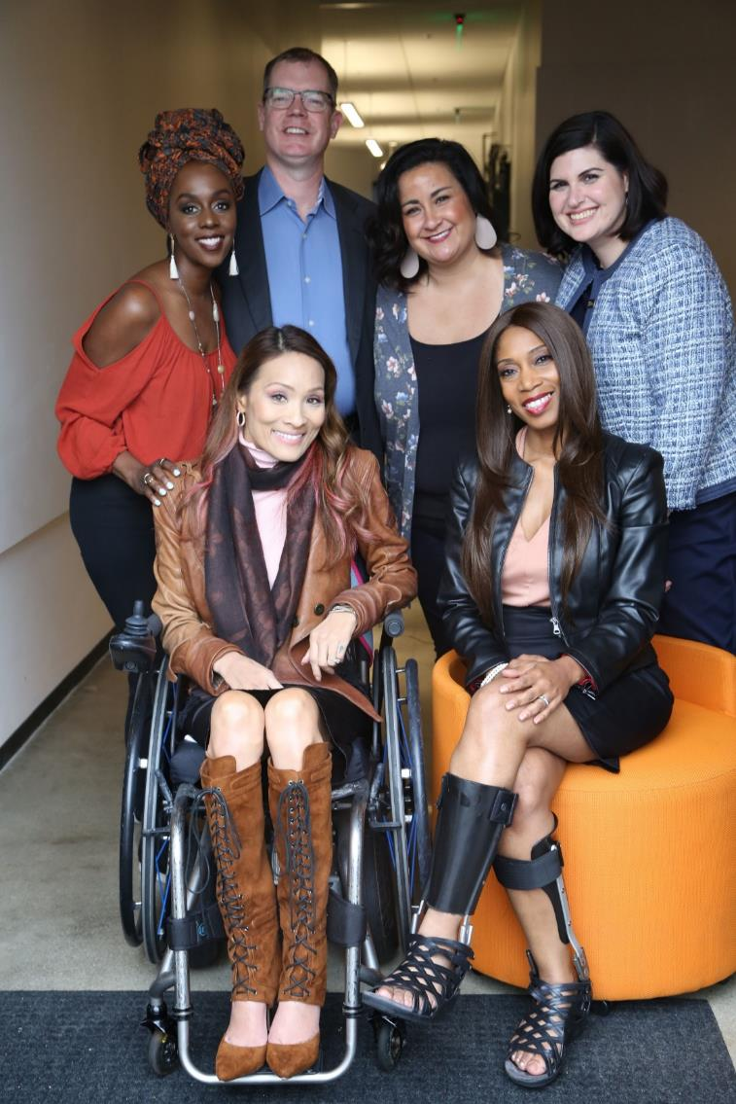
Including the D – Disability – in Diversity
Organizations are at their best when they welcome, respect and include people of all backgrounds. This includes people with disabilities.

Slide 4
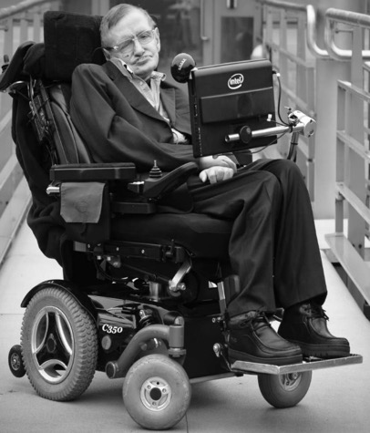
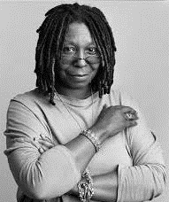
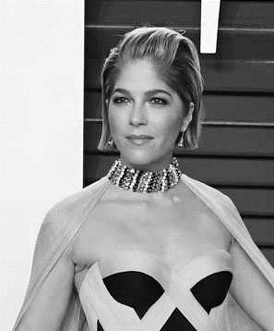
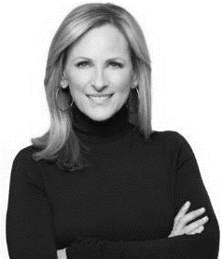
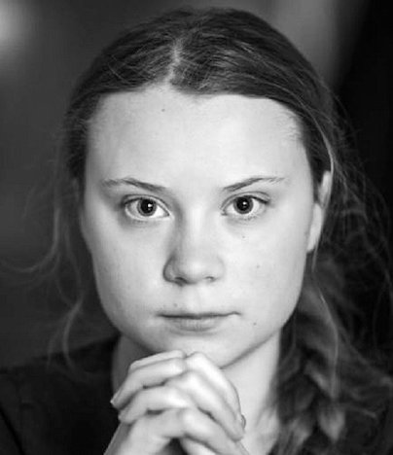
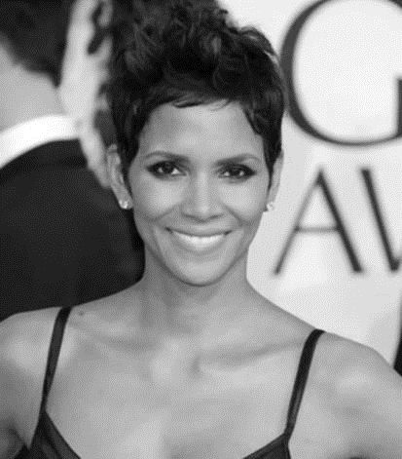
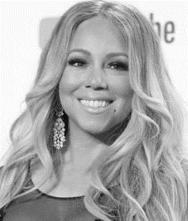
These are people with disabilities.
These are people with disabilities.

Slide 5
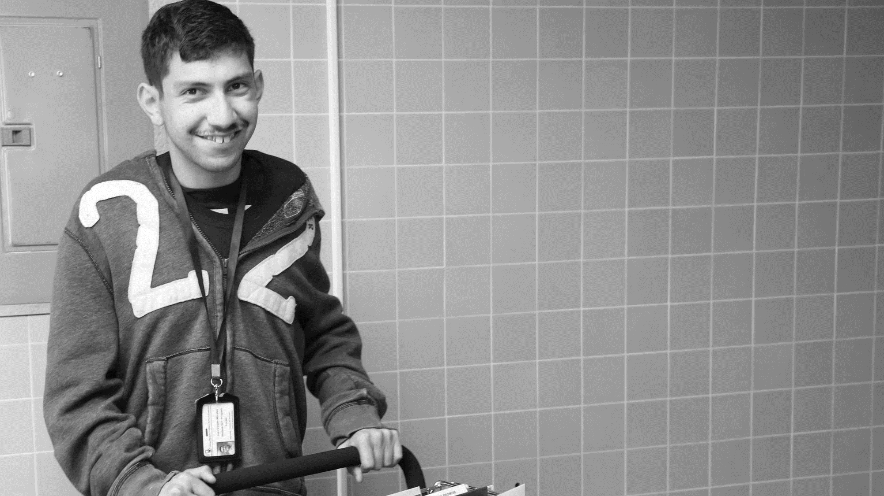
61 million people
61 Million
people in the U.S. have a disability.*
People with disabilities
want
opportunities
Just like anyone else.
* Source: US Census

Slide 6
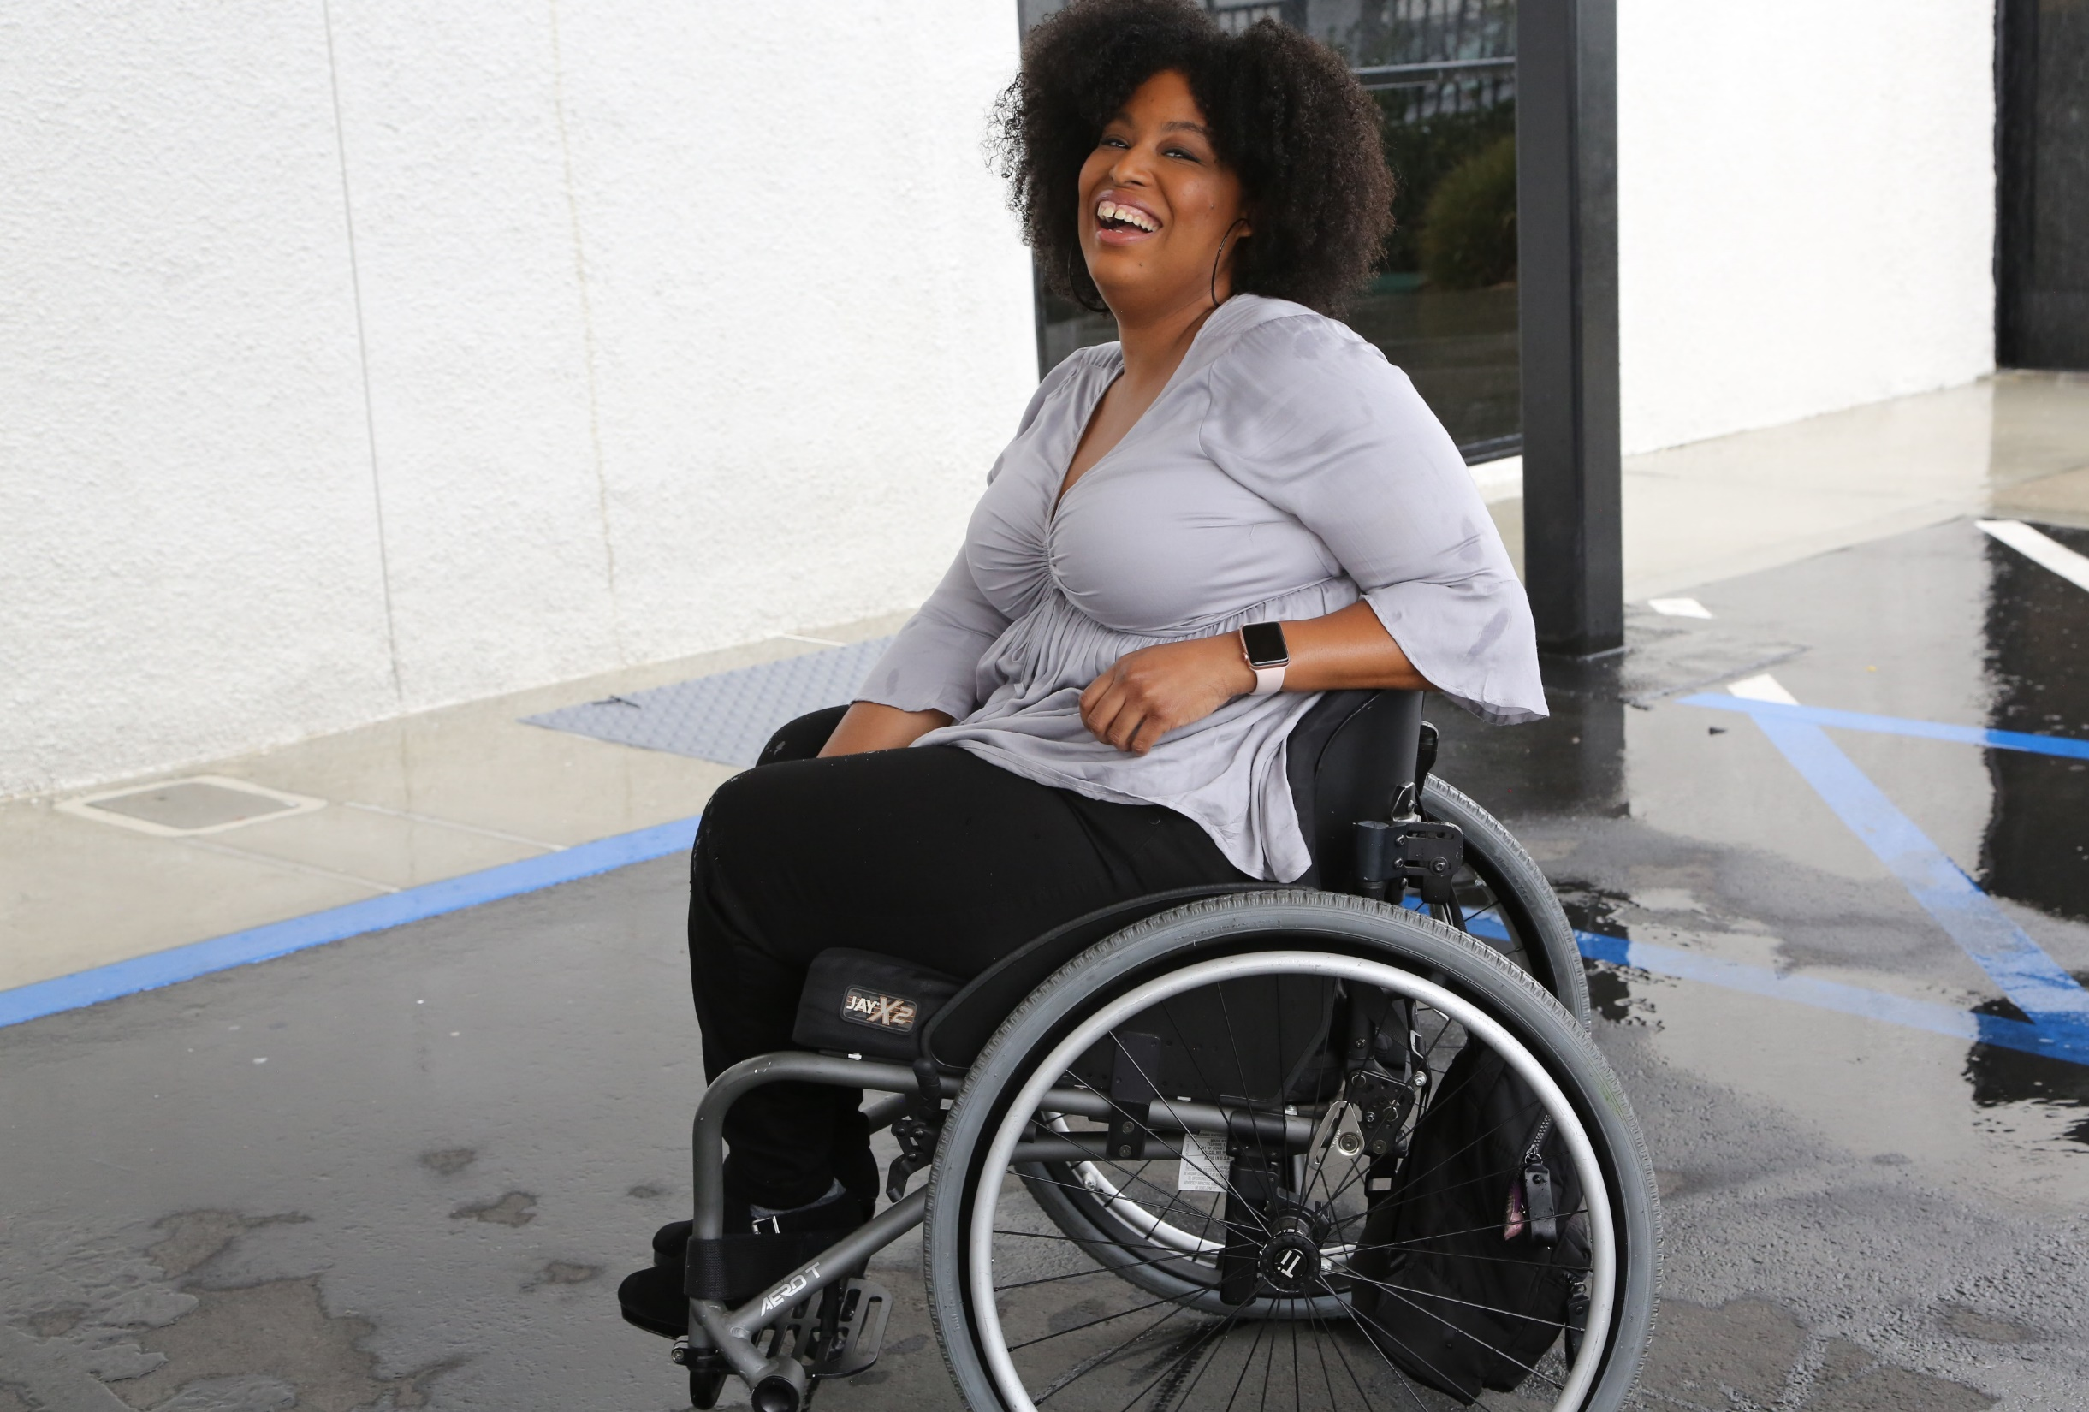
1 in 4 adults
1 in 4
adults have a disability

Slide 7
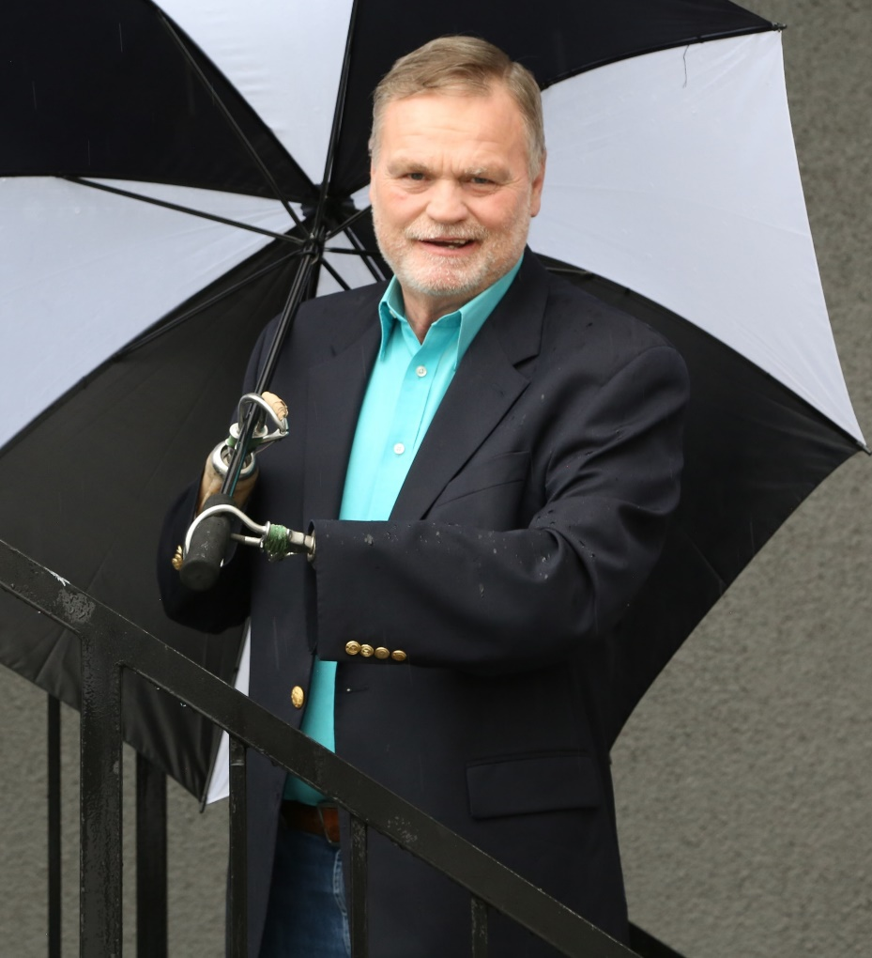
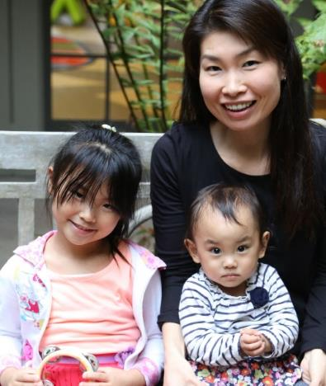
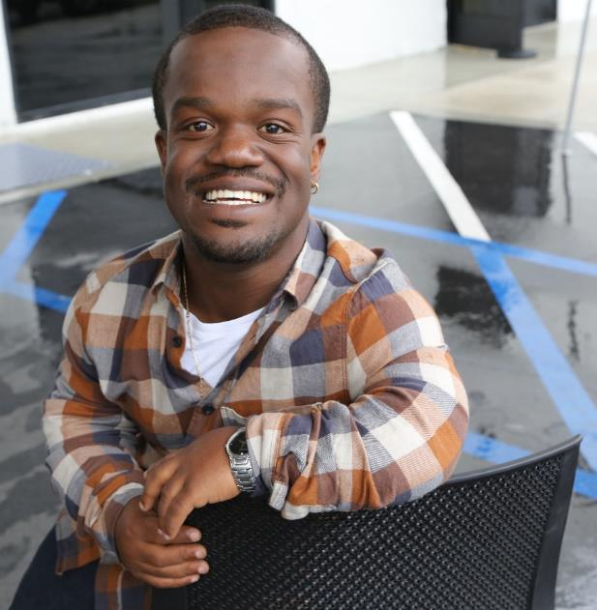
Disabilities Are….
Temporary and Permanent
Visible and Nonvisible
From Birth or Acquired Later

Slide 8
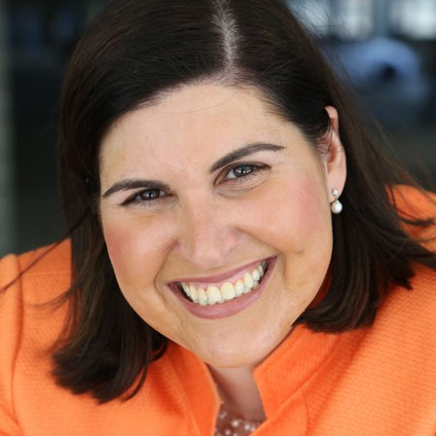
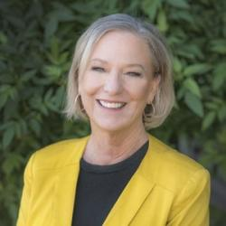
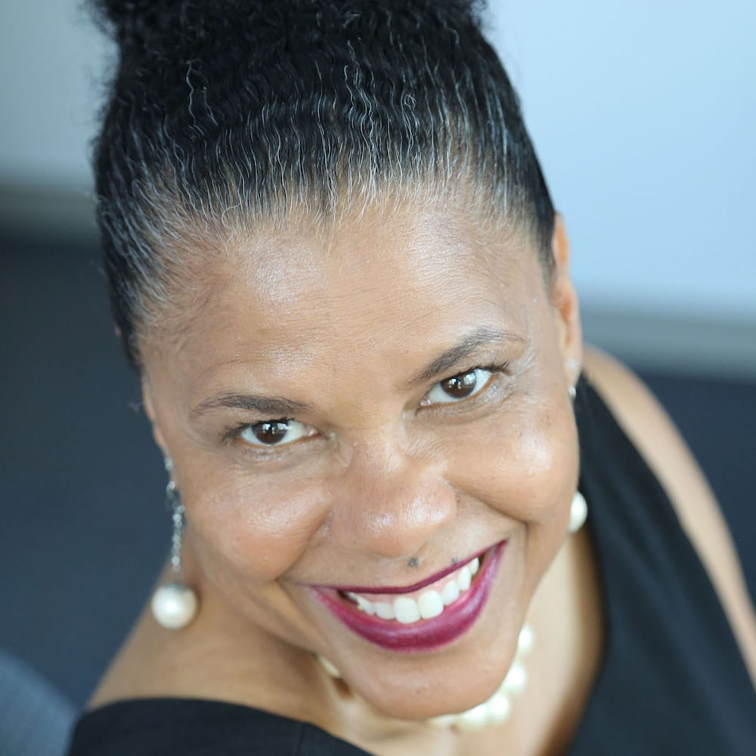
Speakers
Moderator: Lauren Appelbaum
Vice President, Communications, RespectAbility
She/her/hers
Kristin Gilger Director, the National Center on Disability and Journalism
Senior Associate Dean and Reyolds Professor in Business Journalism
Walter Cronkite School of Journalism and Mass Communication
She/her/hers
Dr. Donna R. Walton, Ed.D.
Founder and President, Divas With Disabilities, Inc.
She/her/hers

Slide 9
Words Matter

Slide 10
Defining Disability
The U.S. government defines disability as “a physical or mental impairment that substantially limits one or more major life activities.”
Major life activities include such activities as caring for oneself, performing manual tasks, walking, seeing, hearing, speaking, breathing, learning and working.
Both temporary and permanent disabilities are covered by the ADA.

Slide 11
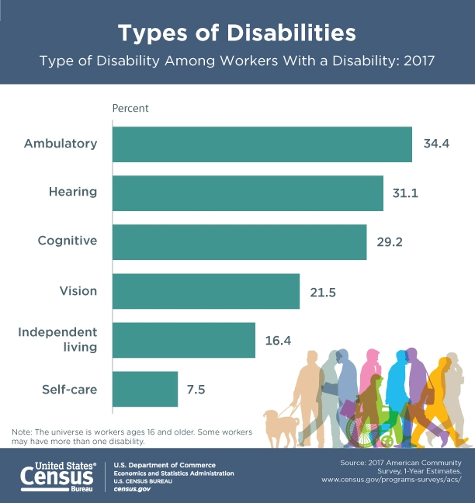
Defining Disability: Census
Hearing
Vision
Cognitive
Ambulatory
Self-care
Independent living
Respondents who report any one of the six disability types are considered to have a disability.

Slide 12
Basic Rule No. 1:
Disability and people who have disabilities are not monolithic. Avoid referring to “the disabled” in the same way that you would avoid referring to “the Asians,” “the Jews” or “the African-Americans.” Instead, consider using such terms as “the disability community” or “the disability activist.”

Slide 13
Basic Rule No. 2:
People with disabilities do not want to be seen as victims. Many have long-term conditions with which they lead full and active lives.
Instead of “he suffers from cerebral palsy,” use “he has cerebral palsy” (if it’s pertinent to the story).
Instead of “he was stricken with paralysis,” use “he became paralyzed.”

Slide 14
People-First Language
Puts the emphasis on the person first; followed by a description of the disability.
EXAMPLES:
A person who lives with a disability vs. a disabled person
A person with an intellectual disability vs. mentally disabled
A person who is epileptic vs. epileptic

Slide 15
Identity-First Language
Puts the emphasis on the disability.
EXAMPLES: Autistic, deaf, blind, disabled
An autistic woman vs. woman with autism
Several U.S. disability groups have always used identity-first terms, specifically the culturally Deaf community and the autistic rights community.

Slide 16
People First vs. Identity First Language
If you are working with individuals with disabilities, ask them their preference.

Slide 17
Say the Word
Disability / Disabled
Not “special needs” or “differently abled”

Slide 18
Terminology Tips: Using Appropriate Lexicon

Slide 19
NCDJ Disability Language Style Guide
http://ncdj.org/style-guide/

Slide 20
Attention-deficit disorder (ADD)/attention-deficit hyperactivity disorder (ADHD)
Background: ADD and ADHD refer to attention-deficit disorder and attention-deficit hyperactivity disorder, respectively. Both are common mental disorders that manifest primarily in children, according to the National Institute of Mental Health. Common symptoms for both disorders include restlessness, difficulty in focusing or staying organized, and impulsivity. Those with an ADHD diagnosis also exhibit a difficulty in sitting still or engaging in quiet activities. Some debate exists as to the accuracy of an ADHD or ADD diagnosis as an actual disorder.
NCDJ Recommendation: Refer to someone as having attention-deficit disorder or attention-deficit hyperactivity disorder only if the information is relevant* to the story and if a licensed medical professional has formally diagnosed the person. Use “attention-deficit disorder” or “attention-deficit hyperactivity disorder” upon first reference; ADD and ADHD are acceptable for each disorder on second reference, respectively.
AP style: Not addressed

Slide 21
Make it Accurate
Confined to a wheelchair or wheelchair-bound:
These terms describe a person only in relationship to a piece of equipment.
They are misleading, as wheelchairs can liberate people, allowing them to move about.
They are inaccurate, as people who use wheelchairs are not permanently confined in them, but transfer to sleep, sit in chairs, drive cars, etc.

Slide 22
Make it Accurate (continued)
Mental condition is an umbrella term for many different conditions that affect how individuals act, think, feel or perceive the world. The most common forms of mental conditions are anxiety disorders, mood disorders, and schizophrenia disorders.
NCDJ Recommendation: Refer to an individual’s mental condition only when it is relevant to the story and the diagnosis comes from a proper source. Whenever possible, specify the specific condition a person has rather than mental conditions in general.
AP style: The stylebook cautions against describing an individual as having a mental condition unless clearly pertinent to a story and the diagnosis is properly sourced. Specific conditions should be used and the source of the diagnosis identified whenever possible.

Slide 23
Other Language
Person without a disability or nondisabled, not “able-bodied” or “normal.”
People with disabilities should not be described as “inspirational” or “courageous” just because they have a disability.

Slide 24
Importance of Storytelling and Diverse Visual Representations

Slide 25
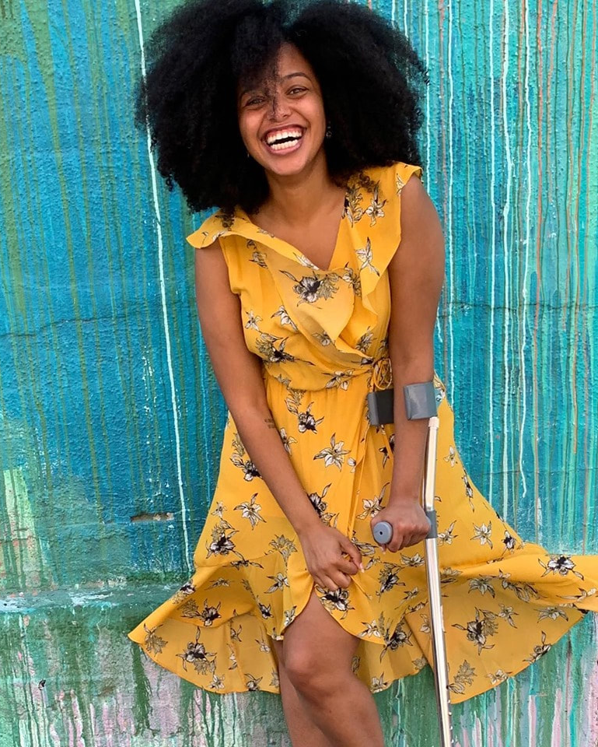
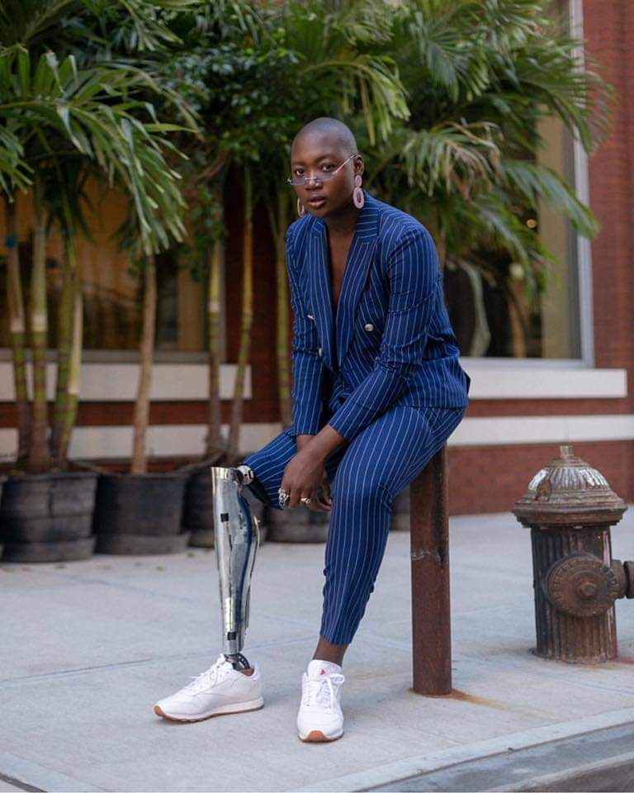
The Divas With Disabilities Project
Mission: To reshape what disability looks like by promoting Black and Brown women and girls with physical disabilities through various media platforms.

Slide 26
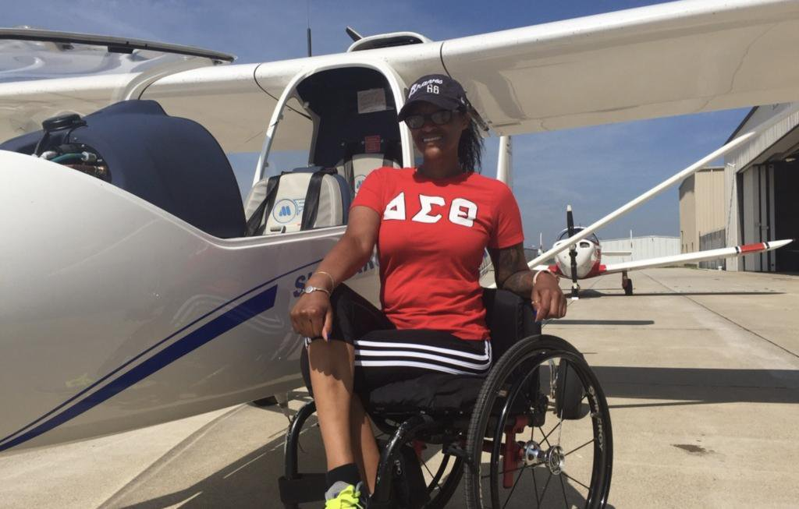
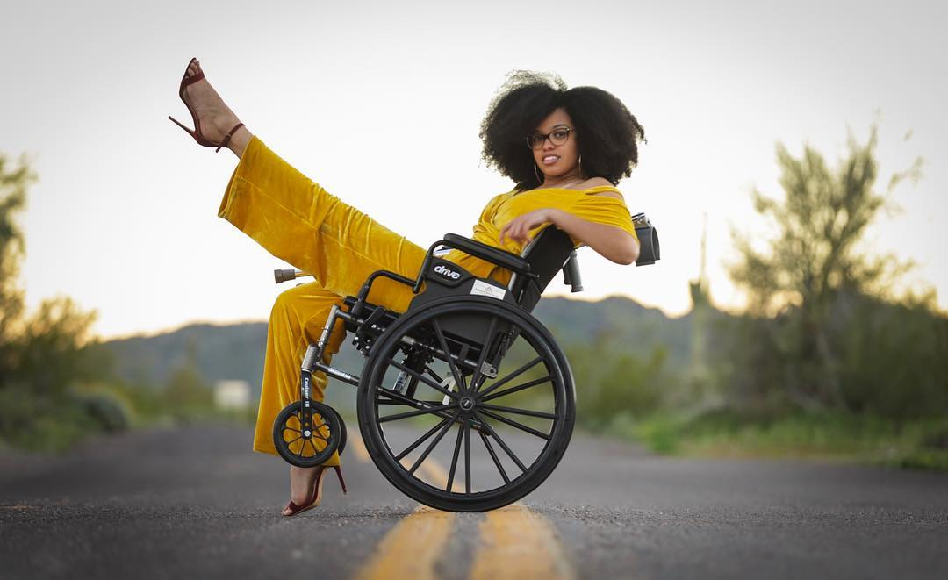
Imagery Tells A Story
Divas with Disabilities: Our Images Tell Our Story

Slide 27
Beauty With a Twist

Slide 28
Disability Impacts Everyone
Disability impacts people of all races, sexual orientations and gender identities, faiths and backgrounds.
African Americans with Disabilities
Latinx People and Hispanics with Disabilities
Women with Disabilities
LGBTQ+ Individuals with Disabilities

Slide 29
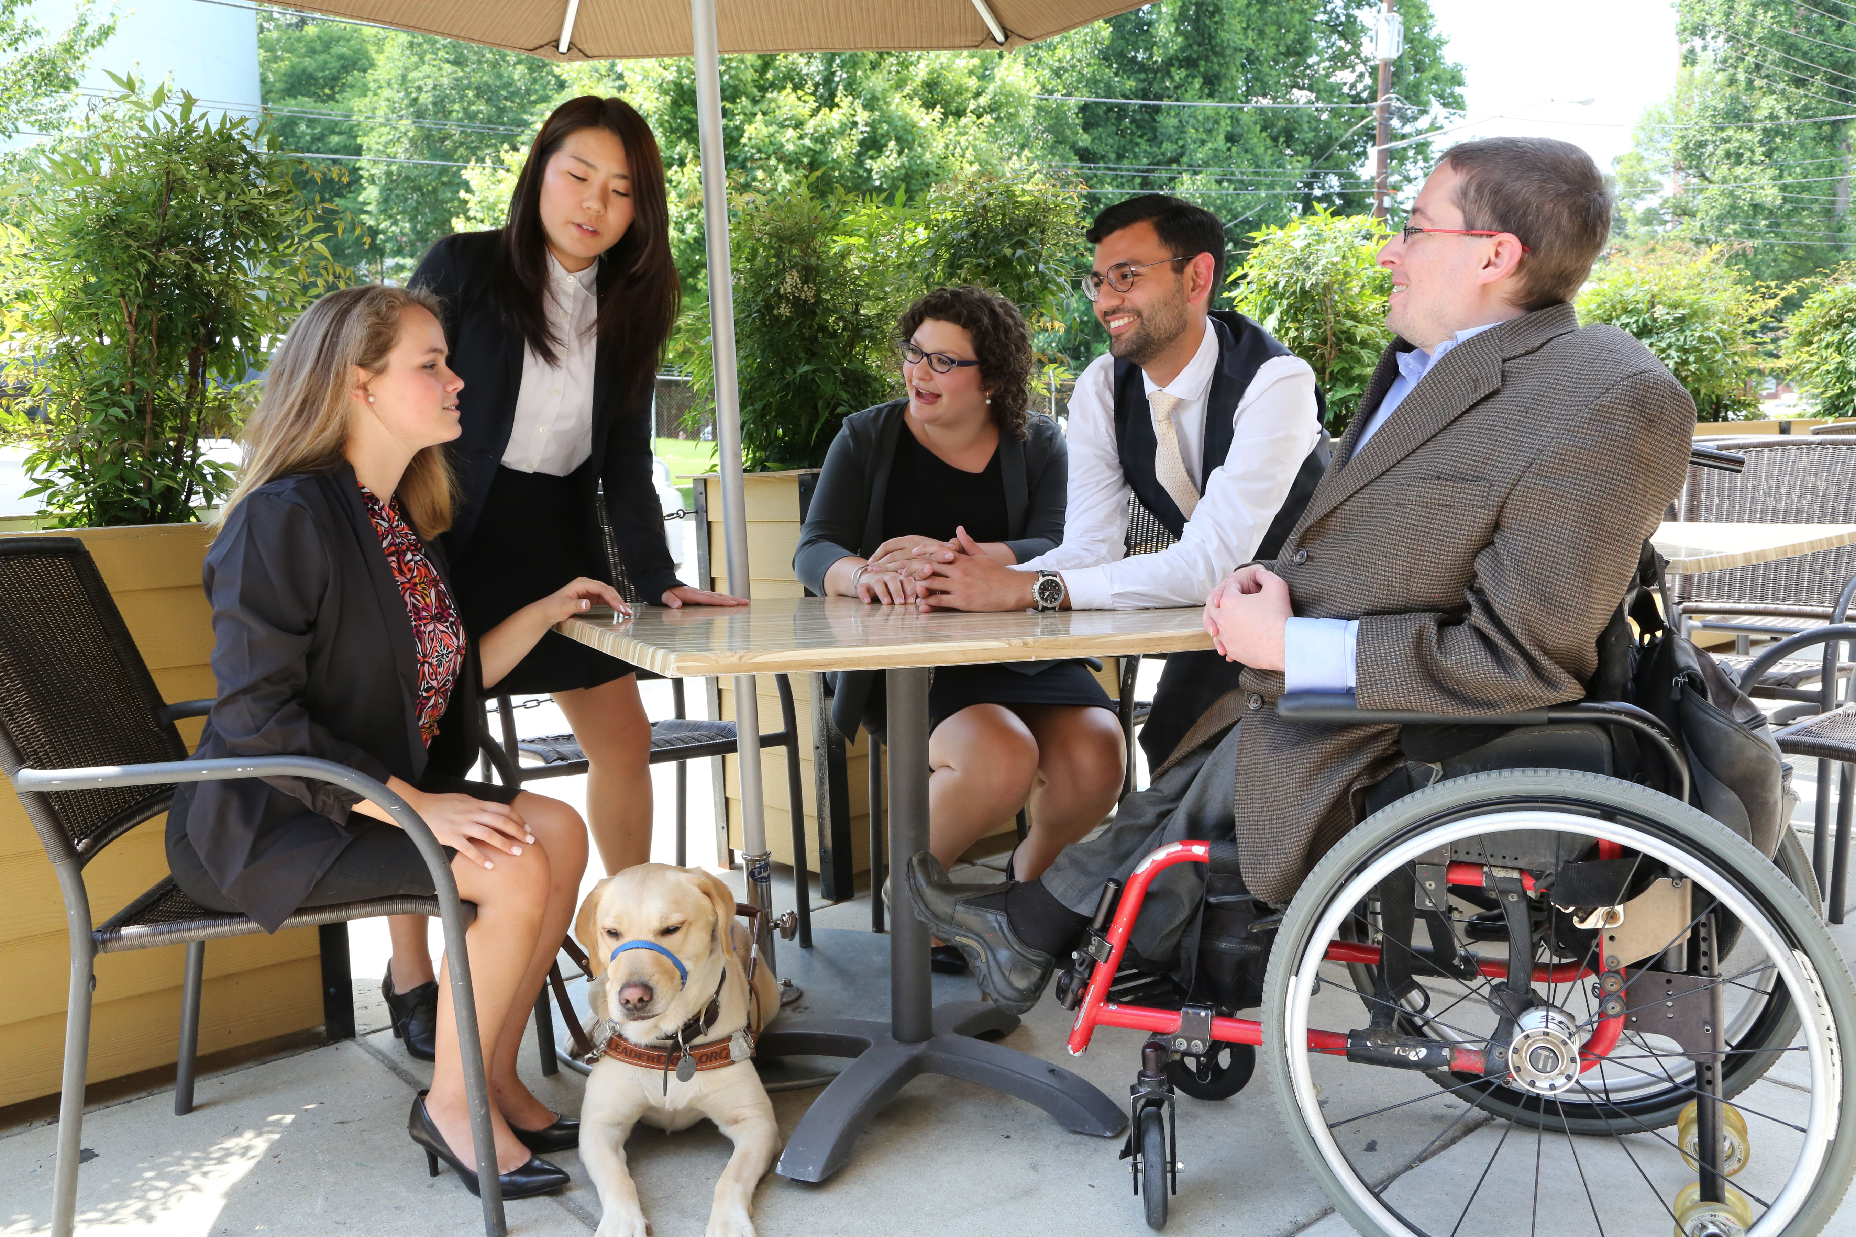
Nothing Without Us
The best way to accurately represent people with disabilities is to include us in the storytelling process!

Slide 30
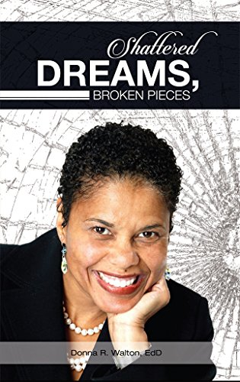
Shattered Dreams, Broken Pieces
An eye-opening tale of reinvention, Shattered Dreams, Broken Pieces is the story of the decades Donna Walton spent working to rebuild her world and discovering new confidence and a fresh sense of purpose along the way.
https://www.amazon.com/Shattered-Dreams-Broken-Pieces-Walton/dp/1533595151

Slide 31
Inspiration Porn

Slide 32
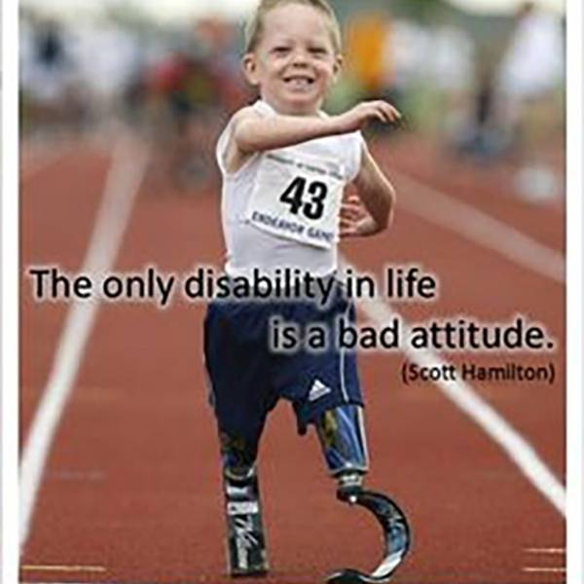
How to Avoid Inspiration Porn
Inspiration porn is when people with disabilities are called inspirational or brave for doing something as simple as exercising or being invited to a prom.
Per the TV show Speechless, “It’s a portrayal of people with disabilities as one-dimensional saints who only exist to warm the hearts and open the minds of able-bodied people.”
Inspiration porn assumes that anyone with a disability must have it so much worse, and it uses people with disabilities to make nondisabled people feel good about themselves or to make them do something, like exercise.

Slide 33
Q&A with the Speakers
Moderator: Lauren Appelbaum
Vice President, Communications, RespectAbility
She/her/hers
Kristin Gilger Director, the National Center on Disability and Journalism
Senior Associate Dean and Reyolds Professor in Business Journalism
Walter Cronkite School of Journalism and Mass Communication
She/her/hers
Dr. Donna R. Walton, Ed.D.
Founder and President, Divas With Disabilities, Inc.
She/her/hers

Slide 34
Equity and Access Webinar Series Schedule
Disability 101 (available online via video and transcript)
Disability History (available online soon!)
How to Ensure Accessible Events (available online via video and transcript)
How to Recruit, Accommodate and Promote People with Disabilities for Volunteer Leadership, Board Positions and Paid Employment (available online via video and transcript)
How to Ensure A Welcoming Lexicon and Inclusive Storytelling (available online soon!)
Jan. 7, 2020: How to Ensue Accessible Websites, Social Media and Inclusive Photos
Jan. 9, 2020: Premium Skills Workshop in Social Media Accessibility
Jan. 15, 2020: How to Ensure Legal Rights and Compliance Obligations: Exploring the Rights of Employees and Participants, and the Obligations of Nonprofit Organizations Under the Law
Learn More and RSVP Here: https://www.respectability.org/accessibility-webinars

Slide 35
Resources and Thank You!
RespectAbility’s Inclusive Philanthropy Toolkit
Access information on disability inclusion, including the new disability in philanthropy & nonprofits study: www.RespectAbility.org/inclusive-philanthropy
Follow us on Social Media!
Twitter: @Respect_Ability
Facebook: RespectAbilityUSA
Instagram: @RespectTheAbility
www.RespectAbility.org | (202) 517-6272 | info@RespectAbility.org
Intersection of Disability and Politics: www.TheRespectAbilityReport.org

