Slide 1
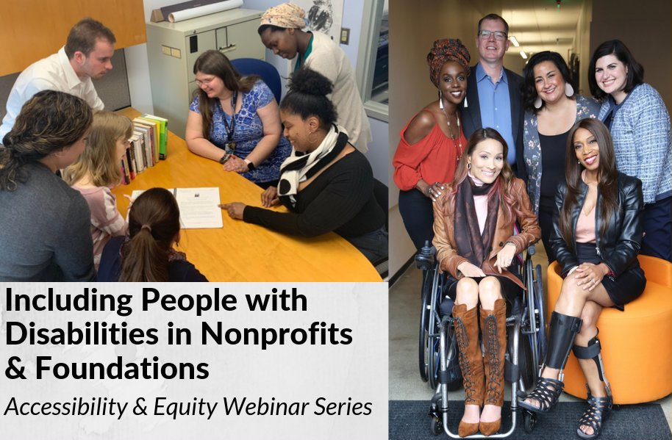
Accessible Events
How to Ensure Accessible Websites and Social Media

Slide 2
Equity and Access Webinar Series Partners
BoardSource
The California Wellness Foundation
Catalogue for Philanthropy, Greater Washington
Center for Disaster Philanthropy
Cerebral Palsy Foundation
The Chronicle of Philanthropy
The Communications Network
The Divas With Disabilities Project
Exponent Philanthropy
Grantmakers Concerned with Immigrants and Refugees
Media Impact Funders
National Center of Disability Journalism
National Committee for Responsive Philanthropy
National Council of Nonprofits
The New York Women’s Foundation
The Unfunded List
Weingart Foundation

Slide 3
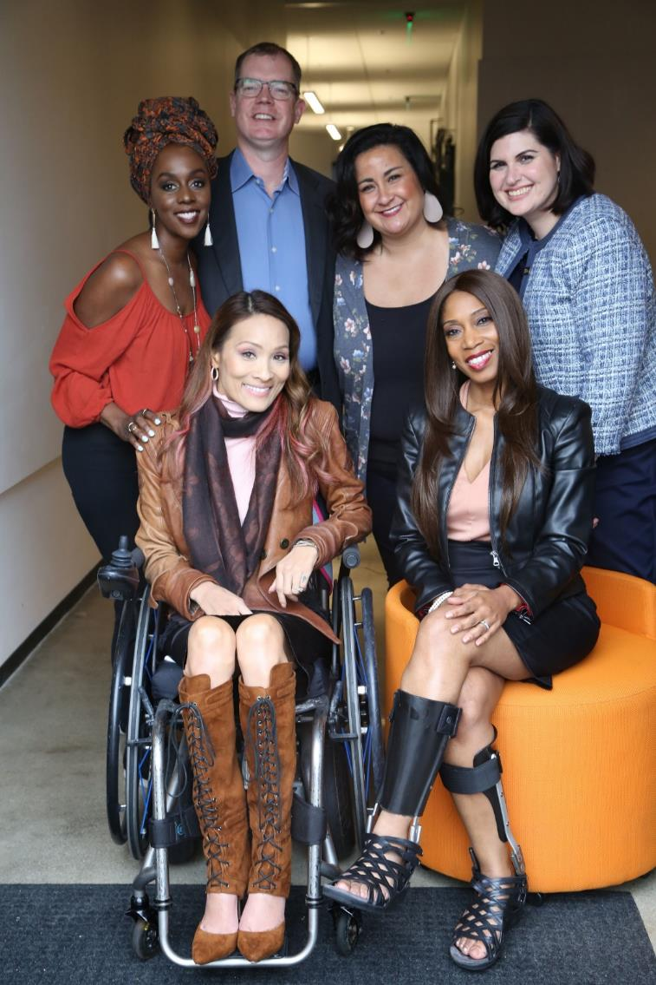
Including the D – Disability – in Diversity
Organizations are at their best when they welcome, respect and include people of all backgrounds. This includes people with disabilities.

Slide 4
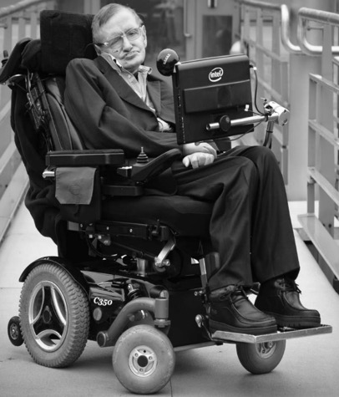
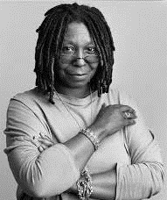
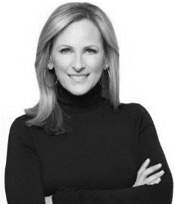
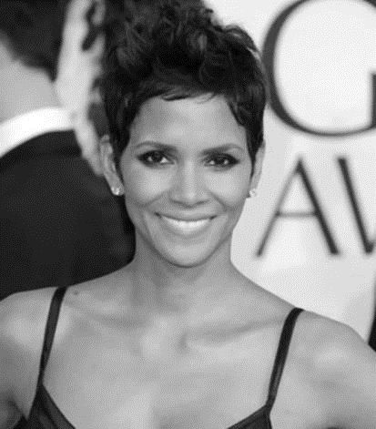
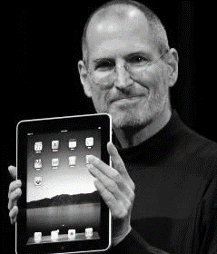
These are people with disabilities.
These are people with disabilities.

Slide 5
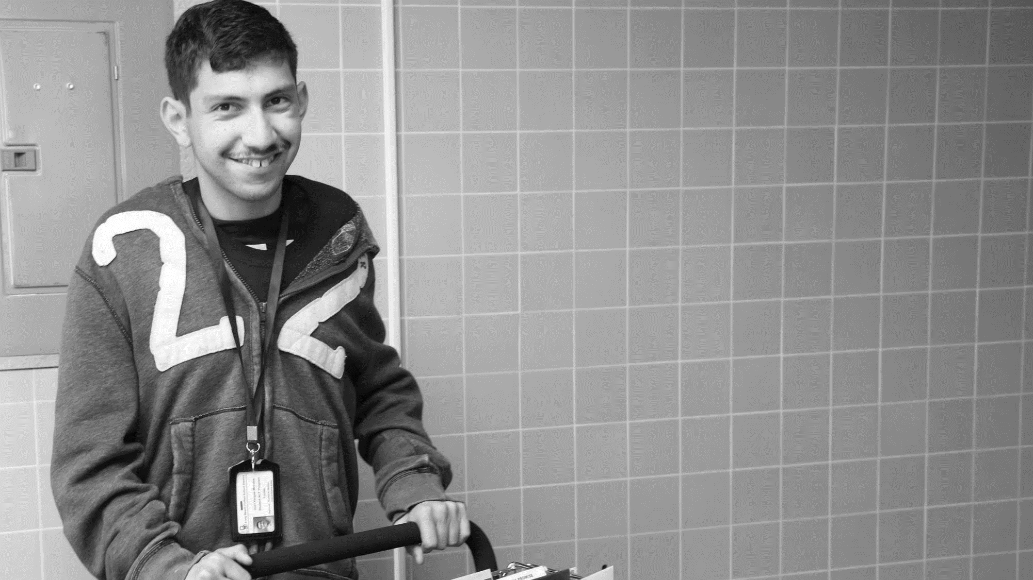
61 million people
61 Million
people in the U.S. have a disability.*
People with disabilities
want
opportunities
Just like anyone else.
* Source: US Census

Slide 6
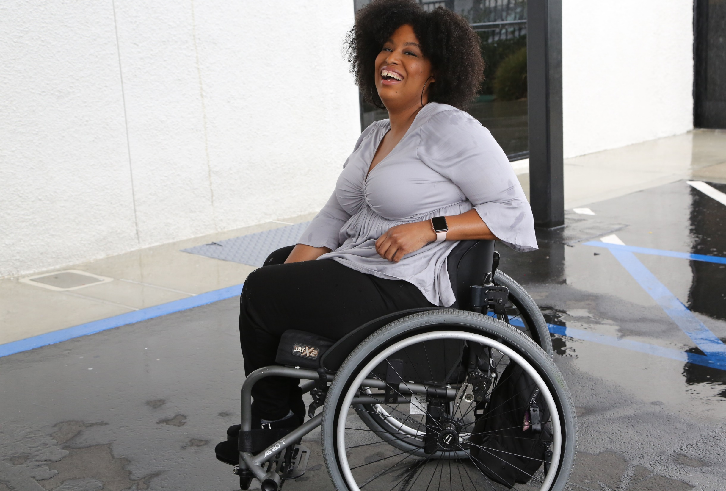
1 in 4 adults
1 in 4
adults have a disability

Slide 7
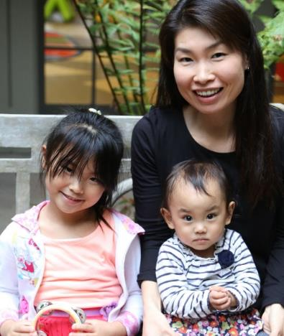
Disabilities Are….
Temporary and Permanent
Visible and Nonvisible
From Birth or Acquired Later

Slide 8
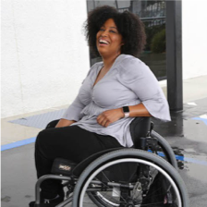
Speakers
Sharon Rosenblatt Director of Communications, Accessibility Partners She/her/hers
Dan Mouyard Front End Technical Architect, Forum One
He/him/his
Moderator: Tatiana Lee
Hollywood Inclusionist, RespectAbility
Founder and Editor, Accessible Hollywood
She/her/hers

Slide 9
What is Accessibility? Why is it important?

Slide 10
Defining Accessibility
“Accessibility is the design of products, devices, services, or environments for people with disabilities.”
Accessibility benefits ALL of us! No matter your ability or disability, we all benefit from accessible, universal design.
Notes:
Henry, Shawn Lawton; Abou-Zahra, Shadi; Brewer, Judy (2014). The Role of Accessibility in a Universal Web. Proceeding W4A '14 Proceedings of the 11th Web for All Conference Article No. 17. ISBN 978-1-4503-2651-3. Retrieved 2014-12-17.

Slide 11
Web Accessibility & ADA Compliance

Slide 12
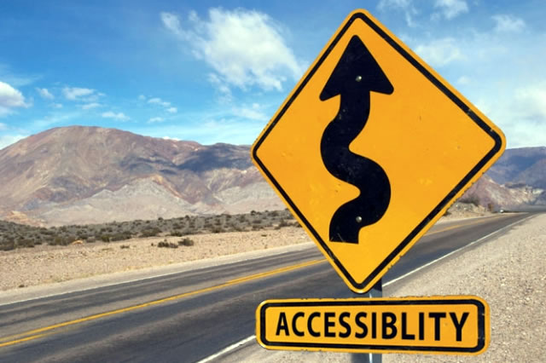
Accessibility
Accessibility means equal access.
Technology must be designed and developed to provide equal access and usability to every member of your target audience.

Slide 13
Web Accessibility
71% of people with disabilities leave a website immediately if it is not accessible.
Essentially, people with disabilities can use the Internet
Perceive, understand, navigate, and interact
Encompasses all disabilities that affect Web access

Slide 14
Assistive Technology
Technology used by people with disabilities to perform functions that might otherwise be difficult or impossible.

Slide 15
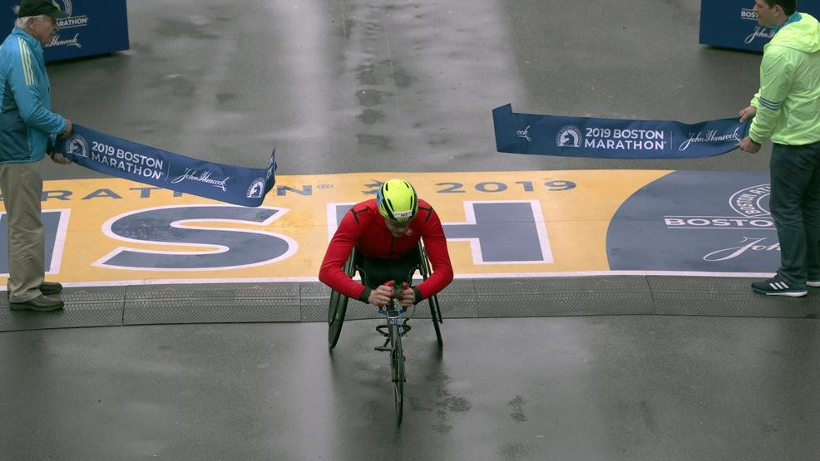
2019 Boston Marathon Handbike Winner

Slide 16
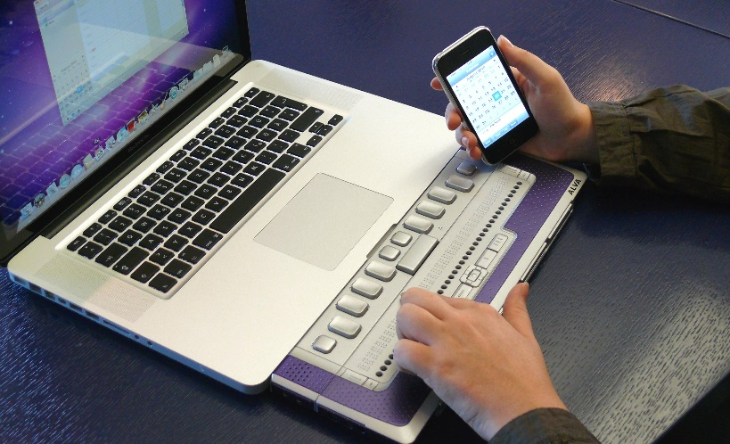
Assistive Technology - Examples
Screen readers/magnifiers
Captions/ASL translation
Text-to-speech
Braille Displays
Videophones
Large print
Tactile keyboards
Joysticks
Augmented input

Slide 17
Something to think about…
Almost 20 million people had difficulty lifting and grasping. This includes, for instance grasping a glass or a pencil.

Slide 18
Web Accessibility Guidelines

Slide 19
Digital Accessibility
Accessibility means equal access and encompasses all disabilities
People with disabilities can:
Perceive
Understand
Navigate
Interact

Slide 20
Accessibility Questions
Is your content available to users with disabilities?
Alt text, form fields, links, keyboard accessibility
How does my site interact with assistive technology?
Screen readers, magnifiers, speech recognition, etc.
What happens when there is multimedia?
How can you reach a wider audience of users, both with and without disabilities?

Slide 21
Legal Landscape
ADA: Americans with Disabilities Act covers websites in all areas:
Title I - Employment
Title II – State and local government
Title III - Public accommodations

Slide 22
Title III of the ADA
Public accommodations
Must provide auxiliary aids and services necessary to ensure equal access to their goods and services and to ensure effective communication
Includes accessible electronic and information technology
The Department of Justice 2010 rulemaking:
“Websites that provide goods and services must be accessible to people with disabilities unless the goods and services are available in some other equivalent manner”

Slide 23
What we’re seeing lately:
Tremendous focus on ADA’s intersection with websites in all industries:
Statutes, revised regulations, and court decisions
Accessibility guidelines updates (Section 508/WCAG)
Lawsuits and settlements
Uptick in legal demand letters

Slide 24
Best Solution? Be Accessible Now!

Slide 25
Web Accessibility Standards
Section 508
Web Content Accessibility Guidelines (WCAG)
Americans with Disabilities Act (ADA)

Slide 26
Who Defines the Guidelines?
The World Wide Web Consortium (W3C) developed the Web Accessibility Initiative (WAI)
Not a legal requirement; however, US courts are using as a global standard in lawsuits
Standards are called W3C Recommendations.
WAI has developed the following W3C Recommendations:
Web Content Accessibility Guidelines: WCAG Overview, WCAG 2.0 (December 2008)
Authoring Tool Accessibility Guidelines: ATAG Overview, ATAG 1.0 (February 2000)
User Agent Accessibility Guidelines: UAAG Overview, UAAG 1.0 (December 2002)

Slide 27
What is WCAG 2.0?
WCAG 2.0 is a technical standard with 12 guidelines that are organized under 4 principles: perceivable, operable, understandable, and robust.
For each guideline, there are testable success criteria, which are at three levels: A, AA, and AAA.

Slide 28
WCAG 2.0 Guidelines - Perceivable
Provide text alternatives for any non-text content
Provide alternatives for video content
Create content that can be presented in different ways without losing information or structure
Make it easier for users to see and hear content.

Slide 29
WCAG 2.0 Guidelines - Operable
Make all functionality available from a keyboard.
Provide users enough time to read and use content.
Do not design content in a way that is known to cause seizures.
Provide ways to help users navigate, find content, and determine where they are.

Slide 30
WCAG 2.0 Guidelines - Understandable
Make text content readable and understandable.
Make Web pages appear and operate in predictable ways.
Help users avoid and correct mistakes.

Slide 31
WCAG 2.0 Guidelines - Robust
Maximize compatibility with current and future user agents, including assistive technologies.

Slide 32
ADA and WCAG: the Relationship
The Americans with Disabilities Act (ADA)
Increasing coverage on websites
Public access=not just locations
Online business that would be covered in brick and mortar form
WCAG are guidelines
Courts seeing WCAG 2.0 as best practice

Slide 33
Top Accessibility Design Tips

Slide 34
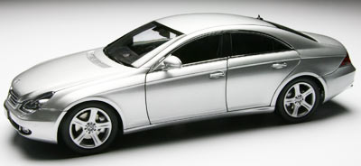
Alternative Text
Textual alternative to image content
Alternative text communicates the purpose of the graphic, not its appearance
Keep in mind how the image is used
to convey important content
to provide visual enhancement
to link to other areas

Slide 35
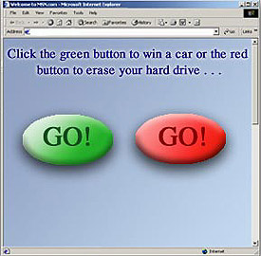
Color Usage
Color should never be the sole way to convey information
Some users with disabilities cannot distinguish colors
May lose meaning if viewed in high contrast

Slide 36
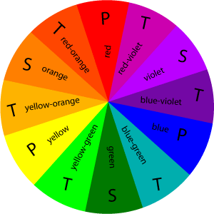
Colors
Not for emphasis
Vocal inflections
Color contrast
Black/white is ideal

Slide 37
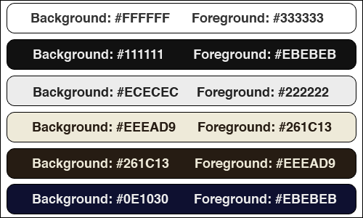
Examples of Good Color Contrast

Slide 38
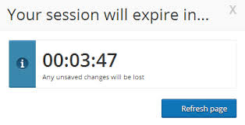
Timeouts
Timeouts are employed to track a user’s inactivity
Issues include:
Not identified on screen
Not long enough to complete an activity

Slide 39
Provide Descriptive Links
Proper links work with all assistive technologies
Must be accessible from the keyboard
Must be descriptive
Stay away from “click here” links
Example: For more information, click here
Example of a good descriptive link: WCAG 2.0

Slide 40
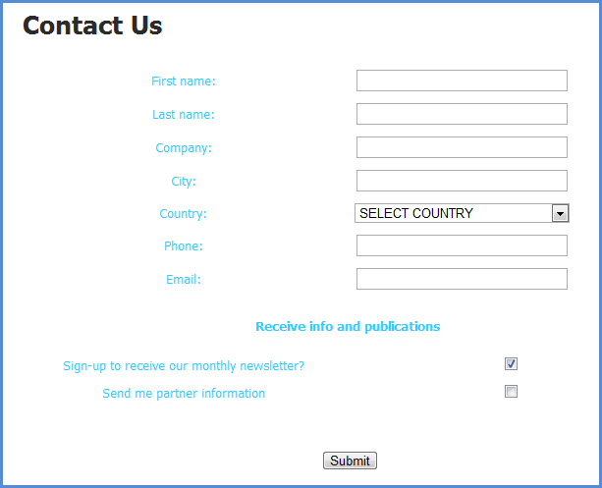
Labeled Form Fields
Matching “for” and “id” labels
ID must be unique, can’t have one label for multiple
Text labels describe the function of each form control
<label> element used to associate text label

Slide 41
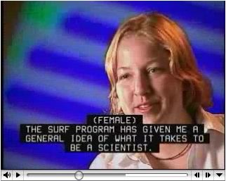
Video & Audio
Equivalent alternatives that are synchronized
Add subtitles/captions for audio and movie

Slide 42
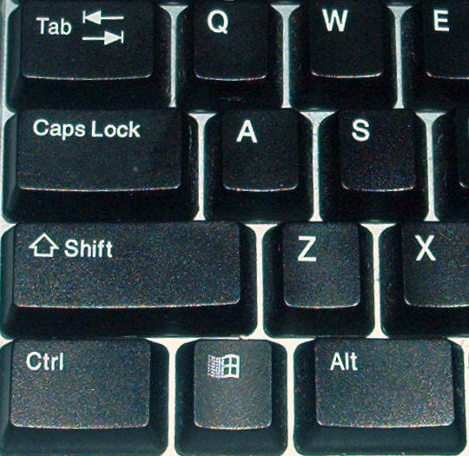
Keyboard Usage
Links, buttons, menus, form controls
Anything controllable with a mouse needs to be operable with the keyboard
Test with Tab and Enter Keys
Some items might need arrow keys such as dropdown lists, etc.

Slide 43
Skip Navigation Action
Main content is not typically located ‘first’
Long navigation lists are first, among others
Skip navigation capability bypasses the top
Create a visible or invisible link that ‘jumps’ or ‘skips’

Slide 44
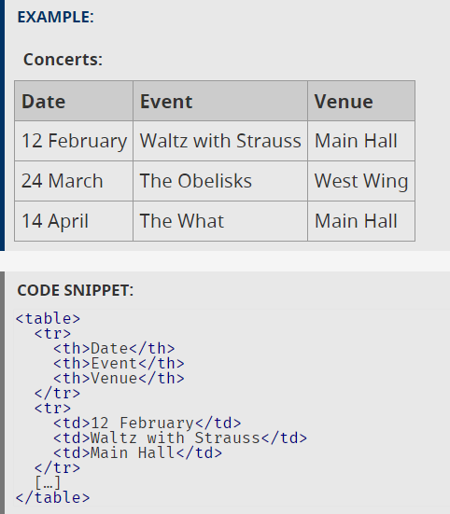
Tables
Data tables can be difficult
Largely visual
Use row and column headers appropriately
Code data cells to show association
Complex tables may need scope, id, etc.

Slide 45
Social Media Accessibility & ADA Compliance

Slide 46
The Basics: Captions on Videos
Open Captions Best for Social Media
41% of videos are incomprehensible without sound or captions.
In fact, 80% of viewers react negatively to videos autoplaying with sound. So now, many social media outlets now autoplay videos on silent.
80% of people who use captions aren't Deaf or hard of hearing.
Captions help with comprehension of dialogue, clarification of terminology, concentration and engagement.

Slide 47
The Basics: Captions on Videos 2
85% of Facebook video is watched without sound
Adding captions to Facebook videos increased view time by 12%.
Facebook video posts with captions have 135% greater organic reach.
80% more people are more likely to watch an entire video when captions are available
Adding captions to YouTube led to a 7.3% increase in views.
82% of Twitter users watch video content on Twitter.
Snapchatters watch 10 billion videos a day.

Slide 48
The Basics: Alt Text for Images
Just like for websites, images on social media need to be described for individuals who cannot view them.

Slide 49
In-Depth Tutorials
Join us on Thursday, Jan. 9 for in-depth tutorials on how to ensure your social media is accessible.
We will show demonstrations on Twitter, Facebook, Instagram, YouTube and Vimeo. Have a request? Let us know today and we will do our best to add that in!

Slide 50
Additional Resources
Clipomatic App
Clips App by Apple
YouTube (free cc generator)
rev.com 1$/min CC 24hr turnaround

Slide 51
Q&A with the Speakers
Sharon Rosenblatt Director of Communications, Accessibility Partners She/her/hers
Dan Mouyard Front End Technical Architect, Forum One
He/him/his
Moderator: Tatiana Lee
Hollywood Inclusionist, RespectAbility
Founder and Editor, Accessible Hollywood
She/her/hers

Slide 52
Equity and Access Webinar Series Schedule
Disability 101 (available online via video and transcript)
Disability History (available online via video and transcript)
How to Ensure Accessible Events (available online via video and transcript)
How to Recruit, Accommodate and Promote People with Disabilities for Volunteer Leadership, Board Positions and Paid Employment (available online via video and transcript)
How to Ensure A Welcoming Lexicon and Inclusive Storytelling (available online via video and transcript)
How to Ensue Accessible Websites and Social Media (available online soon!)
Jan. 9, 2020: Premium Skills Workshop in Social Media Accessibility
Jan. 15, 2020: How to Ensure Legal Rights and Compliance Obligations: Exploring the Rights of Employees and Participants, and the Obligations of Nonprofit Organizations Under the Law
Learn More and RSVP Here: https://www.respectability.org/accessibility-webinars

Slide 53
Resources and Thank You!
RespectAbility’s Inclusive Philanthropy Toolkit
Access information on disability inclusion, including the new disability in philanthropy & nonprofits study: www.RespectAbility.org/inclusive-philanthropy
Follow us on Social Media!
Twitter: @Respect_Ability
Facebook: RespectAbilityUSA
Instagram: @RespectTheAbility
www.RespectAbility.org | (202) 517-6272 | info@RespectAbility.org
Intersection of Disability and Politics: www.TheRespectAbilityReport.org

