Slide 1
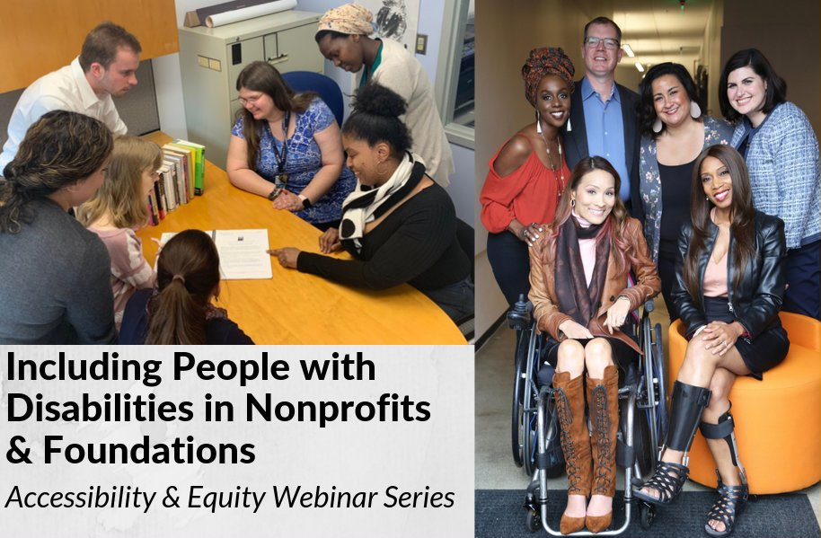
Disability 101
Disability
History

Slide 2
Equity and Access Webinar Series Partners
BoardSource
The California Wellness Foundation
Catalogue for Philanthropy, Greater Washington
Center for Disaster Philanthropy
Cerebral Palsy Foundation
The Chronicle of Philanthropy
The Communications Network
The Divas With Disabilities Project
Exponent Philanthropy
Grantmakers Concerned with Immigrants and Refugees
Media Impact Funders
National Center of Disability Journalism
National Committee for Responsive Philanthropy
National Council of Nonprofits
The New York Women’s Foundation
The Unfunded List
Weingart Foundation

Slide 3
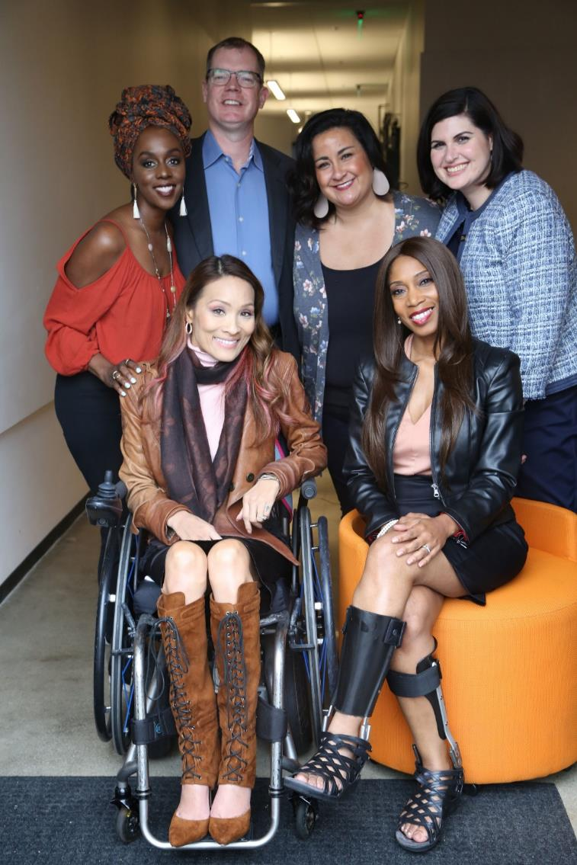
Including the D – Disability – in Diversity
Organizations are at their best when they welcome, respect and include people of all backgrounds. This includes people with disabilities.

Slide 4
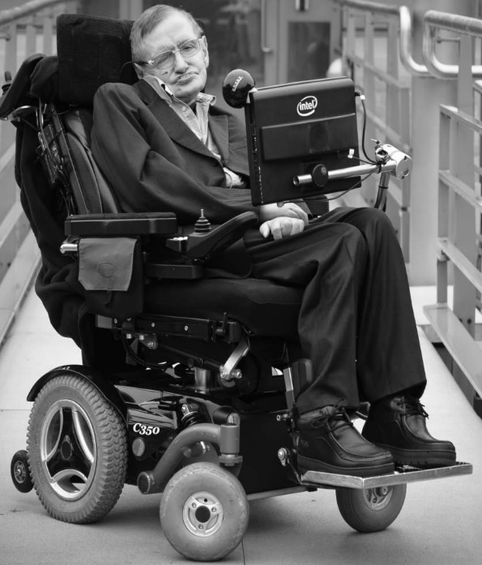
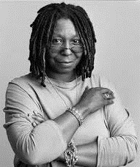
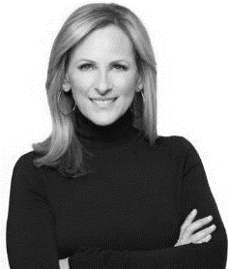
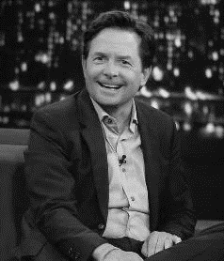
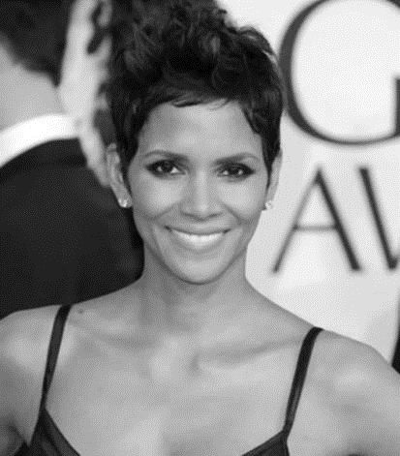
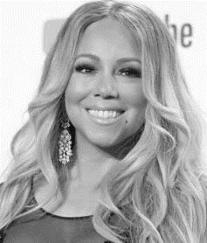
These are people with disabilities.
These are people with disabilities.

Slide 5
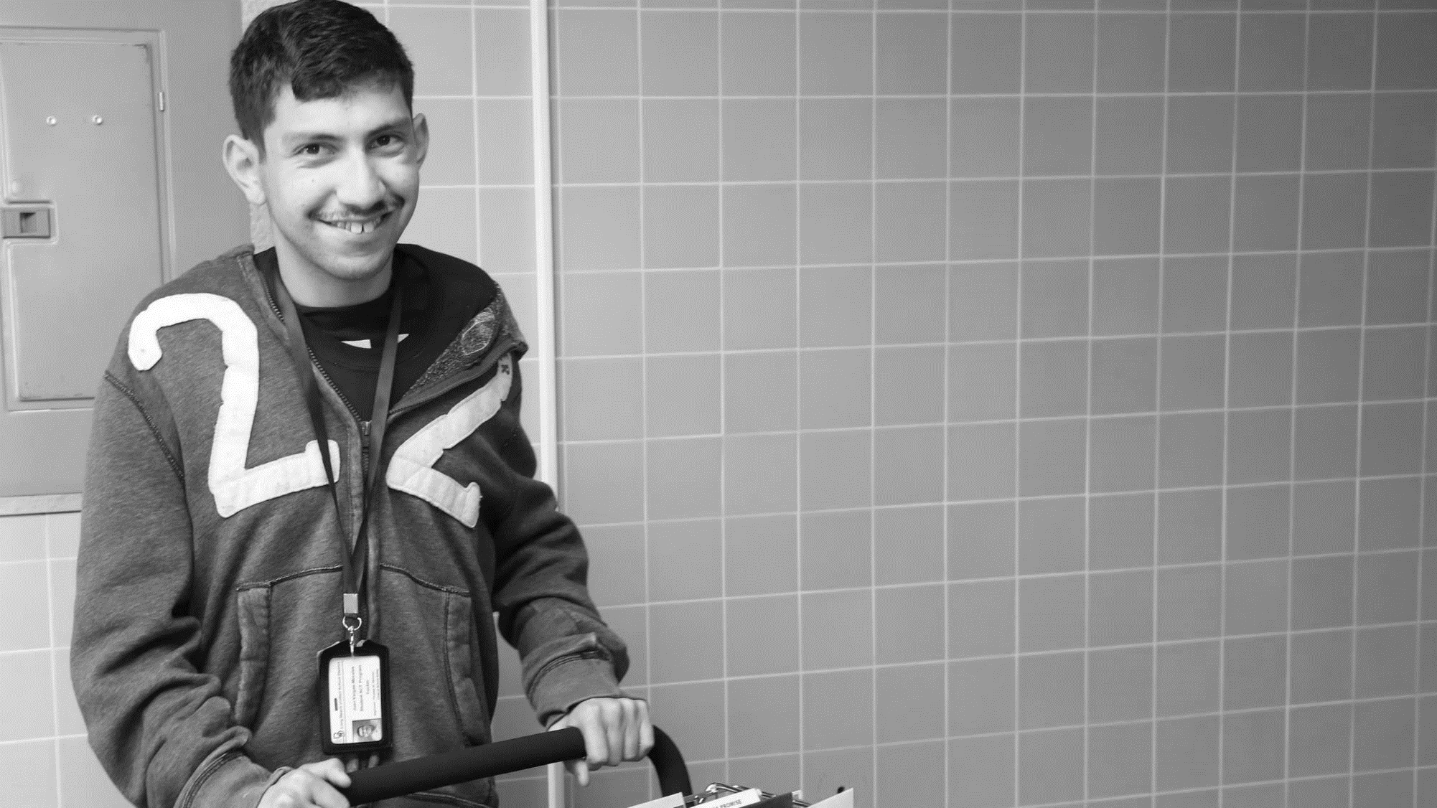
61 million people
61 Million
people in the US have a disability.*
People with disabilities
want
opportunities
Just like anyone else.
* Source: US Census

Slide 6
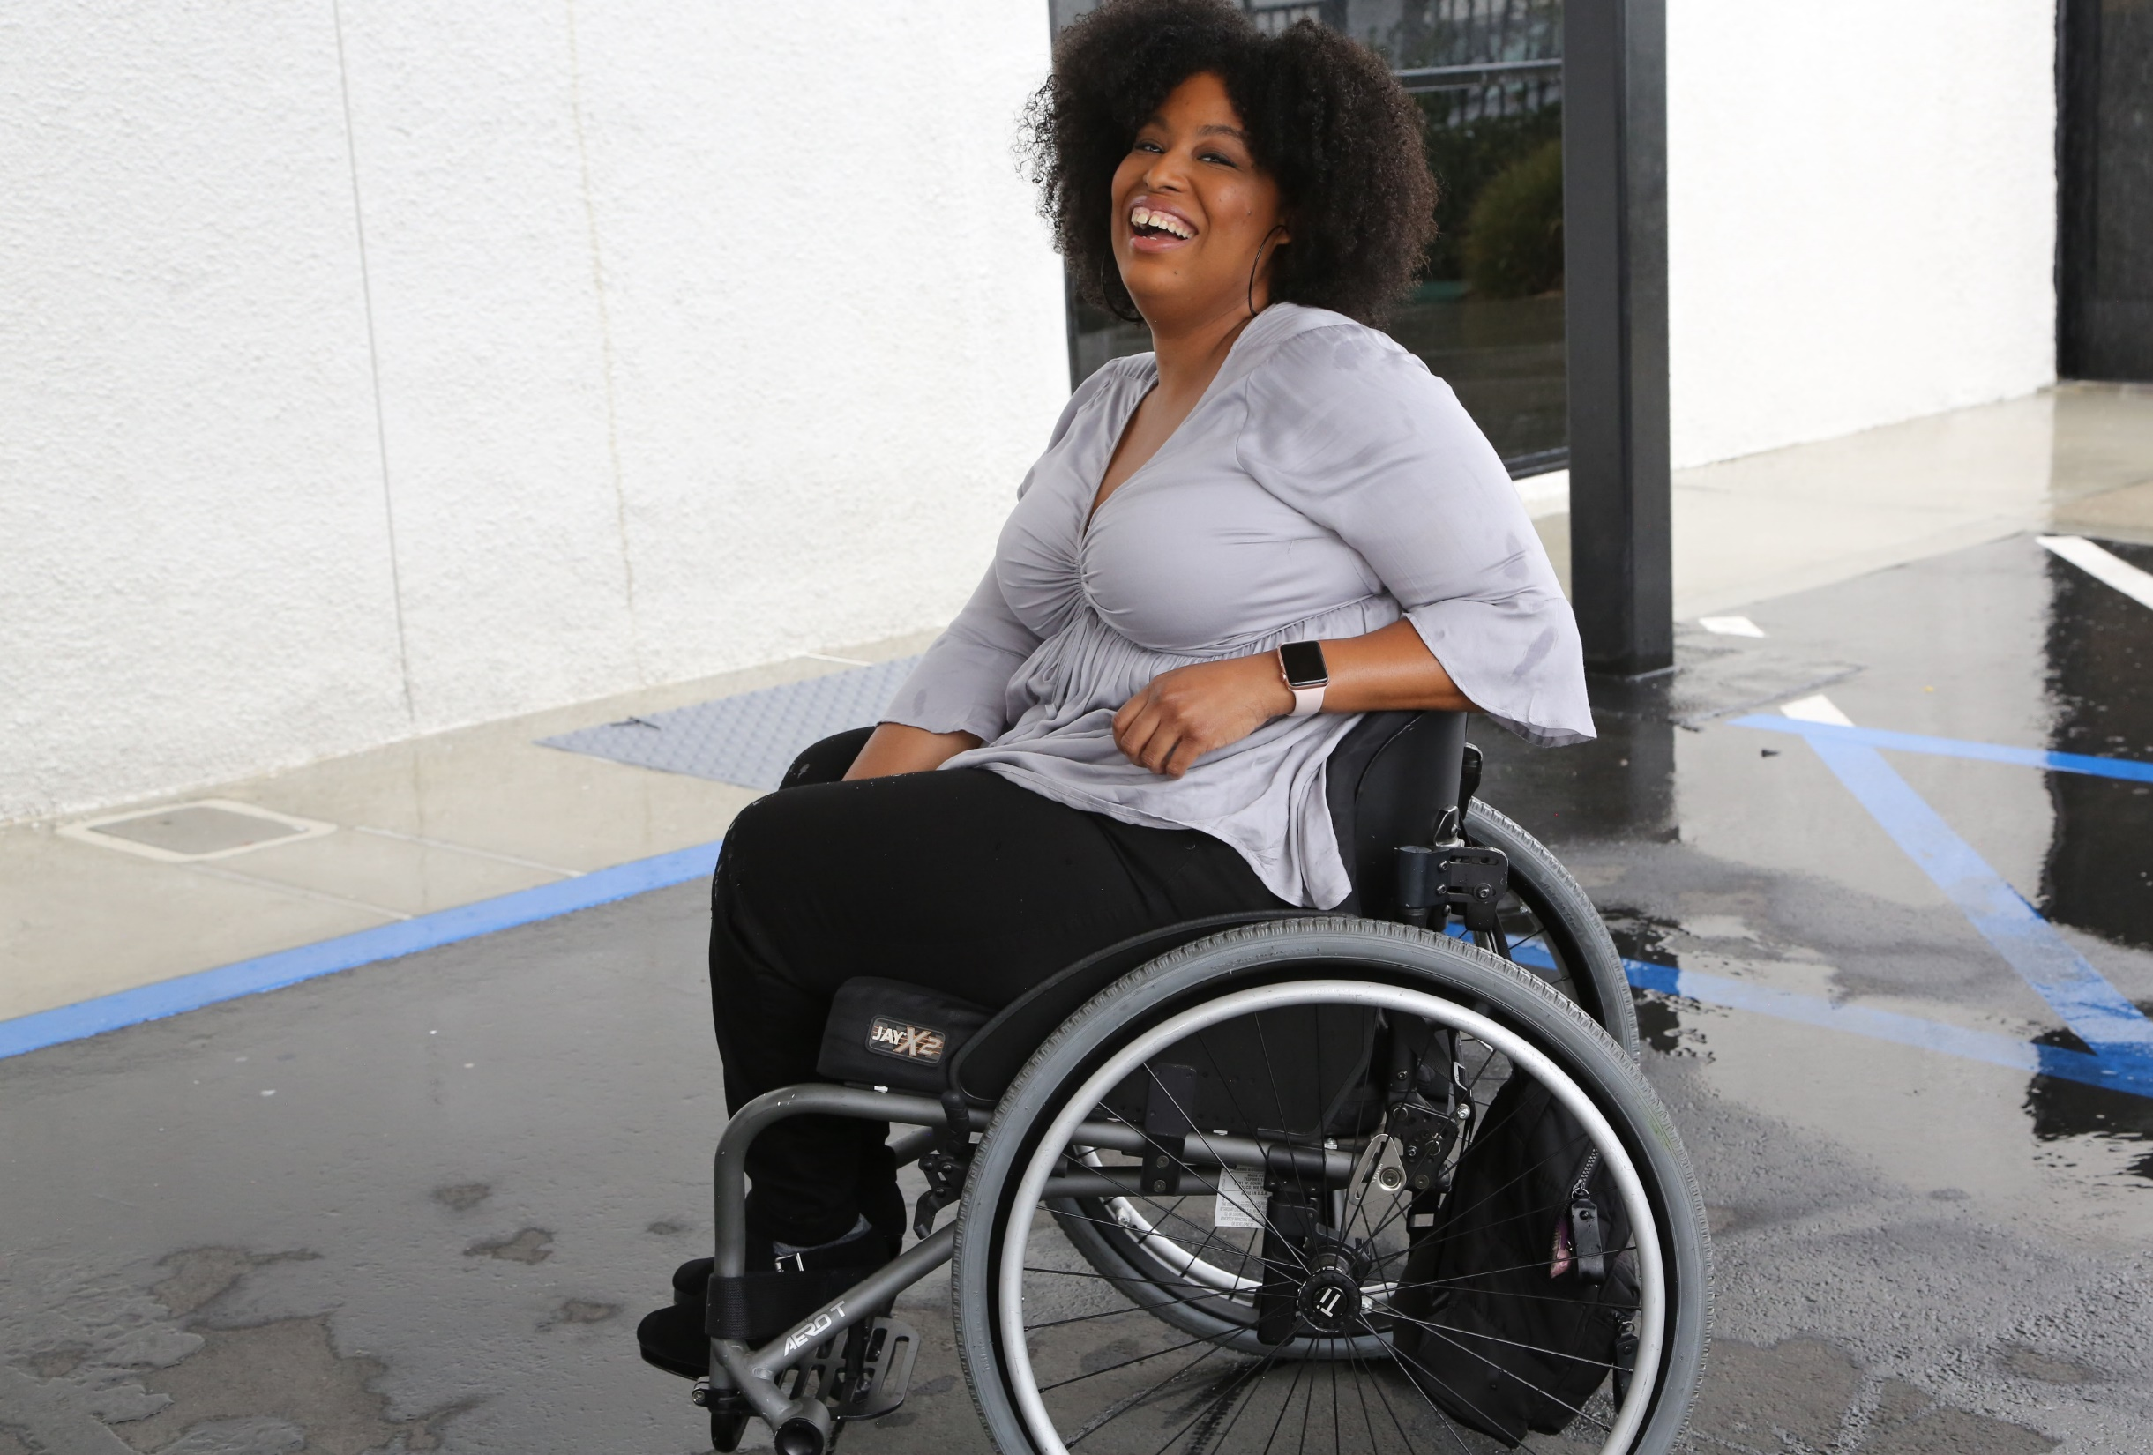
1 in 4 adults
1 in 4
adults have a disability

Slide 7
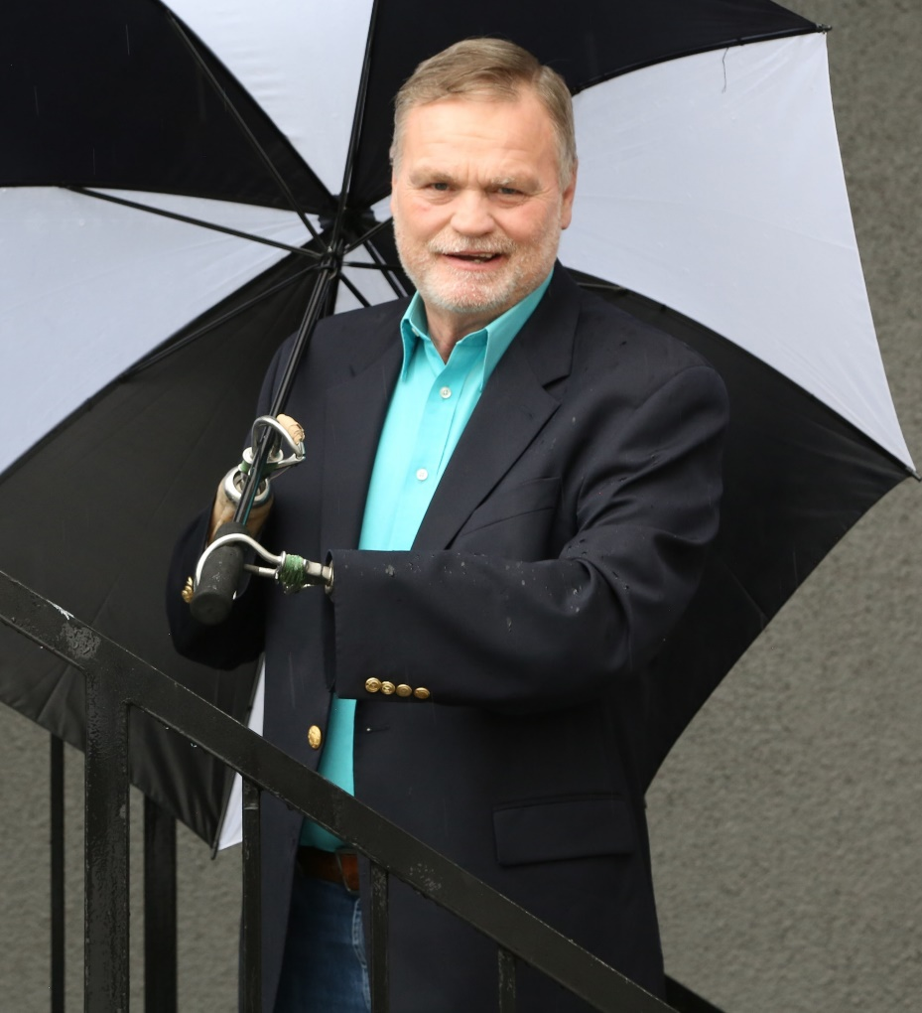
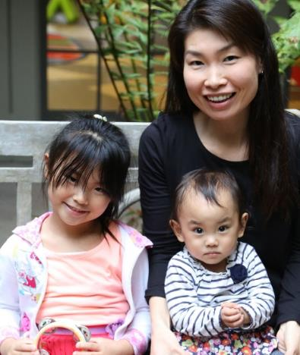
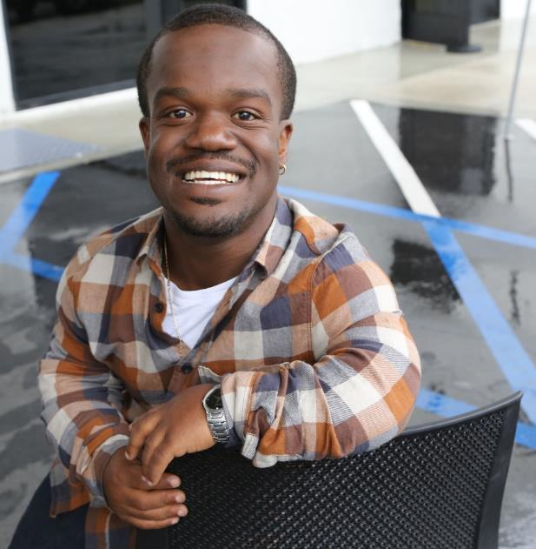
Disabilities Are….
Temporary and Permanent
Visible and Invisible
From Birth or Acquired Later

Slide 8
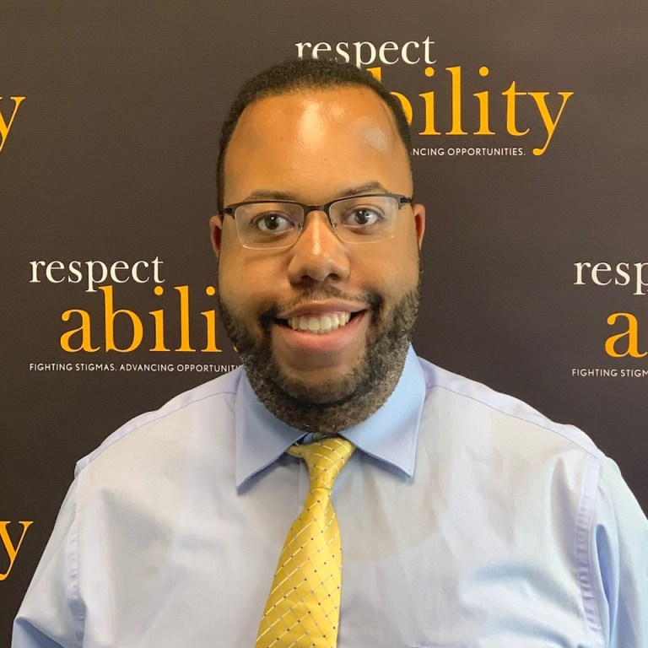
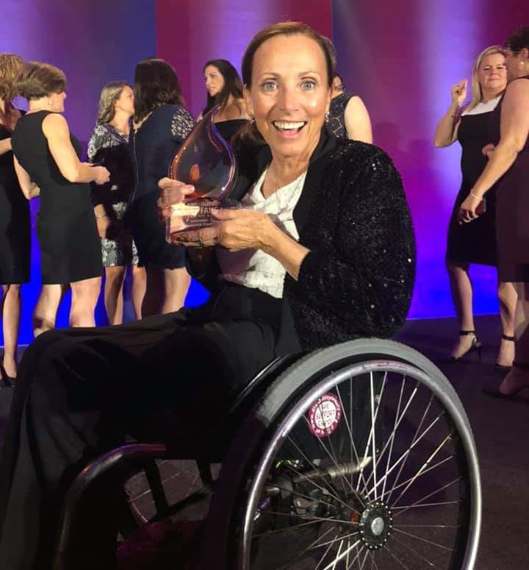
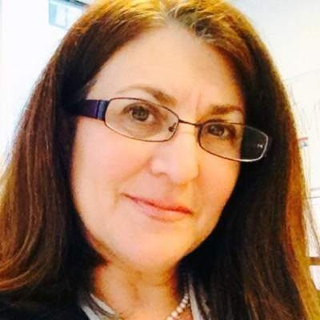
Speakers
Moderator: Anthony Rendolph Clarke Brown II
Communications Fellow, RespectAbility
Writer, Busting Brackets, FanSided Network
He/him/his
Candace Cable California Workforce Program Manager, RespectAbility
Understanding Disability Educator and U.S. Olympic and Paralympic Hall of Fame
She/her/hers
Donna Meltzer
CEO, National Association of Councils on Developmental Disabilities
Co-Chair, Consortium for Citizens with Disabilities Fiscal Policy Task Force
She/her/hers

Slide 9
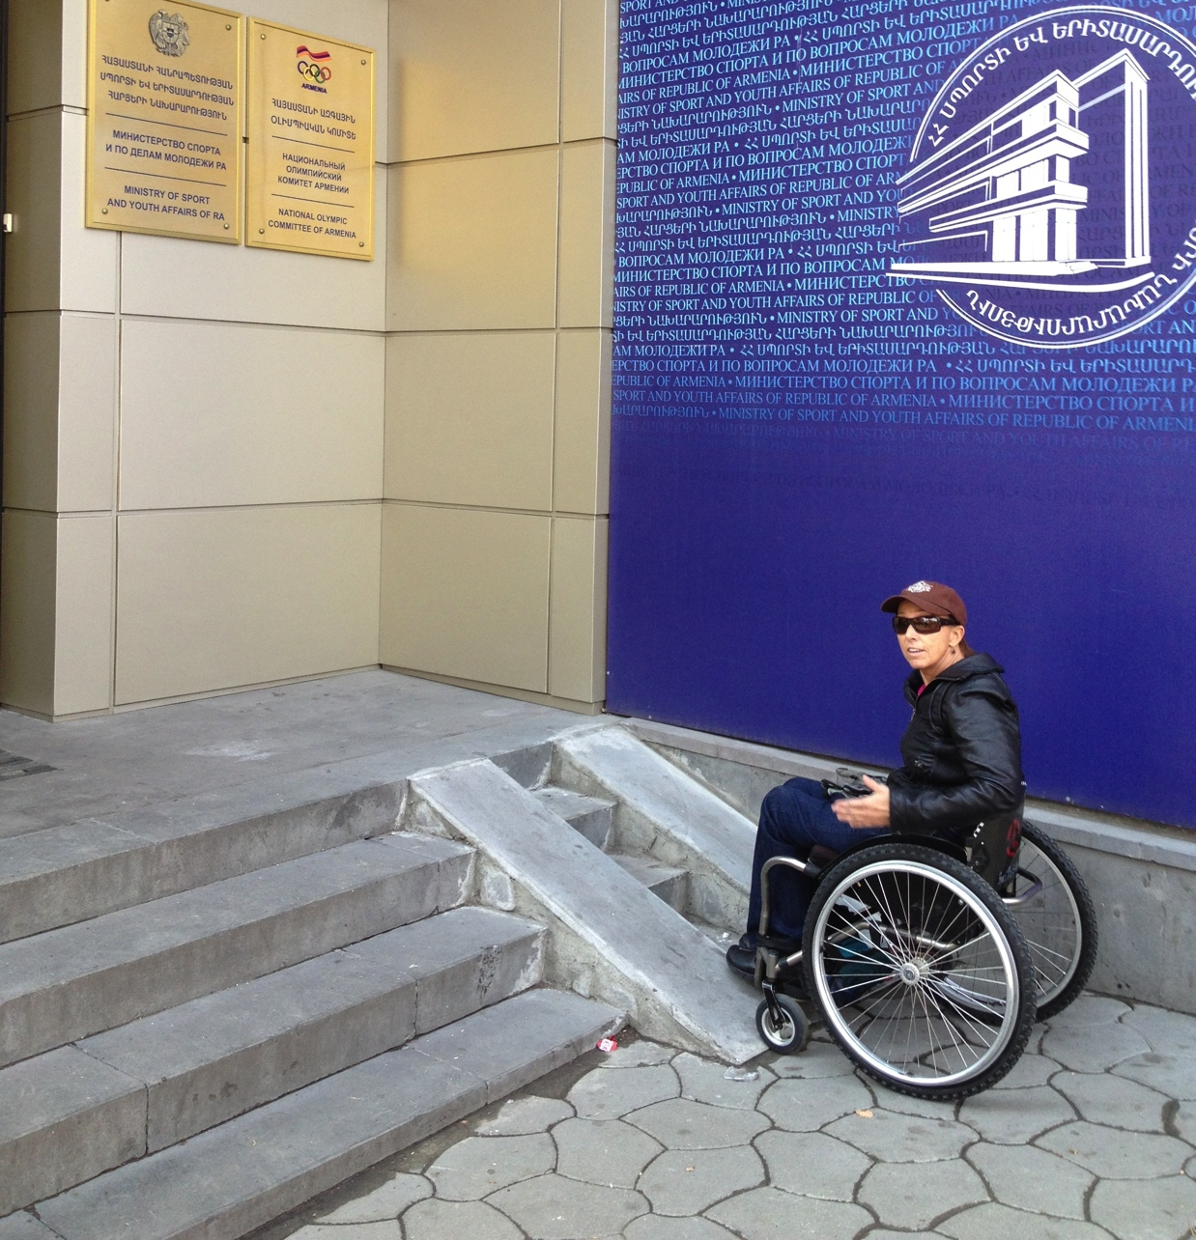
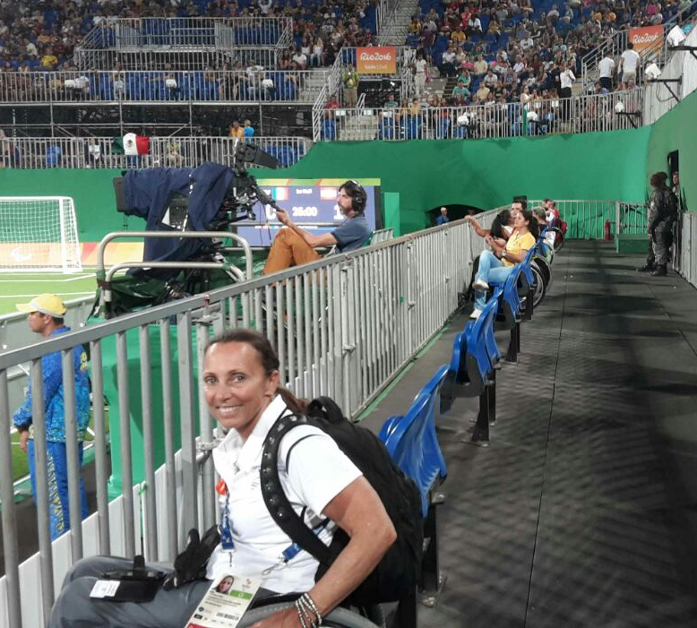
We have to ramp the human mind so the rest of the ramps will work.
Change the Attitudes
Change the Culture
We ramp our minds with education, spending time with disabled people and experiencing the world with a “disability lens” To create a …
“Culture Change”

Slide 10
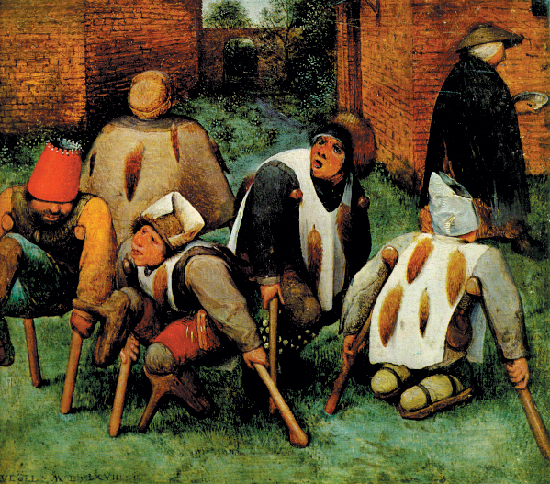
How has disability been defined in different historical eras?
Moral – Disability is the result of sins or a curse.
Middle Ages – 1700: Belief that mental health conditions people had were possessed by the devil and burned at the stake.
Plato, Father of the Eugenics movement, had a goal to improve the quality of the human gene pool.
Aristotle: Unworthy of life

Slide 11
Charity and Medical Models
Charity – Person with a disability is a burden or needs to be cared for. Forced in to institutions observed or guarded by medical or social workers.
Medical – Conditions or illnesses needing a cure or fixed.

Slide 12
Ugly Laws and Forced Sterilization
Mid-1700’s – 1970’s: “Ugly Laws” → Illegal for "any person, who is diseased, maimed, mutilated or deformed in any way, so as to be an unsightly or disgusting object, to expose himself or herself to public view."
29 states pass compulsory sterilization laws directed at people with genetic disabilities.
In 1927, the U.S. Supreme Court rules that forced sterilization of people with disabilities is legal.

Slide 13
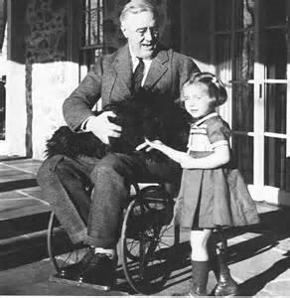
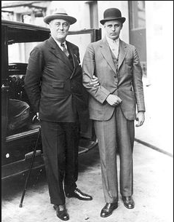
Hiding Your Disability to Appear Stronger
President Franklin D. Roosevelt’s polio, his physical disability and use of a wheelchair was hidden from the public. The wheelchair was considered a sign of weakness and he was required to stand on braces when he spoke publicly.

Slide 14
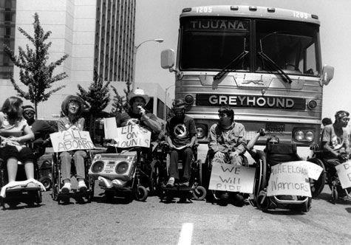
People with Disabilities Come Out: Lives Worth Living
1970: Independent Living Movement begins
1972: First ILC established in Berkeley

Slide 15
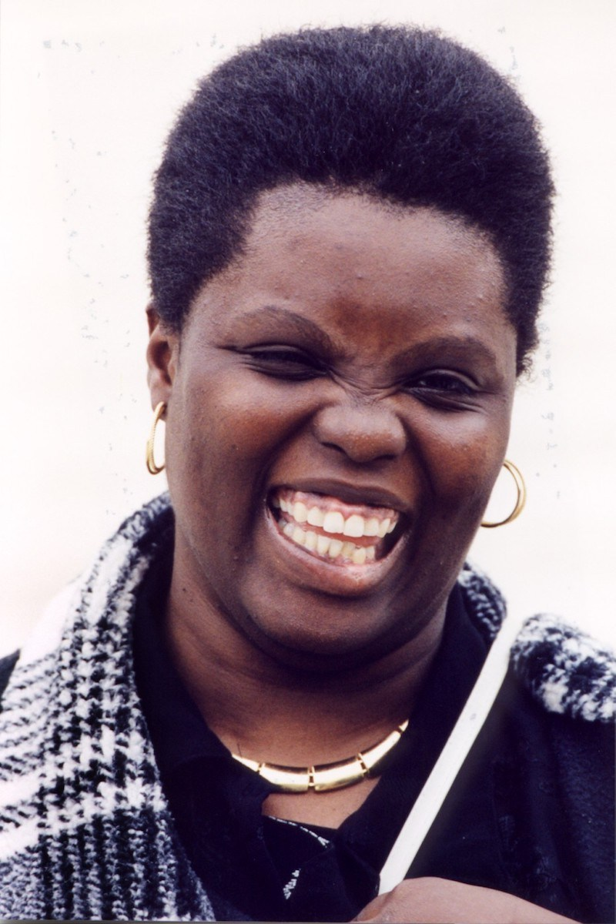
Olmstead v. L.C 527 U.S. 581
The Olmstead Decision justified the right for people with disabilities to live independently but it would take four years to come in effect including being heard in the Supreme Court in 1999.
Lois Curtis: Woman with Disabilities Fights for Freedom For All www.respectability.org/2019/03/women-disabilities-lois-curtis

Slide 16
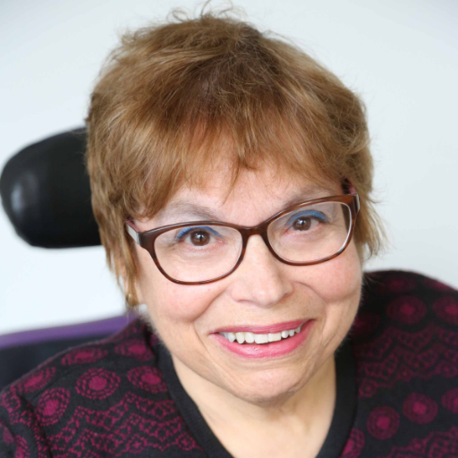
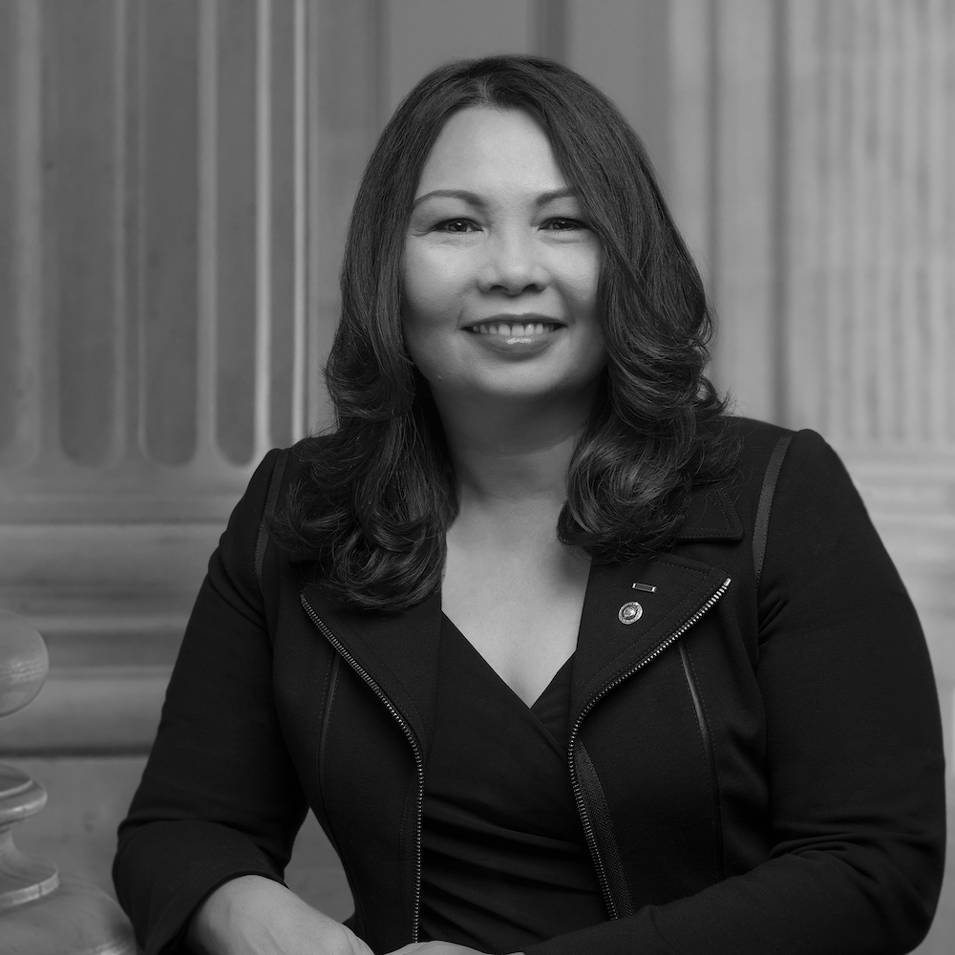
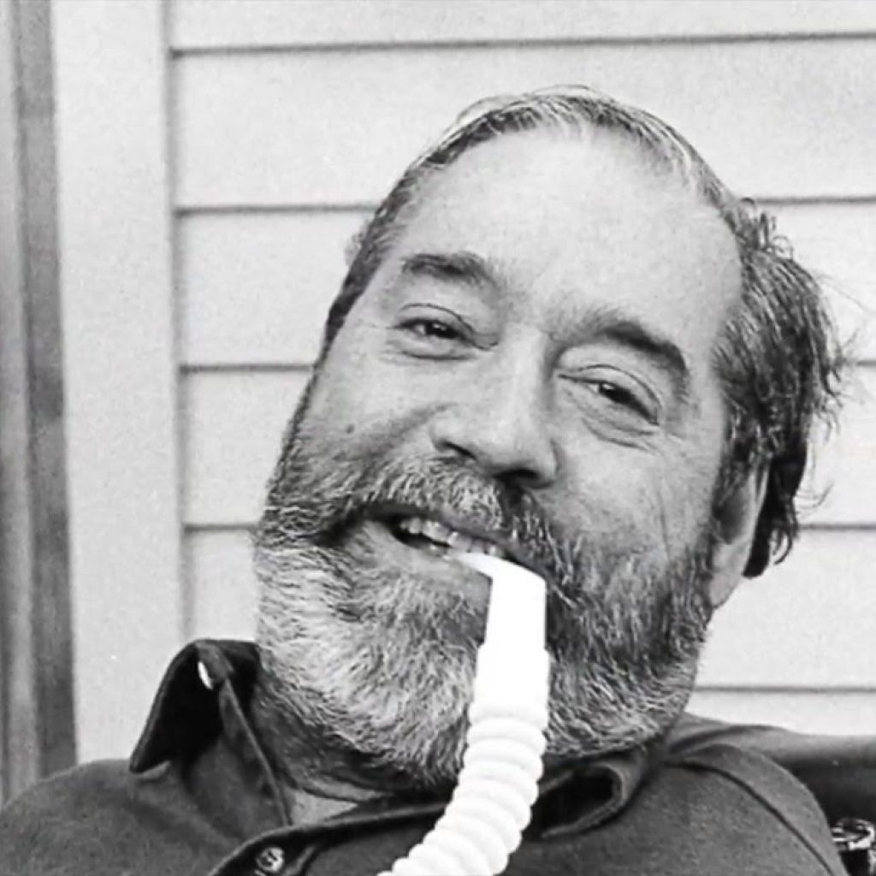
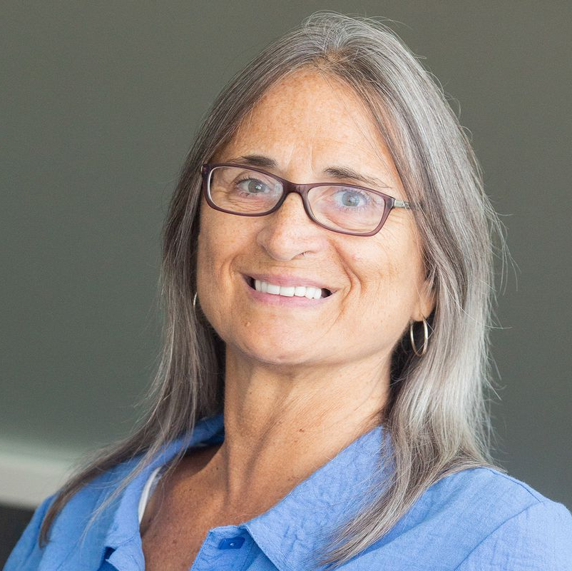
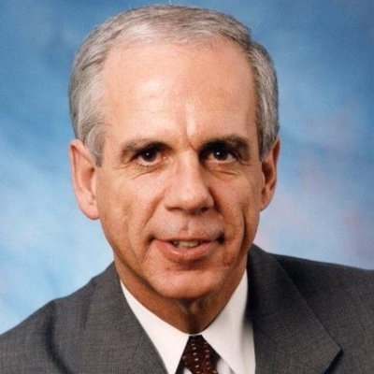
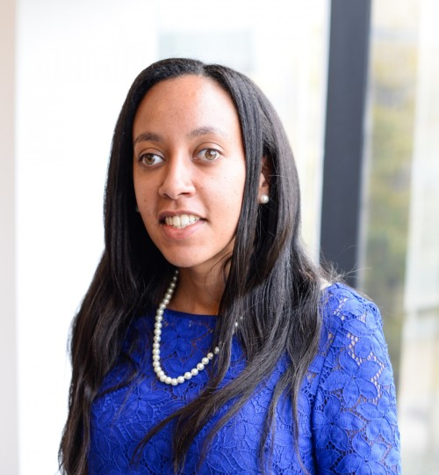
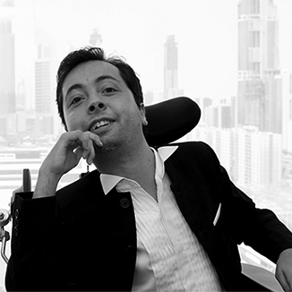
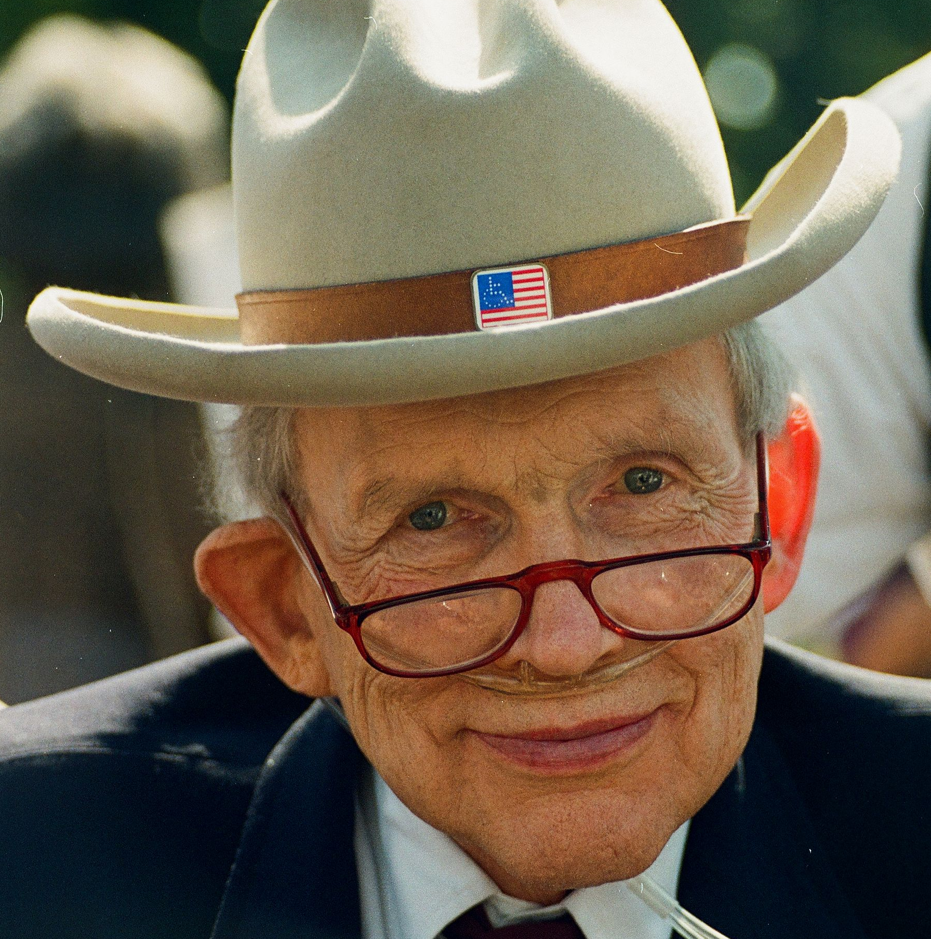
Leaders in the Disability Movement Past and Present
Leaders in the Disability Movement Past and Present

Slide 17
The Role of Government in Advocacy
Executive
Branch
Legislative
Branch
Judicial
Branch
President &
Administration
Congress
Courts
House & Senate
The Role of Government in Advocacy

Slide 18
Major Civil Rights Laws on Disability Issues
Developmental Disabilities Assistance and Bill of Rights Act (DD Act)
Individuals with Disabilities Education Act (IDEA)
Section 504 of the Rehabilitation Act of 1973 (Section 504)
Americans with Disabilities Act of 1990 (ADA)

Slide 19
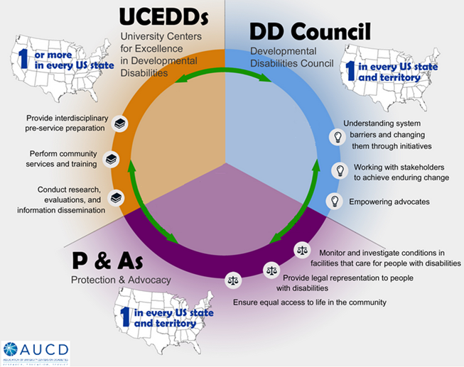
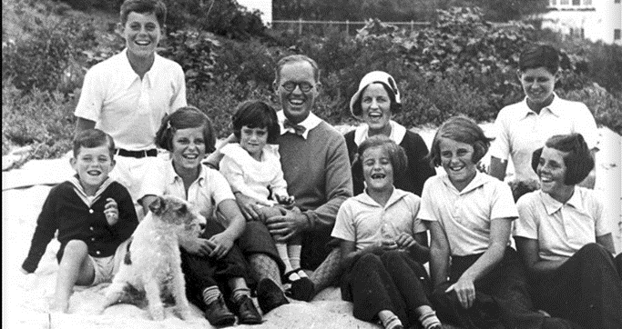
Developmental Disabilities Assistance and Bill of Rights Act (DD Act)
The Kennedy/Shriver family

Slide 20
Individuals with Disabilities Education Act (IDEA)
PARC v. Commonwealth of Pennsylvania (1972)
IDEA Principles Today:
Free Appropriate Public Education
Appropriate Evaluation
Individualized Education Plan (IEP)
Least Restrictive Environment
Parent Participation
Procedural Safeguards
Education for All Handicapped Children Act (1975)
Individuals with Disabilities Education Act (1990)
1972 ad for children denied education due to disability.

Slide 21
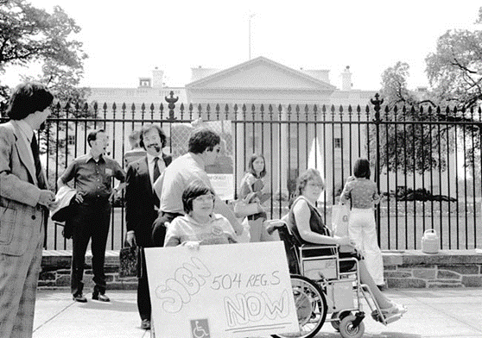
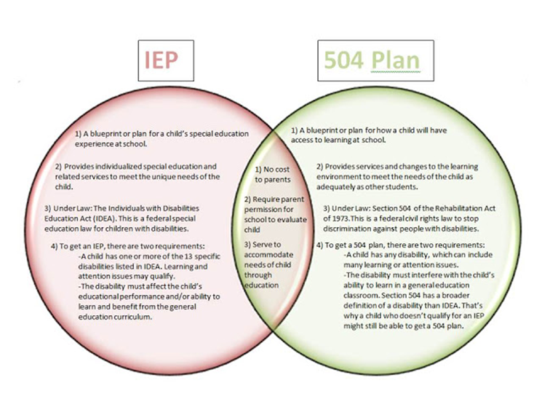
Section 504 of the Rehabilitation Act of 1973 (Section 504)
Section 504 states that "no qualified individual with a disability in the United States shall be excluded from, denied the benefits of, or be subjected to discrimination under" any program or activity that either receives Federal financial assistance or is conducted by any Executive agency or the United States Postal Service.

Slide 22
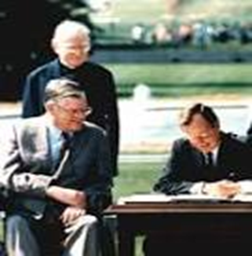
Americans with Disabilities Act of 1990 (ADA)
Passed by Congress in 1990, the Americans with Disabilities Act (ADA) is the nation's first comprehensive civil rights law addressing the needs of people with disabilities, prohibiting discrimination in employment, public services, public accommodations, and telecommunications.
To be protected by the ADA, one must have a disability, which is defined by the ADA as a physical or mental impairment that substantially limits one or more major life activities, a person who has a history or record of such an impairment, or a person who is perceived by others as having such an impairment. The ADA does not specifically name all of the impairments that are covered. The ADA is built upon four pillars: full participation, independent living, equality of opportunity, and economic self-sufficiency.

Slide 23
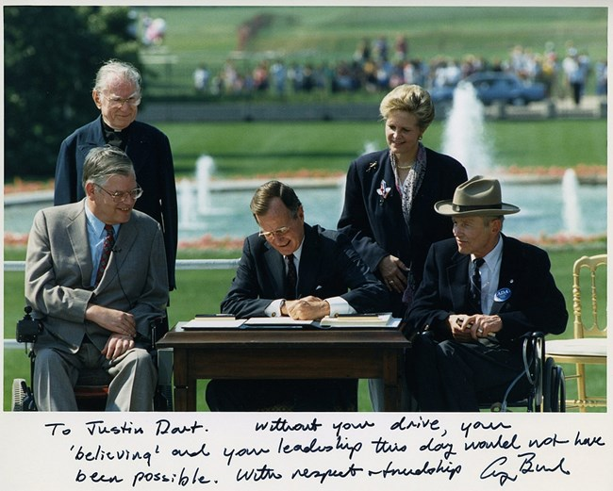
Bipartisanship in the ADA

Slide 24
Dominos Supreme Court Case
The Supreme Court denied a petition from Domino’s to hear whether its website is required to be accessible.
The decision not to grant the case is a loss for the company and a win for disability advocates, who have argued that if businesses do not have to maintain accessible sites, people with disabilities could be effectively shut out of substantial portions of the economy.

Slide 25
Lessons from the Past
All of these laws have common language and were built upon one another – each plays a role in our rights and our responsibilities and helps us know what we can do and what we can achieve. You are standing on the shoulders of giants. You don’t need to be a giant, but you do need to know to know some history and your rights so that you can be the best advocate.

Slide 26
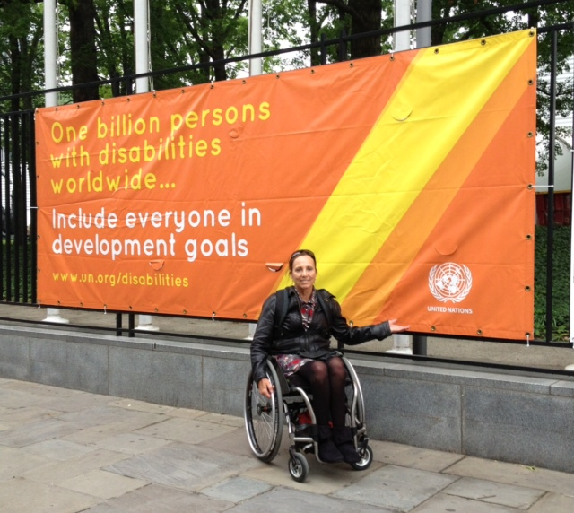
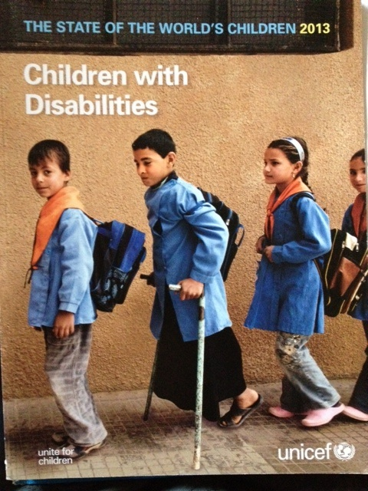
The Convention on the Rights of People with Disabilities – CRPD 2008
First UNICEF study on Children with Disabilities – 2012

Slide 27
Sustainable Development Goals, SDG - 2015 Nothing Without Us

Slide 28
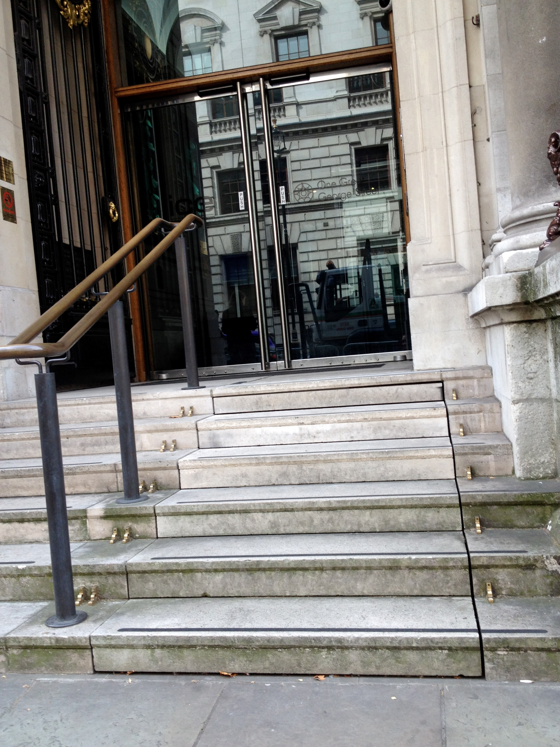
Ancient Design Becomes Universal Design

Slide 29
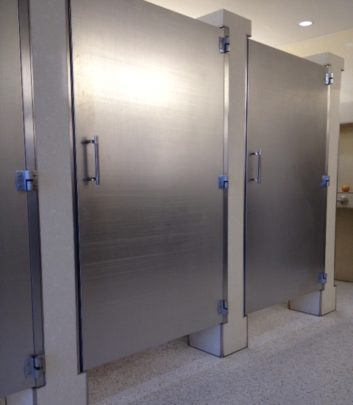
Universal Design Works for Everyone
What is environmental privilege?

Slide 30
Sports and Culture Contribute to Inclusion
Paralympic Games
Special Olympics
Deaflympics

Slide 31
Equity and Access Webinar Series Schedule
Disability 101 (available online via video and transcript)
Nov. 13, 2019: Disability History
Nov. 20, 2019: How to Ensure Accessible Events
Dec. 4, 2019: How to Recruit, Accommodate and Promote People with Disabilities for Paid Employment, Volunteer Leadership and Board Positions
Dec. 11, 2019: How to Ensure A Welcoming Lexicon and Inclusive Storytelling
Jan. 7, 2020: How to Ensue Accessible Websites, Social Media and Inclusive Photos
Jan. 9, 2020: Premium Skills Workshop in Social Media Accessibility
Jan. 15, 2020: How to Ensure Legal Rights and Compliance Obligations: Exploring the Rights of Employees and Participants, and the Obligations of Nonprofit Organizations Under the Law
Learn More and RSVP Here: https://www.respectability.org/accessibility-webinars/

Slide 32
Resources and Thank You!
RespectAbility’s Inclusive Philanthropy Toolkit
Access information on disability inclusion, including the new disability in philanthropy & nonprofits study: www.RespectAbility.org/inclusive-philanthropy
Follow us on Social Media!
Twitter: @Respect_Ability
Facebook: RespectAbilityUSA
Instagram: @RespectTheAbility
www.RespectAbility.org | (202) 517-6272 | info@RespectAbility.org
Intersection of Disability and Politics: www.TheRespectAbilityReport.org

