Slide 1
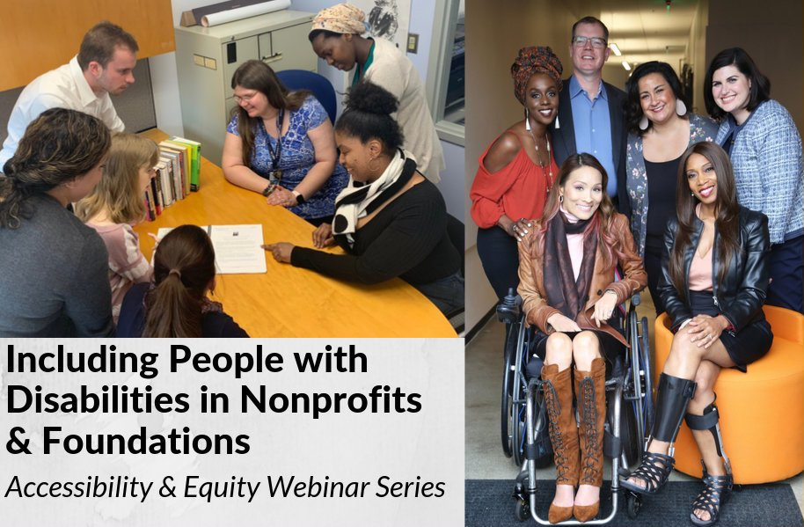

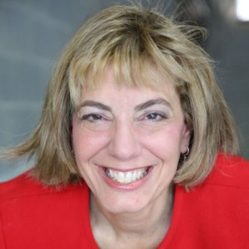
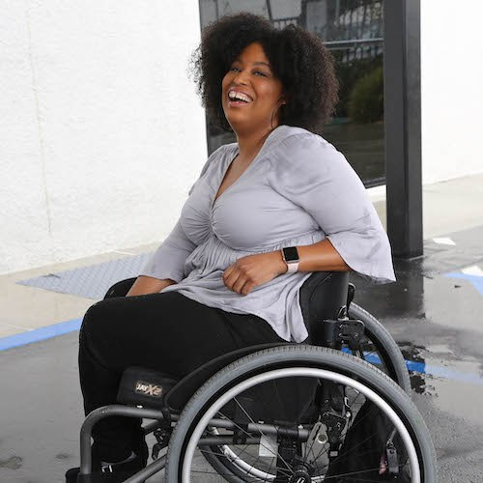
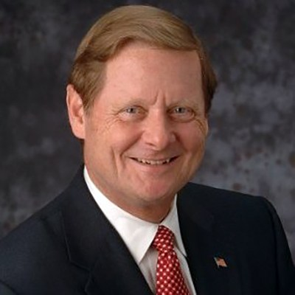
Disability 101
Disability
101
Jennifer Laszlo Mizrahi
President
RespectAbility
Tatiana Lee
Hollywood Inclusionist
RespectAbility
Hon. Steve Bartlett
Chairman
RespectAbility

Slide 2
Equity and Access Webinar Series Partners
BoardSource
The California Wellness Foundation
Catalogue for Philanthropy, Greater Washington
Center for Disaster Philanthropy
Cerebral Palsy Foundation
The Chronicle of Philanthropy
The Communications Network
The Divas With Disabilities Project
Exponent Philanthropy
Grantmakers Concerned with Immigrants and Refugees
Media Impact Funders
National Center of Disability Journalism
National Committee for Responsive Philanthropy
National Council of Nonprofits
The New York Women’s Foundation
The Unfunded List
Weingart Foundation

Slide 3
Including the D – Disability – in Diversity
Organizations are at their best when they welcome, respect and include people of all backgrounds. This includes people with disabilities.

Slide 4
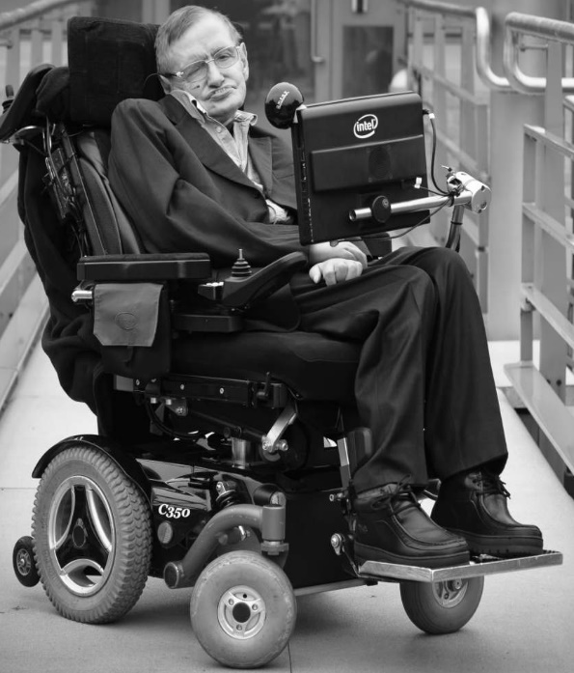
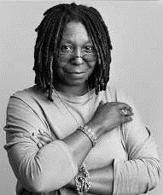
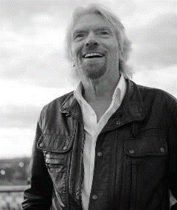

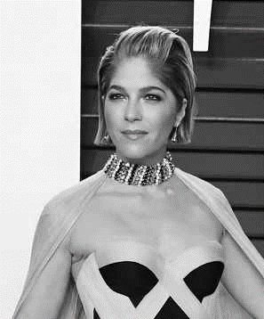
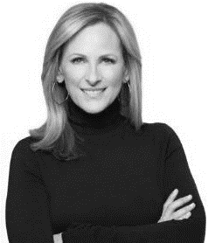
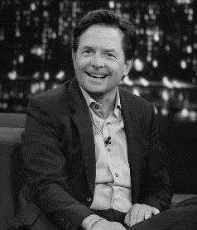
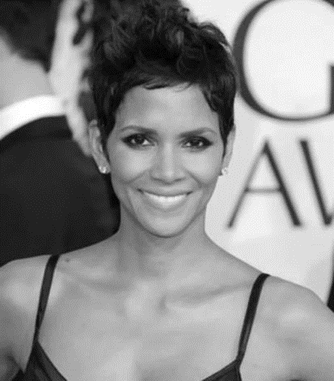
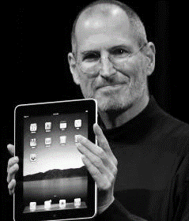

These are people with disabilities.
These are people with disabilities.

Slide 5
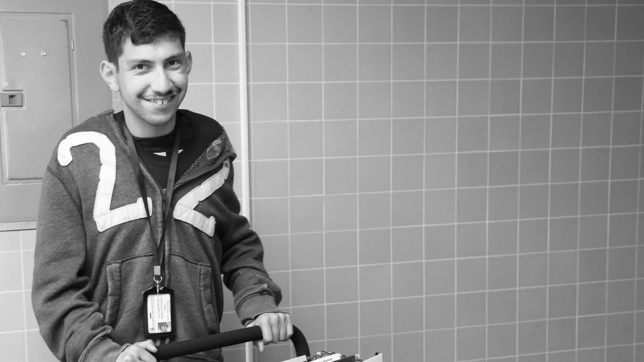

61 million people
61 Million
people in the US have a disability.*
People with disabilities
want
opportunities
Just like anyone else.
* Source: US Census

Slide 6
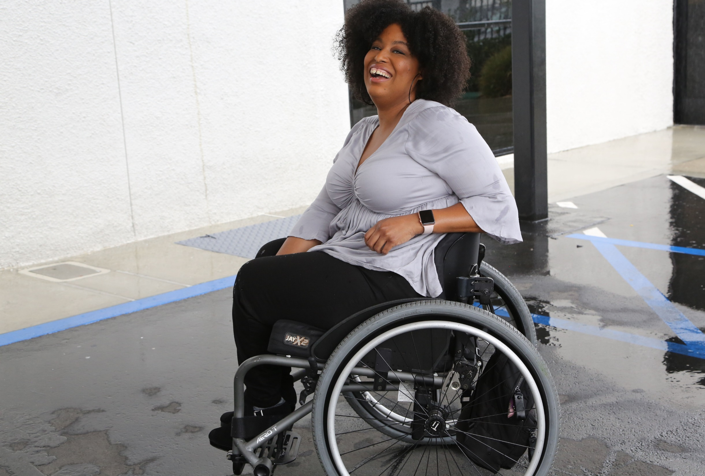
1 in 4 adults
1 in 4
adults have a disability

Slide 7
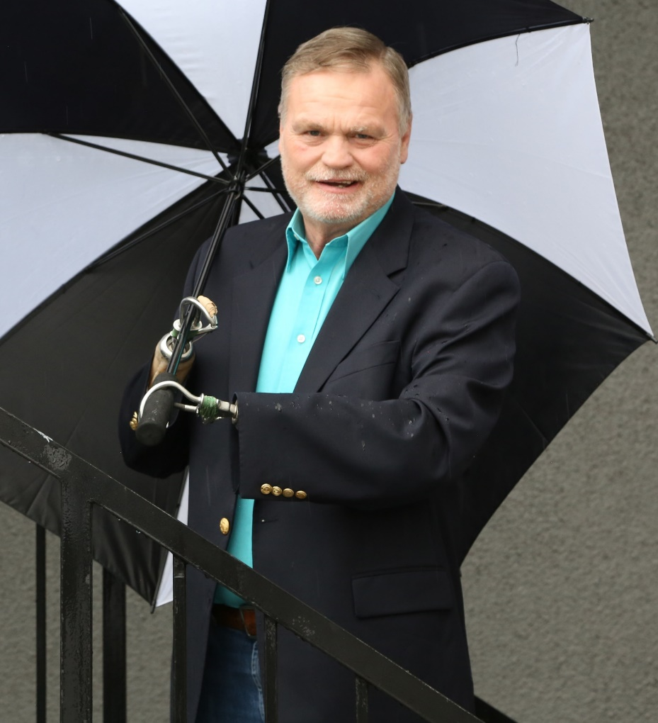
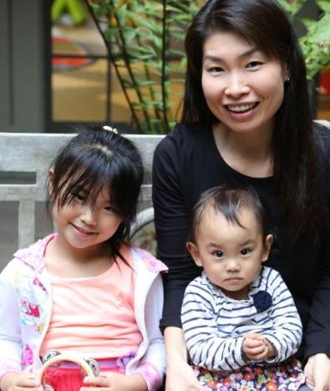
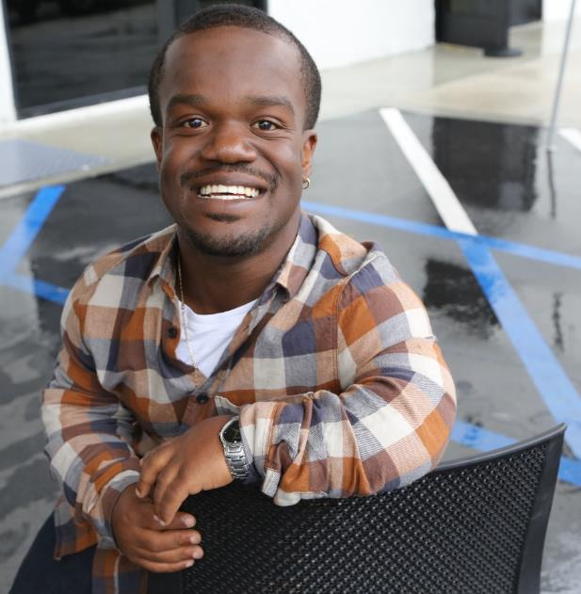
Disabilities Are….
Temporary and Permanent
Visible and Invisible
From Birth or Acquired Later
Anyone can join the disability community at any point.

Slide 8
Disability Impacts Everyone
Disability impacts people of all races, sexual orientations and gender identities, faiths and backgrounds.
African Americans with Disabilities
Latinx People and Hispanics with Disabilities
Women with Disabilities
LGBTQ+ Individuals with Disabilities

Slide 9
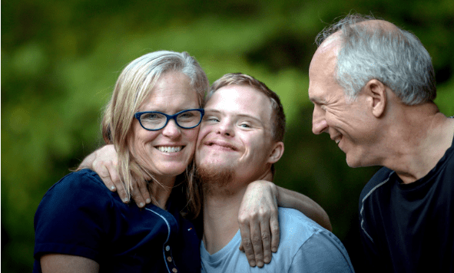
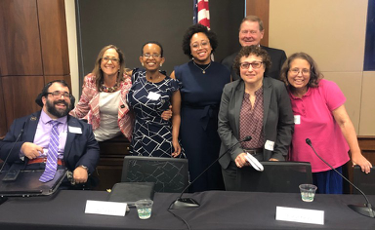
People with Disabilities are Connected to Communities
have a family member with a disability
have a close friend with a disability
48%
42%
* Source: September 2012 poll, Laszlostrategies.com

Slide 10
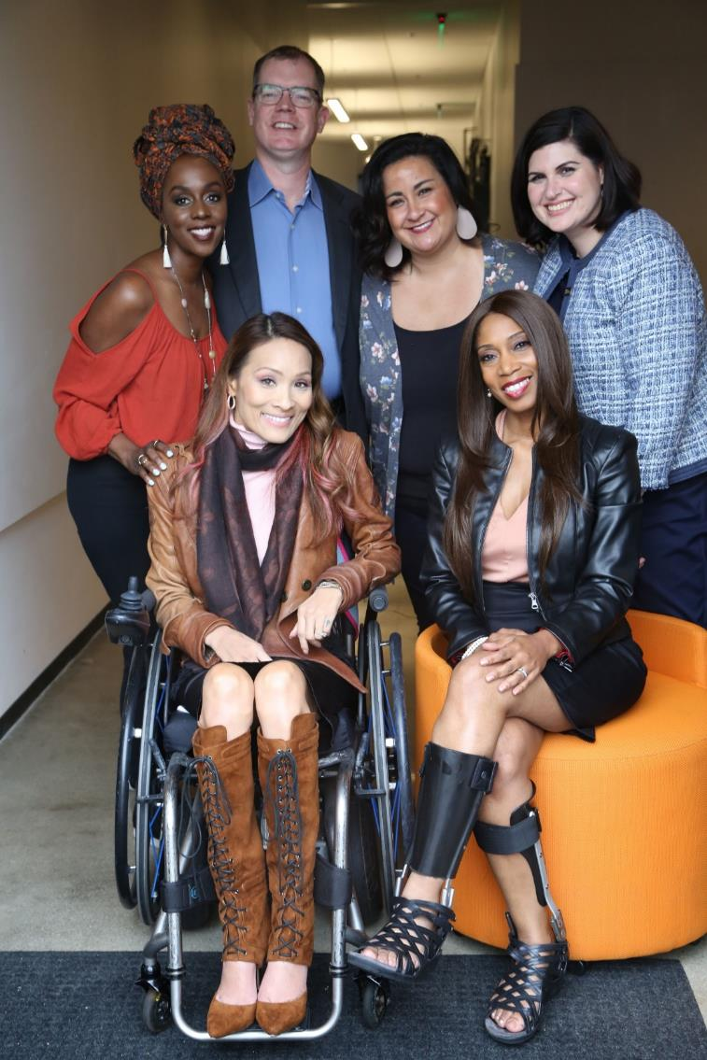
The disability community is cutting edge and innovative.
Anyone can join the disability community at any point.
People with disabilities are diverse and part of all communities.

Slide 11
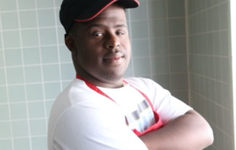
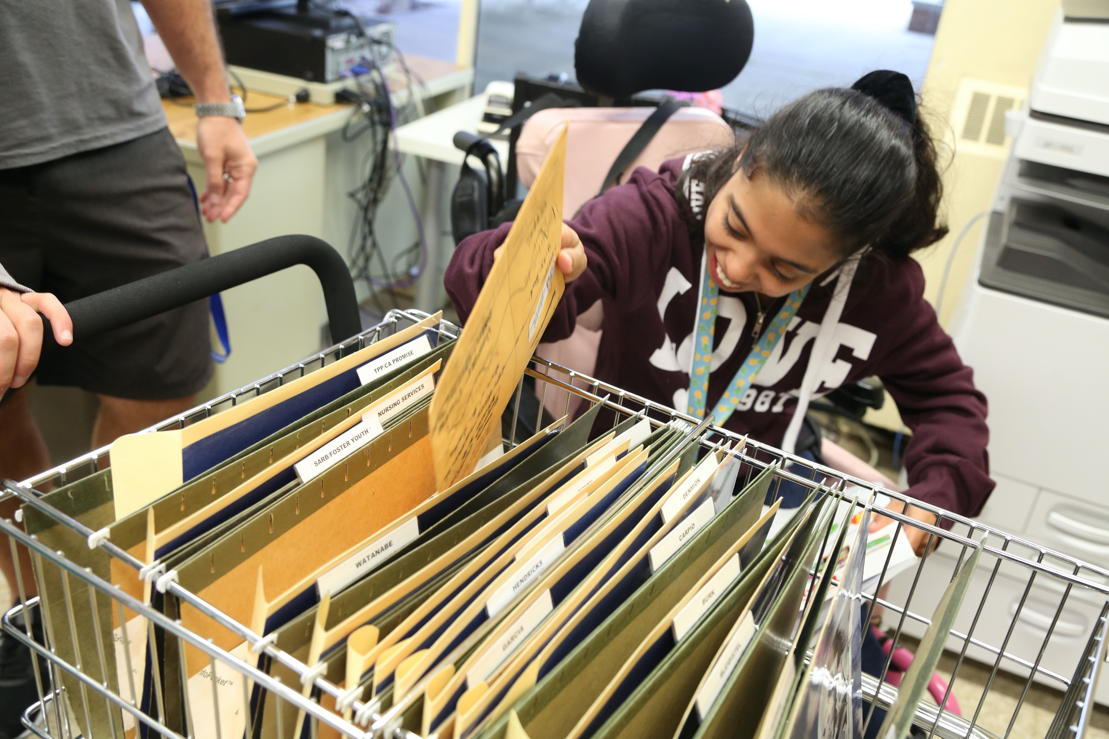
School statistics
There are 7 million students with disabilities in public schools today.
Over 52% of students with disabilities are
people of color.
Only 65% of people with disabilities finish high school.
What can be done to enable people with disabilities to succeed?

Slide 12
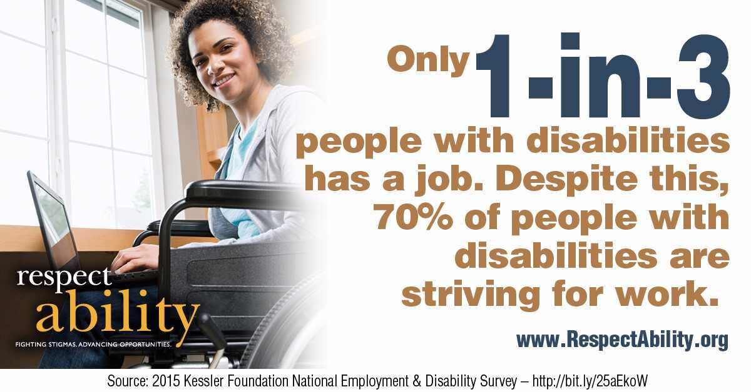
70 percent of People with Disabilities are Striving for Work

Slide 13
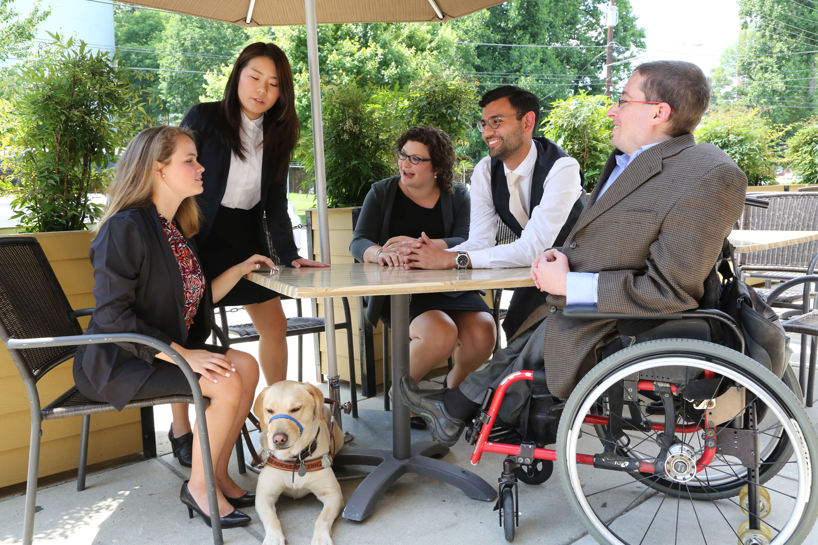
8 million ready to work
That means there are over 8 million
people with disabilities eager and ready to enter the workforce.

Slide 14

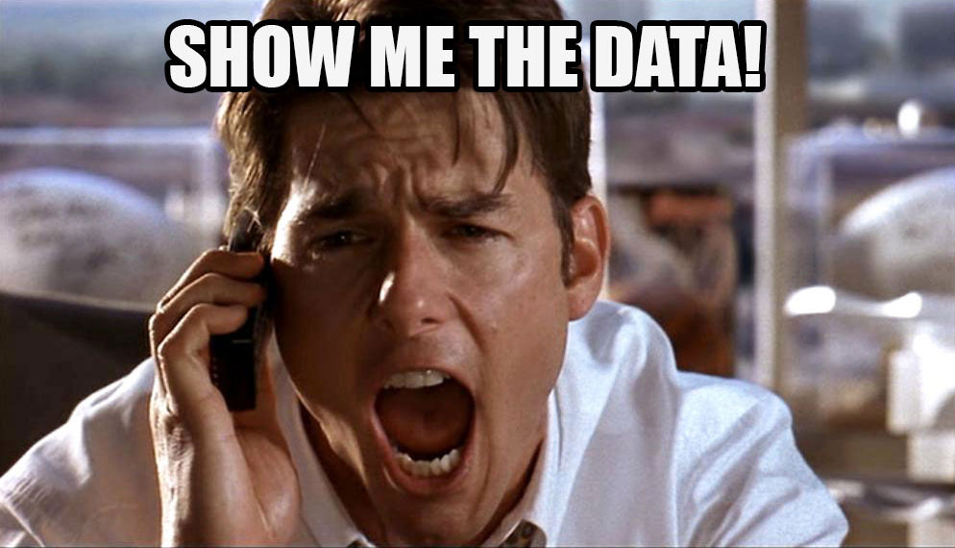
Where Can You Find Local Disability Data?
The Annual Disability Statistics Compendium, published by the Institute on Disability, collects the most up-to-date Census Bureau data on disabilities.
You can download the data, review key statistics and learn more here: disabilitycompendium.org/
You can look at local, county based data here: https://disabilitycompendium.org/county-reports
For more detailed information, go directly to the Census Bureau here: https://data.census.gov/cedsci/?intcmp=aff_cedsci_banner

Slide 15
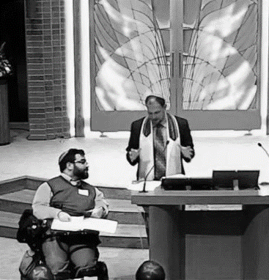

Problem Solving
Problems are best solved by people who have experienced them firsthand and know solutions that work.

Slide 16

Accenture and the Disability Inclusion Advantage
New research from Accenture reveals that companies that embrace best practices for employing people with disabilities have outperformed their peers.
Here’s the study: https://www.accenture .com/_acnmedia/pdf-89/accenture-disability-inclusion-research-report.pdf
Companies that embrace employees with disabilities clearly see the results in their bottom line.
Disability-inclusive companies have higher productivity levels and lower staff turnover rates, are twice as likely to outperform their peers in shareholder returns and create larger returns on investment.

Slide 17
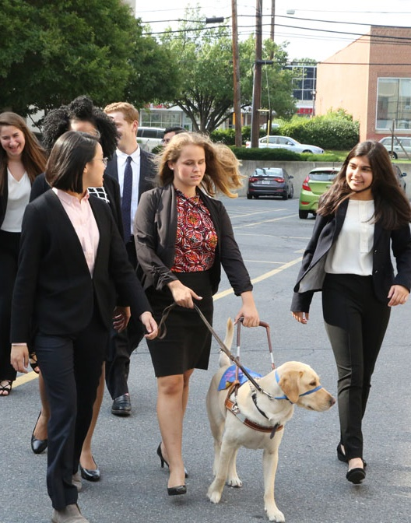
Majority of Voters Have Disability Connections
85% of voters find it very or somewhat important that presidential candidates have campaign events and websites that are open and accessible to people with disabilities, just like everyone else.
73% of voters are more likely to support candidates for elected office who will make ensuring that children with disabilities get the education and training they need to succeed a priority.
70% of voters are more likely to support candidates for elected office who will make expanding job and career opportunities for people with disabilities a priority, so they can succeed just like anyone else.
* The survey was completed by Democratic polling firm Greenberg Quinlan Rosner on behalf of RespectAbility of 2,000 registered voters from September 18 through September 24, 2019.
Notes:
I added the study information from Philip’s deck as a footnote. His deck had two additional stats- 28% higher revenue and double net income. I opted to just include one stat here to keep it simple. However, if you want me to add those stats or replace this one with one of those, let me know.

Slide 18
Disability in Philanthropy and Nonprofits Study
Disability in Philanthropy & Nonprofits:
A study on inclusion and exclusion of the 1-in-5 people who live with a disability and what you can do to make things better
Read the Report: www.respectability.org/inclusive-philanthropy/

Slide 19
Disability in Philanthropy & Nonprofits - Methodology
5 focus groups of people who work in philanthropy done in 2015 in partnership with the Council on Foundations
14 one-on-one interviews done in 2018 by phone with leaders of foundations/philanthropy serving organizations
Evaluation of online accessibility of 25 largest foundations and 25 largest nonprofits (done with assistance from Marcie Lipsitt) in 2018/19
Online survey of 969 people done by Buren Communications of subscribers to NonProfitTimes, Chronicle of Philanthropy and numerous PSO partners
Analysis by Meagan Buren, Amy Chapman, Jennifer Laszlo Mizrahi and others

Slide 20
A major gap between will and skill
There are several accommodations and accessibility tools that enable people with disabilities to engage in organizations and activities. Which of the following are policies of your organization? Please check all that apply.
 | %
Our events are always held in physically accessible spaces that have accessible parking spaces or transportation options for people with physical disabilities | 59%
There is a process where employees, trustees/board members and volunteers with disabilities can request and get needed accommodations if needed so that they can succeed in their roles. | 41%
Our public events enable people with disabilities to request accommodations such as sign language interpreters, live captioning or food allergy issues in the registration form. | 30%
We enable people who are blind or have low vision to be able to access our materials on the web by ensuring that our website is set up properly for screen readers. | 17%
We ensure that people who are deaf or hard of hearing can participate by ensuring that all video content has captions. | 14%
None | 16%
N/A | 10%

Slide 21
Organizations do not represent the people they serve
Which of the following groups in your organization include people with disabilities? Please check all that apply.
 | %
People You Serve | 66%
Staff Overall | 42%
Volunteers | 41%
Board | 24%
Professional Leadership/Management | 20%
Not Applicable | 6%
I Don’t Know | 23%

Slide 22
Performance metrics matter
Do you ask your members or grantees if they are representative (e.g., staff, board) of the people they serve?

Slide 23
Missed opportunity to hold people accountable
Is disability included in that representation?

Slide 24
Inclusion doesn’t happen by accident
Do you ask your members or grantees to intentionally include people with disabilities in their work?

Slide 25
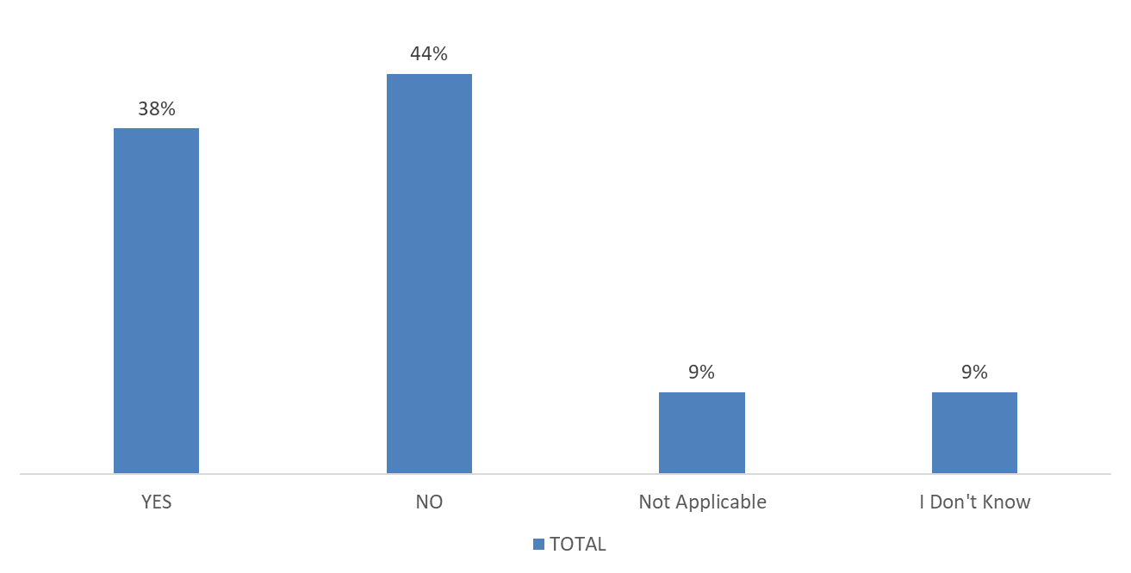
A picture is worth a thousand words
Does your organization depict people with visible disabilities (i.e. show pictures of people who use wheelchairs, white cane, have Down Syndrome etc.) in your internal or external marketing and/or advertising materials?

Slide 26

Adding the Disability Lens…
By adding the disability
lens to your existing work,
you have the opportunity
to create better outcomes
for people with and
without disabilities alike

Slide 27
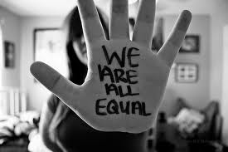
1. Commit publicly to inclusion of people with disabilities
The message that all people are of equal value and must be respected and heard fairly, must be communicated by President and Board.
REPEAT those messages over and over!

Slide 28
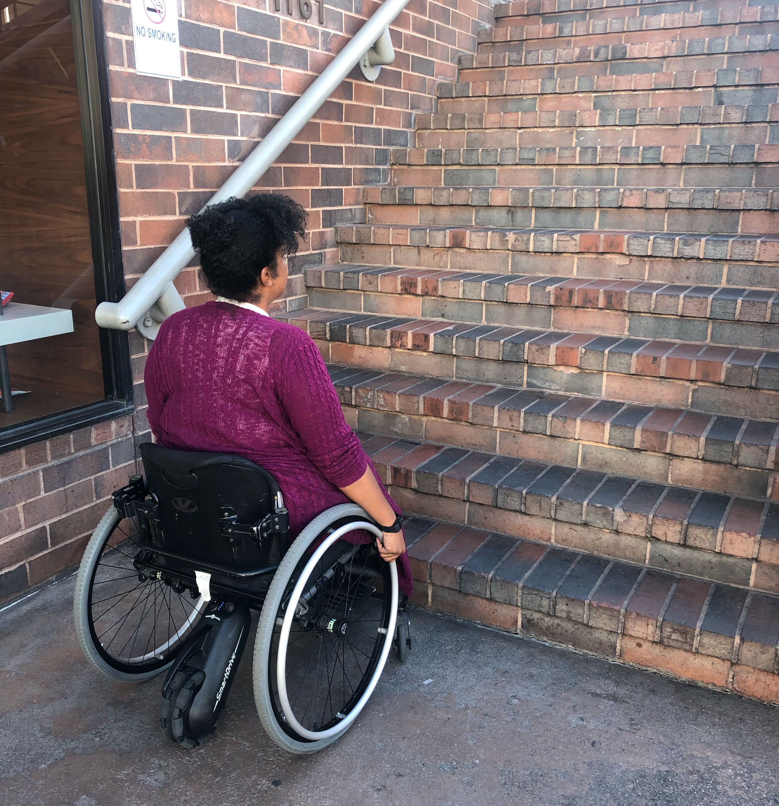
2. When PwDs aren’t at the table, they are on the menu
Organizations are at their best when they welcome, respect, and include people of all backgrounds. This includes people with disabilities (PwDs). Indeed, problems are best solved by working with people who have experienced them first hand and know solutions that work. Just like issues that impact people of different racial, ethnic or other backgrounds, people with disabilities should be involved in solving issues that impact them.
Disability impacts people of all races, genders, and backgrounds. However, youth with multiple minority status (i.e. person of color /English language learners + disability face double discrimination) are most likely to enter the school-to-prison pipeline, become homeless and/or live in poverty. Be sure to look at intersectional issues.
  More information on our December 4th Webinar - How to Recruit, Accommodate and Promote People with Disabilities for Paid Employment, Volunteer Leadership and Board Positions

Slide 29
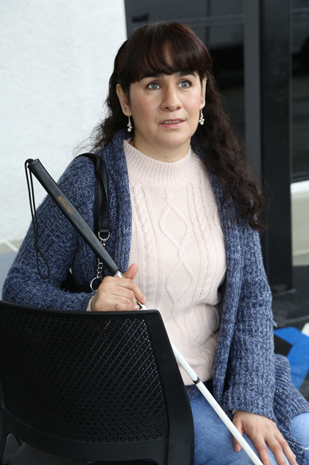
3. Foster an inclusive environment
Use “person first” language when appropriate
Have an accommodation policy
Made a conscious decision and effort to seek out and include certain demographic groups whether that was gender, race, or sexual orientation
  More information on our December 11th Webinar -- How to Ensure A Welcoming Lexicon and Inclusive Storytelling

Slide 30
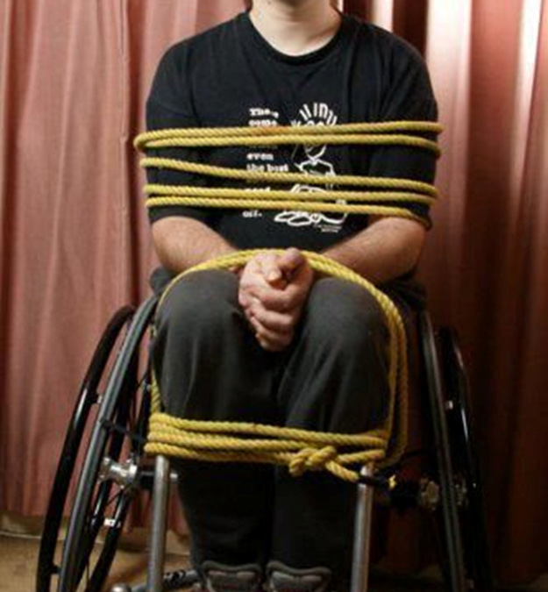
What we say makes a difference
DO SAY:
Someone uses/rides a wheelchair
DON’T SAY:
Wheelchair bound
Confined to a wheelchair
Wheelchair person
WHEN YOU DON’T KNOW WHAT TO DO/SAY, ASK!

Slide 31
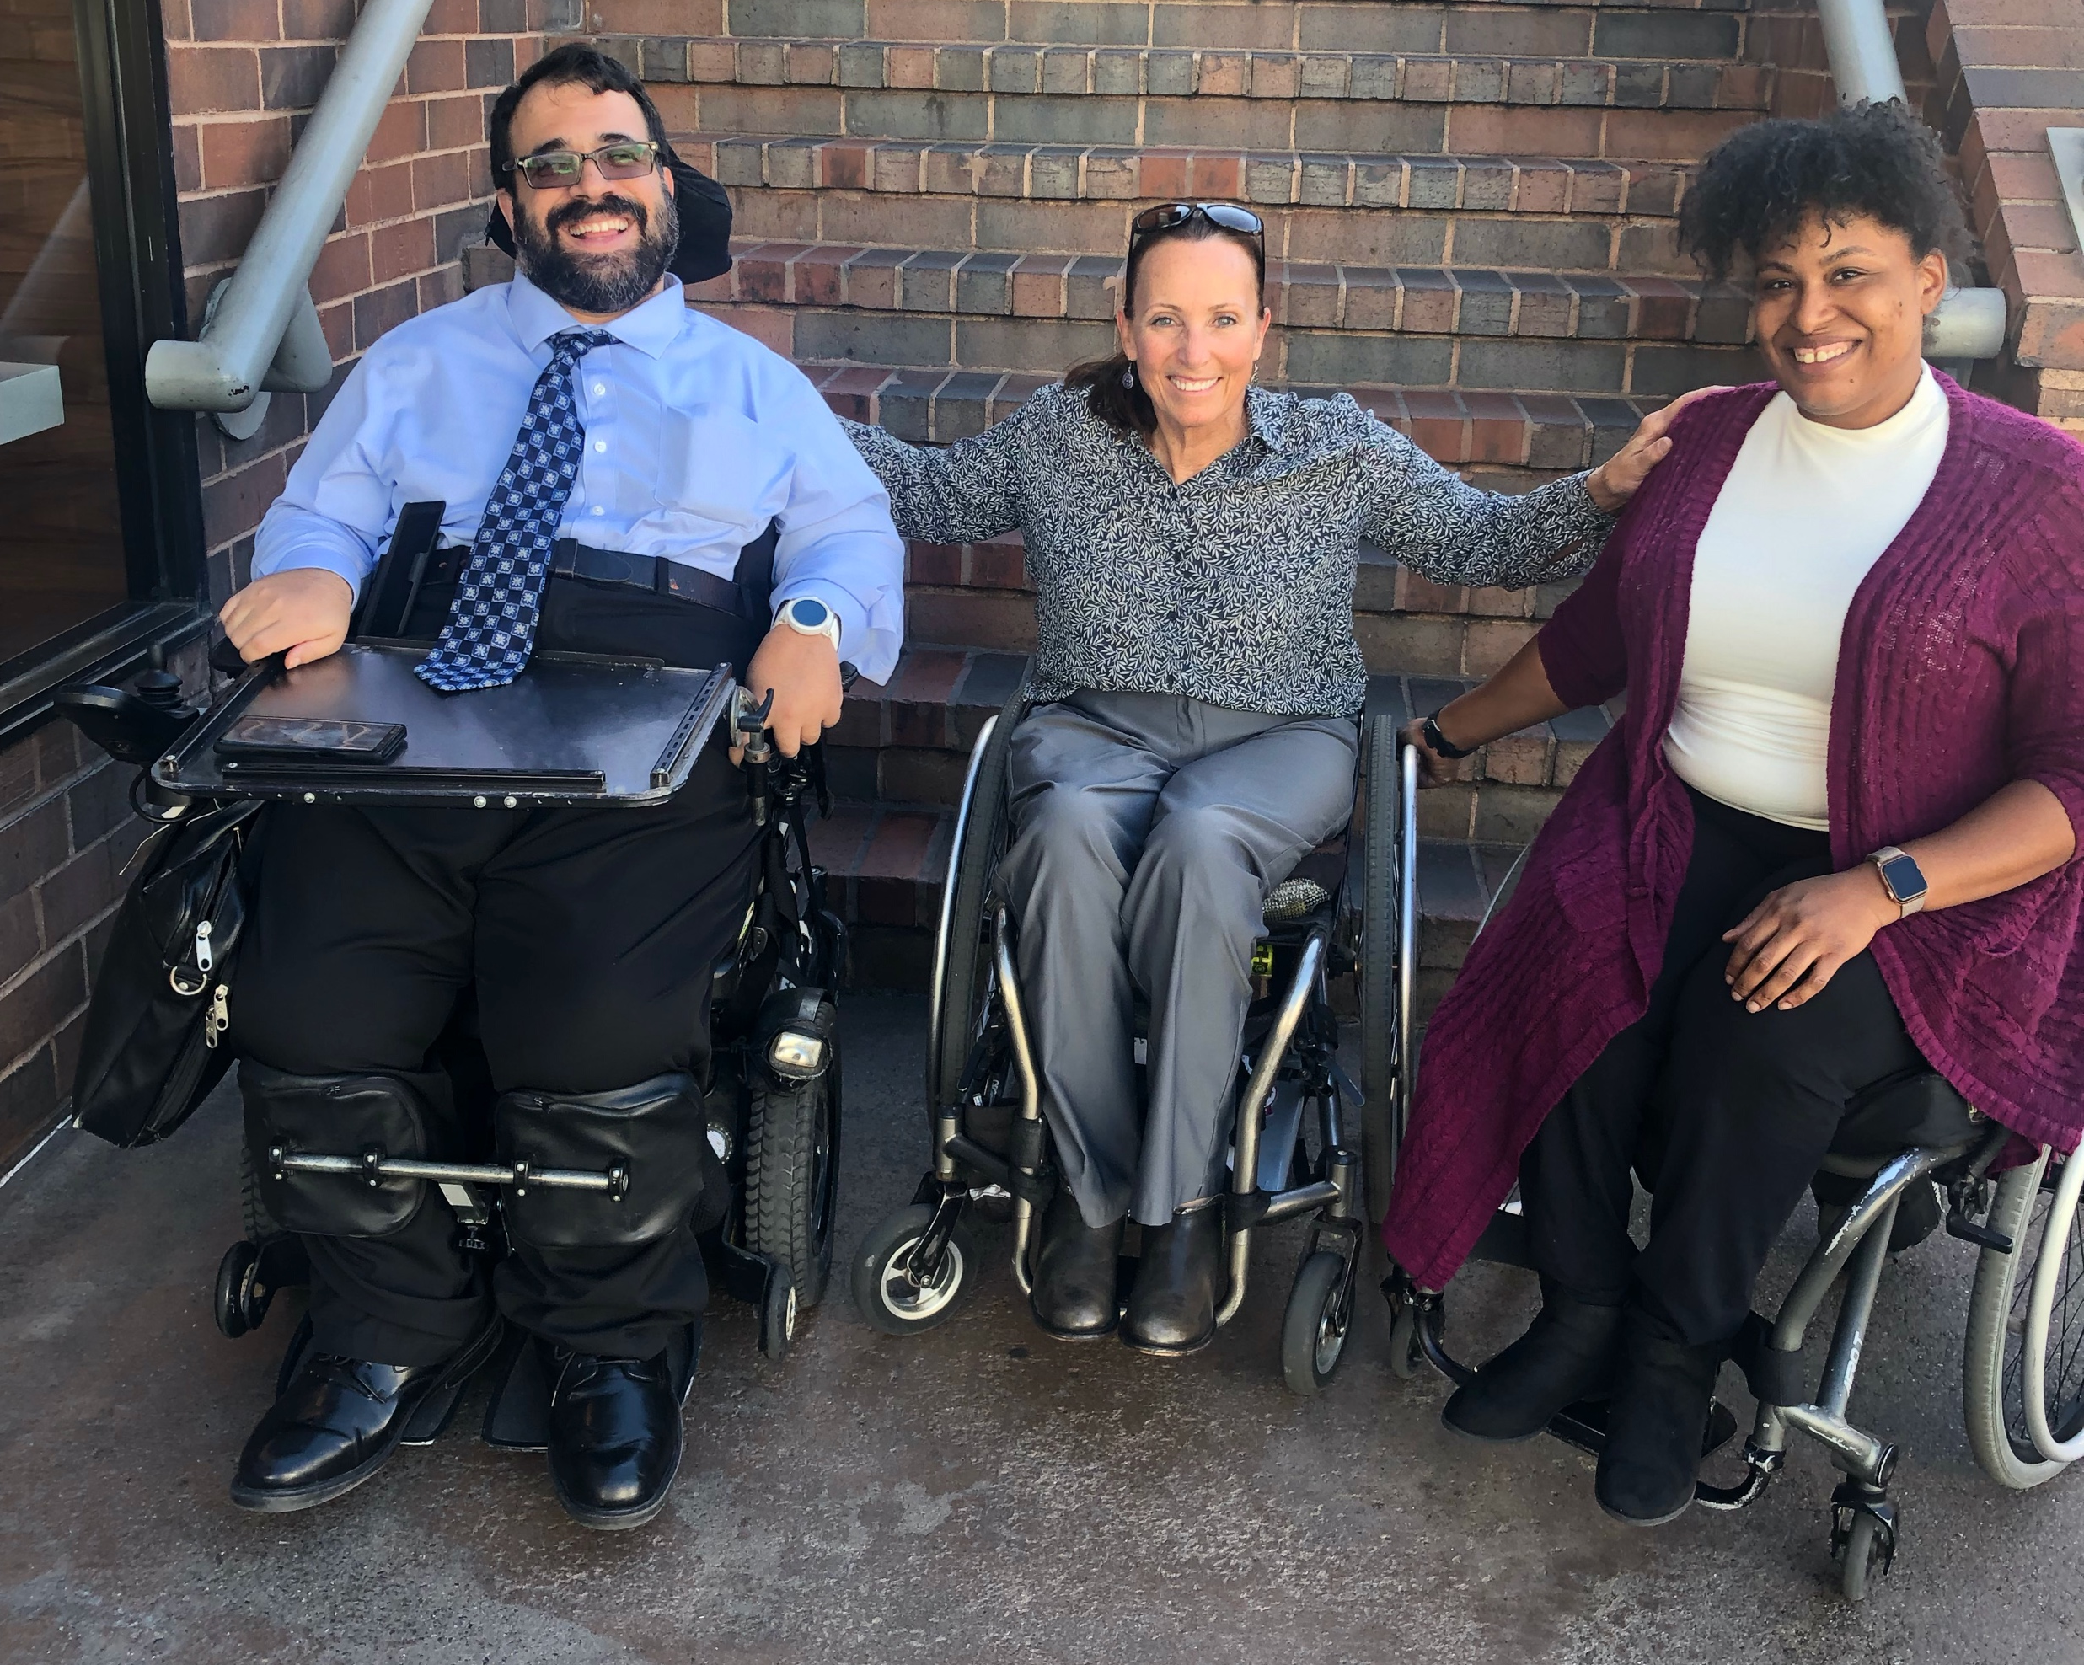
4. Work with people with disabilities
RespectAbility, Best Practices for Employers
TAPAbility, which can source talent
AskJan.org, which can problem solve inclusive employment questions for free
Diverse Managers - Philanthropy’s Next Hurdle
  More information on our December 4th Webinar -- How to Recruit, Accommodate and Promote People with Disabilities for Paid Employment, Volunteer Leadership and Board Positions

Slide 32


5. Have an inclusion point person or committee
Inclusion Statement and how to make requests for disability accommodations should be on your accessible website and event invites
HR Evaluation and program manager evaluation includes diversity as a performance metric
Resource on Disability Inclusion
Ford’s Push for Disability Rights Should Be a Model for Philanthropy

Slide 33
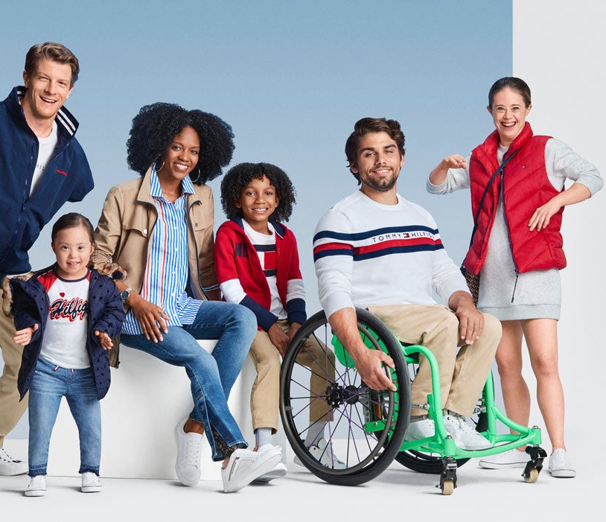
6. Include people with disabilities in your marketing
Example: Photos on website should include individuals with visible disabilities
Toolkit for Media Representation
More information on our January 7th Webinar – How to Ensue Accessible Websites, Social Media and Inclusive Photos
and on our January 9th Webinar – Premium Skills Workshop in Social Media Accessibility

Slide 34

7. Ensure website and online resources are accessible
Websites need to be set up for use by screen readers and people who need captions.
Caption videos
Make documents and presentations accessible
More information on our January 7th Webinar – How to Ensue Accessible Websites, Social Media and Inclusive Photos
and on our January 9th Webinar – Premium Skills Workshop in Social Media Accessibility

Slide 35
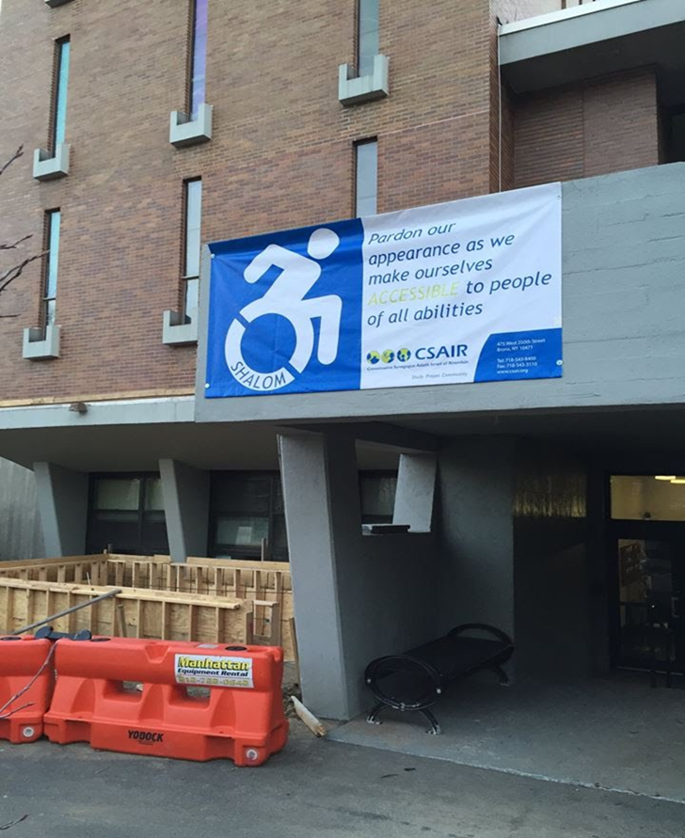
8. Ensure accessibility of office and events
Physical Accessibility
Event Checklist
All of the following must be accessible:
  Invitation/notification of event
  Facilities
  Communication
  Staff/Volunteers
  More information on our November 20th Webinar –
  How to Ensure Accessible Events

Slide 36
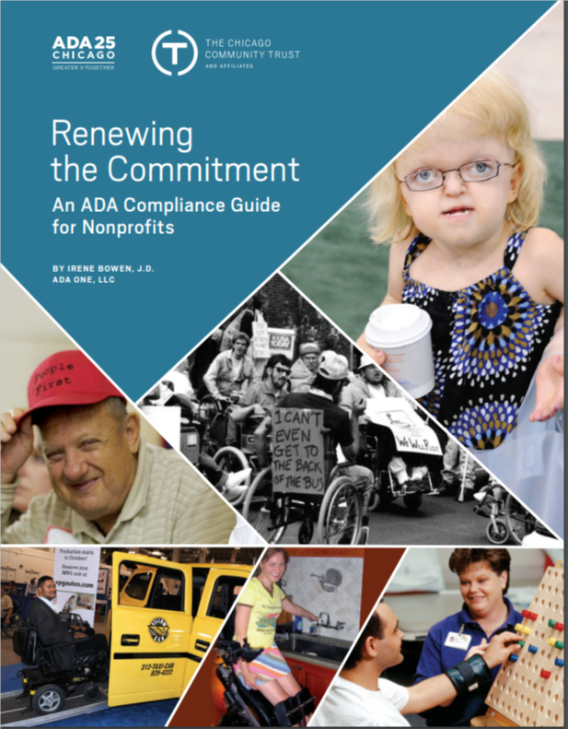
Accessibility: ADA Accessible Resource Guide
The Chicago Community Trust
http://www.cct.org/wp-content/uploads/
2015/08/2015ADAComplianceGuide.pdf

Slide 37
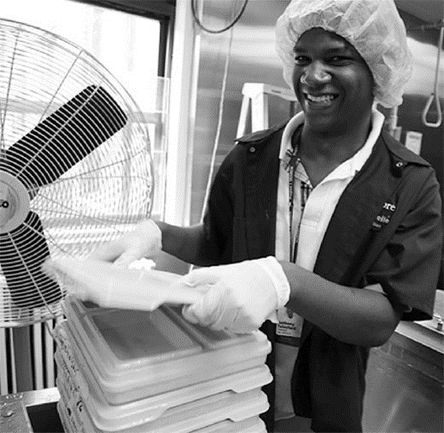
9. Use vendors who are or who hire people with disabilities
Invest in social enterprises who hire people with and without disabilities
Social Enterprise: Creating Employment Opportunities for People with Disabilities

Slide 38
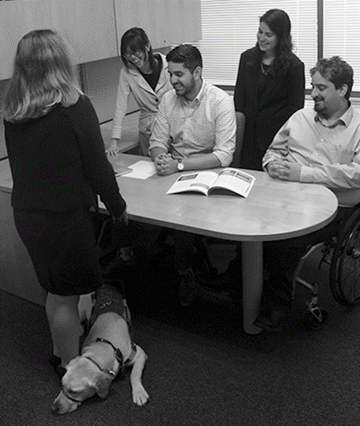
10. Promote a disability lens among grantees/members
Ask Your Grantees/Members About:
Meaningful and inclusive policies and/or programs
Public commitments on website and materials
Employing people with disabilities at all levels
Inviting people to request accommodations
Physical accessibility of office and programs
Website accessibility
Video captioning
Internal and external educational efforts

Slide 39
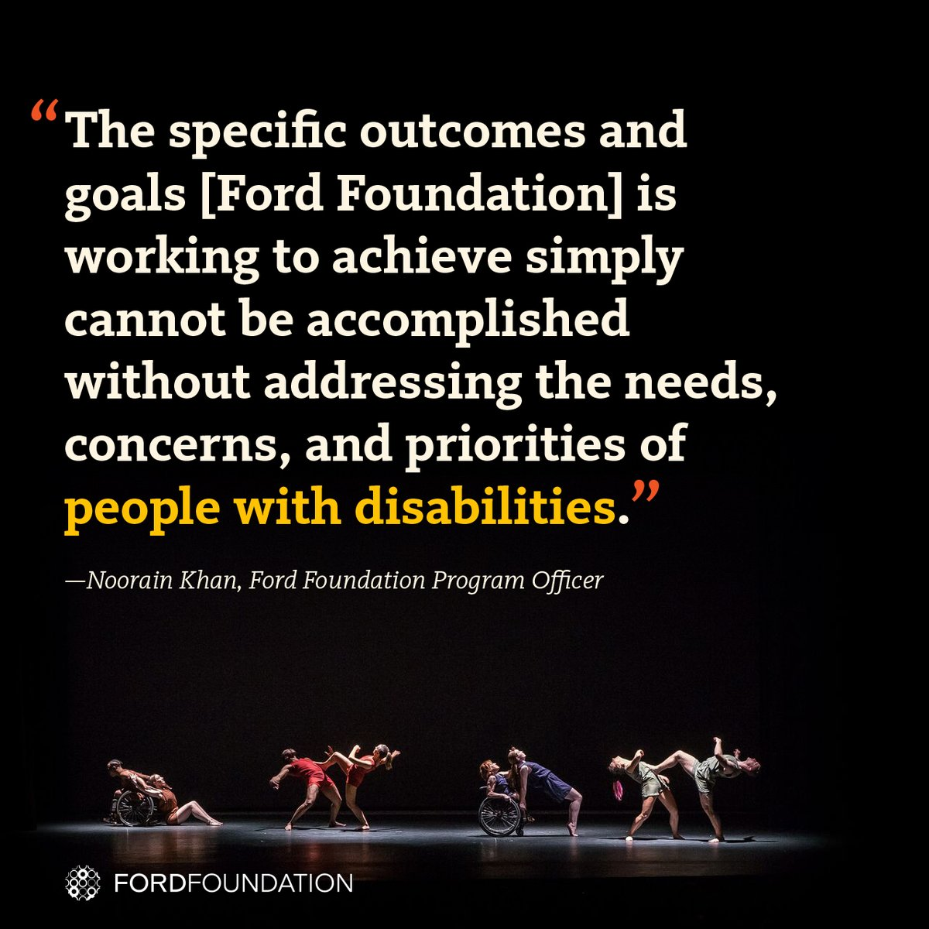
Success Stories: The Ford Foundation Includes Disability
The Ford Foundation has recently added the disability lens to their work http://bit.ly/2jOl3FL
Additionally, Ford’s CEO Darren Walker spoke extensively on why this impacts other funders as well: http://bit.ly/2nr4moJ
Here is Darren Walker’s original letter: http://bit.ly/2Bxy0Lk
This is the response of the co-authors of the Americans with Disabilities Act: http://bit.ly/2AueSyx
Darren Walker and Rich Besser (Robert Wood Johnson Foundation) on the need for disability inclusion in philanthropy: https://bit.ly/2uE8tPh

Slide 40
Today’s Take Away
Organizations are at their best when they welcome, respect and include people of all backgrounds. This includes people with disabilities.
Problems are best solved by working with people who have experienced them first-hand and know solutions that work. Just like issues that impact people of different racial, ethnic or other backgrounds, people with disabilities should be involved in solving issues that impact them.

Slide 41
Resources
RespectAbility’s Inclusive Philanthropy toolkit
Access information on disability inclusion, including the new Disability in Philanthropy & Nonprofits study
www.RespectAbility.org/inclusive-philanthropy
Follow us on Social Media!
Twitter: @Respect_Ability
Facebook: RespectAbilityUSA
Instagram: @RespectTheAbility
Website: www.RespectAbility.org
Intersection of Disability and Politics: www.TheRespectAbilityReport.org

Slide 42
Equity and Access Webinar Series Schedule
Nov. 6, 2019: Disability 101
Nov. 13, 2019: Disability History
Nov. 20, 2019: How to Ensure Accessible Events
Dec. 4, 2019: How to Recruit, Accommodate and Promote People with Disabilities for Paid Employment, Volunteer Leadership and Board Positions
Dec. 11, 2019: How to Ensure A Welcoming Lexicon and Inclusive Storytelling
Jan. 7, 2020: How to Ensue Accessible Websites, Social Media and Inclusive Photos
Jan. 9, 2020: Premium Skills Workshop in Social Media Accessibility
Jan. 15, 2020: How to Ensure Legal Rights and Compliance Obligations: Exploring the Rights of Employees and Participants, and the Obligations of Nonprofit Organizations Under the Law
Learn More and RSVP Here: https://www.respectability.org/accessibility-webinars/

Slide 43
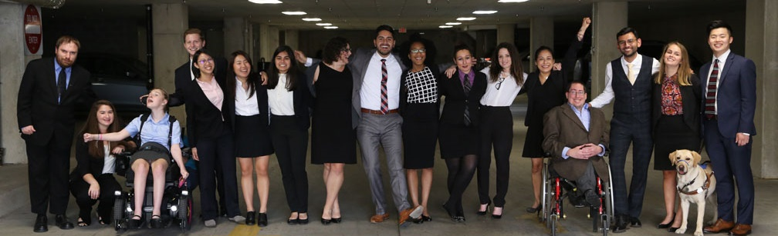
Thank you!
THANK YOU!
Jennifer Laszlo Mizrahi
www.RespectAbility.org
Cell: (202) 365-0787
JenniferM@RespectAbility.org

