Slide 1
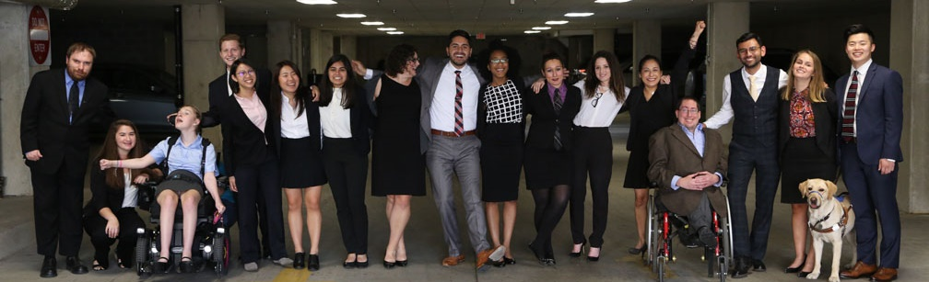

How Disability Inclusion & Equity Can Add to Your Success
COVID-19, Disability & Mental Health
March 11, 2020

Slide 2
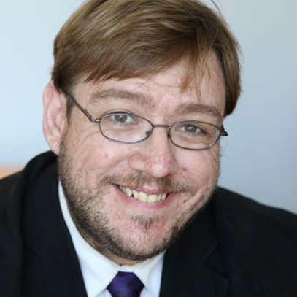
Moderator: Philip Kahn-Pauli
Philip Kahn-Pauli is the Policy and Practices Director of RespectAbility. He educates leaders at the federal and state level about best practices to expand opportunities for people with disabilities. Kahn-Pauli coordinated the development and distribution of both the Disability Employment First Planning Toolkit and Disability and Criminal Justice Reform: Keys to Success report. He frequently organizes accessible webinars on best practices, which are attended by workforce boards, agencies, VR, disability organizations, public officials, artists and more – reaching a national audience of more than 2,000. Kahn-Pauli also speaks at national and regional conferences for workforce boards, agencies and professionals.

Slide 3
Lori Golden
Lori Golden is Ernst & Young’s Abilities Strategy leader, driving efforts to build an enabling, inclusive environment for people of all abilities. She advises the firm’s over 1,000 member AccessAbilities professional resource network and its Abilities Champions leaders network. Lori leads initiatives to enhance ergonomics and accessibility in Ernst & Young offices, communications, meetings, trainings and technology, educate EY people on abilities-related issues and create new diverse abilities recruiting strategies and employment models. She also consults on accommodations and career development issues for EY people working with differing abilities.

Slide 4
Donna Meltzer
Donna Meltzer is CEO of the National Association of Councils on Developmental Disabilities (NACDD), a national nonprofit organization that supports the nation’s 56 governor-appointed Developmental Disabilities Councils that work within state government to promote independence, productivity, and integration of people with disabilities through systems change activities. In this capacity, Meltzer oversees the organization’s public policy and advocacy agenda as well as technical assistance to the members. Meltzer joined the NACDD in October 2012.

Slide 5
German Parodi
Originally from Puerto Rico, Germán has been an active community organizer with Philadelphia ADAPT, is a leader in direct action, and is the first person with a significant spinal cord injury to deploy to a disaster-impacted area. With Portlight and the Partnership for Inclusive Disaster Strategies, he deployed to Puerto Rico shortly after Hurricane Maria. Germán has a key voice in the work of the Partnership shaping language and content for two legislative projects- the Real Emergency Access for Aging and Disability Inclusion in Disasters Act (REAADI) and the Disaster Relief Medicaid Act (DRM).

Slide 6
Shaylin Sluzalis
Shaylin is a life-long advocate for her sister Brittani, the Co Executive Director of The Partnership for Inclusive Disaster Strategies, a disability rights activist with ADAPT, and a disaster relief first responder for the Partnership Portlight division. Shaylin played a major role in the crafting and editing of the Real Emergency Access for Aging and Disability Inclusion for Disasters Act (REAADI) - S. 1755 & H.R. 3208 and the Disaster Relief Medicaid Act (DRMA) - S. 1754 & H.R. 3215. She also has life long experience working with Center for Independent Livings and advocating for the rights of persons with disabilities. Since May of 2019 Shaylin has been actively involved in the United Nations Disaster Risk Reduction Thematic Group for Persons with Disabilities, and advocating for disability rights worldwide.

Slide 7
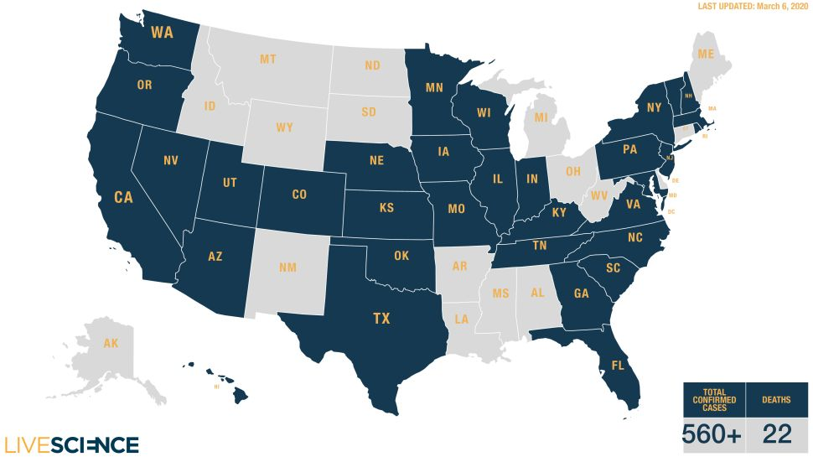
COVID-19 in the US
Source: https://www.livescience.com/coronavirus-updates-united-states.html

Slide 8
Five Things To Know About How COVID-19 Affects People with Disabilities
The people most often cited as being at serious risk are largely, by some definition, people with disabilities.
It can be harder for disabled people to take prudent steps to protect themselves from the coronavirus outbreak.
COVID-19 coronavirus threatens not only disabled people’s health, but their independence.
This outbreak has the potential to add new perspectives and urgency to a number of long-time disability issues.
You can help a lot just being aware and sensitive to the specific risks and obstacles faced by disabled people in an outbreak of contagious illness like COVID-19.
Source: https://www.forbes.com/sites/andrewpulrang/2020/03/08/5-things-to-know-about-coronavirus-and-people-with-disabilities/#2317ea5b1d21

Slide 9
Tips from the CDC
If you are at higher risk of getting very sick from COVID-19, you should:
  Stock up on supplies
  Take everyday precautions to keep space between yourself and others
  When you go out in public, keep away from others who are sick, limit close contact and wash your hands often.
  Avoid crowds as much as possible
During a COVID-19 outbreak in your community, stay home as much as possible.
Source: https://www.cdc.gov/coronavirus/2019-ncov/specific-groups/high-risk-complications.html

Slide 10
Everyday Precautions (1)
Clean your hands often
Wash your hands often with soap and water for at least 20 seconds, especially after blowing your nose, coughing, or sneezing, or having been in a public place.
If soap and water are not available, use a hand sanitizer that contains at least 60% alcohol.
To the extent possible, avoid touching high-touch surfaces in public places – elevator buttons, door handles, handrails, handshaking with people, etc. Use a tissue or your sleeve to cover your hand or finger if you must touch something.

Slide 11
Everyday Precautions (2)
Wash your hands after touching surfaces in public places.
Avoid touching your face, nose, eyes, etc.
Clean and disinfect your home to remove germs: practice routine cleaning of frequently touched surfaces (for example: tables, doorknobs, light switches, handles, desks, toilets, faucets, sinks & cell phones)
Avoid crowds, especially in poorly ventilated spaces. Your risk of exposure to respiratory viruses like COVID-19 may increase in crowded, closed-in settings with little air circulation if there are people in the crowd who are sick.

Slide 12
8 Questions Employers Should Ask About Coronavirus (1)
How can we best protect our employees from exposure in the workplace?
When should we exclude workers or visitors from the workspace?
Should we revise our benefits policies in cases where employees are barred from the worksite or we close it?
Have we maximized employees’ ability to work remotely?
Source: https://hbr.org/2020/03/8-questions-employers-should-ask-about-coronavirus

Slide 13
8 Questions Employers Should Ask About Coronavirus (2)
Do we have reliable systems for real-time public health communication with employees?
Should we revise our policies around international and domestic business travel?
Should we postpone or cancel scheduled conferences or meetings?
Are supervisors adequately trained?
Source: https://hbr.org/2020/03/8-questions-employers-should-ask-about-coronavirus

Slide 14

Disability Organizations Leading the Way
NATIONAL CALL TO ACTION - The Partnership for Inclusive Disaster Strategies, World Institute on Disability, NCIL Emergency Preparedness Subcommittee
Actions taken now can make a big difference in COVID-19 outcomes for the whole community, as well as public health emergency response in the future.
Continuity of Operations and Services / Access to Information
Meeting Daily Living Needs / Living Arrangements and Isolation or Quarantine
Access to Protective Equipment, Bulk Distribution of Food, Medication, and Health Maintenance Supplies
https://mailchi.mp/disasterstrategies/covid19-disability-inclusion-call-to-action
SIGN ON FORM: https://docs.google.com/forms/d/e/1F AIpQLSepXAOWt8oSGgxNIYHFF0YdnWe1MOURqLTkDqBh7GPUJOc-kg/viewform

Slide 15

What You Need to Know About Coronavirus (In ASL)
https://youtu.be/Uu7PRKGK1_s

Slide 16
More Resources
Mental Health and Coping During COVID-19 (CDC)
Taking Care of Your Emotional Health (CDC)
Disaster Preparedness, Response, and Recovery (SAMHSA)
Taking Care of Your Behavioral Health During an Infectious Disease Outbreak (SAMHSA)
National Suicide Prevention Lifeline
1-800-273-8255

Slide 17
Questions?

