Slide 1

RespectAbility
Women’s Disability Leadership, Inclusion & Advocacy Series
Presents:
Intersectionality Among Women and Girls with Disabilities and Their Allies
Keynote Speaker: Donna Walton, Ed.D, RespectAbility Board Member and
Founder and President of Divas with Disabilities
MC: Debbie Fink, Director of Community Outreach and Impact, RespectAbility
and the Women’s Disability Leadership, Inclusion & Advocacy Training Series
Presenter: Stephanie Farfan, Policy, Practices, and Latinx Outreach Associate, RespectAbility
Vivian Bass, Board Member, RespectAbility Executive Committee
www.RespectAbility.org

Slide 2
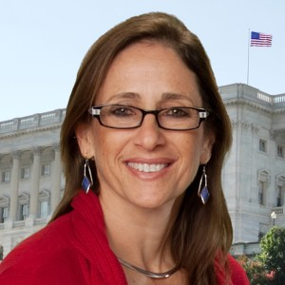
Meet RespectAbility’s Team
Debbie Fink is Director of Community Outreach & Impact for RespectAbility, and responsible for theWomen’s Disability Leadership, Inclusion & Advocacy Training Series.
She brings more than 15 years of diverse leadership experience in public health, education and arts programming to serve RespectAbility’s mission.
Fink has a lifetime commitment to enabling people with disabilities to have a better future and is passionate about the constructive impact volunteers can make in the world.
Picture: Debbie Fink smiling at the camera.

Slide 3
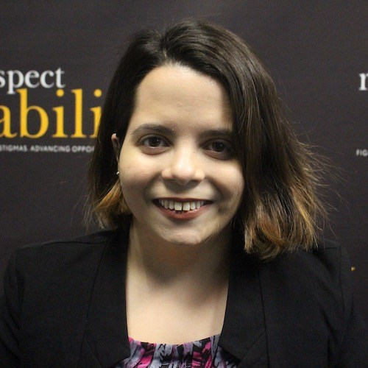
Meet RespectAbility’s Team 2
Stephanie Farfan was the Policy, Practices and Latinx Outreach Associate for RespectAbility. As a little person, she has always been committed to disability rights and advocacy. She has experienced firsthand the discrimination many people with disabilities face. This discrimination led to her commitment to fight the stigmas and social barriers that people with disabilities have to contend with to be taken seriously. Farfan has been a part of Little People of America (LPA) since she was 16 years old and volunteered her time as a co-chair for the Hispanic Affairs Committee. Farfan completed her undergraduate studies with a major in Peace and Conflict Studies and a minor in French at Juniata College in Pennsylvania. She is currently pursuing a Masters’ in International Peace and Conflict Resolution at American University.
Picture: Stephanie Farfan smiling at the camera.

Slide 4
Key Facts in NYC
Did you know that…
… there are almost 500,000 women and girls with disabilities in NYC.
… women with a disability earn on average nearly $9,000 less than women without disabilities, and $16,000 per year less than men without a disability.
… 44% of the city’s women with disabilities live below the poverty line.
… only 29% of African American women with disabilities are employed.
… only 24% of Latinas with disabilities have jobs.

Slide 5
Borough by Borough
BROOKLYN – Average Income: $26,566 (<28% peers)
~68,500 working-age women w/disabilities
QUEENS – Average Income: $24,073 (<24% peers)
~55,500 working-age women w/ disabilities
MANHATTAN – Average Income: $23,715 (<54% peers)
~44,800 working-age women w/ disabilities
THE BRONX – Average Income: $21,151 (<28% peers)
~67,500 working-age women w/ disabilities
STATEN ISLAND – Avg. Income: $21,151 (<32% peers)
~11,000 working-age women with disabilities

Slide 6
Gender-Based Violence
The Intersection between Gender-Based Violence
And Disability
Over 40% of women w/ physical disabilities report being sexually assaulted
83% of women and girls with developmental disabilities are victims of sexual assault
Women w/ disabilities are TWICE as likely to be victims of domestic violence as non-disabled women
It is TIME to change this PARADIGM!!!

Slide 7

Adding the Disability Lens…
By bringing the disability lens, you can help organizations cultivate a more inclusive and equitable environment for people with and without disabilities alike.
New York City needs your participation and leadership!

Slide 8
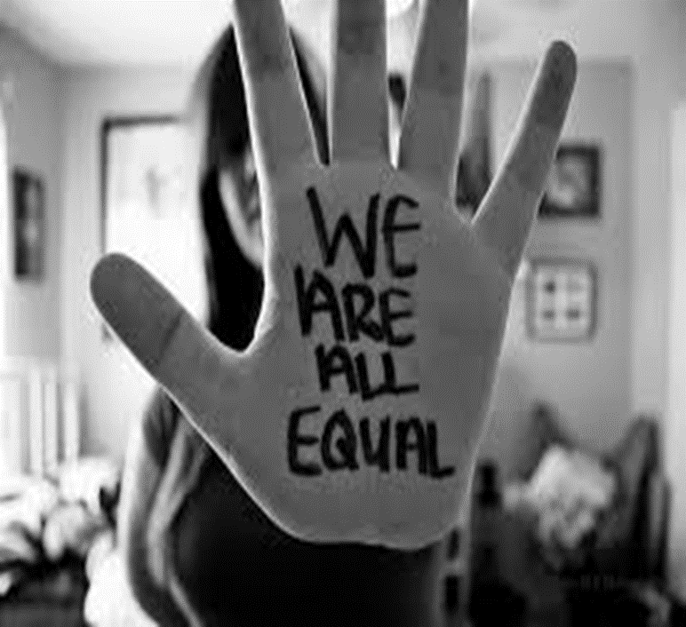
1. Commit publicly to inclusion of people with disabilities
We must send the message time and again that all people are of equal value and must be respected and heard fairly.
This is especially true for women with disabilities and especially true for women of color with disabilities.
Your advocacy is crucial!
Pictured: Words “We are all equal” handwritten on palm of hand

Slide 9
2. Your lived experience can make a difference
Disability impacts people of all races, genders, sexual orientations, and other backgrounds.
Integrating and owning your multiple identities will make your advocacy work stronger and more effective.

Slide 10
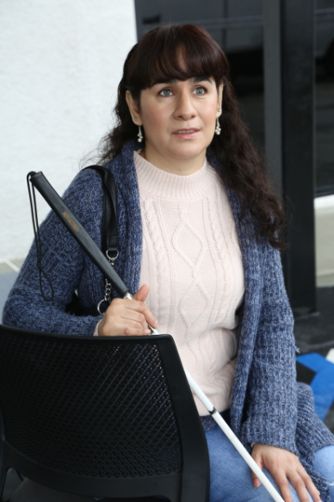
3. Identity Language Preference
Decide whether you prefer “person first” or “identity first” language.
Be comfortable letting other people know your preference.
Webinar on Disability Etiquette
Picture: Blind woman with white cane facing the camera.

Slide 11
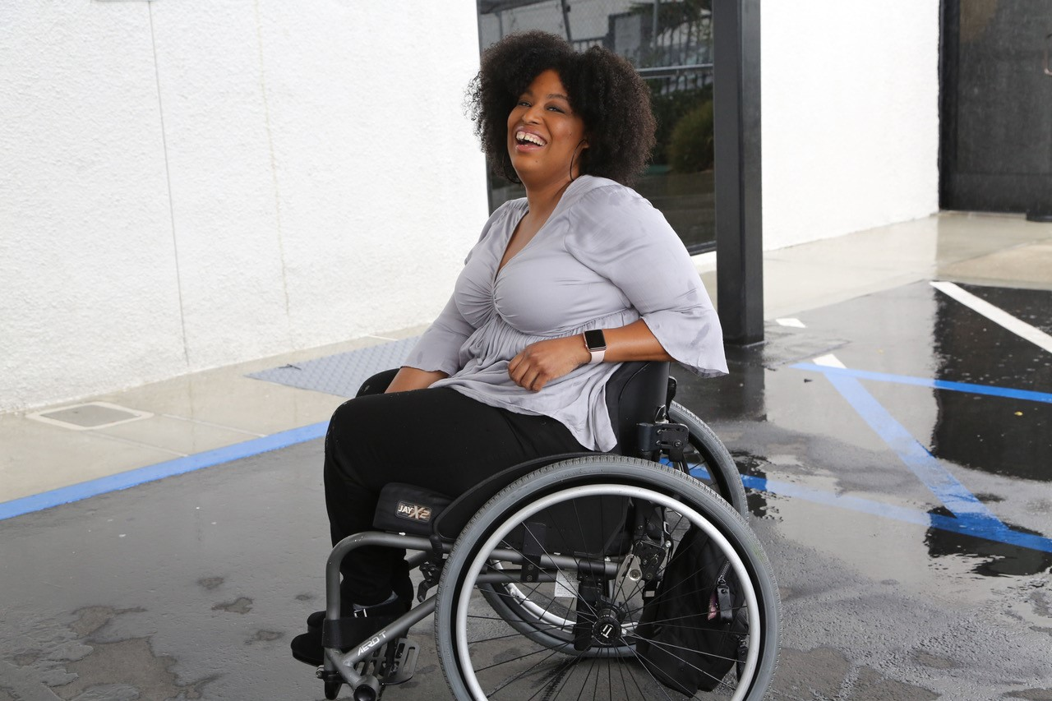
4. Become an “Inclusionist” for an organization or agency
See beyond your own disability(ies) and accommodation requirements.
Learn about other disabilities and their accommodation requirements.
Advocate for all people with disabilities!
Resource on Disability Inclusion
Picture: African American woman in a wheelchair smiling at the camera.

Slide 12
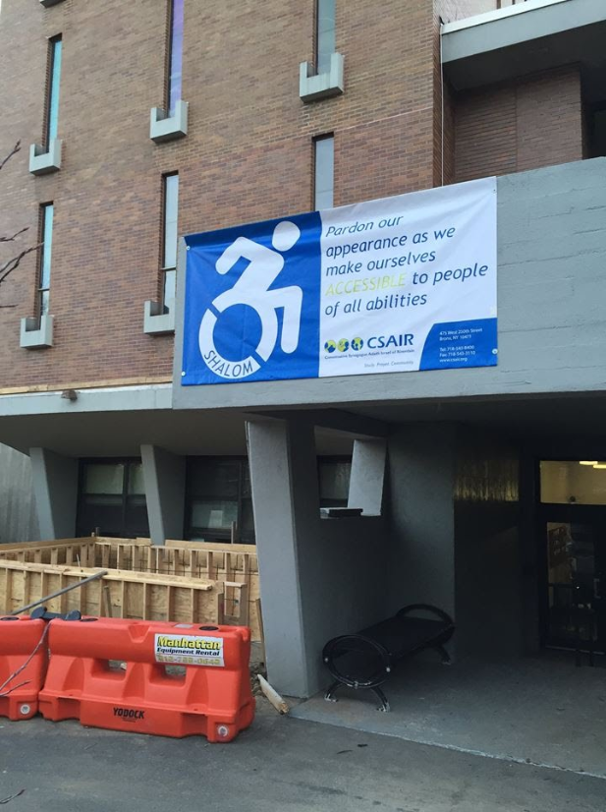
5. Learn how to ensure digital accessibility
Learn how to identify digital inaccessibility.
Figure out who to contact to make a change and follow up!
Caption videos – everyone can do this on YouTube!
Make documents and presentations accessible
  See Webinar
See RespectAbility’s webinar on web accessibility
Share this information with others!
Picture: banner on a building which contains a person in wheelchair and the phrase "pardon our appearance as we make our selves accessible to people of all abilities"

Slide 13
6. Ensure physical accessibility at civic events
Learn how to identify physical inaccessibility before an event.
Figure out who to contact to make a change and follow up!
Refer to the Disability Access Checklist in your packet.
All of the following must be accessible:
      Invitation/notification of event
    Facilities
    Communication
    Staff/Volunteers
Additional Resources:
Physical Accessibility Event Checklist

Slide 14
Disability Access Checklist
☐ Do you have policies or programs that support inclusion of people with disabilities at all levels? Are they prominent on your website and print materials?
☐ Do you serve people with disabilities as you do everyone else, or are they forced into segregated “special-needs programs”?
☐ Do your event registration forms invite people to request any accommodations they might need, such as sign-language interpreters or the ability to bring a service animal?
☐ Has someone who uses a wheelchair checked the physical accessibility of your oﬃces and/or events? Are they accessible?
☐ Has a person who is blind or who uses adaptive computer technology checked your website, social media and facilities for accessibility?
☐ Do your videos have closed captioning? Do you have a way to communicate with people who are deaf or use adaptive devices?
☐ Have you considered how the language you use may aﬀect your ability to include people with disabilities?
☐ Have you thought about Intersectionality? People with disabilities cut across every demographic – gender, age, race, sexual orientation, etc.
☐ “Nothing about us without us” is more than a slogan in the disability community. Are you including qualiﬁed people with disabilities in leadership positions?

Slide 15
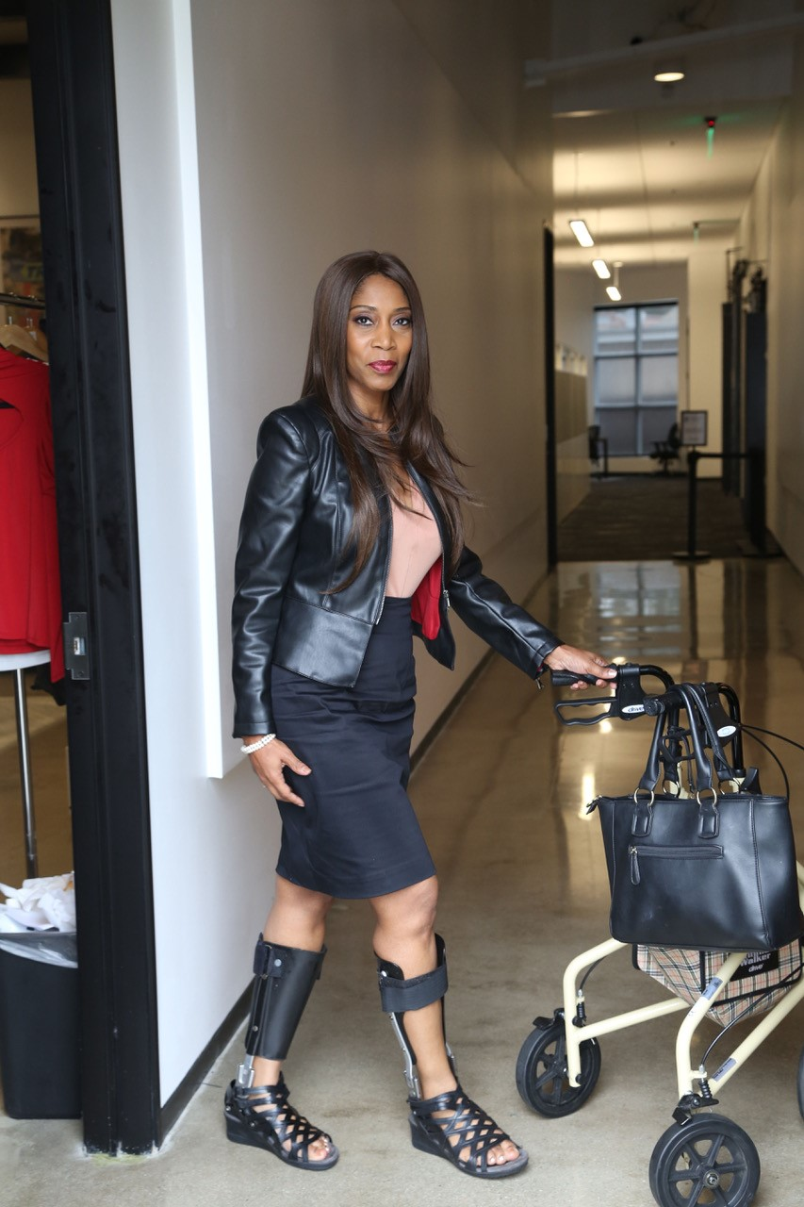
7. Have the resources ready
RespectAbility, Best Practices for Employers
TAPAbility, which can source talent
AskJan.org, which can problem solve inclusive employment questions for free
Picture: African American woman with leg braces and a walker, looking at the camera.

Slide 16
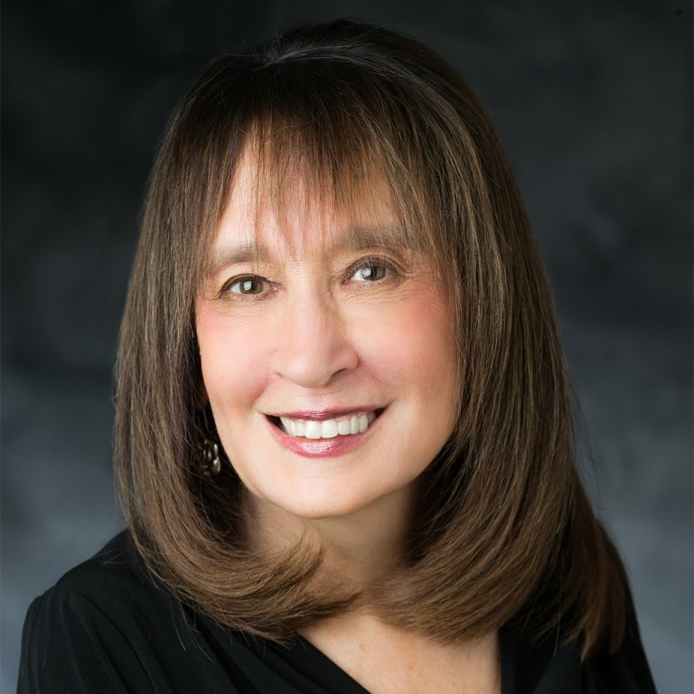
Introduction
Vivian Bass is a vital member of RespectAbility’s
Executive Committee. She has dedicated her career to improving the quality of life, independence and
community inclusion and dignity of persons with
disabilities throughout the Washington, D.C., area, nationally and internationally. She became the CEO Emeritus of The Jewish Foundation for Group Homes (JFGH) in June 2016 subsequent to serving for 30 years
at the helm of the agency. Bass has presented at The
World Congress on Disabilities in conjunction with
the Paralympics, The National Organization on
Disability (NOD), The American Association of Intellectual and Developmental Disabilities (AAIDD),
The National Association of Social Workers (NASW),
The General Assembly of The Jewish Federations of North America, The Jewish Council for Public Affairs (JCPA), The International Lion of Judah Conference and
numerous others.
Picture: Vivian Bass smiling at the camera.

Slide 17
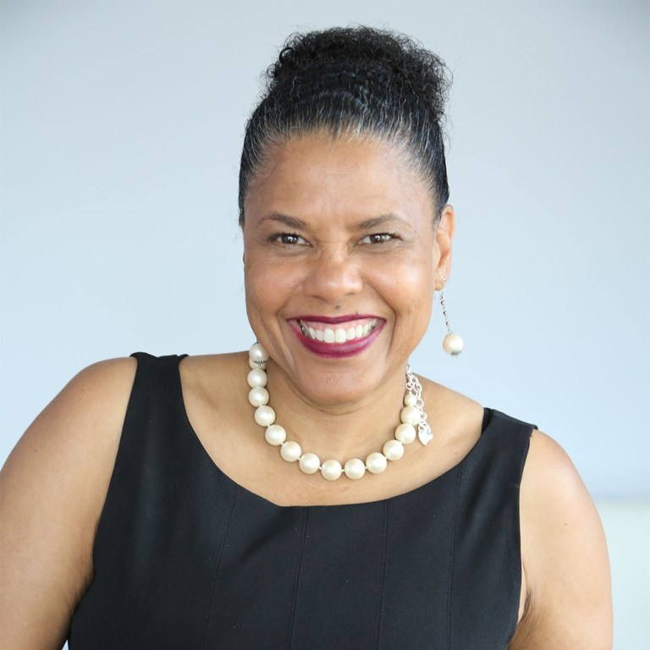
Meet our Keynote
Dr. Donna Rena Walton, Ed.D., currently serves on RespectAbility’s Board of Advisors. She is the author of her newly released book Shattered Dreams, Broken Pieces, an eye-opening tale of reinvention that chronicles the decades Walton spent working to rebuild her world through disasters, setbacks, trials, and tribulations after a dangerous form of bone cancer threatened her life-and forced the amputation of her left leg above the knee.
Founder and President of Divas With Disabilities, Inc., Dr. Walton has made an unprecedented impact in the disability and women of color communities as a hub for thoughtful discussion on issues, self-love, and shaping the perception of what “disability” looks like by promoting women of color through various media platforms. Her work has increased access and inclusion opportunities in countless industries that have traditionally marginalized the participation of the women she represents.
Picture: Dr. Donna Walton smiling at the camera.

Slide 18

RESPECTABILITY
Women’s Disability Leadership, Inclusion & Advocacy Series
Intersectionality Among Women and Girls with Disabilities and Their Allies
Keynote Speaker: Donna Walton, Ed.D, RespectAbility Board Member
Founder and President of Divas with Disabilities
Introduction by Vivian Bass, Board Member, RespectAbility
www.RespectAbility.org
Pictured: Cover of Dr. Donna Walton's book, "Shattered Dreams, Broken Pieces," which contains a photo of Dr. Walton smiling.

Slide 19
I AM ME Exercise Examples
I AM…
I AM Responsible.
I AM Catholic
(or another religion).
I AM nervous.
I AM funny.
I AM Latina
(or another ethnicity).
I AM outspoken.
I AM happy.
I AM competitive
(or another sport).
I AM a poet
(or another special talent).
I AM loveable!
I HAVE…
I HAVE a pet
(name kind of pet).
I HAVE a disability.
I HAVE a supportive family.
I HAVE a home.
I HAVE brown eyes
(or another feature).
I HAVE one best friend.
I HAVE positivity.
I HAVE a good heart.
I HAVE an open-mind.
I BRING…
I BRING enthusiasm.
I BRING experience.
I BRING leadership.
I BRING love.
I BRING compassion.
I BRING humor.
I BRING creativity.
I BRING computer skills (or name other skills).
I BRING strength.

Slide 20
I AM ME Exercise Examples (cont.)
I NEED…
I NEED moral support.
I NEED a sense of humor.
I NEED a friend (or family member).
I NEED to live a healthy lifestyle.
I NEED to be patient.
I NEED leadership skills.
I NEED courage.
I NEED writing skills. (or any other kind of skill).
I NEED independence.
I NEED love.
I SEEK…
I SEEK companionship.
I SEEK employment.
I SEEK independence.
I SEEK positivity.
I SEEK mentorship.
I SEEK teamwork.
I SEEK routine.
I SEEK community.
I SEEK happiness.
I SEEK inclusion.

Slide 21
My Elevator Pitch Template
Hi! My name is _________________________.
I am ___________________________________ and ____________________________________.
(Choose from the list of “I Am”) (Choose from the list of “I Am”)
I am looking to / for an opportunity to ______________________________________________. (Circle One) (Choose from the list of “I Seek”)
I have ___________________________________ and __________________________________. (Choose from the list of “I Have”) (Choose from the list of “I Have”)
I bring __________________________________ and ___________________________________. (Choose from the list of “I Bring”) (Choose from the list of “I Bring”)
I welcome the chance to talk to you more about _____________________________________. (Choose from the list of “I Seek”)
I really think we could work together to _____________________________________________! (make the world a better, more inclusive place for all!)

Slide 22
Contact Us
Debbie Fink
Director, Community Outreach & Impact
and the Women’s Disability Leadership, Inclusion & Advocacy Training Series
DebbieF@RespectAbility.org
11333 Woodglen Drive, Suite 102
Rockville, MD 20852
Office: (202) 517-6272
www.RespectAbility.org

