Slide 1
RespectAbility
Women’s Disability Leadership, Inclusion & Advocacy Series
Welcomes You to Our
Empowerment Training for
Mothers of Students with Disabilities
Saturday, March 9, 2019
www.RespectAbility.org

Slide 2
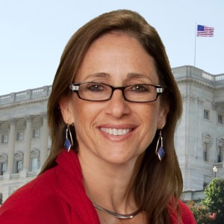
Welcoming 1
Debbie Fink is the Director of
Community Outreach and
Impact for RespectAbility, and
responsible for its
Women’s Disability Leadership,
Inclusion & Advocacy Series.
An author, educator and performer,
her books and curricula have been distributed worldwide, as she ‘edu-tained’ on global tours with the USO.

Slide 3
Welcoming 2
Today’s Goals:
To deliver tools of empowerment to:
Take Charge Advocating for Your Child
Take Charge Caring for Yourself
Take Action in NYC’s Civic Life
Meet new mothers on a similar journey and cultivate new relationships

Slide 4
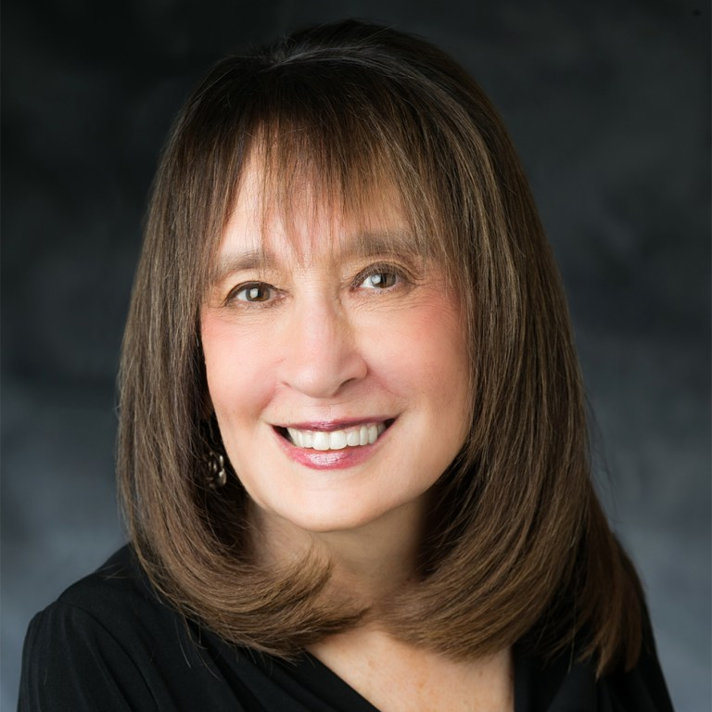
Welcoming 3
Vivian Bass has dedicated her
career as an advocate for
people with disabilities
worldwide. She is Chair of
Jewish Women International
(JWI)’s Board of Trustees;
serves on RespectAbility’s
executive committee; and is CEO Emeritus of The Jewish Foundation for Group Homes.

Slide 5
Thank You!
We wish to express our profound thanks to our generous hosts
here at the Guttman Office of AccessABILITY Services
-------------------------------
And to these organizations for their collaboration (alphabetically):
• Arts for All Abilities Consortium
• DemocracyNYC
• Guttman Oﬃce of Partnerships and Community Engagement
• Girls for Gender Equity
• INCLUDEnyc and
• L.O.V.E. Mentoring
• Youth Action YouthBuild East Harlem
-------------------------------
And thank you to the New York Women’s Foundation and the
Coca-Cola Foundation for its direct support for this effort.

Slide 6
Empowerment Training for Mothers of Students with Disabilities
Disclaimer
Please note that any views expressed by today’s speakers are solely in a personal capacity and are not intended to represent the views of their companies, organizations or RespectAbility; or to be taken as
legal or medical counsel.

Slide 7
Short Film “Ian”
https://www.youtube.com/watch?v=Hz_d-cikWmI#action=share

Slide 8
PANEL: Parent Advocacy
PARENT ADVOCACY:
Victories from the Past, Navigating the Present,
and Advancing the Future
Moderator: Gabby Einstein-Sim, RespectAbility Board Member
Panelists:
Donna Meltzer, CEO, National Association of Councils on Development Disabilities (NACDD)
Michelle Grier, LMSW, Director of Social Work, Girls for Gender Equity; and
Dr. Nelle Robinson, Self Advocate and CEO of
The Will To Win Ministry

Slide 9
Meet Gabby Einstein-Sim
Gabby Einstein-Sim is a board
member of RespectAbility. She is
currently a Master’s Student in
Community Health Education at
Columbia’s Teachers College.
She is a member of the Jewish
National Fund’s Disability Task Force, focusing specifically on the Special in Uniform program, which enables people with disabilities to serve in the Israeli army.

Slide 10
Parent Advocacy: Victories from the Past
Donna Meltzer is a board member
of RespectAbility and the CEO of
the National Association of Councils on Developmental Disabilities (NACDD). NACDD is a national non-profit organization that supports the nation’s 56 governor-appointed Developmental Disabilities Councils that work within state government to promote independence, productivity, and integration of people with disabilities through systems change activities.

Slide 11
Parent Advocacy: Navigating the Present
Michelle Grier, LMSW, is a social justice worker who is the Director of Social Work for Girls for Gender Equity. She dedicates her time to providing culturally relevant mental health services to youth of color. She also trains social workers and educators on bringing culturally sensitive models to their practice. Prior to her current position, Grier worked for Achievement First Endeavor Middle School as the Director of Socio-Emotional Learning and Social Work.

Slide 12
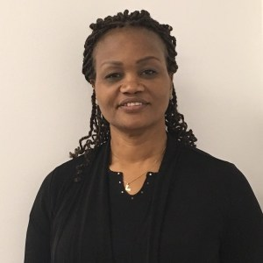
Parent Advocacy: Advancing the Future
Dr. Nelle Richardson is a Pastor and self-advocate with an invisible disability; godmother to Miss Wheelchair NY 2018 and mother of two adult children. Dr. Richardson has worked for the Federation Employment and Guidance Services/NYC LINKS in its Mental Health Unit and a case manager for the Criminal Justice Department. Dr. Richardson volunteers in her community, addressing suicide prevention among youth in the LGBTQ community. Dr. Richardson is completing her first book, Safety in Chaos, to help children find safety when everything around them seems chaotic.

Slide 13
Parent Advocacy: Victories from the Past 2
Victories
from the Past
by
Donna Meltzer

Slide 14
History of Advocacy: Disability Rights
Disability Advocacy:
Victories From the Past 1
Donna Meltzer, CEO National Association of Councils on Developmental Disabilities
Notes:
My name is Donna Meltzer. I am CEO for NACDD. [Insert Name] has dedicated resources to this training because YOU are an investment. We need to build networks of self-advocates so we can be effective as a civil rights movement to change systems that treat persons with disabilities as “less than.”
I work with self-advocates and their families on a daily basis. Many are employed as paid lobbyists and staff at national civil rights organizations. I can tell you that self-advocates, paid or volunteer, make the best case for civil rights. In fact, self-advocates and their families are the reason our disability rights laws exist.

Slide 15
Disability Advocacy:
Victories from the Past 2
Executive Branch
President & Administration
Legislative Branch
Congress
House & Senate
Judicial Branch
Courts
The Role of Government in Advocacy
Notes:
It is important to understand that all three branches of Government play a role in shaping our laws and policies.
Executive: Comes up with ideas for new laws, writes the rules that make the laws work (regulations), enforces laws, signs or vetoes bills, has access to the media, “Bully pulpit”
Self advocacy: Vote, run for office, serve in government, use the media to show policies don’t work (tell your story), participate in notice and comment for proposed regulation.
Legislative Branch: Write the laws and vote on them.
Self advocacy: Vote, hold candidate forums, run, share ideas for new laws, support/opposition for existing laws, influence public opinion through media.
Judicial branch: Interpret the laws and provide remedies.
Self advocacy: Be a plaintiff, practice law, be a judge, support legal advocacy groups.

Slide 16
Disability Advocacy:
Victories from the Past 3
Developmental Disabilities Americans with Disabilities Act of 1990
Individuals with Disabilities Education Act
Section 501 of the Rehabilitation Act of 1973, as amended
Section 503 of the Rehabilitation Act of 1973, as amended
Section 504 of the Rehabilitation Act of 1973, as amended
Section 508 of the Rehabilitation Act of 1973, as amended
Major Civil Rights Laws - Disability
Developmental Disabilities Assistance and
Bill of Rights Act (DD Act)
Individuals with Disabilities Education Act (IDEA)
Section 504 of the Rehabilitation Act of 1973
(Section 504)
Americans with Disabilities Act of 1990 (ADA)
Notes:
For the rest of our short time I will go over major civil rights laws that are disability specific. But, it is important to be aware of other civil rights laws that protect an individual from discrimination as well. It is not uncommon for people with disability to bear the brunt of systemic discrimination based on multiple factors because of their disability, gender, and race for example. Unfortunately, we do not have time to go into those issues today, but it is important to be aware that some actions may violate additional federal laws (for example, Title IX and gender, Title VI and race, et cetera.).

Slide 17
Developmental Disabilities Assistance and Bill of Rights Act (DD Act)
Disability Advocacy:
Victories from the Past 4
Photo of the Kennedy/Shriver family, smiling and laughing at camera, with a dog looking away
Circle diagram showing UCEDDs, DD Council, and P & As
Notes:
In 1963, individuals with developmental disabilities were excluded from aspects of public and private life, including most schools and community spaces. Many people spent most of their lives in large, state-run institutions. These institutions were often grossly underfunded and reports of systemic abuse and neglect were common.
Federal "developmental disabilities" legislation developed from the "mental retardation" laws of the early 1960s. In October 1961 President John F. Kennedy convened the President’s Panel on Mental Retardation, which developed “A Proposed Program for National Action to Combat Mental Retardation” – largely credited as the start of the developmental disabilities rights legislation that led to his signing of legislation that would later lead to the DD Act.
It is undeniable that Kennedy’s personal experience as a sibling Rosemary Kennedy, had a brain injury from lack of oxygen during birth. Tragically, the family authorized a lobotomy treatment after which Rosemary could no longer speak or walk. She lived in institutions isolated from her family for 20 years, until after her father’s death. She was reunited with her family only later in life.
Since the DD Act was enacted, it has come to represent a fundamentally different vision of what it means to live with a developmental disability. It is a vision rooted in the belief that “disability is a natural part of the human experience that does not diminish the right of individuals with developmental disabilities to live independently, to exert control and choice over their own lives, and to fully participate in and contribute to their communities through full integration and inclusion in the economic, political, social, cultural, and educational mainstream of United States society.”
The purpose of the DD Act is to “assure that individuals with developmental disabilities and their families participate in the design of and have access to needed community services, individualized supports, and other forms of assistance that promote self-determination, independence, productivity, and integration and inclusion in all facets of community life …”
The current definition under the DD Act (adopted in 2000) defines “developmental disability” as a severe, chronic disability of an individual that:
"(i) is attributable to a mental or physical impairment or combination of mental and physical impairments;
(ii) is manifested before the individual attains age 22;
(iii) is likely to continue indefinitely;
(iv) results in substantial functional limitations in 3 or more of the following areas of major life activity:
(I) Self-care.
(II) Receptive and expressive language.
(III) Learning.
(IV) Mobility.
(V) Self-direction.
(VI) Capacity for independent living.
(VII) Economic self-sufficiency; and
(v) reflects the individual’s need for a combination and sequence of special, interdisciplinary, or generic services, individualized supports, or other forms of assistance that are of lifelong or extended duration and are individually planned and coordinated."
The 2000 law also further clarified the application of the “developmental disability” definition for children from birth through age 9. A child may still be considered to have a developmental disability without meeting 3 or more of the above criteria (items (i) through (v)) if the individual, without services and supports, has a high probability of meeting these criteria later in life.
DD Act programs in every state and territory empower individuals with developmental disabilities and their families to help shape policies that impact them:
State Councils on Developmental Disabilities. DD Councils bring the voices of individuals with developmental disabilities to the policy-makers whose decisions impact their lives.
State Protection & Advocacy Systems (P&As). Established by the DD Act in 1975, to litigate for new legal and civil rights protections that provide dignity and inclusion.
University Centers for Excellence in Developmental Disabilities Education, Research & Service (UCEDDs) work to improve the lives of people with developmental disabilities and their family members and ensure that voices from this community are heard in the halls of academia.
Projects of National Significance: PNS focus on the most pressing issues affecting people with developmental disabilities and their families. They also allow AIDD to help fill gaps identified by the community, as well as quickly address new issues with a national scope.

Slide 18
Individuals with Disabilities Education Act (IDEA)
Disability Advocacy:
Victories from the Past 5
PARC v. Commonwealth of Pennsylvania (1972)
IDEA Principles Today:
1. Free Appropriate Public Education
2. Appropriate Evaluation
3. Individualized Education Plan
4. Least Restrictive Environment
5. Parent Participation
6. Procedural Safeguards
Education for All Handicapped Children Act (1975)
Individuals with Disabilities Education Act (1990)
1972 ad for children denied education due to disability.
“This desk is empty!”
Notes:
In 1970, schools in America educated only one in five students with disabilities. More than 1 million students were excluded from public schools, and another 3.5 million did not receive appropriate services. Many states had laws excluding certain students, including those who were blind, deaf, or labeled "emotionally disturbed" or "mentally retarded." Almost 200,000 school-age children with mental retardation or emotional disabilities were institutionalized.
Parent groups formed to fight this discrimination in court. Several landmark court decisions established the responsibility of states to educate children with disabilities. The first case in Pennsylvania was filed by the Pennsylvania Association for Retarded Citizens (now known as The Arc of Pennsylvania) and the families of children with intellectual disabilities who were denied an education. These lawsuits and public pressure eventually lead to the passage of federal laws that became Individuals with Disabilities Education Act (IDEA).
IDEA requires public schools to make available to all eligible children with disabilities a free appropriate public education in the least restrictive environment appropriate to their individual needs.
Six major principles of the IDEA focus on students’ rights and the responsibilities of public schools to children with disabilities:
1. Free Appropriate Public Education
Under the IDEA, every child with a disability is entitled to a Free Appropriate Public Education (FAPE). The IDEA emphasizes special education and related services, which should be designed to meet a child’s “unique needs and prepare them for further education, employment, and independent living.”
Furthermore, courts have held that the IDEA requires schools to prepare Individualized Education Plans, which confer “meaningful educational benefit” to children with disabilities. The “meaningful educational benefit” requirement includes a focus on raised student expectations, appropriate progress, and transition into postsecondary education and independent living.
Public schools and local school boards are responsible for ensuring that every child with a disability receives a FAPE.
2. Appropriate Evaluation
The IDEA requires that schools conduct “appropriate evaluations”of students who are suspected of having a disability. An appropriate evaluation must be implemented by a team of knowledgeable and trained evaluators, must utilize sound evaluation materials and procedures, and must be administered on a non-discriminatory basis.
Children should not be subjected to unnecessary assessments or testing, and evaluations must be geared toward planning for the child’s education and future instruction. Finally, an appropriate evaluation must determine and make recommendations regarding a child’s eligibility for special education services in a timely manner.
3. Individualized Education Plan
The Individualized Education Plan (IEP) was established by the IDEA to help ensure every child’s access to a Free Appropriate Public Education. The IEP is a written document, developed by an IEP team, which draws upon existing evaluation information in order to meet a student’s unique educational needs.
Under the IDEA, an IEP must include information regarding a student’s present levels of educational performance, annual goals and benchmarking objectives, services and supplementary aids to be received, and a detailed explanation of instances where a student is not participating in the general classroom and why.
An IEP is also required to include information regarding consistent reporting on student progress as well as “transition” to adult life. Finally, it is required that an IEP account for the planning concerns of the parents and child, the strengths of a particular child, and the specific “academic, developmental, and functional needs” of the child.
4. Least Restrictive Environment
The IDEA places a strong emphasis on placement in a general education setting. Under the IDEA, a student is guaranteed placement in the Least Restrictive Environment (LRE) possible. Therefore, an IEP team must explore a number of alternatives for enabling a student to participate in the general education classroom. These may include: classroom modifications, supplemental aids and services, alternative instructional methods, etc.
If an IEP team determines that a student cannot be satisfactorily educated in a general education setting, then the team must make responsible efforts to determine the LRE for that student outside of the general classroom.
5. Parent Participation
The IDEA has a special provision for “parent participation in placement decisions.” Under this provision, state educational agencies and local school boards must ensure that the parents of a child with a disability are members of any group that makes decisions regarding the placement and LRE of that child.
Parents have the right to equal participation in this process, and are entitled to notification of a planned evaluation, access to planning and evaluation materials, and involvement in all meetings regarding their child’s placement. Additionally, parents retain the right to refuse further evaluation of their child. Both students and parents must be invited to IEP meetings, and the IDEA explicitly establishes a role for the parent as equal participant and decision maker.
6. Procedural Safeguards
Finally, the IDEA establishes procedural safeguards to help parents and students enforce their rights under federal law. The primary purpose of this requirement is twofold: safeguards protect parental access to information pertaining to placement and transition planning; and procedures are put in place to resolve disagreements between parents and schools regarding the placement of a student. If disagreements arise, parents have the right to request mediation or due process hearings with state-level education agencies, and beyond that may appeal the decision in state or federal court.

Slide 19
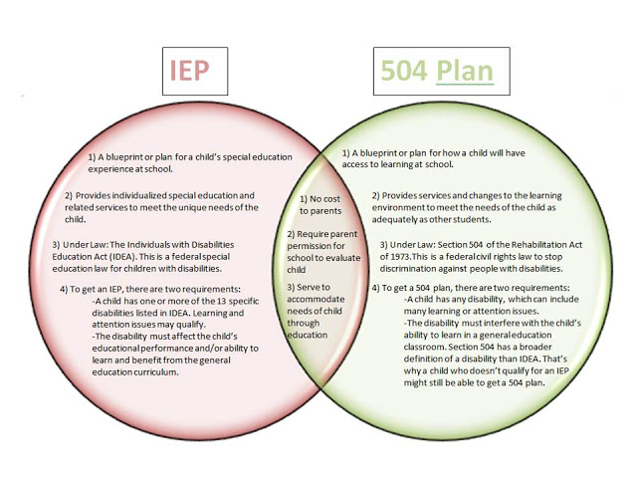
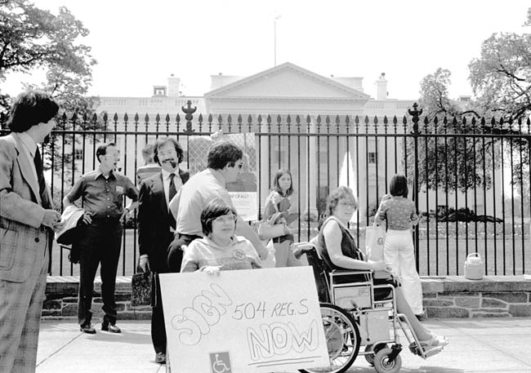
Section 504 of the Rehabilitation Act of 1973 (Section 504)
Disability Advocacy:
Victories from the Past 6
Section 504 states that "no qualified individual with a disability in the United States shall be excluded from, denied the benefits of, or be subjected to discrimination under" any program or activity that either receives Federal financial assistance or is conducted by any Executive agency or the United States Postal Service.
Notes:
In 1973 the first federal civil rights protection for people with disabilities, Section 504 of the Rehabilitation Act was signed into law.
Section 504 states that "no qualified individual with a disability in the United States shall be excluded from, denied the benefits of, or be subjected to discrimination under" any program or activity that either receives Federal financial assistance or is conducted by any Executive agency or the United States Postal Service.
Each Federal agency has its own set of section 504 regulations that apply to its own programs. Agencies that provide Federal financial assistance also have section 504 regulations covering entities that receive Federal aid. Requirements common to these regulations include reasonable accommodation for employees with disabilities; program accessibility; effective communication with people who have hearing or vision disabilities; and accessible new construction and alterations. Each agency is responsible for enforcing its own regulations. Section 504 may also be enforced through private lawsuits. It is not necessary to file a complaint with a Federal agency or to receive a "right-to-sue" letter before going to court.
But the laws on paper are only worth the paper. It took people to force the executive branch to implement the law through a grueling battle with the federal agency that refused to enforce it.

Slide 20
Americans with Disabilities Act of 1990 (ADA)
Disability Advocacy:
Victories from the Past 7
Passed by Congress in 1990, the Americans with Disabilities Act (ADA) is the nation's first comprehensive civil rights law addressing the needs of people with disabilities, prohibiting discrimination in employment, public services, public accommodations, and telecommunications.
To be protected by the ADA, one must have a disability, which is defined by the ADA as a physical or mental impairment that substantially limits one or more major life activities, a person who has a history or record of such an impairment, or a person who is perceived by others as having such an impairment. The ADA does not specifically name all of the impairments that are covered. The ADA is built upon four pillars: full participation, independent living, equality of opportunity, and economic self-sufficiency.
Notes:
The ADA prohibits discrimination on the basis of disability in employment, State and local government, public accommodations, commercial facilities, transportation, and telecommunications. It also applies to the United States Congress.
To be protected by the ADA, one must have a disability or have a relationship or association with an individual with a disability. An individual with a disability is defined by the ADA as a person who has a physical or mental impairment that substantially limits one or more major life activities, a person who has a history or record of such an impairment, or a person who is perceived by others as having such an impairment. The ADA does not specifically name all of the impairments that are covered.
ADA Title I: Employment
Title I requires employers with 15 or more employees to provide qualified individuals with disabilities an equal opportunity to benefit from the full range of employment-related opportunities available to others. For example, it prohibits discrimination in recruitment, hiring, promotions, training, pay, social activities, and other privileges of employment. It restricts questions that can be asked about an applicant's disability before a job offer is made, and it requires that employers make reasonable accommodation to the known physical or mental limitations of otherwise qualified individuals with disabilities, unless it results in undue hardship. Religious entities with 15 or more employees are covered under title I.
Title I complaints must be filed with the U. S. Equal Employment Opportunity Commission (EEOC) within 180 days of the date of discrimination, or 300 days if the charge is filed with a designated State or local fair employment practice agency. Individuals may file a lawsuit in Federal court only after they receive a "right-to-sue" letter from the EEOC.
Charges of employment discrimination on the basis of disability may be filed at any U.S. Equal Employment Opportunity Commission field office. Field offices are located in 50 cities throughout the U.S. and are listed in most telephone directories under "U.S. Government." For the appropriate EEOC field office in your geographic area, contact:
(800) 669-4000 (voice)
(800) 669-6820 (TTY)
www.eeoc.gov
Publications and information on EEOC-enforced laws may be obtained by calling:
(800) 669-3362 (voice)
(800) 800-3302 (TTY)
For information on how to accommodate a specific individual with a disability, contact the Job Accommodation Network at:
(800) 526-7234 (voice)
(877) 781-9403 (TTY)
http://askjan.org
ADA Title II: State and Local Government Activities
Title II covers all activities of State and local governments regardless of the government entity's size or receipt of Federal funding. Title II requires that State and local governments give people with disabilities an equal opportunity to benefit from all of their programs, services, and activities (e.g. public education, employment, transportation, recreation, health care, social services, courts, voting, and town meetings).
State and local governments are required to follow specific architectural standards in the new construction and alteration of their buildings. They also must relocate programs or otherwise provide access in inaccessible older buildings, and communicate effectively with people who have hearing, vision, or speech disabilities. Public entities are not required to take actions that would result in undue financial and administrative burdens. They are required to make reasonable modifications to policies, practices, and procedures where necessary to avoid discrimination, unless they can demonstrate that doing so would fundamentally alter the nature of the service, program, or activity being provided.
Complaints of title II violations may be filed with the Department of Justice within 180 days of the date of discrimination. In certain situations, cases may be referred to a mediation program sponsored by the Department. The Department may bring a lawsuit where it has investigated a matter and has been unable to resolve violations.

Slide 21
All of these laws have common language and were built upon one another – each plays a role in our rights and our responsibilities and helps us know what we can do and what we can achieve. You are standing on the shoulders of giants. You don’t need to be a giant, but you do need to know to know some history and your rights so that you can be the best advocate for your child.
Disability Advocacy: Victories from the Past 8

Slide 22
Parent Advocacy: Navigating the Present 2
Navigating
the Present
by
Michelle Grier, LMSW

Slide 23
Parent Advocacy: Navigating the Present 3
Where are we today?
Notes:
Bullet 1: The number of NYC students with disabilities is larger than the entire population of most school districts around the country.
The number is big in part because, but students in New York City are also more likely to be classified as eligible for special education.
About 19 percent of NYC students have an IEP, compared with 14 percent in Chicago, 12 percent in Los Angeles, and just 7 percent in Houston.
Bullet 2: IEPs encompass a wide variety of specific disabilities. Mirroring national figures, the most prevalent disability classifications in NYC are learning disabilities (40% of all students with disabilities) and speech or language impairments (32%). Other relatively common disability classifications include autism (7%); emotional disturbance (6%); and other health impairments (8%).
Bullet 3: Disparities by gender--we know that those that are invisible or considered less problematic behaviors go untreated and underrecognized.
Girls are 34% of all SWD while boys are 66%
Bullet 4: Disparities by race/ethnicity:
Figure 4 shows that Asian and Latino students are more likely to be diagnosed with speech or language impairments. (Among students with disabilities, 38% of Asian and 36% of Latino students have an IEP for speech or language impairments, compared with 26% of Black and 28% of White students.) This difference is driven in part by the fact that students who are English Language Learners are overrepresented among those classified as having speech or language impairments.
White and Asian students are diagnosed with autism at higher rates than Black and Latino students (11% and 10% of White and Asian students with disabilities, respectively, vs. 7% and 6% among Black and Latino students with disabilities). Finally, Black students are more than twice as likely to have an IEP for emotional disturbance.

Slide 24
Parent Advocacy: Navigating the Present 4
What the data tells us . . .
The percent of students with IEPs varies greatly across
New York City.
The most prevalent disability classifications are learning disabilities and speech or language impairments.
Boys are more likely to be classified with autism, emotional disturbance, and other health impairments.
Disability classifications vary substantially by race/ethnicity.
Sources: https://steinhardt.nyu.edu/site/research_alliance/2018/11/19/what-are-the-contours-of-nycs-special-education-landscape
Notes:
Bullet 1: The number of NYC students with disabilities is larger than the entire population of most school districts around the country.
The number is big in part because, but students in New York City are also more likely to be classified as eligible for special education.
About 19 percent of NYC students have an IEP, compared with 14 percent in Chicago, 12 percent in Los Angeles, and just 7 percent in Houston.
Bullet 2: IEPs encompass a wide variety of specific disabilities. Mirroring national figures, the most prevalent disability classifications in NYC are learning disabilities (40% of all students with disabilities) and speech or language impairments (32%). Other relatively common disability classifications include autism (7%); emotional disturbance (6%); and other health impairments (8%).
Bullet 3: Disparities by gender--we know that those that are invisible or considered less problematic behaviors go untreated and underrecognized.
Girls are 34% of all SWD while boys are 66%
Bullet 4: Disparities by race/ethnicity:
Figure 4 shows that Asian and Latino students are more likely to be diagnosed with speech or language impairments. (Among students with disabilities, 38% of Asian and 36% of Latino students have an IEP for speech or language impairments, compared with 26% of Black and 28% of White students.) This difference is driven in part by the fact that students who are English Language Learners are overrepresented among those classified as having speech or language impairments.
White and Asian students are diagnosed with autism at higher rates than Black and Latino students (11% and 10% of White and Asian students with disabilities, respectively, vs. 7% and 6% among Black and Latino students with disabilities). Finally, Black students are more than twice as likely to have an IEP for emotional disturbance.

Slide 25
Parent Advocacy: Navigating the Present 5
Organizations in NYC
What are the contours of NYC’s Special Education landscape?
https://steinhardt.nyu.edu/site/research_alliance/2018/11/19/ what-are-the-contours-of-nycs-special-education-landscape/
IncludeNYC - www.includenyc.org
Post-School Success for English Learners with IEPs https://www.postschoolsuccessiepbilingual.org
Advocates for Children - www.advocatesforchildren.org
Notes:
Bullet 1: The number of NYC students with disabilities is larger than the entire population of most school districts around the country.
The number is big in part because, but students in New York City are also more likely to be classified as eligible for special education.
About 19 percent of NYC students have an IEP, compared with 14 percent in Chicago, 12 percent in Los Angeles, and just 7 percent in Houston.
Bullet 2: IEPs encompass a wide variety of specific disabilities. Mirroring national figures, the most prevalent disability classifications in NYC are learning disabilities (40% of all students with disabilities) and speech or language impairments (32%). Other relatively common disability classifications include autism (7%); emotional disturbance (6%); and other health impairments (8%).
Bullet 3: Disparities by gender--we know that those that are invisible or considered less problematic behaviors go untreated and underrecognized.
Girls are 34% of all SWD while boys are 66%
Bullet 4: Disparities by race/ethnicity:
Figure 4 shows that Asian and Latino students are more likely to be diagnosed with speech or language impairments. (Among students with disabilities, 38% of Asian and 36% of Latino students have an IEP for speech or language impairments, compared with 26% of Black and 28% of White students.) This difference is driven in part by the fact that students who are English Language Learners are overrepresented among those classified as having speech or language impairments.
White and Asian students are diagnosed with autism at higher rates than Black and Latino students (11% and 10% of White and Asian students with disabilities, respectively, vs. 7% and 6% among Black and Latino students with disabilities). Finally, Black students are more than twice as likely to have an IEP for emotional disturbance.

Slide 26
Parent Advocacy: Navigating the Present
What does this mean for mothers and caregivers
of students in NYC schools?
You have to be an advocate for your child and for others in the school.
Get informed, know your rights, and document everything.
Recognize your social location and find allies in your community and within the school to support your child.
Ask questions (i.e.):
What programs does this school offer?
Do they have:
Culturally Responsive Differentiated Instructional Strategies,
Inclusive classroom settings (what does that model look like and if they don’t have it what can they offer), and
Personnel who are trained in the best practice modalities.
Notes:
Bullet 1: The number of NYC students with disabilities is larger than the entire population of most school districts around the country.
The number is big in part because, but students in New York City are also more likely to be classified as eligible for special education.
About 19 percent of NYC students have an IEP, compared with 14 percent in Chicago, 12 percent in Los Angeles, and just 7 percent in Houston.
Bullet 2: IEPs encompass a wide variety of specific disabilities. Mirroring national figures, the most prevalent disability classifications in NYC are learning disabilities (40% of all students with disabilities) and speech or language impairments (32%). Other relatively common disability classifications include autism (7%); emotional disturbance (6%); and other health impairments (8%).
Bullet 3: Disparities by gender--we know that those that are invisible or considered less problematic behaviors go untreated and underrecognized.
Girls are 34% of all SWD while boys are 66%
Bullet 4: Disparities by race/ethnicity:
Figure 4 shows that Asian and Latino students are more likely to be diagnosed with speech or language impairments. (Among students with disabilities, 38% of Asian and 36% of Latino students have an IEP for speech or language impairments, compared with 26% of Black and 28% of White students.) This difference is driven in part by the fact that students who are English Language Learners are overrepresented among those classified as having speech or language impairments.
White and Asian students are diagnosed with autism at higher rates than Black and Latino students (11% and 10% of White and Asian students with disabilities, respectively, vs. 7% and 6% among Black and Latino students with disabilities). Finally, Black students are more than twice as likely to have an IEP for emotional disturbance.

Slide 27
Parent Advocacy: Advancing the Future 2
Advancing
the Future
by
Dr. Nelle Richardson

Slide 28
Parent Advocacy: Advancing the Future 3
Make a conscious decision to take care of your health. Do whatever you can to make sure you are physically and mentally fit, including:
Illness Prevention
Exercise
Diet/healthy eating
Taking medicine as prescribed…HBP, Diabetes, pain meds
Illness Behavior – Moderate / avoid use of:
Alcohol
Drugs
Cigarettes
Sugar
Salt
Sodas and soft beverages
Lack of healthy foods / too much fried food

Slide 29
Parent Advocacy: Advancing the Future 4
Proper Self-Care
Get adequate sleep: 7-8 hours per night
Sleep deprivation leads to many illnesses including: Memory loss, anxiety, stress, depression and even death.
Meet with your dentist and your medical doctor annually.
Take vitamins on a daily basis – don’t wait until you are sick.
Take a warm bath especially when you are stressed, as it helps to calm you down.
Most people need motivation to get healthy and remain healthy. Always remember, you have an obligation to take care of yourself, so you can better take care of others.
Listen to them, lift them up, laugh with them, meet their needs, too.
Make / Take Time with Your Other Kids!

Slide 30
Parent Advocacy Q & A

Slide 31
TIP
TALKS
TALKS
Planning for Success: Advocating for
Your Daughter or Son with a Disability:
Panelists will be joined by the following co-facilitators:
Ketrina Hazell, Ms. Wheelchair NY 2018;
Jordana Mendelson, Parent Advocate and
Associate Professor, NYU; and
RespectAbility Fellows:
Tatiana Lee, Award-Winning Actress
Candace Cable, Paralympian Champion
TIP

Slide 32
TIP 2
TALKS
“TipTalks” – 5 Stations to discuss 10+ Tips:
Planning for Success: Advocating for Your Daughter or Son with a Disability:
TipTalks: #1 and #8 with Dr. Jordana Mendelson, steering committee of Arts for All Abilities and NYU professor
TipTalks: #2, #9, and #“10+” with Dr. Nelle Richardson and Ketrina Hazell, Ms. Wheelchair NY 2018
TipTalks: #3 and #10 with Tatiana Lee and Candace Cable, RespectAbility Fellows (Communications and Policy)
TipTalks: #4 and #5 with Michelle Grier, LMSW
TipTalks: #6 and #7 with Donna Meltzer

Slide 33
Taking Action! Community Resources & Opportunities
INCLUDEnyc
Arts for All Abilities Consortium
Sign-Up for Social Outing / Networking Opportunity to see “Addy & Uno” at Kirk Theatre (410 W. 42nd St)
DemocracyNYC
Today’s Survey – please complete!

Slide 34
Thank You! 2
Once again, our profound thanks to our generous hosts
here at the Guttman Office of AccessABILITY Services
-------------------------------
And to these organizations for their collaboration (alphabetically):
• Arts for All Abilities Consortium
• DemocracyNYC
• Guttman Oﬃce of Partnerships and Community Engagement
• Girls for Gender Equity
• INCLUDEnyc and
• L.O.V.E. Mentoring
• Youth Action YouthBuild East Harlem
-------------------------------
And thank you to the New York Women’s Foundation and the
Coca-Cola Foundation for its direct support for this effort.

Slide 35
Thank You! 3
“It takes a village to
educate a child!”
Thanks again to everyone for being a part of the village and
teaming together today!
© RespectAbility 2019

Slide 36
Stay in touch with us!
Debbie Fink
Director, Community Outreach & Impact
and Women’s Disability Leadership, Inclusion & Advocacy Series
DebbieF@RespectAbility.org
11333 Woodglen Drive, Suite 102
Rockville, MD 20852
Office: (202) 517-6272
www.RespectAbility.org
© RespectAbility 2019

