Slide 1

RespectAbility
Women’s Disability Leadership, Inclusion & Advocacy Series
Welcomes You to Our
Empowerment Training for Latinas
with Disabilities
www.RespectAbility.org
¡Bienvenido!

Slide 2
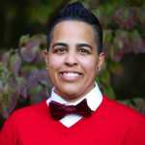
Welcome!
¡Bienvenido!
Allilsa Fernandez is the Founder
and Former President of Peer
Mental Health Alliance, a student
organization at Stony Brook
University that helps raise
Awareness on mental health. She sits on the
advisory board for DREAM: Disability Rights, Education, Activism, and Mentoring, which is a national organization run for and by college students with disabilities.

Slide 3
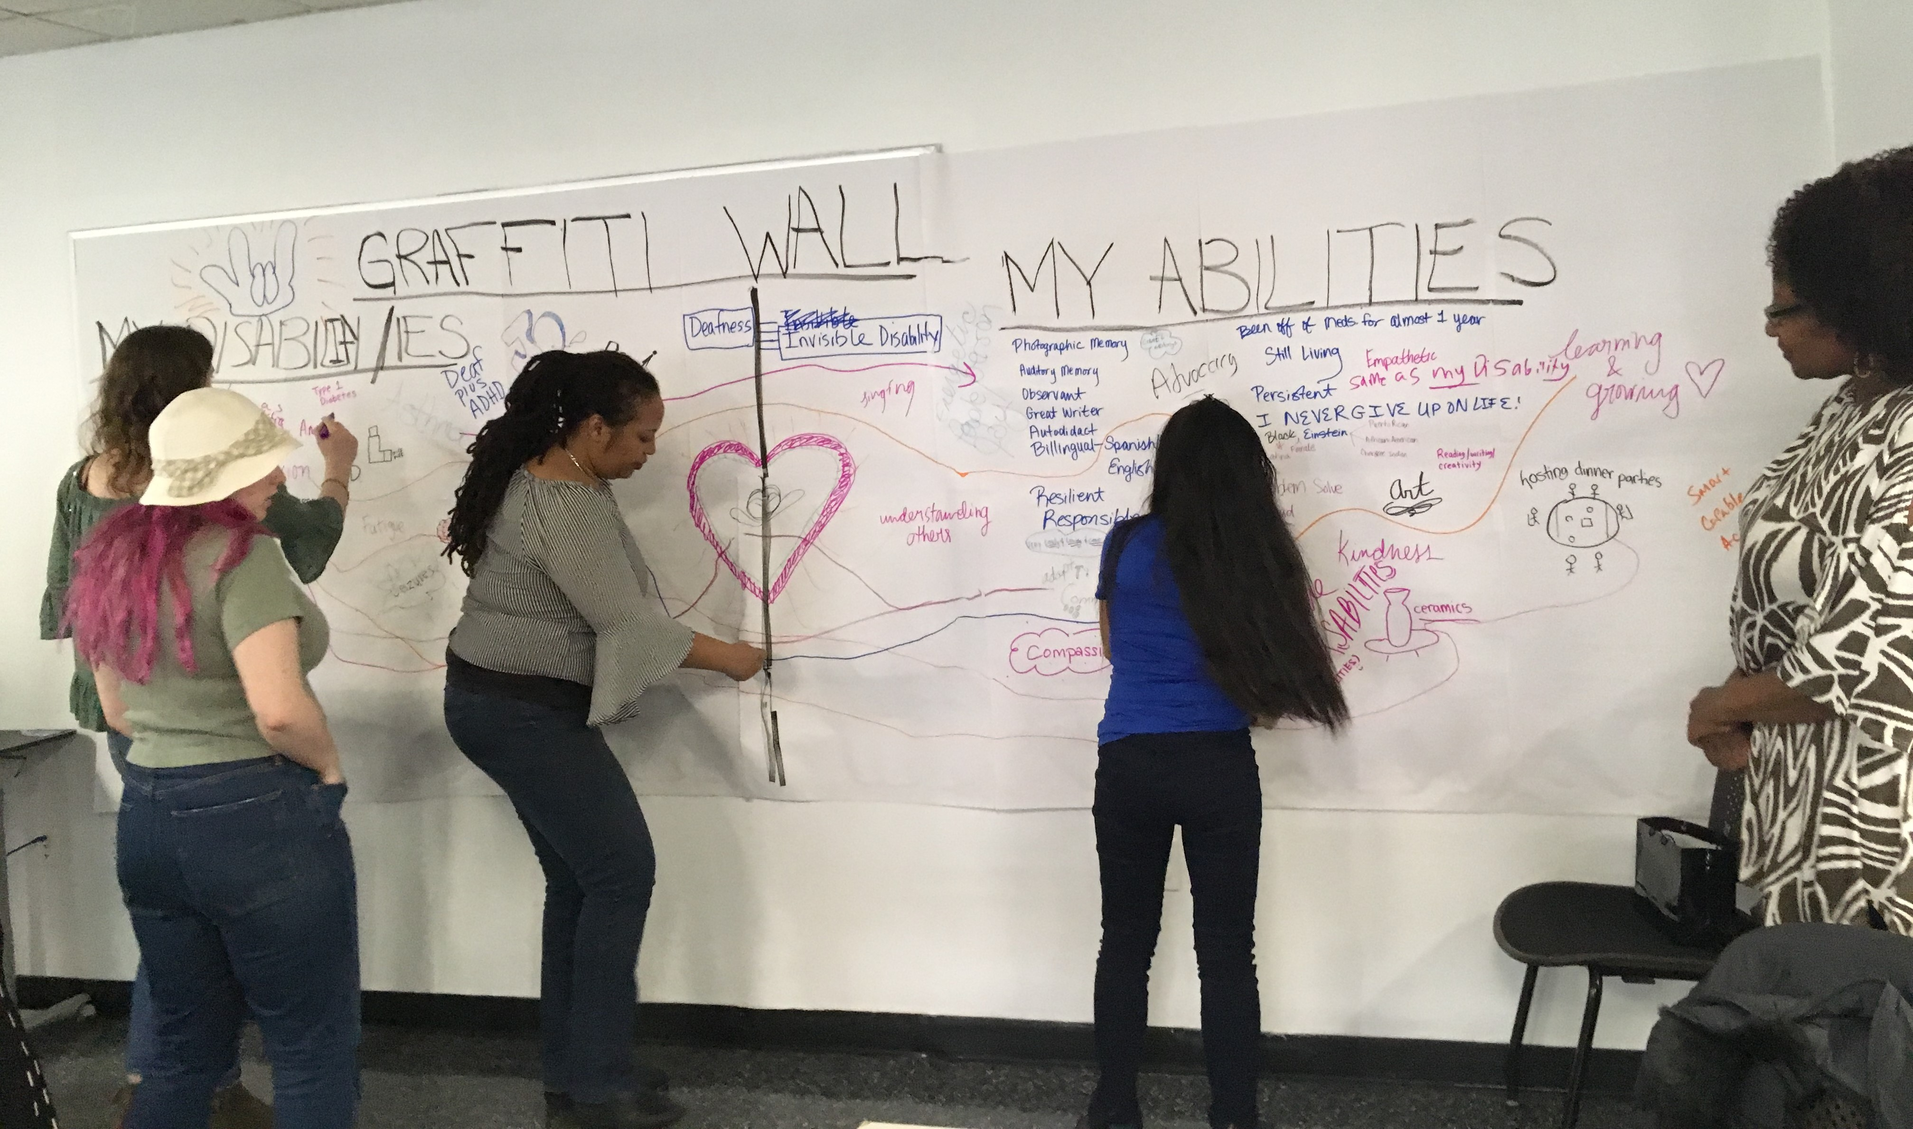
Self-Expression Graffiti Wall

Slide 4
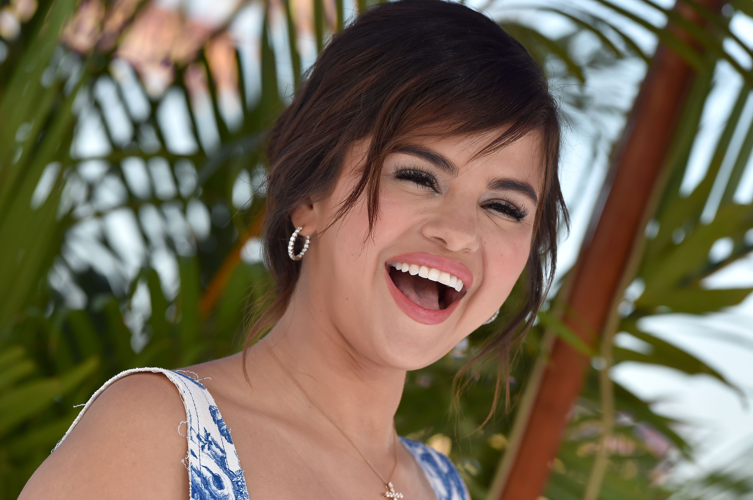
Quote from Selena Gomez, who lives with a disability
“Always be yourself, there's no one better!”
“You have every right to a beautiful life.”
“Being yourself is all it takes!”

Slide 5
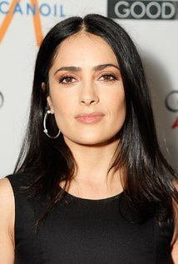
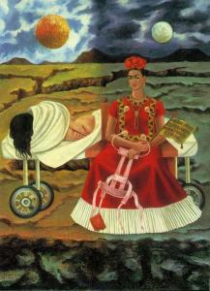

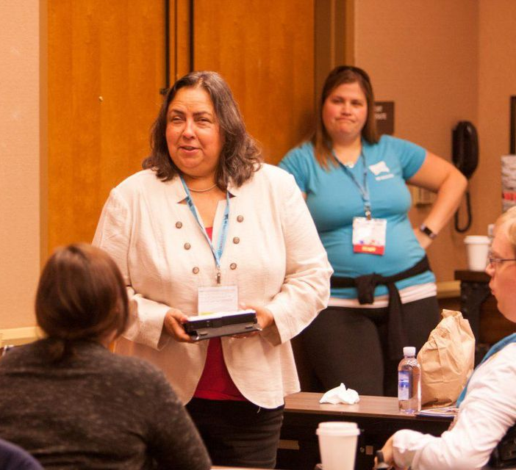
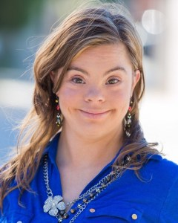
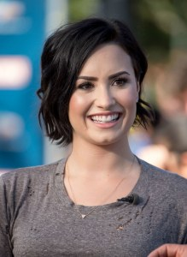
Notable Latinas who live(d) with disabilities
Michelle Rodriguez,
Actress, ADD
Salma Hayek,
Actress,
Dyslexia
Kathy Martinez, Sr. VP, Wells Fargo Bank; former Assistant US Secretary of Labor Office of Disability, Employment, and Policy; Blind
Frida Kahlo, Artist,
Polio and Chronic Pain
due to accident
Demi Lovato,
Singer, Bipolar Disorder
Cristina Sanz, Actress,
Downs Syndrome

Slide 6
Today’s Goals objetivos de hoy
Today we aim to deliver tools,
empowering you to:
Take charge of your self-advocacy
Take action getting involved in NYC’s civic life
(in the Latinx &/or general community); and,
Take home new experiences, new connections, new resources.

Slide 7
Disclaimer renuncia
Please note that any views expressed by today’s speakers are solely in a personal capacity and are not intended to represent the views of their companies, organizations or RespectAbility; or to be taken as
legal or medical counsel.

Slide 8
¡Gracias!
Thank you!
We wish to express our profound thanks to our generous hosts
here at Guttman Community College!
-------------------------------
And to these organizations for their collaboration:
Hunter College Includenyc
Girls for Gender Equity Latin Women in Action
Loisaida Mano a mano
Masa Sinergia
Consulado General del Ecuador en New York
Consulado General del Mexico en New York
L.O.V.E. (Latinas On the Verge of Excellence) Mentoring
-------------------------------
Thank you to the New York Women’s Foundation and the
Coca-Cola Foundation for its direct support for this effort …
¡ Gracias!

Slide 9
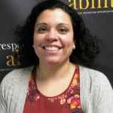
Introduction-1
La introducción-1
Elizabeth Jones is the Manager of Partnerships for RespectAbility.
Born in Honduras, she is a lifelong advocate for people with
disabilities, and ensures smooth operations of the office, expanding RespectAbility’s impact for people with disabilities. Elizabeth enjoys watching telenovelas and Cold Mango on a Hot Day.

Slide 10

Amanda Lopez
Singer/Actress
Amanda Lopez, a Cuban-American
performer, was born with Latin
rhythm in her blood. She has
been dancing and singing forever.
Amanda earned a degree in
musical theater at The Boston Conservatory. Amanda resides in NYC; performs with the off-Broadway musical Addy & Uno – the first family musical about disability; and is represented by Daniel Hoff Agency.

Slide 11
“I Am Woman” lyrics-1
By Helen Reddy and Ray Burton, 1972
Lyrics adapted by Debbie Fink, 2019
Sung by Amanda Lopez, with Rebecca Muller, guitarist
I am woman hear me roar in numbers too big to ignore
And I know too much to go back and pretend
‘Cause I've heard it all before
And I've been down there on the floor
No one's ever gonna keep me down again
Oh yes, I am wise but it's wisdom born of pain
Yes, I've paid the price. But look how much I gained
If I have to, I can do many things
I am strong (Strong)
I am invincible (Invincible)
I am woman

Slide 12
“I Am Woman” lyrics 2
You can bend but never break us
‘Cause it only serves to make us
More determined to achieve our final goal
And we come back even stronger
Not novices any longer
Cause you've deepened the conviction in our soul
Oh yes, we are wise
But it's wisdom born of pain
Yes, we’ve paid the price but look how much we gained
If we have to, we can do anything
We are strong (Strong)
We are invincible (Invincible)
We are woman

Slide 13
“I Am Woman” lyrics 3
Somos mujeres, watch us grow
See us moving to and fro
As we spread our lovin' arms across the land
But we’re still an embryo
With a long long way to go
Until we make all ableists understand
Oh yes, we are wise
But its wisdom born of pain
Yes, we’ve paid the price
But look how much we gained
If we have to, we can face anything
We are strong (Strong!)
We are invincible (Invincible!)
We are Latinas (Latinas!)
We are woman!

Slide 14
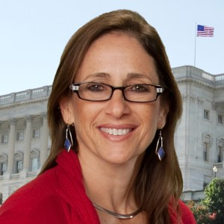
Introduction-2
La introducción-2
Debbie Fink is the Director
of Community Outreach and
Impact for RespectAbility,
and is responsible for the
Women’s Disability Leadership,
Inclusion & Advocacy Series.
Having spent two years immersed in Argentinian culture, she enjoys its zest for life, la música y la danza, asado, y dulce de leche!

Slide 15
KEYNOTE SPEAKER:
Carol Robles-Román, Esq.
Latinas with Disabilities:
The Convergence of Women’s Rights,
Disability Rights,
and Civil Rights in the Latinx Community
With
Carol Robles-Román, Esq.
General Counsel and Dean of Faculty at Hunter College
Former NYC Deputy Mayor

Slide 16
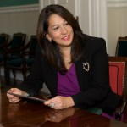
Living a Life of Leadership:
Carol Robles-Román
Carol Robles-Román is Chief
Legal Counsel and Dean of
Faculty at Hunter College.
Carol is also Secretary of the
ERA Coalition/Fund for
Women’s Equality; was CEO &
President of Legal Momentum,
where she spearheaded equal rights for women and girls, and was Deputy Mayor to NYC Mayor Michael Bloomberg for 12 years.

Slide 17

Living a Life of Leadership-2:
Carol Robles-Román
600 × 460
Preguntas y respuestas

Slide 18
“The Impossible Dream” lyrics-1
Lyrics by Joe Darion; music by Mitchell Leigh
Lyrics adapted by Debbie Fink, 2019
Sung by Amanda Lopez, with Rebecca Muller, guitarist
600 × 460
To dream the impossible dream
To fight the unbeatable foe
To bear with unbearable sorrow
To run where the brave dare not go
To right the unrightable wrong
To love pure and chaste from afar
To try when your arms are too weary
To reach the unreachable star
This is my quest,
to follow that star
No matter how hopeless,
no matter how far
To fight for the right
Without question or pause
To be willing to march
Into hell for a heavenly cause

Slide 19
“The Impossible Dream” lyrics-2
And I know if I'll only be true
To this glorious quest
That my heart will lay peaceful and calm
When I'm laid to my rest
And the world will be better for this.
That one woman scorned and covered with scars
Still strove with her last ounce of courage
To reach the unreachable star
The Impossible Dream lyrics © Sony/ATV Music Publishing LLC,
The Bicycle Music Company, Helena Music Company
600 × 460

Slide 20
Introduction-3
La introducción-3
Allilsa Fernandez is the Founder
and Former President of Peer
Mental Health Alliance, a student
organization at Stony Brook
University that helps raise
Awareness on mental health. She sits on the
advisory board for DREAM: Disability Rights, Education, Activism, and Mentoring, which is a national organization run for and by college students with disabilities.

Slide 21
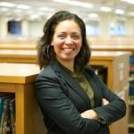
Living a Life of Leadership: Addressing Mental Health bordar la salud mental
Shirley Leyro, PhD, is an Assistant
Professor of Criminal Justice at
CUNY’s Borough of Manhattan
Community College. Dr. Leyro is
a certified Mental Health First Aid instructor, conducting trainings within CUNY as well as for local community organizations. A critical criminologist, her research focuses on deportation effects. She is also part of the campaign: #thisiswhataprofessorlookslike.

Slide 22
THE VALUE OF CRISIS INTERVENTION
Living a Life of Leadership: Addressing Mental Health-2
Mental health problems are common
Stigma is associated with mental health problems
Many people are not well informed
Professional help is not always on hand
People often do not know how to respond
People with mental health problems often do not seek help
Notes:
SL

Slide 23
IT IS ALL ONE BODY
Living a Life of Leadership: Addressing Mental Health-3
salud mental
Some folks tend to pay more attention to—and seek treatment for—physical ailments, but do not do the same for their mental wellbeing.
Yet, mental illnesses can be more disabling than many chronic physical illnesses. For example:
  Moderate depression is similar to the impact from relapsing multiple sclerosis, severe asthma, or chronic hepatitis B.
  Severe depression is comparable to the disability that comes with quadriplegia.
Notes:
SL

Slide 24
LATINAS AND MENTAL HEALTH
Living a Life of Leadership: Addressing Mental Health-4
CDC (2017):
Almost 1 in 2 (48%) Latinx high school girls have felt persistently sad or hopeless within the past year
More than 1 in 5 (22%) have seriously considered suicide within the past year
1 in 10 having made attempts.

Slide 25
LATINAS AND MENTAL HEALTH
Living a Life of Leadership: Addressing Mental Health-5
CDC (2017):
For queer Latina girls: 64% have felt persistently sad or hopeless
Nearly 1 in 2 (48%) have seriously considered suicide
1 in 4 have attempted suicide within the past year alone

Slide 26

Living a Life of Leadership:
Addressing Mental Health-6
MICRO-AGGRESSIONS:
Even well-intended people (teachers,
parents and peers) may say or do
things that are actually micro aggressions. They may not understand why the student gets up-set, angry, or avoidant by their attempts to “help.” It’s important for all of us to find better ways of interacting and communicating. We might be part of their problem. … So whose problem is their mental illness, really?
Notes:
YV

Slide 27
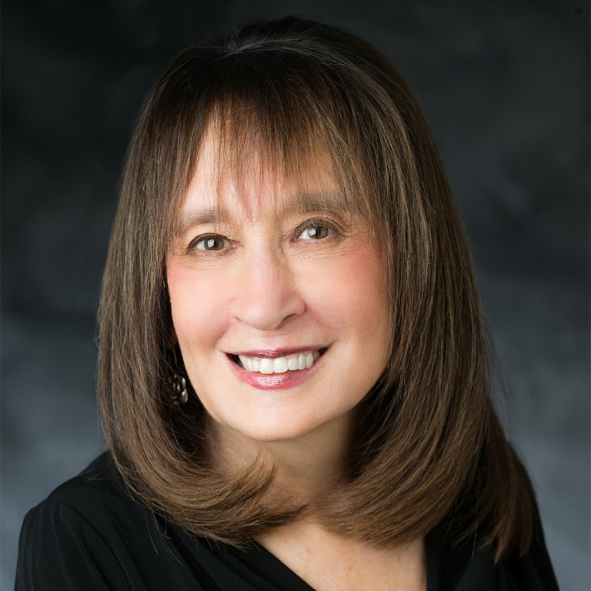
Introduction-4
La introducción-4
Vivian Bass has dedicated her
career as an advocate for people
people with disabilities world-
wide, including a presentation
at The World Congress on
Disabilities. She serves on RespectAbility’s executive committee; as Chair of the international JWI; and is CEO Emeritus of The Jewish Foundation for Group Homes.

Slide 28
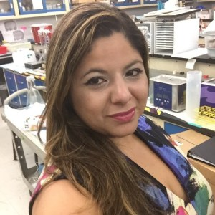
Living a Life of Leadership:
Self-Advocacy and Racial Bias
Kaliris Salas-Ramirez, PhD is an
adjunct Assistant Professor in
the Dept. of Psychology at
Hunter College, CUNY and an
Ass’t Medical Professor at CUNY’s
School of Medicine, where she runs research studies. Kaliris was recently awarded the Faculty Service Award for the CCNY Alumni Association. Kaliris is facilitating a discussion on Self-Advocacy and Racial Bias.

Slide 29
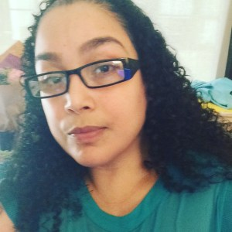
Living a Life of Leadership:
Self-Advocacy and Benefits
Crystal Vazquez, M.P.A., M.S.,
is the Associate Director of
AccessABILITY Services
and Women’s Resources
Services Specialist at Guttman
Community College. Crystal holds an M.P.A. and has extensive leadership experience
in higher education. Crystal is facilitating a discussion on Self-Advocacy and Housing and Benefits.

Slide 30
Living a Life of Leadership:
Self-Advocacy at Work
Self-Advocacy at Work
Fireside Chat with:
Clarissa Ramos-Cafarelli
Managing Director,
Global Head of Corporate Employee Relations
JP Morgan Chase
by:
Jessica Palacios
Vice President, Human Resources Business Partner
BlackRock

Slide 31
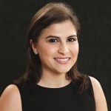
Living a Life of Leadership:
Self-Advocacy at Work-2
Jessica Palacios is an HR Business
Partner supporting the Aladdin
Product Group (APG) at BlackRock. As an HRBP, Jessica works closely with
executives to deliver a talent
strategy that aligns with business workforce
objectives. Jessica is on the volunteer board for the NY Chapter of the Association of Latino Professionals for America (ALPFA) and
the Hispanic Scholarship Fund (HSF).

Slide 32
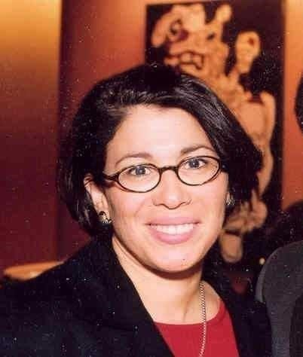
Living a Life of Leadership:
Self-Advocacy at Work-3
Clarissa Ramos-Cafarelli is a
Managing Director and Global Head
of Corporate Employee Relations
at JPMorgan Chase. In this role,
Clarissa leads a team of Employee
Relations professionals who support
employees, managers, and HR colleagues
in addressing sensitive workplace issues, HR Policies, and enabling initiatives. Clarissa is a member of the Hispanic Executive Forum.

Slide 33
Living a Life of Leadership:
Self-Advocacy at Work-4
IF … SI …
WHY? ¿POR QUÉ?
HOW? ¿CÓMO?
WHEN? ¿CUANDO?
WITH WHOM? ¿CON QUIEN?
WHAT … ¿QUÉ …
. . . can be shared by HR? . . .puede ser compartido por HR?

Slide 34
“Mi Libertad” lyrics-1
Lyrics by Catalina * Music by Monsieur Perine
Sung by Amanda Lopez, with Rebecca Muller, guitarist
Hoy me levanté en otro lugar
Today I woke up in another place
siento ansiedad, la necesidad de contar quién soy
I feel the eagerness, the desire to tell who I am
para no morir, para no olvidar
que la vida es un pequeño soplo de libertad
So as not to die, to not forget that life is a little breath of freedom
Hoy seré canción, volaré detrás de las coplas del trovador del campo y de la ciudad
Today I will be song, I will fly behind the verses of a juglar of the country and the city
Para no morir, To not die
Para no olvidar, To not forget
Que dolor existe y con amor lo voy a curar
that pain exists and I will heal it with love.
600 × 460

Slide 35
“Mi Libertad” lyrics-2 (Chorus)
Yo soy una aventurera,
I am an adventuress
Una madrugada en soledad,
a dawn in solitude
Soy una guitarra que canta al viento
I am a guitar that sings to the wind
Una cordillera que llega al mar
A mountain range that reaches the sea
Por mis venas corre fuego,
Through my veins runs fire
Mis ojos brillan en la oscuridad,
My eyes shine in the dark
Y mi voz hambrienta no tiene miedo
And my hungry voice has no fear
De cantar por siempre mi libertad!
of singing forever my freedom!
600 × 460

Slide 36
“Mi Libertad” lyrics-3
Hoy te llevaré hacia el interior
Today I will take you inside
De mis sentimientos al lado oculto del corazón
From my feelings to the hidden side of the heart
Para no morir, para no olvidar
Not to die, not to forget
Que somos del tiempo, polvo del viento, suerte fugaz
That we are of time, dust of the wind, fleeting luck
Yo soy una aventurera,
I am an adventuress
Una madrugada en soledad,
a dawn in solitude
Soy una guitarra que canta al viento
I am a guitar that sings to the wind
Una cordillera que llega al mar
A mountain range that arrives at sea
Por mis venas corre fuego,
Through my veins runs fire
Mis ojos brillan en la oscuridad,
My eyes shine in the dark
Y mi voz hambrienta no tiene miedo, no
And my hungry voice has no fear, no
De cantar por siempre mi libertad!
of singing forever my freedom!
600 × 460

Slide 37

JOIN US in DC on July 22nd!
Annual Capitol Hill Summit
600 × 460
MONDAY, JULY 22nd, Washington, D.C.: www.respectability.org/2018/11/2019-dc-summit/

Slide 38
Stay in touch with us!
Thank you, virtual attendees,
for your participation –
stay in touch with us!
Respectfully,
Debbie Fink
Director, Community Outreach & Impact
DebbieF@RespectAbility.org
11333 Woodglen Drive, Suite 102
Rockville, MD 20852
Office: (202) 517-6272
www.RespectAbility.org
© RespectAbility 2019

Slide 39
I AM ME Exercise Examples
I AM…
I AM Responsible.
I AM an Atheist
(or a religion).
I AM nervous.
I AM funny.
I AM Latina
(or other ethnicity).
I AM outspoken.
I AM happy.
I AM competitive
(or other sport or talent).
I AM loveable!
I HAVE…
I HAVE a pet
(name kind of pet).
I HAVE a disability.
I HAVE a supportive family.
I HAVE a home.
I HAVE brown eyes
(or other feature).
I HAVE one best friend.
I HAVE positivity.
I HAVE a big heart.
I BRING…
I BRING enthusiasm.
I BRING experience.
I BRING leadership.
I BRING love.
I BRING compassion.
I BRING humor.
I BRING creativity.
I BRING computer skills (or other skills).
I BRING strength.

Slide 40
I AM ME Exercise Examples
(cont.)
  I NEED…
  I NEED moral support.
  I NEED a sense of humor.
  I NEED a friend (or family member).
  I NEED to live a healthy lifestyle.
  I NEED to be patient.
  I NEED leadership skills.
  I NEED courage.
  I NEED writing skills. (or any other kind of skill).
  I NEED independence.
  I NEED love.
  I SEEK…
  I SEEK companionship.
  I SEEK employment.
  I SEEK independence.
  I SEEK positivity.
  I SEEK mentorship.
  I SEEK teamwork.
  I SEEK routine.
  I SEEK community.
  I SEEK happiness.
  I SEEK inclusion.

Slide 41
My Elevator Pitch Template
Hi! My name is ____________________________________________.
I am ___________________________________ and ____________________________________.
(Choose from the list of “I Am”) (Choose from the list of “I Am”)
I am looking to / for an opportunity to ___________________________________. (Circle One) (Choose from the list of “I Seek”)
I have ___________________________________ and __________________________________. (Choose from the list of “I Have”) (Choose from the list of “I Have”)
I bring __________________________________ and ___________________________________. (Choose from the list of “I Bring”) (Choose from the list of “I Bring”)
I welcome the chance to talk to you more about ____________________. (Choose from the list of “I Seek”)
I really think we could work together to __________________________________! (make the world a better, more inclusive place for all!)

Slide 42
Taking Charge of Your
Self-Advocacy
Small Group Sessions:
Pick 3 out of 5!
  Conversations with Carol (Carol Robles-Román, Esq.)
  Self-Advocacy and the Workplace (Clarissa Ramos-Cafarelli and Jessica Palacios)
  Self-Advocacy and Mental Health (Shirley Leyro, PhD)
  Self-Advocacy and Racial Bias (Kaliras Salas-Ramirez, PhD)
  Self-Advocacy and Housing and Benefits (Crystal Vazquez)
-------------------------------------------------------------------------
For Men-as-Allies (Facilitator: Kris Robinson)

Slide 43
Taking Action! Get Involved in NYC’s Civic Life!
NYC Needs YOU!!!
Want to register to vote?
Visit DemocracyNYC.org
Want to volunteer after today?
Visit Table / talk to Kris
Want to leave with Community Resources?
Materials are waiting for you at our Resource Table!

Slide 44

Taking Action! Get Involved in NYC’s Civic Life! 2
Navigating the System for People with Developmental Disabilities
YAI.org
Wed, May 22, 2019 - 10:00 am-12:00 pm (EST)

Slide 45
Closing (Meaningful) Fun!
Survey
Self-Expression Graffiti Wall-Webbing
Group Photo and
Farewell . . .
Stay in touch!

Slide 46
¡Gracias!-2
Thank you-!-2
We wish to express our profound thanks to our generous hosts
here at Guttman Community College!
-------------------------------
And to these organizations for their collaboration:
Hunter College Includenyc
Girls for Gender Equity Latin Women in Action
Loisaida Mano a mano
Masa Sinergia
Consulado General del Ecuador en New York
Consulado General del Mexico en New York
L.O.V.E. (Latinas On the Verge of Excellence) Mentoring
-------------------------------
And thank you to the New York Women’s Foundation and the
Coca-Cola Foundation for its direct support for this effort …
¡ Gracias!

Slide 47
Stay in touch with us! mantenerse en contacto con nosotros
Debbie Fink
Director, Community Outreach & Impact
and Women’s Disability Leadership, Inclusion & Advocacy Series
DebbieF@RespectAbility.org
11333 Woodglen Drive, Suite 102
Rockville, MD 20852
Office: (202) 517-6272
www.RespectAbility.org
© RespectAbility 2019

Slide 48
JOIN US in DC on July 22nd!
Annual Capitol Hill Summit 2
600 × 460
MONDAY, JULY 22nd, Washington, D.C.: www.respectability.org/2018/11/2019-dc-summit/

