Slide 1

RespectAbility
Women’s Disability Leadership, Inclusion & Advocacy Series Welcomes You to Our
Empowerment Training for Jewish Women with Disabilities
Bruchot Ha’ba’ot!
Welcome!
www.RespectAbility.org

Slide 2
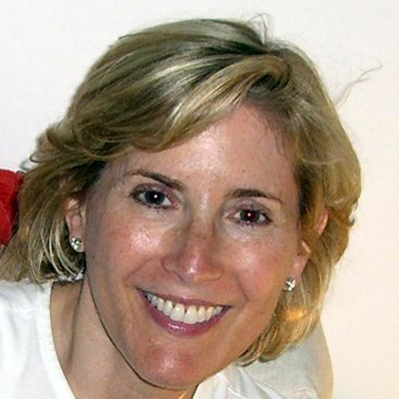
Welcoming 1
Shelley Cohen is the Secretary and Co-Founder of RespectAbility; and Founder and Director of The Jewish Inclusion Project, which develops and conducts Disability Inclusion Training Programs for Rabbinic Students and Jewish Leaders.
Picture: Shelley Cohen smiling at the camera.

Slide 3
Thank You! Todah Rabah!
We wish to express our profound thanks to our generous hosts
here at Marlene Meyerson JCC Manhattan
-------------------------------
And to these organizations for their collaboration (alphabetically):
Alliance for Girls New York Board of Rabbis
B’nai Jeshurun The Rabbinical Assembly
Camp Ramah ReelAbilities
The Jewish Inclusion Project Repair the World
Jewish Women International UJA Federation of New York
Limmud YACHAD & Yad HaChazakah
-------------------------------
And thank you to the New York Women’s Foundation and the
Coca-Cola Foundation for its direct support for this effort …
Todah Rabah – It takes a shtetl!

Slide 4
Welcoming 2
Today’s Goals:
To deliver tools of empowerment to:
take charge of
  your self-care &
  your self-advocacy
take action getting involved in NYC’s civic life (in the Jewish &/or general community); and,
If you wish, to leave this experience with new Jewish connections.

Slide 5
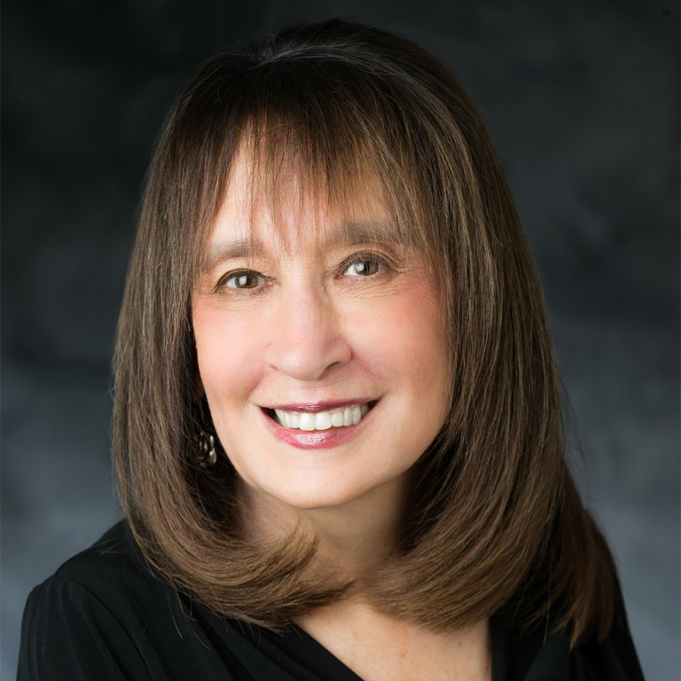
Welcoming 3
Vivian Bass has dedicated her
career as an advocate for
people with disabilities
worldwide. She is Chair of
Jewish Women International
(JWI)’s Board of Trustees;
serves on RespectAbility’s
executive committee; and is CEO Emeritus of The Jewish Foundation for Group Homes.
Picture: Vivian Bass smiling at the camera.

Slide 6
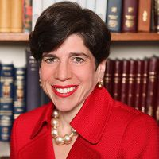
Welcoming 4
Julie Schonfeld is the
Chief Executive Officer of the
Rabbinical Assembly, the
international organization of
Conservative/Masorti rabbis.
Rabbi Schonfeld is the first
woman to lead a major rabbinical
organization and served on President Obama’s White House Council for Faith-Based and Neighborhood Partnerships.
Picture: Rabbi Julie Schonfeld smiling at the camera.

Slide 7
Henei Ma Tov
HENEI MA TOV
Led by Joanie Leeds
Lyric adapted by Debbie Fink, 2019
Hinei ma tov u’ma’naim Here is what’s good and what’s nice
Shevet achayot gam yachad Sitting as sisters together
Hinei ma tov u’manaim Here is what’s good and what’s nice
Shevet achayot gam yachad Sitting as sisters together
Hinei ma tov (hinei ma tov) Hinei ma tov (hinei ma tov)
Lai lai lai lai lai lai lai Lai lai lai lai lai lai lai
Hinei ma tov (hinei ma tov) Hinei ma tov (hinei ma tov)
Lai lai lai lai lai lai lai Lai lai lai lai lai lai lai

Slide 8
I Am Woman, lyrics 1
“I Am Woman”
By Helen Reddy and Ray Burton, 1972
Lyrics adapted by Debbie Fink, 2019
Sung by Joanie Leeds
I am woman hear me roar in numbers too big to ignore
And I know too much to go back and pretend
‘Cause I've heard it all before
And I've been down there on the floor
No one's ever gonna keep me down again
Oh yes, I am wise but it's wisdom born of pain
Yes, I've paid the price. But look how much I gained
If I have to, I can do many things
I am strong (Strong)
I am invincible (Invincible)
I am woman

Slide 9
I Am Woman, lyrics 2
You can bend but never break us
‘Cause it only serves to make us
More determined to achieve our final goal
And we come back even stronger
Not novices any longer
Cause you've deepened the conviction in our soul
Oh yes, we are wise
But it's wisdom born of pain
Yes, we’ve paid the price but look how much we gained
If we have to, we can do anything
We are strong (Strong)
We are invincible (Invincible)
We are woman

Slide 10
I Am Woman, lyrics 3
We are woman watch us grow
See us moving to and fro
As we spread our lovin' arms across the land
But we’re still an embryo
With a long long way to go
Until we make all ableists understand
Oh yes, we are wise
But its wisdom born of pain
Yes, we’ve paid the price
But look how much we gained
If we have to, we can face anything
We are strong (Strong!)
We are invincible (Invincible!)
We are Jewish (Jewish!)
We are woman!

Slide 11
Empowerment Training for
Jewish Women with Disabilities
Disclaimer
Please note that any views expressed by today’s speakers are solely in a personal capacity and are not intended to represent the views of their companies, organizations or RespectAbility; or to be taken as
legal or medical counsel.

Slide 12
PANEL: Living a Life of Leadership
LIVING A LIFE OF LEADERSHIP:
Owning One’s Disability
Moderator: Rabbi Julie Schonfeld
Panelists:
Ila Eckhoﬀ, CPA, BlackRock
Amy Rosenfeld, Marlene Meyerson JCC Manhattan
Dr. Danielle Sheypuk, Sexpert

Slide 13
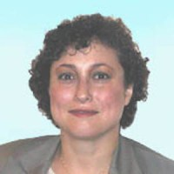
PANEL: Living a Life of Leadership 1
Ila Eckhoff, CPA serves on the Board of Directors of the Cerebral Palsy Foundation. As a Jewish woman with this lived disability, Ms. Eckhoff is a Managing Director at Blackrock and has over 30 years of financial services experience.
Picture: Ila Eckhoff, smiling at the camera.

Slide 14
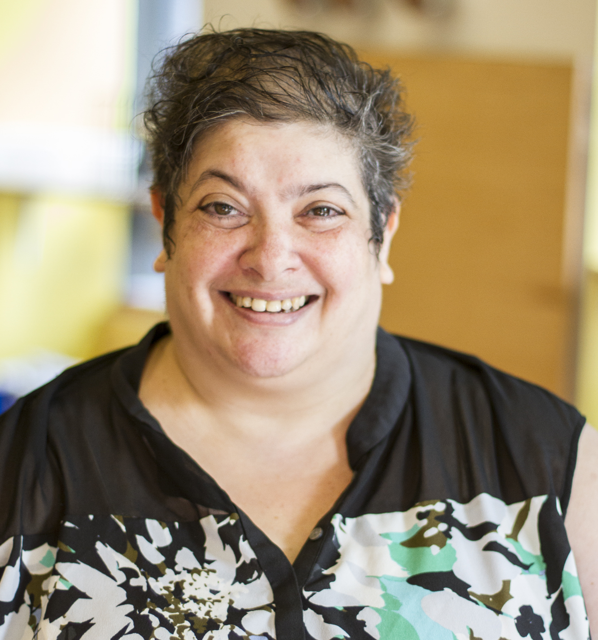
PANEL: Living a Life of Leadership 2
Amy Rosenfeld is a librarian at
Marlene Meyerson JCC
Manhattan’s Saul and Carole
Zabar Nursery School. Owning
her learning disability, Ms.
Rosenfeld earned her BA and
a master’s degree in special
education from Bank Street
Graduate School of Education.
Picture: Amy Rosenfeld smiling at the camera.

Slide 15
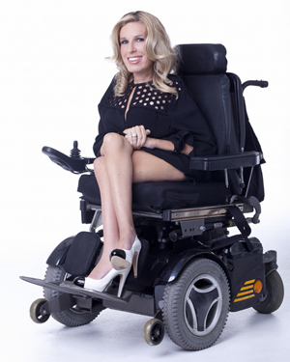
PANEL: Living a Life of Leadership 3
Dr. Danielle Sheypuk is a licensed clinical psychologist and widely regarded as a “sexpert” and leading commentator on the psychology of dating, relationships, and sexuality for people with disabilities.
Picture: Dr. Danielle Sheypuk sitting in her powerchair, smiling at the camera.

Slide 16

PANEL: Living a Life of Leadership 4
600 × 460
Picture: Enlarged Q & A in 3-D; Q in red, & in blue, A in green

Slide 17
LIFE DAY! Addressing Mental Health
LIFE DAY! CHOOSING LIFE:
Owning One’s Mental Health Condition
Presenter / Performer:
Rachel Kunstadt, Mental Health Advocate
&
Vocalist: Marissa Davis
Pianist: Anessa Marie

Slide 18
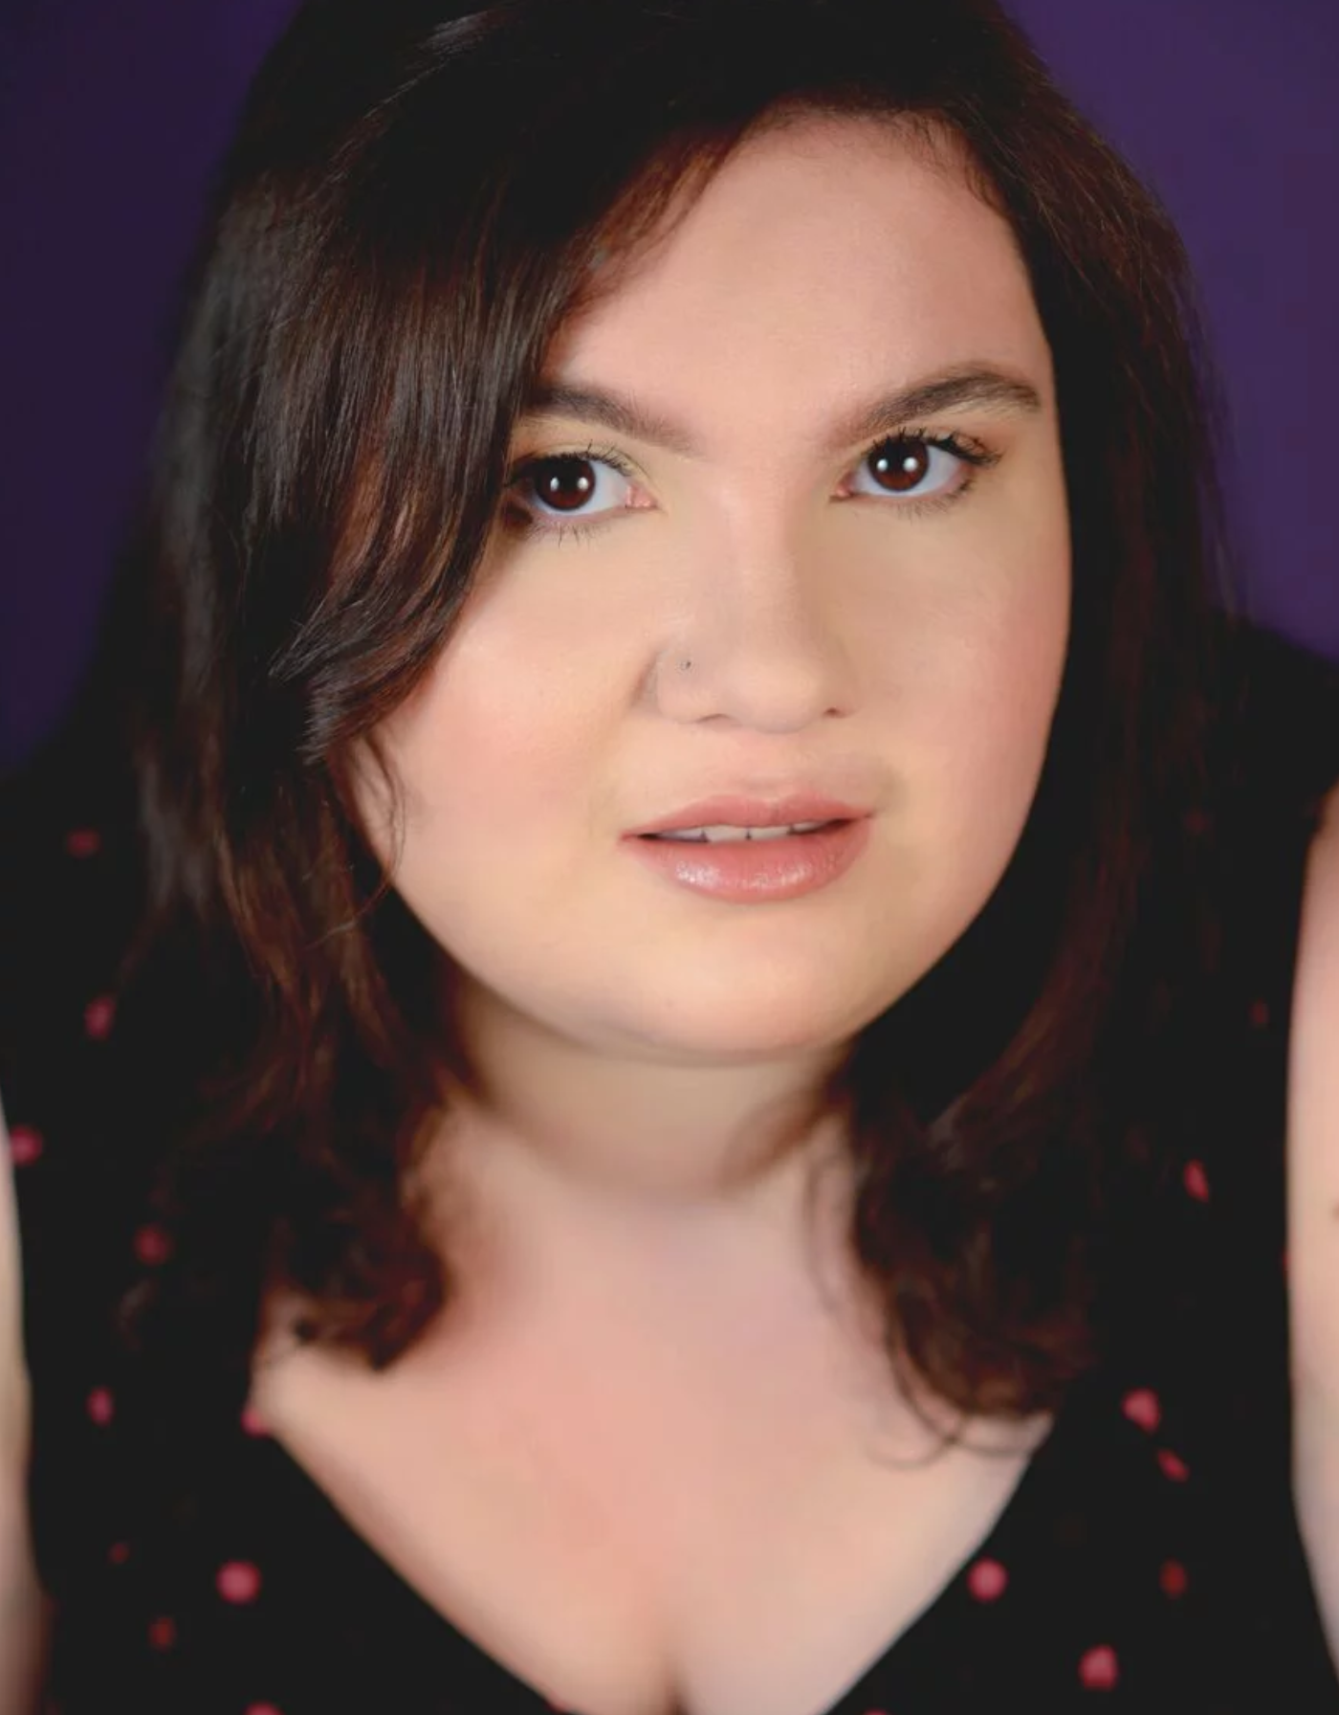
LIFE DAY! Addressing Mental Health 1
Rachel Kunstadt is a musical
theatre writer (librettist/lyricist),
playwright, theatre producer,
artistic director, Jewish non-profit professional, and mental health
advocate. Ms. Kunstadt is
passionate about using the arts for
mental health advocacy and is
currently writing a musical about her experience as a teenager with agoraphobia.
Picture: close up of Rachel Kunstadt looking at camera

Slide 19
Open the Door, Lyrics 1
“Open the Door”
Music by Heidi Joosten; lyrics by Rachel Kunstadt, 2018
Left shoe first,
Then the right.
Steady,
Tie the laces,
Not too tight.
They’re worn and forgiving,
Old strangers to my feet.
But they have to hit the ground,
To make their lives complete.
Open the door,
Open the door.
Get your coat,
Hat and gloves,
Slowly,
Brace the bitter,
Warm with love.
The wind chill is brutal,
But autumn felt the pain.
I didn’t know the leaves,
But winter still remains.
Open the door,
Open the door.

Slide 20
Open the Door, Lyrics 2
Take a breath,
Then let go.
Exhale,
Eyes stay open,
Start to grow.
Open the door,
Open the door . . .
© Joosten & Kunstadt 2018
Moses spent forty years in the desert,
And I spent six months in my room.
Almost dead, he said “choose life”
Before I died, I cried, “I choose life.”
I choose to live,
I will not hide:
From fear, from panic, from love.
I choose to live,
I choose to give,
I choose to try,
Today, I do not die.

Slide 21
Spinning Our Stories into
Self-Advocacy
LIVING A LIFE OF LEADERSHIP:
Spinning Our Stories into Self Advocacy
Interview with:
Lori Golden, Abilities Strategy Leader
Ernst & Young
Interview by:
Debbie Fink, Director of Community Outreach RespectAbility

Slide 22
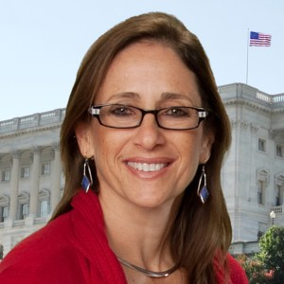
Spinning Our Stories into
Self-Advocacy 1
Debbie Fink is the Director of
Community Outreach and
Impact for RespectAbility, and
responsible for itsWomen’s
Disability Leadership,
Inclusion & Training Series.
As a former Hillel Director, and
having lived and studied in Israel for four years, she also oversees RespectAbility’s
Jewish Inclusion advocacy.
Picture: Debbie Fink smiling
at the camera.

Slide 23
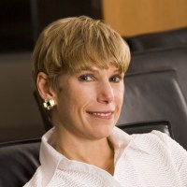
Spinning Our Stories into
Self-Advocacy 2
Lori Golden is the Abilities
Strategy Leader at Ernst & Young.
She has non-visible disabilities
and is the mother of young adults
with non-visible disabilities. She
helped build innovative programs
including EY’s Neurodiversity Centers
of Excellence and We Care, equipping colleagues to support colleagues struggling with mental illness or substance misuse.
Picture: Lori Golden, smiling at the camera.

Slide 24
Spinning Our Stories into
Self-Advocacy 3
IF …

Slide 25
Spinning Our Stories into
Self-Advocacy 4
HOW?

Slide 26
Spinning Our Stories into
Self-Advocacy 5
WHEN?

Slide 27
Spinning Our Stories into
Self-Advocacy 6
WITH WHOM?

Slide 28
Taking Charge of Your
Self-Care and Self-Advocacy
Small Group Sessions:
Pick 2 out of 3!
Take Charge of Your Sexuality
Co-facilitators: Dr. Danielle Sheypuk and Amy Rosenfield
Take Charge of Your Mental Health
Co-Facilitators: Rachel Kundstadt and Allison Kleinman
Take Charge of Your Self-Advocacy
Co-Facilitators: Ila Eckhoff and Lori Golden
-------------------------------------------------------------------------
For Men-as-Allies: Facilitator: Matan Koch

Slide 29
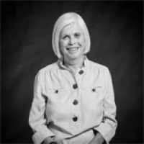
Taking Action! - Get Involved in NYC’s Civic Life!
Eve Landau Eve Landau is the
Director of the Joseph Stern
Center for Social Responsibility
at the Marlene Meyerson JCC
Manhattan. The Center's mission
is to engage people to become
more effective civic actors, through education, engagement and advocacy. Prior to her current role, Landau served as the Founding Executive Director of Ma’ayan.
Picture: Eve Landau, smiling at the camera.

Slide 30
Taking Action! Get Involved in NYC’s Civic Life! 2
NYC Needs YOU!!!
Want to make a difference TODAY?
Visit the Action-Oriented Activity Table
Want to register to vote?
Visit the Voter Registration Table
Want to volunteer after today?
Visit the Volunteer Opportunities Table
Want to leave today with Community Resources?
Visit the Community Resources Table

Slide 31
Thank You! Todah Rabah! 2
Once again, we wish to express our profound thanks to our generous hosts here at Marlene Meyerson JCC Manhattan
-------------------------------
And to these organizations for their collaboration (alphabetically):
Alliance for Girls New York Board of Rabbis
B’nai Jeshurun The Rabbinical Assembly
Camp Ramah ReelAbilities
The Jewish Inclusion Project Repair the World
Jewish Women International UJA Federation of New York
Limmud YACHAD & Yad HaChazakah
-------------------------------
And thank you to the New York Women’s Foundation and the
Coca-Cola Foundation for its direct support for this effort …
Todah Rabah – It takes a shtetl!

Slide 32
Thank You! Todah Rabah! 3
“It takes a shtetl!”
Thanks again to everyone for teaming together today!
PLANNING GROUP:
Vivian Bass
Howard Blas
Shelley Cohen
Gabby Einstein-Sim
Rachel Figurasmith
Rabbi Diana Gershon
Elise Hahn-Felix
Allison Kleinman
Rabbi Shuli Passow
Rabbi Joe Potasnik
Rebecca Schrag-Mayer
Sharon Shapiro
VOLUNTEERS:
Caryn Ben-Ami
Lucy Ford
Tobie Franklin
Andrea Goodman
Lisa Lewtan
Karen Mashmoor
Deborah Silver
RA / J STAFF:
Michelle Adams
Ariella Barker
Candace Cable
Debbie Fink
Jeff Fontaine
Rebecca Gross
Matan Koch
Tatiana Lee
Caitlin McInerney
Curtis Nesbit
Maddy Tasini
Matt Tempkin

Slide 33
Farewell and Shalom!
HENEI MA TOV
Lyric adapted by Debbie Fink, 2019
Hinei ma tov u’ma’naim Here is what’s good and what’s nice
Shevet achayot gam yachad Sitting as sisters together
Hinei ma tov u’manaim Here is what’s good and what’s nice
Shevet achayot gam yachad Sitting as sisters together
Hinei ma tov (hinei ma tov) Hinei ma tov (hinei ma tov)
Lai lai lai lai lai lai lai Lai lai lai lai lai lai lai
Hinei ma tov (hinei ma tov) Hinei ma tov (hinei ma tov)
Lai lai lai lai lai lai lai Lai lai lai lai lai lai lai
Chazak chazak v’nitchazek! Be strong, be strong, and
we will be strengthened … or empowered!

Slide 34
Stay in touch with us!
Debbie Fink
Director, Community Outreach & Impact
and theWomen’s Disability Leadership, Inclusion & Advocacy Training Series
DebbieF@RespectAbility.org
11333 Woodglen Drive, Suite 102
Rockville, MD 20852
Office: (202) 517-6272
www.RespectAbility.org
© RespectAbility 2019

