Slide 1
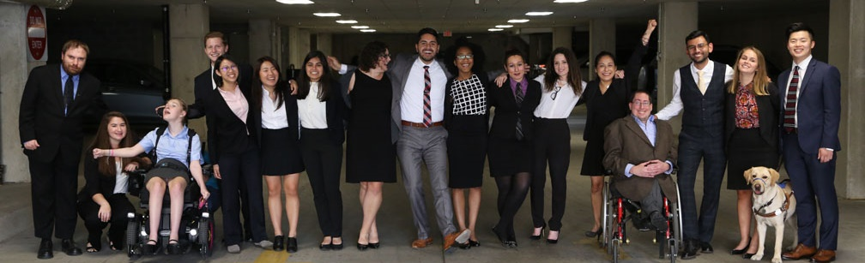

Welcome to Today’s Webinar!
Improving Education and Career Opportunities for Youth with Disabilities - Lessons from Maryland's PROMISE Grant
July 10th, 2019
Jade Gingerich, MD DOD

Slide 2

MD DOD
Maryland Department
Of Disabilities
Opportunity Access Choice

Slide 3
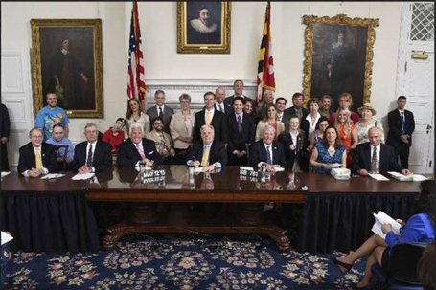

History/Mission
The Maryland Department of Disabilities was created in 2004
Only cabinet level department in the United States representing all disabilities
Charged with coordinating​ and improving the delivery of services to individuals with disabilities in Maryland
The Department is informed by the Maryland Commission on Disabilities
Changing Maryland for the better by promoting equality of opportunity, access, and choice for Marylanders with disabilities.

Slide 4
Employment Focus:
Progress in Maryland
MDOD collaborates with DLLR, DDA, DORS, MSDE, BHA and others around a number of employment related efforts. Some of which include:
Disability Employment Awareness Month Executive Order
Implementation of State Hiring Preference
MD Equal Employment Opportunity Act 2016
Maryland PROMISE
Employment First, NTACT, DEI, Workplace Learning and more!

Slide 5
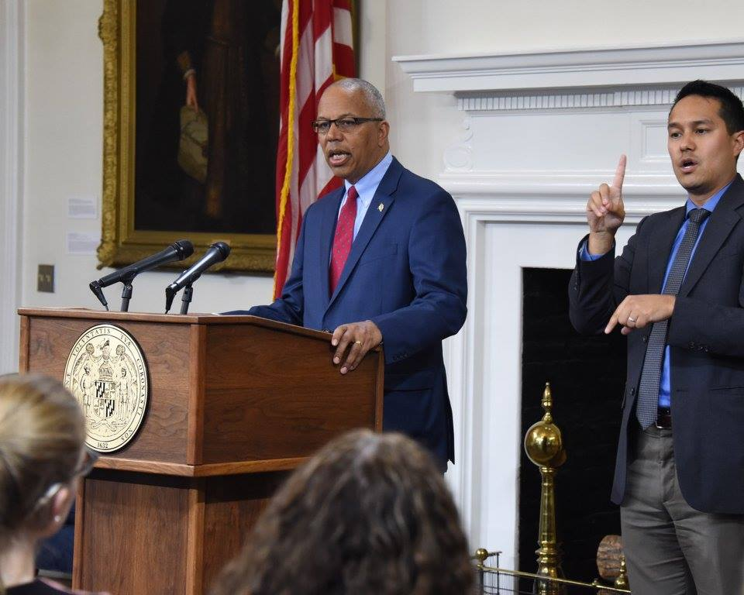
Disability Employment Awareness Month Executive Order
Governor Larry Hogan signed Executive Order 01.01.2017.23 declaring every October Disability Employment Awareness Month in Maryland. The month will be used to highlight the immense contributions made by workers with disabilities and the increased economic strength gained through an inclusive workforce.

Slide 6
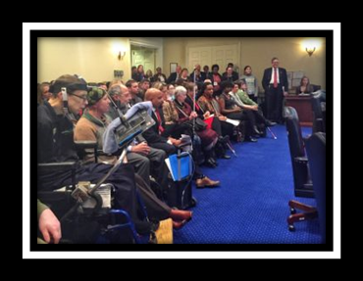
Maryland Equal Employment Opportunity Act
Passed in 2016
Eliminates the use in Maryland of federal 14c certificates (sub-minimum wage)
Phases out over several years up to 2020
Advisory group co-chaired by People on the Go and MDOD and including other key entities.

Slide 7

Implementation of State Hiring Preference
HB 928 passed during the 2016 MD Legislative session and requires all appointing authorities in the State Personnel Management System (SPMS) to apply a credit of five points on a selection test for an applicant with a disability, as defined by the federal Americans with Disabilities Act.
For more information contact Denise Carter McCormick at
denise.carter-mccormick@maryland.gov or visit
http://dbm.maryland.gov/jobseekers/Pages/Disabilities.aspx

Slide 8



Maryland PROMISE Program-It Pays to Work

Slide 9
Purpose
Six grants were awarded in FY2013 for 5 years to implement Model Demonstration Projects (MDPs) to promote positive outcomes for children who receive SSI and their families.
PROMISE aims to encourage new ways of providing support and to build an evidence base on the effectiveness of promising interventions related to the transition from school to postsecondary education and employment.
Notes:
The Consolidated Appropriations Act, 2012 (P.L. 112-74) provided funds for activities to improve the outcomes of child SSI recipients and their families.
The 6 Model Demonstration Projects received a total of approximately $229 million for 5 years.

Slide 10
The Context FOR PROMISE
Research from the Center on Transition to Employment for Youth with Disabilities (Sima, et al., in press; Wehman, et al., in press; Gold, et al., 2013) and other research on the interventions in isolation ie benefits counseling.
National Youth Transition Demonstration project (Fraker, et al., in press)
Maryland Seamless Transition Collaborative (Luecking & Luecking)

Slide 11



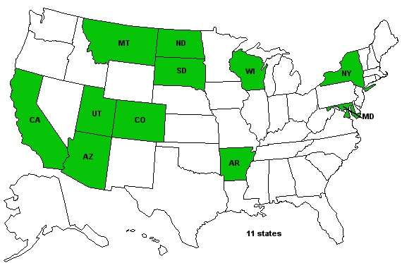




PROMISE SITES
PROMISE Sites

Slide 12
Research Design
Target Population: Youth, 14-16 years of age, enrolled in the SSI program through the Social Security Administration and their families
Six grant awardees were required to recruit 13,172 participants for the study (all MDPs were required to recruit 2,000 participants , except CA – 3,172 participants); recruitment ended on 4.30.16 and all MDPs met or exceeded their enrollment targets (total enrollment- 13,444/102%)
Experimental Research Design: RCT used to test interventions to predict positive outcomes for SSI eligible youth. The control group continues to receive typical services available to them in their state.

Slide 13
Federal Partners
PROMISE
U.S. Department of Education
U.S. Social Security Administration
U.S. Health & Human Services
Association for University Centers on Disabilities
(National Technical Assistance Center)
Mathematica Policy Research
(National Evaluator)
U.S. Department of Labor
PROMISE Model Demonstration Projects (MDPs)

Slide 14
PROMISE MDP Core Features
Develop partnerships with multiple state agencies and organizations
Provide services and supports which include:
  case management
  benefits counseling and financial capability services
  career and work-based learning experiences, to include paid employment in integrated settings
  parent training and information
Participant outreach and recruitment
Provide technical assistance and training to include professional development for stakeholders

Slide 15
PROBLEM
A significant number of child SSI recipients do not become independent, self-sufficient tax paying members of the community as adults.
Families of many SSI recipients are not self-sufficient.
Child SSI recipients become adult SSI recipients due to
  Low educational attainment and employment rates.
  Low postsecondary, vocational rehabilitation or other enrollment rates.
Rangarajan, Fraker, Honeycutt, Mamun, Martinez, O’Day, & Wittenburg. (2009). The Social Security Administration’s Youth Transition Demonstration Projects: Evaluation Design Report.; Davies, Rupp, & Wittenburg. (2009). A life-cycle perspective on the transition to adulthood among children receiving supplemental security income payments.; Fraker, & Rangarajan. (2009). The social security administration’s youth transition demonstration projects.; Loprest, & Wittenburg. (2005). Choices, Challenges, and Options: Child SSI Recipients Preparing for the Transition to Adult Life. The Urban Institute.

Slide 16
MD PROMISE Intervention
COMMUNITY-BASED intervention
NOT school-based;
Making the case for WORK;
Coordinated, Assertive Case Management

Slide 17
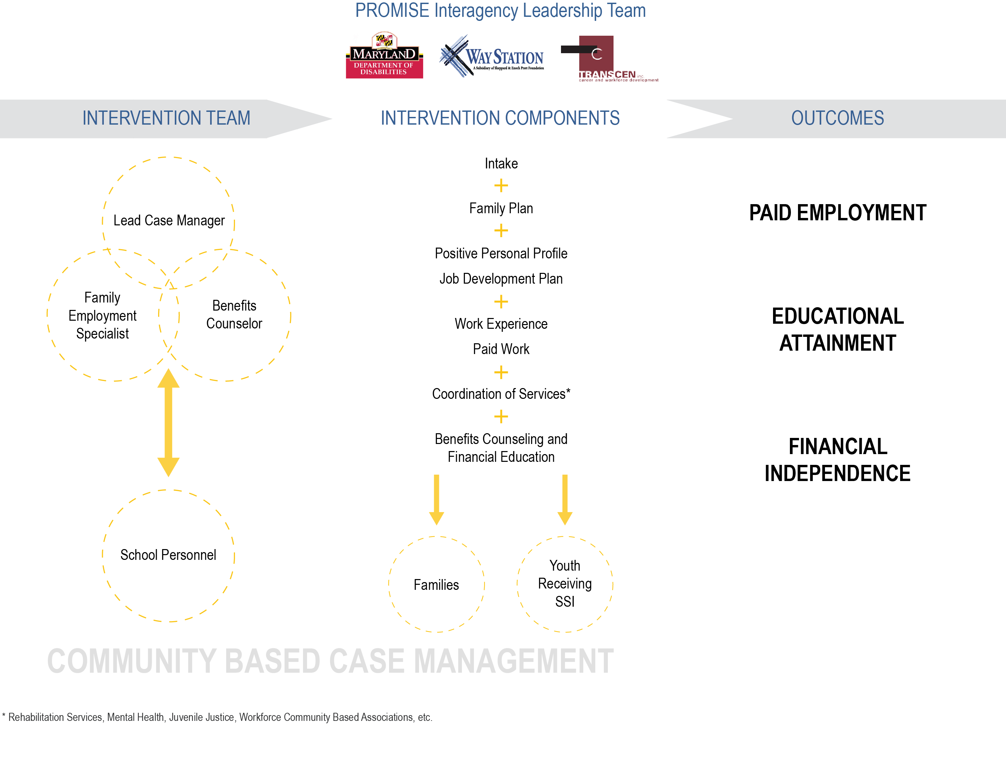
Intervention Components

Slide 18
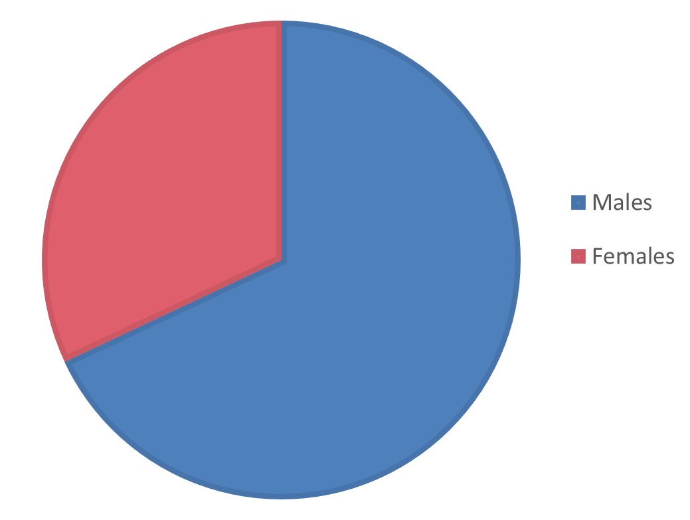
MD PROMISE Demographics
N=997
32 % Females
68% Males
32%
68%

Slide 19
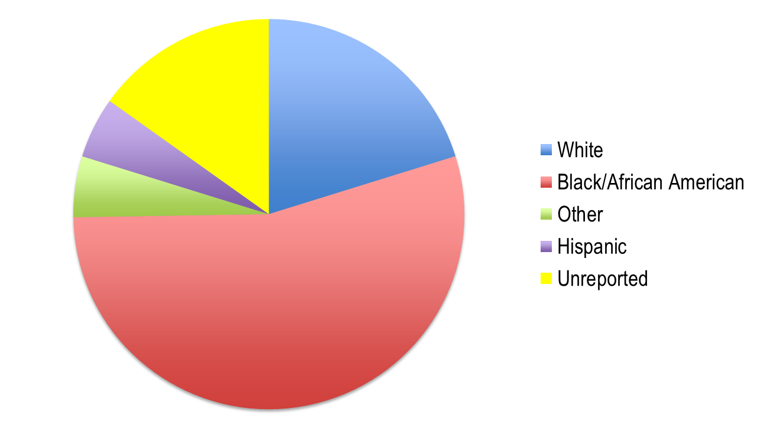
MD PROMISE Demographics 2
N=997
20% White
54 % Black
5% Other
5% Hispanic
15% Unreported
15%
20%
5%
5%
54%

Slide 20
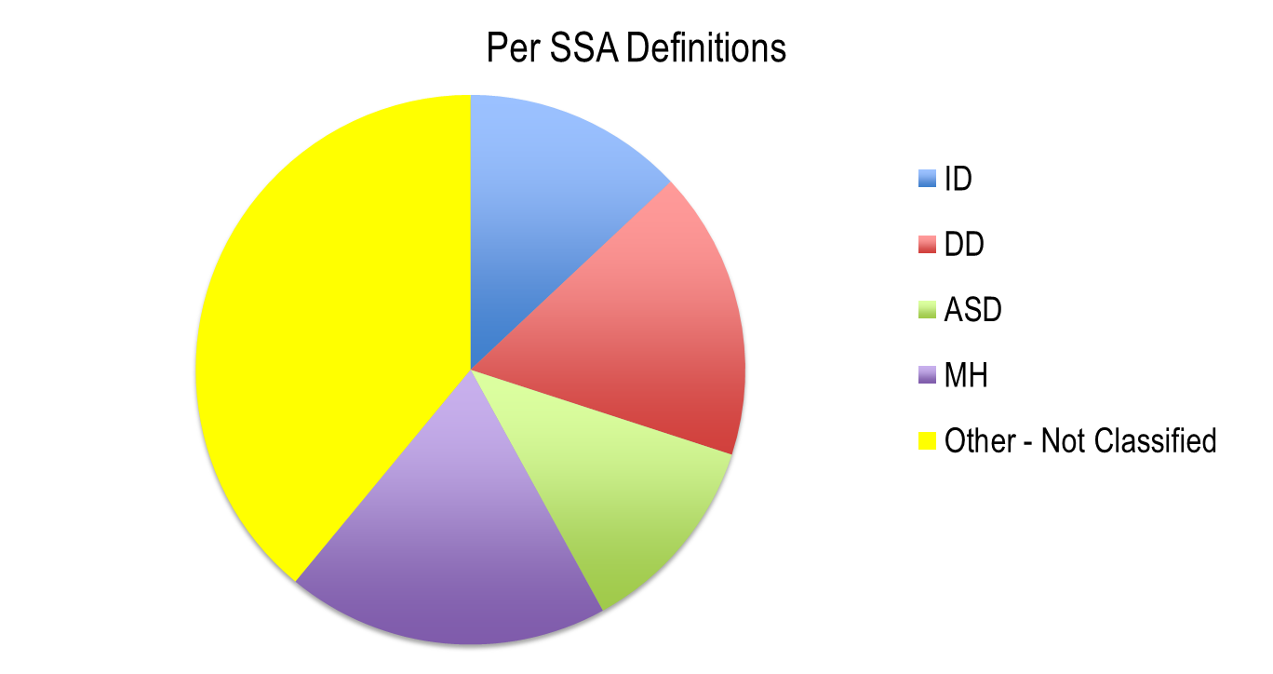
MD PROMISE Demographics 3
N=997
13% ID
17% DD
12% ASD
19% MH
39% Other
13%
39%
17%
12%
e.g., LD, ADHD, ADD
19%

Slide 21
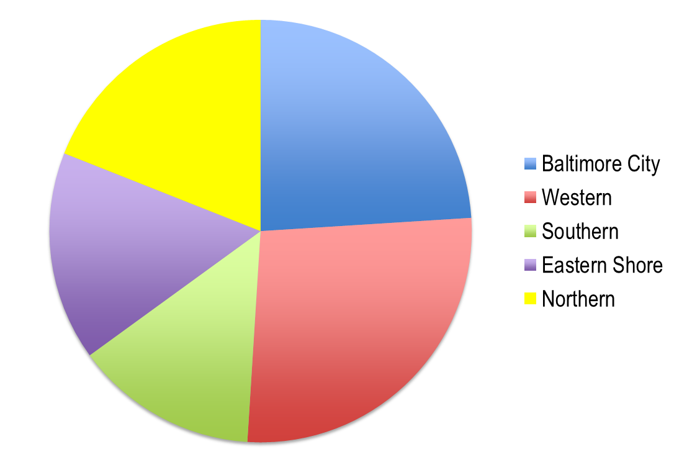
MD PROMISE Demographics 4
N=997
55% Urban 45% Rural
23% Baltimore City
26% Western
16% Southern
15% Eastern Shore
19% Northern
19%
23%
15%
26%
16%

Slide 22
Core Interventions: % of 997
Coordinated Case Management/Family Plan 94%
Positive Personal Profile 87%
Individual Job Development Plan 87%
Work Experience 81%
Paid Work 73%
Benefits Counseling 81%
Financial Education 52%

Slide 23
MD PROMISE Key Features
Project Interventions:
  Assertive case management and Family Plan
  Career and work based experiences, at least one paid job for youth
  Benefits counseling and Financial education
Intervention Teams:
  Case Manager
  Family Employment Specialist
  Benefit Counselor
  School Personnel

Slide 24
Coordinated Case Management
State Partners
Local Partners
MSDE
DHS
DJS
DLLR
DDA
BHA
Medicaid
Schools
DORS
DDS offices
AJCs
Other Community services and resources

Slide 25
MD PROMISE Work Strategies
Numeric targets for employment specialists
  10 employer contacts per week
Monitor job development activities
  Technical assistance to support staff and youth
Partner with school and DORS personnel
Tools: asset based youth profile (e.g., Positive Personal Profile) and Job Development Plan
Notes:
Numeric goals for staff contacts with employers and placements of participants in unpaid and paid work experiences were tracked and monitored by supervisors and leadership

Slide 26
MD PROMISE Success
Work Experience Participation | # N=997 | %
at least 1 work experience (paid or unpaid) | 814 | 82%
at least 1 unpaid work experience | 806 | 81%
more than 1 unpaid work experience | 417 | 42%
at least 1 paid work experience | 724 | 73%
at least 1 unpaid and 1 paid work experience | 716 | 72%
More than 1 paid work experience | 710 | 71%

Slide 27
Benefits Counseling
Allows youth to learn early that they are always better off working
  Important because many will not qualify for benefits as adults at age 18 redetermination
SSI potentially keeps families trapped in poverty
  Engaging Pre Employment Transition Services for work and planning for the future will have NO IMPACT on the youth’s eligibility for SSI
Benefits will not automatically be lost when a youth or even an adult begins to work

Slide 28
Addressing Challenges
Challenge
Solution
Engagement in PROMISE services
Linkages to adult services
Staff capacity RE employment services
Community Oversight and Supervision
Specialized Case Managers/Streamline paperwork
Transition Tracker Tool
Intensive Field Based TA & training
Performance management tools & Data reports

Slide 29
Continuous Quality Improvement
Fidelity Report
Intensive Field Based TA
Individual Weekly Action Tracker
Performance Matrix
MD PROMISE = data informed & driven

Slide 30
Lessons Learned/Implications
Need to expand principle that all individuals with disabilities can work, with the right supports and services to social services and beyond.
Need to promote the importance and value of participation in IEPs to families/social services staff.
Need to expand policy work to include a focus on those not eligible for VR particularly those with non-obvious disabilities and in poverty.

Slide 31
Engagement
Engagement can be successful with intensive strategic outreach, while highly transient, text messages and community presence work.
Employment capacity lacking in the broader system
Staff wages don’t align with skills needed
Serving youth is different then serving adults

Slide 32
Poverty and Disability
  Many youth on child SSI will not meet adult criteria for SSI, and won’t be eligible for adult disability services, so America’s Job Centers need to improve their knowledge/capacity of serving individuals with disabilities
  Staff working with individuals in poverty particularly on SSI eligibility need to better understand how all individuals with disabilities can work with the right supports, and without jeopardizing critical benefits.
  Knowledge of things such as Trauma Informed Care and Motivational Interviewing are critical
  Many youth with non obvious disabilities, with or without IEPs are unwilling to self identify.

Slide 33
Systems Changes
  All community based/how to supervise staff in the field/ What gets measured gets done: UMD Webinars
  Post School connections need improved information sharing between schools and agencies: piloting: MSDE/UMD Tracker
  DHS/Social Services: Allegany Co and link to 2 GEN
  Parents Place: Training/need to make outreach/engagement of youth and families with non obvious disabilities less academic/overwhelming.

Slide 34
Gaps
Need increased access and availability of work incentives counseling and look at how to refine it to better meet the needs of this population.
Need to increase capacity at America’s Job Centers
Schools are require to plan and provide information to parents, they do not/can’t assist with applications.
Need more Financial Education/ABLE linkages
Increased assertive community services and staff in the field
Funding gaps include drivers education, fees to obtain IDs (required to apply for jobs), and transportation.
Schools must have parent consent to invite/share info with DORS, DDA etc.

Slide 35

https://mdtransitions.org/
For More Information:
Jade Gingerich
MD PROMISE Project Director
Jade.gingerich@maryland.gov
University of Maryland Center for Transition and Career Innovation https://education.umd.edu/research/centers/ctci
The contents of this brief were developed under a grant from the Department of Education (cooperative agreement #H418P130005). However, those contents do not necessarily represent the policy of the Department of Education, and you should not assume endorsement by the Federal government.

Slide 36

Please Join Us for our Next Webinar!
Please Join Us For Our Next Webinar
Leaders Advancing Opportunities for People with Disabilities: Reflections on Best Practices
https://secure.confertel.net/tsRegisterD.asp?course=6269080
Date: Wednesday, July 31st
Time: 1:30pm EST
Speakers: Jennifer Laszlo Mizrahi, President and CEO, RespectAbility / Philip Kahn-Pauli - Policy Director, RespectAbility
Topic: RespectAbility’s staff will talk about integrated mission of fighting stigmas, advancing opportunities and elevating young leaders with disabilities. Please join us to learn about simple, effective strategies that local leaders can adapt to their work.

Slide 37
THANK YOU!
THANK YOU!
Jennifer Laszlo Mizrahi
www.RespectAbility.org
Cell: (202) 365-0787
JenniferM@RespectAbility.org

