Slide 1
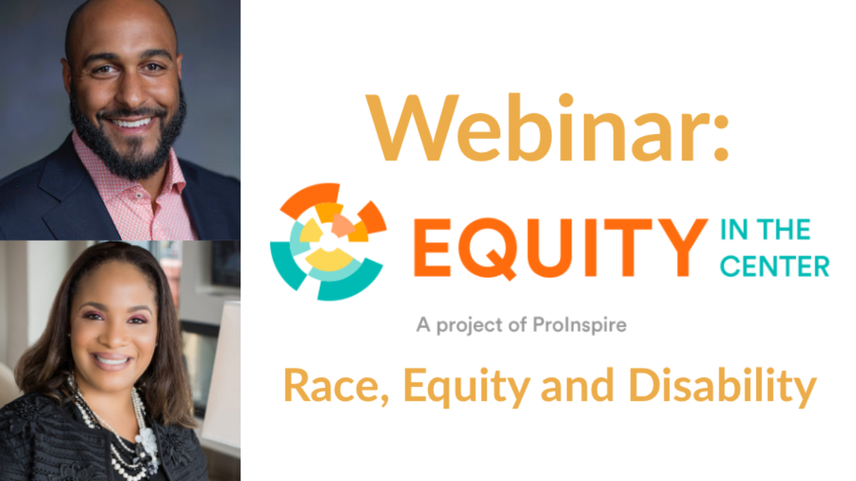


IMPROVING EDUCATIONAL SUCCESS FOR STUDENTS WITH DISABILITIES LUMINA FOUNDATION
Jennifer Laszlo Mizrahi, President, RespectAbility
Kerrien Suarez, Executive Director, Equity in the Center
Andrew Plumley, Associate Director, Equity in the Center

Slide 2
RespectAbility’s Commitment to Equity
RespectAbility knows we are stronger and better when we are accepting, welcoming and respectful of all people. Since day one, RespectAbility had board-approved intentional diversity and equality policies. We are a “Nothing Without Us” organization. RespectAbility provides equal employment opportunities (EEO) to all employees and applicants for employment without regard to race, color, religion, gender, sexual orientation, gender identity or expression, national origin, age, disability, veteran status or genetics. In addition to federal law requirements, RespectAbility complies with applicable state and local laws governing nondiscrimination in employment. This policy applies to all terms and conditions of employment, including recruiting, hiring, placement, promotion, termination, layoff, recall, transfer, leaves of absence, compensation and training.
RespectAbility has a commitment to individual and organizational efforts to build respect, dignity, fairness, compassion, equality and self-esteem in order to create an environment that is inclusive of all throughout our organization and the disability community. We acknowledge and honor the fundamental value and dignity of all individuals. We pledge ourselves to creating and maintaining an environment that respects diverse traditions, heritages and experiences.
People with disabilities make up the largest minority group in the United States. In fact, one-in-five Americans has a disability, and this includes people from all genders, races, sexual orientations and other minorities. In addition, due to accident, aging or illness, disability can impact anyone at any time. RespectAbility believes all people with developmental, physical, sensory, mental health and other differences deserve to be able to achieve their hopes and dreams, just like anyone else.
Our office is located on the ground floor and has electronic doors and accessible restrooms. Both our building entrance and the underground parking area are accessible as well. All office doors are up-to-date with ADA rules and we purposefully keep wide aisles in all open areas. We have private offices for people with sensory issues and/or service animals. We provide appropriate software and other accommodations for people with visual differences. When needed, we pay for personal care assistants for members of our team.

Slide 3
Our Data
Organization Level | People of Color* | Disability** | LGBTQIA+***
Board | 30% | 47% | 10%
Staff | 33% | 56% | 33%
Paid Fellows | 90% | 100% | 40%
Stipend Fellows | 38% | 71% | 21%
*Compared to 17% of nonprofits organizations and 22% of foundations (Source: Community Wealth Partners)
**Compared to national data of one-in-four adults having a disability (Source: CDC)
***Compared to 4.5% of US population (Source: Williams Institute at UCLA School of Law)

Slide 4
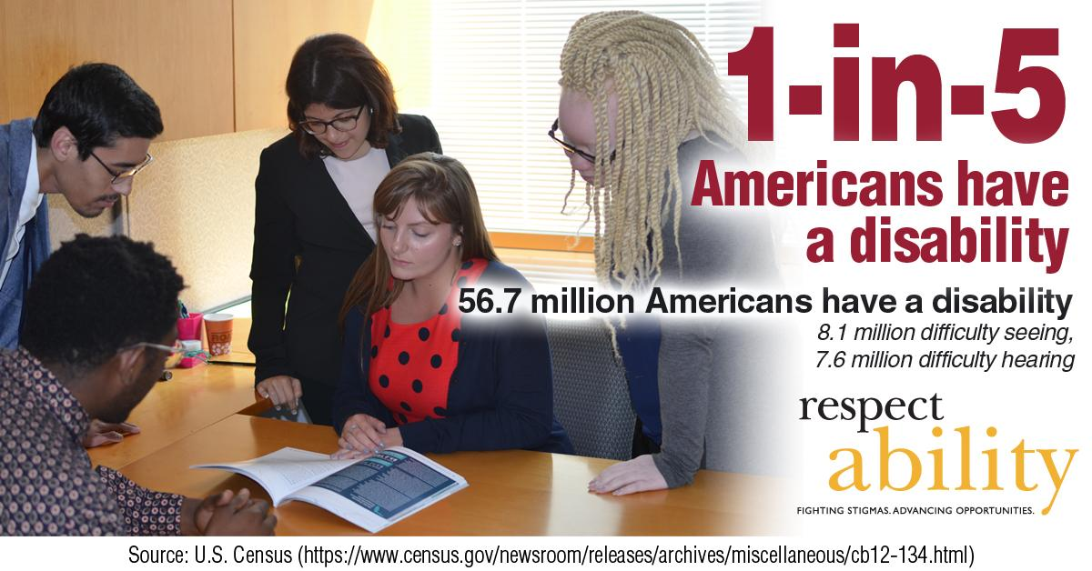
1 in 5 Americans

Slide 5
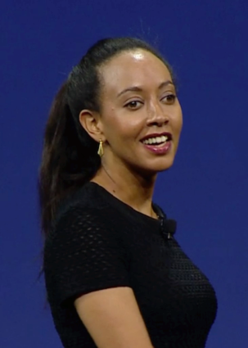




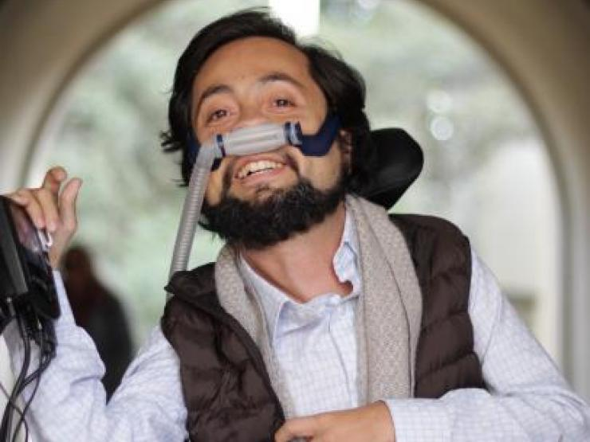
People with disabilities can be some of the MOST talented people
Haben Girma:
Deaf and Blind
Harriet Tubman: Seizures
Clarence Page: ADHD
Gina Rodriguez:
Anxiety
Maya Angelou: Selective Mutism
Frida Kahlo: Polio
Daymond John: Dyslexia & Hearing Impaired
Victor Pañeda, Activist: Spinal muscular atrophy
Harry Belafonte: Dyslexia

Slide 6
Disability Impacts Everyone
Disability impacts people of all races, gender identities and orientations, faiths and backgrounds.
African Americans with Disabilities
Latinx and Hispanics with Disabilities
Women with Disabilities
LGBTQ Individuals with Disabilities

Slide 7
Intersectionality, education, and disability stats
Intersectionality, Education and Disability Data
Six million students with diagnosed disabilities are enrolled in America’s public schools.
There are 1,107,606 African American/black students with disabilities enrolled in America’s public schools
Likewise, there are 1,531,699 Latino students with disabilities in our schools today.
Children with disabilities and students of color are disproportionately suspended and expelled, which can be a contributing factor to the school-to-prison pipeline. Many student of color and/or ESL learners do not get a needed disability diagnosis or get the wrong one.
Only 57 percent of black students with disabilities graduate high school compared to 76 percent of black students without disabilities.
Only 59 percent of Latino students with disabilities graduate high school, compared to 79 percent of Latino students without a disability.

Slide 8

Latinx Americans with Disabilities
RespectAbility has created a Spanish language toolkit for Spanish-speaking caretakers of children with disabilities, particularly girls. The toolkit was featured on CNN en Espanol.
Our Women’s Disability Leadership initiative has focused a specialized focus in giving Latina women the training and access to resources to become effective self-advocates themselves, ensuring an inclusive disability movement.

Slide 9
Intersectionality
In a 2017 study done by Cornell, people with disabilities were nearly 44 percent more likely to be arrested by age 28. Black men with disabilities in the study were at a particularly high risk: 55 percent had been arrested by age 28.
Additionally, 750,000+ people with disabilities are behind bars in America today.
RespectAbility authored a policy report on Criminal Justice and Disability with detail on these statistics and more.

Slide 10
Employment by Disability Status and Race/Ethnicity

Slide 11
Awake to Woke to Work:
Building a Race Equity Culture
Kerrien Suarez, Andrew Plumley

Slide 12
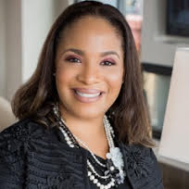
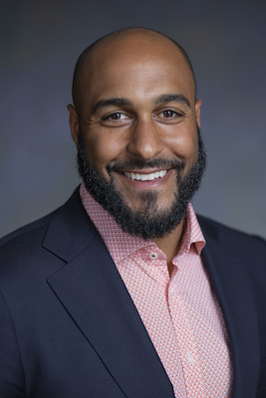
Webinar Facilitators
Kerrien is the Executive Director of Equity in the Center, a new initiative launched through ProInspire. With over 19 years of management and consulting experience, Kerrien has supported executive and leadership teams in bold decision making to solve strategic and operational challenges. As an executive coach, Kerrien supports senior leaders and social entrepreneurs in clarifying a vision for measurable social impact and building the leadership and management capacity to achieve it. In addition to her support of leaders in education reform, she previously coached grantees of the Annie E. Casey, Wells Fargo and Robert Wood Johnson foundations on issues ranging from organizational capacity and sustainability to place-based collective impact.
Kerrien Suarez
Executive Director
Equity in the Center
Andrew Plumley
Associate Director
Equity in the Center
Andrew Plumley is experienced in sustainability, strategy, and diversity, equity, and inclusion consulting in both the social and private sectors. He has also worked in education, where he’s advised on diversity and inclusion strategy at higher ed. institutions, as well as provided access and success programming for Pell eligible, students of color. In his role as Senior Program Manager, Andrew manages the launch of Equity in the Center, which is a field wide initiative to influence leaders to shift mindsets, practices, and systems to create a more diverse and equitable social sector.

Slide 13
About Equity in the Center
Equity in the Center works to shift mindsets, practices, and systems within the social sector to increase racial equity. We envision a future where nonprofit and philanthropic organizations advance race equity internally while centering it in their work externally.
Equity in the Center’s goals are:
Nonprofit and philanthropic organizations adopt a Race Equity Culture focused on proactive counteraction of social inequities
Organizations define, implement, and advance race equity internally while advocating for it in their work externally
Race Equity is centered as a core goal of social impact across the sector

Slide 14
Webinar Results
Participants will be introduced to research and resources Equity in the Center provides to support leaders and organizations in advancing race equity.
Participants will understand key research findings from the “Awake to Woke to Work: Building a Race Equity Culture” publication, and how to apply the Race Equity Cycle framework in their own work.
Participants will learn about management and operational levers that can shift organizational culture towards race equity.

Slide 15
Terms and Definitions
RACE EQUITY: The condition where one’s race identity has no influence on how one fares in society. Race equity is one part of race justice and must be addressed at the root causes and not just the manifestations. This includes the elimination of policies, practices, attitudes, and cultural messages that reinforce differential outcomes by race.
RACE EQUITY LENS: The process of paying disciplined attention to race and ethnicity while analyzing problems, looking for solutions, and defining success. A race equity lens critiques a “color blind” approach, arguing that color blindness perpetuates systems of disadvantage in that it prevents structural racism from being acknowledged. Application of a race equity lens helps to illuminate disparate outcomes, patterns of disadvantage, and root cause.
RACE EQUITY CULTURE: A culture focused on proactive counteraction of social and race inequities inside and outside of an organization.

Slide 16
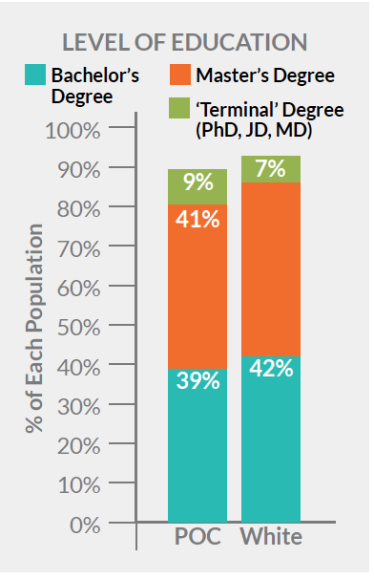
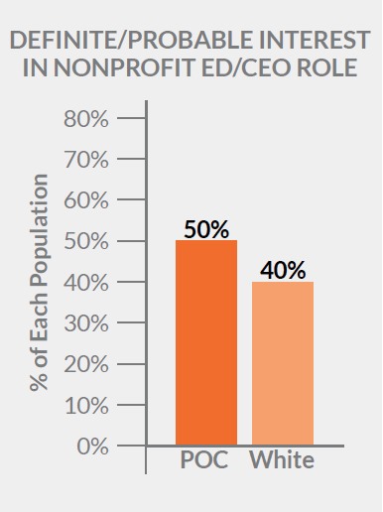
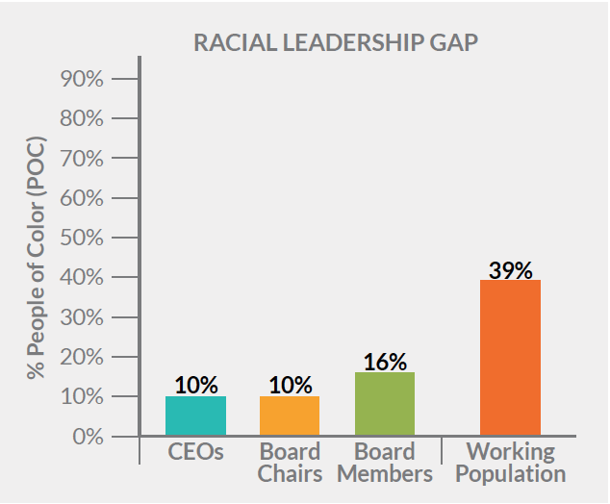
Building A Race Equity Culture in the Social Sector
SOCIAL SECTOR ORGANIZATIONS NEED A RACE EQUITY CULTURE TO ADDRESS
THE RACIAL LEADERSHIP GAP
Creating a race equity culture and closing the racial leadership gap will
help organizations succeed at their missions.
Sources: Leading with Intent: 2017 National Index of Nonprofit Board Practices, BoardSource; Pew Research Center
Source: Race to Lead: Confronting the Nonprofit Racial Leadership Gap, Building Movement Project, 2017
Source: Race to Lead: Confronting the Nonprofit Racial Leadership Gap, Building Movement Project, 2017

Slide 17
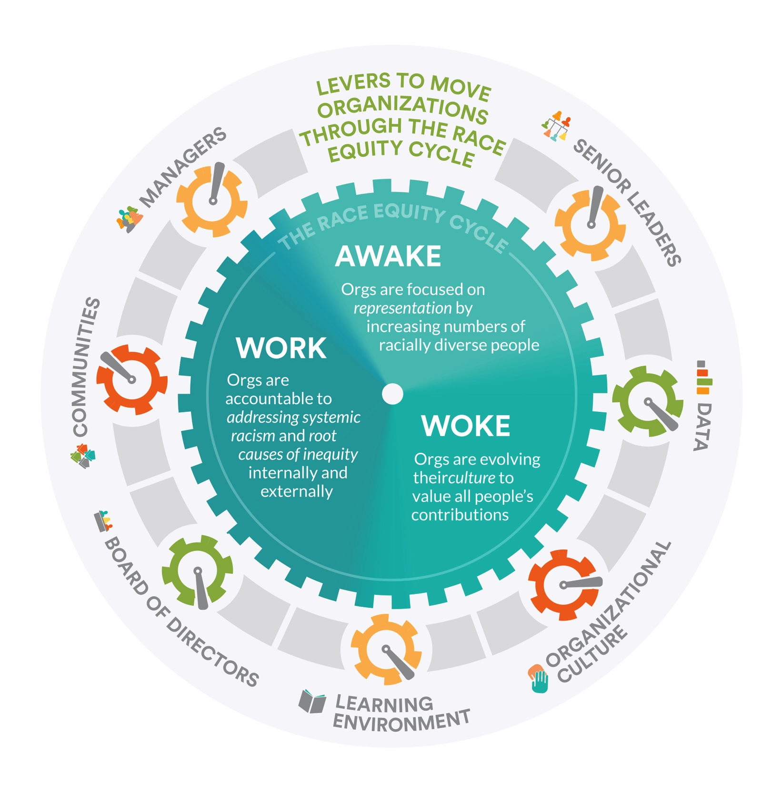
The Race Equity Cycle Diagram

Slide 18







The Role of Levers in Building a Race Equity Culture
Senior Leaders
Individuals in a formal leadership role
Learning Environment
Investment in staff capacity
Managers
Individuals who oversee operations of teams
Data
Metrics to drive improvements and focus
Board Of Directors
Governing body of an organization
Organizational Culture
Shared values, assumptions, and beliefs
Community
Populations served by the organization

Slide 19
Agenda
Senior Leaders Lever
Managers Lever
1
5
2
Board of Directors Lever
6
Learning Environment Lever
Organizational Culture Lever
Data Lever
3
7
4
Community Lever
Questions?
8

Slide 20
Senior Leaders Lever
AWAKE
WOKE
WORK
Personal Beliefs & Behaviors
Policies & Processes
Data
Believe that diverse representation is important, but may feel uncomfortable discussing issues tied to race
Place responsibility for creating and enforcing DEI policies within HR department
Have started to gather data about race disparities in the populations they serve

Slide 21
Senior Leaders Lever (2)
AWAKE
WOKE
WORK
Personal Beliefs
& Behaviors
Policies & Processes
Data
Prioritize an environment where different lived experiences and backgrounds are valued and seen as assets to teams and to the organization
Evaluate hiring and advancement requirements that often ignore system inequities and reinforce white dominant culture, such as graduate degrees and internship experience
Disaggregate internal staffing data to identify areas where race disparities exist, such as compensation and promotion

Slide 22
Senior Leaders Lever (3)
AWAKE
WOKE
WORK
Personal Beliefs
& Behaviors
Policies & Processes
Data
Model a responsibility to speak about race, dominant culture, and structural racism both inside and outside the organization
Show a willingness to review personal and organizational oppression, and have the tools to analyze their contribution to structural racism
Can illustrate, through longitudinal outcomes data, how their efforts are impacting race disparities in the communities they serve

Slide 23
Senior Leaders Lever in Practice
Leadership for Educational Equity:
Analyzed disaggregated program data to identify how many people of color participated in external leadership programs about running for elected office.
AWAKE
Leadership for Educational Equity:
Sets and communicates goals around diversity, equity, and inclusion across all programming. Incorporates goals into staff performance metrics. Adjusts strategy upon quarterly reviews at the department and organizational levels.
WOKE
Leadership for Educational Equity:
After a four-month pilot, executive coaching program for VPs expanded to a year-long investment. VPs receive coaching about diversity/inclusion to help improve their team and organizational leadership.
WORK

Slide 24
Agenda (2)
Senior Leaders Lever
Managers Lever
1
5
2
Board of Directors Lever
6
Learning Environment Lever
Organizational Culture Lever
Data Lever
3
7
4
Community Lever
Questions?
8

Slide 25
Board of Directors Lever
AWAKE
WOKE
WORK
Personal Beliefs
& Behaviors
Policies & Processes
Data
May not be comfortable discussing issues tied to race at the board level
Seek individuals from various racial backgrounds for board and Executive Director/CEO positions
Have limited understanding about race disparities in the populations served by their organizations

Slide 26
Board of Directors Lever (2)
AWAKE
WOKE
WORK
Personal Beliefs
& Behaviors
Policies & Processes
Data
Create and sustain practices (e.g., shared norms, vision, values, policies) to foster an inclusive environment that encourages and values differing viewpoints in decision making process
Evaluate board membership requirements that ignore systemic racial inequities and reinforce dominant culture, such as minimum donation amounts and conventionally prestigious backgrounds
Analyze disaggregated data and root causes of race disparities that impact the organization’s programs and the populations they serve

Slide 27
Board of Directors Lever (3)
AWAKE
WOKE
WORK
Personal Beliefs
& Behaviors
Policies & Processes
Data
Lead internal processes, procedures, and culture to eliminate bias and disparate treatment
Show a willingness to review personal and organizational oppression, and have the tools to analyze their contribution to structural racism
Hold the Executive Director/CEO accountable for all measures related to CEO performance on race equity, ensuring that financial resources are allocated to support the work

Slide 28
Board of Directors Lever in Practice
Year Up:
Conducted a review of its board member selection process and, based on the outcomes, revamped the composition of the board to include racially diverse alumni from its programs — with the express purpose of providing a unique perspective and skill sets.
AWAKE
Year Up:
While the board engaged in its own learning about DEI, the organization created a special task force comprised of board members and staff who reviewed board policies and outlined recommendations for change.
WOKE
Year Up:
Added trainings on diversity and inclusion to the board onboarding process so that every board member had the same base level of DEI knowledge. The board’s quarterly learning sessions are focused on different diversity topics, including systemic racism and privilege, that relate to Year Up’s work and students served.
WORK

Slide 29
Agenda (3)
Senior Leaders Lever
Managers Lever
1
5
2
Board of Directors Lever
6
Learning Environment Lever
Organizational Culture Lever
Data Lever
3
7
4
Community Lever
Questions?
8

Slide 30
Organizational Culture Lever
AWAKE
WOKE
WORK
Personal Beliefs
& Behaviors
Policies & Processes
Data
Are aware that a white dominant workplace culture exists, but expect people to adhere to dominant organizational norms in order to succeed
Share the organization’s commitment to DEI as part of the onboarding process of new employees
Emphasize increasing diverse staff representation over addressing retention issues

Slide 31
Organizational Culture Lever (2)
AWAKE
WOKE
WORK
Personal Beliefs
& Behaviors
Policies & Processes
Data
Are compelled to discuss racially charged events with their staff when they occur without placing undue responsibility on people of color to explain or defend themselves or their communities
Expect participation in race equity work across all levels of the organization
Have long-term strategic plans and measurable goals for creating an equity culture, and an understanding of the organizational change needed to realize it

Slide 32
Organizational Culture Lever (3)
AWAKE
WOKE
WORK
Personal Beliefs
& Behaviors
Policies & Processes
Data
Foster a positive environment where people feel they can raise race-related concerns about policies and programs without experiencing negative consequences or risking being labeled as a troublemaker
Thread accountability across all efforts to support and sustain a racially equitable organization
Assess achievement of social inclusion through employee engagement surveys

Slide 33
Organizational Culture Lever in Practice
Leadership for Educational Equity:
Established a DEI Team to set a vision and define positions, language, and curriculum to achieve it.
Year Up:
Created a design team comprised of a cross-section of staff that was diverse in terms of race and function. Team met regularly for “deep dives” to improve DEI knowledge.
AWAKE
Leadership for Educational Equity:
Created identity-based employee resource groups that invited cross-functional staff to discuss their experiences and identify actions the organization can take to support them.
Year Up:
Held conversations with senior leadership to create clear definitions for diversity and inclusion prior to writing a diversity statement.
WOKE
Annie E. Casey Foundation:
Defined the work of race equity, as well as the organizations needed to understand and embrace it internally, as mission-critical. Make a clear and explicit connection between their equity work and the Foundation’s overall outcomes.
WORK

Slide 34
Agenda (4)
Senior Leaders Lever
Managers Lever
1
5
2
Board of Directors Lever
6
Learning Environment Lever
Organizational Culture Lever
Data Lever
3
7
4
Community Lever
Questions?
8

Slide 35
THANK YOU!
Follow Us!
Facebook: Equity in the Center
Instagram: equity_in_the_center_
Twitter: @equityinthectr, @klrs98, @aplums22
Website - www.equityinthecenter.org
Jennifer Laszlo Mizrahi
RespectAbility.org
Cell: (202) 365-0787
JenniferM@RespectAbility.org
Twitter: @respect_ability /
Facebook: https://www.facebook.com/RespectAbilityUSA and

