Slide 1


Authentic Inclusion™ Drives Disruptive Innovation
Authentic Inclusion™ Drives Disruptive Innovation
Frances West Founder | Author | Speaker
04.10.2018

Slide 2


What is Authentic Inclusion™？
FrancesWestCo
2

Slide 3

AUTHENTIC
INCLUSION™
AUTHENTIC INCLUSION™
The institutional insight that human diversity is at the core of disruptive innovation.
It calls for holistic actions across all parts of an institution to respect an individual human’s ability to make a difference not in spite of, but because of, their difference.
By putting humans first, prosperity can have longevity because principle, purpose, and profit are harmoniously aligned.
FrancesWestCo
3

Slide 4
Authentic Inclusion™
Part 2
Authentic Inclusion™
Human first
Drives disruptive innovation
Strategic business imperative
Blueprint to operationalize inclusion
Underpinned by technology
FrancesWestCo
4

Slide 5
Why is it a business imperative?
FrancesWestCo
5

Slide 6
Global Drivers:
Demographic
Legislation
Social Expectation
Technology
FrancesWestCo
6

Slide 7
New Technology Perspective:
Technology Made Human
Human put Human First
Technology By People, For People
FrancesWestCo
7

Slide 8
New Business Perspective:
Fortune 500 to Impact 500
Profit vs Purpose
Return on Innovation
FrancesWestCo
8

Slide 9
Operationalize Inclusion:
Vision & Strategy
Research & Innovation
Product Design & Development
Marketing & Sales
Information Technology
Corporate Functions: HR, Legal
FrancesWestCo
9

Slide 10
Authentic Inclusion by Design:
Individual
Manager
Executive
Organization
FrancesWestCo
10

Slide 11
Why Now?
Future of Work
Future of Society
Future of Humanity
FrancesWestCo
11

Slide 12

The Great Way
大同之道
Digital Promise
Inclusion of All
FrancesWestCo
12

Slide 13
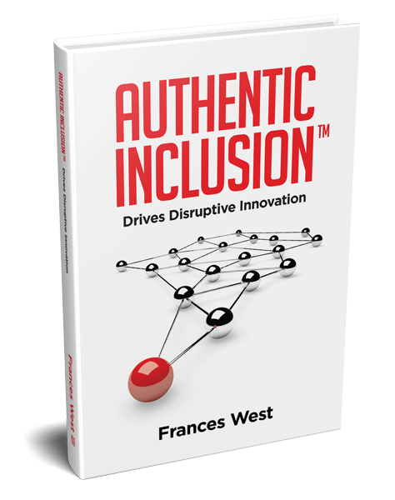




Authentic Inclusion™ Drives Disruptive Innovation – B
Stay Connected
@fwest34
Frances-West
info@franceswest.co
franceswest34
#authenticinclusion
www.franceswest.co

