Slide 1
RespectAbility
Women’s Disability Leadership, Inclusion & Advocacy Series
Welcomes You to Our
Empowerment Training for
Female Students with Disabilities
Saturday, April 6, 2019
www.RespectAbility.org

Slide 2
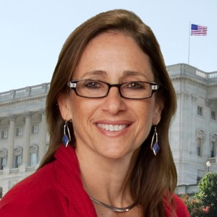
Welcoming 1
Debbie Fink is the Director of
Community Outreach and
Impact for RespectAbility, and responsible for its Women’s
Disability Leadership,
Inclusion & Advocacy Series.
An author, educator and performer,
her books and curricula have been distributed worldwide, as she ‘edu-tained’ on global tours with the USO.
Picture: Debbie Fink
smiling at the camera.

Slide 3
Welcoming 2
Today’s Motivational Quote
“Trust yourself. Create the kind of self that you will be happy to live with all your life. Make the most of yourself by fanning the tiny, inner sparks of possibility into flames of achievement.”
(Golda Meir)

Slide 4
Welcoming 3
Today’s Goals:
To deliver tools of empowerment to:
Take Charge Self-Advocating On-&-Beyond Campus (academics, extra-curriculars, and beyond campus)
Take Charge Self-Advocating Socially
Take Action Advocating for Others on campus
Meet other students on a similar journey and
cultivate new relationships

Slide 5
Disclaimer
Please note that any views expressed by today’s speakers are solely in a personal capacity and are not intended to represent the views of their companies, organizations or RespectAbility; or to be taken as
legal or medical counsel.

Slide 6
Thank You!
We wish to express our profound thanks to our generous hosts
here at the Guttman Community College
-------------------------------
To these NYC organizations for their collaboration (alphabetically):
DemocracyNYC
Girls for Gender Equity
Guttman Office of AccessABILITY Services
Guttman Oﬃce of Partnerships and Community Engagement
L.O.V.E. Mentoring
Hunter College
Several other colleges for sharing this opportunity with its students.
-------------------------------
And thank you to the New York Women’s Foundation and the
Coca-Cola Foundation for its direct support for this effort.

Slide 7
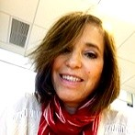
Welcoming 5
Barbara Bookman is CUNY’s
University Director of Disability Programs. Prior to her role at
CUNY, she was the Director of
Services for Students with
Disabilities at Queensborough Community College. She earned her Master of Arts, Counseling & Vocational Rehabilitation, from Teachers College, Columbia University.
Barbara Bookman, smiling
at the camera.

Slide 8
PANEL: Self-Advocacy On-&-Beyond Campus
Moderator: Gabby Einstein-Sim, RespectAbility Board Member
Panelists:
Crystal Vasquez, Academics / Curricular Self-Advocacy:
How to Self-Advocate with your Disability Services Office
Rebecca Gross, Campus-wide Advocacy: How to Broaden Inclusive Advocacy on Campus through Grassroots Organizing
Brilynn Rakes, Extra-Curricular Advocacy:
How to Self-Advocate in Extra-Curricular Settings

Slide 9
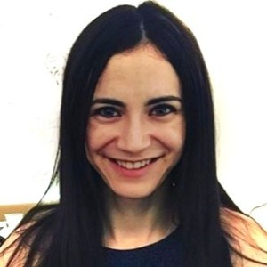
Gabby Einstein-Sim: Moderator
Gabby Einstein-Sim is a board
member of RespectAbility. She is
currently a Master’s Student in
Community Health Education at
Columbia’s Teachers College.
She is a member of the Jewish
National Fund’s Disability Task Force, focusing specifically on the Special in Uniform program, which enables people with disabilities to serve in the Israeli army.
Picture: Gabby Einstein-Sim smiling at the camera.

Slide 10
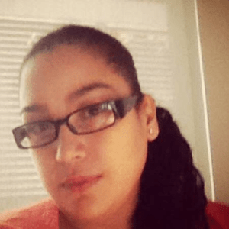
Self-Advocacy: Academics / Curricular Advocacy
Crystal M. Vazquez, a CUNY
Alum, is the Associate Director
of AccessABILITY Services
and Women’s Resources
Services Specialist at Guttman
Community College. Crystal
holds an M.A. in public administration
and has extensive leadership experience
in higher education.
Crystal Vasquez, looking
at the camera.

Slide 11
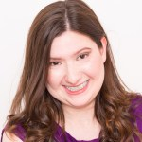
Campus-Wide Advocacy: Grassroots Organizing 1
Rebecca Gross, a self-advocate
with learning disabilities,
graduated from Sarah Lawrence
College with a BA in Theater,
Disability Studies, and Education.
She co-led the Sarah Lawrence Disability Alliance (SLCDA). Rebecca is doing a Master’s Degree in Disability Studies at the CUNY School of Professional Studies, and works part-time as RespectAbility’s NYC Inclusionist.
Rebecca Gross, smiling
at the camera

Slide 12
Who Benefits from Campus Disability Advocacy?
Campus-Wide Advocacy: Grassroots Organizing 2
Students with Disabilities
Providing a welcoming community space for students with disabilities to connect and share experiences.
2. Non-disabled students (a.k.a. allies and “future allies”)
Educating non-disabled peers about disability issues through events and collaboration with other student groups.
3. School Staff and Faculty
Advocating for physical, psychological, and academic accessibility on campus through interactions with staff and faculty.

Slide 13
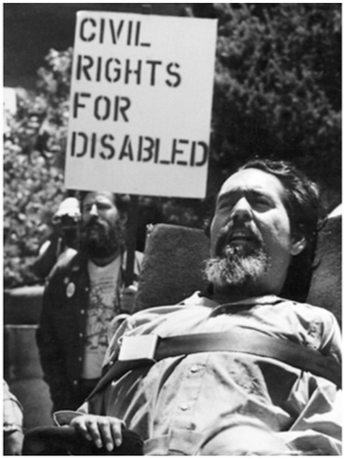
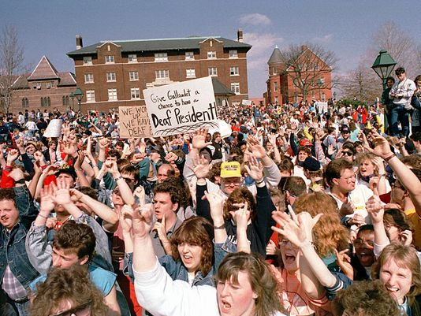
Never Underestimate the Power of Student Activism!
Campus-Wide Advocacy: Grassroots Organizing 3
The Rolling Quads, University of California Berkeley, 1960s
B&W photo of a man in wheelchair at outdoor protest, holding
up a sign saying “Civil Rights for Disabled”
Source: https://www.bamsi.org/administration/celebrating-the-life-of-disability-advocate-ed-roberts/
Deaf President Now,
Gallaudet University, 1988
Source: https://www.usatoday.com/story/news/nation/2018/04/03/gallaudet-deaf-president-now-30-anniversary/464611002/
Color Photo hundreds of students at protest, each holding
up an arm, some holding up a sign that says “Give Gallaudet a chance to have a Deaf President!”

Slide 14
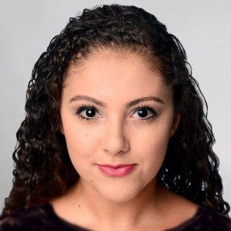
Self-Advocacy 301: Extra-Curricular Advocacy
Brilynn Rakes, a self-advocate,
completed a dual-degree
program in New York City at
Fordham Univ. with a BA in
Communications and Media
Studies, and a BFA in Dance. Brilynn
competed in the NYC Finals of the Youth
American Grand Prix and was featured on ABC’s Dancing with the Stars. Brilynn is currently getting a degree in Business Administration.
Brilynn Rakes, smiling
at the camera

Slide 15
Self-Advocacy 301: Extra-Curricular Advocacy2
https://drive.google.com/a/fordham.edu/file/d/1mQbfhCLARUud_00pOFbElJWMjbZnNCJo/view?usp=drive_web

Slide 16
Self-Advocacy On-&-Beyond Campus Q & A
Picture: Enlarged Q & A in 3-D; Q in red, & in blue, A in green

Slide 17
Stay in touch with us!
Thank you, Webinar attendees,
for your participation –
stay in touch with us!
Respectfully,
Debbie Fink
Director, Community Outreach & Impact
DebbieF@RespectAbility.org
11333 Woodglen Drive, Suite 102
Rockville, MD 20852
Office: (202) 517-6272
www.RespectAbility.org
© RespectAbility 2019

Slide 18
I AM ME Exercise Examples
I AM…
I AM Responsible.
I AM an Atheist
(or a religion).
I AM nervous.
I AM funny.
I AM Latina
(or other ethnicity).
I AM outspoken.
I AM happy.
I AM competitive
(or other sport or talent).
I AM loveable!
I HAVE…
I HAVE a pet
(name kind of pet).
I HAVE a disability.
I HAVE a supportive family.
I HAVE a home.
I HAVE brown eyes
(or other feature).
I HAVE one best friend.
I HAVE positivity.
I HAVE a big heart.
I BRING…
I BRING enthusiasm.
I BRING experience.
I BRING leadership.
I BRING love.
I BRING compassion.
I BRING humor.
I BRING creativity.
I BRING computer skills (or other skills).
I BRING strength.

Slide 19
I AM ME Exercise Examples (cont.)
I NEED…
I NEED moral support.
I NEED a sense of humor.
I NEED a friend (or family member).
I NEED to live a healthy lifestyle.
I NEED to be patient.
I NEED leadership skills.
I NEED courage.
I NEED writing skills. (or any other kind of skill).
I NEED independence.
I NEED love.
I SEEK…
I SEEK companionship.
I SEEK employment.
I SEEK independence.
I SEEK positivity.
I SEEK mentorship.
I SEEK teamwork.
I SEEK routine.
I SEEK community.
I SEEK happiness.
I SEEK inclusion.

Slide 20
My Elevator Pitch Template
Hi! My name is ____________________________________________.
I am ___________________________________ and ____________________________________.
(Choose from the list of “I Am”) (Choose from the list of “I Am”)
I am looking to / for an opportunity to ___________________________________. (Circle One) (Choose from the list of “I Seek”)
I have ___________________________________ and __________________________________. (Choose from the list of “I Have”) (Choose from the list of “I Have”)
I bring __________________________________ and ___________________________________. (Choose from the list of “I Bring”) (Choose from the list of “I Bring”)
I welcome the chance to talk to you more about ____________________. (Choose from the list of “I Seek”)
I really think we could work together to __________________________________! (make the world a better, more inclusive place for all!)

Slide 21
SMALL GROUP SESSIONS: Advocacy 101, 201, 301, 401 & 501
Self-Advocacy 101: How to Self-Advocate with your Disability Services Office with Maryanne Sackarnoski, AccessABILITY Services and Candace Cable, 12-time Paralympian and Respectability Senior Fellow
Campus-wide Advocacy 201: How to Broaden Inclusive Advocacy on Campus through Grassroots Organizing: Rebecca Gross, Sarah Lawrence College Alum, RespectAbility’s NYC Inclusionist and
Candace Cable, 12-time Paralympian and RespectAbility Senior Fellow
Self-Advocacy 301: How to Self-Advocate in Extra-Curricular Settings with Brilynn Rakes, Fordham University Alum, ABC Dancing with the Stars,
MBA student, former RespectAbility Fellow
Self-Advocacy 401: How to Self-Advocate in Personal Relationships with Gabby Einstein-Sim: RespectAbility Board Member and Master’s student in Community Health Education at Teachers College, Columbia University
Community-wide Advocacy 501: How to Broaden Inclusive Advocacy Beyond Campus with Valora Blackson, Director of the Office of Partnerships and Community Engagement, Guttman Community College

Slide 22
Self-Advocacy 301: Extra-Curricular Advocacy
Brilynn Rakes, a self-advocate,
completed a dual-degree
program in New York City at
Fordham Univ. with a BA in
Communications and Media
Studies, and a BFA in Dance. Brilynn
competed in the NYC Finals of the Youth
American Grand Prix and was featured on ABC’s Dancing with the Stars. Brilynn is currently getting a degree in Business Administration.
Brilynn Rakes, smiling
at the camera

Slide 23
Taking Action! Use Your Voice to Improve NYC
Committee on Mental Health, Disabilities and Addiction
4/8/2019 10:00 AM
Council Chambers - City Hall Jointly with the Committee
on Aging
https://legistar.council.nyc.gov/MeetingDetail.aspx?ID=685312&GUID=61016C9A-D016-42E9-B063-504D6BD52048&Options=info&Search=
Committee on Higher Education (yes, that’s your college!)
4/30/2019 1:00 PM
Committee Room - City Hall Jointly with the
Committee on Women and the Committee on Education
https://legistar.council.nyc.gov/MeetingDetail.aspx?ID=685412&GUID=9B72DA49-DE1F-4814-9566-D4717ECF51AC&Options=info&Search=

Slide 24
Closing (Meaningful) Fun!
Survey
Self-Expression Graffiti Wall-Webbing
Eminem “Lose Yourself” with
ASL interpreter
Group Photo
and
Farewell . . .
Stay in touch!

Slide 25
Eminem “Lose Yourself” with ASL interpreter
https://www.youtube.com/watch?v=9P_4D26hApY
Followed by motivational music on CD

Slide 26
Thank You! 2
Once again, our profound thanks to our generous hosts
here at the Guttman Office of AccessABILITY Services
-------------------------------
And to these organizations for their collaboration (alphabetically):
• Guttman Oﬃce of AccessABILITY Services • Guttman Oﬃce of Partnerships and Community Engagement (OPCE)• DemocracyNYC• Girls for Gender Equity• Hunter College• L.O.V.E. (Latinas on the Verge of Excellence) Mentoring•
-------------------------------
And thank you to the New York Women’s Foundation and the
Coca-Cola Foundation for its direct support for this effort.

Slide 27
Thank You! 3
Please remember to . . .
“Trust yourself. Create the kind of self that you will be happy to live with all your life. Make the most of yourself by fanning the tiny, inner sparks of possibility into flames of achievement.” (Golda Meir)
Thanks to everyone at
Guttman Community College and all
speakers and participants for teaming
together today!
© RespectAbility 2019

Slide 28
Stay in touch with us! 2
You are our future leaders!
Please stay in touch,
Debbie Fink
Director, Community Outreach & Impact
DebbieF@RespectAbility.org
11333 Woodglen Drive, Suite 102
Rockville, MD 20852
Office: (202) 517-6272
www.RespectAbility.org
© RespectAbility 2019

