Slide 1

Disability in Philanthropy & Nonprofits:
A study on inclusion and exclusion of the 1-in-5 people who live with a disability and what you can do to make things better
Jennifer Laszlo Mizrahi,
www.RespectAbility.org
Contact: JenniferM@RespectAbility.org
(202) 365-0787

Slide 2
RespectAbility
RespectAbility’s mission is to fight stigmas and advance opportunities so that people with disabilities can fully participate in all aspects of community.
RespectAbility is a nonprofit, nonpartisan organization that understands we are a stronger community when we demonstrate our values – when we are welcoming, learning, diverse, moral and respect one another.
Led by diverse people with disabilities and those who love them, we know that people with disabilities and their families have the same hopes and dreams as everyone else.

Slide 3
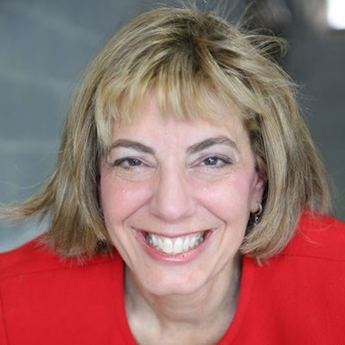
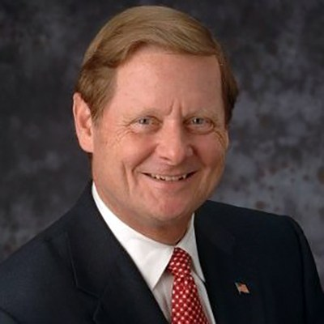
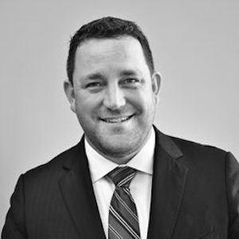
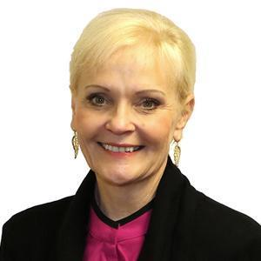
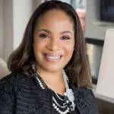
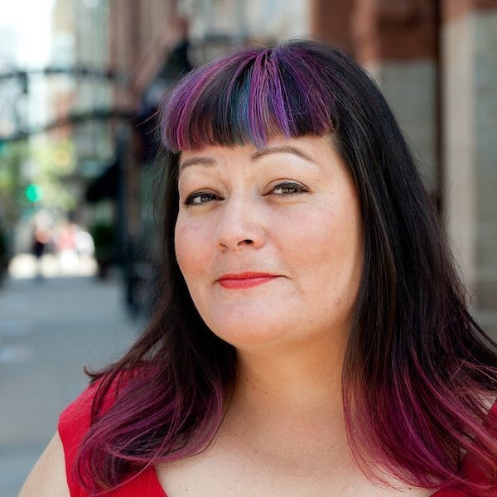
Speakers
Jennifer Laszlo Mizrahi
President, RespectAbility
Hon. Steve Bartlett
Chair, RespectAbility
Aaron Dorfman
President and CEO, The National Committee for Responsive Philanthropy
Stephanie Powers
Vice President for Policy Partnerships, Council on Foundations
Kerrien Suarez Executive Director, Equity in the Center
Carly Hare
Coalition Director for CHANGE Philanthropy

Slide 4
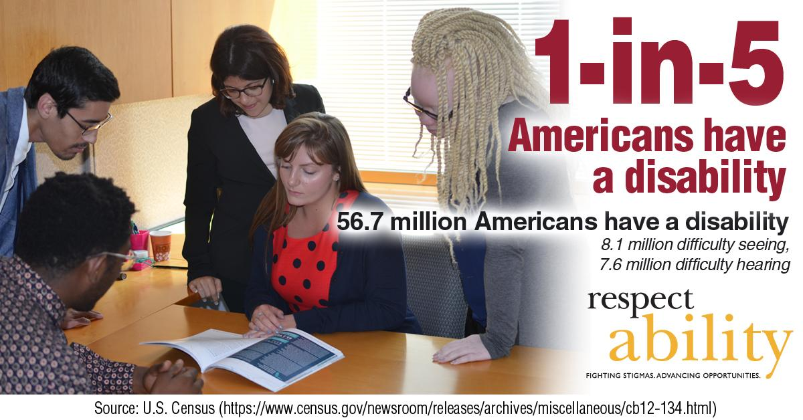
1 in 5 Americans

Slide 5
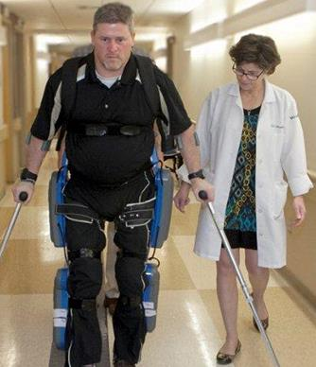
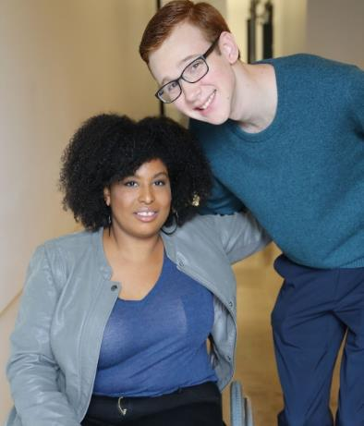
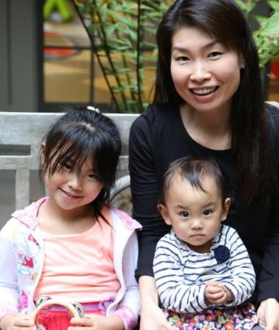
Not All Disabilities Are Visible
Temporary and Permanent
Visible and Invisible
Born with it or Acquired
Anyone can join the disability community at any point.

Slide 6
Disability Impacts Everyone
Disability impacts people of all races, gender identities and orientations, faiths and backgrounds.
Including African Americans with Disabilities in Inclusive Philanthropy
Including Latinx and Hispanics with Disabilities in Inclusive Philanthropy
Empowering Women with Disabilities
Including LGBTQ Individuals with Disabilities in Inclusive Philanthropy

Slide 7
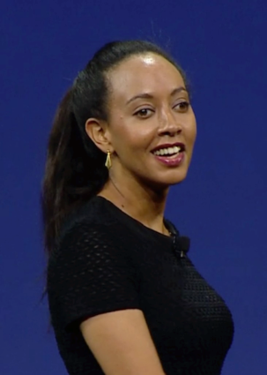

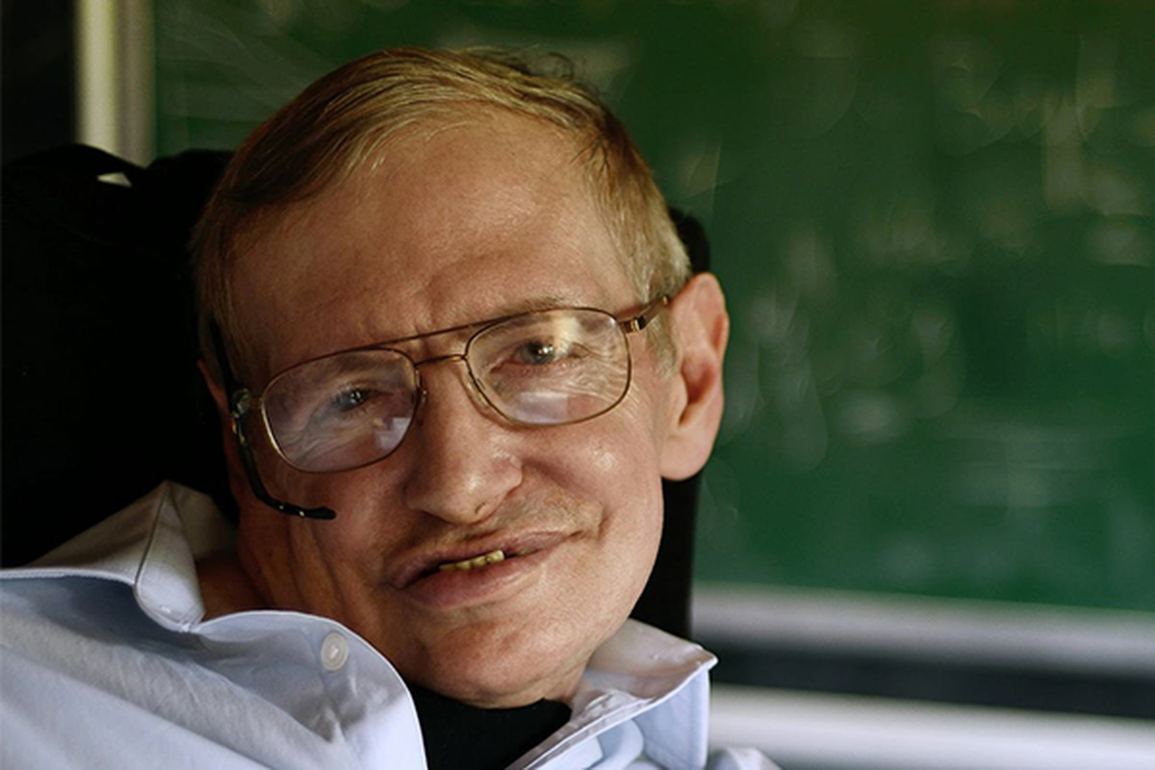
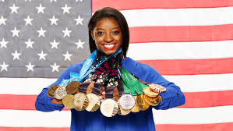
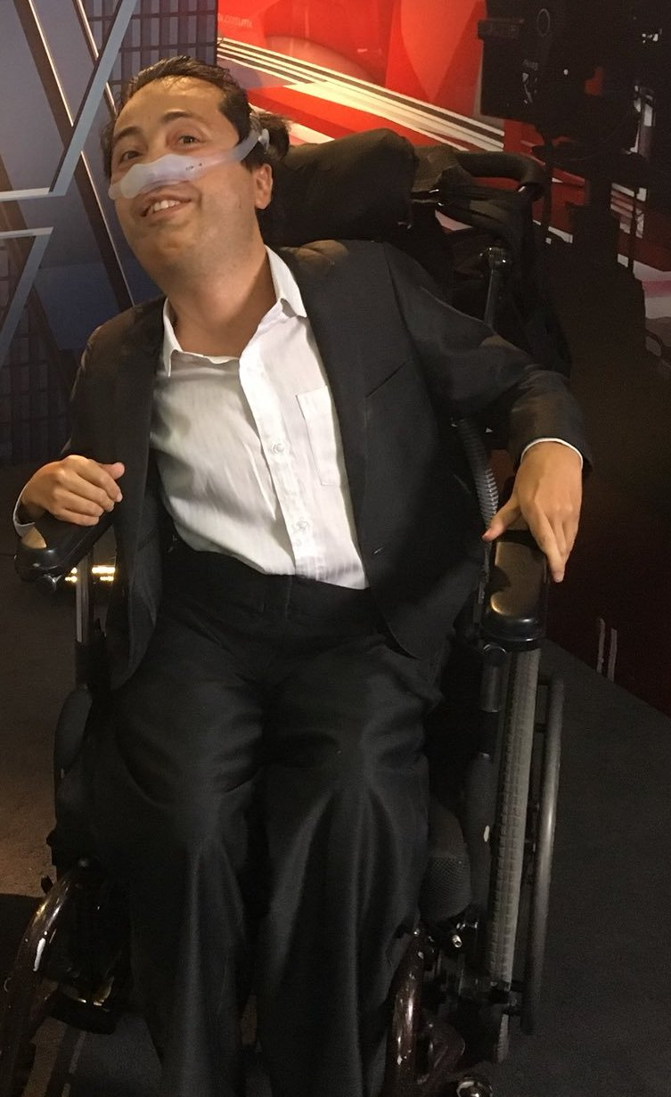
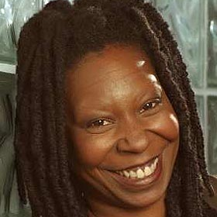
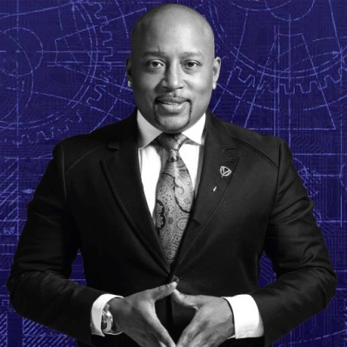
People with disabilities are some of the MOST talented people
Haben Girma:
Deaf and Blind
Harriet Tubman: Seizures
Stephen Hawking:
ALS
Simone Biles:
ADHD
Maya Angelou: Selective Mutism
Whoopi
Goldberg: Dyslexia
Daymond John: Dyslexia & Hearing Impaired
Dr. Victor Piñeda, Activist: Spinal muscular atrophy
Harry Belafonte: Dyslexia

Slide 8
Methodology
5 focus groups of people who work in philanthropy done in 2015 in partnership with the Council on Foundations
14 one-on-one interviews done in 2018 by phone with leaders of foundations/philanthropy serving organizations
Evaluation of online accessibility of 25 largest foundations and 25 largest nonprofits (done with assistance from Marcie Lipsitt) in 2018/19
Online survey of 969 people done by Buren Communications of subscribers to NonProfitTimes, Chronicle of Philanthropy and numerous PSO partners
Analysis by Meagan Buren, Amy Chapman, Jennifer Laszlo Mizrahi and others

Slide 9
Bias and lack of awareness are major barriers
Q 8: Many organizations do not fully include people with disabilities. What do you think is the top reason why the inclusion of people with disabilities has not happened yet in so many organizations?

Slide 10
Quotes from participants
“The first thing [we need to do] is improve dialogue and conversations about people with disabilities. People tiptoe because it feels like a taboo subject and they don’t want to acknowledge their unconscious bias.”
“Philanthropy and the foundation community need to shift to be a more welcoming place. Philanthropy is so focused on hiring ‘the best and brightest’ and that explicitly is presenting a disability bias.”
“Our experience has been that there is so little exposure of people with disabilities to the general public that most people are simply ignorant.”
“I see an unconscious attitude that a person with a disability is a goodwill project, not a peer or a colleague. … There are basic underlying attitudes that need to evolve.”
“It’s just something that many people do not think about, which can be exacerbated by the fact than many disabilities aren’t visible or obvious.”
“[We need to] openly address implicit bias and create strategic goals with clear metrics for engaging individuals with disabilities.”

Slide 11
Disability not yet a DEI priority
Q 4: Has the leadership of your organization made a specific commitment to diversity, equity, and inclusion that has been made public to management, staff, stakeholders, and the public? If yes, check all the diversity areas you specifically named:

Slide 12
People lack training on disability inclusion
Q 5: In the past 2 years, in what areas have you or your organization sought out additional learning opportunities for staff and leadership around diversity, equity and inclusion? Please check all that apply.

Slide 13
Quotes from participants 1
“While we define diversity broadly, the place that we have been pushing the most in terms of our outreach to our members and our broader [audience] is around racial and ethnic diversity.”
“In my large national organization, we are committed to equity – for race, gender, sexual orientation, and citizenship. Disabilities have never been discussed at least in the trainings and presentations I’ve attended.”
“It really hasn’t been on our radar. We’re so focused on race, and sometimes gender, that we don’t think about much else.”
“I attended a session on people with disabilities at [a recent conference] and heard that it was unusual to have a session on this topic.”
“We have been hearing a lot about the importance of diversity but we have been translating that primarily as racial diversity so this is a new concept for us.”
“Often I see that unless a nonprofit specifically serves people with disabilities, they are forgotten.”

Slide 14
Quotes from participants 2
“Our organization pays lip service to engaging folks with disabilities more than taking meaningful and substantive actions. I've heard leadership pat themselves on the back for hiring a person with a disability—to our buildings and grounds department to work as a day porter. There is nothing wrong with that, and I'm happy we made this hire, but I don't believe we employ people with disabilities in our leadership or management staff, so it feels like tokenism and I worry that it could be detrimental, leading to the conclusion that we've checked that box.”
“It’s not that we have a whole system that is not inclusive of individuals with disabilities. It’s not intentional that there are not currently individuals with disabilities [on our board or in leadership positions] but I will be honest that it also hadn’t been a stated priority. … So it’s not exclusion, but we have also not been as intentional there in terms of inclusion as perhaps we could be.”
“Just as we have focused on intentionality bringing in women of color, an organization would need to have an intention/initiative to identify, recruit, and cultivate people with disabilities.”

Slide 15
Three-quarters haven’t recruited people with disabilities
Q 18. Has your organization made an intentional effort to recruit individuals with disabilities for employment, interns, volunteers and/or board positions in your organization?

Slide 16
Quotes from participants 3
“I suspect one barrier is the perception that finding capable, well-educated people with disabilities to fill roles is hard, or that we’ve already done what we can to seek out these populations. I think our HR department posts jobs on the ‘usual’ sites and expects that individuals with disabilities have the same opportunity and likelihood to find and access those postings. There doesn't seem to be a deliberate and concerted effort to reach people with disabilities where they are.”
“As a disabled executive, I have had many issues with trustees and staff members who are not inclusive, do not help, and sometimes ‘doubt’ the level of my disability.”
“Leadership needs to step up and make a real effort, including directing HR to do more targeted recruitment.”
“On the non-HR side, there is a taboo around pointing out the opportunities associated with hiring for equity and diversity. I feel like if I openly bring up the fact that we only appear to have two staff members with disabilities and that they are not in management or leadership positions (even if I do so diplomatically), I would be perceived as negative and problematic.”
“We need to attract more people with disabilities to apply for jobs with us. They are not on our radar.”

Slide 17
Positive messaging works!
Q 10. What do you think is the most compelling reason to include and increase opportunities for people with disabilities?

Slide 18
Negative messaging backfires
Q 11. And what would be your second choice?

Slide 19
Emphasize positive proven outcomes
Q 12. Which one of these facts is most compelling that increasing inclusion of people with disabilities is important?

Slide 20
Two-thirds excited to work with people with disabilities, one-third concerned
Be honest here. If you knew that someone you were going to be working with had a disability, would you be…

Slide 21
A major gap between will and skill
There are several accommodations and accessibility tools that enable people with disabilities to engage in organizations and activities. Which of the following are policies of your organization? Please check all that apply.

Slide 22
Organizations do not represent the people they serve
Which of the following groups in your organization include people with disabilities? Please check all that apply.

Slide 23
Performance metrics matter
Do you ask your members or grantees if they are representative (e.g., staff, board) of the people they serve?

Slide 24
Missed opportunity to hold people accountable
Is disability included in that representation?

Slide 25
Inclusion doesn’t happen by accident
Do you ask your members or grantees to intentionally include people with disabilities in their work?

Slide 26
A picture is worth a thousand words
Does your organization depict people with visible disabilities (i.e. show pictures of people who use wheelchairs, white cane, have Down Syndrome etc.) in your internal or external marketing and/or advertising materials?

Slide 27
Organizations with intentional disability inclusion are more successful
 | ORGS WITH NO DEI POLICY | ORGS WITH DEI POLICY | ORGS WITH DEI POLICY THAT INCLUDES DISABILITY | ORGS W/ PEOPLE W/ DISABILITIES AMONG BOARD, STAFF, OR LEADERSHIP
Board includes people with disabilities | 17% | 26% | 34% | 45%
Professional leadership includes people with disabilities | 11% | 22% | 28% | 38%
Staff overall includes people with disabilities | 27% | 47% | 57% | 81%
Org has made intentional efforts to recruit people with disabilities for employment, internships, volunteer or board positions | 15% | 26% | 34% | 38%
Org asks members or grantees to intentionally include people with disabilities in their work | 10% | 23% | 28% | 25%
Org depicts people with visible disabilities in marketing materials | 28% | 41% | 50% | 53%
Org has an explicit, public policy that people with disabilities cannot be denied an equal opportunity to participate in services and activities | 58% | 77% | 82% | 81%
Events are always held in physically accessible spaces | 49% | 63% | 67% | 71%
Website is set up properly for screen readers for people with low vision | 9% | 19% | 24% | 24%
All video content has captions for people who are deaf or hard of hearing | 5% | 17% | 21% | 20%
Public events enable with people disabilities to request accommodations such as sign language interpreters, live captioning, or food allergy alternatives | 21% | 34% | 38% | 40%
There is a process for employees, board, or trustees to request and receive accommodations if needed | 20% | 49% | 56% | 58%
Learning opportunities for staff include disability as an area of focus | 23% | 39% | 51% | 48%

Slide 28
Quotes from participants 4
“Having persons with disabilities on staff, in planning committees and as major contributors to events or campaigns will lead to more acceptance and inclusion. Essentially, just ‘doing it.’ As more people with disabilities are included, there will be more visibility and awareness and that will grow the acceptance and inclusion rates.”
“If people were able to see themselves in the place of someone with a disability – or if they had the chance to really know someone or work with someone with a disability – that would really help people see the issue beyond their preconceived notions.”
“We are usually hesitant to accept someone who is different from ourselves because we are not informed. Education, information, and training is always a place to start when it comes to accepting change.”

Slide 29

Adding the Disability Lens…
By adding the disability lens to your existing work, you have the opportunity to create better outcomes for people with and without disabilities alike

Slide 30
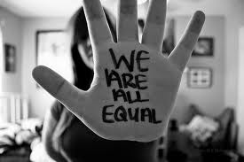
1. Commit publicly to inclusion of people with disabilities
The message that all people are of equal value and must be respected and heard fairly, must be communicated by President and Board
REPEAT those messages over and over!
Pictured: WE ARE ALL EQUAL written on a person’s hand
30

Slide 31
2. When PwDs aren’t at the table,
they are on the menu
When you add a disability lens to your philanthropy/nonprofit you will be more successful
Organizations are at their best when they welcome, respect, and include people of all backgrounds. This includes people with disabilities (PwDs). Indeed, problems are best solved by working with people who have experienced them first hand and know solutions that work. Just like issues that impact people of different racial, ethnic or other backgrounds, people with disabilities should be involved in solving issues that impact them.
Disability impacts people of all races, genders, and backgrounds. However, youth with multiple minority status (i.e. person of color /English language learners + disability face double discrimination) are most likely to enter the school-to-prison pipeline, become homeless and/or live in poverty. Be sure to look at intersectional issues.

Slide 32
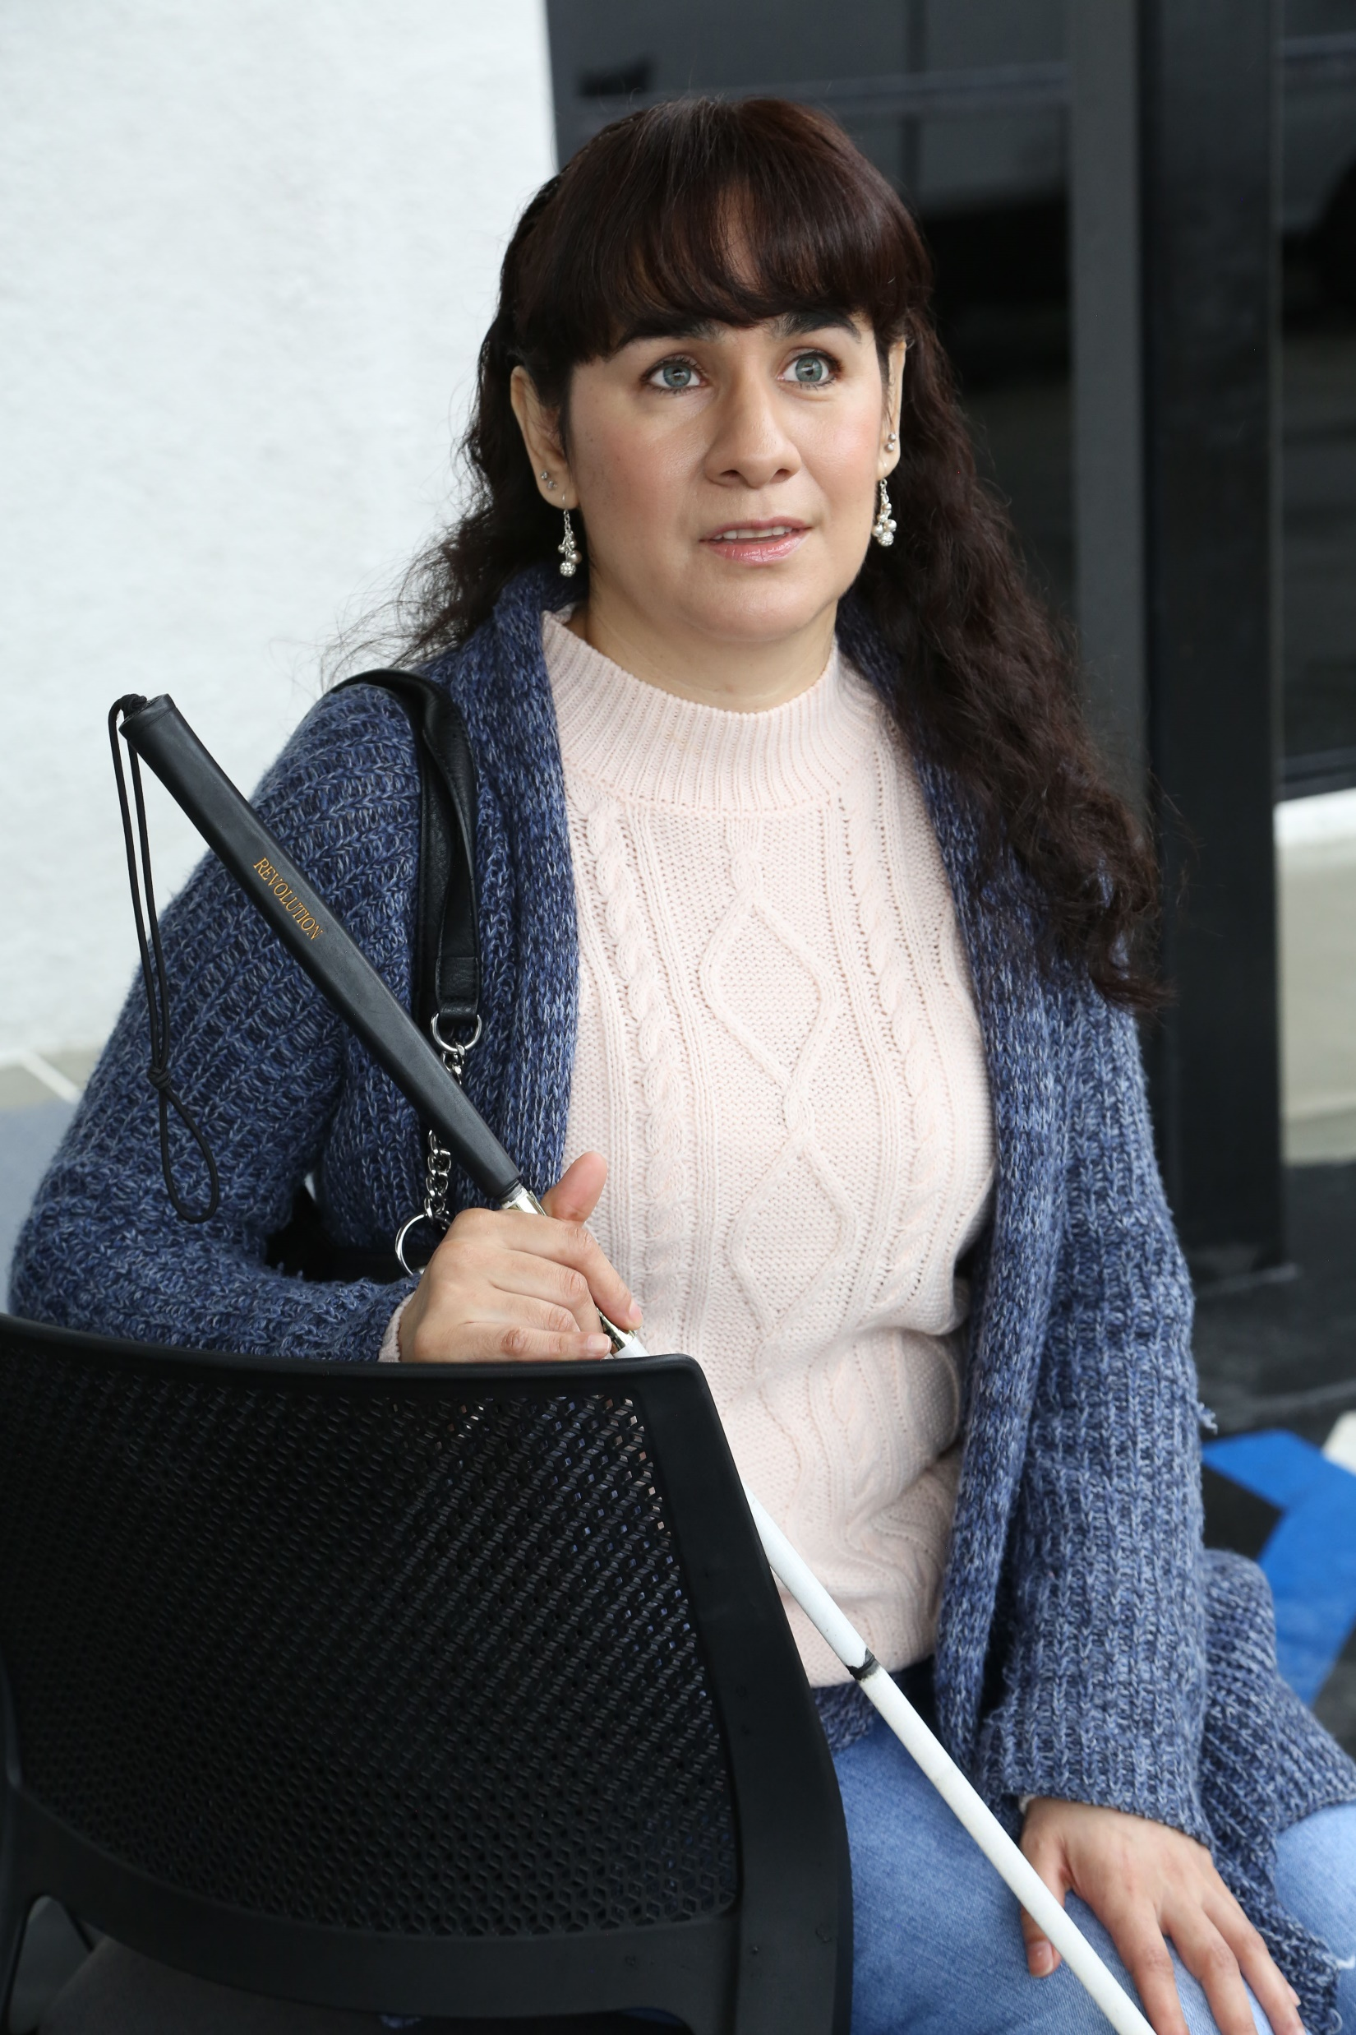
3. Foster an inclusive environment
Use “person first” language when appropriate
Have an accommodation policy
Made a conscious decision and effort to seek out and include certain demographic groups whether that was gender, race, or sexual orientation
Webinar on Disability Etiquette

Slide 33
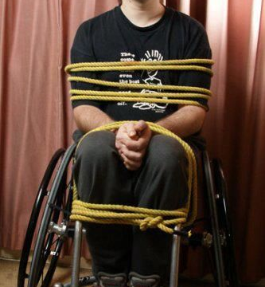
What we say makes a difference
DO SAY:
Someone uses/rides a wheelchair
DON’T SAY:
Wheelchair bound
Confined to a wheelchair
Wheelchair person
WHEN YOU DON’T KNOW WHAT TO DO/SAY, ASK!

Slide 34
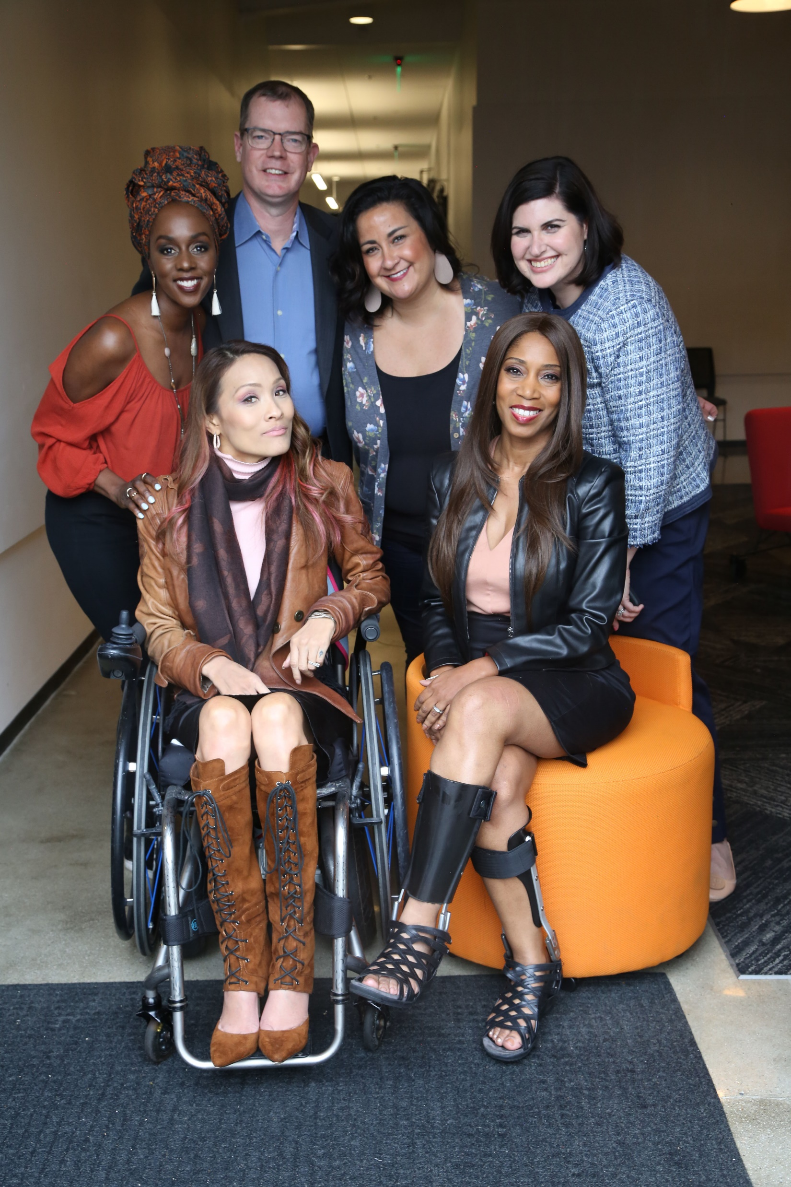
4. Work with people with disabilities
RespectAbility, Best Practices for Employers
TAPAbility, which can source talent
AskJan.org, which can problem solve inclusive employment questions for free
Diverse Managers - Philanthropy’s Next Hurdle

Slide 35


5. Have an inclusion point person or committee
Inclusion Statement and how to make requests for disability accommodations should be on your accessible website and event invites
HR Evaluation and program manager evaluation includes diversity as a performance metric
Resource on Disability Inclusion
Ford’s Push for Disability Rights Should Be a Model for Philanthropy

Slide 36

6. Include people with disabilities in your marketing
Example: Photos on website should include individuals with visible disabilities
Toolkit for Media Representation

Slide 37
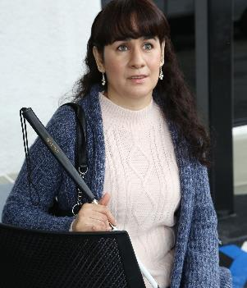
7. Ensure website and online resources are accessible
Websites need to be set up for use by screen readers and people who need captions.
Caption videos
Make documents and presentations accessible
See RespectAbility’s webinar on web accessibility

Slide 38
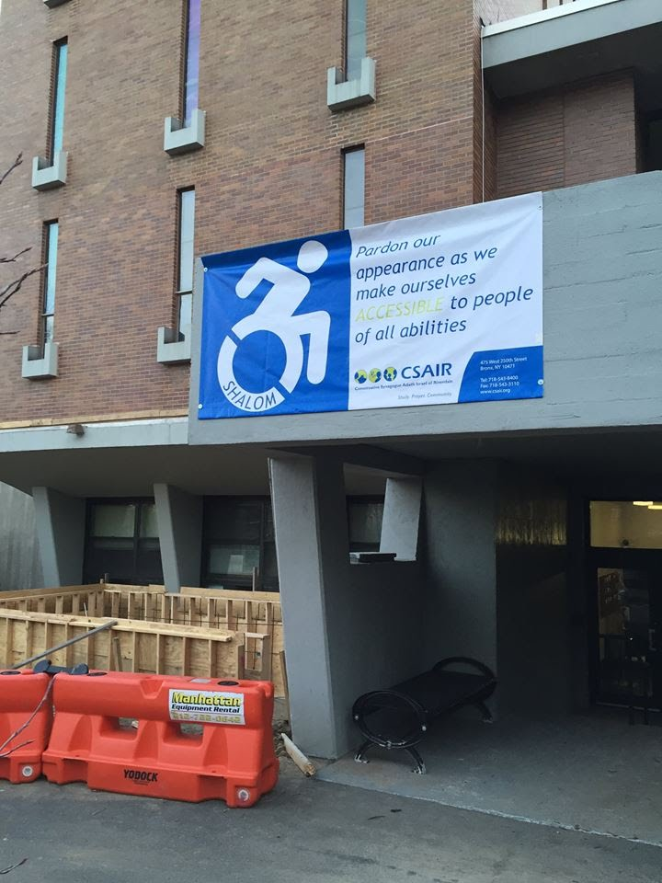
8. Ensure accessibility of office and events
Physical Accessibility
Event Checklist
All of the following must be accessible:
  Invitation/notification of event
  Facilities
  Communication
  Staff/Volunteers

Slide 39
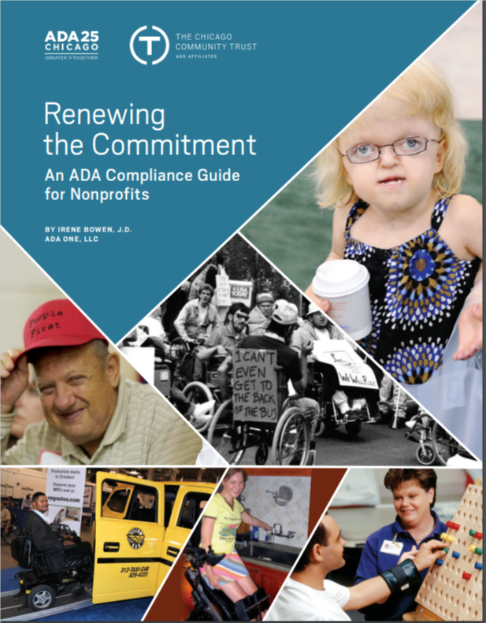
Accessibility: ADA Accessible
Resource Guide
  The Chicago Community Trust
http://www.cct.org/wp-content/uploads/2015/08/2015ADAComplianceGuide.pdf

Slide 40
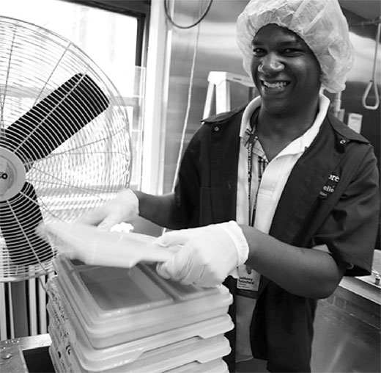
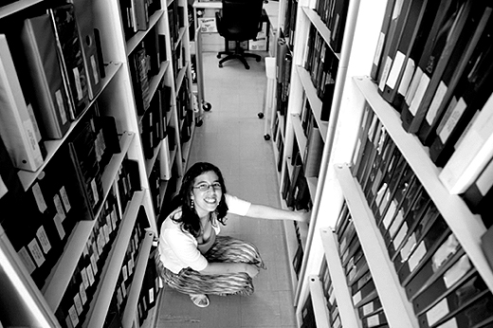
9. Use vendors who are PwDs or hire people with disabilities
Invest in social enterprises who hire people with and without disabilities
Social Enterprise: Creating Employment Opportunities for People with Disabilities

Slide 41
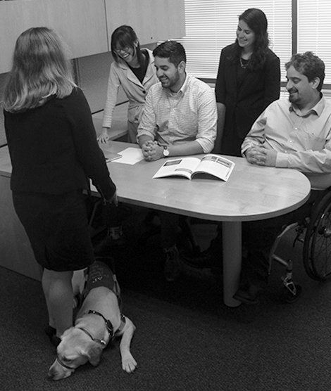
10. Promote a disability lens among grantees/members
Ask Your Grantees/Members About:
Meaningful and inclusive policies and/or programs
Public commitments on website and materials
Employing people with disabilities at all levels
Inviting people to request accommodations

Slide 42
10. Promote a disability lens among grantees (cont.)
Ask Your Grantees/Members About
Physical accessibility of office and programs
Website accessibility
Video captioning
Internal and external educational efforts

Slide 43
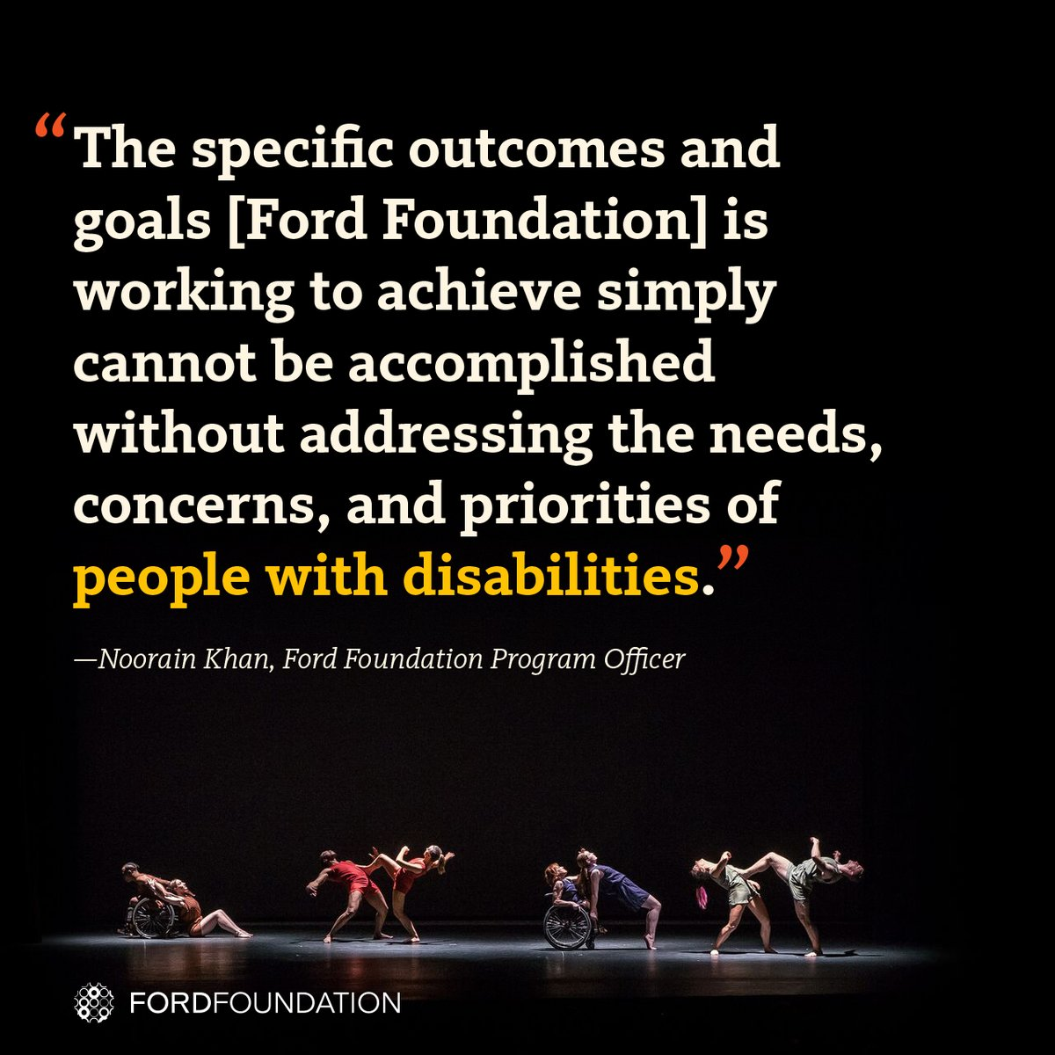
Success Stories: The Ford Foundation Includes Disability
The Ford Foundation has recently added the disability lens to their work http://bit.ly/2jOl3FL
Additionally, Ford’s CEO Darren Walker spoke extensively on why this impacts other funders as well: http://bit.ly/2nr4moJ
Here is Darren Walker’s original letter: http://bit.ly/2Bxy0Lk
This is the response of the co-authors of the Americans with Disabilities Act: http://bit.ly/2AueSyx
Darren Walker and Rich Besser (Robert Wood Johnson Foundation) on the need for disability inclusion in philanthropy: https://bit.ly/2uE8tPh
43

Slide 44


Success: MacArthur Foundation newly including disability
The MacArthur Foundation has also recently added the disability lens to their work with their new 100 Million Dollar Grant
See: https://www.macfound.org/press/perspectives/nothing-about-us-without-us
And: https://www.macfound.org/media/files/Checklist_for_MacArthur_100Change_Semifinalists.pdf
Plus: https://www.macfound.org/programs/100change
44

Slide 45

Inclusive Philanthropy Video

Slide 46
Resources/Contact Information
RespectAbility’s Inclusive Philanthropy toolkit
Access information on disability inclusion, including the new Disability in Philanthropy & Nonprofits study
www.RespectAbility.org/inclusive-philanthropy
Cell: (202) 365-0787
JenniferM@RespectAbility.org
Twitter: @respect_ability / @jewishinclusion
Facebook: https://www.facebook.com/RespectAbilityUSA and https://www.facebook.com/RespectAbility4All/

