Slide 1
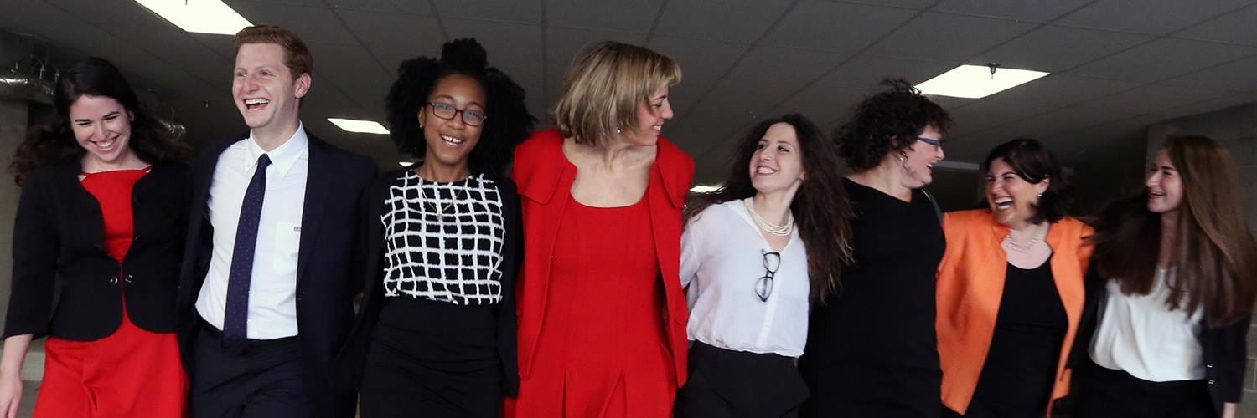

RespectAbility Project Moses
Project Moses Webinar
March 19, 2019
Jennifer Mizrahi, Matan Koch, Vivian Bass

Slide 2
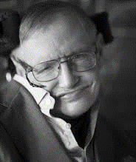
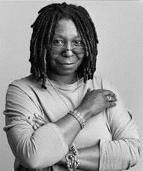


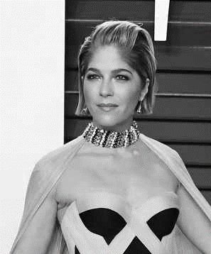
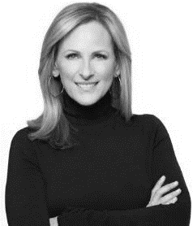
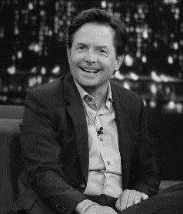
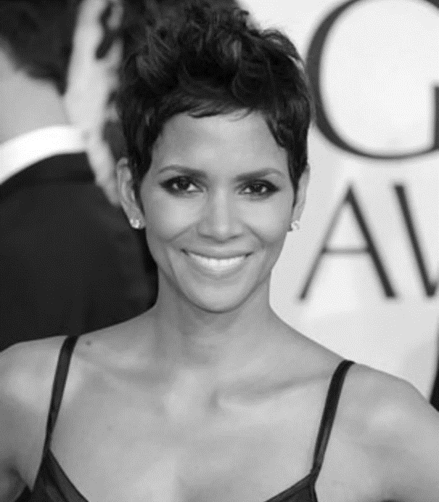
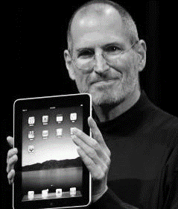
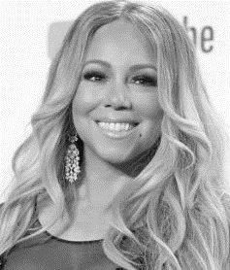
Celebrities with Disabilities
These are the faces of people with disabilities.

Slide 3
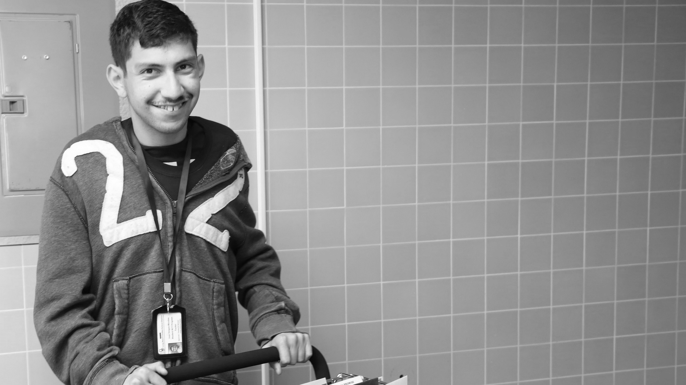
Key Disability Statistics
56 Million
people in the US have a disability.*
People with disabilities are the largest minority in America.
* Source: US Census

Slide 4
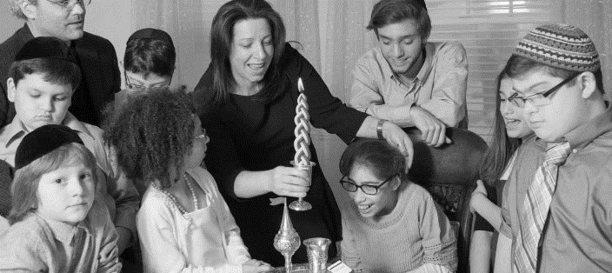
1 in 5 Jews has a disability.
1 in 5 Jews has a disability.

Slide 5
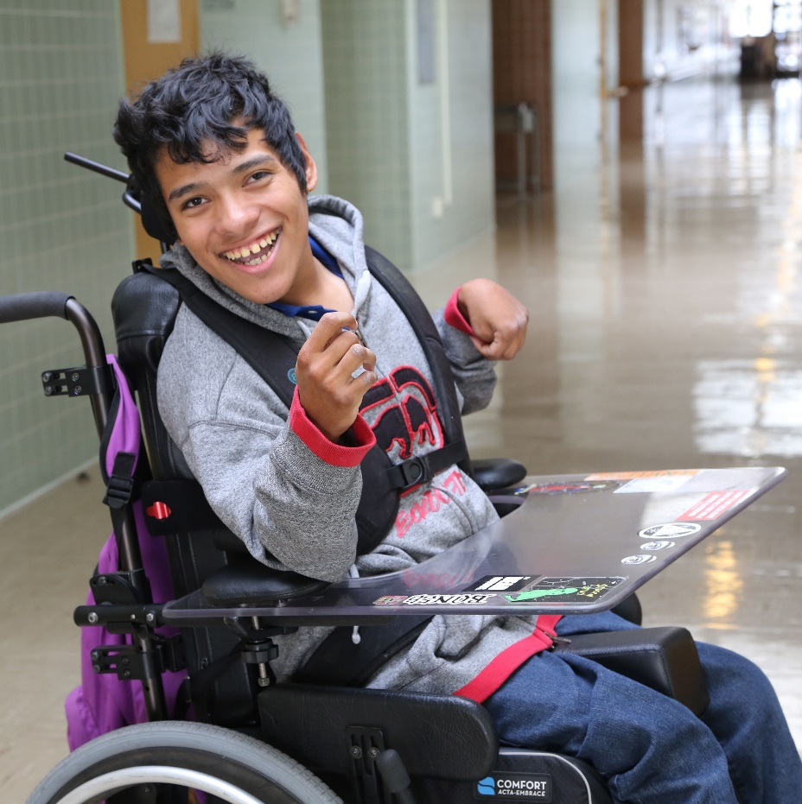
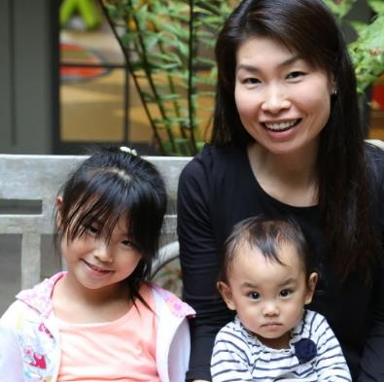
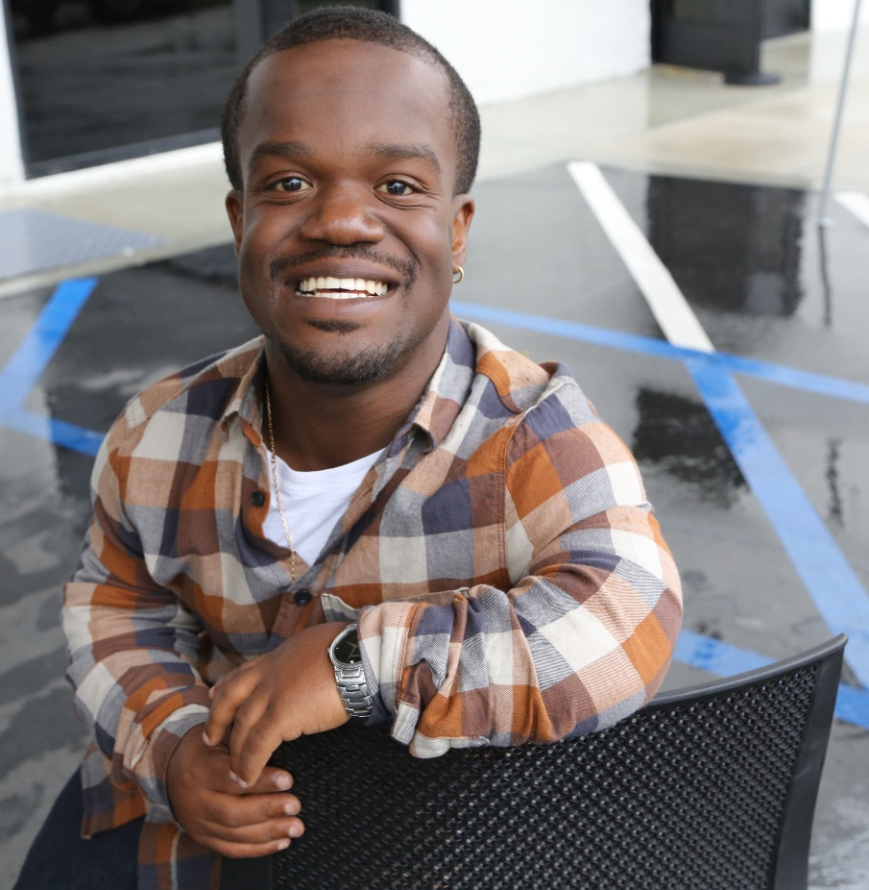
Disabilities Are….
Visible and Invisible
Born with it or Acquired
Temporary and Permanent

Slide 6
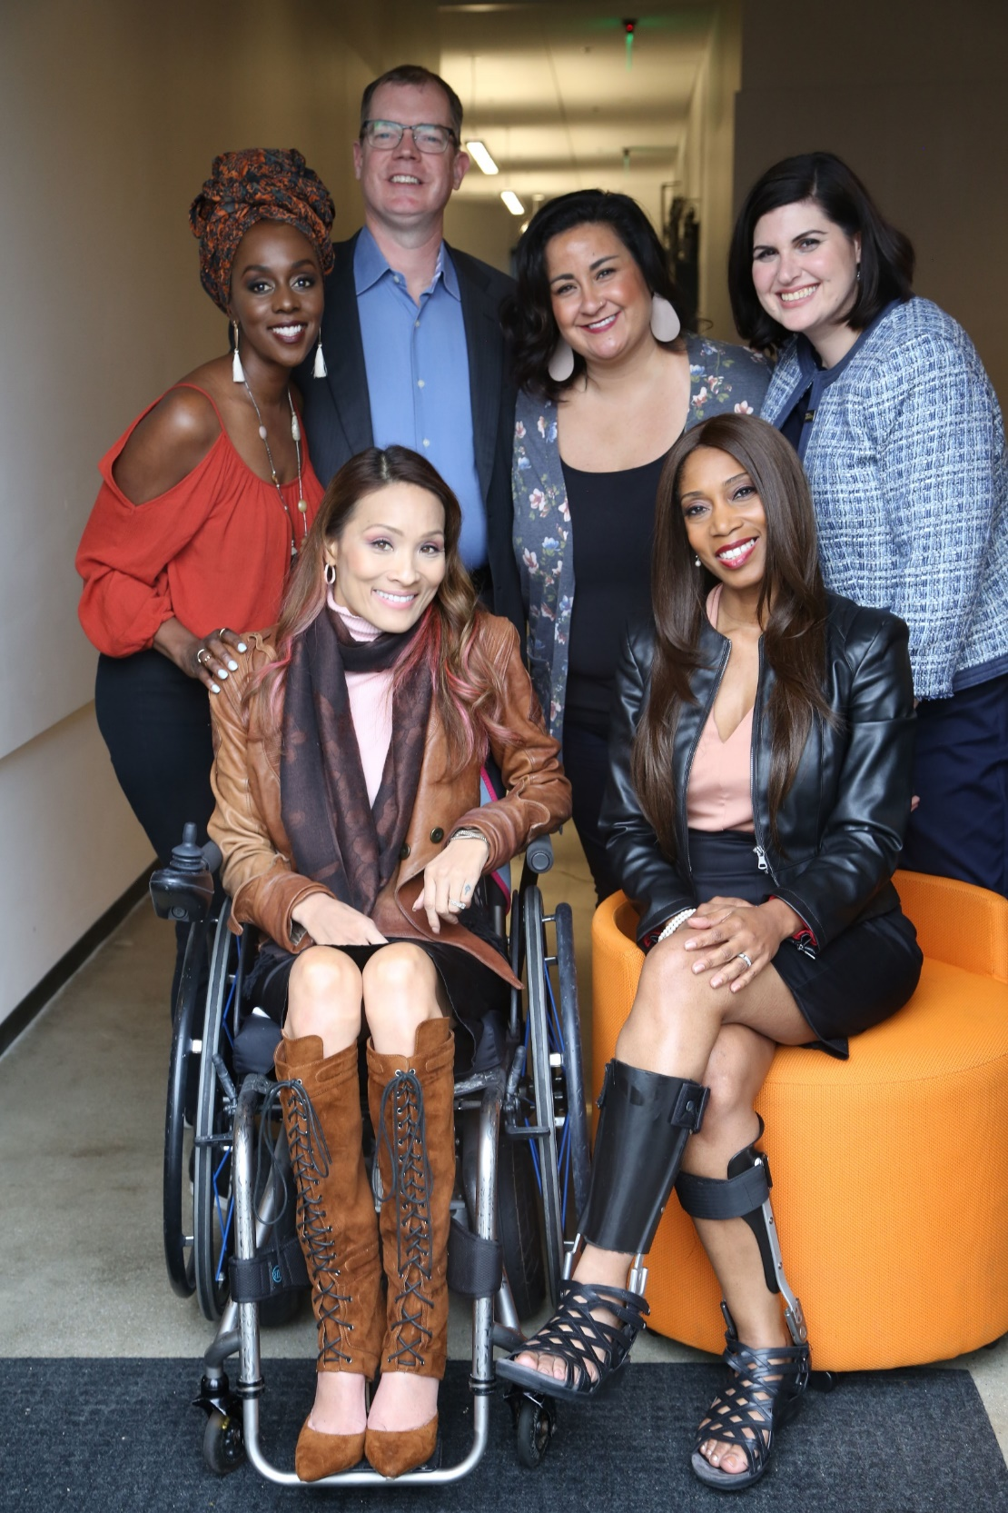
The disability community is diverse.
Anyone can join the disability community at any point.
People with disabilities come from all minority communities.

Slide 7
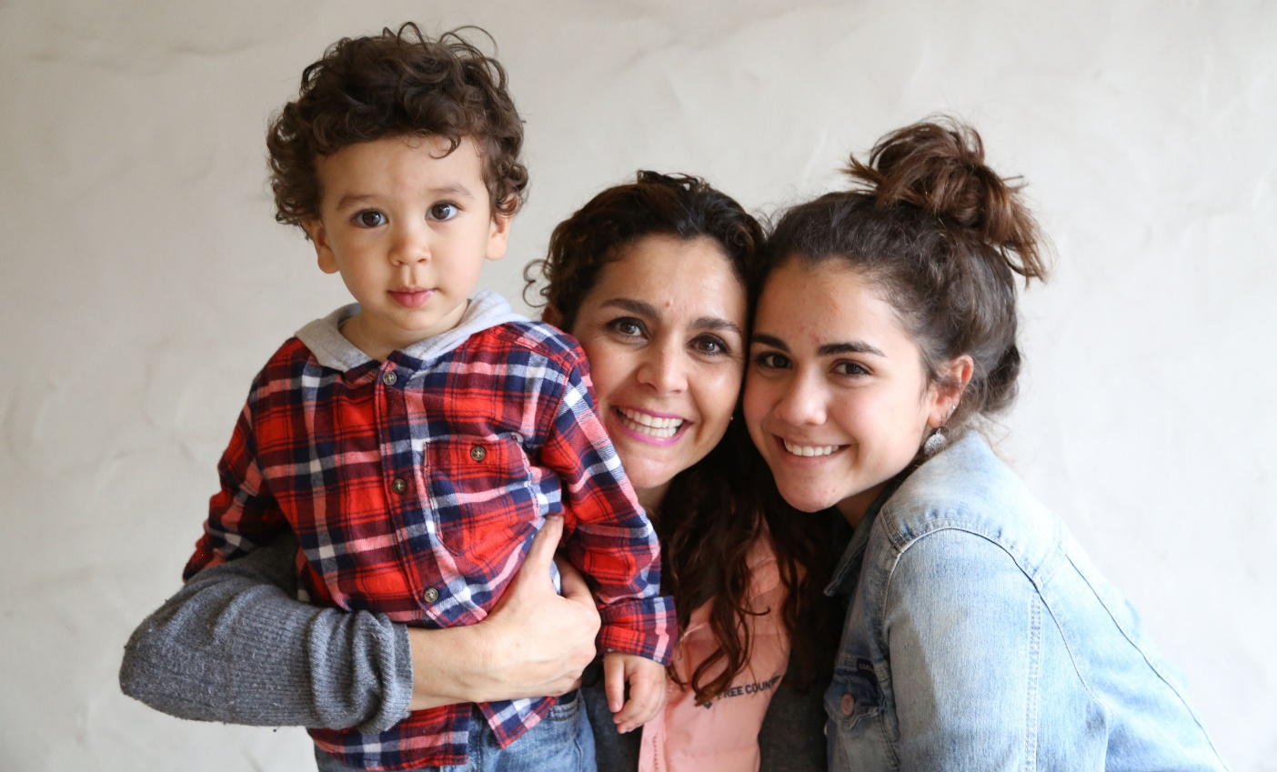
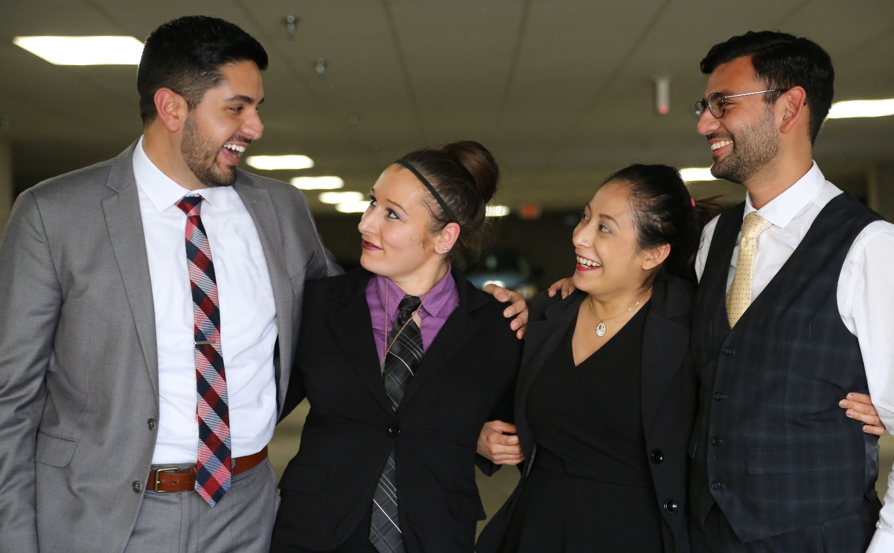
People with Disabilities are Important to Jews
have a family member with a disability
have a close friend with a disability
48%
42%
* Source: September 2012 poll, Laszlostrategies.com

Slide 8
Inclusion is Very Important to CA Jews
Percentage of California Jews who say inclusion in these places is extremely important to them:
Employment Opportunities
Transition from School to Workforce
Jewish Summer Camp
Synagogue Services
Jewish Early Education
Hebrew School
80%
71%
66%
63%
61%
61%
* Source: RespectAbility Survey

Slide 9
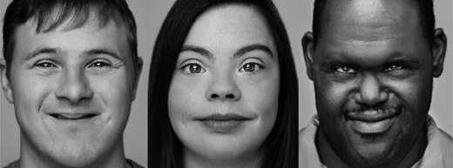
More Statistics
Only 1 in 3 people with a disability have a job.
The poverty rate is 2x that of people without a disability.

Slide 10

RespectAbility’s Mission
Mission:
To fight stigmas and advance opportunities so that people with disabilities can fully participate in all aspects of community.

Slide 11
Theory of Change
To fight stigmas and advance opportunities so that people with disabilities can fully participate in all aspects of community.
Mission
Theory of Change
Fight Implicit Bias
Advocate for Best Practices
Prepare
Leadership
Pipeline
1
2
3
Narrative Change in Hollywood
Representation of PWDs in News Media
Facts, White Papers & Social Media
Solution Center for Best Practices
Task Force of Disability Groups
National Leadership Program
Inclusive Philanthropy
Jewish Inclusion
Women’s Disability Leadership
Initiatives
PWDs drive innovation and solutions
PWDs are viewed for what they can do
PWDs are hired and heard
Outcomes

Slide 12
Fight Implicit Bias
1
  Narrative Change in Hollywood
  Representation of PWDs in News Media
  Facts, White Papers & Social Media
PWDs are viewed for what they can do

Slide 13
Advocate for Best Practices
2
  Solution Center for Best Practices
  Task Force of 120+ Disability Groups
PWDs are hired and heard

Slide 14
Prepare Leadership Pipeline
3
National Leadership Program
Inclusive Philanthropy
Jewish Inclusion
Women’s Disability Leadership
PWDs drive innovation and solutions

Slide 15


Jewish values are at the heart of our mission.
RespectAbility was founded by three Jewish leaders and built on tikkun olam—repairing the world.

Slide 16
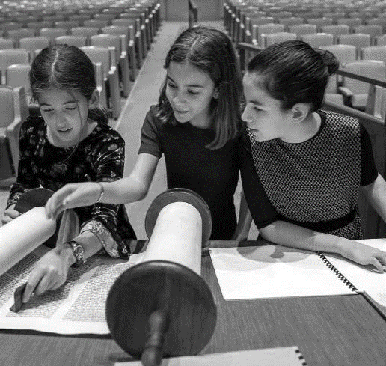
Commitment to Inclusion
RespectAbility works to build a stronger commitment to inclusion in Jewish camping, synagogues, day schools, JCCs, colleges and universities.

Slide 17
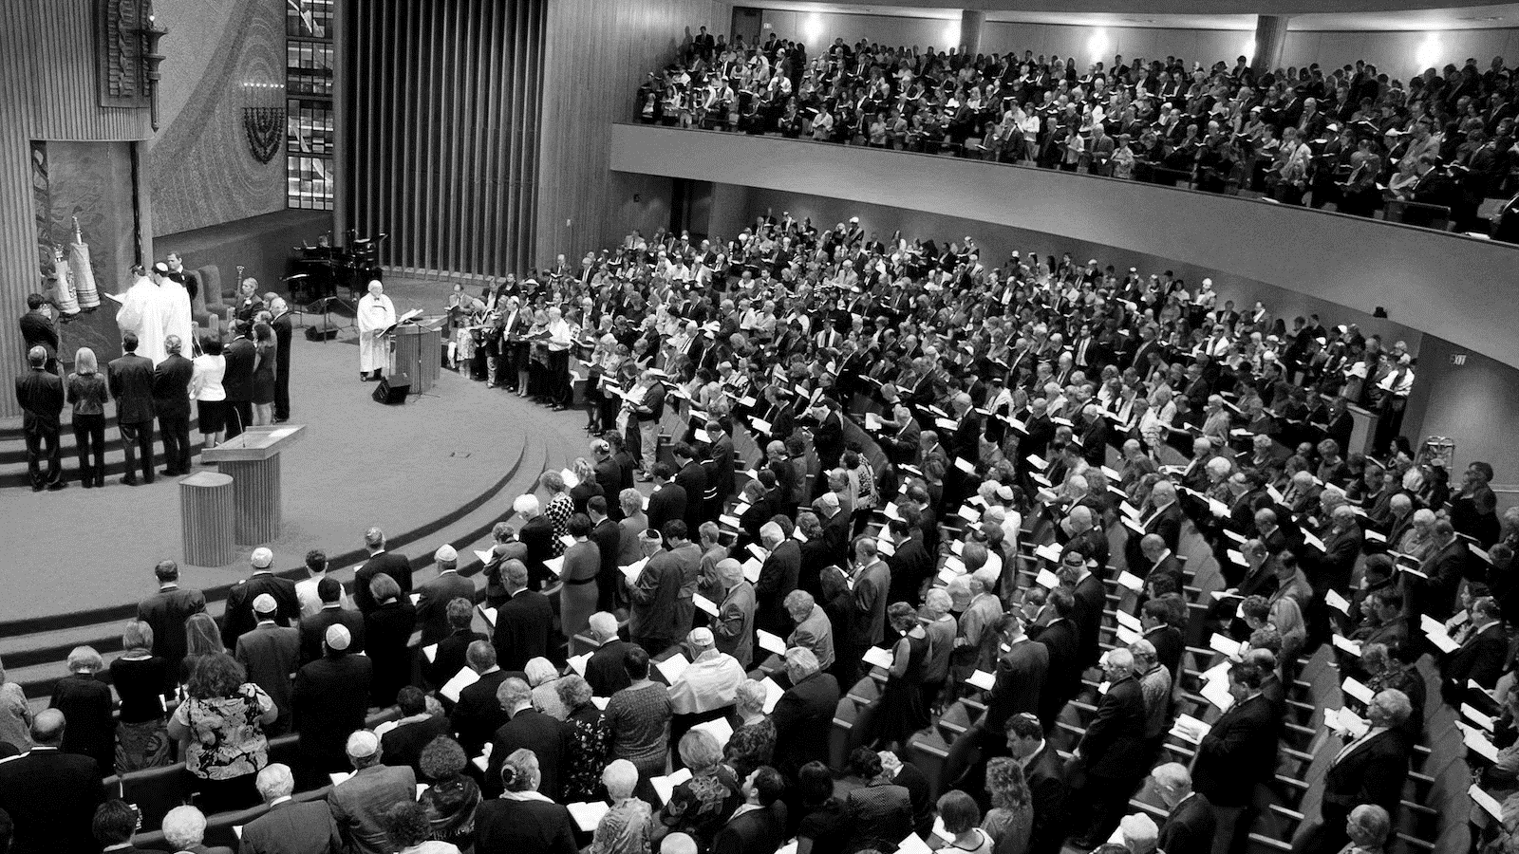
Project Moses

Slide 18
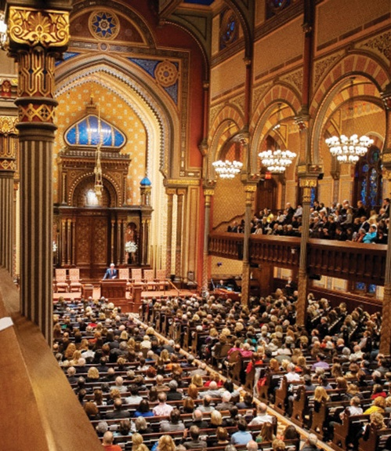

There are more than 600 open positions on Jewish jobs.com.
75-90% of Jewish nonprofits must find new executive leadership in the next 5-7 years.*
The need for capable Jewish professionals is huge and growing.
*Leading Edge

Slide 19
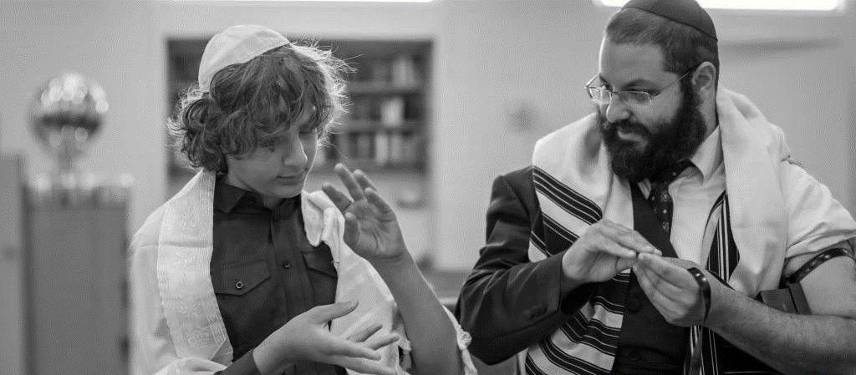
Jewish Leaders with Disabilities
Less than 15% of American Jews can name a Jewish leader with a disability.
.

Slide 20
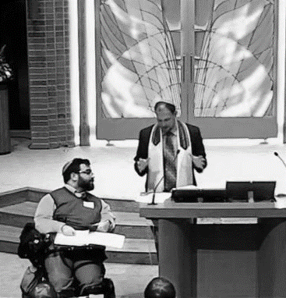
Problem Solving
Problems are best solved by people who have experienced them firsthand and know solutions that work.

Slide 21
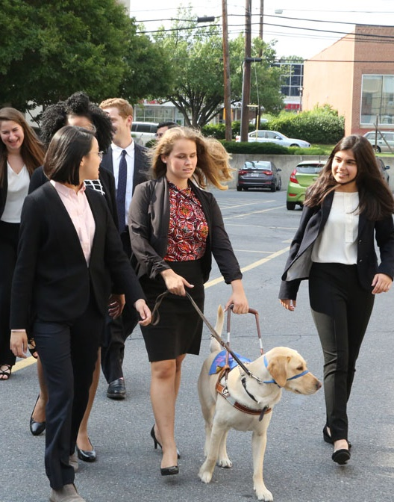
Companies that recruited and supported employees with disabilities have a 30% greater profit margin.
People with disabilities have problem-solving experience, as well as loyalty to their employers.

Slide 22
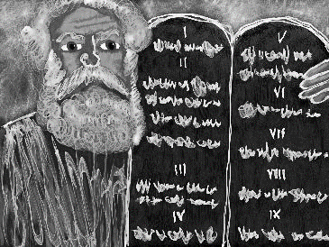
Inspiration from the Torah
The Torah suggests Moses had a speech impediment as he was, "of a heavy mouth and a heavy tongue.”
When Moses protested to God that this made him unable to lead, God said that it made him exactly the leader that was needed.
*Exodus 4:10

Slide 23
Project Moses
Cultivating Authentic Leadership
We will train Jewish leaders with disabilities so they are ready to serve and succeed in Jewish leadership either as lay leaders or as Jewish communal professionals.
Project Moses

Slide 24
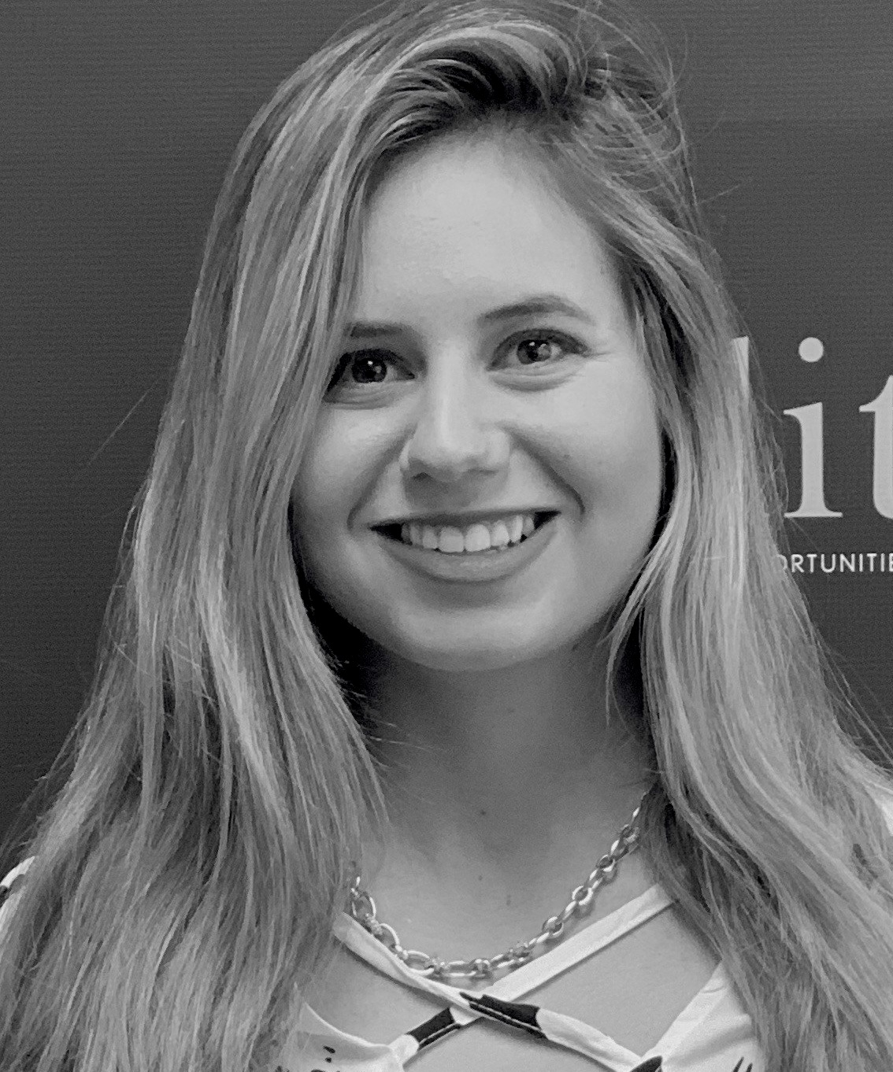
What We Do
  Expose participants to innovation, excellence in leadership, social services, advocacy and philanthropic entities within the Jewish community
  Teach strategic communications, self-advocacy, Jewish knowledge, and strategic decision making
  Teach Jewish organizations how to attract the talent and loyalty of Jews with disabilities to serve as volunteers, staff, and board members

Slide 25
Who We Reach
1
Young Jewish adults with disabilities who were raised after the start of the Jewish inclusion movement
Jews who were born with or acquired disabilities before the inclusion movement
2
3
Jews who were born and educated before acquiring a disability due to accident, aging or illness
TABS (Temporarily Able Bodied) Jews who can benefit from the talents of Jews with disabilities
4

Slide 26
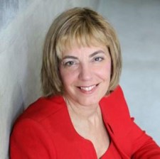
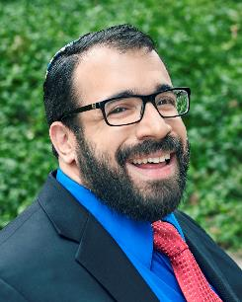
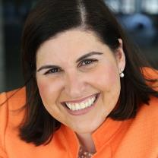
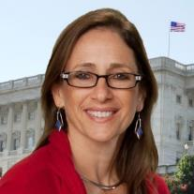
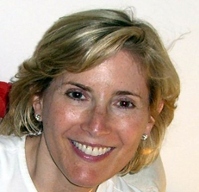
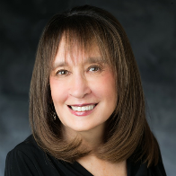
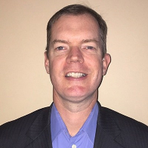
Project Moses Team
Jennifer Mizrahi
Co-Founder/President
Matan Koch
Senior Advisor
She is dyslexic and has ADHD. Three times The Forward has listed her as one of the 50 most influential Jews in North America.
A Harvard trained lawyer who went to Yale for his undergraduate years, he uses a wheelchair. He has spent decades working successfully on inclusion in the Jewish community.
Lauren Appelbaum Communications Director
Debbie Fink
Dir. of Community Outreach
Shelley Richman Cohen
Cofounder/Board Member
Vivian Bass
Board Member
Delbert A. Whetter
Board Member

Slide 27















Our Success will be in Partnerships

Slide 28

Program Goals
36+ Jews with disabilities participate in self-advocacy & communal involvement as volunteers, employees or board members
12+ LA-based Jewish organizations will utilize the skills of Jews with disabilities
6+ Jewish groups will retain board, staff or volunteers who acquired new disabilities
We will track our results via surveys.
Notes:
We will track and report our successes Via survey:
We will track and report on how our new leaders are succeeding and staying on as staff, volunteers and board members at nonprofits and Jewish communal organizations.
We will measure increases in awareness among employers of best practices in disability employment, leadership, and anti-stigma, as well as Jewish people with disabilities serving as Jewish community leaders in LA.

Slide 29
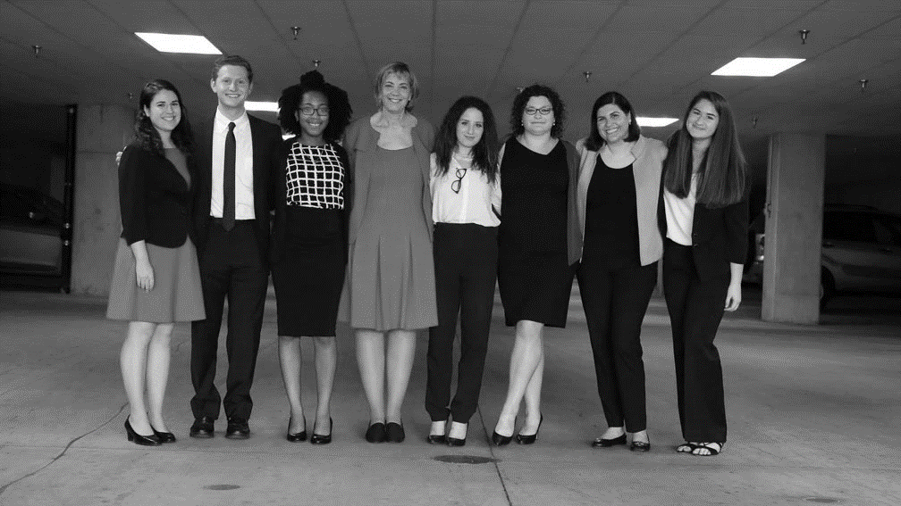
Why RespectAbility?
Why RespectAbility?

Slide 30
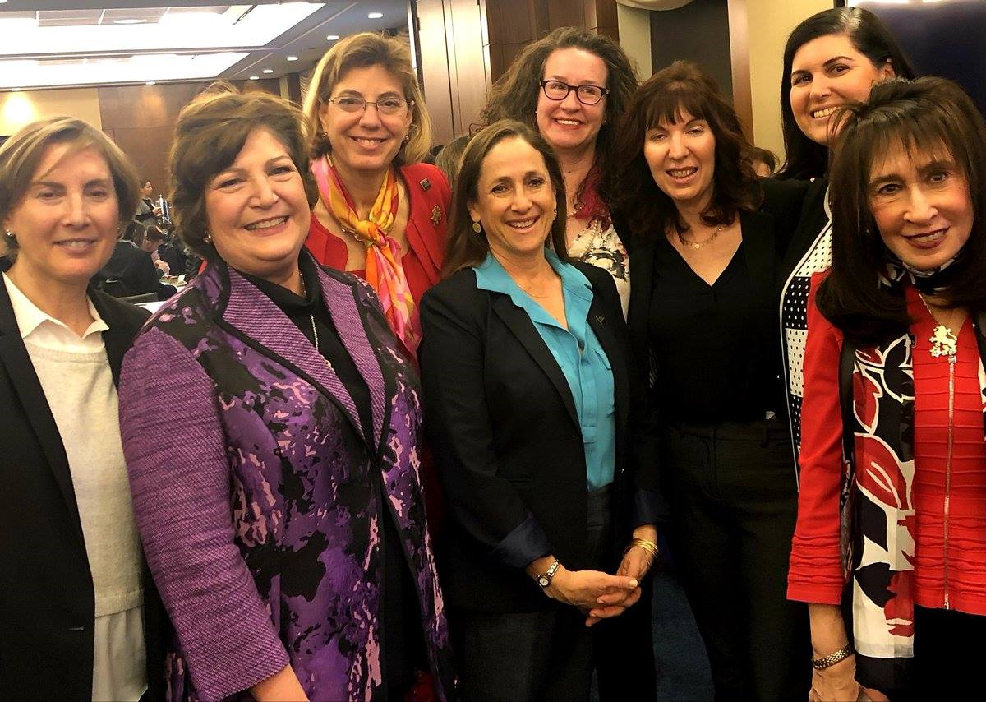
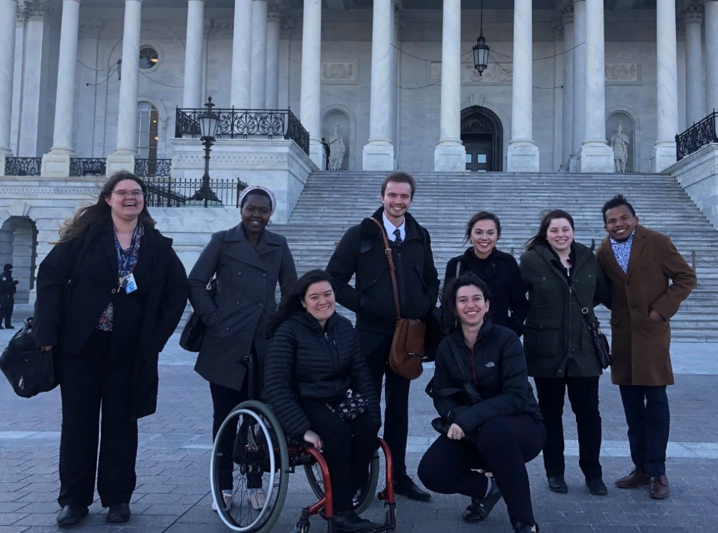
What Makes Us Unique
  Skillful Leadership
  Differentiated Mission
  Politically Savvy
  Demonstrable Progress
  Training Expertise

Slide 31
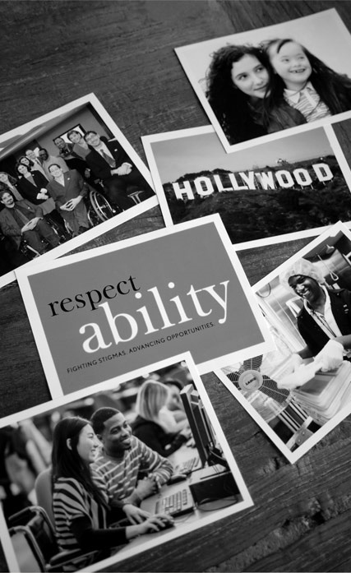
Our Programs Reaching Beyond the Jewish World
Synergy with our LA Programs
Our LA office will have three separate program areas and funding streams:
Stigma reduction/Hollywood outreach
Opportunity agenda/education and employment programming and
Jewish leadership work

Slide 32
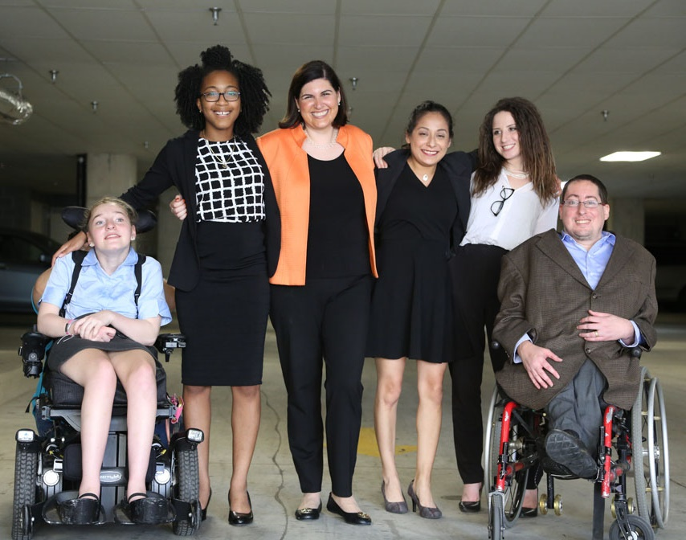
RespectAbility Accomplishments
Helped create a 4x improvement in new jobs for PwDs
Created the first Hollywood Disability Inclusion Toolkit
Provided skill-building tools and training to 1000+ people
Trained 120 young leaders & 550 volunteers
Met with 46 governors to advocate for better education and training

Slide 33
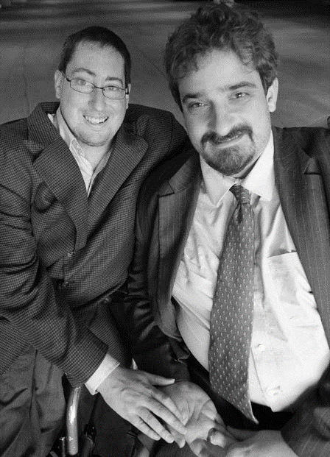
Together we can build a stronger community that will take advantage of the ABILITIES of Jews with disabilities, just like anyone else.

Slide 34
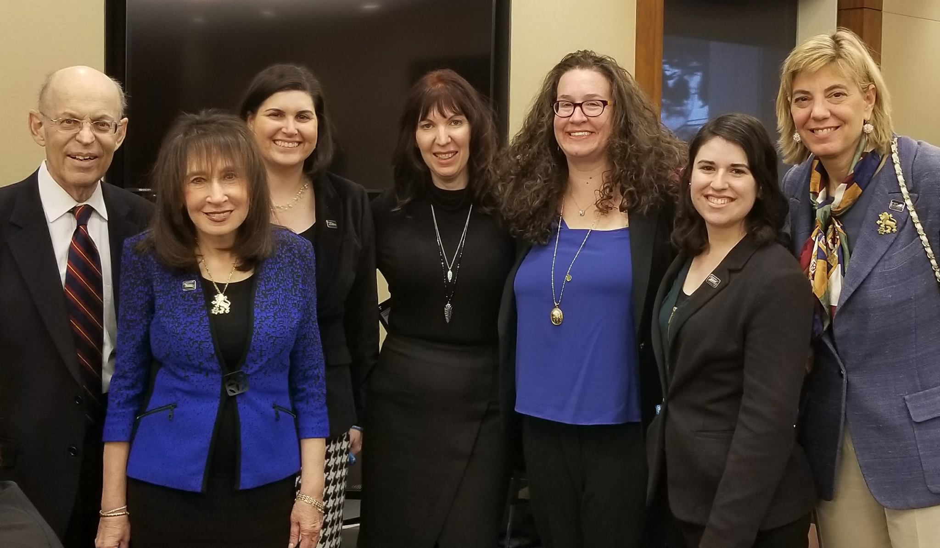
Contact Information
THANK YOU!
Jennifer Laszlo Mizrahi
www.RespectAbility.org
Cell: (202) 365-0787
JenniferM@RespectAbility.org

Slide 35
Appendix

Slide 36
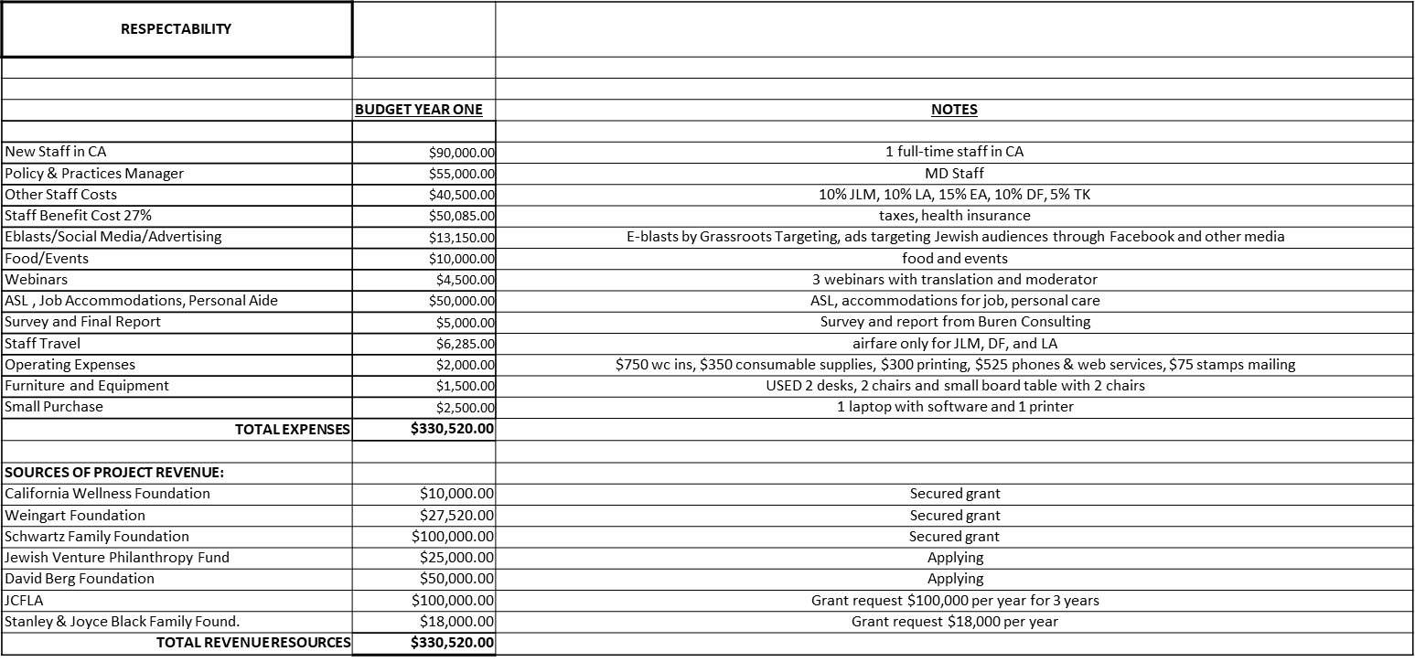
Moses Budget

