Slide 1

03-13 Cover
Women’s Disability Leadership, Inclusion & Advocacy Series
Welcomes You to
ADDING THE ‘D’ TO DIVERSITY:
Enabling Foundations, Nonprofits and Partners to
Include People with Disabilities
Wednesday, March 13, 2019

Slide 2



Thank You!
Thank you to the New York Women’s Foundation and the Coca-Cola Foundation for their direct support for this effort.
And
Thank you to our generous hosts here
at the Guttman Office of AccessABILITY Services

Slide 3
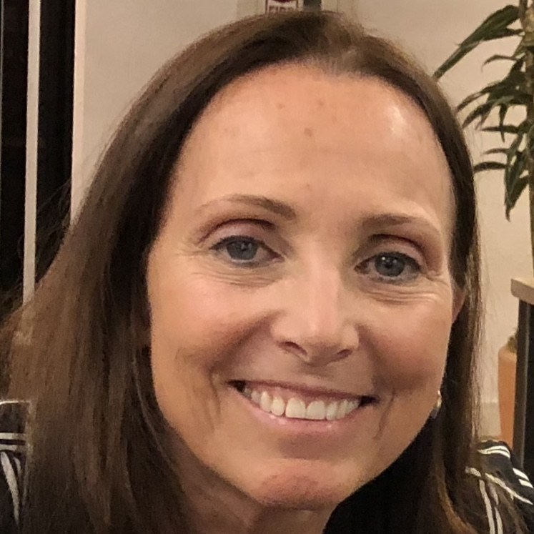
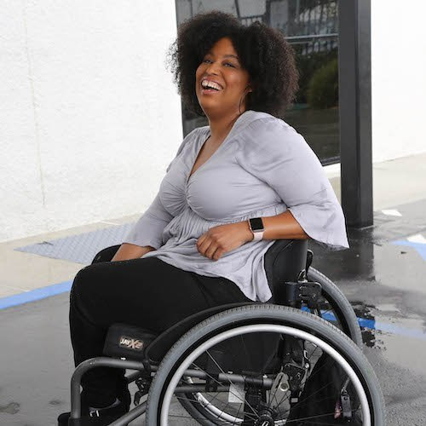
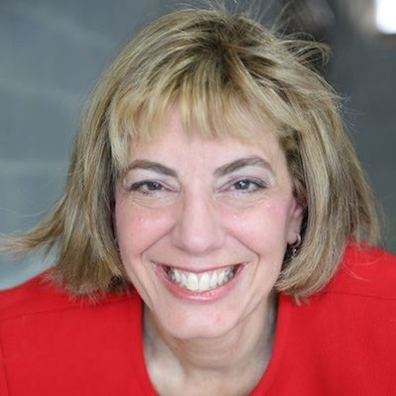
Speakers
Candace Cable
Policy Fellow
Tatiana Lee
Communications Fellow
Jennifer Laszlo Mizrahi
President
Notes:
Characters - e.g. lazy, heroic, pitiful?

Slide 4
Disclaimer
Please note that any views expressed by today’s speakers are solely in a personal capacity and are not intended to represent the views of their companies, organizations or RespectAbility; or to be taken as legal or medical counsel.
Notes:
Characters - e.g. lazy, heroic, pitiful?

Slide 5
Self-Assessment
When in growing up, did you have a friend, family member, neighbor, or schoolmate with a disability? What kinds of interactions did you have? Were you taught any social, cultural or family rules about interacting with them?
Think of some fictional characters from movies, television, books who had a disability. How were they portrayed?
Today at work, are there people with disabilities on your team? Are they given the same respect and responsibilities as others on your team?
Notes:
Characters - e.g. lazy, heroic, pitiful?

Slide 6
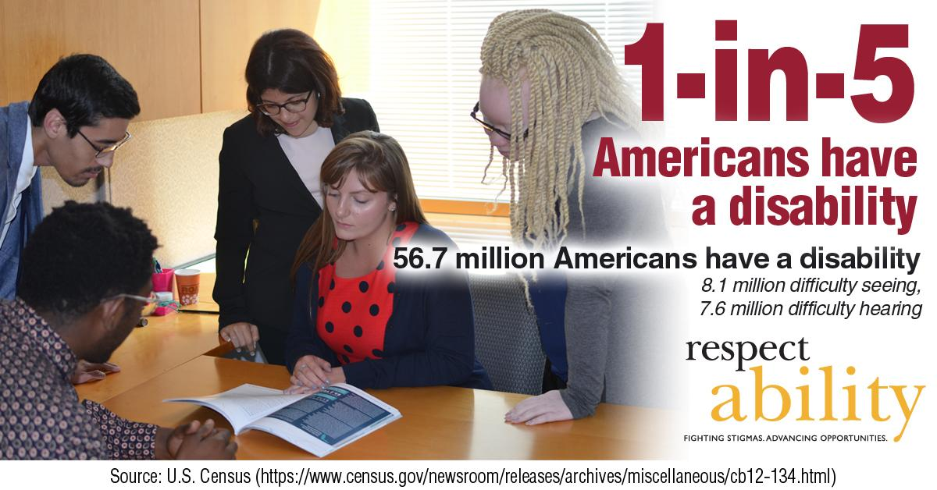
1 in 5 Americans

Slide 7
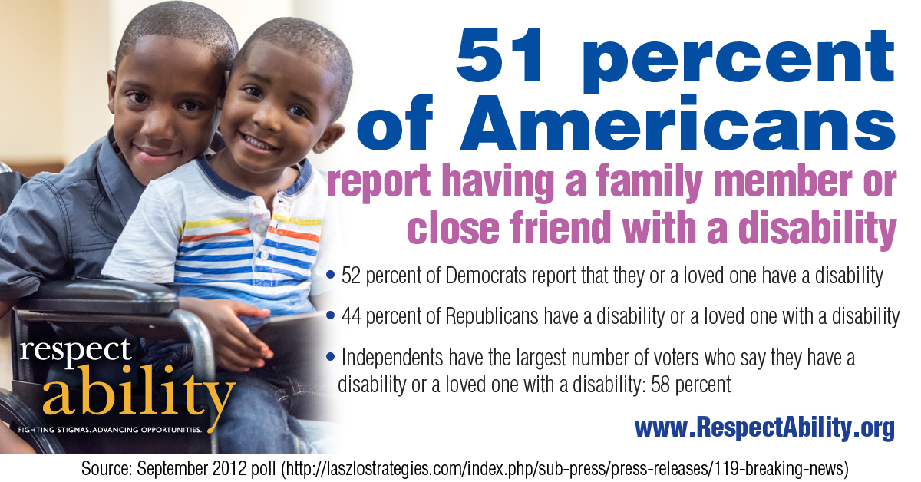
51 Percent….

Slide 8
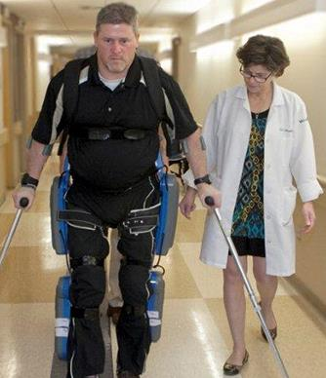
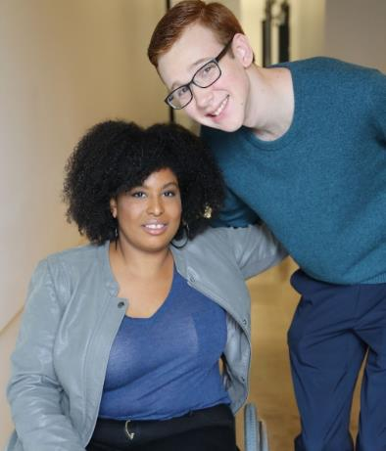
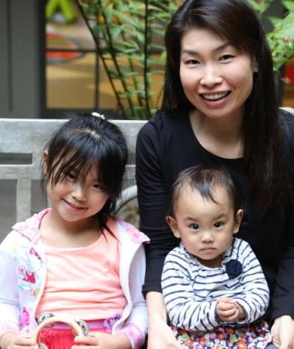
Not All Disabilities Are Visible
Temporary and Permanent
Visible and Invisible
Born with it or Acquired
Anyone can join the disability community at any point.

Slide 9
Disability Impacts Everyone
Disability impacts people of all races, gender identities and orientations, faiths and backgrounds.
However, youth with multiple marinized identities (i.e. person of color + disability) are most likely to enter the school-to-prison pipeline, become homeless.

Slide 10
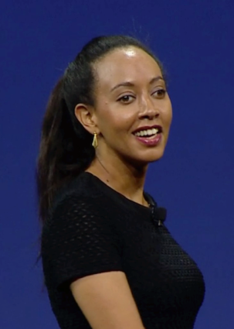

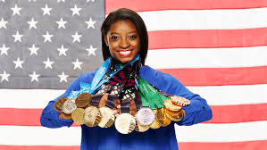
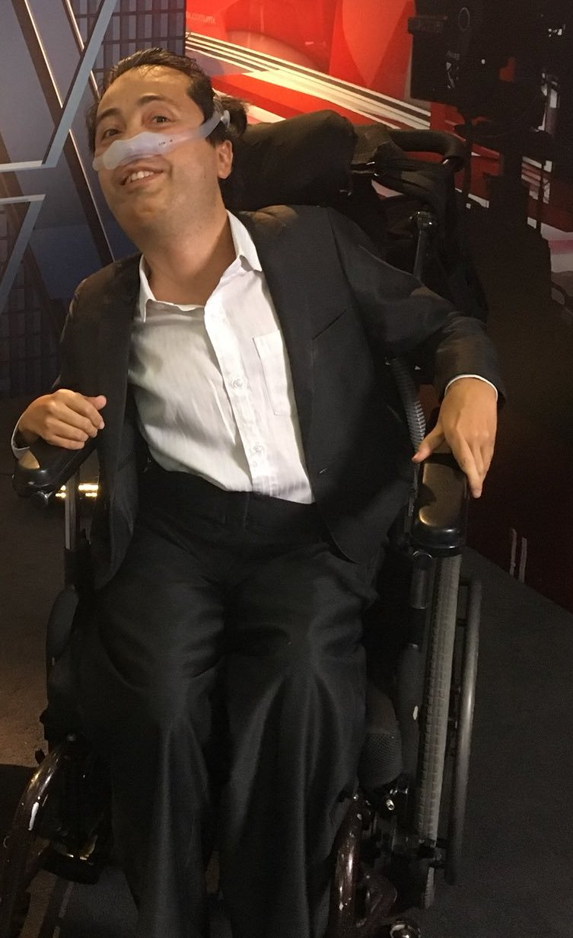
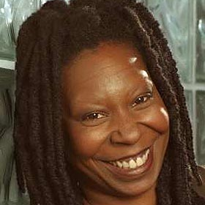
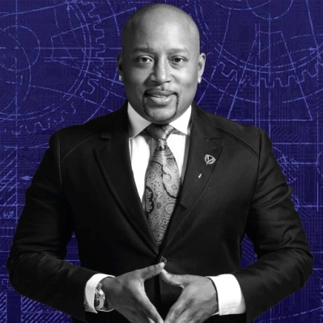
People with disabilities are some of the MOST talented people
Haben Girma:
Deaf and Blind
Harriet Tubman: Seizures
Clarence Page: ADHD
Simone Biles:
ADHD
Maya Angelou: Selective Mutism
Whoopi
Goldberg: Dyslexia
Daymond John: Dyslexia & Hearing Impaired
Victor Pañeda, Activist: Spinal muscular atrophy
Harry Belafonte: Dyslexia

Slide 11

How People React to Disability

Slide 12
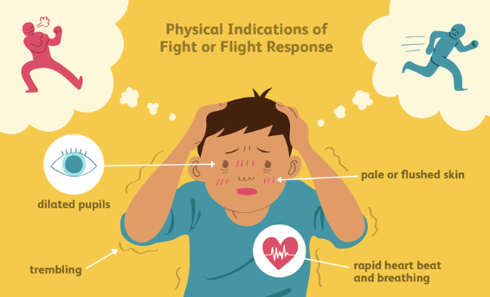
What Happens: Fight or Flight

Slide 13
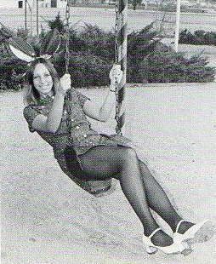
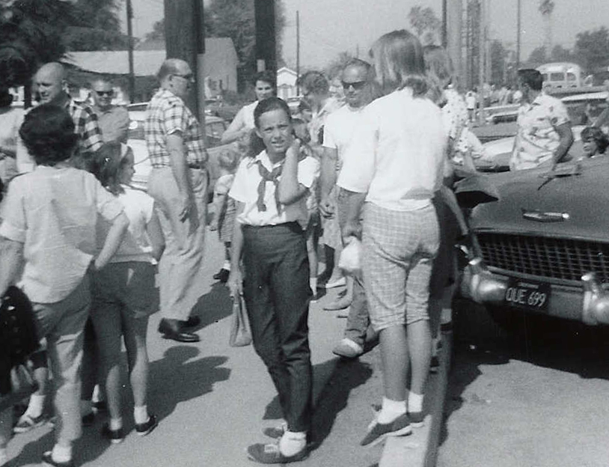
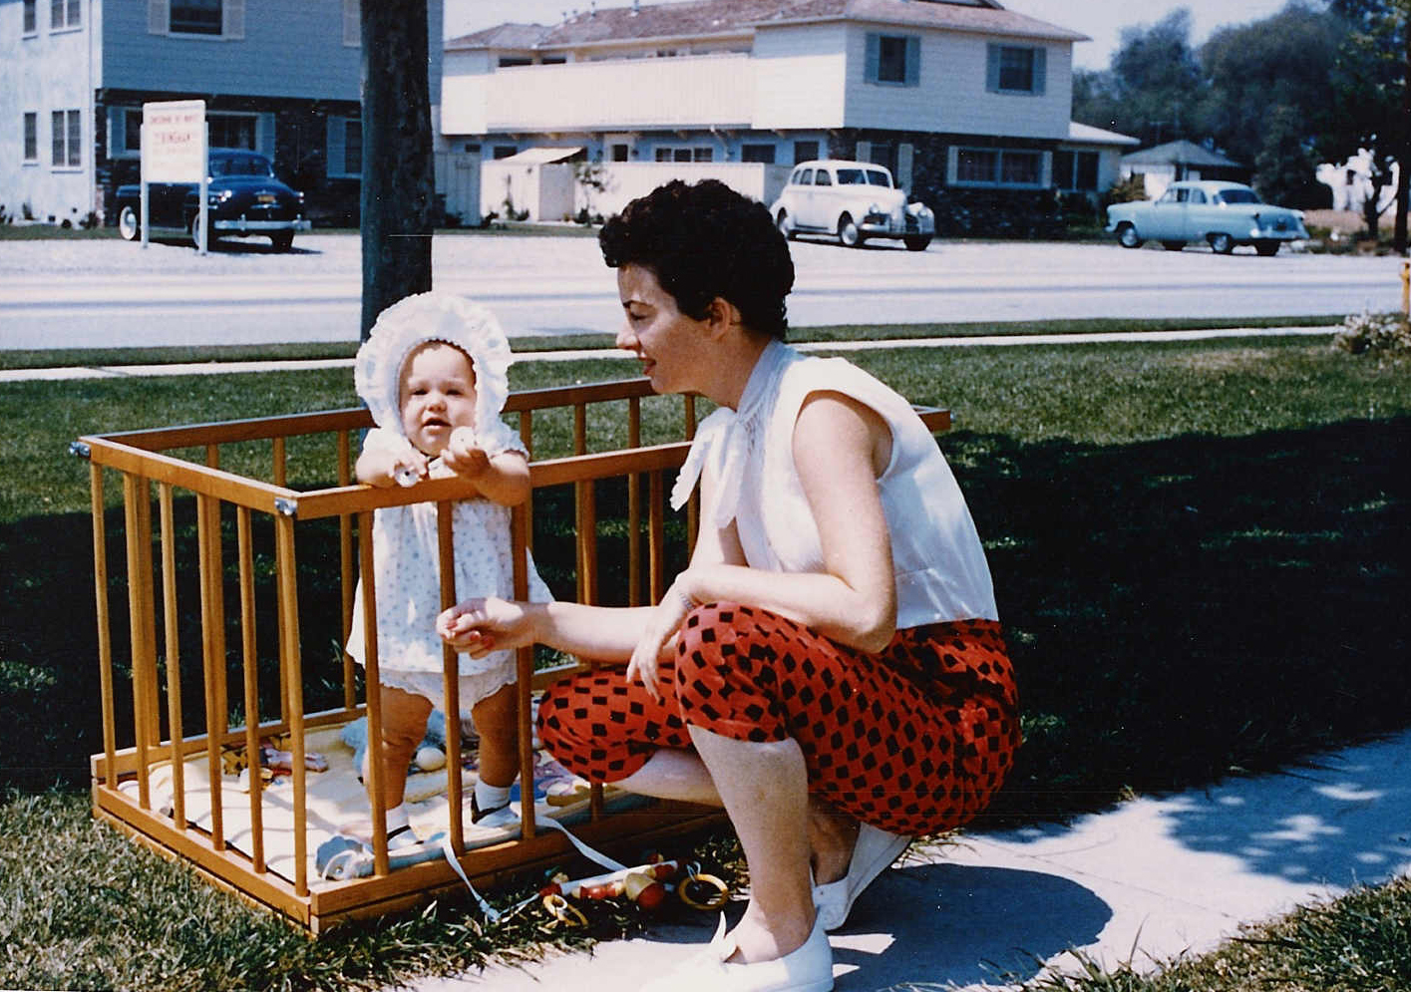
Candace Cable and Implicit Bias

Slide 14
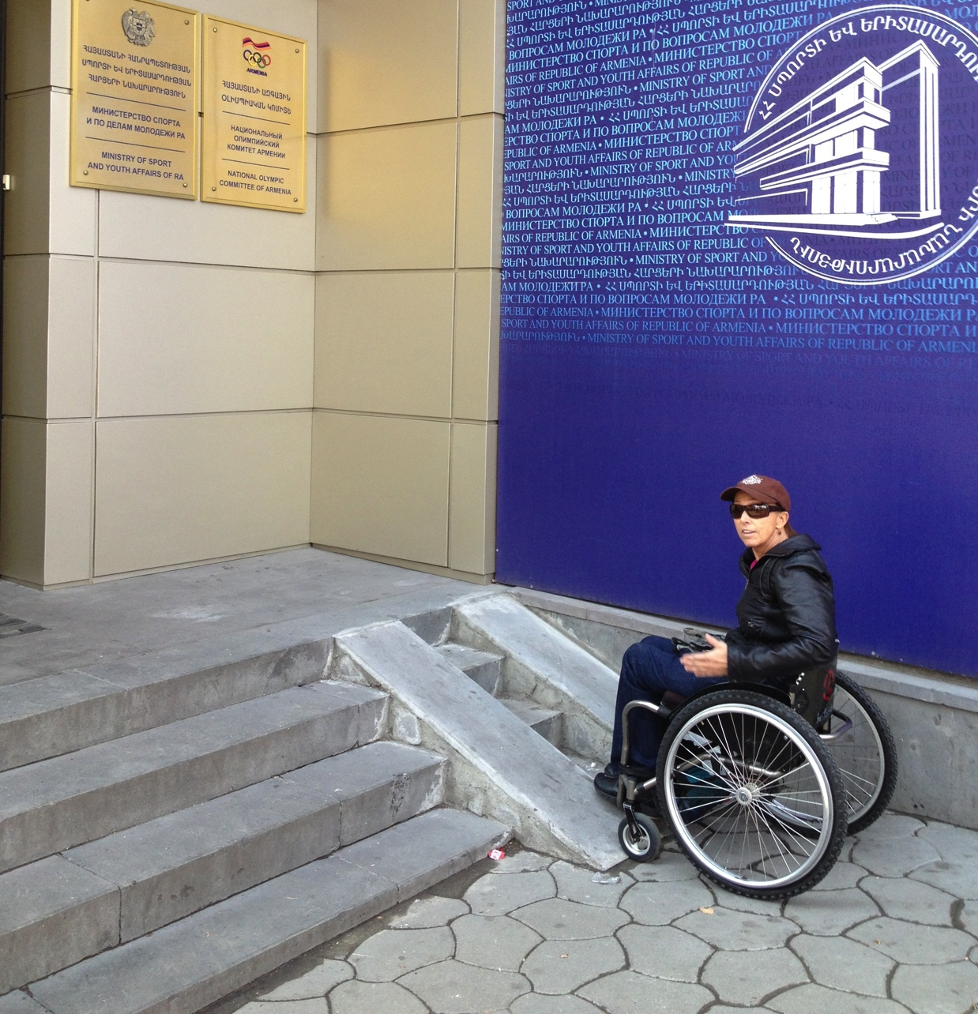
You have to ramp the human mind before ramps will work

Slide 15
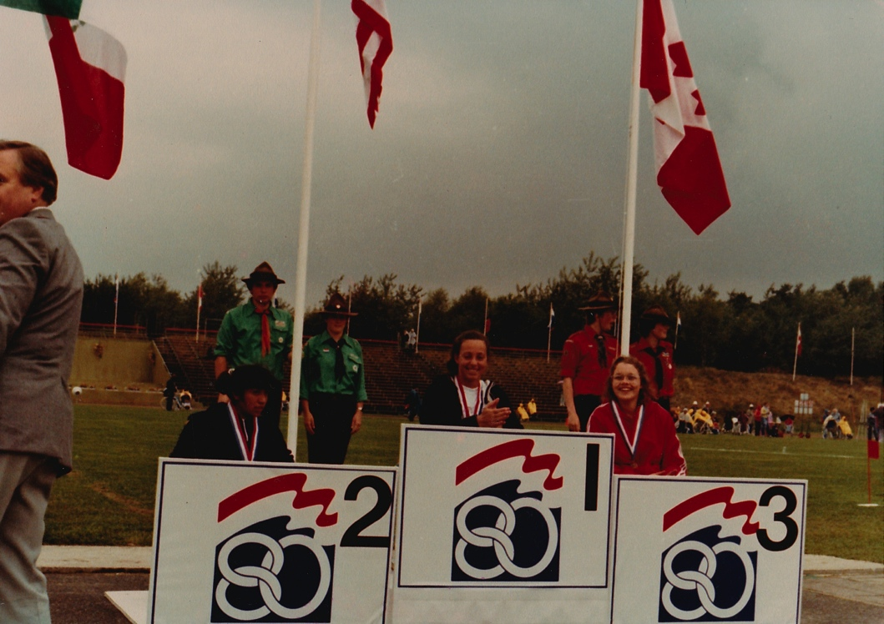
1980 Paralympic Games
, 1st Gold Medal
Moscow said they didn’t have any disabled people
and wouldn’t hold the Paralympic Games!
Hence, the Games were held in Holland

Slide 16

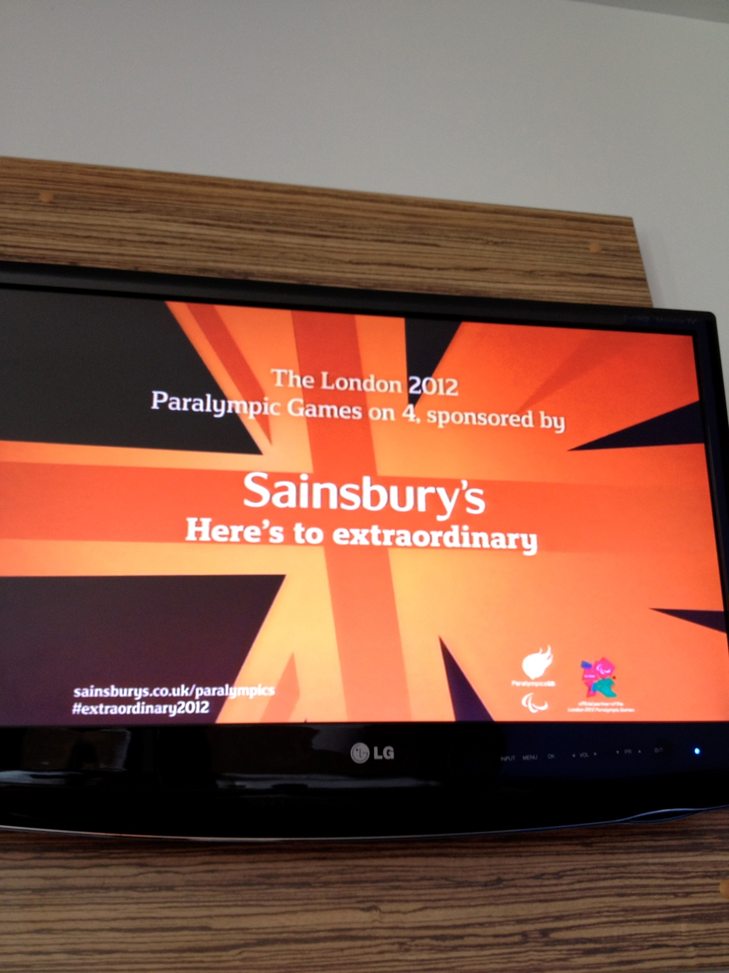
Experiential Education
Can Undo Stigmas

Slide 17
3 Historical Models of Disability
Moral - disability is the result of sins or a curse.
Charity – disabled person needs to be cared for.
Medical - conditions or illnesses needing a cure and institutionalization because of disruptive
Persons with disabilities are viewed as objects of charity, medical treatment and social protection, as the “other”. When rather they should be subjects with rights, who are capable of claiming those rights and making decisions for their lives based on their free and informed consent as well as being active members of society

Slide 18
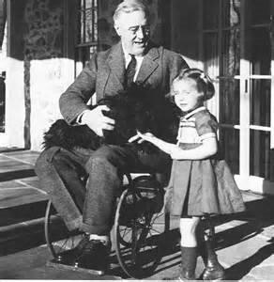
President Franklin Delano Roosevelt’s physical disability was hidden from the public.
Disability History - Prejudice
1900’s: 29 states pass compulsory sterilization laws directed at people with genetic illnesses or conditions. US Supreme Court rules that forced sterilization of people with disabilities is not a violation of constitutional rights.
“Ugly Laws” in some states prohibit persons “diseased, maimed, or deformed” from appearing in public. (San Francisco, 1867 )
Eugenics Movement

Slide 19
Stigma: Disability in the Closet
The Big 3: Aging, Disability & Death
As human beings, our “superpower” is denial
People with non-visible disabilities such as mental health conditions, learning disabilities, being hard of hearing often are “in the closet” about their disabilities.

Slide 20
What is Disability in Social Model?
Disability results from an interaction between a non-inclusive society and individuals:
  Person using a wheelchair might have difficulties gaining employment not because of the wheelchair, but because there are environmental barriers such as inaccessible buses or staircases impede their access
  Person with extreme near-sightedness who does not have access to corrective lenses may not be able to perform daily tasks. This same person with prescription eyeglasses would be able to perform all tasks without problems

Slide 21
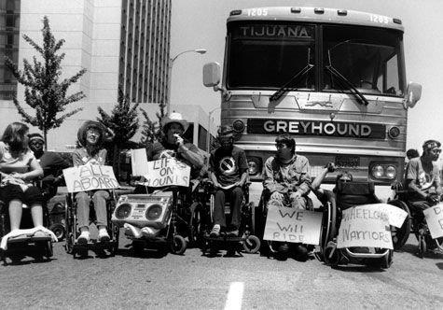

Nothing Without Us
Civil Rights Act outlaws discrimination based on race in public accommodations and employment. Becomes a model for subsequent disability rights legislation. (1964)
Independent Living Movement begins. (1970) First ILC established in Berkeley (1972)
Section 504 of the
Rehab Act signed (1977)
Air Carriers Act ACAA (1986)
Americans with Disabilities Act ADA (1990)

Slide 22
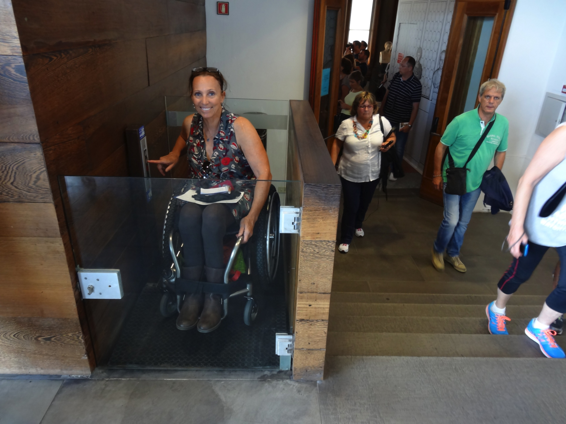
Not Access in the Back but Side by Side-Together

Slide 23
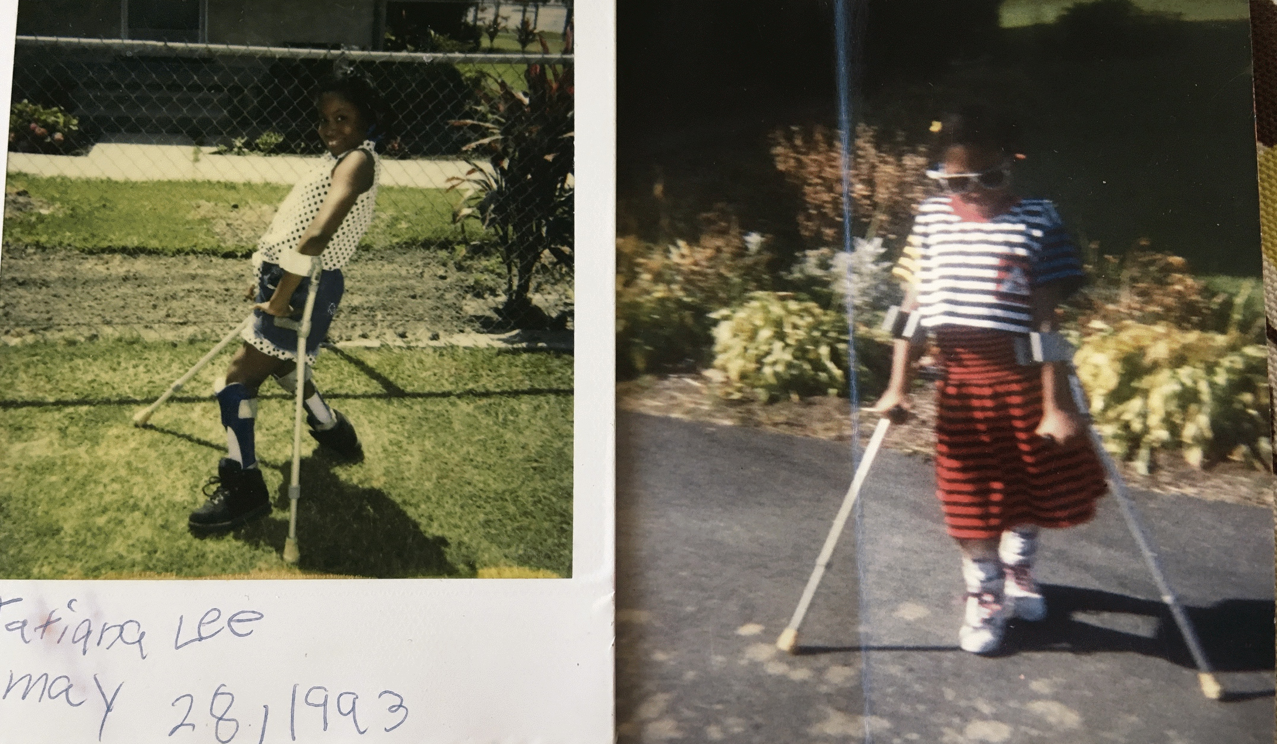
Tatiana Lee

Slide 24
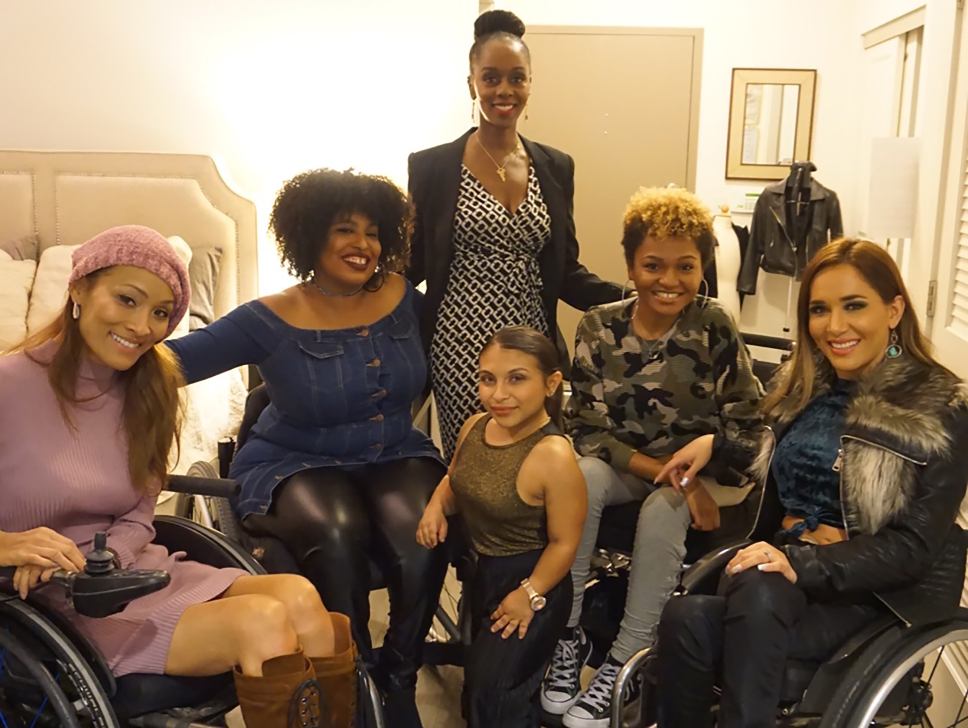
“People Will Stare,
Make It Worth Their While”

Slide 25



People with Disabilities On Screen
The Good Doctor
2.4 % of scripted television characters have disabilities in 2018-2019
NCIS: New Orleans
Almost all portrayals of people with disabilities are white, despite the fact that disability impacts all.
A Quiet Place
Actors without disabilities play more than 95% of all characters with disabilities

Slide 26

Adding the Disability Lens…
By adding the disability lens to your existing work, the Foundation has the opportunity to create better outcomes for people with and without disabilities alike

Slide 27
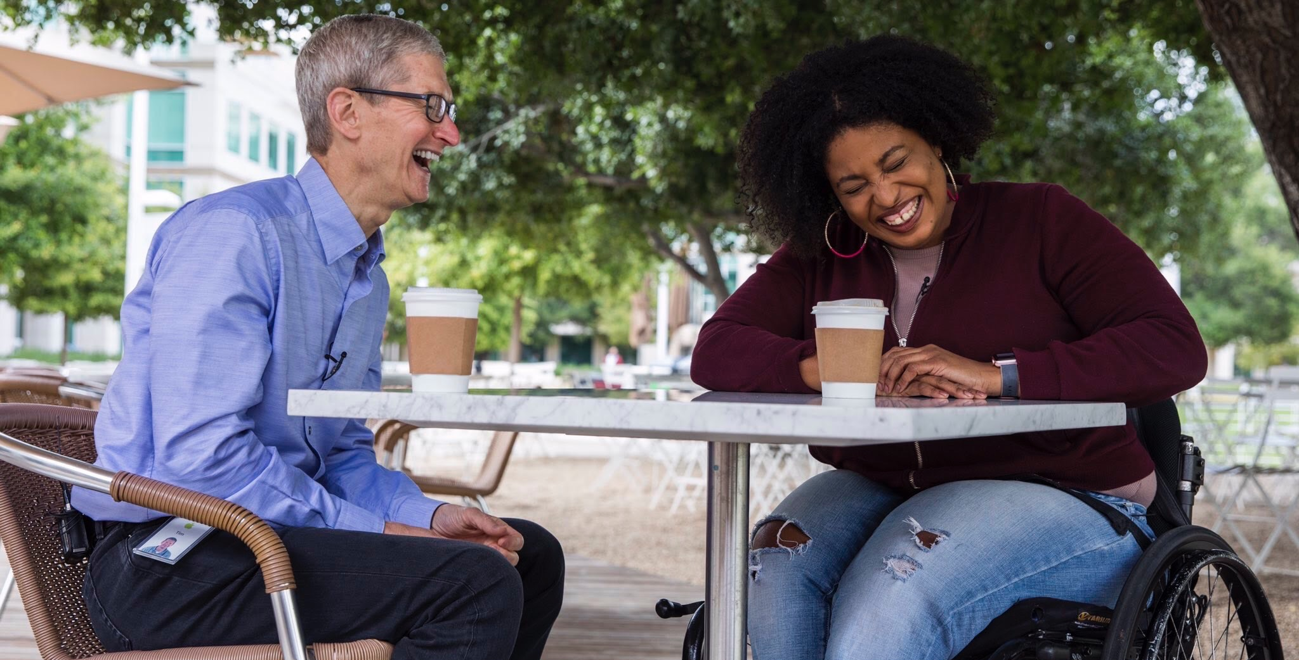
1. Commit publicly to inclusion of people with disabilities
The message that all people are of equal value and must be respected and heard fairly, must be communicated by President and Board
Pictured: Coffee with Tim Cook and Tatiana Lee
27

Slide 28
2. When PwDs aren’t at the table, they are on the menu
When you add a disability lens to your philanthropy/nonprofit you will be more successful
Disability impacts people of all races, genders, and backgrounds. However, youth with multiple minority status (i.e. person of color /English language learners + disability face double discrimination) are most likely to enter the school-to-prison pipeline, become homeless and/or live in poverty. Be sure to look at intersectional issues.
Organizations are at their best when they welcome, respect, and include people of all backgrounds. This includes people with disabilities. Indeed, problems are best solved by working with people who have experienced them first hand and know solutions that work. Just like issues that impact people of different racial, ethnic or other backgrounds, people with disabilities should be involved in solving issues that impact them.

Slide 29
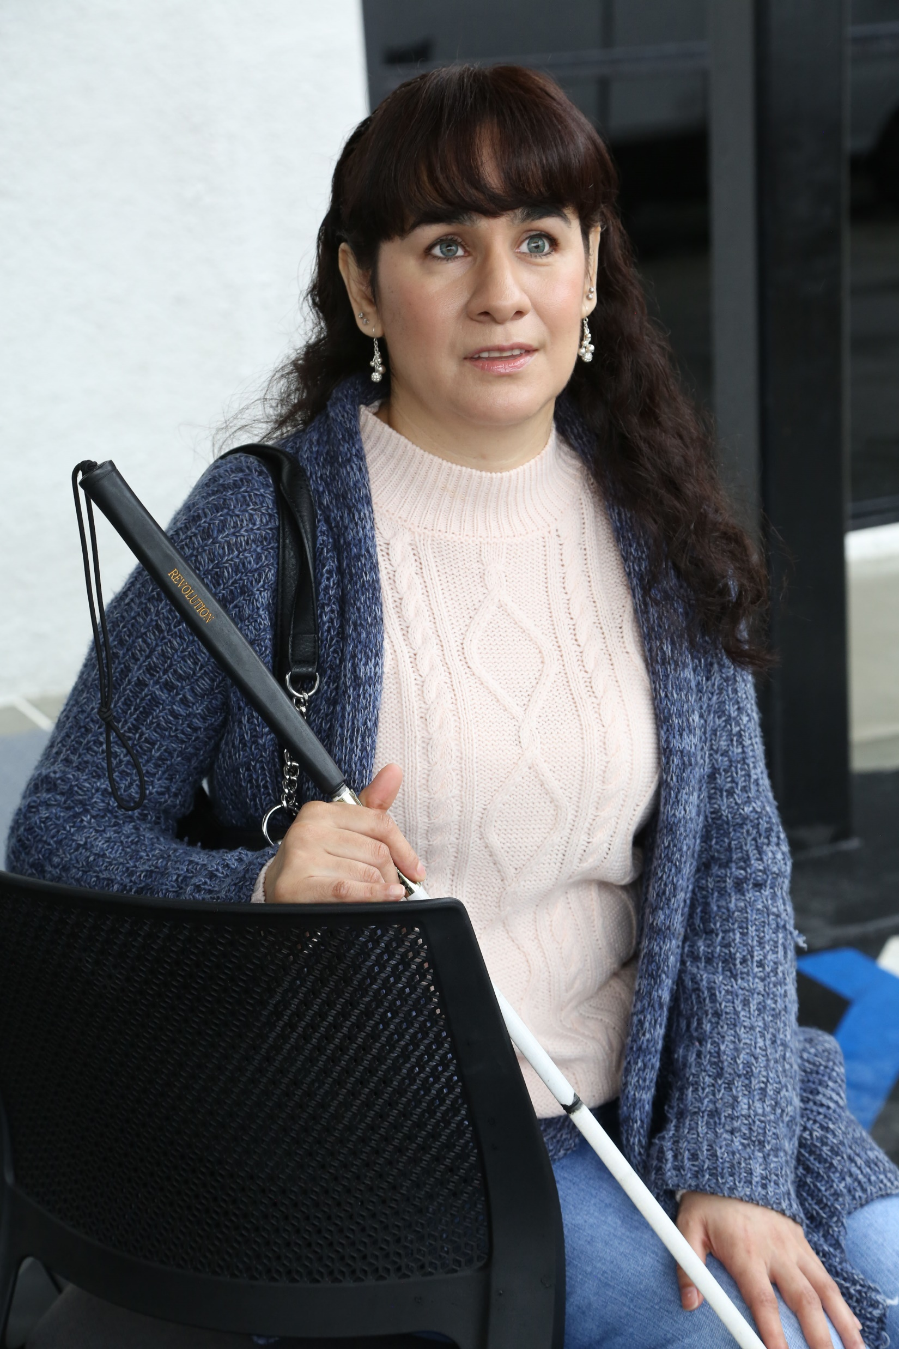
3. Foster an inclusive environment
Use “person first” language when appropriate
Have an accommodation policy
Made a conscious decision and effort to seek out and include certain demographic groups whether that was gender, race, or sexual orientation
Webinar on Disability Etiquette

Slide 30
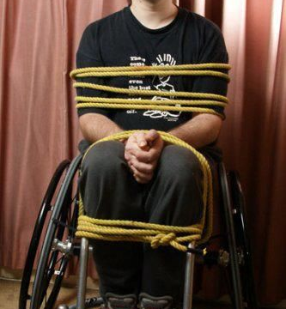
What we say makes a difference
DON’T USE:
Wheelchair bound
Confined to a wheelchair
Wheelchair person
Wheelchair user/rider

Slide 31
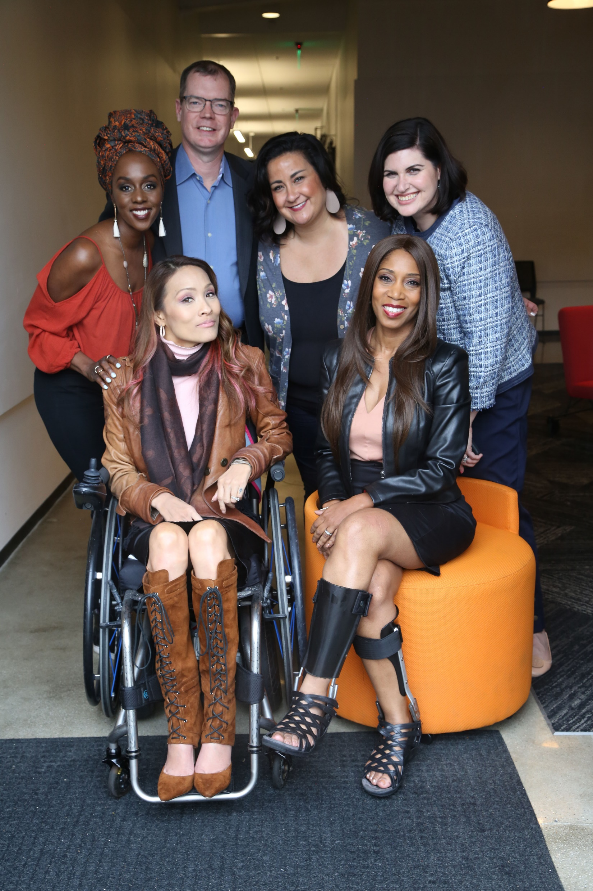
4. Work with people with disabilities, not for them
RespectAbility, Best Practices for Employers
TAPAbility, which can source talent
AskJan.org, which can problem solve inclusive employment questions for free
Diverse Managers - Philanthropy’s Next Hurdle

Slide 32


5. Have an inclusion point person or committee
Inclusion Statement and how to make requests for disability accommodations on your accessible website.
HR Evaluation and program manager evaluation includes diversity as a performance metric.
Resource on Disability Inclusion
Ford’s Push for Disability Rights Should Be a Model for Philanthropy

Slide 33
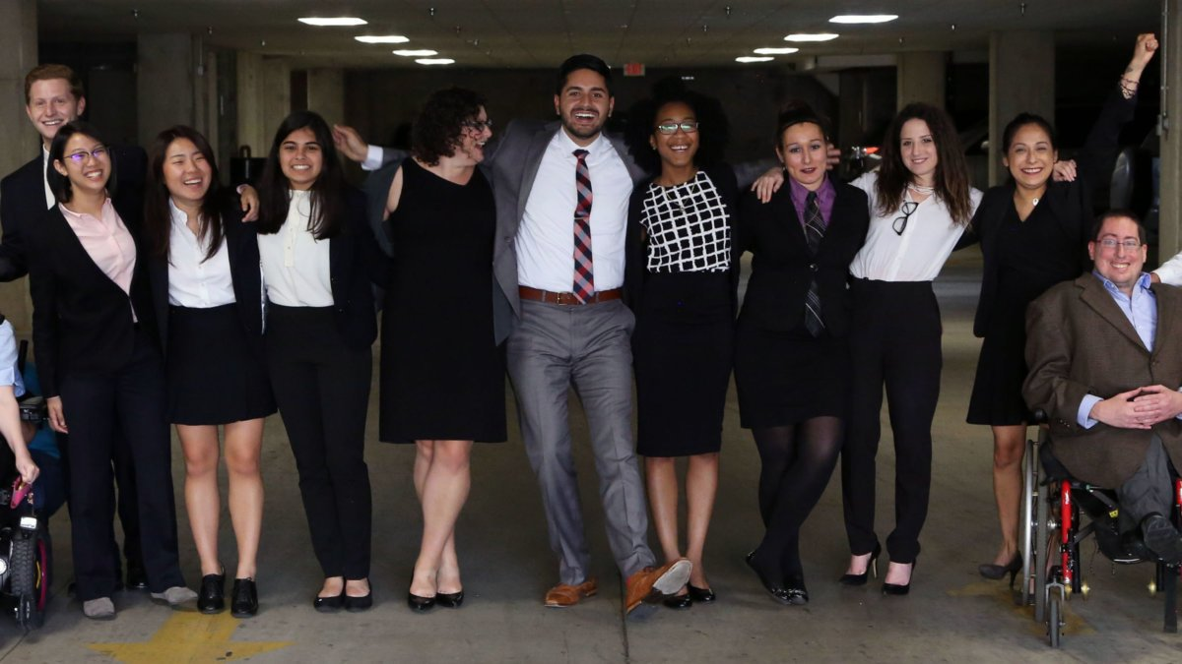
6. Include people with disabilities in your marketing
Example: Photos on website should include individuals with visible disabilities
Toolkit for Media Representation

Slide 34
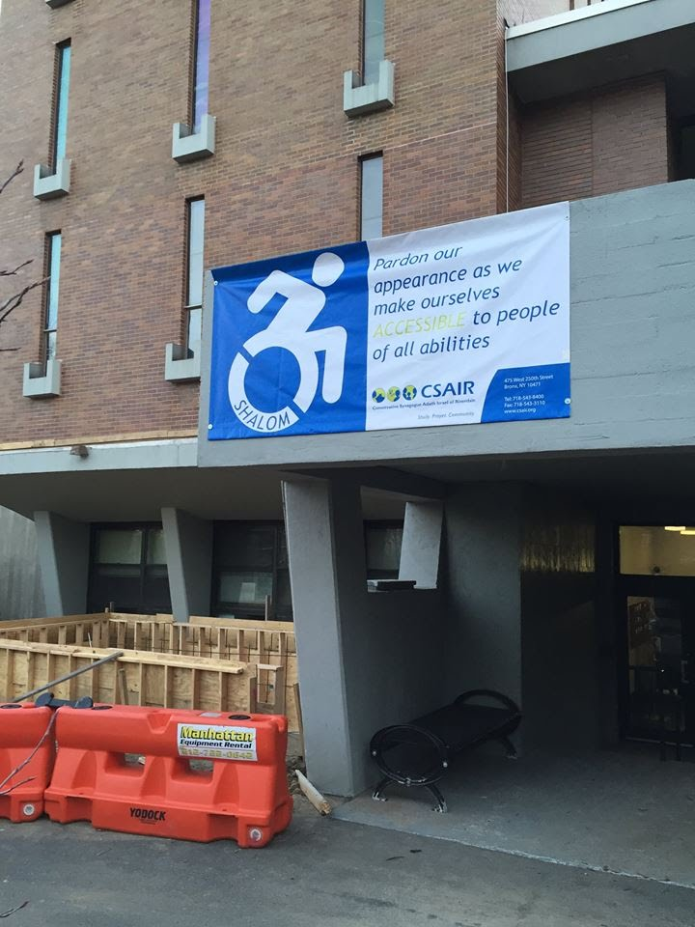
7. Ensure website and online resources are accessible
Websites need to be set up for use by screen readers and people who need captions.
Caption videos
Make documents and presentations accessible
See RespectAbility’s webinar on web accessibility

Slide 35
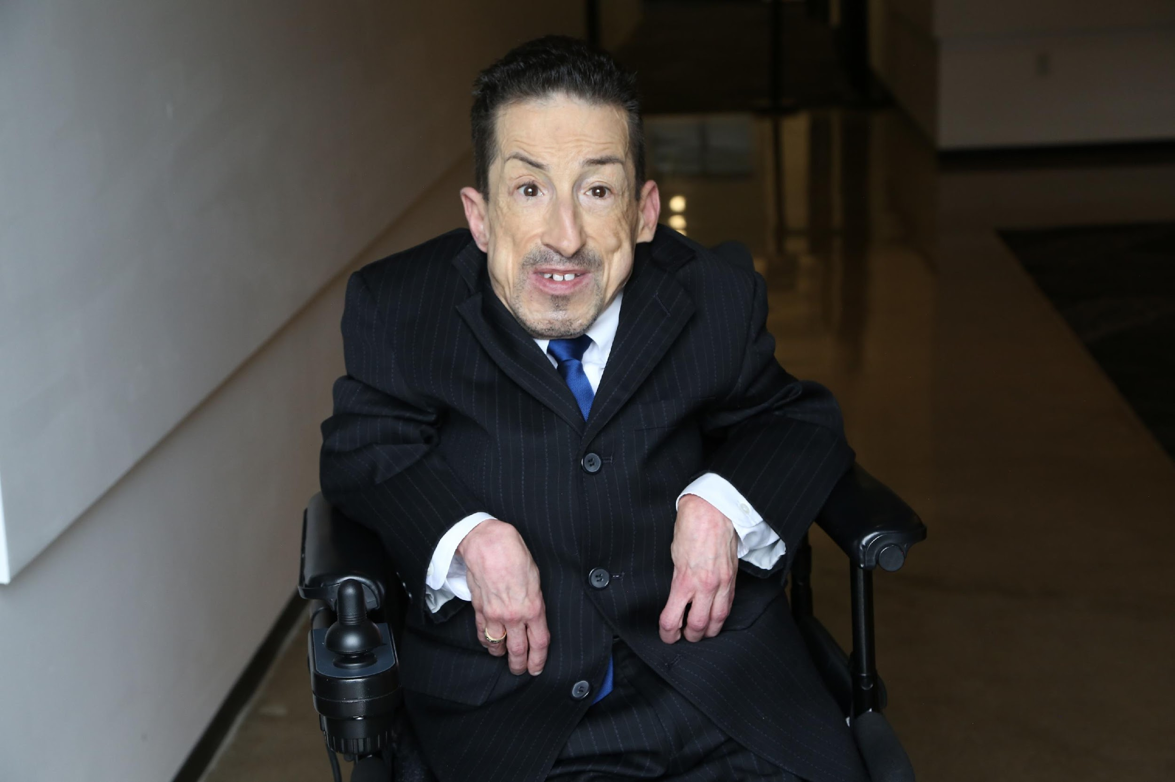
8. Ensure accessibility of office and events
Physical Accessibility
Event Checklist
All of the following must be accessible:
  Invitation/notification of event
  Facilities
  Communication
  Staff/Volunteers

Slide 36

Accessibility: ADA Accessible
Resource Guide
  The Chicago Community Trust
http://www.cct.org/wp-content/uploads/2015/08/2015ADAComplianceGuide.pdf

Slide 37
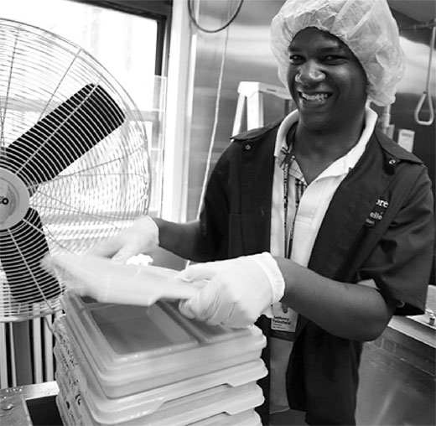
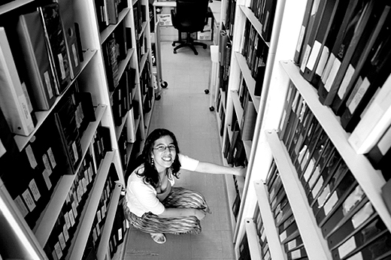
9. Use vendors who are or hire people with disabilities
Invest in social enterprises who hire people with and without disabilities
Social Enterprise: Creating Employment Opportunities for People with Disabilities

Slide 38
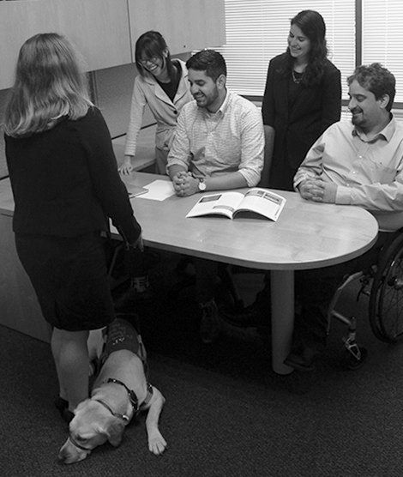
10. Promote a disability lens among grantees/members
Ask Your Grantees/Members About:
Meaningful and inclusive policies and/or programs
Public commitments on website and materials
Employing people with disabilities at all levels
Inviting people to request accommodations

Slide 39

10. Promote a disability lens among grantees (cont.)
Ask Your Grantees/Members About
Physical accessibility of office and programs
Website accessibility
Video captioning
Internal and external educational efforts

Slide 40
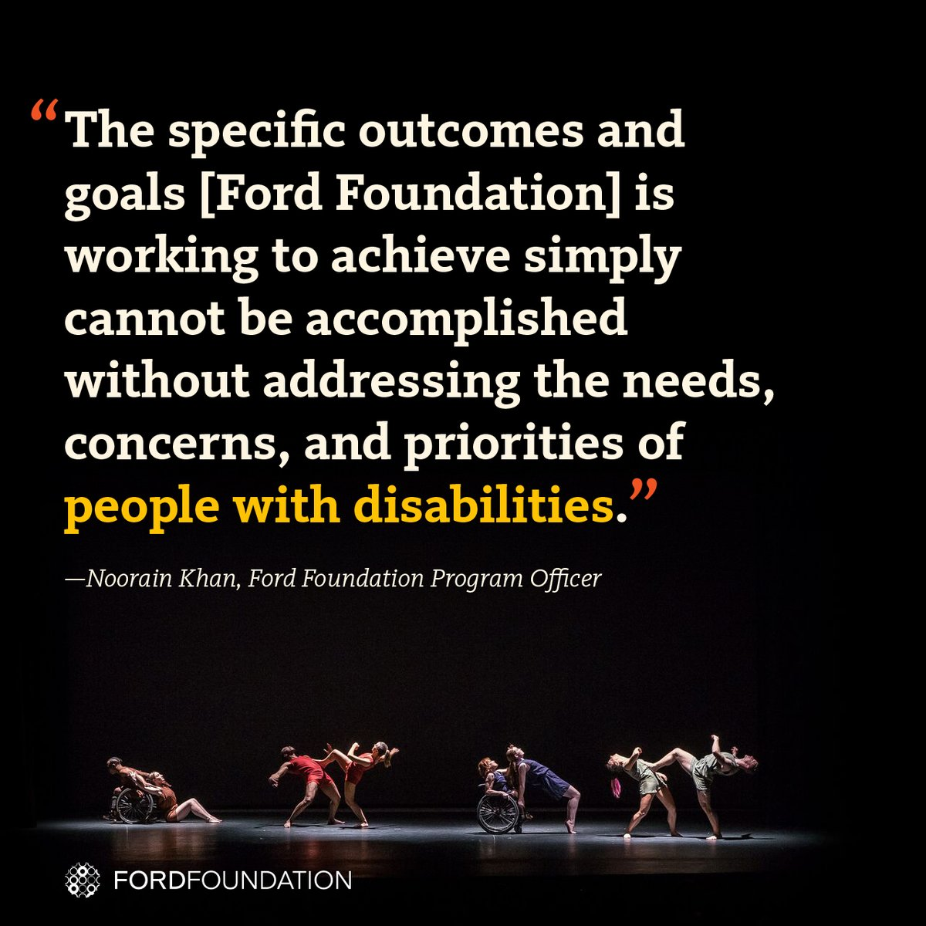
Examples: The Ford Foundation Includes Disability
The Ford Foundation has recently added the disability lens to their work http://bit.ly/2jOl3FL
Additionally, Ford’s CEO Darren Walker spoke extensively on why this impacts other funders as well: http://bit.ly/2nr4moJ
Here is Darren Walker’s original letter: http://bit.ly/2Bxy0Lk
This is the response of the co-authors of the Americans with Disabilities Act: http://bit.ly/2AueSyx
Watch the Darren Walker-Sen. Tom Harkin interview on YouTube: http://bit.ly/2zrgFpE
40

Slide 41


Examples: MacArthur Foundation newly including disability
The MacArthur Foundation has also recently added the disability lens to their work with their new 100 Million Dollar Grant
See: https://www.macfound.org/press/perspectives/nothing-about-us-without-us
And: https://www.macfound.org/media/files/Checklist_for_MacArthur_100Change_Semifinalists.pdf
Plus: https://www.macfound.org/programs/100change
41

Slide 42
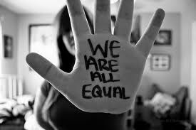

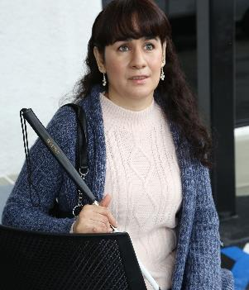
To Recap…
1
Commit publicly to inclusion of people with disabilities
2
Apply a disability lens to your work
3
Foster an inclusive environment
Notes:
1) The message that all people are of equal value and must be respected and heard fairly, must be communicated by President and Board
2) Disability impacts people of all races, genders, and backgrounds. However, youth with multiple minority status (i.e. person of color /English language learners + disability face double discrimination) are most likely to enter the school-to-prison pipeline, become homeless and/or live in poverty.
It’s Time to Add a Disability Lens to Our Philanthropy
3) Use “person first” language when appropriate
Have an accommodation policy
Made a conscious decision and effort to seek out and include certain demographic groups whether that was gender, race, or sexual orientation
Webinar on Disability Etiquette

Slide 43
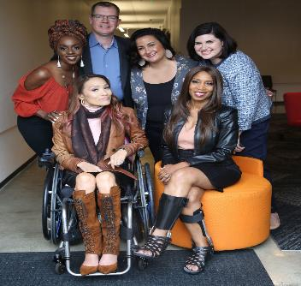
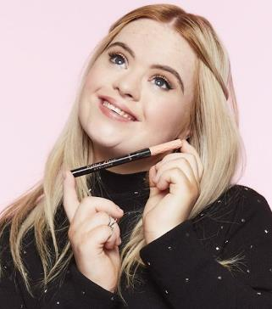
To Recap (Cont.)…
4
Work with people with disabilities, not for them.
5
Have an inclusion point person or committee
6
Include people with disabilities in your marketing
Notes:
4)
RespectAbility, Best Practices for Employers
TAPAbility, which can source talent
AskJan.org, which can problem solve inclusive employment questions for free
Diverse Managers - Philanthropy’s Next Hurdle
5)
Inclusion Statement and how to make requests for disability accommodations on your accessible website.
HR Evaluation and program manager evaluation includes diversity as a performance metric.
Resource on Disability Inclusion
Ford’s Push for Disability Rights Should Be a Model for Philanthropy
6)
Example: Photos on website should include individuals with visible disabilities
Toolkit for Media Representation

Slide 44
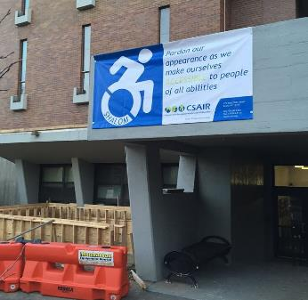
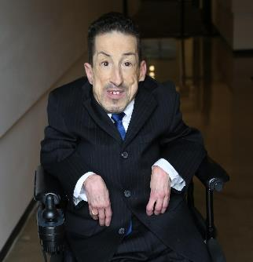
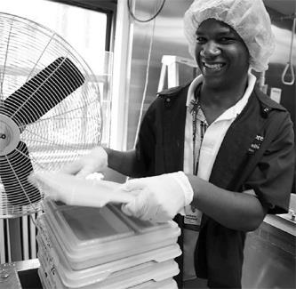
To Recap (Cont. 3)…
7
Ensure website and resources are accessible
8
Ensure accessibility of office and events
9
Use vendors who hire people with disabilities
Notes:
7) Websites need to be set up for use by screen readers and people who need captions.
Caption videos
Make documents and presentations accessible
See Webinar
See RespectAbility’s webinar on web accessibility
8)
Physical Accessibility
Event Checklist
All of the following must be accessible:
Invitation/notification of event
Facilities
Communication
Staff/Volunteers
9) Invest in social enterprises who hire people with and without disabilities
Social Enterprise: Creating Employment Opportunities for People with Disabilities

Slide 45

To Recap (Cont. 4)…
You Can Do It!!!
10
Promote a disability lens among grantees
Notes:
Ask your members about:
Meaningful and inclusive policies and/or programs
Public commitments on website and materials
Employing people with disabilities at all levels
Inviting people to request accommodations
Physical accessibility of office and programs
Website accessibility
Video captioning
Internal and external educational efforts

Slide 46
Resources/Contact Information
StateData: The National Report on Employment Services and Outcomes, 2015 (data from 2014)
2015 Disability Status Report United States, Cornell University, 2015: www.disabilitystatistics.org
Fedspending: www.fedspending.org
Job Accommodation Network: https://askjan.org/
State Vocational Rehabilitation Agency: http://wdcrobcolp01.ed.gov/Programs/EROD/org_list.cfm?category_cd=SVR
“Why intersectionality can’t wait: https://www.washingtonpost.com/news/in-theory/wp/2015/09/24/why-intersectionality-cant-wait/?utm_term=.78c0611a8cb0
Kimberlé Crenshaw Explains The Power Of Intersectional Feminism In 1 Minute: https://www.huffingtonpost.com/entry/kimberle-crenshaw-intersectional-feminism_us_598de38de4b090964296a34d
Jennifer Laszlo Mizrahi
www.RespectAbility.org
Cell: (202) 365-0787
JenniferM@RespectAbility.org
Twitter: @respect_ability / @jewishinclusion
Facebook: https://www.facebook.com/RespectAbilityUSA and https://www.facebook.com/RespectAbility4All/

Slide 47

Q&A

Slide 48
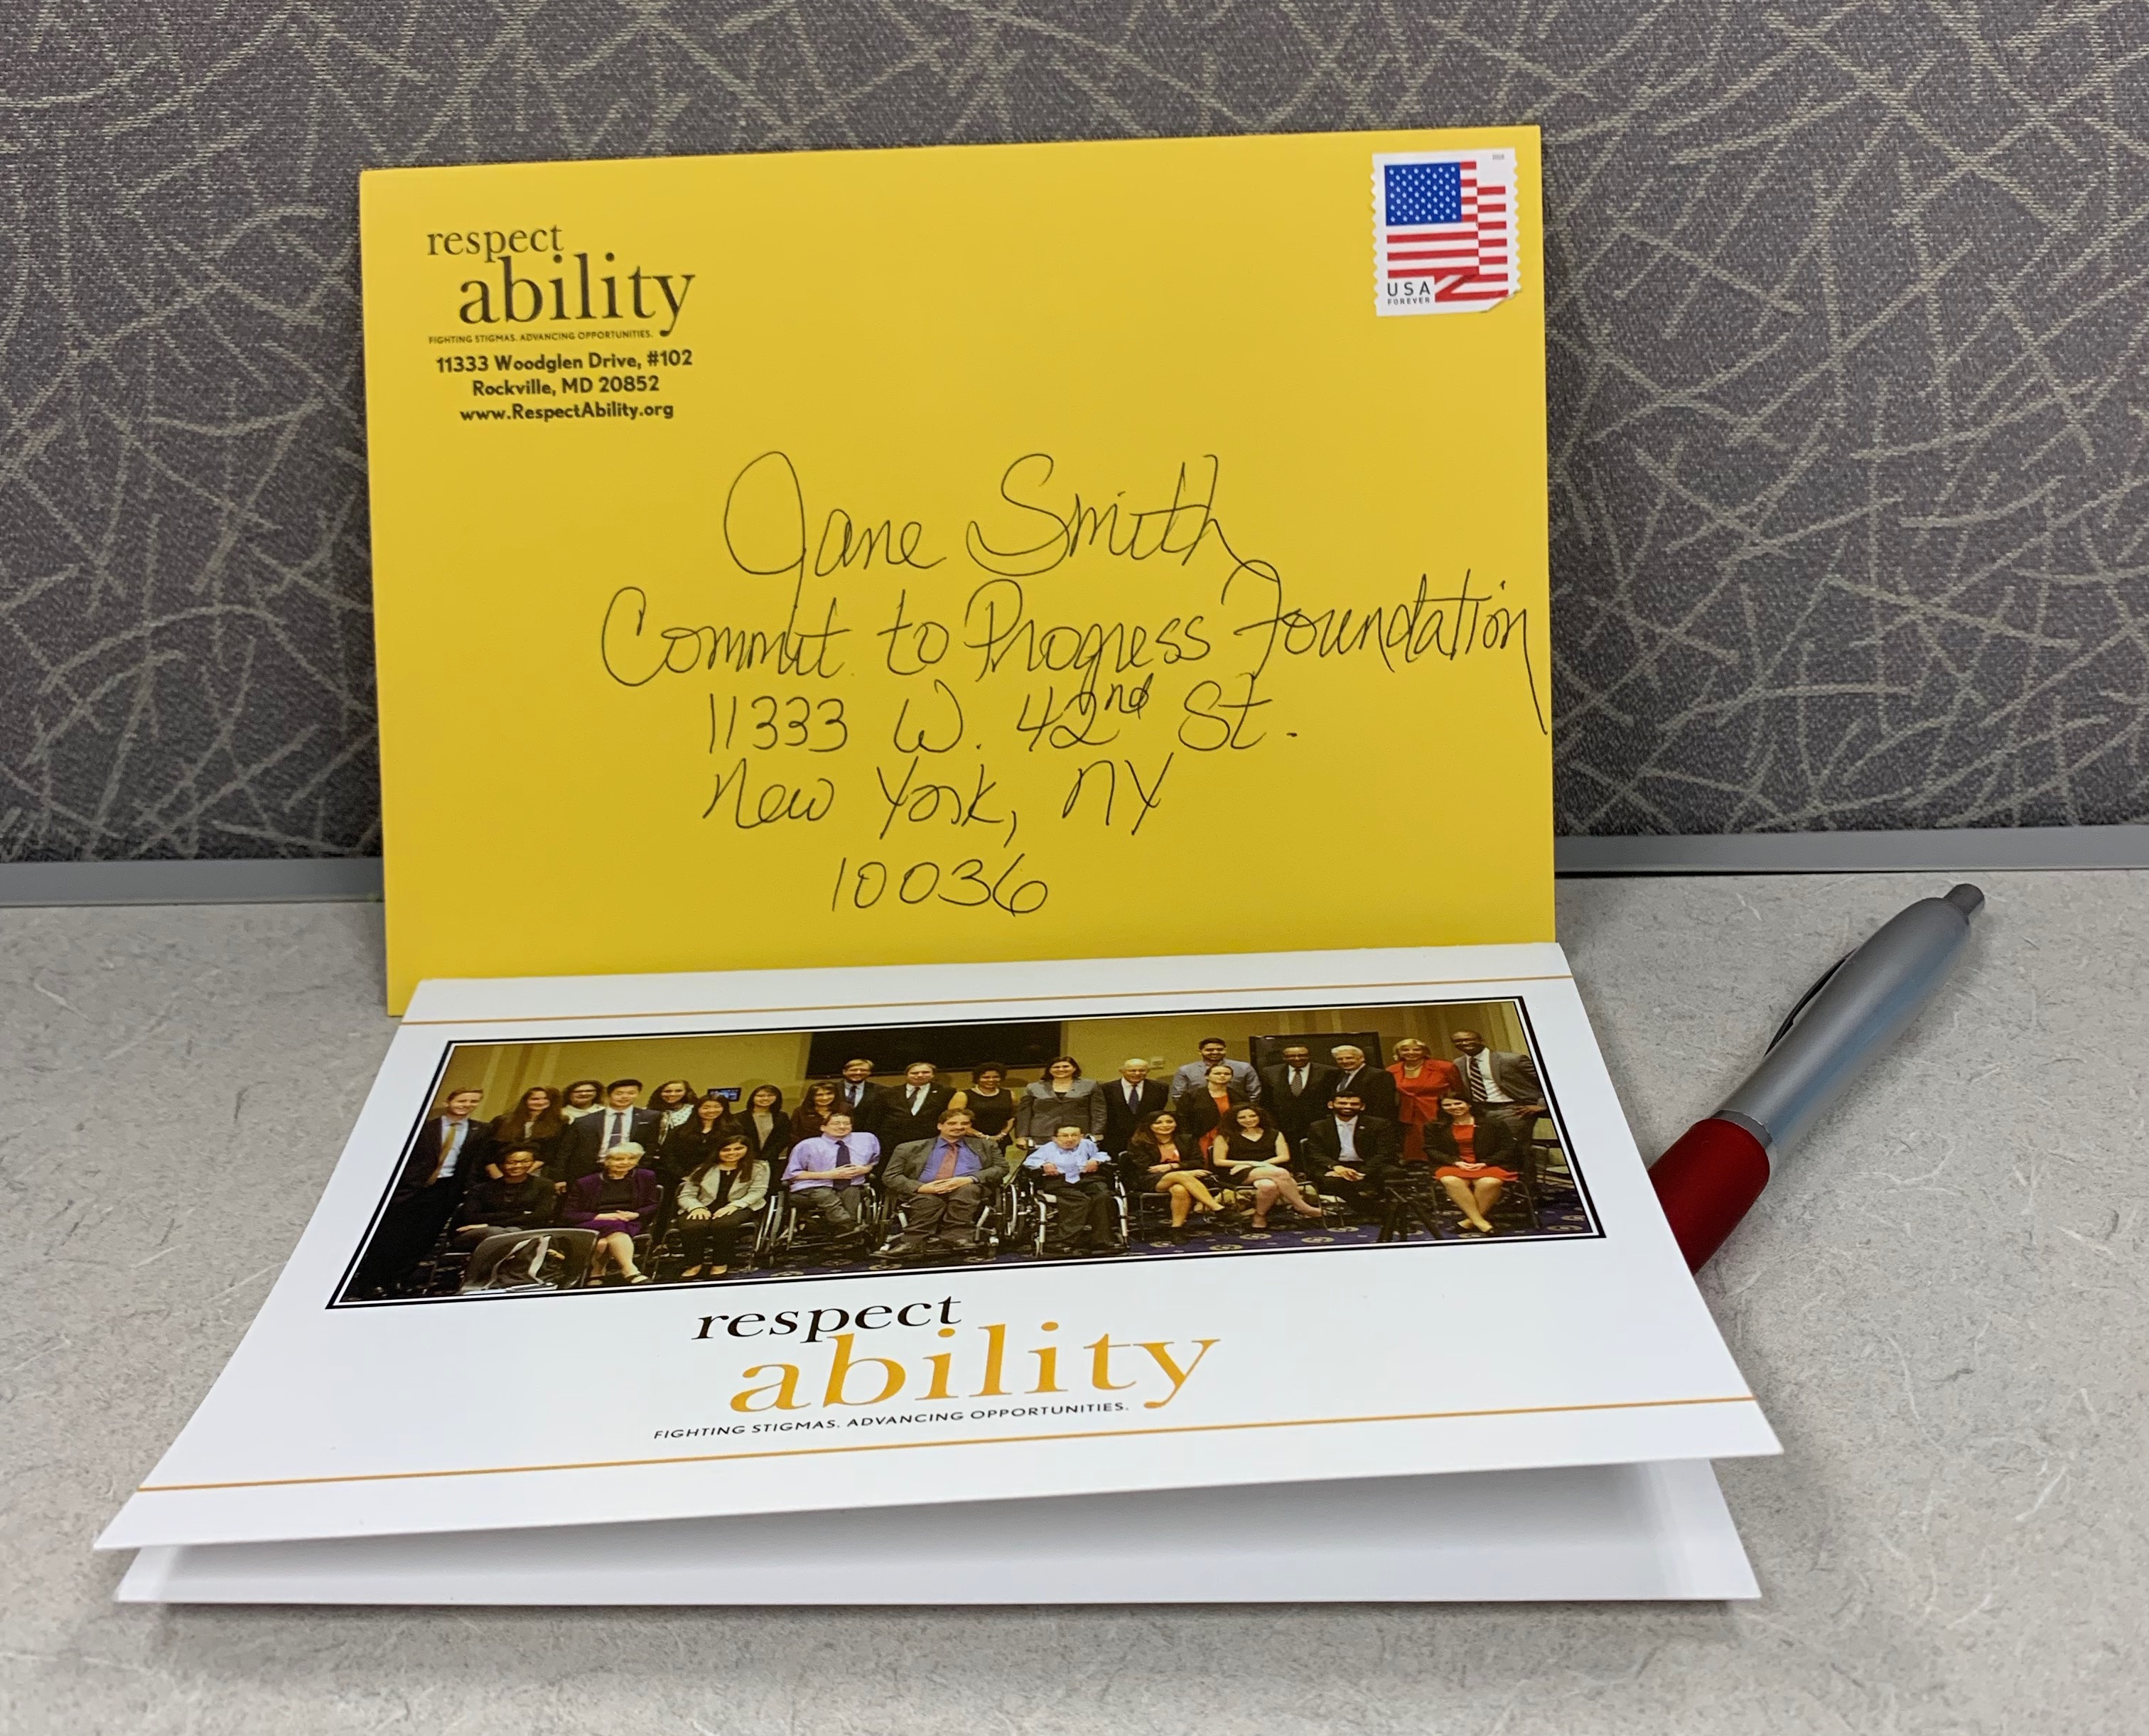
Taking Action!
Commit to Progress

Slide 49
Thank you so much!
Once again …
Thank you to the New York Women’s Foundation and the Coca-Cola Foundation for its direct support for this effort.
And
Thank you to our generous hosts here
at the Guttman Office of AccessABILITY Services

Slide 50
Stay in touch with us!
Jennifer Laszlo Mizrahi
President
JenniferM@RespectAbility.org
11333 Woodglen Drive, Suite 102
Rockville, MD 20852
Office: (202) 517-6272
www.RespectAbility.org

Slide 51
Appendix Slides
Appendix Slides

Slide 52
New York City Stats
  NYC’s Labor Force Participation Rate (LFPR) is 60.2%. ¹
  70.4% of people without disabilities aged 18 to 64 in New York City are employed. ²
  32.3% of NYC residents w/ disabilities (ages 18-64) have jobs. ²
  There is a 38.1 point gap between the employment rates of PWDs and those without disabilities. “The employment gap is greater in NYC than it is at the State or national level.” ³
Mayor Bill de Blasio
(D)
NYC Comptroller-2016-The State of the City’s Economy and Finances
Census Bureau - 2015 American Community Survey
CID-NY ADA at 26 in New York City
Notes:
http://www.nyc.gov/html/mopd/downloads/pdf/ACCESS_NYC_updated.pdf
http://respectabilityusa.com/Resources/RespectAbiltiy%20NY%20WIOA%20State%20Plan%20Comments.pdf

Slide 53
NYC and PWDs Stats
  New York ranks 37th in the country in terms of jobs for PWDs. ¹
  In total, there are 948,208 NYC residents with disabilities. ²
  Out of that number, there are 460,425 working age (18-64) people with disabilities living in New York City. ²
  31% of all NYC residents with disabilities live in poverty.²
    39.3% (116,313) of Hispanics with disabilities in NYC live in poverty.
    34.5% (84,066) of African Americans with disabilities in NYC live in poverty.
    28.9% ( 24,868) of Asians with disabilities in NYC live in poverty.
Mayor Bill de Blasio
(D)
Annual Disability Statistics Compendium
MOPD-NYC PWDs Statistics Updated 2016
Notes:
http://www.nyc.gov/html/mopd/downloads/pdf/ACCESS_NYC_updated.pdf
http://respectabilityusa.com/Resources/RespectAbiltiy%20NY%20WIOA%20State%20Plan%20Comments.pdf

Slide 54
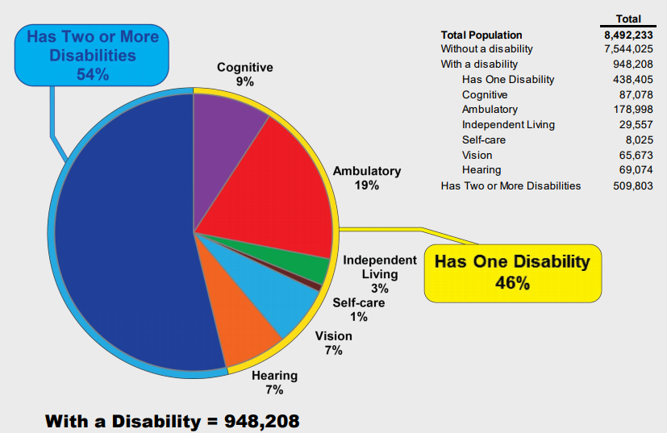
Population by Disability Type
New York City, 2014
Sources: U.S. Census Bureau, 2014 American Community Survey-Public Use Microdata Sample Population Division-New York City Department of City Planning / MOPD NYC People with Disabilities Statistics Updated 2016

Slide 55
Intersectionality, Education and Disability Stats
Six million students with diagnosed disabilities are enrolled in America’s public schools.
There are 1,107,606 African American/black students with disabilities enrolled in America’s public schools
Likewise, there are 1,531,699 Latino students with disabilities in our schools today.
Children with disabilities and students of color are disproportionately suspended and expelled, which can be a contributing factor to the school-to-prison pipeline. Many student of color and/or ESL learners do not get a needed disability diagnosis or get the wrong one.
Only 57 percent of black students with disabilities graduate high school compared to 76 percent of black students without disabilities.
Only 59 percent of Latino students with disabilities graduate high school, compared to 79 percent of Latino students without a disability.

Slide 56
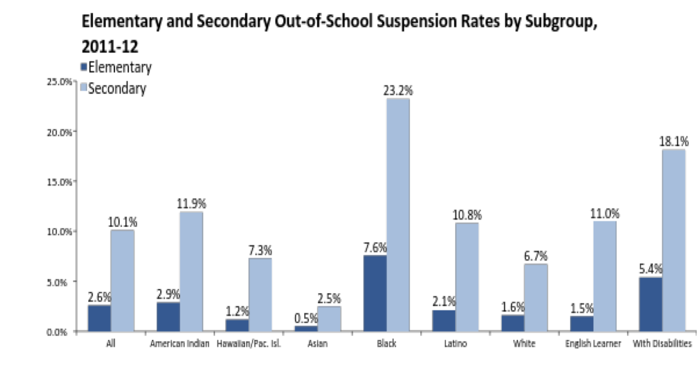
Youth with Disabilities and
Out-of-School Suspension Rates
Source: The Civil Rights Project

Slide 57
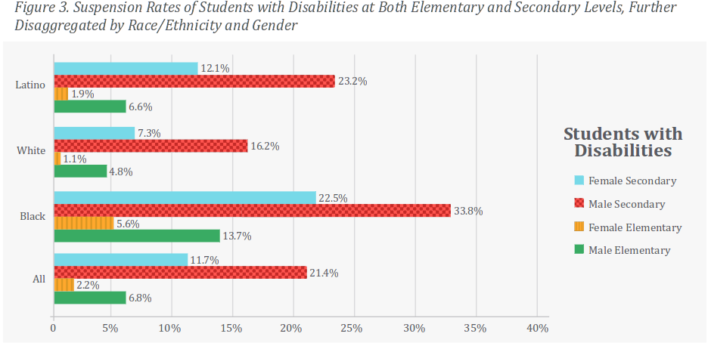
Marginalized Students with
Disability & Suspension
Minority youth with disabilities are suspended at the highest rates of all.
Notes:
Source: https://civilrightsproject.ucla.edu/resources/projects/center-for-civil-rights-remedies/school-to-prison-folder/federal-reports/are-we-closing-the-school-discipline-gap/AreWeClosingTheSchoolDisciplineGap_FINAL221.pdf

Slide 58
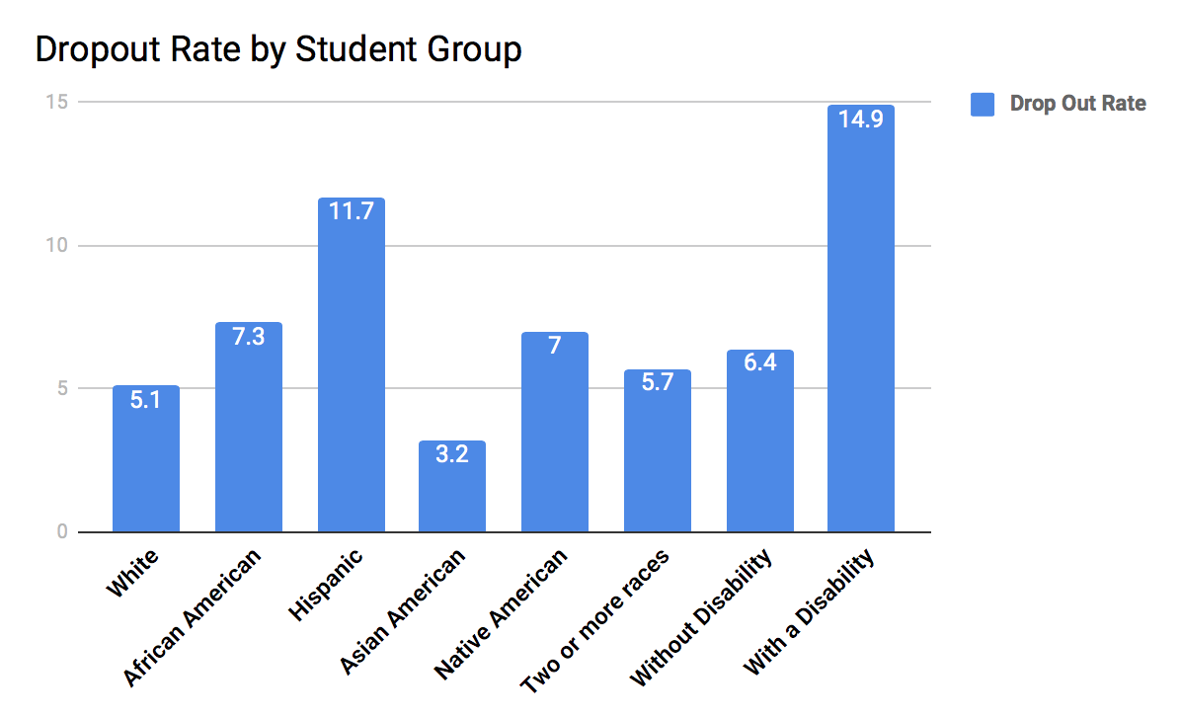
Drop Out Rates Highest for Students with Disabilities

Slide 59
People with Disabilities –
Cycles of Violence
People with disabilities (PwDs) are twice as likely to be victims of crime than people without disabilities. In addition, they are more likely to be victims of police violence.
This does not even take into account people with other disabilities who were improperly handled by police, due to insufficient officer training. For example, police may think people with epilepsy, diabetes, cerebral palsy or disabilities resulting from a stroke are instead intoxicated or using drugs – and therefore subjected to unnecessary force by officers.

Slide 60
The Disability Penalty
In a 2017 study done by Cornell, people with disabilities– including emotional, physical, cognitive or sensory disabilities – were nearly 44 percent more likely to be arrested by age 28, while those without had a lower probability of arrest, at 30 percent.
This “disability penalty” was strongest for African-American men.
Black men with disabilities in the study were at a particularly high risk of arrest: 55 percent had been arrested by age 28. In contrast, nearly 40 percent of whites with disabilities in the study had been arrested by that age.
Source: American Journal of Public Health (AJPH) - The Cumulative Probability of Arrest by Age 28 Years in the US by Disability Status, Race/Ethnicity, and Gender

Slide 61
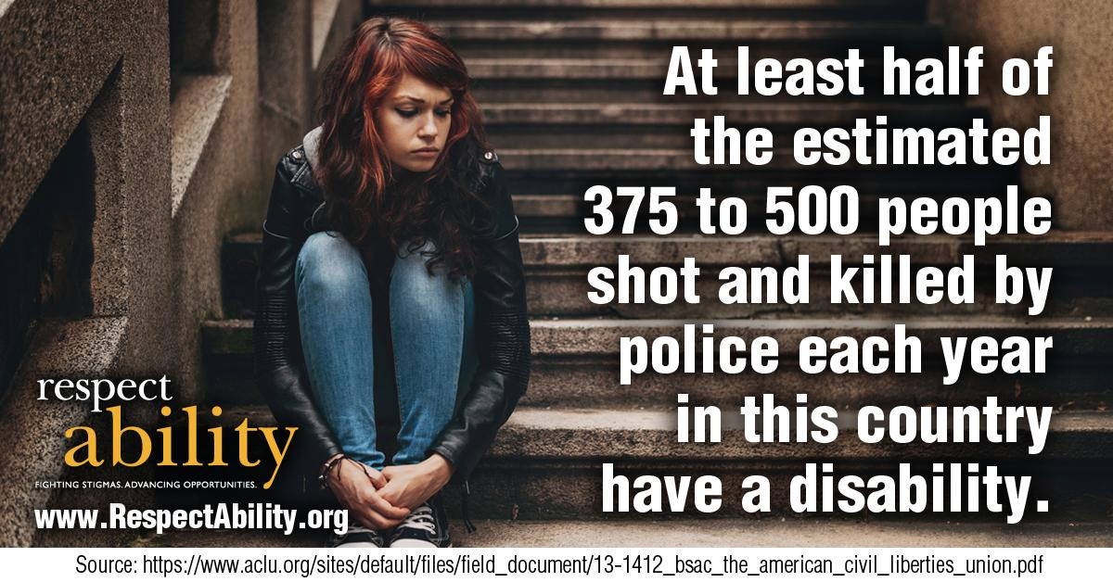
Disability and
Police Shootings

Slide 62
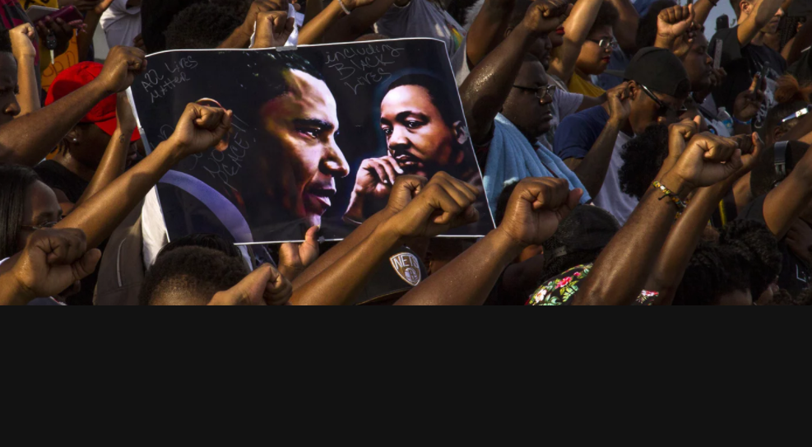
“Police killings: the price of being disabled and black in America”
“No one knows how many of the victims of police violence are disabled.” Quote from David M. Perry, Ph.D. in The Guardian, July 22nd 2017
Source: https://www.theguardian.com/us-news/2017/jun/22/police-killings-disabled-black-people-mental-illness

Slide 63

Freddie Gray had
an Invisible Disability
Freddie Gray had unaddressed disability issues that helped set him up for failure. “Before Freddie Gray was injured in police custody…his life was defined by failures in the classroom, run-ins with the law and an inability to focus on anything for very long.”
Executive Functioning Disorder

Slide 64
5 Connections – Disability & Criminal Justice Reform
Education: Each year, 300,000 people with disabilities leave high school, 40% without a diploma. Students with disabilities have much higher suspension rates.
Preschool to Prison Pipeline: 750,000 people behind bars have one or more disabilities.
Unemployment: 1 in 3 people with disabilities has a job.
Poverty: In 2016, people with disabilities live at a poverty rate of 26.8%, nearly twice that of people without disabilities.
Double discrimination: About 40% of African Americans with disabilities are in poverty compared to 22% of African Americans without disabilities.
Risk: People with disabilities, especially minorities, are among the most vulnerable when it comes to poverty, exploitation, victimization and violence.

Slide 65

95% are Coming Home

Slide 66

Only 1 in 3…

Slide 67

Successful Transitions are Needed
Notes:
"300,000 young people with disabilities age into what should be the workforce each year. 1.3 million young Americans ages 16-20 with disabilities."
Source: Disability Statistics, by Cornell University

Slide 68

People with Disabilities Need Jobs
34% of people with disabilities aged 18 to 64 are employed.
9,850,966 of people with disabilities aged 18 to 64 receive benefits.
In 2012,US’s total expenditure on SSDI benefits was $127,941,612.
Annual Disability Statistics Compendium
Notes:
Annual Disability Statistics Compendium http://www.disabilitycompendium.org/docs/default-source/2014-compendium/2014_compendium.pdf
Exact Resources:
-Persons without disabilities aged 18 to 64 who are employed → Annual Disability Statistics Compendium, Pg 29. Table 2.2
- % of PwDs aged 18 to 64 who are employed → Annual Disability Statistics Compendium, Pg 32. Table 2.1.
Civilians with a disability who live in the community in x state. → Annual Disability Statistics Compendium, Pg 14. Table 1.3.
Persons aged 18 to 64 who have a disability. → Annual Disability Statistics Compendium, Pg 17. Table 1.6.
-The Employment Gap between PwDs and people with disabilities has decreased x% pts between 2010 and 2011. → Annual Disability Statistics Compendium, Pg 37. Table 2.10.
⁻ In 2012, total expenditure on SSDI benefits for PwDs → Annual Disability Statistics Compendium, Pg 89. Table 9.6.
Voc. Rehab received x general rehab applicants and x blind applicants in x state in 2012. → Annual Disability Statistics Compendium, Pg 117. Table 12.1.
Voc. Rehab. obtained x jobs for PwDs in x State in 2012. → Annual Disability Statistics Compendium, Pg 119. Table 12.3.
-PWDs in US receiving benefits 18-64 (SSI & SSDI) → Annual Disability Statistics Compendium, Table 9.7

Slide 69

Employment Rates – People With
and Without Disabilities

