Slide 1
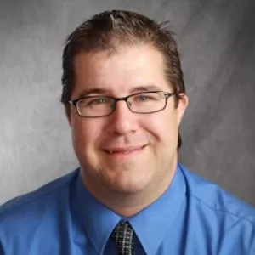
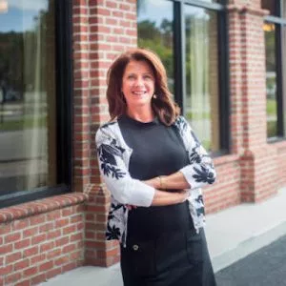
Advancing Inclusion – Careers in Philanthropy for Professionals with Disabilities November 7th, 2018 Webinar
James Emmett
Meg O’Connell
Jennifer Laszlo Mizrahi, President, RespectAbility
Steve Bartlett, Chairman, RespectAbility

Slide 2
About Our Speakers
James Emmett is one of the most recognizable leaders in the field of disability inclusion. He is currently the Lead Strategist of the Workplace Initiative for the Poses Family Foundation where he oversees strategy development & implementation of projects that impact the area of disability inclusion. James has worked on many of the most visible disability & inclusion projects in the country with companies like Walgreens, Best Buy, Office Depot/Max, PepsiCo, and Mercy Health.
Meg O’Connell has worked with some of the nation’s top brands across a variety of industries and has been implementing and leading disability inclusion efforts for large corporations since the mid-‘90s. She has won numerous awards for her work, developing talent management, consumer solutions, and corporate marketing/branding campaigns, all geared towards including people with disabilities in the workforce as a part of diversity initiatives.

Slide 3
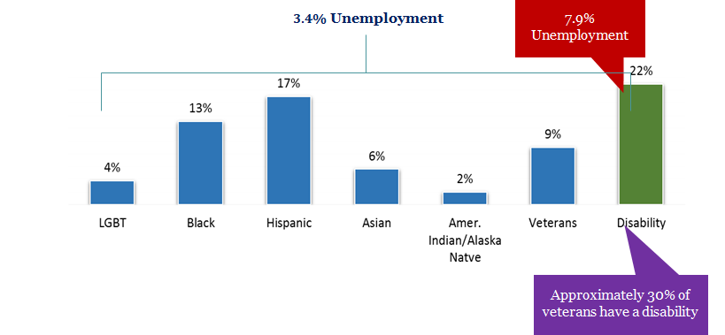
There are 22 million working age Americans with disabilities
There are 56 million people in the U.S. with a disabling condition – representing 22% of the U.S. population.
Data Source: US Census 2012, CDC 2013
DOL October 2018 Unemployment Data

Slide 4
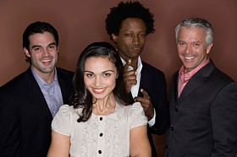
Over 12,000 jobs in philanthropy today - LinkedIn
Opportunities in Philanthropy
Being part of a philanthropic organization allows you to use your time and talent in areas where you have a passion
Philanthropy helps drive innovation and change locally and globally
Philanthropy helps drive social change in ways that other organizations are not able to
4

Slide 5
Benefits of disability inclusion
Inclusion Works
Increased talent pool
90% perform on par or better
48% greater tenure
40% less absenteeism
$225B Market Opportunity
Employees
Managers report no difference in working with those with disabilities
Managers report improved culture
Policy changes or work adjustments are good for everyone
Culture/ Climate
5

Slide 6
Employees with disabilities are more dedicated & less likely to leave
Source: NOD –Kessler/Harris Poll 2010

Slide 7
Jobs in philanthropy
Overview of Job Types
Grants Management
Operate against grant making strategy
Focuses on key issue areas for grant making
Works to create partnerships with foundations and non profit partners
Programs Management
Directs programs activities
Oversees grantees work
Manages relationships
Investigates and evaluates proposals, conducts due diligence on potential grantees
Operations
Finance
Accounting
Human Resources
Operations

Slide 8
What makes a good philanthropist
Overview:
Program staff are responsible for creating and implementing a grantmaking portfolio for the foundation that effectively addresses the foundation's core mission. Conducting research, evaluation, and analysis of potential programs, partnerships, and initiatives allows program staff to determine a course of action that helps the foundation address its primary issue areas. Among the skills and activities involved in program work are:
Adaptability: become knowledgeable in a broad range of areas or become a specialist
Offering thoughtful analysis of proposals
The ability to synthesize large amounts of data
Strong research skills
Reading proposals
Writing reports and evaluations
Programmatic due diligence
Financial due diligence
Legal compliance
Reading financial statements
Visiting prospective grantees
Communicating with one’s board and staff
Answering questions from both potential grantees and from your colleagues

Slide 9
Top 5 things to do to start a career in philanthropy
Get non profit experience: Work for a non profit in an area you are passionate about, or volunteer for your favorite non profit and learn how they run and operate.
Get Passionate On an Issue: Whether it is clean water, reducing plastic, human rights or saving the whales
Translate Skills & Experience: Like any industry you have to speak the language. Your corporate experience may not directly translate to a foundation. Find a way to translate what you have done to your new career path.
Build Relationships & Be Flexible: Meet as many people as you can to learn more about philanthropy. You may also have to be opportunistic and not take the “perfect job” but the next right job to get to your goal.
Consider Multiple Options in Philanthropy: Philanthropy can happen within corporations, or municipalities – not just foundations. Look for your opportunities outside of big foundations.

Slide 10
History of strategic philanthropy for disability employment
5_84
Obstacles
Our Framework
Become a catalyst for the employment of people with disabilities by creating a high volume of jobs in a relatively short period of time by using a variety of models
Companies
Low demand for hiring people with disabilities
Few case studies of hiring at volume
Little knowledge of how to find, recruit, hire or retain
Few disability inclusion consultants
Disability/Workforce Agencies
Little understanding of business needs
Little benefit to jobseekers from large-scale workforce development programs
National: Company readiness through one-to-one or cohort
Local: Networks of businesses, government, nonprofit agencies
Funders
Low interest from foundations on disability employment
Field-Building: Increased numbers of consultants and funders

Slide 11
Sample strategy from the Poses Family Foundation Workplace Initiative
5_84
National Strategy
Field-Building
We support major corporations to implement largescale disability hiring programs.
We collaborate across the field to share knowledge, increase resources, and amplify impact. We build capacity and expertise in the field to activate a new generation of leaders in disability inclusion.
Local Strategy
We support local communities to collaborate and employ people with disabilities locally.

Slide 12
We focused on delivery and initial scale
5_84
Ramp-up
3
Horizon 3
Deliver and scale
2
Horizon 2
Learn and thrive
1
Horizon 1
Set foundation
Q4 2015– Q1 2016
Q2 2016 – Q3 2016
Q4 2016 -
Q4 2017
Establish national & cluster inclusion programs
Establish a number of field-building programs
Strengthen business case for hiring people with disabilities
Grow program and codify learnings
Publish case studies and learnings
Encourage other employers and communities to scale

Slide 13
Our work informed opportunities
Action
Transform HR practices (certifications, employee referrals, etc.)
Establish model companies
Build on current communities
Improve technology for job seekers
DIY
Guide
Company
Cohorts
Learning
Increase knowledge of the pipeline
Increase knowledge of policy levers

Slide 14
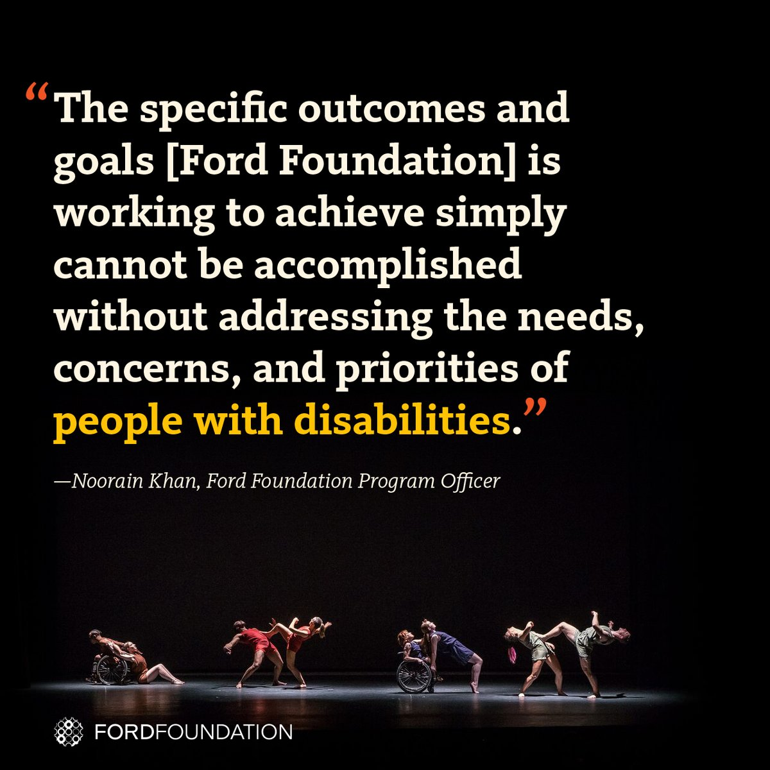
Examples: The Ford Foundation Includes Disability
The Ford Foundation has recently added the disability lens to their work http://bit.ly/2jOl3FL
Additionally, Ford’s CEO Darren Walker spoke extensively on why this impacts other funders as well: http://bit.ly/2nr4moJ
Here is Darren Walker’s original letter: http://bit.ly/2Bxy0Lk
This is the response of the co-authors of the Americans with Disabilities Act: http://bit.ly/2AueSyx
Watch the Darren Walker-Sen. Tom Harkin interview on YouTube: http://bit.ly/2zrgFpE
14

Slide 15
Examples: JP Morgan Chase
J.P. Morgan has funded and initiative to cover the direct disability accommodation costs for 10 major community development and civil rights conferences for people with disabilities
Important because many non profit groups and events are NOT inclusive of PwDs
No captioned videos
Non-accessible events

Slide 16
Examples: MacArthur Foundation newly including disability
The MacArthur Foundation has also recently added the disability lens to their work with their new 100 Million Dollar Grant
See: https://www.macfound.org/press/perspectives/nothing-about-us-without-us
And: https://www.macfound.org/media/files/Checklist_for_MacArthur_100Change_Semifinalists.pdf
Plus: https://www.macfound.org/programs/100change
16

Slide 17
Resources for your Job Hunt
Respectability: www.respectability.org has a inclusive philanthropy toolkit
Council on Foundations: www.cof.org has articles, tools, and a job board.
Linkedin: www.linkedin.com the world’s most used recruiting too
Philanthropy New York: www.philanthropynewyork.org
Job Accommodation Network: https://askjan.org/
State Vocational Rehabilitation Agency: http://wdcrobcolp01.ed.gov/Programs/EROD/org_list.cfm?category_cd=SVR
Noorain Khan’s job list - https://tinyletter.com/noorain
Chronicle of Philanthropy’s job list - https://www.philanthropy.com/jobs
CHANGE Philanthropy - http://changephilanthropy.org/our-work/job-bank/
Philanthropy training - https://grantspace.org/training/
Washington Regional Association of Grantmakers Jobs - https://www.washingtongrantmakers.org/jobs

Slide 18
Philanthropy Serving Organizations
Asian Americans/Pacific Islanders in Philanthropy
Association of Black Foundation Executives (ABFE)
BoardSource
California Endowment
Center for Disaster Philosophy
Center for Effective Philanthropy
Confluence Philanthropy
Emerging Practitioners in Philanthropy
Environmental Grantmakers Association
Exponent Philanthropy
Foundation Center
Funders' Committee for Civic Participation
Grantmakers Concerned with Immigrants & Refugees
Grantmakers for Education
Grantmakers for Effective Organization
Grassroots Grantmakers
Hispanics in Philanthropy
Independent Sector
National Center for Family Philanthropy
National Council of NonProfits
Philanthropy for Active Civic Engagement
United Philanthropy Forum
Jennifer Laszlo Mizrahi
www.RespectAbility.org
Cell: (202) 365-0787
JenniferM@RespectAbility.org
Twitter: @respect_ability / @jewishinclusion
Facebook: https://www.facebook.com/RespectAbilityUSA and https://www.facebook.com/RespectAbility4All/

