Slide 1
RespectAbility
How to Write Winning Op-eds on Jobs for People with Disabilities
Thursday, September 20th, 2018
Calvin Harris, Chairman, RespectAbility
Jennifer Laszlo Mizrahi, President, RespectAbility
Philip Kahn-Pauli, Policy Director, RespectAbility
www.RespectAbility.org

Slide 2
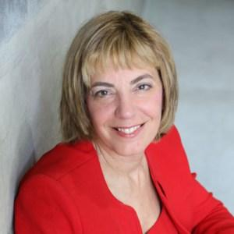
Hello and Welcome!
Jennifer Laszlo Mizrahi is President of RespectAbilty, a non-profit organization working to empower people with disabilities to achieve the American Dream. She works regularly with national, state, and local policy leaders, workforce development professionals, media and employers, as well as with disability and faith-based organizations in order to expand opportunities for people with disabilities. She has met with teams from all 50 states, including 40 governors, on WIOA implementation. She has published more than 55 op-eds on disability issues, including in USA Today, Huffington Post, The Hill and other publications. Dyslexic herself, she also knows what it means to parent a child with multiple disabilities.

Slide 3
Introducing Eleanor
Eleanor Clift
As a member of our board of directors, Clift contributes her knowledge as a renowned journalist. She had a career reporting with Newsweek and currently writes for the Daily Beast. Additionally, she was a panelist for the McLaughlin Report. Specializing on politics and culture, Clift has written numerous books and contributes her knowledge to various boards and councils.

Slide 4
Introducing Clarence
Clarence Page
Page is a well known journalist and columnist that currently serves as a senior member of The Chicago Tribune’s Editorial Board. As a member of RespectAbility’s Board of Directors, he contributes his experiences with disability along with his knowledge of politics and culture gained as a journalist. Page has been a panelist on the McLaughlin Group along with contributing essays to PBS NewsHour, hosting PBS documentaries, and commenting on NPR. He is well known for his work regarding politics and culture.

Slide 5
Why Write Op-eds?
To improve the lives of people with disabilities and all who want a welcoming, just and respectful world
An opportunity to get your voice heard
A chance to educate the public through facts and your personal experience
An opportunity to change public opinion and improve legislation/policy/reality for people with disabilities and our communities

Slide 6
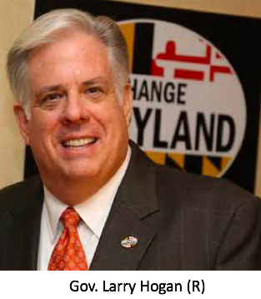
Maryland
78.3% of persons without disabilities aged 18 to 64 are employed.³
40.0% of PwDs aged 18 to 64 are employed.³
321,409 persons aged 18 to 64 have a disability.³
The Employment Gap between PwDs and people with disabilities has decreased 0.3% pts between 2010 and 2011.³
56,600 PwDs aged 18 to 64 receive benefits.¹
622,682 people in MD have a disability.³
In 2012, MD’s total expenditure on SSDI benefits was $1,922,172,000.³
Voc. Rehab. received 9,405 general applicants in MD 2012.³
Voc. Rehab. obtained 2,506 jobs for PwDs in MD in 2012.²
2012 Disability Status Report: New York, disabilitystatistics.org
StateData: The National Report on Employment Services and Outcomes, 2013
Annual Disability Statistics Compendium

Slide 7
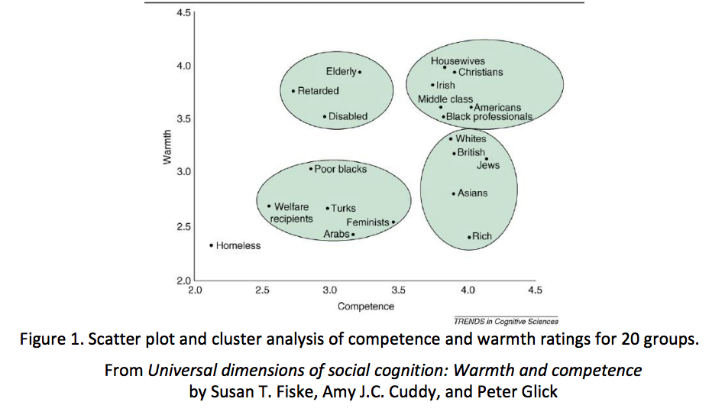
Perception: PWDS Seen as Warm, But Not Competent

Slide 8
What are your media goals?
Who specifically do you want to impact? Governor? Employers? People with Disabilities?
What do THEY read/watch?
Whose opinions do they trust?
What facts will move their brains?
What “human interest” story will win their hearts?
Picture your reader/viewer when you write or do interviews!

Slide 9
Focus on the Persuadables

Slide 10
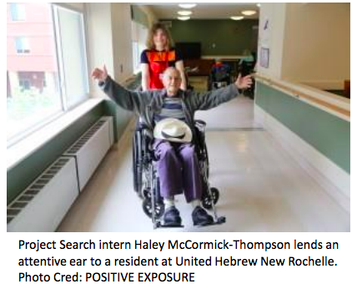
Young People with Disabilities
1,200,000 Americans with disabilities between ages 16 and 20¹
300,000 people will age into what should be the workforce yearly
Achievement of competitive integrated employment or collect and depend on government benefits depends on your decisions
High expectations, eliminating stigmas, and connecting them to effective programs and supports can enable positive outcomes
1. 2012 Disability Status Report United States, Cornell University. Pg. 16. Link: http://www.disabilitystatistics.org/StatusReports/2012-PDF/2012-StatusReport_US.pdf

Slide 11
You Don’t Have to Be a Professional Writer or PR Expert!
Your Most Important Tools:
Your passionate opinion: People will listen when you speak from your heart
A desire to share and educate: Help people understand why your issue is important
The facts: Do your research and be accurate

Slide 12
Tips for Interviews & Op-eds
Number One Rule: Use the “KISS” Method KISS = Keep It Simple & Straightforward
Don’t use jargon and technical terms
Use your personal experience to help others understand and care
Use facts – and double-check for accuracy
Use “people-first” language – terms that respect people with disabilities.
You are in a unique position to shape the public image for people with disabilities

Slide 13
Structure/Components of an Op-ed
First paragraph: Concisely introduce your topic
State your argument
Give 3-6 facts that support your argument
Don’t be afraid to use your personal experience
Ensure each paragraph supports your argument
Be your own critic: After each paragraph, ask yourself: “Why is this important? Why should others care?”
Link your conclusion back to your original point
How long? Typically 500-700 words but check the guidelines of your target population

Slide 14
Your Goal for Writing an Op-ed
Make people aware of the many benefits of
employing people with disabilities
Strive to make these points:
Most people with disabilities WANT to work: Nearly three quarters
of people with disabilities want jobs and independence
more than benefits
Hiring people with disabilities can make companies more
profitable and saves taxpayers money

Slide 15
Some Facts You Can Use
56 million Americans – 1 out of 5 – live with disabilities
51 percent of likely voters say they, a family member, or a close friend has a disability
70 percent of working-age Americans with disabilities are not employed, leading to high levels of poverty, isolation, depression and financial dependency
More Americans have a disability than are Hispanic, African American or Asian
U.S. taxpayers spend more than $350 billion a year on benefits to people who, in most cases, would rather have a “hand-up” than a hand-out

Slide 16
Benefits for Companies of Hiring PwDs
Benefits of Hiring PwDs (competitive advantage) Kalargyrou and Volis, 2014
PwD's turnover rates are lower than people without disabilities (Grant, 1991)
Increases psychological safety and productivity
Improves innovation, problem solving abilities, ability to compete in all markets, react to expectations of diverse consumers
Establishes positive company image and increasing customer satisfaction
Positive effects on workforce
Increases attendance of both people with and without disabilities (Grant, 1991)
Improves corporate reputation (Grant, 1991)
Walgreens as a case study: http://www.kter.org/conference/materials/docs/SafetyManagement.pdf
2010 Kessler-NOD Survey by Harris Interactive: http://www.nod.org/assets/downloads/01- 2011_Exec_Summary.pdf
Lowe’s example: http://nod.org/assets/downloads/NOD_Rutgers_Evaluation.pdf
Challenges :
Stereotyping/skepticism New studies (Kuo and Kalargyrou 2014)
Productivity issues when there is a mismatch between position and abilities

Slide 17
Examples You Can Use
JP Morgan Chase, Coca-Cola, UPS, SAP, EY, IBM, Starbucks and Walgreens are great examples of companies with successful disability inclusion programs.
You can find more here: https://workplaceinitiative.org/case-studies/ or here: https://www.respectability.org/category/respecttheability/
For a list of companies excelling at inclusive employment, see Disability Equality Index: http://www.usbln.org/programs-dei.html

Slide 18
Poll: American Dream Strongest Message
Our nation was founded on the principle that anyone who works hard should be able to get ahead in life. People with disabilities deserve the opportunity to earn an income and achieve independence, just like anyone else
People with disabilities bring unique characteristics and talents to workplaces that benefit employers and organizations. Stephen Hawking is a genius who happens to use a wheelchair. People with disabilities can work in hospitals, hotels, be super talents in developing computer software and in many other fields
Companies including Amazon, Starbucks, Pepsi and others have shown that employees with disabilities are loyal, successful and help them make more money. If we find the right jobs for the right people it can and does increase the bottom line of companies
“Now I am going to read you statements from people who want political and business leaders to make employment for people with disabilities a national priority. After each statement I read, please tell me if you find it to be a very convincing, somewhat convincing, not very convincing or not at all convincing reason to make increasing levels of employment among people with disabilities more of a national priority.”
Our nation was founded on the principle that anyone who works hard should be able to get ahead in life. People with disabilities deserve the opportunity to earn an income and achieve independence, just like anyone else, 61 percent very convinced. People with disabilities bring unique characteristics and talents to workplaces that benefit employers and organizations. Stephen Hawking is a genius who happens to use a wheelchair. People with disabilities can work in hospitals, hotels, be super talents in developing computer software and in many other fields, 51 percent very convinced. Companies including Amazon, Starbucks, Pepsi and others have shown that employees with disabilities are loyal, successful and help them make more money. If we find the right jobs for the right people it can and does increase the bottom line of companies, 51 percent very convinced.

Slide 19
Your 3 Messages (a.k.a your “Message Triangle”)
1. Our nation was founded on the principle that anyone who works hard should be able to get ahead in life. People with disabilities deserve to be able to work to achieve the American dream, just like anyone else.
3. Government policies that help people with get and keep jobs are a disabilities win-win-win because they allow people with disabilities the dignity and financial benefits of work and also grow our economy and save taxpayer money.
2. Companies like Walgreens, E.Y. which was formally known as Ernst and Young, AMC and others have shown that employees with disabilities are loyal, successful and help them make more money. If we find the right jobs for the right people it can and does increase the bottom line of companies

Slide 20
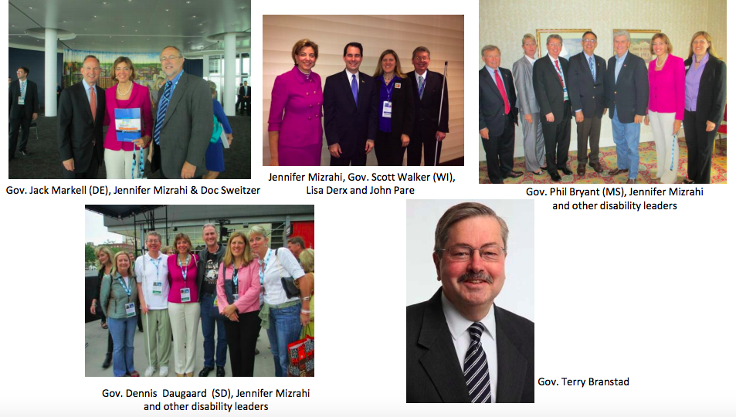
Mention Your Governor

Slide 21
Use your local statistics and facts!
Alabama: Download the PDF here. Download the PPT here.
❖ Alaska: Download the PDF here. Download the PPT here.
❖ Arizona: Download the PDF here. Download the PPT here.
❖ Arkansas: Download the PDF here. Download the PPT here.
❖ California: Download the PDF here. Download the PPT here.
❖ Colorado: Download the PDF here. Download the PPT here.
❖ Connecticut: Download the PDF here. Download the PPT here.
❖ DC: Download the PDF here. Download the PPT here.
❖ Delaware: Download the PDF here. Download the PPT here.
❖ Florida: Download the PDF here. Download the PPT here.
❖ Georgia: Download the PDF here. Download the PPT here.
❖ Hawaii: Download the PDF here. Download the PPT here.
❖ Idaho: Download the PDF here. Download the PPT here.
❖ Illinois: Download the PDF here. Download the PPT here.
❖ Indiana: Download the PDF here. Download the PPT here.
❖ Iowa: Download the PDF here. Download the PPT here.
❖ Kansas: Download the PDF here. Download the PPT here.
❖ Kentucky: Download the PDF here. Download the PPT here.
❖ Louisiana: Download the PDF here. Download the PPT here.
❖ Maine: Download the PDF here. Download the PPT here.
❖ Maryland: Download the PDF here. Download the PPT here.
❖ Massachusetts: Download the PDF here. Download the PPT here.
❖ Michigan: Download the PDF here. Download the PPT here.
❖ Minnesota: Download the PDF here. Download the PPT here.
Mississippi: Download the PDF here. Download the PPT here.
Missouri: Download the PDF here. Download the PPT here.
Montana: Download the PDF here. Download the PPT here.
Nebraska: Download the PDF here. Download the PPT here.
Nevada: Download the PDF here. Download the PPT here.
New Hampshire: Download the PDF here. Download the PPT here.
New Jersey: Download the PDF here. Download the PPT here.
New Mexico: Download the PDF here. Download the PPT here.
New York: Download the PDF here. Download the PPT here.
North Carolina: Download the PDF here. Download the PPT here.
North Dakota: Download the PDF here. Download the PPT here.
Ohio: Download the PDF here. Download the PPT here.
Oklahoma: Download the PDF here. Download the PPT here.
Oregon: Download the PDF here. Download the PPT here.
Pennsylvania: Download the PDF here. Download the PPT here.
Rhode Island: Download the PDF here. Download the PPT here.
South Carolina: Download the PDF here. Download the PPT here.
South Dakota: Download the PDF here. Download the PPT here.
Tennessee: Download the PDF here. Download the PPT here.
Texas: Download the PDF here. Download the PPT here.
Utah: Download the PDF here. Download the PPT here.
Vermont: Download the PDF here. Download the PPT here.
Virginia: Download the PDF here. Download the PPT here.
Washington: Download the PDF here. Download the PPT here.
West Virginia: Download the PDF here. Download the PPT here.
Wisconsin: Download the PDF here. Download the PPT here.
Wyoming: Download the PDF here. Download the PPT here

Slide 22
Find Your Employer Heroes
Every state needs “leadership employers.” EY, Prudential Financial, Procter & Gamble, IBM, KPMG, Merck & Co., AT&T, Sodexo, Kaiser Permanente, Comcast, Walgreens, AMC Theaters, hospitals, senior living among others have found they can “do good and do well” at the same time.
http://abcn.ws/1GCPssI
http://nbcnews.to/1D4l0c3
The Business Case of Employing People with Disabilities (Tourism Research & Hospitality Journal): http://scitechnol.com/business-case-ofemploying-people-with-disabilitiesnl3W.php?article_id=169
People with Disabilities: A new model of productive labor (Advances in Hospitality): http://www.ahtmm.com/proceedings/2012 /2ndahtmmc_submission_71.pdf

Slide 23
Which Employers in Your State Must Meet 503 Rules (Hire PwDs)?
Top Contractors
General Dynamics Corp.
Emergent Biosolutions Inc.
BAE Systems PLC
Kelly Service Inc.
Kellogg Company
Complete List: Fed Spending Website
http://www.fedspending.org/fpds/fpds.php?stateCode=MI&sortp=r&detail=-1&datype=T&reptype=p&database=fpds&fiscal_year=2012&submit=GO
Complete Federal Lists of 2006-2013: Federal Procurement Data System Website
https://www.fpds.gov/fpdsng_cms/index.php/en/reports/62-top-100-contractors-report3.html
How to Get Started
• Job Accommodation Network https://askjan.org
• U.S. Business Leadership Network http://usbln.org

Slide 24
More Information About ADA
ADA Timeline: http://www.dol.gov/featured/ada/
Non-Discrimination Guide: https://blog.dol.gov/2015/07/07/ensuring-equal-opportunity-atamerican-job-centers/
Key Points on Disability and Occupational Projections Tables: http://www.dol.gov/odep/pdf/20141022-KeyPoints.pdf

Slide 25
And Finally…Pitching Your Story or Op-ed
Decide where you want to get press/publish your op-ed. Consider regional/personal ties. It still counts if it’s not in The New York Times.
Who do you know? If you have ties to an editorial board member, email your op-ed or press release directly to them.
If possible, send by email with a short note to introduce yourself, your topic and its relevance (the news hook). Do coffee!
Include your full name, telephone number and email. Publications often call/email to verify your identity.
Paste – don’t attach – your op-ed or release into the email.

Slide 26
Where to Send it?
Check out guidelines for various publications & alternative publication venues: http://www.ccmc.org/node/16179
Google your top media outlets and then do searches on their websites.
See which reporters cover disability issues at that media outlet.

Slide 27
More Examples of Op-eds
http://www.abqjournal.com/610907/opinion/people-with-disabilities-deserve-the-dignity-of-a-job.html
http://savannahnow.com/column/2015-05-30/opinion-we-must-do-better-people-disabilities
http://www.idahostatesman.com/2015/06/07/3836845_guest-opinion-idahos-citizens.html?rh=1
http://www.newsobserver.com/opinion/op-ed/article22373913.html
http://www.d5coalition.org/2015/06/celebrating-ada-its-time-to-add-a-disability-lens-to-our-philanthropy/
http://blog.ncrp.org/2015/07/respect-is-key-to-inclusive-funding.html
http://nonprofitquarterly.org/2015/04/17/the-workforce-innovation-and-opportunity-act-unprecedented-opportunities-for-philanthropists/

Slide 28
Q&A
Questions?
Comments?
How can we be helpful?

Slide 29
Resources / Contact Info
2015 Disability Status Report United States, Cornell University, 2015: www.disabilitystatistics.org
Fedspending: www.fedspending.org
Project SEARCH: www.projectsearch.us
Job Accommodation Network: https://askjan.org/
State Vocational Rehabilitation Agency: http://wdcrobcolp01.ed.gov/Programs/EROD/org_list.cfm?category_cd=SVR
Selected Economic Characteristics for Civilian Noninstitutionalized Population by Disability Status, 2011-2015 ACS (focused on Long Beach) http://bit.ly/LBDisabilityjobs
Local Disability Data for Planners (focused on Montgomery County) http://bit.ly/MontgomeryCountydisabilityjobs
Jennifer Laszlo Mizrahi
www.RespectAbility.org
Cell: (202) 365-0787
JenniferM@RespectAbility.org
Twitter: @respect_ability / @jewishinclusion
Facebook: https://www.facebook.com/RespectAbilityUSA and https://www.facebook.com/RespectAbility4All/

