Slide 1
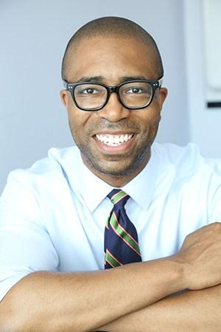
Advocating Your Governor on Jobs for PWDs
September 26th, 2018: RespectAbility Webinar
Jennifer Laszlo Mizrahi, President, RespectAbility
Calvin Harris, Chairman, Respect Ability
Contact: JenniferM@RespectAbility.org
202-517-6272

Slide 2
What are we learning today?
Advice from RA Vice Chair / Former Representative / Former Mayor of Dallas, and Co-Author of the ADA, Steve Bartlett
What do we want Governors to do?
What is NDEAM?
How can you help?
What do you need to know?
Who you need to talk to?
What do you need to say?
What do you do to follow up?

Slide 3
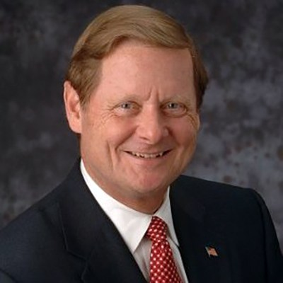
Speaker #1
Steve Bartlett
Vice Chair, Board of Directors
The Honorable Representative Bartlett,
Vice Chair of RespectAbility’s Board of Directors, previously served as a member of Congress for eight years, authoring 18 major pieces of legislation. Most notably, Bartlett co-authored the Americans with Disabilities Act of 1990. He has served as the President and CEO of the Financial Services Roundtable in Washington, D.C., the Mayor of Dallas, and a board member of several for-profit and non-profit organizations. Currently, he is a Senior Advisor with Treliant Risk Advisors.

Slide 4
Civic Engagement Etiquette
In meetings with a public audience, remember to:
Arrive 15 – 30 minutes early.
Sit in the 2nd or 3rd row.
Ask a 15-30 second question in a friendly, respectful way.
* Don’t ask the first question; try to ask the 2nd – 5th question.
Listen intently to the answer.
Take down notes.
Afterwards, connect with others from different groups.

Slide 5
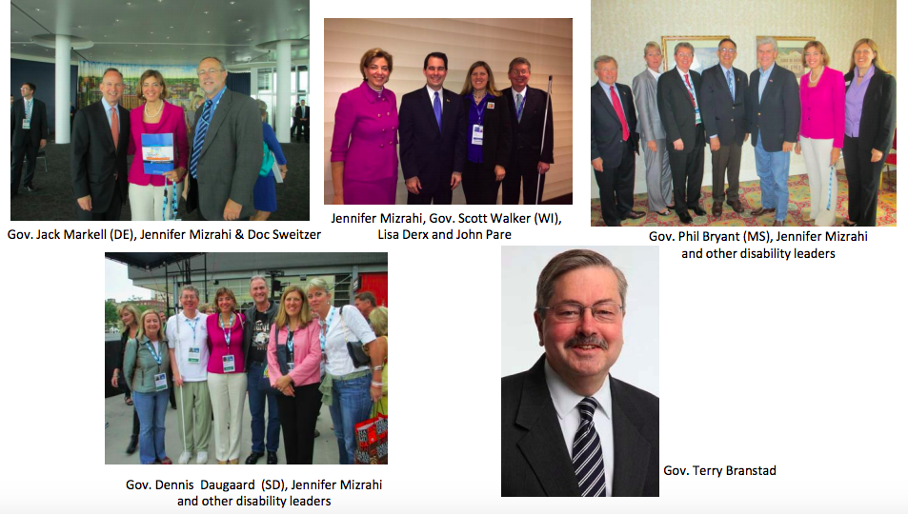
Meeting Your Governor

Slide 6
Governors are Partners
Governors work for the people of their states. They are our employees.
The nation’s governors are critical partners in the continuing effort to advance job opportunities for millions of people with disabilities.
Governors drive policy, prioritize programs, and bring attention to what people with disabilities can accomplish if and when given a fair chance.
RespectAbility has met with 46 governors to discuss disability employment and to advocate for best practices.
A nonpartisan endeavor, RespectAbility connects all governors to promote the idea that people with disabilities deserve the opportunity to work and achieve independence.

Slide 7
What do we want Governors to do?
RespectAbility has several key goals when it comes to our nation’s governors:
1. We want Governors to make public proclamations for National Disability Employment Awareness Month (NDEAM).
2. We want RespectAbility volunteers to sit down and meet with Governors or their staff to talk about jobs for people with disabilities in each state.
3. We want Governors to do press events at programs / projects supporting Competitive Integrated Employment for people with disabilities.
BOTTOM LINE: We want Governors to become “champions” on jobs for people with disabilities.

Slide 8
Wait, what’s an NDEAM?
Launched in 1945, National Disability Employment Awareness Month is an annual celebration in October to raise awareness of the employment needs and contributions of individuals with all types of disabilities.
The 2018 NDEAM Theme is “America’s Workforce: Empowering All.”

Slide 9
NDEAM 2018

Slide 10
Why proclamations?
There are three reasons why we want Governors to make proclamations for NDEAM:
1. We want Governors to publicly commit to work on disability employment issues in their states.
2. We want the public to know that their Governor cares about disability issues.
3. Governors deserve public credit for good work being done that impacts job opportunities for people with disabilities.
Think about it this way….a public proclamation is a public promise. By releasing a statement on our issues, a state leader is signaling that they know and care about that issue.
If they do that, we can hold them accountable.

Slide 11
Sample NDEAM Proclamation
WHEREAS Our nation was founded on the principle that anyone who works hard should be able to get ahead in life. People with disabilities deserve equal opportunity to earn an income and achieve independence just like anyone else.
WHEREAS People with disabilities bring unique characteristics and talents to the workplaces. People with disabilities can work in hospitals and hotels, or apply their talents to develop computer software. There are no limits to what they can do.
In this spirit, the <CITY OF/STATE OF (NAME)> is recognizing National Disability Employment Awareness Month this October to raise awareness about disability employment issues and celebrate the many and varied contributions of people with disabilities. Activities during this month will reinforce the value and talent people with disabilities add to our workplaces and communities and affirm <CITY'S/STATE'S> commitment to an inclusive community.
NOW, THEREFORE, I, _______________________ do hereby proclaim October 2018 as National Disability Employment Awareness Month. In so doing, I call upon employers, schools and other community organizations in <CITY/STATE> to observe this month with appropriate programs and activities, and to advance its important message that people with disabilities are equal to the task throughout the year.

Slide 12
How can you help?
RespectAbility has already done the hard part…we have written to every Governor and asked them for a NDEAM Proclamation.
We need YOUR HELP to:
follow up by phone and
potentially meet in person!

Slide 13
What do you need to know?
If you are ready to talk to your Governor or staff, you need to know:
how many working-age PwDs live in your state.
how many PwDs have jobs.
how many PwDs entered the workforce in the last year.
Where do you find that? Click below! respectability.org/resources/Policy-Makers/

Slide 14
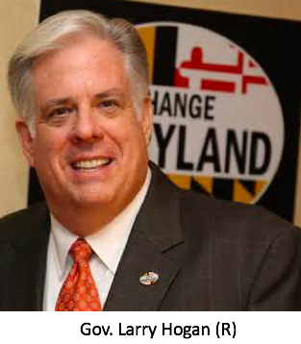
Maryland
78.3% of persons without disabilities aged 18 to 64 are employed.³
40.0% of PwDs aged 18 to 64 are employed.³
321,409 persons aged 18 to 64 have a disability.³
The Employment Gap between PwDs and people with disabilities has decreased 0.3% pts between 2010 and 2011.³
56,600 PwDs aged 18 to 64 receive benefits.¹
622,682 people in MD have a disability.³
In 2012, MD’s total expenditure on SSDI benefits was $1,922,172,000.³
Voc. Rehab. received 9,405 general applicants in MD 2012.³
Voc. Rehab. obtained 2,506 jobs for PwDs in MD in 2012.²
2012 Disability Status Report: New York, disabilitystatistics.org
StateData: The National Report on Employment Services and Outcomes, 2013
Annual Disability Statistics Compendium

Slide 15
Use your local statistics and facts!
Alabama: Download the PDF here. Download the PPT here.
❖ Alaska: Download the PDF here. Download the PPT here.
❖ Arizona: Download the PDF here. Download the PPT here.
❖ Arkansas: Download the PDF here. Download the PPT here.
❖ California: Download the PDF here. Download the PPT here.
❖ Colorado: Download the PDF here. Download the PPT here.
❖ Connecticut: Download the PDF here. Download the PPT here.
❖ DC: Download the PDF here. Download the PPT here.
❖ Delaware: Download the PDF here. Download the PPT here.
❖ Florida: Download the PDF here. Download the PPT here.
❖ Georgia: Download the PDF here. Download the PPT here.
❖ Hawaii: Download the PDF here. Download the PPT here.
❖ Idaho: Download the PDF here. Download the PPT here.
❖ Illinois: Download the PDF here. Download the PPT here.
❖ Indiana: Download the PDF here. Download the PPT here.
❖ Iowa: Download the PDF here. Download the PPT here.
❖ Kansas: Download the PDF here. Download the PPT here.
❖ Kentucky: Download the PDF here. Download the PPT here.
❖ Louisiana: Download the PDF here. Download the PPT here.
❖ Maine: Download the PDF here. Download the PPT here.
❖ Maryland: Download the PDF here. Download the PPT here.
❖ Massachusetts: Download the PDF here. Download the PPT here.
❖ Michigan: Download the PDF here. Download the PPT here.
❖ Minnesota: Download the PDF here. Download the PPT here.
Mississippi: Download the PDF here. Download the PPT here.
Missouri: Download the PDF here. Download the PPT here.
Montana: Download the PDF here. Download the PPT here.
Nebraska: Download the PDF here. Download the PPT here.
Nevada: Download the PDF here. Download the PPT here.
New Hampshire: Download the PDF here. Download the PPT here.
New Jersey: Download the PDF here. Download the PPT here.
New Mexico: Download the PDF here. Download the PPT here.
New York: Download the PDF here. Download the PPT here.
North Carolina: Download the PDF here. Download the PPT here.
North Dakota: Download the PDF here. Download the PPT here.
Ohio: Download the PDF here. Download the PPT here.
Oklahoma: Download the PDF here. Download the PPT here.
Oregon: Download the PDF here. Download the PPT here.
Pennsylvania: Download the PDF here. Download the PPT here.
Rhode Island: Download the PDF here. Download the PPT here.
South Carolina: Download the PDF here. Download the PPT here.
South Dakota: Download the PDF here. Download the PPT here.
Tennessee: Download the PDF here. Download the PPT here.
Texas: Download the PDF here. Download the PPT here.
Utah: Download the PDF here. Download the PPT here.
Vermont: Download the PDF here. Download the PPT here.
Virginia: Download the PDF here. Download the PPT here.
Washington: Download the PDF here. Download the PPT here.
West Virginia: Download the PDF here. Download the PPT here.
Wisconsin: Download the PDF here. Download the PPT here.
Wyoming: Download the PDF here. Download the PPT here

Slide 16
Who you need to talk to?
When you reach out to your Governor, you need to get in touch with his/her team, which will includes:
Scheduler – person who manages Gov’s calendar a.k.a. The Gatekeeper.
Communications Director – staffer responsible for press releases/media.
Note: Some Gov’s have a specific staffer who works on proclamations.
Review contact list on RA Website.

Slide 17
What do you need to say?
1. Our nation was founded on the principle that anyone who works hard should be able to get ahead in life. People with disabilities deserve to be able to work to achieve the American dream, just like anyone else.
3. Government policies that help people with disabilities get and keep jobs are a win-win-win. They allow people with disabilities the dignity and financial benefits of work but also grow our economy and save taxpayer money.
2. Companies like Walgreens, E.Y. (formally known as Ernst and Young), AMC and others have shown that employees with disabilities are loyal, successful and help them make more money.

Slide 18
If you do get a meeting, remember...
Dress professionally.
Be on time.
Be polite.
If you need advice…talk to RA staff. Trust us, we’ve done this before...

Slide 19
Remember… the 30-Second Rule
Open with 30 seconds of small talk (sports, weather, movies), then pivot to your first goal.

Slide 20
Prepare Your Leave-Behinds and Hand Them Over
What the heck is a “leave behind”?
A leave behind is a packet of key information that an advocate leaves behind in a public official’s office.
Such as a RespectAbility flyer, RespectAbility state statistics, and fact sheets on key best practices.
We are happy to provide materials!

Slide 21
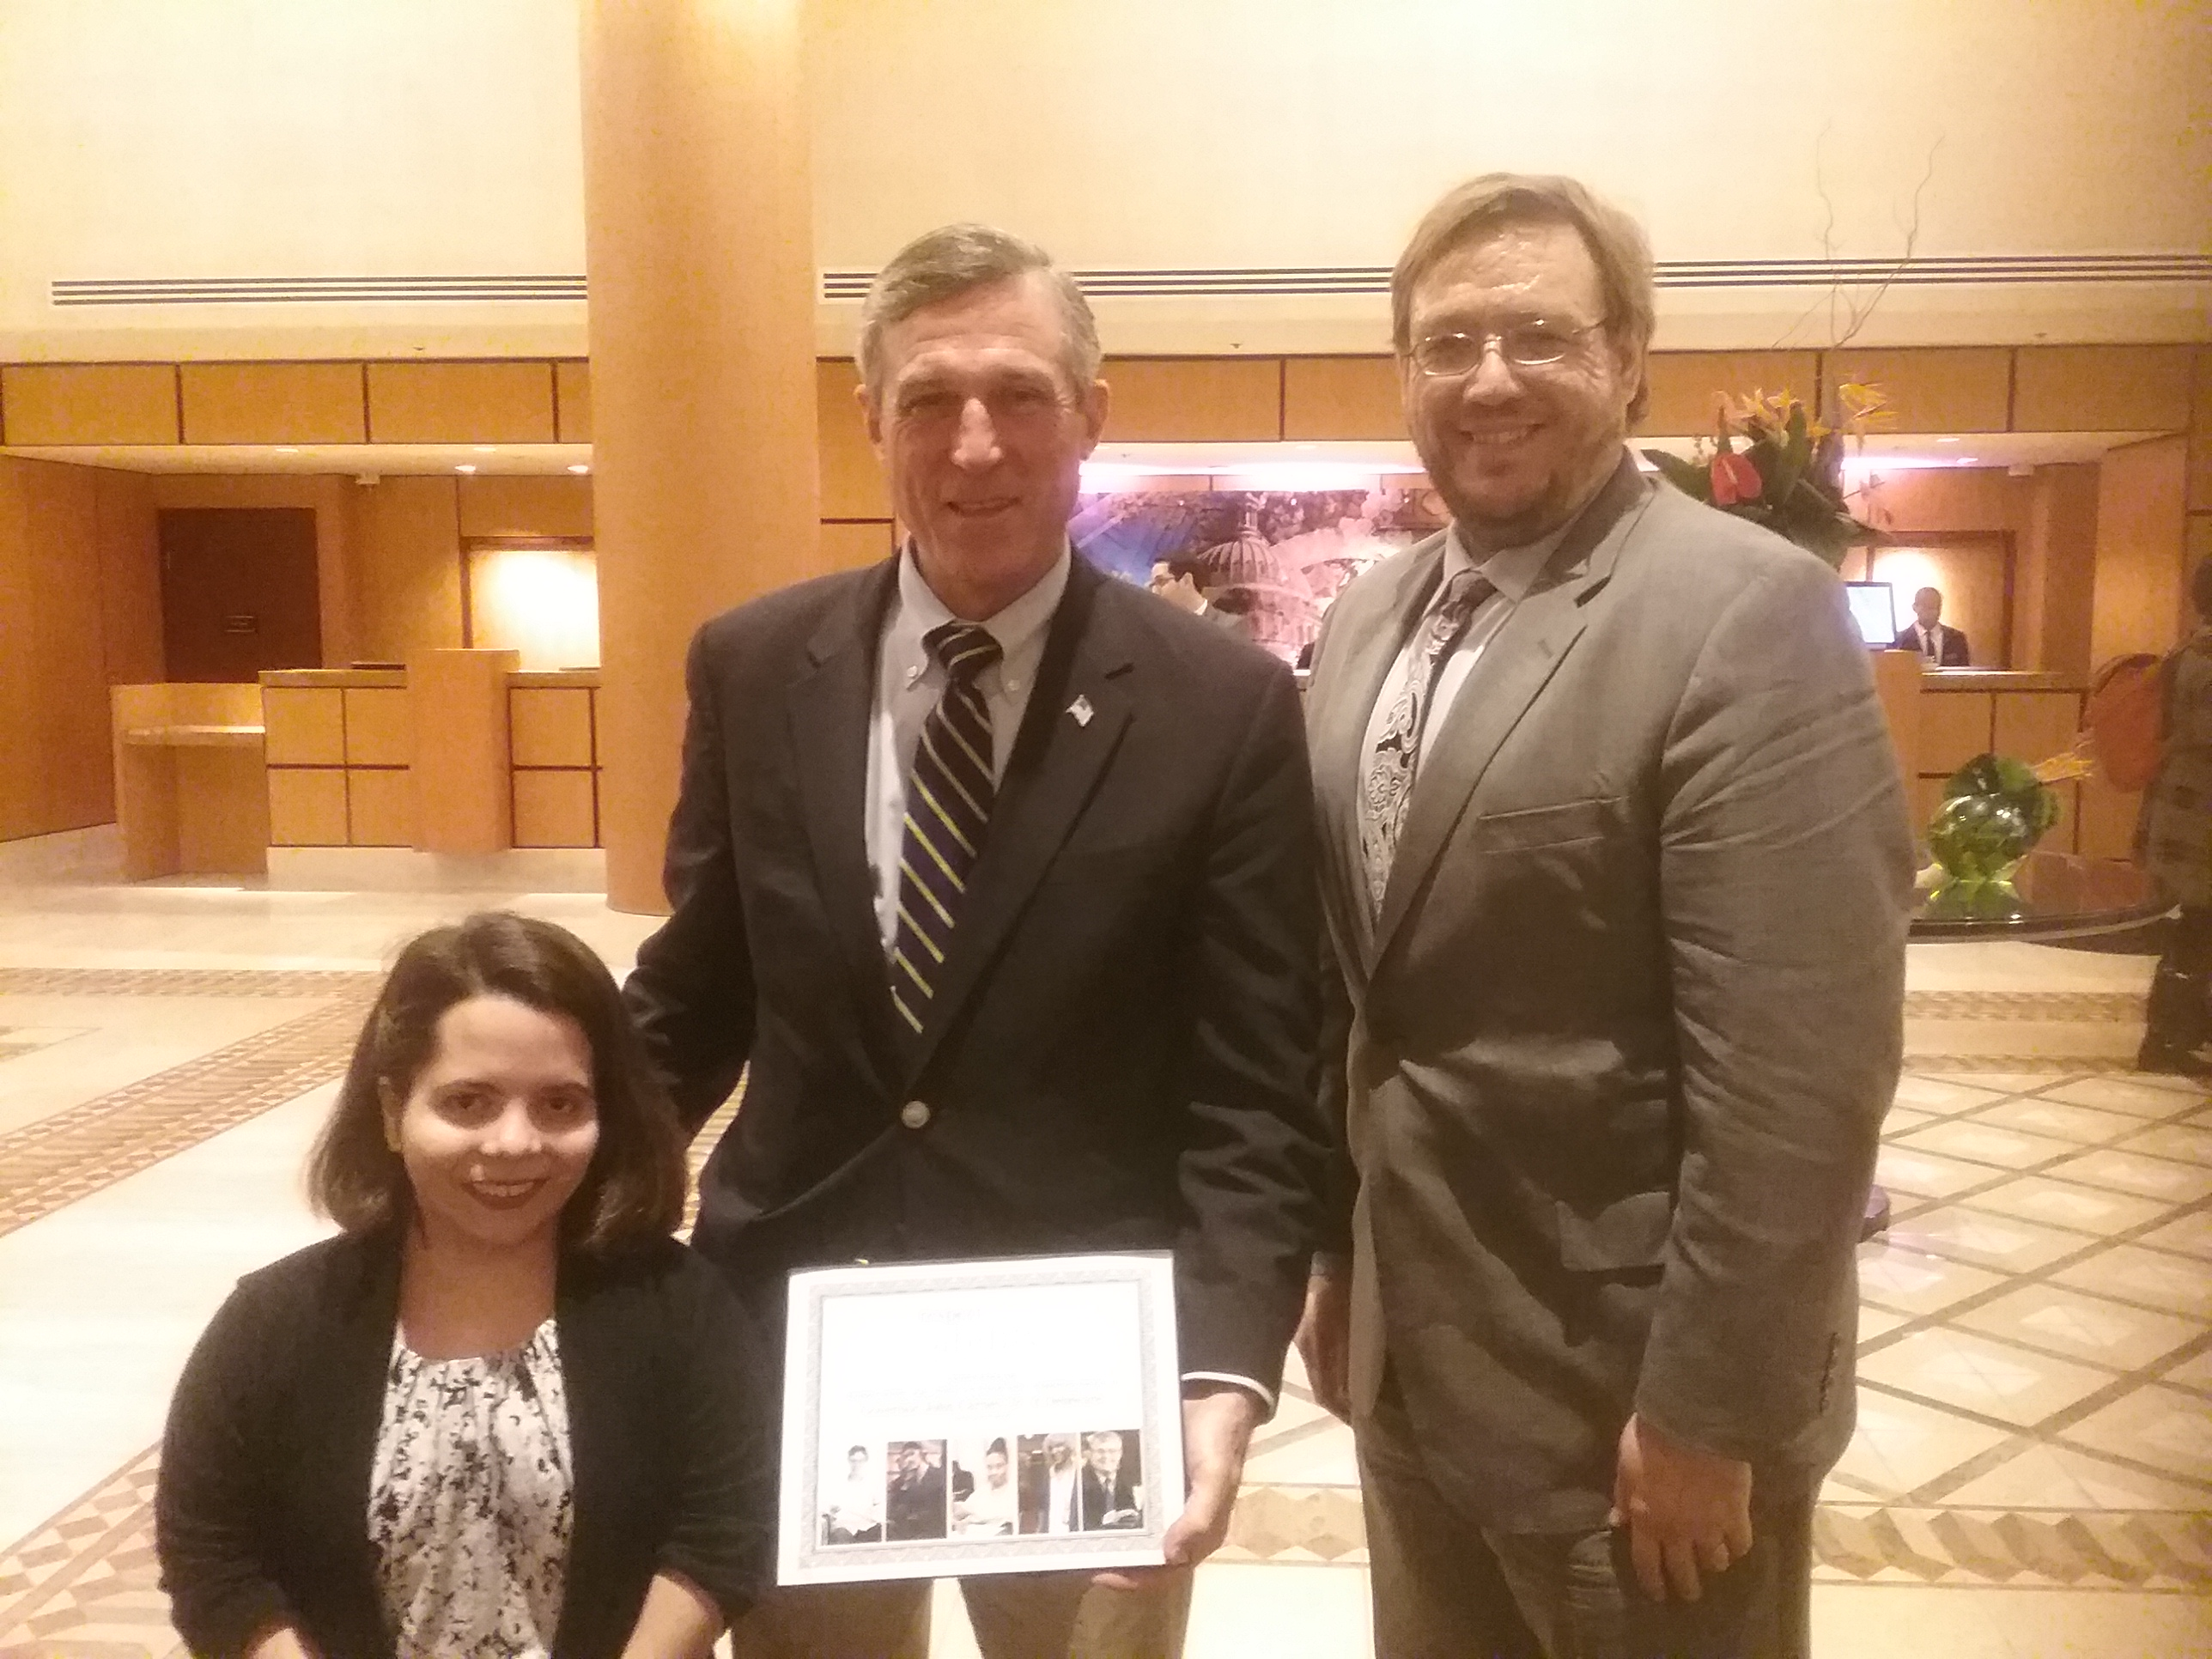
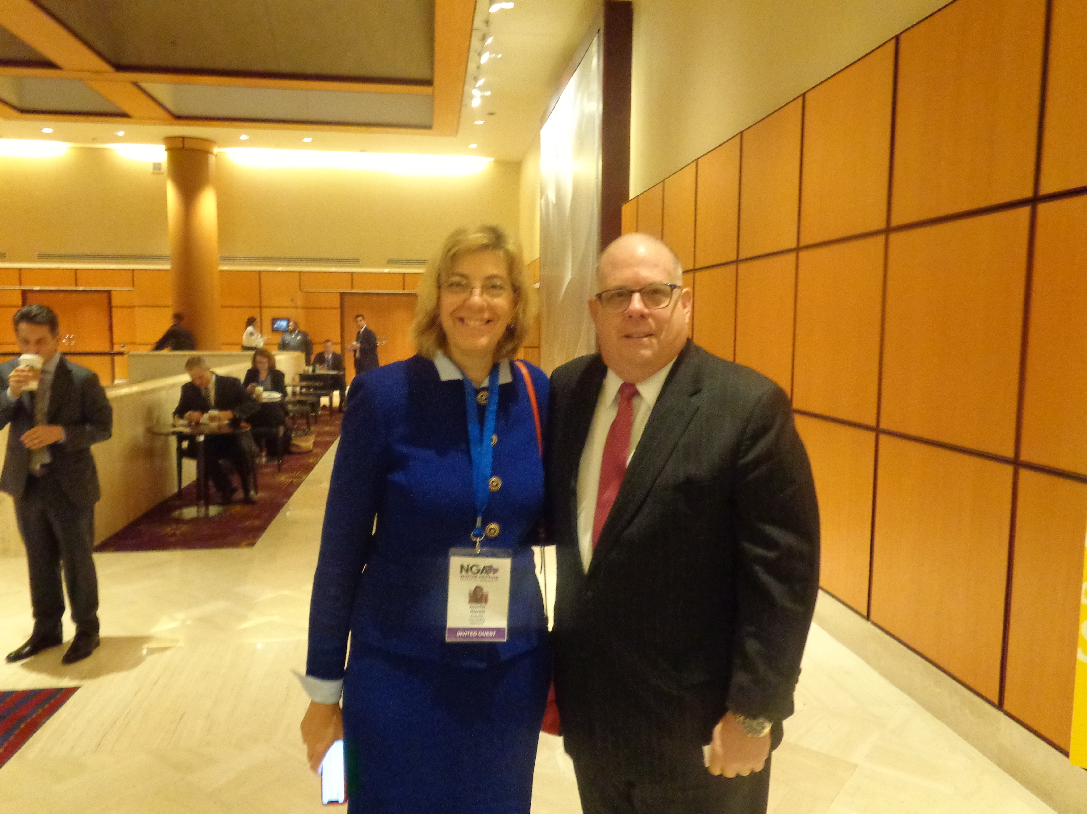
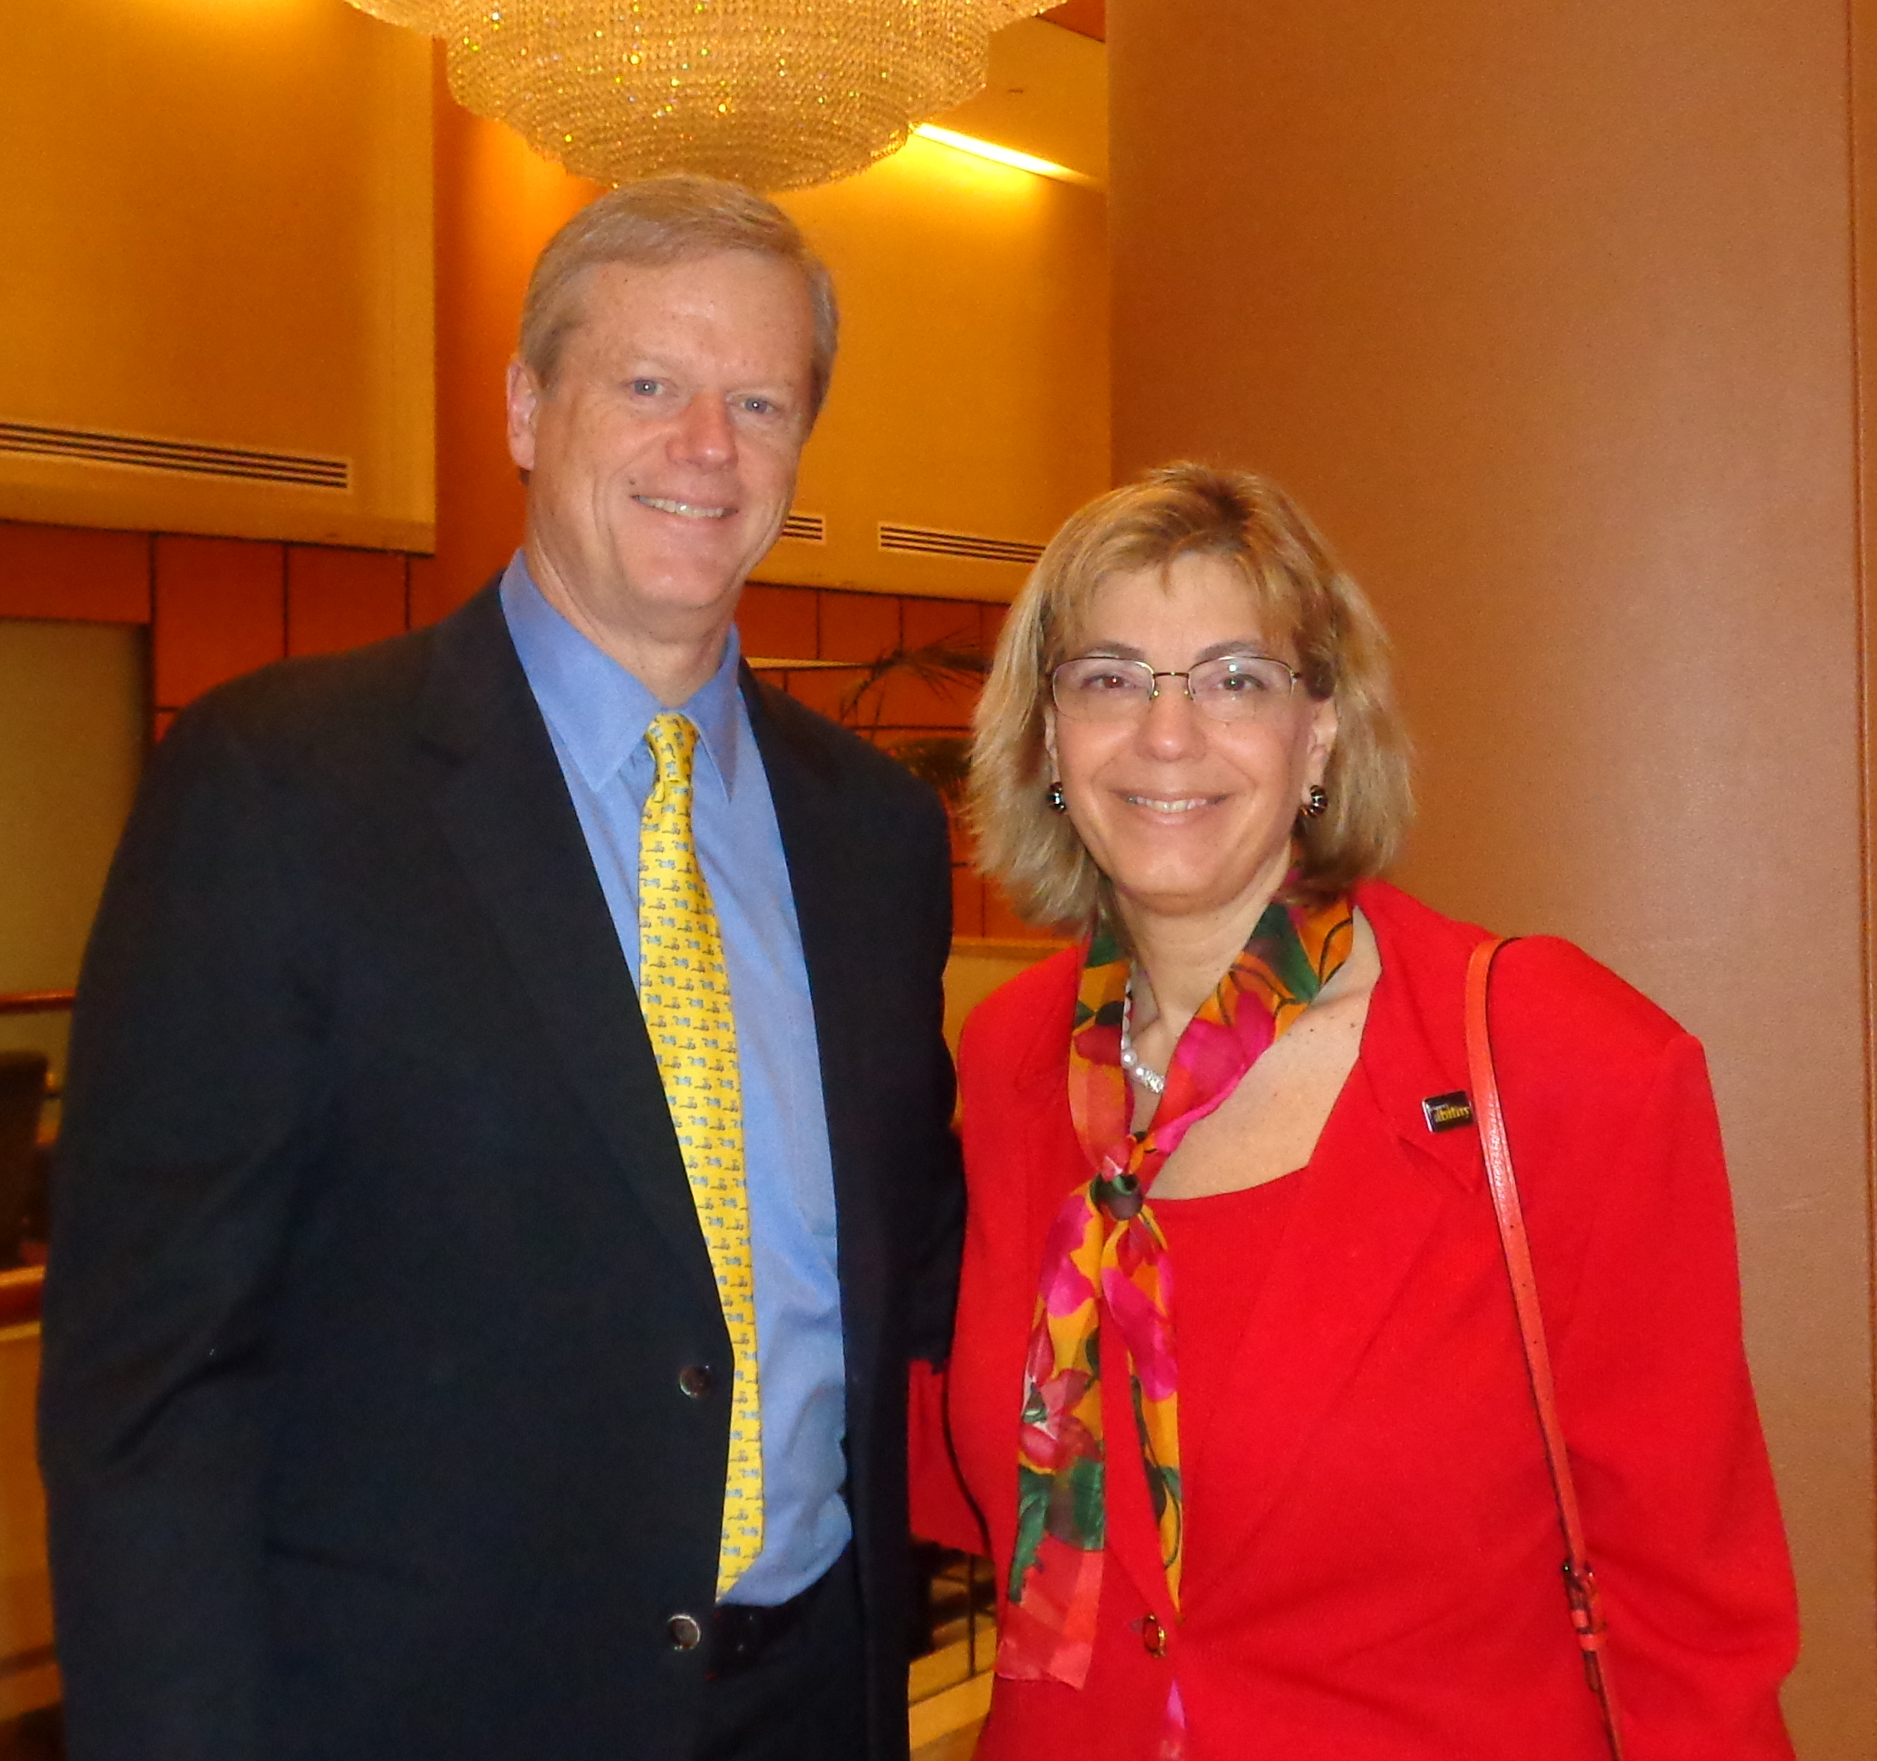
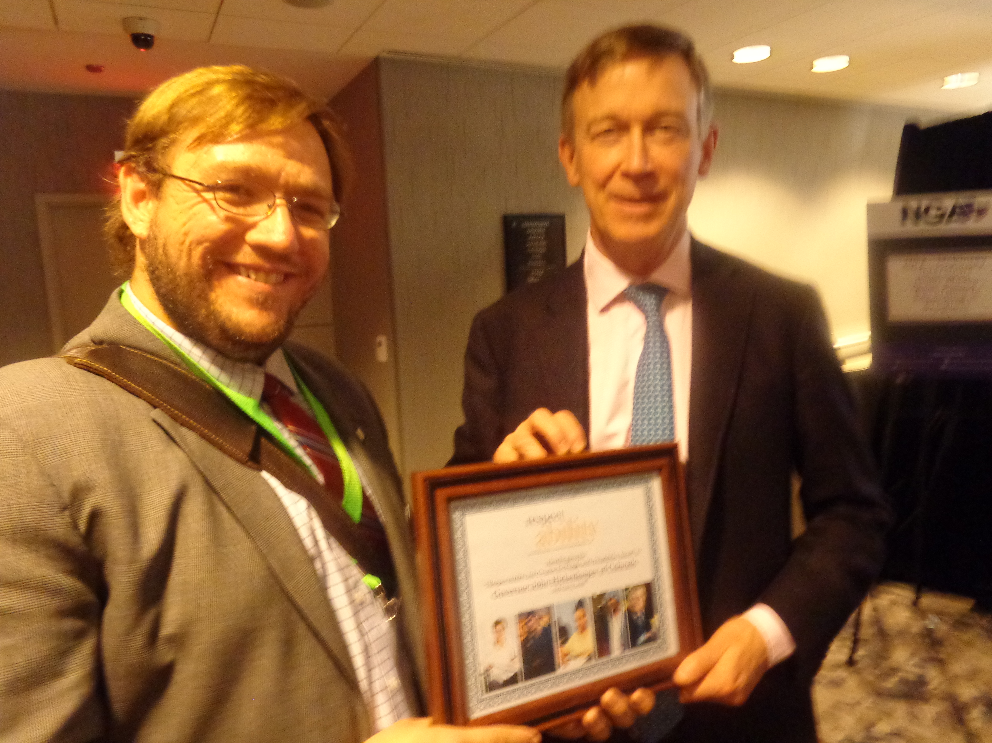
If you get a meeting… take a picture!

Slide 22
What do you do to follow up?
If you use Twitter, take that picture, tag your Governor and thank them.
By the next business day you should send a polite thank you email.
If you feel like it, mail a thank you note back to the Governor’s Office.

Slide 23
Stay Positive and Stay on Message!
1. Our nation was founded on the principle that anyone who works hard should be able to get ahead in life. People with disabilities deserve to be able to work to achieve the American dream, just like anyone else.
3. Government policies that help people with disabilities get and keep jobs are a win-win-win. They allow people with disabilities the dignity and financial benefits of work but also grow our economy and save taxpayer money.
2. Companies like Walgreens, E.Y. (formally known as Ernst and Young), AMC and others have shown that employees with disabilities are loyal, successful and help them make more money.

Slide 24
Option – Write an Op-ed for NDEAM!
Another great way to get involved is to write an op-ed to your local newspaper about NDEAM.
See our recent webinar about how to write winning op-eds: https://bit.ly/2IahSUx

Slide 25
Option – Contact your State Workforce Board
WHAT IS A STATE WORKFORCE BOARD? These boards oversee federal, state, and local funding to workforce development; ie, programs that help people with barriers get good paying jobs. Each state has one statewide workforce board with multiple local boards that welcome involvement.
We would love it if you could attend the next meeting of your state’s workforce development board.
List of state workforce boards: http://www.workforceinvestmentworks.com/workforce_board_finder.asp

Slide 26
Q&A
Questions?
Comments?
Smart Remarks?

Slide 27
Resources / Contact Info
2015 Disability Status Report United States, Cornell University, 2015: www.disabilitystatistics.org
Fedspending: www.fedspending.org
Project SEARCH: www.projectsearch.us
Job Accommodation Network: https://askjan.org/
State Vocational Rehabilitation Agency: http://wdcrobcolp01.ed.gov/Programs/EROD/org_list.cfm?category_cd=SVR
Selected Economic Characteristics for Civilian Noninstitutionalized Population by Disability Status, 2011-2015 ACS (focused on Long Beach) http://bit.ly/LBDisabilityjobs
Local Disability Data for Planners (focused on Montgomery County) http://bit.ly/MontgomeryCountydisabilityjobs
Jennifer Laszlo Mizrahi
www.RespectAbility.org
Cell: (202) 365-0787
JenniferM@RespectAbility.org
Twitter: @respect_ability / @jewishinclusion
Facebook: https://www.facebook.com/RespectAbilityUSA and https://www.facebook.com/RespectAbility4All/

Slide 28
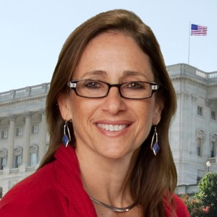
Volunteer Reporting and Coordination
Debbie Fink
Director, Community Outreach & Impact
DebbieF@RespectAbility.org
11333 Woodglen Drive, Suite 102
Rockville, MD 20852
Office: (202) 517-6272
www.RespectAbility.org

