Slide 1
RespectAbility
Faith and Disability Inclusion Survey
October 16, 2018
Calvin Harris, Chairman, RespectAbility
Jennifer Laszlo Mizrahi, President, RespectAbility
www.RespectAbility.org

Slide 2
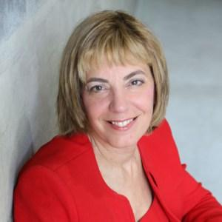
Hello and Welcome!
Jennifer Laszlo Mizrahi is President of RespectAbilty, a non-profit organization working to empower people with disabilities to achieve the American Dream. She works regularly with national, state, and local policy leaders, workforce development professionals, media and employers, as well as with disability and faith-based organizations in order to expand opportunities for people with disabilities. She has met with teams from all 50 states, including 40 governors, on WIOA implementation. She has published more than 55 op-eds on disability issues, including in USA Today, Huffington Post, The Hill and other publications. Dyslexic herself, she also knows what it means to parent a child with multiple disabilities.
Notes:
Picture of Jennifer Lazlo-Mizrahi

Slide 3
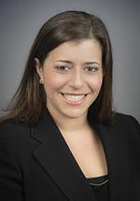
Introducing Meagan Buren
Meagan Buren is a strategist and public opinion research expert with a strong background in focus groups, dials tests, polling, media relations and in leading communications and training programs. Previously she served as senior project director for Luntz Global, a leader in corporate, political and nonprofit message creation and image management worldwide. Prior to that, Buren worked with Jennifer Laszlo Mizrahi at The Israel Project (TIP) from its inception. The two worked side by side for eight years. Together, and with their teams, they built the organization into a major educational, policy and communications organization that reached out globally in 10 languages. At TIP, Buren managed focus groups, polling, dial testing, grassroots and educational training, and media outreach in the U.S., Europe, Russia and the Arab world. Buren conducted interactive language and media training sessions for ambassadors, top-ranking public officials, professionals and leaders who had significant impact on Middle East security and peace.
Notes:
Picture of Megan Buren

Slide 4
Survey Sample 1778- Jewish Disability Community Nationwide, including: 556- Jews with Disabilities Nationwide 798- Jews with No Disability Connection Nationwide

Slide 5
Survey Overview
The survey was fielded July–September 2018 and includes 4,061 respondents; 2,570 are Jewish, 559 of whom are Jews with disabilities. It is important to note that while this study is extremely extensive and has a large sample size that this poll was fielded almost exclusively online and was distributed widely via social media, Jewish press, and by partnering organizations in the Jewish community. Phone survey options and assistance were made available to respondents although, due to the nature of the online survey instrument, the sample likely underreports people with cognitive and intellectual disabilities among others.
This survey was made possible by the financial support of The Genesis Prize Foundation, which worked with the Jewish Funders Network to conduct the Breaking Barriers Initiative, created to honor Itzhak Perlman, 2016 Genesis Prize Laureate and world-renowned violinist and activist for people with disabilities. Ahuva and Aaron Orlofsky of the ORLO Fund, and the Beverly Foundation matched that support. The overwhelming response to the survey would not have been possible without the partnership of the Jewish Federation of Greater Houston, Jewish Federation of Greater Los Angeles, Jewish Federation of Greater Washington, UJA–Federation of New York, Jewish Federation of Greater Philadelphia, the LA Jewish Journal, New York Jewish Week’s New Normal and JTA.

Slide 6
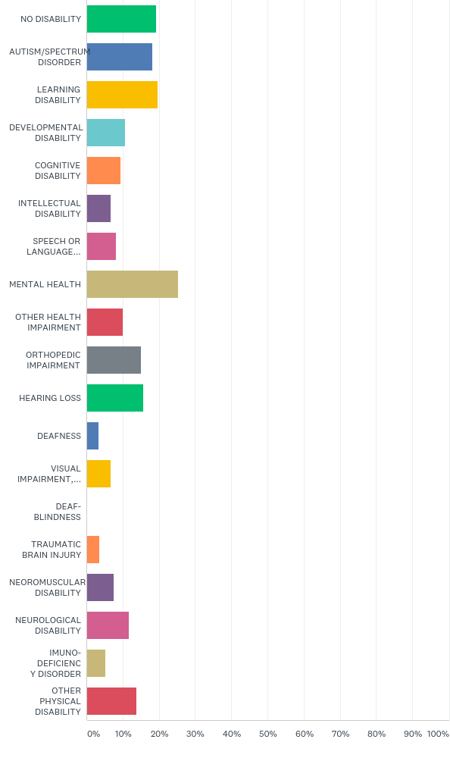
Q37: What type of disability do you have or does a member of your household have?(PLEASE CHECK ALL THAT APPLY)
Answered: 1,351 Skipped: 437
Notes:
Slide 6: Bar Graph of responses to what type of disability do you have or does a member of your household have? Answered 1,351 Skipped 437 Green No Disability Blue Autism/Spectrum Disorder Yellow Learning Disability Light blue Developmental Disability Orange Cognitive Disability Purple Intellectual Disability Pink Speech and Language Disability Brown Mental Health Red Other Health Impairment Gray Orthopedic Impairment Green Hearing Loss Blue Deafness Yellow Vision Impairment , Blank Deaf Blindness Orange Traumatic Brain Injury Dark Purple Neuromuscular Disorder Pink Neurological Disability Beige Imuno-deficiency Disorder Red Other Physical Disability

Slide 7
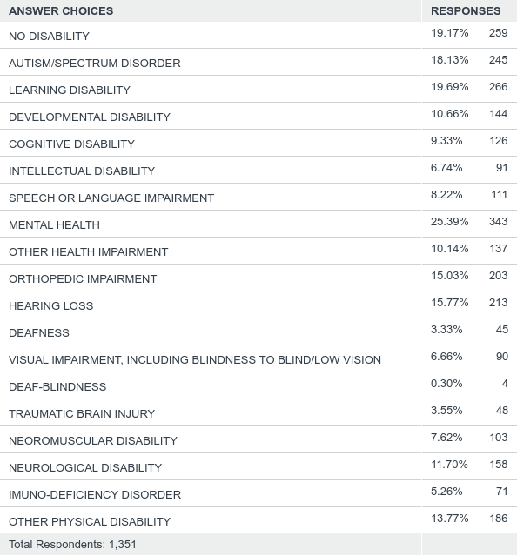
Q37: What type of disability do you have or does a member of your household have?(PLEASE CHECK ALL THAT APPLY)
Answered: 1,351 Skipped: 437
Notes:
Slide 7 Table of what type of disability do you have or does a member of your household have? Answered 1,351 Skipped 437 Answer Choices No Disability 19.17% 259 Autism/Spectrum Disorder 18.13% 245 Learning Disability 19.69% 266 Developmental Disability 10.66% 144 Cognitive Disability 9.33% 126 Intellectual Disability 6.74% 91 Speech or Language Impairment 8.22% 111 Mental Health 25.39% 343 Other Health Impairment 10.14% 137 Orthopedic Impairment 15.03% 203 Hearing Loss 15.77% 213 Deafness 3.33% 45 Visual Impairment including Blindness to Blind/Low Vision 6.66% 90 Deaf -Blindness 0.30% 4 Traumatic Brain Injury 3.55% 48 Neoromuscular Disability 7.62% 103 Neurological Disability 11.70% 158 Imuno-Deficiency Disorder 5.26% 71 Other physical disability 13.77% 186 Total Respondents 1,351

Slide 8
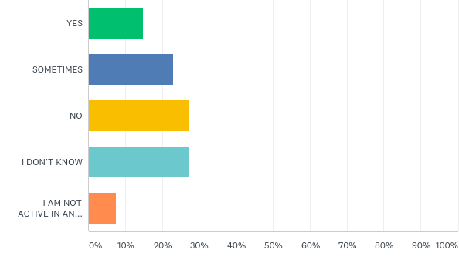
Q16: Do you feel that people with disabilities are encouraged to serve on the boards and committees of your faith based institutions?
Answered: 1,568 Skipped: 220
Notes:
Slide 8 Bar Graph of responses to Do you feel that people with disabilities are encouraged to serve on the boards and committees of your faith based institutions with percentages from 0-100%. Answer 1,568 Skipped 220 Green Yes Purple Sometimes Yellow No Blue I Don’t Know Orange I Am Not Active In An…

Slide 9
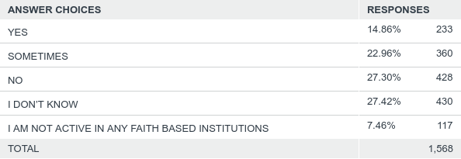
Q16: Do you feel that people with disabilities are encouraged to serve on the boards and committees of your faith based institutions?
Answered: 1,568 Skipped: 220
Notes:
Bar graph Do you know of any clergy or staff with disabilities at your own faith based organizations? Green yes No purple Yellow I don’t know Blue I am not active in an

Slide 10
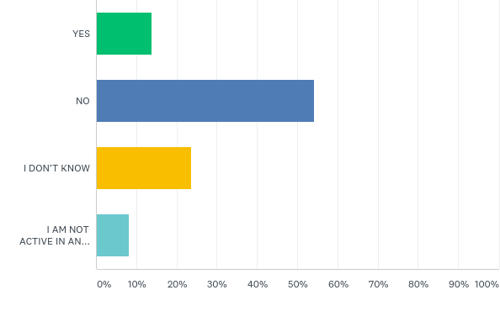
Q17: Do you know of any clergy or staff with disabilities at your own faith based institutions?
Answered: 1,567 Skipped: 221
Notes:
Bar graph Do you know of any clergy or staff with disabilities at your own faith based organizations? Green yes No purple Yellow I don’t know Blue I am not active in an

Slide 11
Q17: Do you know of any clergy or staff with disabilities at your own faith based institutions?
Answered: 1,567 Skipped: 221
Notes:
Table of responses to Do you know of any clergy or staff with disabilities at your own faith based organizations? Answer choices Yes 13.91% 218 No 54.24% 850 I Don’t Know 23.74% 372 I am not active in any faith based organizations 8.10% 127 Total 1,567

Slide 12
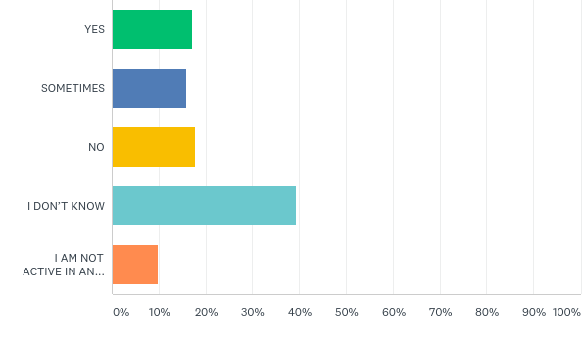
Q16: Do you feel that people with disabilities are encouraged to serve on the boards and committees of your faith based institutions?
Answered: 672 Skipped: 126
Notes:
Bar graph of Do you feel that people with disabilities are encouraged to serve on the boards and committees of your faith based institutions? Answered 672 Skipped 126 Green Yes Purple Sometimes Yellow No Blue I don’t know Orange I’m not active in an…

Slide 13
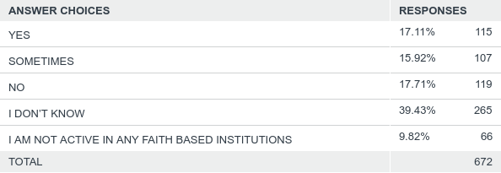
Q16: Do you feel that people with disabilities are encouraged to serve on the boards and committees of your faith based institutions?
Answered: 672 Skipped: 126
Notes:
Table of Do you feel that people with disabilities are encouraged to serve on the boards and committees of your faith based institutions? Answered 672 Skipped 126 Yes 17.11% 115 Sometimes 15.92% 107 No 17.71% 119 I don’t know 39.43% 265 I am not active in any faith based institutions 9.82% 66 Total 672

Slide 14
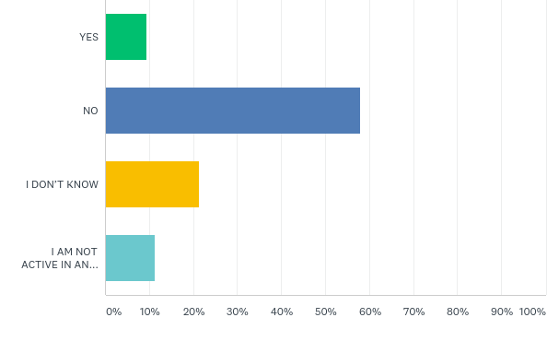
Q17: Do you know of any clergy or staff with disabilities at your own faith based institutions?
Answered: 674 Skipped: 124
Notes:
Bar graph of Do you know of any clergy or staff with disabilities at your own faith based institutions? Green yes No purple Yellow I don’t know Blue I’m not active in an No PWD

Slide 15
Q17: Do you know of any clergy or staff with disabilities at your own faith based institutions?
Answered: 674 Skipped: 124
Notes:
Table of Do you know of any clergy or staff with disabilities at your own faith based institutions? Yes 9.35% 63 No 58.01% 391 I don’t know 21.36% 144 I am not active in any faith based institutions 11.28% 76 Total 674

Slide 16
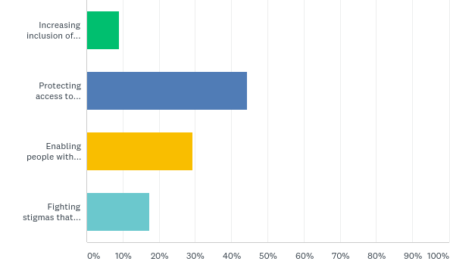
Q4: Which is currently most important to you?
Answered: 1,773 Skipped: 15
Notes:
Bar graph of the responses Which is currently most important to you? Answered 1,773 Skipped 15 Green Increasing inclusion of Purple protecting access to Yellow enabling people with Blue Fighting stigmas that… PWD Comm

Slide 17
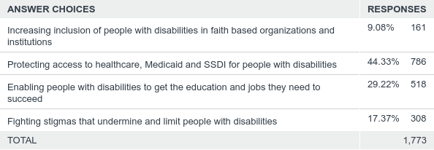
Q4: Which is currently most important to you?
Answered: 1,773 Skipped: 15
Notes:
Bar graph of the responses Which is currently most important to you? Answered 1,773 Skipped 15 Green Increasing inclusion of Purple protecting access to Yellow enabling people with Blue Fighting stigmas that… PWD Comm

Slide 18
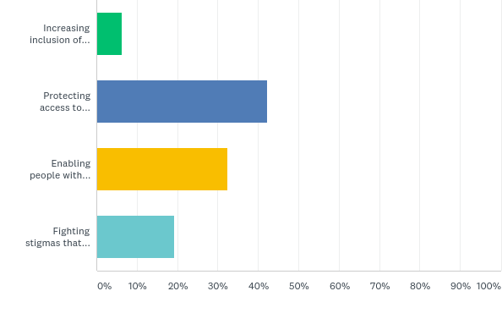
Q4: Which is currently most important to you?
Answered: 787 Skipped: 11
Notes:
Table of the responses Which is currently most important to you? Answered 1,773 Skipped 15 Answer choices Increasing inclusion of people with disabilities in faith based organizations and institutions 9.06% 161 Protecting access to health care, Medicaid and SSDI for people with disabilities 44.33% 786 Enabling people with disabilities to get the education and jobs they need to succeed 29.22% 518 Fighting stigmas that undermine and limit people with disabilities 17.37% 308 Total 1,773 No PWD

Slide 19
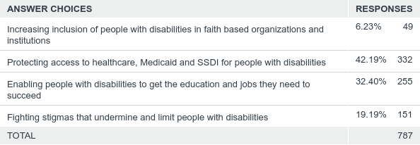
Q4: Which is currently most important to you?
Answered: 787 Skipped: 11
Notes:
Bar graph of responses to Which is currently most important to you? Answered 787 Skipped 11 Green Increasing inclusion of Purple protecting access to Yellow enabling people with Blue fighting stigmas that Total 787 No PwD

Slide 20
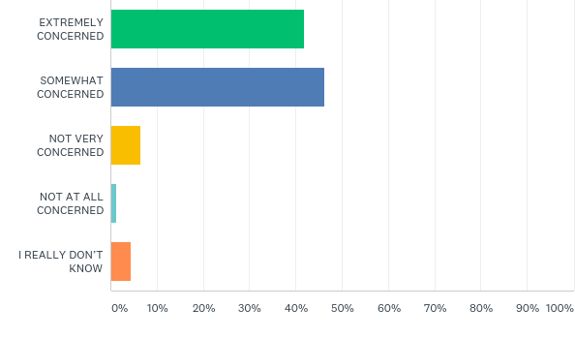
Q19: Overall, how concerned are you about increasing inclusion of people with disabilities in your faith community?
Answered: 1,564 Skipped: 224
Notes:
Bar graph of Overall, how concerned are you about increasing inclusion of people with disabilities in your faith community? Answered 1,564 Skipped 224 Green extremely concerned Purple somewhat concerned Yellow not very concerned Blue not at all concerned Orange I don’t know PWD Comm

Slide 21
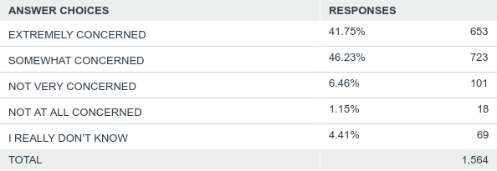
Q19: Overall, how concerned are you about increasing inclusion of people with disabilities in your faith community?
Answered: 1,564 Skipped: 224
Notes:
Table of Overall how concerned are about increasing inclusion of people with disabilities in your faith community? Answered 1,564 Skipped 224 Extremely concerned 41.75% 653 Somewhat concerned 46.23% 653 Not very concerned 6.46% 101 Not at all concerned 1.15% 18 I really don’t know 4.41% 69 Total 1,564 PWD Comm

Slide 22
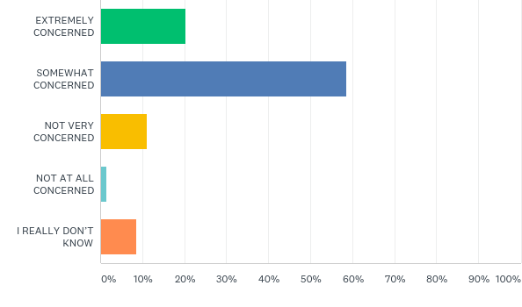
Q19: Overall, how concerned are you about increasing inclusion of people with disabilities in your faith community?
Answered: 672 Skipped: 126
Notes:
Bar graph of Overall, how concerned are you about increasing inclusion for people with disabilities in your faith community? Green extremely concerned Purple Somewhat concerned Yellow not concerned Blue not at all concerned Orange I don’t really know No PWD

Slide 23
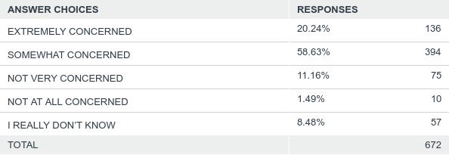
Q19: Overall, how concerned are you about increasing inclusion of people with disabilities in your faith community?
Answered: 672 Skipped: 126
Notes:
Table of responses of How concerned are you about inclusion of people with disabilities in your faith community? Answer choices Extremely concerned 20.24% 136 Somewhat concerned 58.63% 394 Not very concerned 11.16% 75 Not at all concerned 1.49% 10 I don’t really know 8.48% 57 Total 672 No PWD

Slide 24
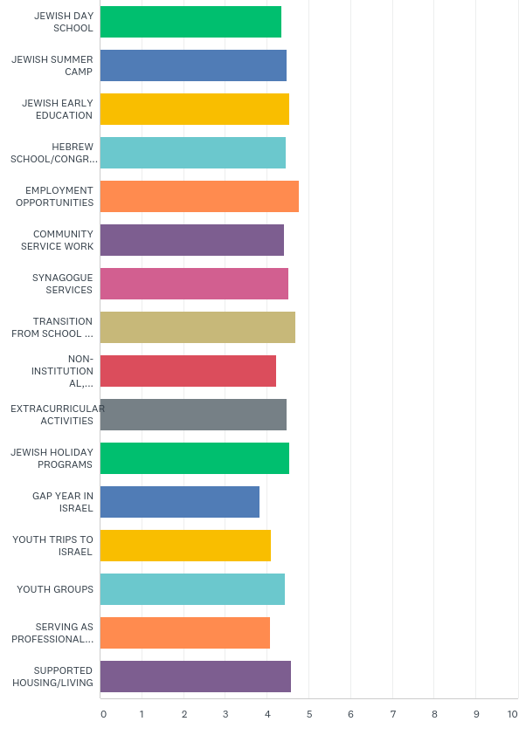
Q8: Please rate how important it is for Jewish people with disabilities to be able to attend and fully participate in each of the following:
Answered: 1,606 Skipped: 182
Notes:
Table of Please rate how important it is for Jewish people with disabilities to be able to participate in the following Answered 1,606 Skipped 182 Jewish Day School 58.07% 917 Very important 25.08% 396 Somewhat important 12.79% 202 Not so important 2.66% 42 Total 1,579 Weighted average 4.36 Jewish Summer Camp 63.01% 998 25.6% 397 9.66% 153 Not so important 0.88% 14 1,584 4.48 Jewish Early Education 65.39% 1,028 24.66% 388 8.21% 129 1.08% 17 0.64% 10 1,572 4.53 Hebrew School/Congregational School/ Sunday School 61.23% 968 26.31% 416 9.93% 157 1.83% 29 0.70% 11 1,581 4.46 Employment Opportunities 80.90% 1,283 16.58% 263 1.51% 24 0.57% 9 0.44% 7 1,586 4.46 Community Service Work 58.29% 925 16.58% 263 1.51% 24 0.57% 9 0.44% 7 1,586 4.77 Synagogue Services 58.29% 1,283 16.58% 263 1.51% 24 0.57% 9 0.44% 7 1,586 4.52 Transition From School To Workforce 75.40% 1,186 19.14% 301 4.26% 67 0.51% 8 0.70% 11 1,573 4.68 Non-Institutional, Non-Membership Jewish (IE Pop-Up Shabbat, Chavurahs) 50.09% 791 27.61% 436 17.61% 278 3.36% 53 1.33% 21 1,579 Weighted Average 4.22 Extracurricular Activities 59.34% 937 30.53% 482 9.25% 146 0.44% 7 0.44% 7 1,579 4.48 Jewish Holiday Programs 66.08% 1,046 25.39% 7.01% 111 0.95% 15 0.57% 9 1,583 4.55 Gap Year In Israel 39.13% 22.70% 355 23.72% 371 10.87% 170 3.58% 56 1,564 3.83 Youth Trips to Israel 47.24% 737 26.35% 411 18.53% 289 5.71% 89 2.18% 34 1,560 4.11 Youth Groups 58.91% 919 28.91% 451 9.94% 155 1.54% 24 0.71% 11 1.5860 4.44 Serving As Professional Staff In Organizations 45.34% 711 28.13% 441 18.11% 284 6.31% 99 2.10% 33 2.10% 33 1,568 4.08 Supported Housing/Living 69.37% 1,094 21.56% 340 7.23% 114 1.40% 22 0.44% 7 1,577 4.58 PWD Comm

Slide 25
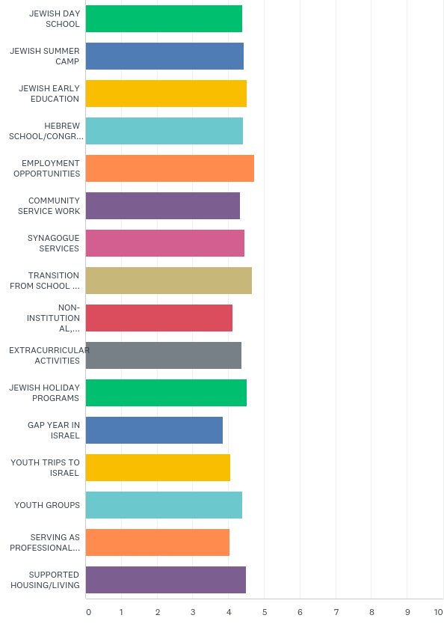
Q8: Please rate how important it is for Jewish people with disabilities to be able to attend and fully participate in each of the following:
Answered: 691 Skipped: 107
Notes:
Bar graph of Please rate how important it is for Jewish people with disabilities to be able to attend and fully participate Answered 691 Skipped 107 Green Jewish Day School Dark Blue Jewish Summer Camp Yellow Jewish Early Education Light Blue Hebrew School/Congregation Orange Employment Opportunities Purple Community Service Work Pink Synagogue Services Beige Transition From School Red Non-Institutional Gray Extracurricular Activities Medium Blue Gap Year In Israel Yellow Youth Trips To Israel Orange Serving As Professional Purple Supported Housing/Living No PWD

Slide 26
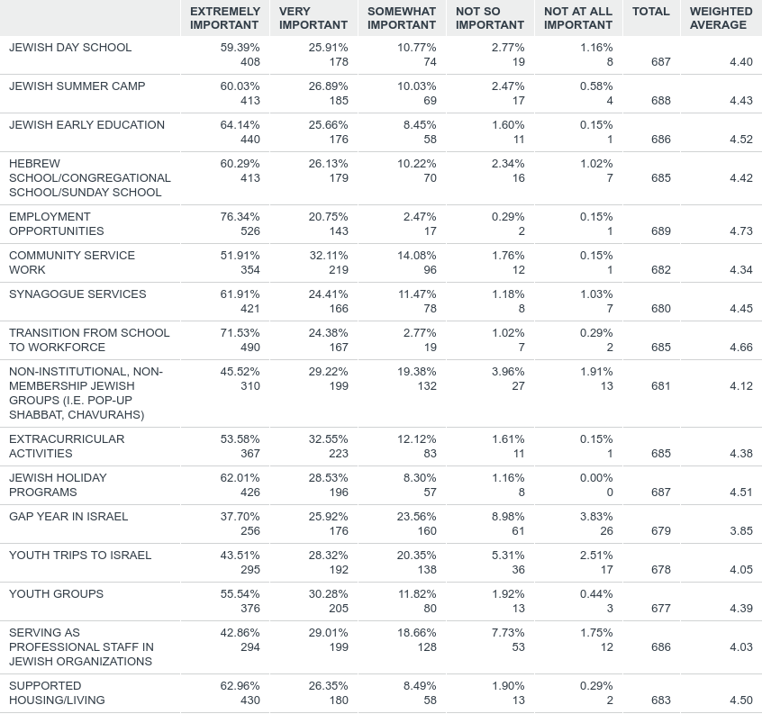
Q8: Please rate how important it is for Jewish people with disabilities to be able to attend and fully participate in each of the following:
Answered: 691 Skipped: 107

Slide 27
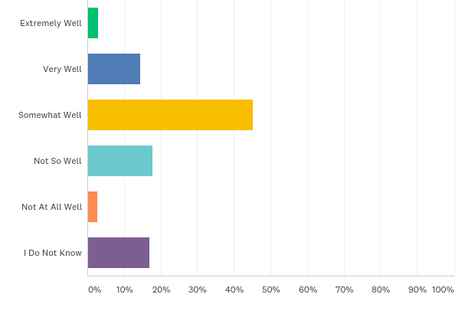
Q9: Overall, how well is the Jewish community doing at including people with disabilities in those activities?
Answered: 1,597 Skipped: 191
Notes:
Bar graph of Overall, how well is the Jewish community doing at including people with disabilities in those activities. Green Extremely well Blue Very well Yellow Somewhat well Blue Not so well Orange Not AT Well Purple I don’t know PWD Comm

Slide 28
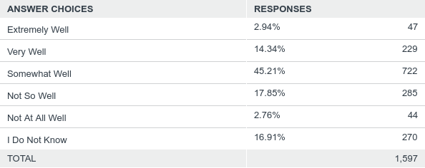
Q9: Overall, how well is the Jewish community doing at including people with disabilities in those activities?
Answered: 1,597 Skipped: 191
Notes:
Table of Overall How Well is the Jewish community at including at including people with disabilities in those activities? Answer choices Responses Extremely Well 2.94% 47 Very well 14.34% 229 Somewhat Well 45.29% 722 Not So Well 17.85% 285 Not At All Well 2.76% I Don’t Know 16.91% 270 Total 1,597 PWD Comm

Slide 29
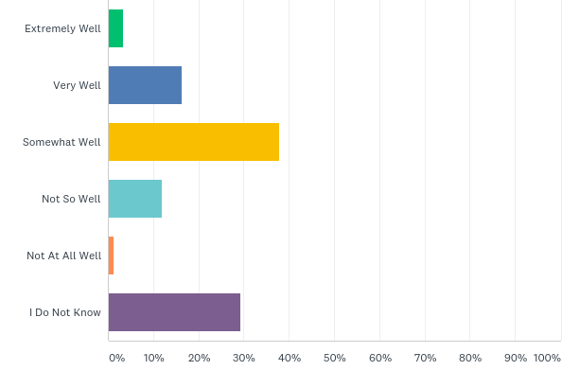
Q9: Overall, how well is the Jewish community doing at including people with disabilities in those activities?
Answered: 692 Skipped: 106
Notes:
Overall, how well is the Jewish community doing at including people with disabilities people with disabilities in those activities including with disabilities in those activities extremely well? Green Extremely well Blue Very Well Yellow Somewhat Well Light Blue Not So Well Purple I Don’t Know No PWD

Slide 30
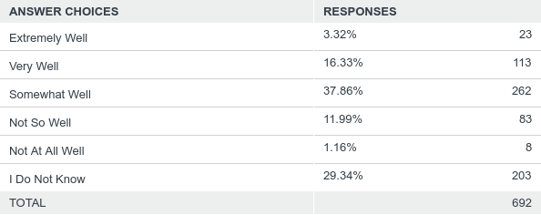
Q9: Overall, how well is the Jewish community doing at including people with disabilities in those activities?
Answered: 692 Skipped: 106
Notes:
Table of responses Overall, how well is the Jewish community doing at including people with disabilities people with disabilities in those activities including people with disabilities? Answered 692 No PWD

Slide 31
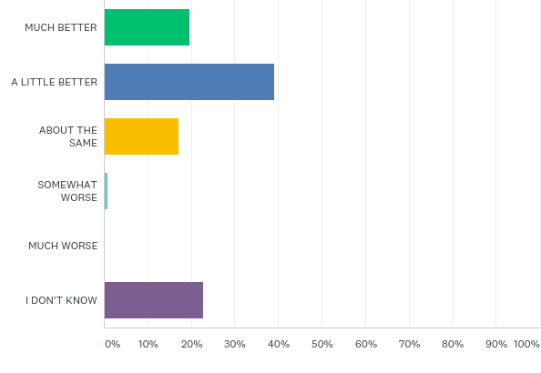
Q10: Compared to 5 years ago, how is the Jewish community at including people with disabilities?
Answered: 1,599 Skipped: 189
Notes:
32 Bar graph of responses Compared to 5 years ago, how is the Jewish community doing at including people with disabilities? Answered 1,599 Skipped 189 Green Much Better Blue A Little Better Yellow About The Same Blue Somewhat Worse White Much Worse Purple I Don’t Know PWD Comm

Slide 32
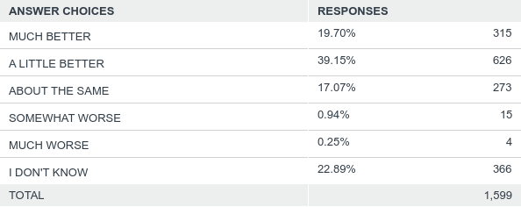
Q10: Compared to 5 years ago, how is the Jewish community at including people with disabilities?
Answered: 1,599 Skipped: 189
Notes:
Bar graph of responses Compared to 5 years, how is the Jewish community at including people with disabilities? Answer Choices Responses Much Better 19.70% 315 A Little Better 39.15% 626 About The Same 17.07% 273 Somewhat Worse 0.25% 4 I Don’t Know 22.89% 366 Total 1,599 PWD Comm

Slide 33
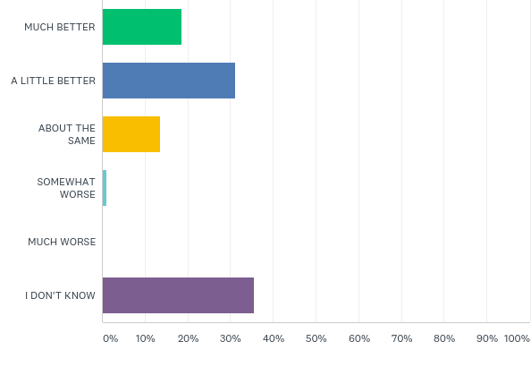
Q10: Compared to 5 years ago, how is the Jewish community at including people with disabilities?
Answered: 691 Skipped: 107
Notes:
Bar graph of Compared to 5 years ago, how is Jewish community at including people with disabilities Answered 691 Skipped 107 Green Much Better Blue A Little Better Yellow About The Same Light Blue Somewhat Worse White Much Worse Purple I Don’t Know No PWD

Slide 34
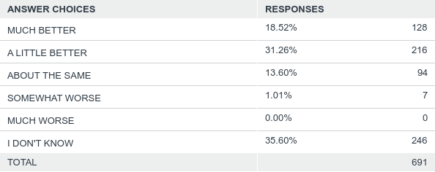
Q10: Compared to 5 years ago, how is the Jewish community at including people with disabilities?
Answered: 691 Skipped: 107
Notes:
Table of Compared to 5 years, how is Jewish community at including people with disabilities? Answered 691 Skipped 107 Much Better 18.52% 128 A Little Better 31.26% 216 About The Same 13.60% 94 Somewhat Worse 1.01% 7 Much Worse 0.00% 0 I Don’t Know 35.60% 246 Total 691 No PWD

Slide 35
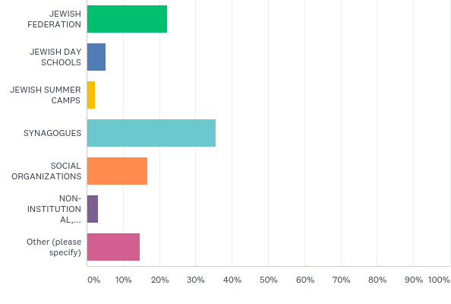
Q13: Aside from an individual’s family and friends, which part of the community is most responsible for increasing inclusion of people with disabilities?
Answered: 1,570 Skipped: 218
Notes:
Bar graph of an individual’s family and friends, which part of the community is the most responsible for increasing inclusion of people with disabilities? Answered 1,570 Skipped 218 Green Jewish Federation Blue Jewish Day Schools Yellow Jewish Summer Camps Light Blue Synagogues Orange Social Organizations Purple Non- Institutional Pink Other (please specify) PWD Comm

Slide 36
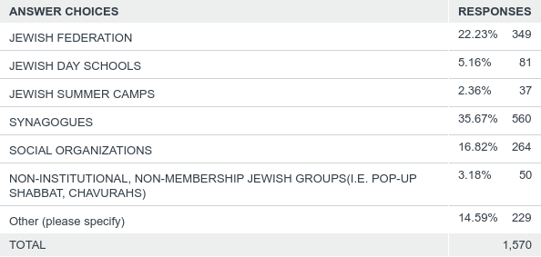
Q13: Aside from an individual’s family and friends, which part of the community is most responsible for increasing inclusion of people with disabilities?
Answered: 1,570 Skipped: 218
Notes:
Table of responses Aside from an individual’s family and friends, which part of the community is most responsible for increasing inclusion of people with disabilities? Answer Choices Responses Jewish Federation 22.23% 349 Jewish Day Schools 5.16% 81 Jewish Summer Camps 2.36% 37 Synagogues 35.67% 560 Social Organizations 16.82% 264 Non-Institutional, Non-Membership Jewish Groups (I.E Pop-Up Shabbat, Chavurahs) 3.18% 50 Other (please specify) 14.59% 229 Total 1,570 PWD Comm

Slide 37
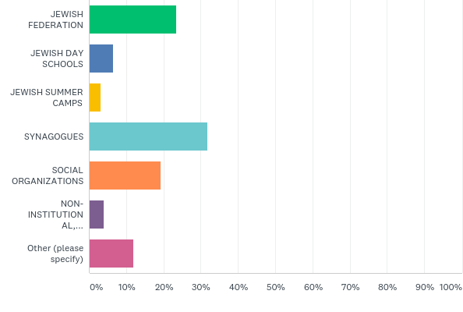
Q13: Aside from an individual’s family and friends, which part of the community is most responsible for increasing inclusion of people with disabilities?
Answered: 672 Skipped: 126
Notes:
Bar graph of responses Aside from an individual’s family and friends, which part of the community is most responsible for increasing inclusion of people with disabilities? Answered 672 Skipped 126 Green Jewish Federation Dark Blue Jewish Day Schools Light Blue Synagogues Orange Social Organizations Purple Non-Institutional Pink Other (please specify) No PWD

Slide 38
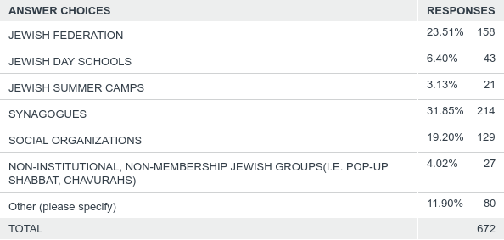
Q13: Aside from an individual’s family and friends, which part of the community is most responsible for increasing inclusion of people with disabilities?
Answered: 672 Skipped: 126
Notes:
Table of responses Aside from an individual’s family and friends, which part of the community is most responsible for increasing inclusion of people with disabilities? Answered 672 Skipped 126 Answer Choices Responses Jewish Federation 23.51% 158 Jewish Day Schools 6.40% 43 Jewish Summer Camps 3.13% 21 Synagogues 31.85% 214 Social Organizations 19.20% 129 Non-Institutional, Non-Membership Jewish Groups (I.E Pop-Up Shabbat, Chavurahs) 11.90% 80 Total 672 No PWD

Slide 39
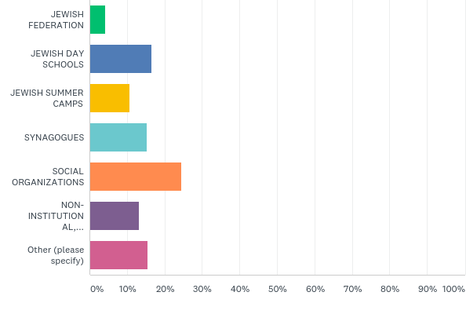
Q12: Where in the community do you find the most challenges for inclusion of people with disabilities?
Answered: 1,544 Skipped: 244
Notes:
Table of responses Where in the community do you find the most challenges for inclusion of people with disabilities? Answered 1,544 Skipped 244 Green Jewish Federation Blue Jewish Day Schools Yellow Jewish Summer Camps Light Blue Synagogues Purple Non-Institutional Pink Other (please specify) PWD Comm

Slide 40
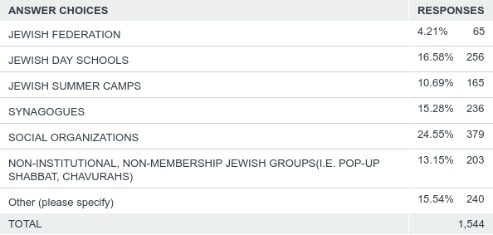
Q12: Where in the community do you find the most challenges for inclusion of people with disabilities?
Answered: 1,544 Skipped: 244
Notes:
Table of responses Where in the community do you find the most challenges for inclusion of people with disabilities? Answered 1, 544 Skipped 244 Answer Choices Responses Jewish Federation 4.21% 65 Jewish Day Schools 16.58% 256 Jewish Summer Camps 10.69% 165 Synagogues 15.28% 236 Social Organizations 24.55% 379 Non-Institutional, Non-Membership Jewish Groups (I.E Pop-Up Shabbat, Chavurahs) 13.15% 203 Other (please specify) 15.54% 240 Total 1,544 PWD Comm

Slide 41
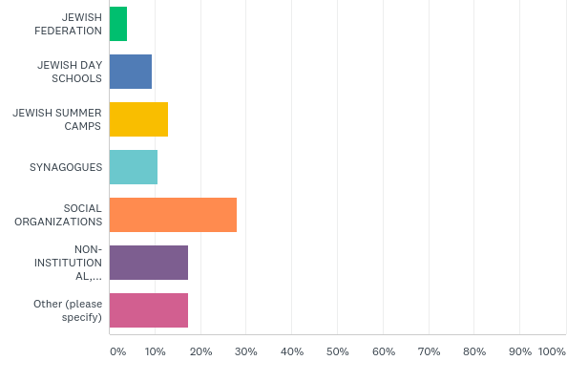
Q12: Where in the community do you find the most challenges for inclusion of people with disabilities?
Answered: 662 Skipped: 136
Notes:
Bar graph of responses Aside from an individual’s family and friends, which part of the community is most responsible for increasing inclusion of people with disabilities? Answered 672 Skipped 126 Green Jewish Federation Dark Blue Jewish Day Schools Light Blue Synagogues Orange Social Organizations Purple Non-Institutional Pink Other (please specify) No PWD

Slide 42
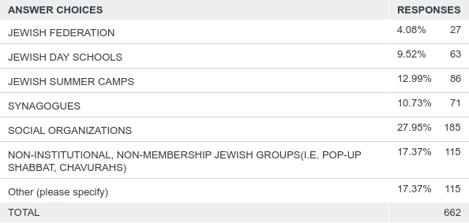
Q12: Where in the community do you find the most challenges for inclusion of people with disabilities?
Answered: 662 Skipped: 136
Notes:
Table of responses Where in the community do you find the most challenges for inclusion of people with disabilities? Answered 662 Skipped 136 Answer Choices Responses Jewish Federation 4.08% 27 Jewish Day Schools 9.52% 63 Jewish Summer Camps 12.99% 86 Social Organizations 27.95% 185 Non-Institutional, Non-Membership Jewish Groups ( IE Pop-Up Shabbat, Chavurahs) 17.37% 115 Other (please specify) 17.37% 115 Total 662 No PwD

Slide 43
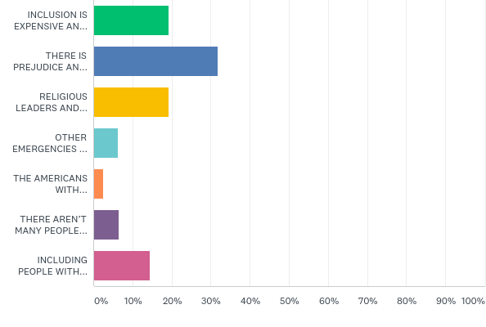
Q20: Which of the following do you think is the biggest barrier to fully including more people with disabilities in your faith community?
Answered: 1,461 Skipped: 327
Notes:
Bar graph of responses Which of the following do you think is the biggest barrier to fully including more people with disabilities in your faith community? Answered 610 Skipped 188 Green Inclusion is Expensive An… Dark Blue There is Prejudice An…. Yellow Religious Leaders and… Orange The Americans With Purple There Aren’t Many People Pink Including People With… PWD Comm

Slide 44
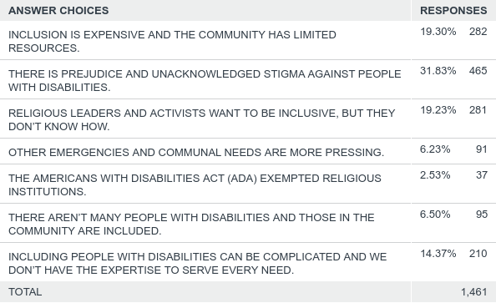
Q20: Which of the following do you think is the biggest barrier to fully including more people with disabilities in your faith community?
Answered: 1,461 Skipped: 327
Notes:
46 Bar graph of responses Which of the following do you think is the biggest barrier to fully including more people with disabilities in your faith community? Answered 610 Skipped 188 Green Inclusion is Expensive An… Dark Blue There is Prejudice An…. Yellow Religious Leaders and… Orange The Americans With Purple There Aren’t Many People Pink Including People With Total 1,461 PWD Comm

Slide 45
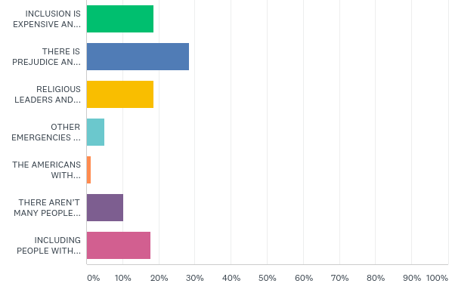
Q20: Which of the following do you think is the biggest barrier to fully including more people with disabilities in your faith community?
Answered: 610 Skipped: 188
Notes:
46 Bar graph of responses Which of the following do you think is the biggest barrier to fully including more people with disabilities in your faith community? Answered 610 Skipped 188 Green Inclusion is Expensive An… Dark Blue There is Prejudice An…. Yellow Religious Leaders and… Orange The Americans With Purple There Aren’t Many People Pink Including People With No PWD

Slide 46
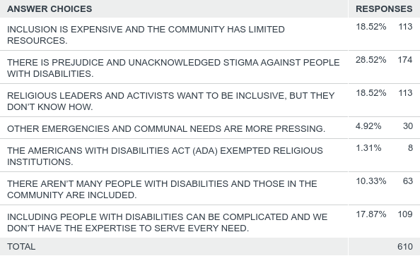
Q20: Which of the following do you think is the biggest barrier to fully including more people with disabilities in your faith community?
Answered: 610 Skipped: 188
Notes:
Which of the following do you think is the biggest barrier to fully including more people with disabilities with disabilities in your faith community Answered 610 Skipped 188 Answer Choices Responses Answer Choices Responses Inclusion Is Expensive And The Community Has Limited Resources 18.52% 113 There Is Prejudice And Unacknowledged Stigma Against People With Disabilities 28.52% 174 Religious Leaders and Activists Want To Be Inclusive, But They Don’t Know How 18.52% 113 Other Emergencies And Communal Needs Are More Pressing 4.92% 30 The Americans With Disabilities Act (ADA) Exempted Religious Institutions 1.31% 8 There Aren’t Many People With Those In The Community Are Included 10.33% 63 Including People With Disabilities Can Be Complicated And We Don’t Have The Expertise To Serve Every Need 17.87% 109 Total 610 No PWD

Slide 47
Resources / Contact Info
Leadership training for board members of Jewish organizations: http://boardmemberinstitute.tilda.ws
Leadership training for people with disabilities: http://www.ada25chicago.org/leadership-institute-application-2
Facebook: https://www.facebook.com/RespectAbilityUSA and https://www.facebook.com/RespectAbility4All/
Twitter: @respect_ability / @jewishinclusion
Faith inclusion resources: https://www.respectability.org/resources/faith-inclusion
VOTER GUIDES: www.TheRespectAbilityReport.org
Jennifer Laszlo Mizrahi
www.RespectAbility.org
Cell: (202) 365-0787
JenniferM@RespectAbility.org

Slide 48
Q&A Time
Questions?
Comments?
How can we be helpful?

Slide 49
Please Join Us for Our Next Webinar
Webinar: “Advancing Inclusion - Careers in Philanthropy for Professionals with Disabilities”
Featuring Special Guests James Emmett, Lead Strategist, Workplace Initiative, Poses Family Foundation and Meg O’Connell, PHR, CEO & Founder, Global Disability Inclusion
DATE: Wednesday, November 7, 2018 TIME: 1:30PM(Eastern) / 12:30PM(Central) / 11:30AM(Mountain) / 10:30AM(Pacific)
Duration: 1 hour.
PLEASE RSVP TODAY!
https://secure.confertel.net/tsRegisterD.asp?course=6269064

