Slide 1

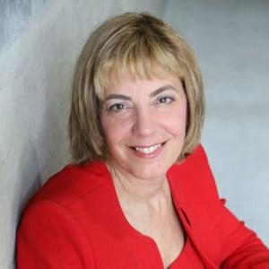
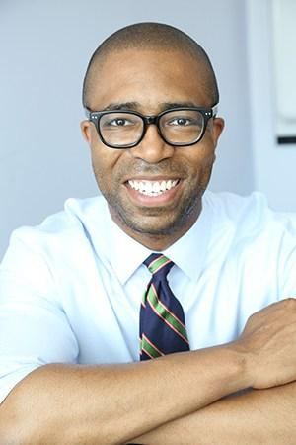
Saving Lives: A Conversation about Suicide Prevention in the Jewish Community
October 3rd, 2018 Webinar
Jennifer Laszlo Mizrahi, President, RespectAbility
Calvin Harris, Chairman, Respect Ability
Contact: JenniferM@RespectAbility.org
202-517-6272

Slide 2

Saving Lives: A Conversation about Suicide Prevention in the Jewish Community
October 3, 2018

Slide 3
WEBINAR AGENDA
Jewish Family Service
2018 Comprehensive Program for Suicide Prevention and Aftercare
1.WELCOME
Linda Burger & Laurie Silver
2. OVERVIEW of SUICIDE STATISTICS
Linda Burger
3. INTRODUCTION OF JFS COMPREHENSIVE
PREVENTION & AFTERCARE PROGRAMMING
JFS Council of Advisors
Mental Health First Aid, Sources of Strength,
Website, Social Media & PSA’s
Weekly Column Jewish Herald Voice,
Touching the Heart, Counseling,
Aftercare Services, Bereavement Guide
Support Groups, Bright Stars
Corporate, Agency, Synagogue and School Trainings, Speakers
Addiction Services
Research Collaborations
Linda Burger/ Laurie Silver
4. QUESTIONS & DISCUSSION
1

Slide 4
U.S. Suicides 1999-2016
Jewish Family Service
2018 Comprehensive Program for Suicide Prevention and Aftercare
While the percentage has leveled off over the last several years, the numbers are still increasing. There were 29,199 recorded suicides in the U.S. in 1999; within 12 years, the numbers increased over 30%.*
39,158 in 2011
40600 in 2012
41,149 in 2013
42,773 in 2014
44,193 in 2015
44,965 in 2016
* American Association of Suicidology – January 2017
2

Slide 5
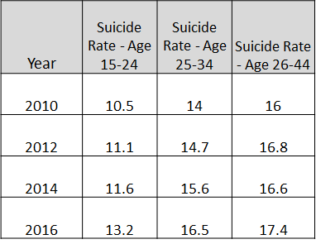
Suicide Rates by Age
Jewish Family Service
2018 Comprehensive Program for Suicide Prevention and Aftercare
The American Foundation for Suicide Prevention statistics reflect an increase in the suicide rate for all three age cohorts between 2010 and 2016.
* American Foundation for Suicide Prevention, Fatal Injury Report for 2016
3

Slide 6
Texas Suicide Rates
Jewish Family Service
2018 Comprehensive Program for Suicide Prevention and Aftercare
Suicides in Texas have increased 23% over the past 15 years.
In 2017, Texas’ suicide rate was 12.9 per 100,000, slightly below the national average.*
3,403 Texans died from suicide in 2015, the most recent year for which there are numbers. This is more than double the number killed by homicide, and the second leading cause of death for those 15-24 years of age.**
Suicide rates in Texas were more than triple for white people than for black and Hispanic people in 2015, according to an analysis from the University of Texas.**
The 46% increase in the suicide rate among Caucasians is almost entirely responsible for the overall 23% increase.**
*Suicide Trends and Characteristics, Texas vs. United States, Texas Department of State Health Services
**University of Texas System Office of Health Affairs, June 2017
4

Slide 7
2016 Population and Suicide Statistics in Texas, Houston and Among the Jewish Population*
Jewish Family Service
2018 Comprehensive Program for Suicide Prevention and Aftercare
The population of Texas was 28 million people. The Texas suicide rate was approximately 13% (out of 100,000 deaths) or 3,000-4,000 suicides.*
The population of Houston was approximately 2.3 million people or approximately 300 suicides.*
The Jewish population of Texas was .6% (160,000 people) or approximately 20-30 suicides.**
The Jewish population of Houston was approximately 67,000.***
That translates to approximately 8-10 suicides among Jewish adolescents and young adults annually
*The United States Census Bureau
**United Health Foundation, America’s Health Rankings, 2016
**”Houston Jewish Community Could Take Years to Recover from Harvey, Jewish Telegraphic Agency, August 2017
5

Slide 8

Youth Mental Health First Aid
Jewish Family Service
2018 Comprehensive Program for Suicide Prevention and Aftercare
6

Slide 9

Outreach To Jewish Community
Jewish Family Service
2018 Comprehensive Program for Suicide Prevention and Aftercare
Jewish Family Service is a Host Site with multiple autumn trainings
Step 1: Train the Trainers scheduled for January 7-9, 2019. Goal of this 40 hour course is to train approximately 15 men and women within the Jewish who will then teach three, eight hour MHFA courses per year
Step 2: Trainers will pair to reach out to each Jewish agency, and organization to fill the classes throughout our multi-county
Step 3: Schedule at least three trainings per year in each synagogue and community organization. Ie. JFS, JFGH, JCC
7

Slide 10
MHFA in Numbers
Jewish Family Service
2018 Comprehensive Program for Suicide Prevention and Aftercare
As a Host Site we plan to train 15 to 30 community members to facilitate the 8 hour adult MHFA course
15 facilitators should lead to 22 courses citywide resulting in approximately 330 adults per adult receiving MHFA certification
Courses will be offered throughout the Jewish community of Houston two or three times per month, depending on the number of available facilitators
30 facilitators should lead to 45 courses citywide resulting in approximately 675 adults per year receiving MHFA certification
8

Slide 11

Sources of Strength
Jewish Family Service
2018 Comprehensive Program for Suicide Prevention and Aftercare
http://mentalhealthletstalk.org/event/sources-of-strength/
9
Notes:
Sources of Strength is a universal suicide prevention program designed to build socioecological protective influences around youth and to reduce the likelihood that vulnerable youth/young adults will become suicidal

Slide 12
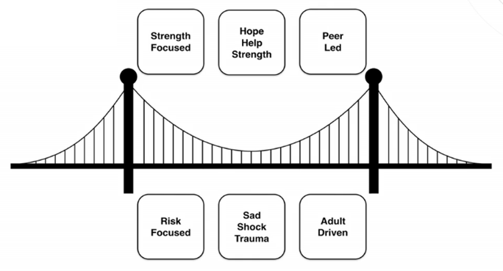
Why is it Different?
Jewish Family Service
2018 Comprehensive Program for Suicide Prevention and Aftercare
10
Notes:
Statistics: According to the Youth Risk Behavior Survey, depending on where you are in the country, 1/7 report seriously considering suicide and 1/13 report making an attempt; However, the death data shows that 1/10,000 youth actually dies by suicide. This means that the vast majority who consider suicide, recover. Recovery and resiliency are the true norm.
Sad images and shocking statistics make kids empathize with reinforces negativity. Instead, Sources of Strength focuses on positives: resiliency and recovery; We can say “Actually, the majority of the population is engaged in positive social norms. This can reinforce healthy behavior in the majority.
It bridges gaps in prevention; Positives focus; upstream model; evidence based

Slide 13
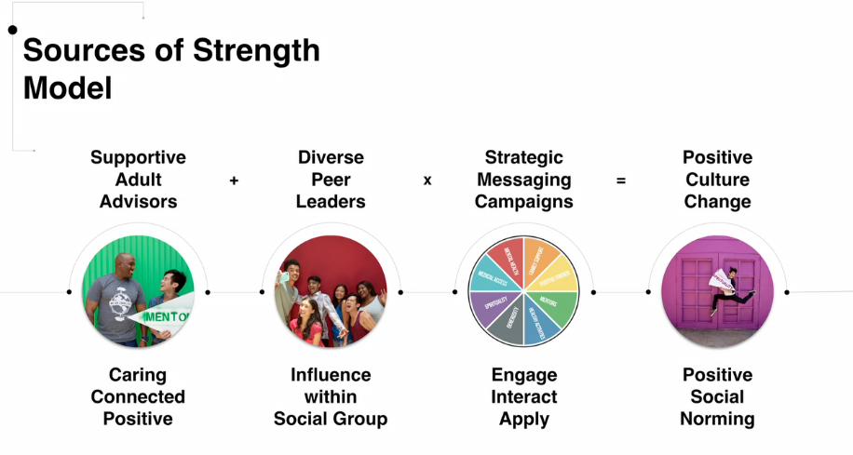
SOS MODEL
Jewish Family Service
2018 Comprehensive Program for Suicide Prevention and Aftercare
11
Notes:
In the same way risk behaviors spread among social groups, protective factors spread among social groups. We are using this existing network to spread positivity.
What does strength, resiliency, and recovery look like?

Slide 14


SOS Handouts
Jewish Family Service
2018 Comprehensive Program for Suicide Prevention and Aftercare
12
Notes:
Bridges: go between groups; fit in at any lunch table because they're in band, play on the soccer team, and smoke under the bleachers.
Central Members: "status quo" keepers; popular; slow to change
Peripherals: early adapters; want change and ready to make it happen
Isolates: 2-3% of students; say they have no friends; important because they help us understand how to reach isolates

Slide 15
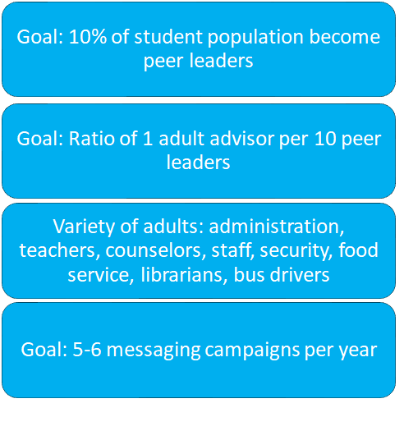
Recruitment
Jewish Family Service
2018 Comprehensive Program for Suicide Prevention and Aftercare
Notes:
10% means students are 1-2 degrees of separation from a peer leader (even if 3 year goal); means better saturation of program
Variety of staff means everyone is free at different times.
https://sourcesofstrength.org/adult-advisors/assemblingyourteam/
The implementation cycle consists of a repeating process yearly: pre-training (raising awareness), training, messaging, and transition to year 2.

Slide 16
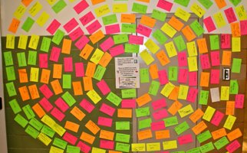
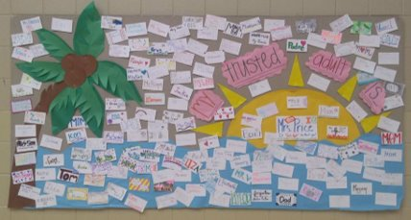
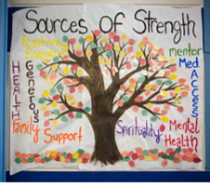
Campaign Examples 1
Jewish Family Service
2018 Comprehensive Program for Suicide Prevention and Aftercare
Trusted Adult Displays
14
Notes:
Trusted Adult Displays
Visual displays are an important part of the program

Slide 17

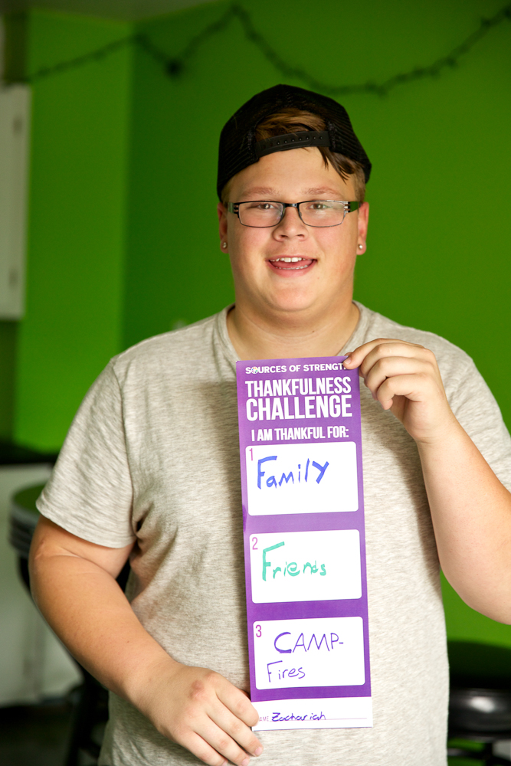
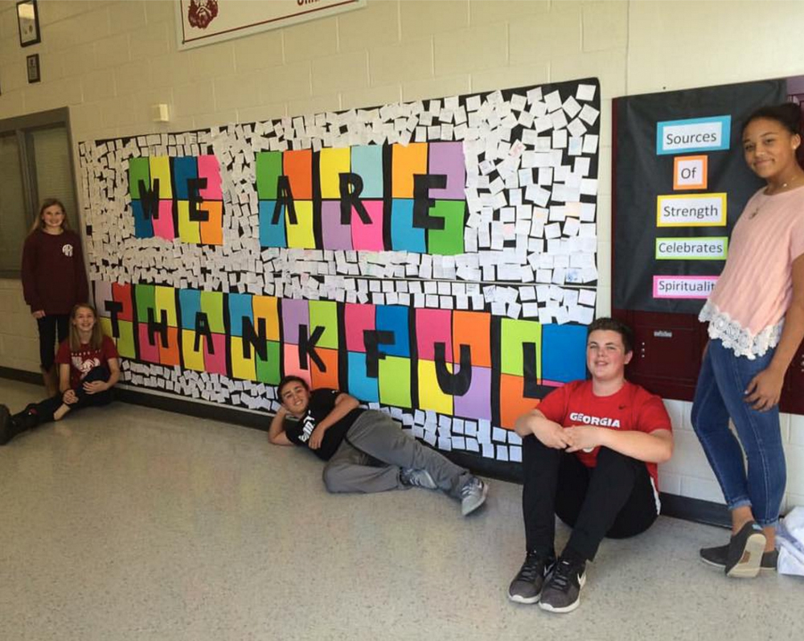

Campaign Examples 2
Jewish Family Service
2018 Comprehensive Program for Suicide Prevention and Aftercare
Thankfulness Displays
15
Notes:
Thankfulness Displays
Use and adapt different templates

Slide 18
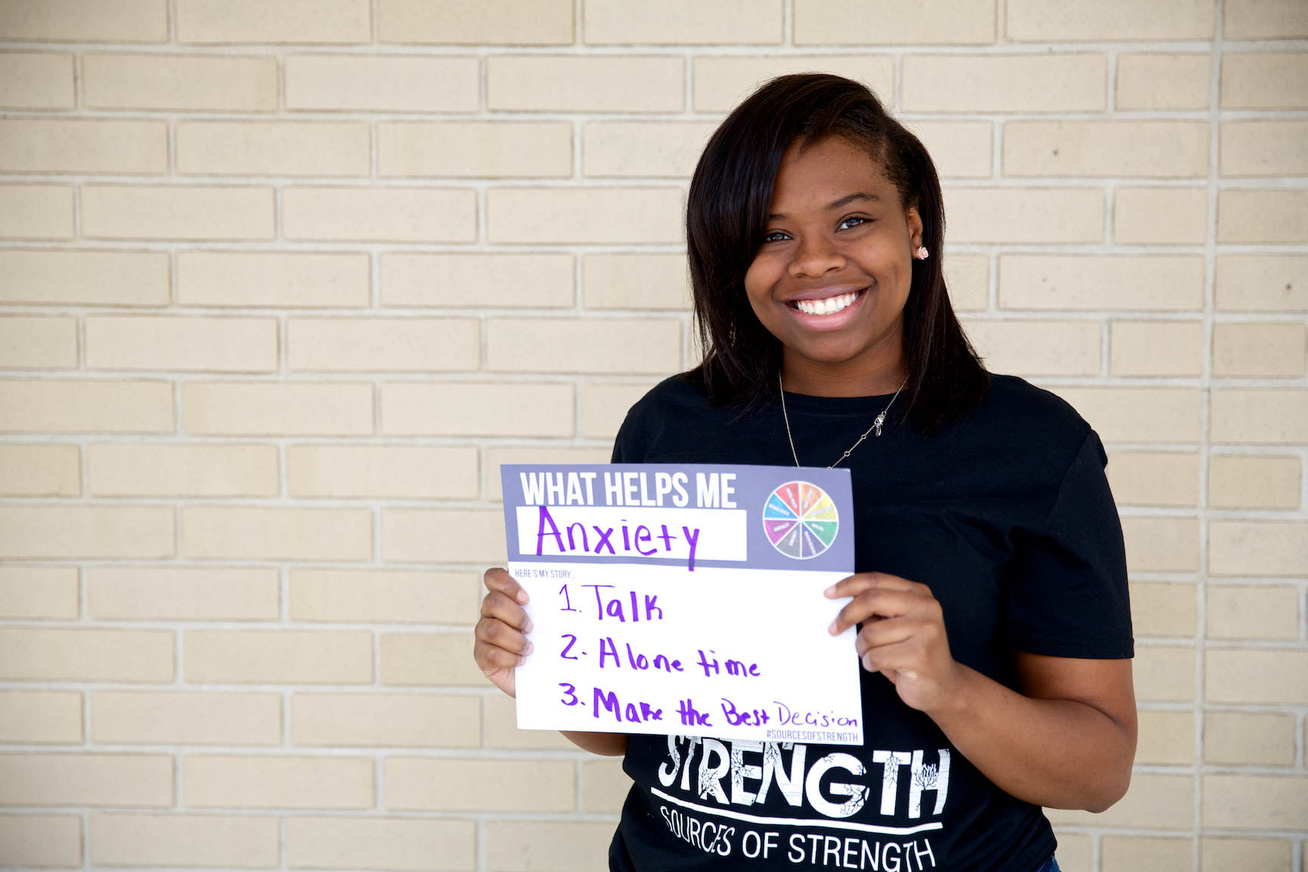
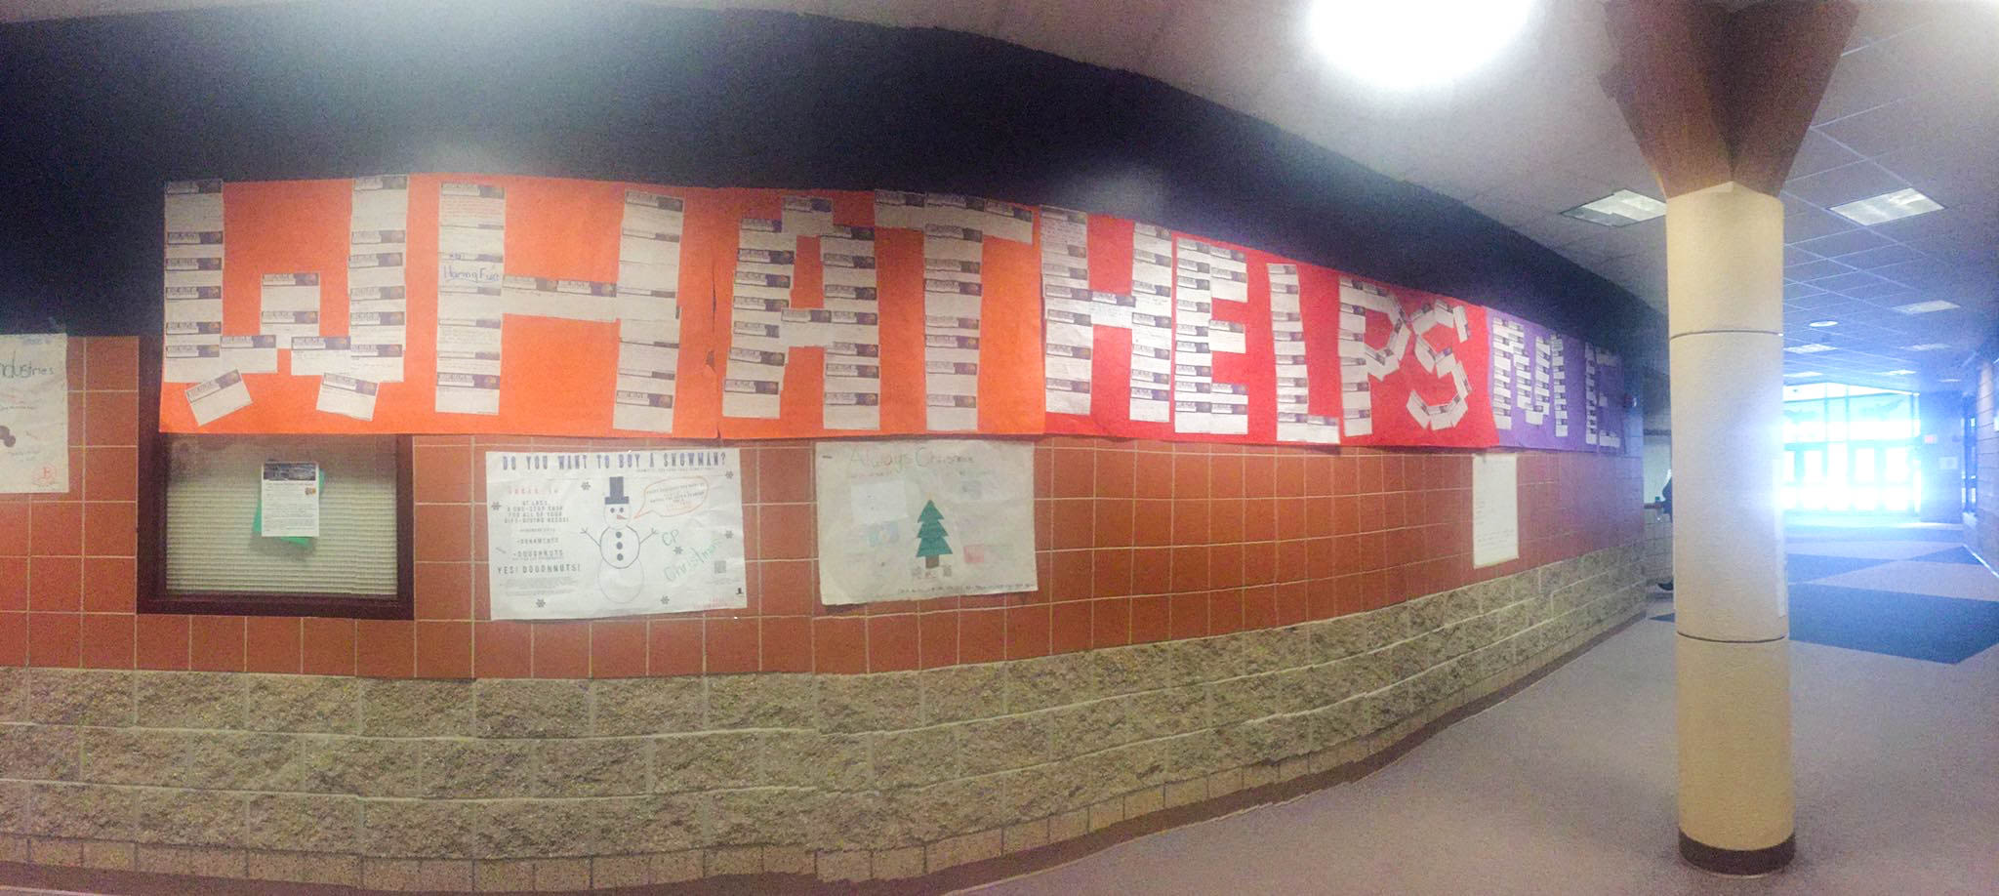

Campaign Examples 3
Jewish Family Service
2018 Comprehensive Program for Suicide Prevention and Aftercare
What Helps Me
16
Notes:
What Helps Me

Slide 19

www.mentalhealthletstalk.org
Jewish Family Service
2018 Comprehensive Program for Suicide Prevention and Aftercare
Crisis Support
Suicide prevention/aftercare access
Website
About Us-Mental Health Let’s Talk About It
Programs and Services
Resources
Bereavement Guide
Teen Component
Social Media
Public Service Media Spots
FB, Twitter, Instagram, Linkedin, UTube
Partnership JFS & Jewish Herald Voice
Weekly Be Well mental health and wellness column

Slide 20
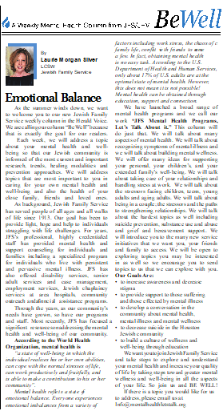
BeWell
Jewish Family Service
2018 Comprehensive Program for Suicide Prevention and Aftercare
Weekly Column and Weekly Ad in Jewish Herald Voice
Topics relate to mental health and wellbeing, JFS mental health program initiatives, parenting, coupling, conflict resolution, forgiveness for example
http://jhvonline.com/index325.htm
18

Slide 21

Videos
Jewish Family Service
2018 Comprehensive Program for Suicide Prevention and Aftercare
http://mentalhealthletstalk.org/mental-health-issues/suicide-prevention/

Slide 22

Touching the Heart
Jewish Family Service
2018 Comprehensive Program for Suicide Prevention and Aftercare
Technology platform
Recruitment efforts
Message content
Sponsorship
http://mentalhealthletstalk.org/touching-the-heart/
19

Slide 23
Postcard Program
Jewish Family Service
2018 Comprehensive Program for Suicide Prevention and Aftercare
Based on 1950s postcard program to veterans adopted by Thomas Joiner as part of suicide reduction in the military evidence based and quantitatively shown to reduce depression and suicidal ideation test program to Jewish high school students leaving for college and those in college messages of support and wellness and resilience tips and information to be expanded to young Jewish professionals and those moving to Houston to work.
20

Slide 24

Aftercare
Jewish Family Service
2018 Comprehensive Program for Suicide Prevention and Aftercare
Aftercare
Upon a Death
immediate outreach call and letter
Crisis bereavement support before funeral and Shiva days
Bereavement guide and support at month one, three, six and eleven
Bereavement Support Groups
Bright Stars
Counseling. Individual, couple and family
21

Slide 25

Bereavement
Jewish Family Service
2018 Comprehensive Program for Suicide Prevention and Aftercare
Bereavement Guide
Grief support for friends and family
Distributed by funeral homes, rabbis, therapists, first responders
Bereavement Support Groups
Family and friends of deceased by suicide and overdose deaths
22

Slide 26
Bright Stars
Jewish Family Service
2018 Comprehensive Program for Suicide Prevention and Aftercare
When a friend or loved one dies by suicide, their life story can become about their death versus their life
Launch annual memorial service “Bright Stars” during December
Align with strength and resilience messages of Hanukkah
Opportunity for survivors of suicide to speak about the life of their loved one versus their death
Opportunity for community to light candles together
23

Slide 27
Corporate, Agency, Synagogue & School Trainings
Jewish Family Service
2018 Comprehensive Program for Suicide Prevention and Aftercare
Suicide Protocol Training for Clergy and Staff
Suicide Protocol Training for Faculty and School Administrators
Corporate Suicide Protocol Trainings
Corporate Self Care Trainings
School Faculty and Administration Self Care Trainings
24

Slide 28
Speakers
Jewish Family Service
2018 Comprehensive Program for Suicide Prevention and Aftercare
Speakers
Broad Speaker’s Topic Areas
Suicide Prevention and Aftercare
Mental Health Psycho-education
Gender Identity
Psychological Impact of Infertility
Grief and Loss
Research Collaborations
Menninger Clinic, JFS, Hope & Healing Center “Faith & Resilience Post Hurricane Harvey
University of Houston, JFS, “Suicide Assessment”
25

Slide 29
Addiction Services
Jewish Family Service
2018 Comprehensive Program for Suicide Prevention and Aftercare
Addiction Services
Psycho-Education Programming
Substance Use Support Group
Grief and Bereavement Support Group for those who have lost a loved one to death by overdose
Individual, Couple and Family Psychotherapy
26

Slide 30
Questions & Answers
Jewish Family Service
2018 Comprehensive Program for Suicide Prevention and Aftercare
How to reach us:
  Laurie Silver, lsilver@jfshouston.org or 713-542-5544
  Linda Burger, llburger@jfshouston.org or 281-236-6849
26

Slide 31
Resources on Mental Health
Disabilities from NOD
Courtesy of the National Organization on Disability (NOD)
NOD: How Is Your Company Addressing this Trillion Dollar Issue? 6 key takeaways from NOD’s Corporate Leadership Council Roundtable on Mental Health Disabilities https://www.nod.org/company-addressing-trillion-dollar-issue/
NOD: Five Questions with Dr. Ronald Copeland of Kaiser Permanente on Addressing Mental Health in the Workplace https://www.nod.org/five-questions-with-dr-copeland/
World Economic Forum: 7 steps to build a mentally healthy workplace https://www.weforum.org/agenda/2017/04/7-steps-for-a-mentally-healthy-workplace/
Kaiser Permanente: Find Your Words https://findyourwords.org/
JAN: Job Accommodation Network https://askjan.org/disabilities/Mental-Health-Impairments.cfm
Disability Visibility Project https://disabilityvisibilityproject.com/
National Alliance on Mental Illness https://www.nami.org

Slide 32
Special Resources
The Steve Fund is the nation’s only organization focused on supporting the mental health and emotional well-being of young people of color. The Steve Fund works with colleges and universities, non-profits, researchers, mental health experts, families, and young people to promote programs and strategies that build understanding and assistance for the mental and emotional health of the nation’s young people of color. https://www.stevefund.org/About/
The Jed Foundation is a nonprofit that exists to protect emotional health and prevent suicide for our nation's teens and young adults. JED is a nonprofit that exists to protect emotional health and prevent suicide for our nation’s teens and young adults. https://www.jedfoundation.org/who-we-are/

Slide 33

Please Join Us for
Our Next Webinar
Webinar: “RespectAbility 2018 National Jewish Disability Inclusion Survey”
Featuring Special Guests Jennifer Laszlo Mizrahi, RespectAbility President and Meagan Buren, RespectAbility Pollster
DATE: Tuesday, October 16, 2018
TIME: 1:00 pm ET / 12:00 pm CT / 11:00 am MT / 10:00 am PT
DURATION: 1 hour
PLEASE RSVP TODAY!
https://bit.ly/2QnZJ8F

