Slide 1

RespectAbility
Empowering Job Seekers with Disabilities in New York City
Friday, June 29th, 2018
Calvin Harris, Chairman, RespectAbility
Jennifer Laszlo Mizrahi, President, RespectAbility
Philip Kahn-Pauli, Policy Director, RespectAbility
www.RespectAbility.org

Slide 2
Getting to Know You!

Slide 3
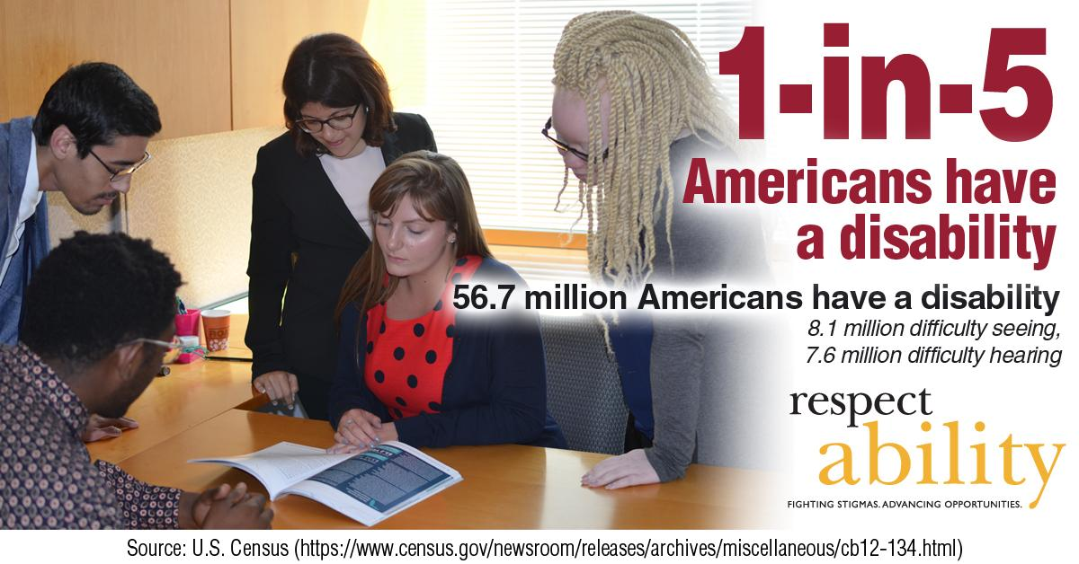
1 in 5 Americans

Slide 4

51 percent of Americans

Slide 5
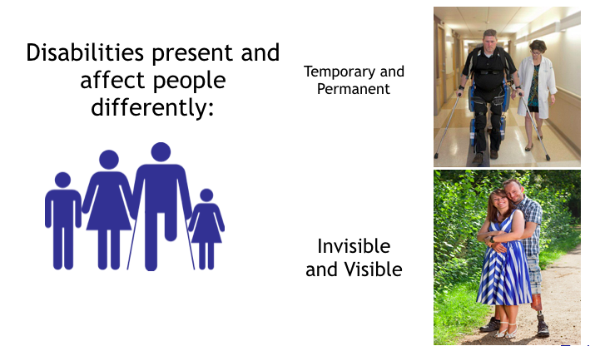
Not All Disabilities Can Be Seen

Slide 6


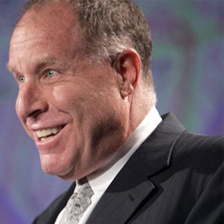




Role Models with Disabilities
Derrick Coleman: Deaf
Stephen Hawking: ALS
Peter Orfalea: ADD/ADHD & Dyslexia
Ludwig van Beethoven: Deaf
Harriet Tubman: Seizures
Albert Einstein:
Asperger Syndrome
Richard Branson: Dyslexia

Slide 7
New York City Stats
  NYC’s Labor Force Participation Rate (LFPR) is 60.2%. ¹
  70.4% of people without disabilities aged 18 to 64 in New York City are employed. ²
  32.3% of NYC residents w/ disabilities (ages 18-64) have jobs. ²
  There is a 38.1 point gap between the employment rates of PWDs and those without disabilities. “The employment gap is greater in NYC than it is at the State or national level.” ³
  New York ranks 37th in the country in terms of jobs for PWDs. ⁴
  In total, there are 948,208 NYC residents with disabilities. ⁵
  Out of that number, there are 460,425 working age (18-64) people with disabilities living in New York City. ⁵
  31% of all NYC residents with disabilities live in poverty.⁵
    39.3% (116,313) of Hispanics with disabilities in NYC live in poverty.
    34.5% (84,066) of African Americans with disabilities in NYC live in poverty.
    28.9% ( 24,868) of Asians with disabilities in NYC live in poverty.
Mayor Bill de Blasio
(D)
NYC Comptroller-2016-The State of the City’s Economy and Finances
Census Bureau - 2015 American Community Survey
CID-NY ADA at 26 in New York City
Annual Disability Statistics Compendium
MOPD-NYC PWDs Statistics Updated 2016
Notes:
http://www.nyc.gov/html/mopd/downloads/pdf/ACCESS_NYC_updated.pdf
http://respectabilityusa.com/Resources/RespectAbiltiy%20NY%20WIOA%20State%20Plan%20Comments.pdf

Slide 8
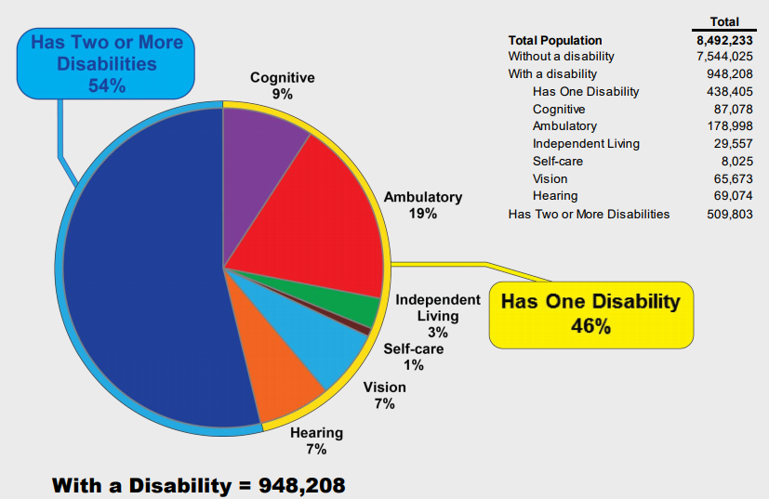
Population by Disability Type
New York City, 2014
Sources: U.S. Census Bureau, 2014 American Community Survey-Public Use Microdata Sample Population Division-New York City Department of City Planning / MOPD NYC People with Disabilities Statistics Updated 2016

Slide 9
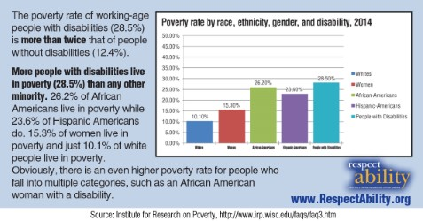
People with Disabilities are the Poorest of the Poor
Notes:
Sources: EPI Chart, Annual Disability Statistics Compendium, Disability Statistics, by Cornell University, U.S. Census Data

Slide 10

New York City Women
In total, there are 251,089 working-age women with disabilities living in New York City.¹
In total, there are 111,236 women living in New York City aged 21-64 with a disability who have an income below the poverty level.²
1 U.S. Census Bureau, 2016 American Community Survey 1-Year Estimates
2 U.S. Census Bureau, 2005-2007 American Community Survey

Slide 11

Intersectionality in
New York City Women
  In total, there are 96,478 working-age African American women with disabilities living in NYC.
  Only 28,806 or 29% of working-age African American women with disabilities living in NYC have jobs.
  There are 113,604 working-age Latina women with disabilities living in NYC.
  27,879 or only 24% working-age Latina women with disabilities have jobs in NYC.
Source:1 U.S. Census Bureau, 2016 American Community Survey 1-Year Estimates

Slide 12

High School Graduation Rates in NYC
NYC has an overall high school graduation rate of 70.5%
NYC students with disabilities have an high school graduation rate of only 44.8%
Out of the 74,172 students in the class of 2016 in NYC, 12,938 were students with disabilities.
439 NYC students with disabilities left high school with only an IEP Diploma (not equivalent to a GED or HS diploma).
In total, 5,800 students with disabilities graduated NYC high schools in the class of 2016. (Out of 53,848 graduates overall)
NYC Special Ed. Enrollment by Ethnicity:
295 Native American students with disabilities
1,637 Asian Americans students with disabilities
9,189 Latino/Latina students with disabilities
8,719 African American students with disabilities
3,080 White students with disabilities
From The New York Times: “…white students remained far more likely to receive a diploma than black or Hispanic students. And high school graduation remained out of reach for many students with disabilities.”

Slide 13
Class of 2017
Bronx:
1237 graduates out of 3118 students with disabilities
39.7% graduation rate
18.7% drop out rate
Brooklyn:
1673 graduates out of 3583 students with disabilities,
46.7% graduation rate
12.7% drop out rate
Manhattan:
1225 graduates out of 2511 students with disabilities
48.8% graduation rate
12.4% drop out rate
Queens:
1436 graduates out of 2859 students with disabilities
50.2% graduation rate
11.5% drop out rate
Staten Island:
519 graduates out of 965 students with disabilities
53.8% graduation rate
12.7% drop out rate

Slide 14
Factors Driving Absenteeism
Abuse
  Youth with disabilities are 3x more likely to be victims of abuse
Health
  Physical and mental health contribute to attendance
Teacher Training
  Inadequately preparing teachers to teach students with disabilities leads to inability to tackle underlying problems
”Dumping”
  Putting a poorly performing student in another school to maintain or boost their won performance metrics

Slide 15
Suspensions and Capacity
Suspensions
  Evidence of lack of adequate staffing and training in that school
  Warning sign of a lack of knowledge, competency, and capacity to educate students with disabilities
  High rates of referrals to law enforcement negatively impact students with disabilities
Capacity of Staff
  600,000 special educators
  224,160 students with disabilities in NY Public Schools
  Importance of educating general educators, such as school resource offices and administrators

Slide 16
Resources and Transitions
Resources for Spanish Speaking Parents
  NYC is a home for many immigrant communities
  40.5% Latino students make up NY Public Schools
  There is a need for more Spanish resources
School to Work Transitions and Innovative Schools
  Programs like SEARCH and Bridges from School to Work have made large success with 78% of their students with disabilities getting a job
  YWLN public charter schools are present nationwide and provide a unique learning style to prep students for college through missions, different types of assessment, and student performance goals.
    YWLN Harlem, has 19% of students with disabilities and an overall 97% of its students graduate the school.
    91% of those who graduate will go to college.

Slide 17
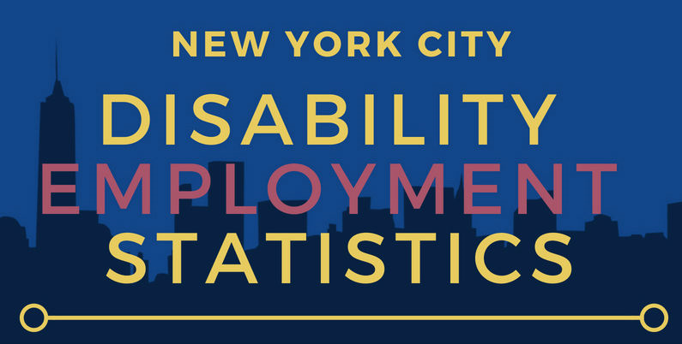
NYC Borough Statistics

Slide 18
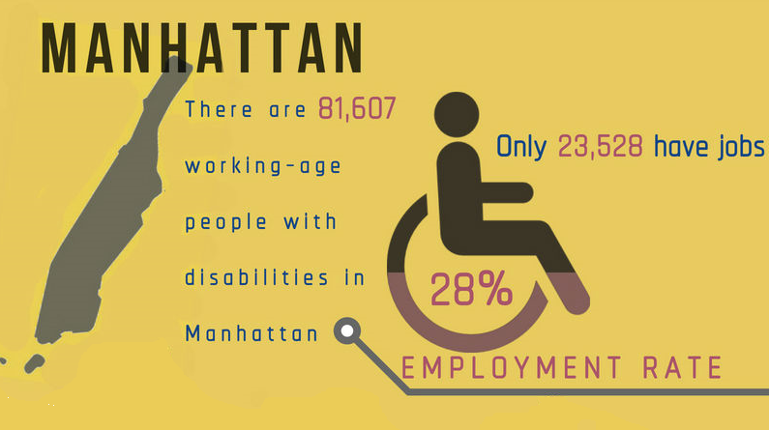
Manhattan Statistics

Slide 19
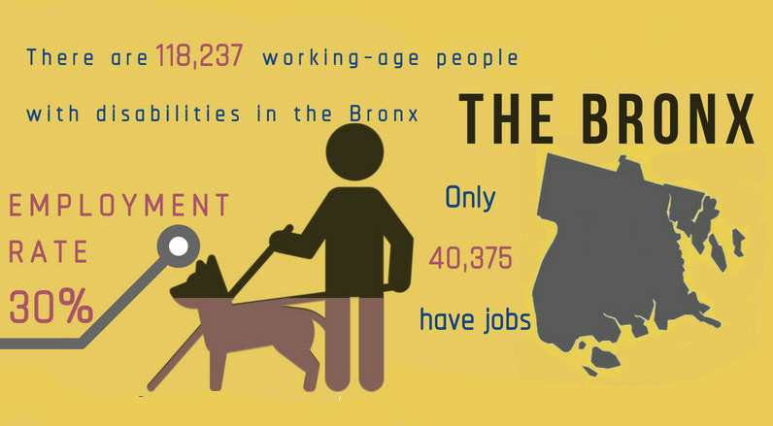
Bronx Statistics

Slide 20
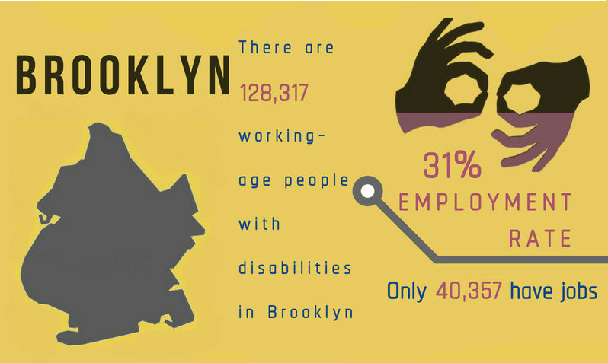
Brooklyn Statistics

Slide 21
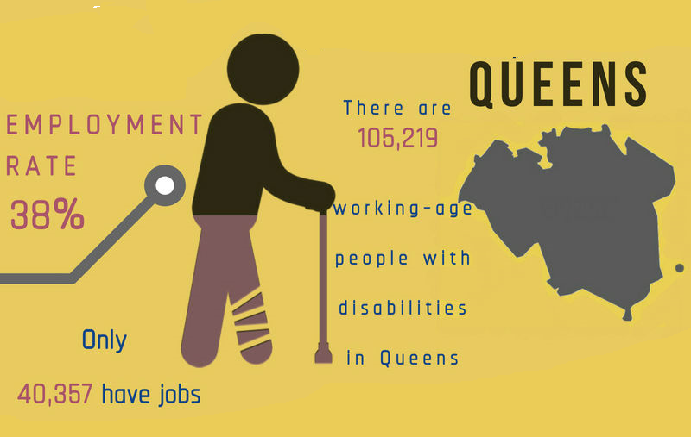
Queens Statistics

Slide 22
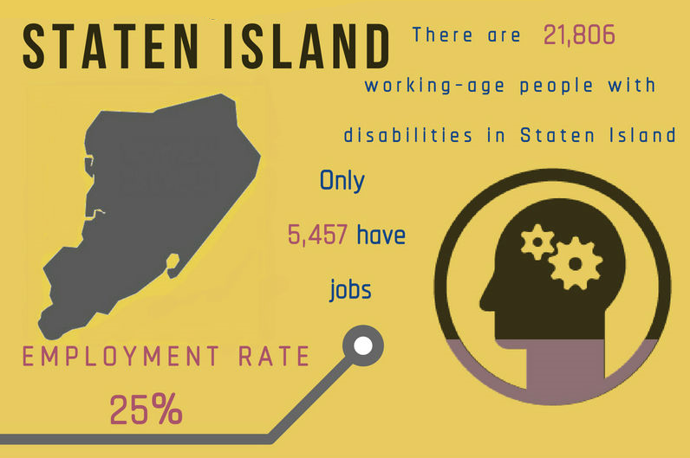
Staten Island Statistics

Slide 23
Transportation
NYC’s subways are one of the main sources of public transportation.
80% of subway stations do not have elevators available for both wheelchair users or those with other mobility issues that might make walking or climbing stairs difficult
Undertaking a project to update all NYC subway stations to ADA standards is no small task, both financially and structurally.
Disability Rights Advocates has been joined by the U.S. Department of Justice in a lawsuit against for the Metropolitan Transportation Authority (MTA
  MTA recently added an “accessibility chief”

Slide 24

Majority Outside the Workforce
Notes:
"70 percent of the 21 million working-age people with disabilities are outside of the workforce. For people without disabilities, this is less than 22 percent."
Source: Bureau of Labor Statistics

Slide 25
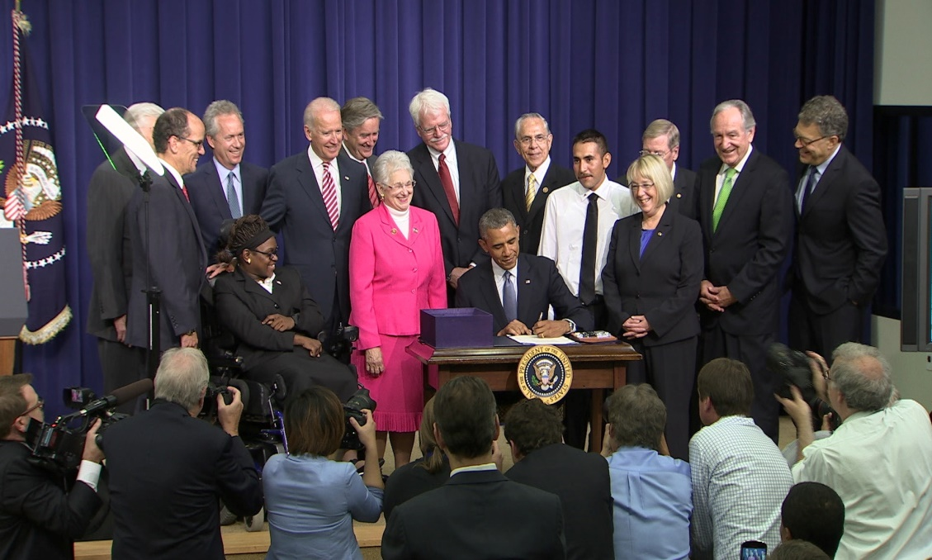
That is where WIOA comes in…
Think about the main goals of the Workforce Innovation and Opportunity Act (WIOA):
1 Increase access to education, training, and employment--particularly for people with barriers to employment.
2 Create a comprehensive, high-quality workforce development system.
3 Improve the quality and labor market relevance of workforce efforts.
4 Promote improvement in the structure and delivery of services.
5 Increase the prosperity of workers and
employers.
6 Reduce dependency, increase self-sufficiency, meet employer needs, and enhance the productivity and competitiveness of the nation.
What are the disability
dimensions of each of those goals?

Slide 26

RELAX

Slide 27
“It” vs You
…..“Sometimes the worst thing about having a disability is that people meet it before they meet you”

Slide 28
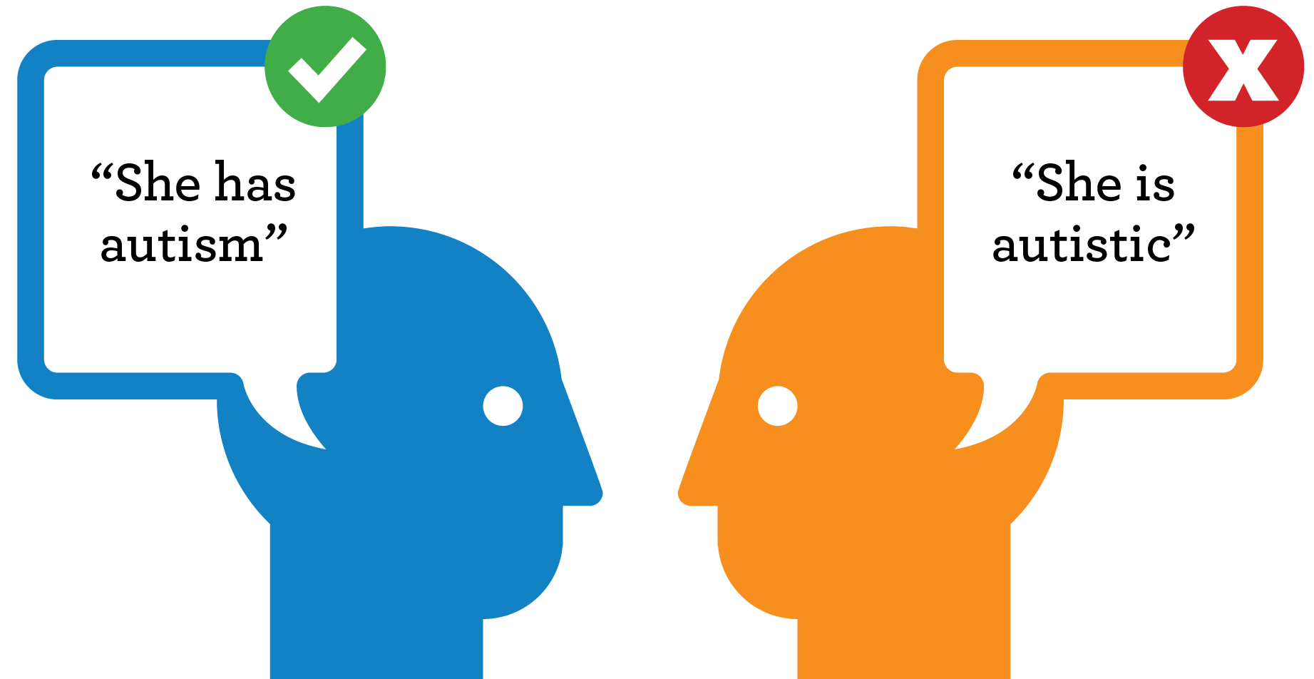
Words Are Powerful Tools
Language reflects society’s beliefs
Always put the person before the disability
Use “Person first” language

Slide 29
Best Practices
Everyone responds to language differently
Focus on being respectful and polite
Start out communicating by introducing yourself as you would in any other situation
Adapt communication as necessary or requested

Slide 30
Person First Language
Please say…
  Person with a disability
  Person who has/had a stroke/Polio/MS
  Person who uses a wheelchair
Previously you may have said…
  Handicapped - History
  Disabled
  Crippled
  Stroke/MS/Polio VICTIM
  Wheelchair bound/confined
Remember:
Words Are Powerful!

Slide 31
Wheelchair Users
Wheelchair Users
Put person first by saying: Person who uses a wheelchair, wheelchair user
Previously you may have said: Confined to a wheelchair, wheelchair bound

Slide 32
Person who is Blind
Person First Language
Put person first by saying: Person who is blind/person with a visual impairment
Previously you may have said: Blind person
Put person first by saying: Person with a disability
Previously you may have said: The disabled, crippled, suffers from a disability

Slide 33
Person who is Deaf
Deafness and Mental Health
Put person first by saying: Person who is deaf/person with a hearing impairment
Previously you may have said: The deaf, deaf and dumb, suffers a hearing loss
Person with Mental Illness
Put person first by saying: Person with a mental illness
Previously you may have said: Crazy, psycho, lunatic

Slide 34

Tips For Working With Persons
Who Use Wheelchairs
Do not hold on to a person's wheelchair – it is a part of their personal space
Talk directly to a person using a wheelchair, not to an attendant or third party
Try to come to eye level when communicating

Slide 35

Intellectual, Cognitive
Or Developmental Disabilities
Do not make assumptions about the person’s abilities, desires, or preferences
Talk directly to the person with the disability,
as well as others present
If necessary, break down concepts into
small, easy-to-understand components
Involve an advocate or caretaker when
necessary
Refrain from making decisions for others

Slide 36

Interacting With People Who Have Vision Impairments
Identify yourself
Never touch someone unless the person knows you are there
Tell the person when you leave
Ask before moving a person’s assistive device
Ask before petting/calling a service animal
Do not fret if you say something like “see you later”

Slide 37
People Who
Have Hearing Impairments
Gain eye contact with the person
Use a normal tone, speak clearly
Use facial expressions or body language
If a sign language interpreter is involved, speak directly to the person not the interpreter
Ask the person to repeat if you do not understand

Slide 38

Additional Tips
Do not assume someone’s physical and cognitive abilities based on their physical appearance
  Offer to shake hands even if a person
  appears to have a prosthetic or little grasping ability
Use common sense!

Slide 39
Disabilities are not mutually exclusive!
Types Of Disabilities
Someone with a spinal cord injury may have a traumatic brain injury
Someone who uses a wheelchair may have a temporary disability (broken leg)

Slide 40
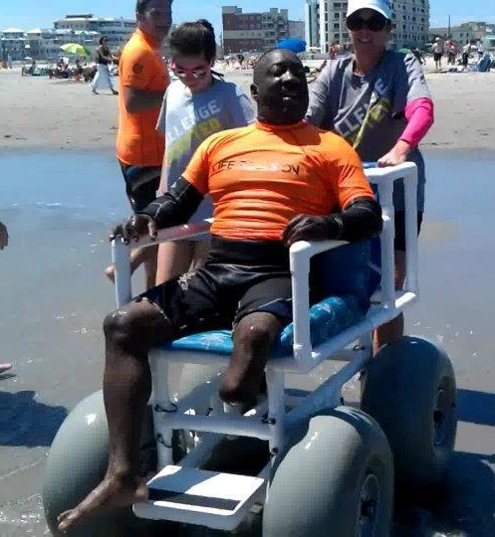
Providing Accommodations
And Assistance
Do not assume someone needs assistance!
If you believe someone needs help:
  Ask if they want or need your help
  Ask how you can help
Don’t just accommodate, be inclusive

Slide 41
Final Advice
Lead by example
  Use language that puts the person first
  Practice good etiquette
Remember: It’s Just Respect

Slide 42
Discussion Time:
How has WIOA changed your work? Your organization? Your client base?
What are the strengths of NYC’s workforce system?
Where are there areas for improvement?
Where are there opportunities for improving service to job seekers with disabilities
What have you done around Section 188? Programmatic Accessibility? Physical Accessibility?

Slide 43

Anyone for a Kit-Kat?

Slide 44


Accessibility Under WIOA
Promising Practices in Achieving Universal Access and Equal Opportunity: A Section 188 Disability Reference Guide
DOL-ODEP / LEAD Center
September 2015
DOL developed this Reference Guide to assist AJCs by providing promising practices that correlate with specific nondiscrimination requirements in Section 188 and the current Section 188 regulations.
This Guide “…may be used as a resource document for anyone that desires to ensure universal access and equal opportunity in the workforce development system. “

Slide 45
Section 188 Triangle
Universal Access: Take steps to ensure access to programs and activities are open for all eligible individuals, including individuals with disabilities.
Governance Requirements: includes the designation of an equal opportunity officer; assurances; notice and communication; data collection; monitoring and continuous improvement; complaint resolution; and corrective action.
Equal Opportunity: includes applying nondiscrimination prohibitions; providing accommodations and; engaging in effective communication; and ensuring accessibility of programs, facilities, and information..

Slide 46


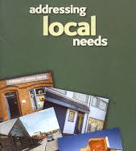

Universal Access
Universal access includes performance of the following functions
Understanding local needs;
Marketing and outreach;
Involving community groups and schools;
Effecting collaboration;
Staff training;

Slide 47


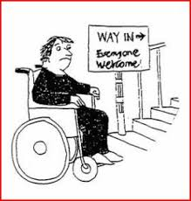

Equal Opportunity
Equal Opportunity means
applying nondiscrimination prohibitions;
providing accommodations and;
engaging in effective communication; and
ensuring accessibility of programs, facilities, and information..

Slide 48




Governance Requirements
Governance Requirements includes the:
designation of an equal opportunity officer;
notice and communication;
data collection;
monitoring and continuous improvement;
complaint resolution;
and corrective action.

Slide 49

MOPD NYC: ATWORK
The Mayor’s Office for People with Disabilities is proud to announce NYC: ATWORK, a public-private partnership to provide unemployed or underemployed New Yorkers with disabilities access to jobs, and build a sustainable pipeline of qualified talent in high-growth industries.
NYC: ATWORK is funded by the the Poses Family Foundation, Kessler Foundation, Institute for Career Development, and New York State Adult Career and Continuing Education Services-Vocational Rehabilitation (ACCES-VR).
The program will be grant-funded for three years before transitioning in-house at the NYC Department of Small Business Services.
  NYC: ATWORK Video Series

Slide 50
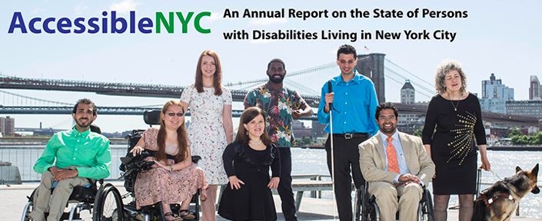
NYC Leadership-
Accessible NYC
Download the PDF

Slide 51

Learning Disabilities
Parents want the best for their children. We do, too. For the first time ever, 15 nonprofit organizations have joined forces to support parents of the one in five children with learning and attention issues throughout their journey.
With the right support, parents can help children unlock their strengths and reach their full potential. With state-of-the-art technology, personalized resources, free daily access to experts, a secure online community, practical tips and more, Understood aims to be that support.
https://www.understood.org/en

Slide 52
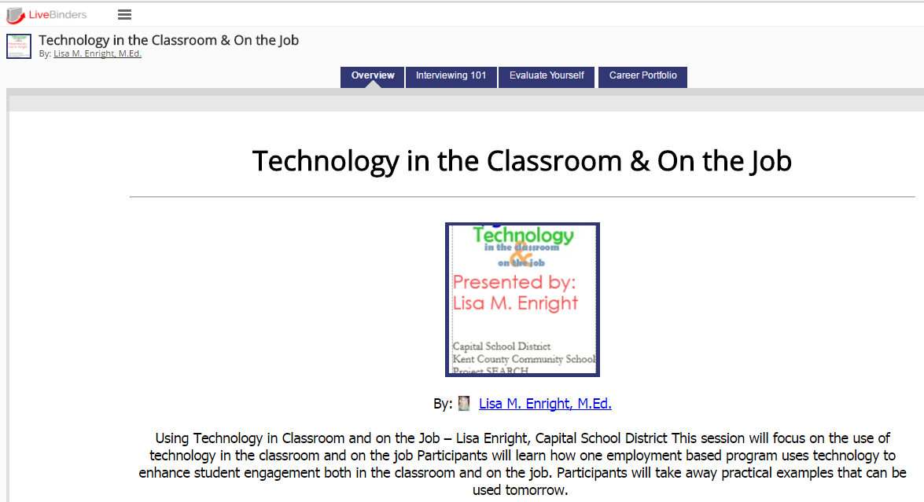
Free Resources at Work
Livebinder resource:
http://bit.ly/DesignDeliver

Slide 53
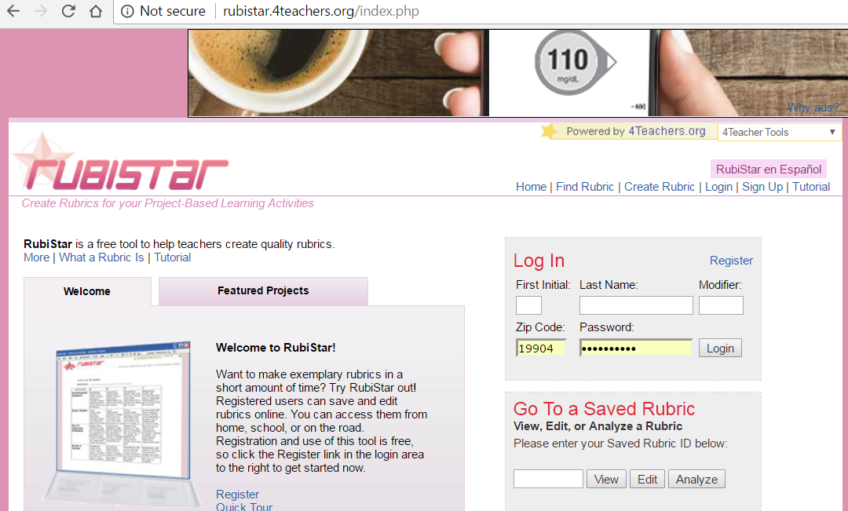
Rubistar: http://rubistar.4teachers.org/index.php

Slide 54
Even More Options
LiveBinders: Organize online content or upload your own to bring the traditional static binder of information to life!
  Create an account and get started: http://www.livebinders.com/
YouTube: Find videos that provide helpful information or upload your own!
  Use your Google account for best results: https://www.youtube.com/
RubiStar: Create rubrics quickly and easily! You can also evaluate individual or class data on the site.
  Create an account and get started: http://rubistar.4teachers.org/index.php
Google Docs: Create, edit, collaborate and share documents with ease.
  Create or use your Google account: http://www.google.com
Google Drive: Store files, videos, pictures, and documents for easy access and sharing with your team! (Think sharing career portfolios of clients with VR, job developers and job coaches.)
  Create or use your Google account: http://www.google.com
Bitly: Shorten and customize lengthy website URLs.
  Use your Twitter or Facebook account or create an account with your email: https://app.bitly.com/bitlinks

Slide 55
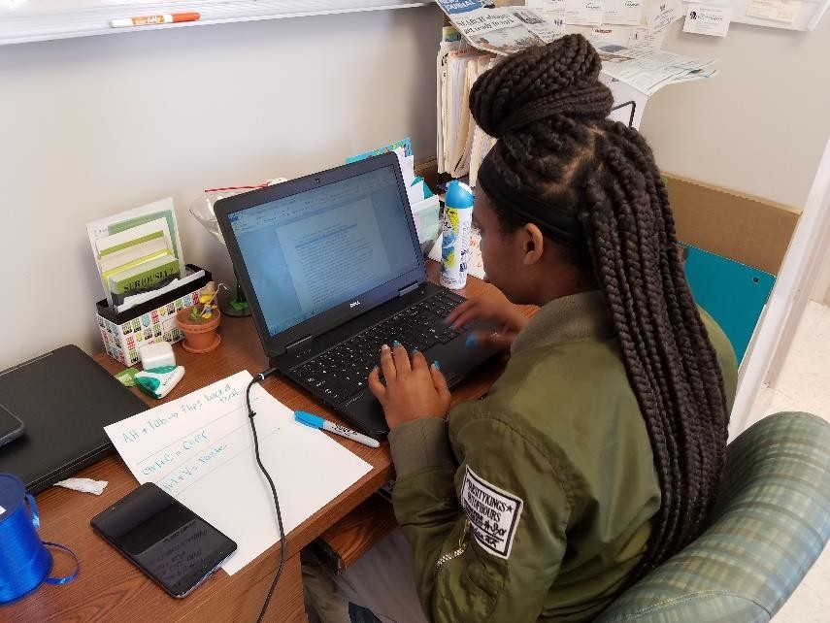
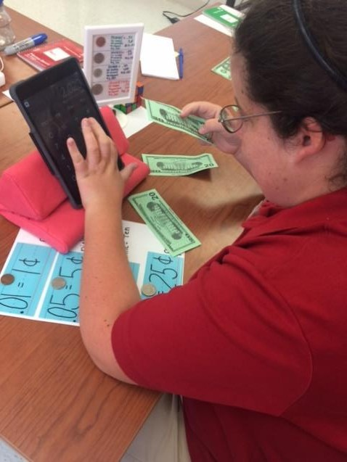
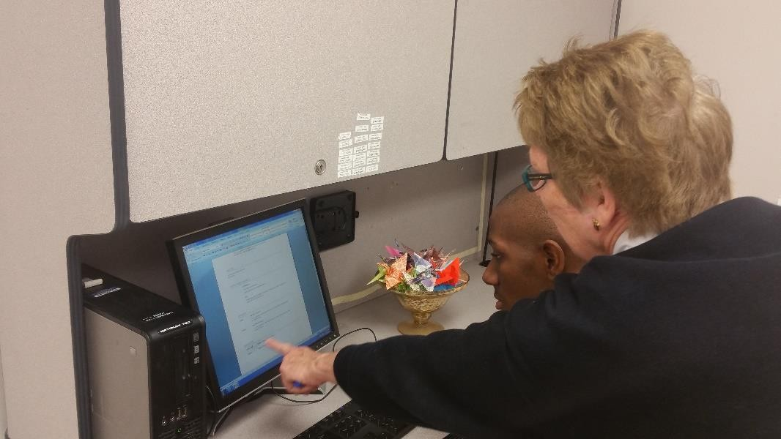
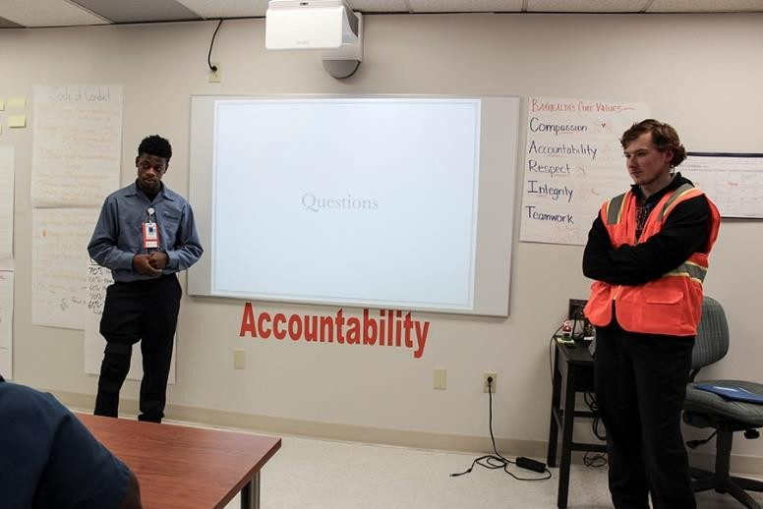
Tech in the Classroom
Ashley uses an iPad to calculate money in preparation for banking at Del-One. She uses the Checkbook App to record deposits and withdraws. She uses the Del-One online banking app to reconcile her account on a monthly basis.
Dejah utilizes a laptop to complete a task. She alternated between two programs, copying text from Microsoft Word and pasting the data into a spreadsheet in Microsoft Excel.
Wayne and Daniel created a Prezi presentation on the iPad. They connected the iPad to the SMART Board and presented their presentation to Senator Carper.
Maliek utilizes a desktop computer and Microsoft Word to create, edit, and print his resume. Next he will upload the completed document to Google Drive, place it in his Career Portfolio, and share that folder with instructors, job coaches, job developers, and VR.

Slide 56
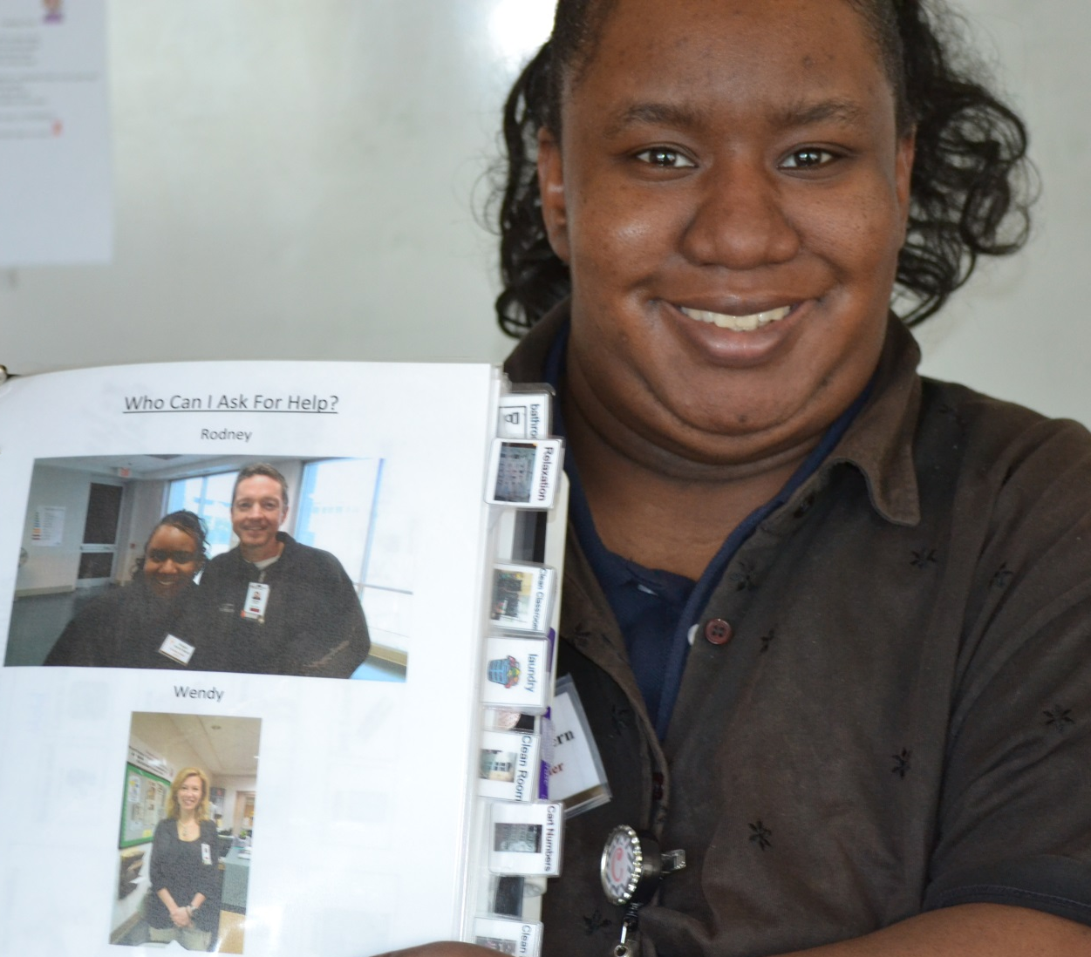
Accommodations & Supports

Slide 57
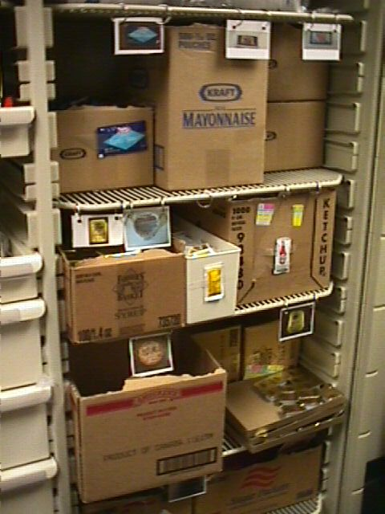

Use Pictures instead of Words

Slide 58
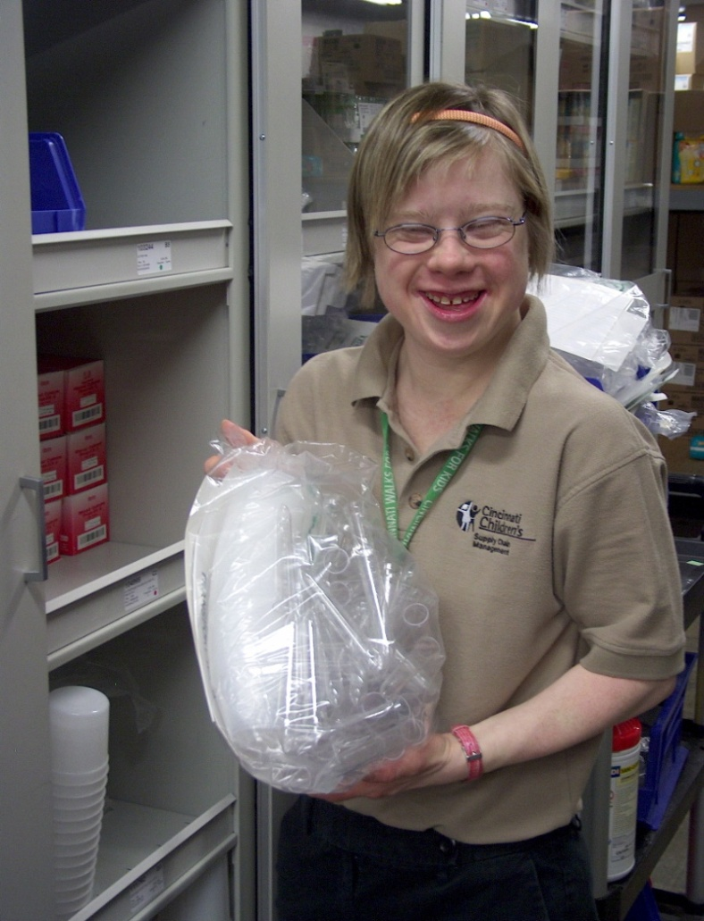
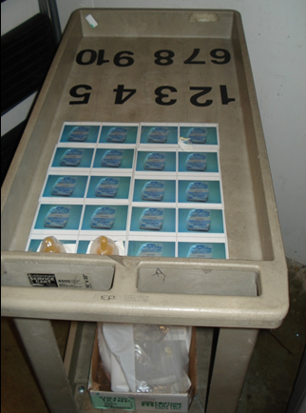
      Counting Cart to establish accuracy and efficiency!

Slide 59
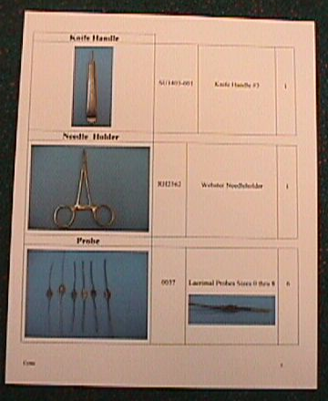
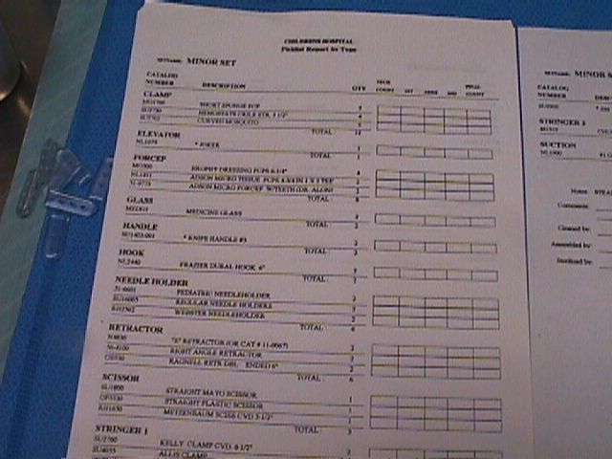
Inclusive Training Resources to Promote Skills
Before = A Pick List
After

Slide 60
Now…pay attention.
Is It ADHD? Or Executive Functions?
A child or an adult with attention deficit disorder (ADHD or ADD) might be hyperactive, inattentive, and/or impulsive. Clinicians have always understood hyperactivity and impulsivity. The understanding of inattention, though, has shifted from primarily “the inability to stay on task” to a broader concept called executive function disorder (EFD), which involves a pattern of chronic difficulties in executing daily tasks.
What Is Executive Function?
Think of executive function as what the CEO of a company does – they analyze, organize, decide, and execute. Higher-level tasks like :
Analyze a task
Plan how to address the task
Organize the steps needed to carry out the task
Develop timelines for completing the task
Adjust or shift the steps, if needed, to complete the task
Complete the task in a timely way
https://www.additudemag.com/executive-function-disorder-adhd-explained/

Slide 61

There is an app for that!
Making cognitive connections through apps, strategies & training.
“Smartphones, the brain prosthetic of the 21st century.”

Slide 62

Online Course – Pace My Day
PaceMyDay – Optimize the energy you have for success!
PaceMyDay is available to help individuals learn to plan their day based on how they feel, monitor their energy throughout the day, and evaluate their progress and overall energy in order to set themselves up for success.

Slide 63

Course – ReachMyGoals
ReachMyGoals (free) – Set goals. Monitor progress. Build on successes. ReachMyGoals is available to help individuals set SMART goals, break down their goals into manageable tasks with due dates, and identify self-goal-related challenges and successes.

Slide 64



Other Online Courses
Notability ($30)
Notability allows the user to take notes and link recorded audio for easy organization and retrieval of specific information. It can be used in the classroom and in everyday life.
Inspiration Maps ($30)
Inspiration Maps allows users to create graphic organizers/mind maps for organizing ideas, papers, projects, etc. It also allows users to switch from graphic to outline mode.
Week Calendar HD ($30)
Week Calendar includes a variety of important features beyond those available in the native iOS Calendar app. Additional features including notification of overlapping appointments, color coding, etc.

Slide 65

Technology Resources:
PEAT
PEAT promotes the employment, retention, and career advancement of people with disabilities through the development, adoption, and promotion of accessible technology.
Selected Resources:
  PEATWorks.org, a central hub for accessible technology-related tools and resources
  TechCheck, a powerful but simple tool to help employers assess their technology accessibility practices and find tools
Partnership on Employment & Accessible Technology (PEAT)

Slide 66

Office of Disability
Employment Policy (ODEP)
The Office of Disability Employment Policy (ODEP) is the only non-regulatory federal agency that promotes policies and coordinates with employers and all levels of government to increase workplace success for people with disabilities.
https://www.dol.gov/odep/

Slide 67

ODEP Workforce Resources:
LEAD Center
National Center on Leadership for the Employment and Economic Advancement of People with Disabilities
(LEAD Center).
The LEAD Center is a collaborative of disability, workforce and economic empowerment organizations led by National Disability Institute.
The LEAD Center is dedicated to advancing sustainable individual and systems-level change to improve competitive, integrated employment and economic self-sufficiency for adults across the spectrum of disabilities.
The LEAD Center's work focuses on three core leadership areas: policy, employment and economic advancement.
Other resources:
  Employment First Website
  LEAD On! quarterly newsletter.

Slide 68

ODEP Youth Resources:
NCWD
National Collaborative on Workforce and Disability for Youth (NCWD/Youth) is a partnership to promote success for youth with disabilities entering the world of work.
The NCWD/Youth website houses numerous youth-focused resources including:
  Guideposts for Success
  Career Development
  Professional Development
  Youth Development and Leadership
National Collaborative on Workforce and Disability for Youth (NCWD/Youth)

Slide 69

Employer Resources
(EARN) helps employers recruit, hire, retain and advance people with disabilities.
EARN also maintains a website, AskEARN.org, which provides information on: recruiting and hiring; retention and advancement; laws and regulations; creating an accessible and welcoming workplace; and federal contractor requirements.
Other Resources:
  Primer on Disability Inclusion
  Business Strategies that Work: A Framework for Disability Inclusion
  Small Business & Disability: Steps to Success
  Fact Sheet on Self-Identification of Disability
Employer Assistance and Resource Network on Disability Inclusion (EARN)

Slide 70

Accommodations Resources
  Job Accommodation
  Network: AskJAN.org
JAN is the leading source of free, expert and confidential guidance on workplace accommodations and disability employment issues.
Working toward practical solutions that benefit both employer and employee, JAN helps people with disabilities enhance their employability, and shows employers how to capitalize on the value and talent that people with disabilities add to the workplace.
Recent JAN activities and areas of focus include:
  JAN Workplace Accommodation Toolkit
  JAN Just-In-Time Training Modules
  Workplace Accommodations: Low Cost, High Impact

Slide 71


Finding Inclusive Employers
US Business Leadership
Network® (USBLN®)
National Organization
on Disability (NOD)

Slide 72
Group Discussion Round 2!
What tools or resources would be most helpful as you endeavor to serve job seekers with disabilities?
What is one thing that you might do different in your office or at your program after today?
What topics would you most want to learn more about?
Are there specific disability topics you would be interested in learning about?

Slide 73



Meet some new partners
Disabled in Action (DIA): A civil rights organization committed to ending discrimination against people with disabilities — all disabilities. DIA consists primarily of and is directed by people with disabilities. We believe in the motto, "Nothing about us without us!"
Center for the Independence of the Disabled in New York (CIDNY): CIDNY’s goal is to ensure full integration, independence and equal opportunity for all people with disabilities by removing barriers to the social, economic, cultural, and civic life of the community.
Guide to Independent Living
"What does it mean to live in my own place?" an illustrated guide to independent living for People with Intellectual and Developmental Disabilities. Created by the Center for Urban Pedagogy (CUP) and AHRC.
For more information, connection to more organizations and more details, please visit MOPD’s page here: https://www1.nyc.gov/site/mopd/resources/advocacy-groups.page

Slide 74

Common Goal: Employment
High School Transition that Works: Lessons Learned from Project SEARCH By Maryellen Daston, Erin Riehle, and Susie Rutkowski
Paul H. Brookes Publishing Co.,
For more information go to:http://projectsearch.us/
Notes:
Need Erin’s Headshot

Slide 75

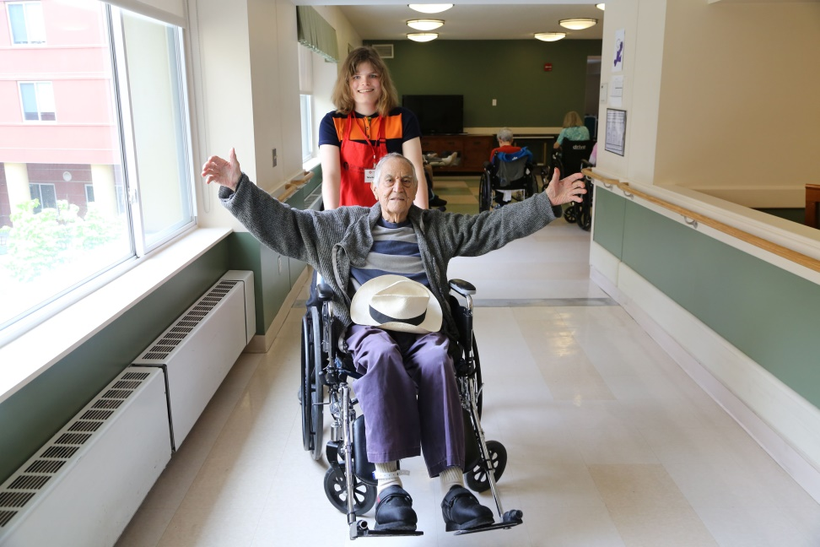
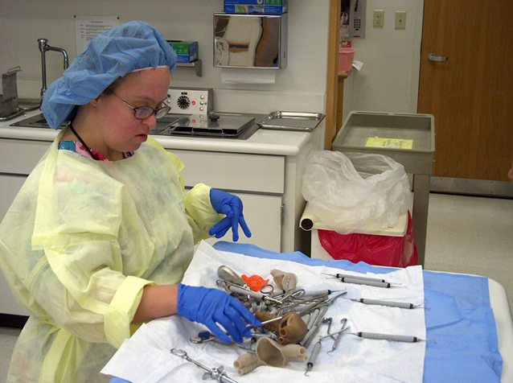
PWDs can Succeed in
Healthcare Jobs
  Workers with disabilities help hospitals help
  Best Practices Webinar on Project SEARCH and Healthcare Jobs for PWDs
  Young people with disabilities help senior citizens– Example of Project SEARCH in New York

Slide 76

Jobs in Government
❖ On Jan. 3, 2017, the EEOC issued a final rule about employment opportunities for PWDs in the fed government.
❖ Each federal agency has been directed to set a goal of having 12% of its workforce be people with disabilities, and 2% of its workforce be people with targeted disabilities.
❖ For more information, please visit EEOC’s website.
❖ State gov can also serve as a model employer of PWDs.
❖Learn from Delaware’s effort to hire talented employees with disabilities.

Slide 77


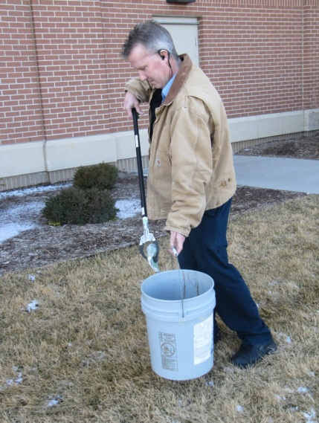
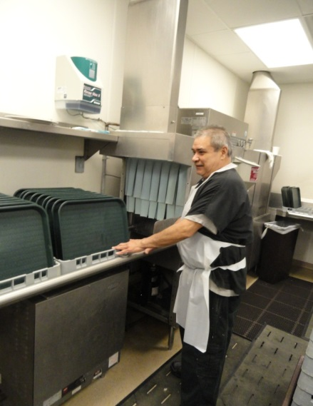
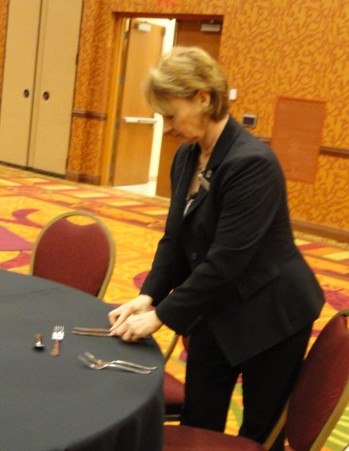
People with Disabilities and the Hospitality Industry
  NYC employs more than 340,000 people in this sector.
  Best Practices Webinar- Hospitality Sector for PWDs.
  From the NYC Workforce Board’s 2016 Regional Plan: “Sizable labor shortage of qualified talent...and very high turnover.”
  People with disabilities are known to be loyal employees. In an industry with such high turnovers, hiring people with disabilities can benefit the bottom line.
Guest Services
Housekeeping
Engineering
Culinary
Banquets

Slide 78
Sector Strategies –
Gov’t Contractors
Top contractors include:
  Brookhaven Science Association
  Truth North Communications
  Leidos Holdings, Inc.
  Continental Sciences Group
  Bank of New York
For complete list go to: https://www.usaspending.gov/Pages/TextView .aspx?data=StateMostFundedRecipientsByAwardType&AwardType=C&statecode=NY&fiscalyear=2017
Complete federal lists of 2006-2013 → Federal Procurement Data System

Slide 79
Entertainment / Culture
  NY State Dept of Labor Report on Motion Picture Industry
    The motion picture industry in New York City has always played a visible role in the city’s culture.
    In 2013, California had the most film jobs (138,000) of any state. New York State ranked second, with slightly less than 56,000.
    Over the last ten years, New York State’s share of U.S. motion picture jobs has risen dramatically...
    However, fewer than one percent of people employed by cultural institutions in New York City are PwDs.
  Combating stigma against PWDs needs to include engagement with showrunners / producers / actors.
  See the example and success of Born this Way.

Slide 80

PWDs CAN Succeed

Slide 81
Circle Up
Groups…what did you discuss? What did you learn?
What do you want to do next?

Slide 82
Resources / Contact Info
2015 Disability Status Report United States, Cornell University, 2015: www.disabilitystatistics.org
Fedspending: www.fedspending.org
Project SEARCH: www.projectsearch.us
Job Accommodation Network: https://askjan.org/
State Vocational Rehabilitation Agency: http://wdcrobcolp01.ed.gov/Programs/EROD/org_list.cfm?category_cd=SVR
Selected Economic Characteristics for Civilian Noninstitutionalized Population by Disability Status, 2011-2015 ACS (focused on Long Beach) http://bit.ly/LBDisabilityjobs
Local Disability Data for Planners (focused on Montgomery County) http://bit.ly/MontgomeryCountydisabilityjobs
Jennifer Laszlo Mizrahi
www.RespectAbility.org
Cell: (202) 365-0787
JenniferM@RespectAbility.org
Twitter: @respect_ability / @jewishinclusion
Facebook: https://www.facebook.com/RespectAbilityUSA and https://www.facebook.com/RespectAbility4All/

Slide 83



Empowering New York Women with Disabilities
Interested in advancing the empowerment of NYC’s women with disabilities?
We invite you to share the following opportunity:
Through a generous grant from New York Women’s Foundation (NYWF), RespectAbility will be launching a
Training Program to Upskill Women and Girls with Disabilities in NYC
to
Advance Skills in Preparation for Civic Engagement
Now is your time to share this priceless opportunity for the advancement of women and girls with disabilities who you know within your NYC network!
CONTACT PERSON: Debbie Fink, DebbieF@respectability.org
DEADLINE FOR APPLICATION: October 1, 2018 (Rolling Admission)
FOR MORE INFORMATION: www.RespectAbility.org/RA-NYWF

