Slide 1





Planning for Success:
Advocating for your daughter or son with a disability
This work is made possible by:
This work is made possible by:
Dr. Victor Santiago Pineda
Stephanie Farfan
Paola Vergara Acevedo
Edith Espiritu

Slide 2
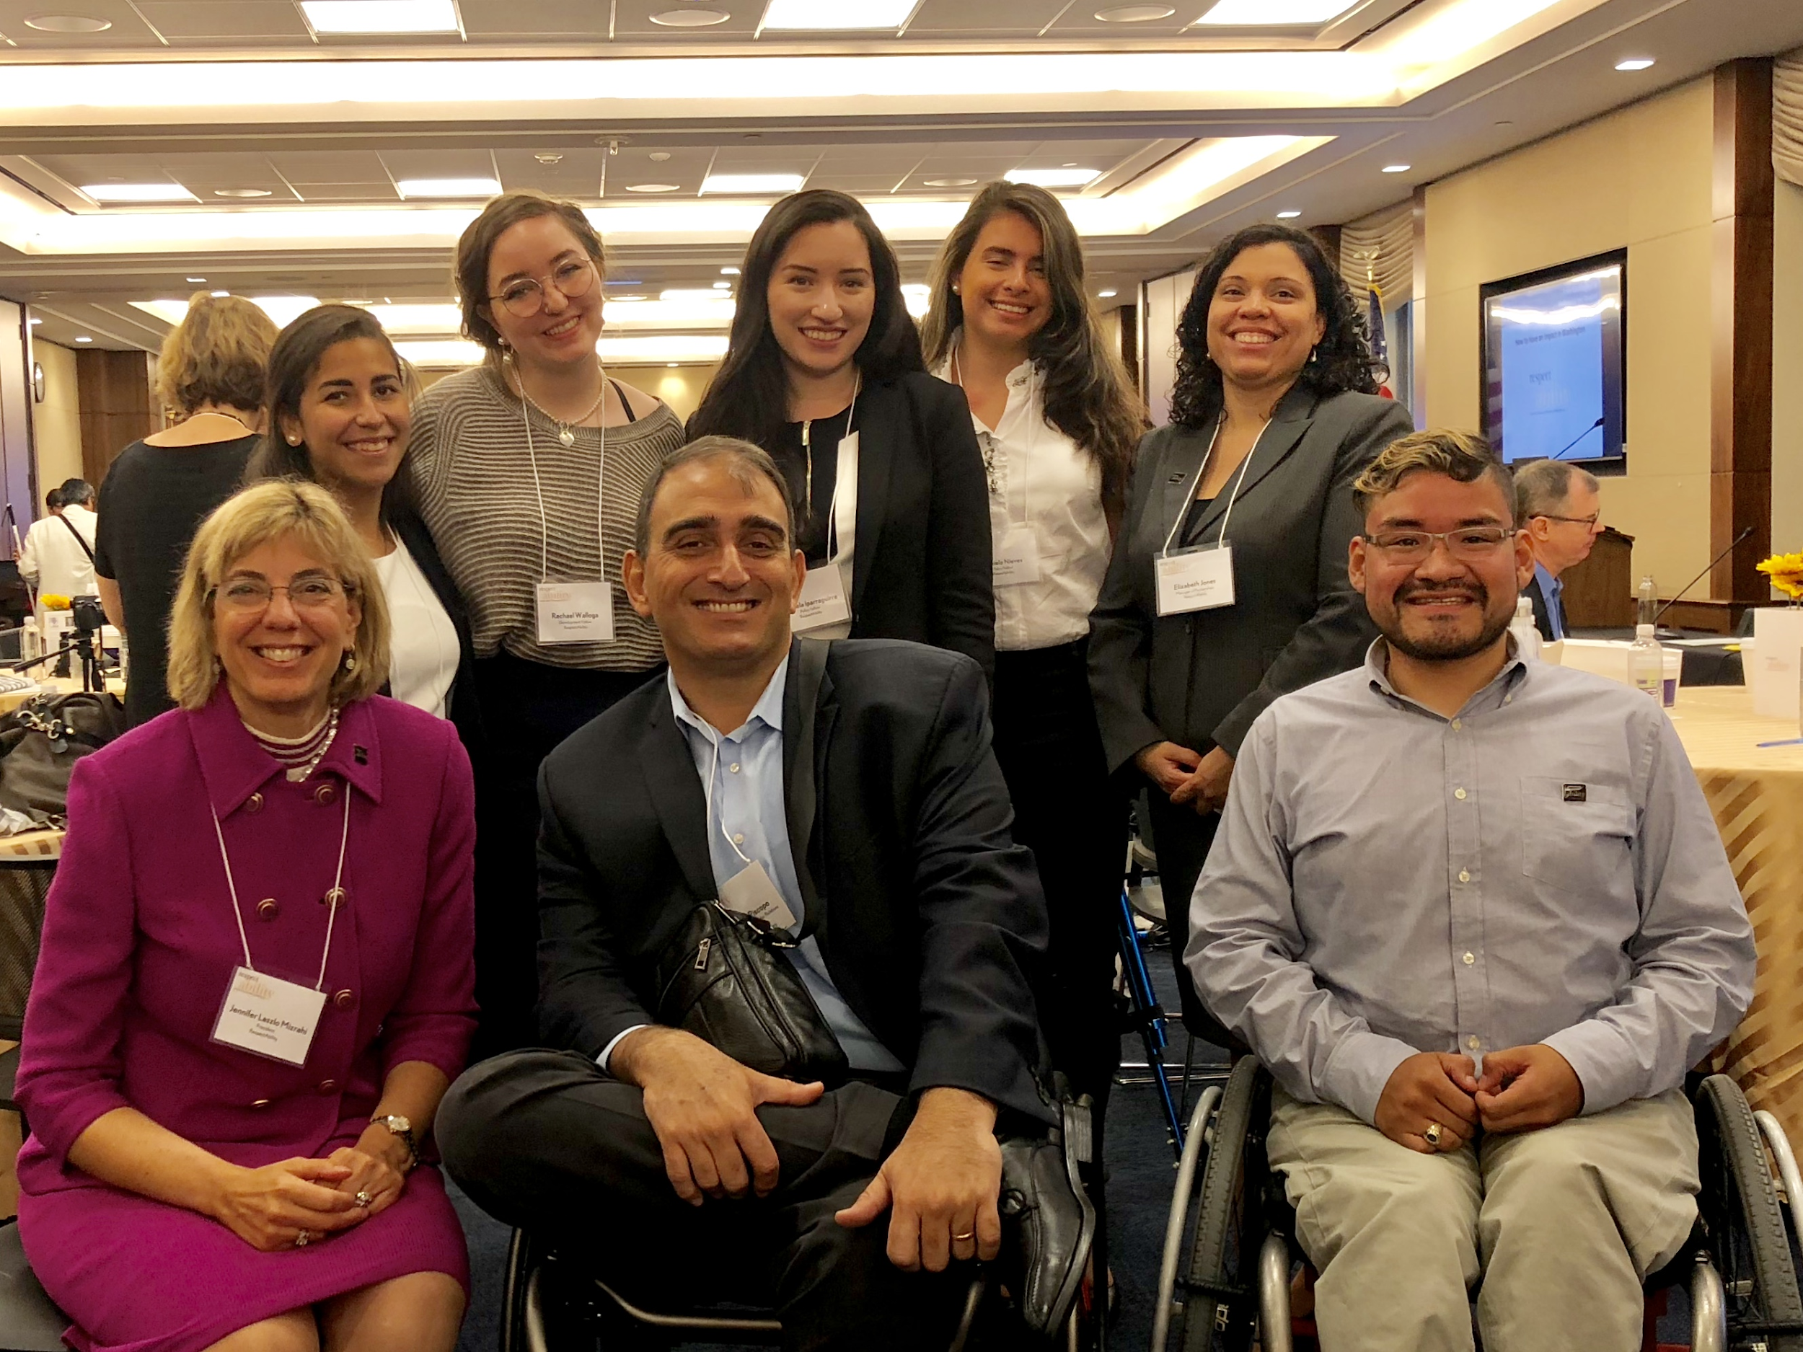
Thank you-Coca-Cola Foundation
“When we ensure that Latinx kids with disabilities have access to the same opportunities as everybody else, not only they win but society as whole wins” - Vincenzo Piscopo, Community & Stakeholder Relations Director
Vincenzo Piscopo is surrounded by RespectAbility Fellows: Daniela Nieves, Mannela Iparraguirre, Christina Revilla Chacon, Rachel Walloga and Steve Bobadilla as well as Jennifer Mizrahi and Elizabeth Jones from RespectAbility’s Staff.

Slide 3
Thank You-NY Women’s Foundation
The responsibility of caregiving for a disabled family member falls disproportionately on women; 20% of all female workers in the US are family caregivers. The “average” U.S. caregiver spends nearly 20 hours per week, the equivalent of another part-time job, providing unpaid care for nearly five years. Of course, informal (family) caregiving is not paid. Latinas are disproportionally involved in the caregiving industry, as well as taking care of their own loved ones as a family role.

Slide 4
Acknowledgments
RespectAbility would like to thank our co-authors, our partners plus the following individuals for their help in the creation of this guide:
National Leadership Fellows:
Daniela Nieves
Mannela Iparraguirre
Christina Revilla Chacon
Rachel Walloga
Analucia Figueroa
Steve Bobadilla
Adie Baez
RespectAbility Staff:
Jennifer Laszlo Mizrahi
Philip Kahn-Pauli
Lauren Appelbaum
Ben Spangenberg
Frank Anderson
Elizabeth Jones
Special thanks goes to the Embassies of Ecuador and Spain

Slide 5
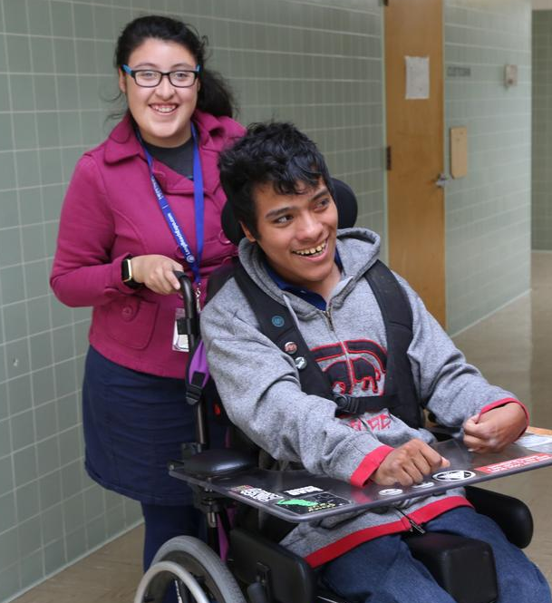
Latinx with Disabilities – Statistics
  9.1% of Latinx living in the US reports they have a disability (numbers are likely much larger)
  Number and percentage of Latinx with disabilities by disability type:
      Visual: 1,253,400
      Hearing: 1,186,200
      Ambulatory: 2,477,900
      Cognitive: 2,230,800
      Self-care: 1,119,400
      Independent Living: 1,786,400
Source: Disability Statistics from the American Community Survey (ACS). Ithaca, NY: Cornell University Yang-Tan Institute (YTI). Retrieved from Cornell University Disability Statistics website: www.disabilitystatistics.org

Slide 6
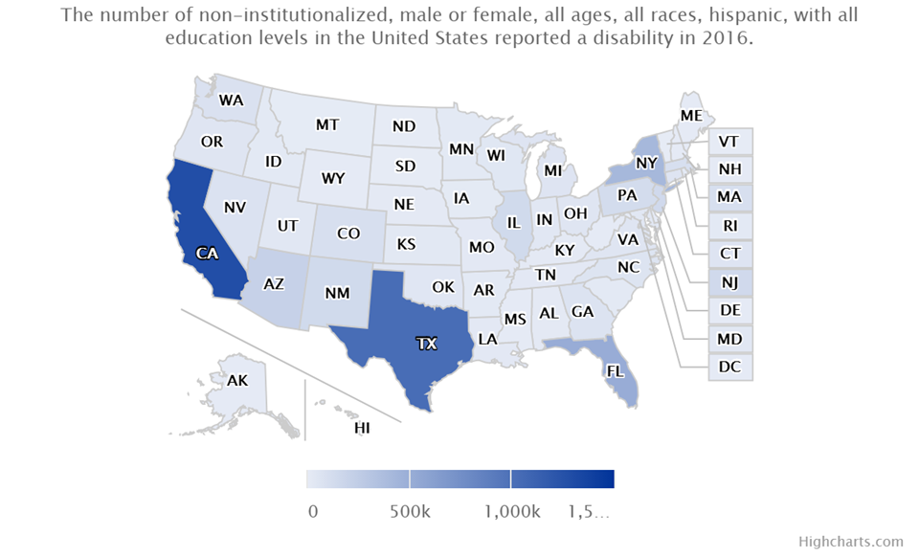
Latinx Disability Employment Rate
The employment rate of working-age (18-64) Latinx with disabilities is 37.5%

Slide 7




States and Latinx with Disabilities
  CA, TX, FL and NY are the states with highest number of Latinx with disabilities:
    There are 1,279,500 Latinx Californians with disabilities.
    There are 1,027,600 Latinx Texans with disabilities.
    There are 511,400 Latinx Floridians with disabilities.
    There are 417,100 Latinx New Yorkers with disabilities.

Slide 8
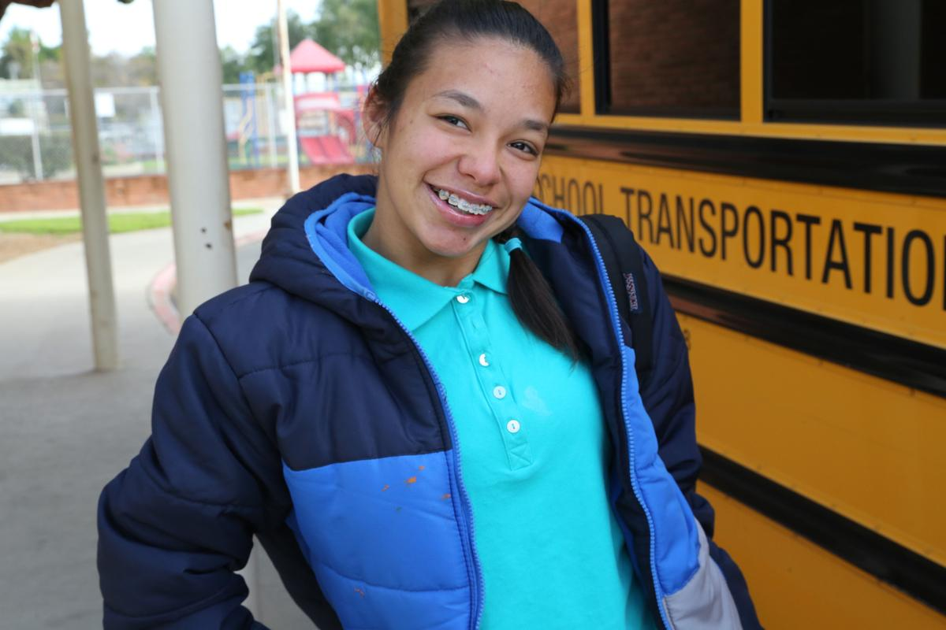
Latinx Students with Disabilities
Latinx students with disabilities account for 12% of all students being served under the Individuals with Disabilities Education Act (IDEA).
42% of Latinx students with disabilities were receiving services for a specific learning disability.
Latinx students with disabilities have a high school graduation rate of 59%
Student with a disability stands in front of Long Beach Unified School District bus.
Source: National Center for Education Statistics Children and Youth With Disabilities https://nces.ed.gov/programs/coe/indicator_cgg.asp
IDEA Section 618 Data Products https://www2.ed.gov/programs/osepidea/618-data/state-level-data-files/index.html

Slide 9
Latinx Students by Disability Type
In total there are 1,586,009 Latinx students with disabilities enrolled in our nation’s public schools. Note that most of them are INVISIBLE disabilities, thus harder to diagnose.
    There are 128,023 Latinx students with Autism.
    There are 320 Latinx students with Deaf-blindness.
    There are 28,946 Latinx students with Developmental delays.
    There are 57,891 Latinx students with Emotional disturbances.
    There are 20,403 Latinx students with Hearing impairments.
    There are 104,387 Latinx students with intellectual disabilities.
    There are 10,469 Latinx students with Orthopedic impairments.
    There are 736,053 Latinx students with Specific learning disabilities.
    There are 278,568 Latinx students with Speech or language impairments.
    There are 4,851 Latinx students with Traumatic brain injuries.
    There are 6,141 Latinx students with Visual impairments.

Slide 10
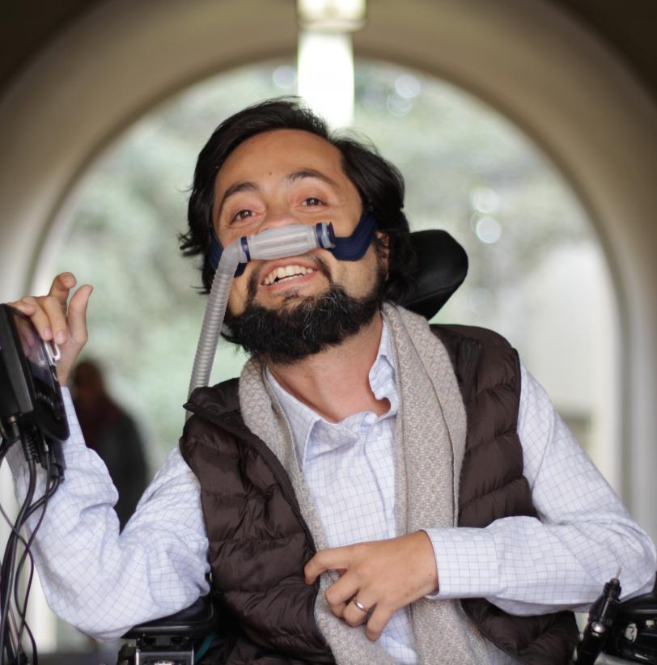
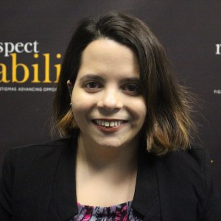
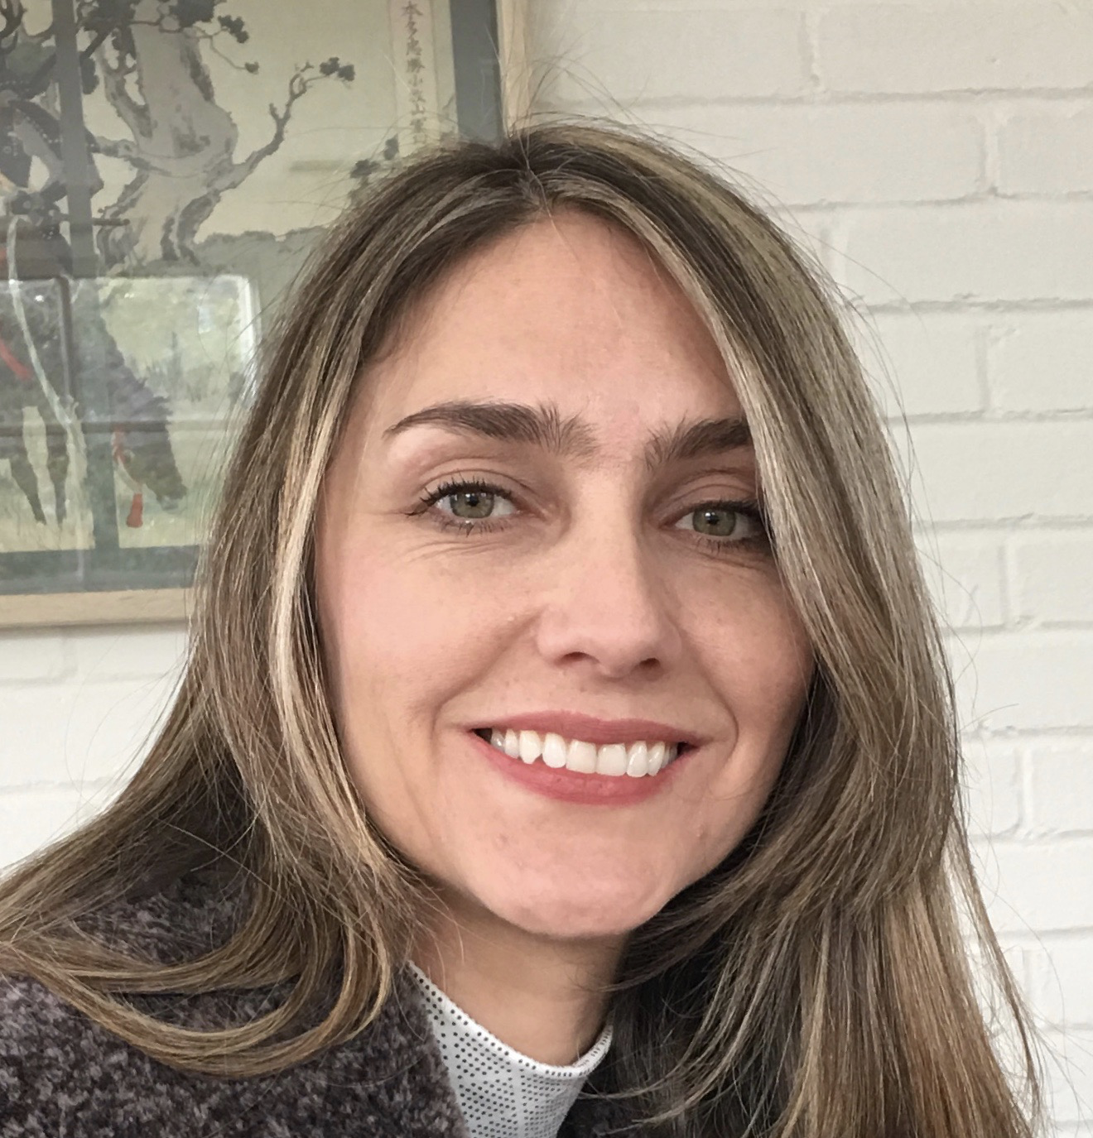
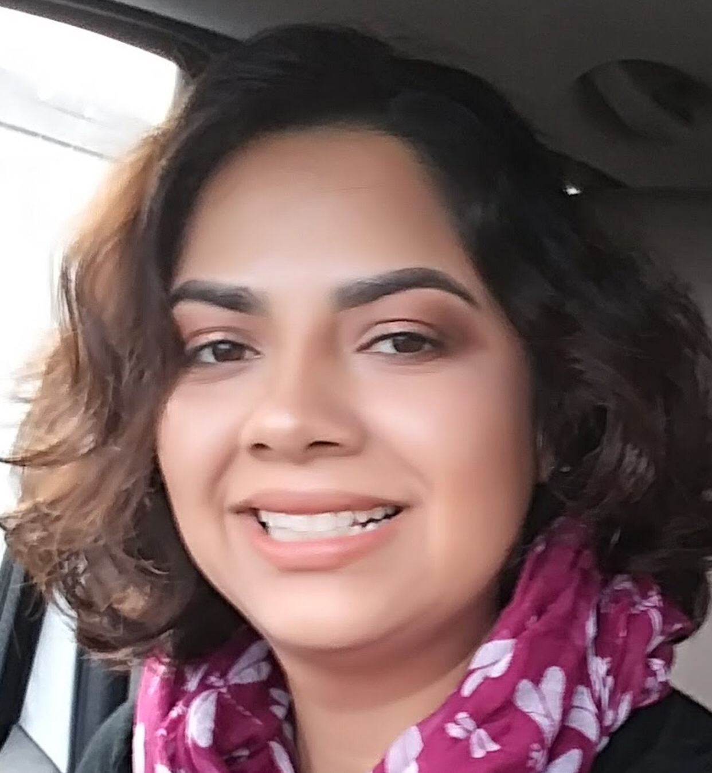
Co-authors/partners
Dr. Victor Santiago Pineda President, World Enabled Senior Advisor, RespectAbility
Stephanie Farfan
Policy, Practices, Latinx Outreach, RespectAbility
Paola Vergara Acevedo
Co-Chair of Spanish Language Committee
Edith Espiritu
Parent Coordinator and Outreach, Fiesta Educativa
http://worldenabled.org/who-we-are/
http://fiestaeducativa.org /about/our-team/

Slide 11


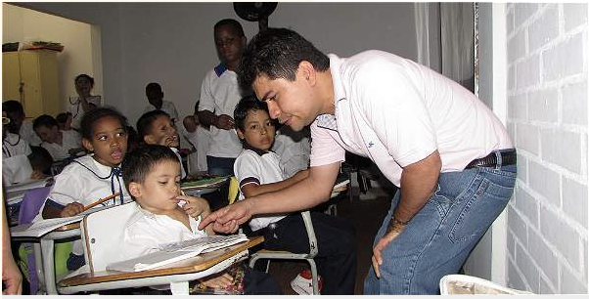
Defining Disability
Attention Deficit Disorder Hyperactivity Disorder (ADHD)/Attention Deficit Disorder
Amputation/Amputee
Autism/Autism Spectrum Disorder (ASD)
Blind/Vision Loss
Cerebral Palsy
Deaf/Hard of Hearing
Down Syndrome
Michelle Rodriguez, Fast and Furious / ADD
Cristina Sanz, Born this Way / Down Syndrome
Jeison Aristizabal, Nonprofit Founder / Cerebral Palsy

Slide 12



Defining Disability Part 2
Dyslexia and Other Learning Disabilities
Epilepsy
Little People/Dwarfism
Mental Illness
Mobility Impairments Requiring the Use of a Wheelchair
Obsessive Compulsive Disorder (OCD)
Salma Hayek, Frida, Ugly Betty, / Dyslexia
Gina Rodriguez, Jane the Virgin, / Anxiety and Hashimoto’s Disease
Dr. Victor Pineda, founder of World Enabled, scholar, activist / Muscular Distrophy

Slide 13

Michelle Rodriguez, Actress / ADD
  Rodriguez has Attention Deficit Disorder (ADD), which led her to being expelled from five schools
  “I want to write and direct, but it’s not easy with ADD. I have a hard time focusing when I’m alone. I’m a scatterbrain, but I’m nervous of taking medication, I don’t really want to depend on anything to control my brain.”

Slide 14
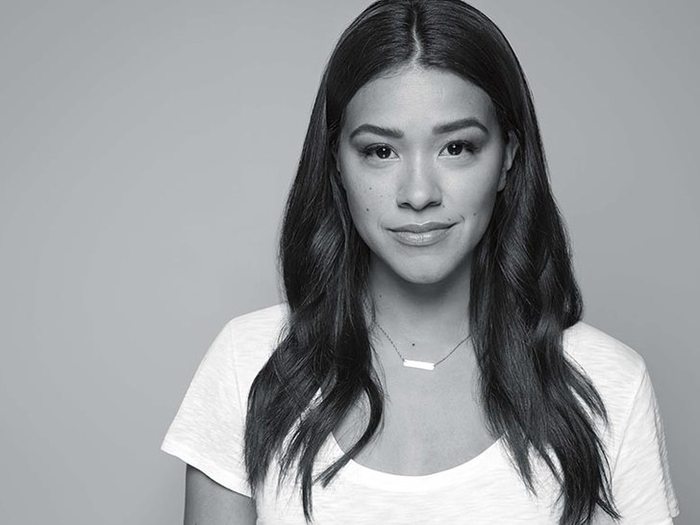
Gina Rodriguez, Actress / Anxiety
Rodriguez has Anxiety and Hashimoto’s Disease.
“I suffer from anxiety. And watching this clip I could see how anxious I was but I empathize with myself. I wanted to protect her and tell her it’s ok to be anxious, there is nothing different or strange about having anxiety and I will prevail.”

Slide 15

Selena Gomez, Lupus
Gomez has Lupus, a chronic autoimmune disease that causes the body to attack itself, unable to differentiate between its own healthy tissue and invaders.
“It is an autoimmune disease; I will have it forever and you just have to take care of yourself.”

Slide 16
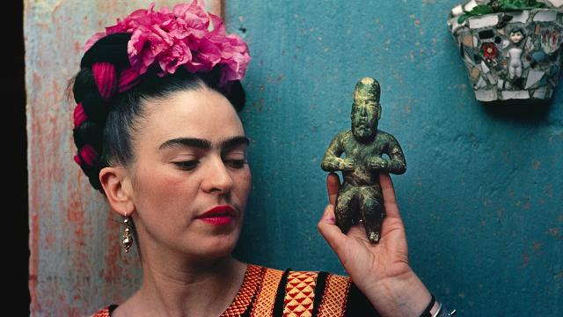
Frida Kahlo, Artist / Polio
Frida Kahlo, a Mexican woman who had multiple disabilities including polio as a child and spinal and pelvis damage from a car accident, became a world-renowned self-portrait painter.
Throughout her life, Kahlo came face-to-face with her disabilities and turned them into art. She has many paintings depicting her disabilities.

Slide 17
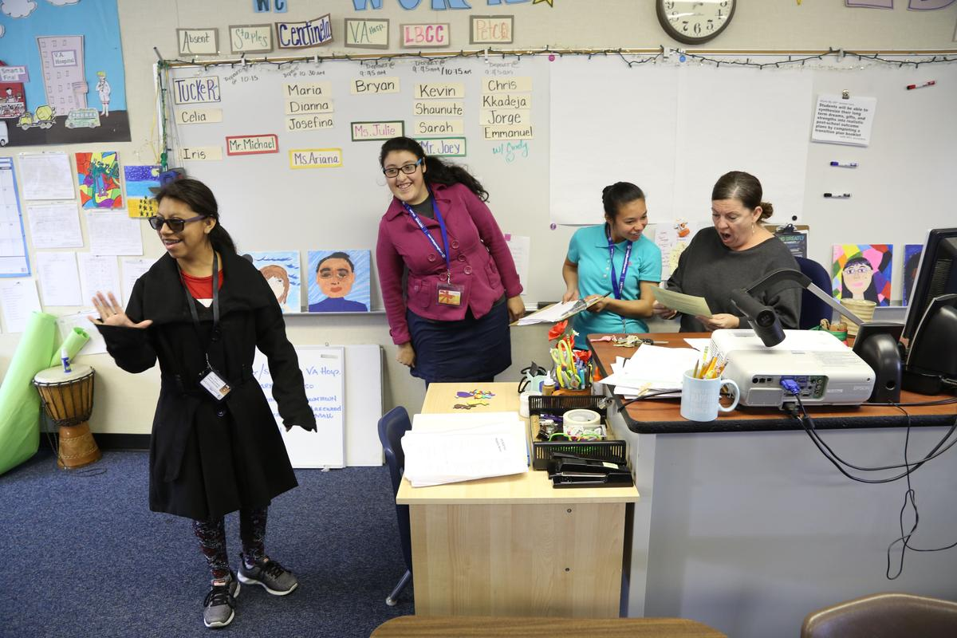
1. Recognize children with disabilities are capable and can change the world
It’s important to have high expectations for your child because all children have the ability to learn and grow.
Don’t let the negative views of others define them.
Recognize their talents and potential to contribute to their communities.
With a support network, available resources, mentors and the love of their family, your daughter or son can achieve their highest potential.
Students with disabilities learn jobs skills at a Long Beach Unified High School in Southern California.
Notes:
Recognize girls and boys with disabilities are capable and can change the world
It’s important to have high expectations of your daughter or son. All children have the ability to learn and grow. Don’t let the negative views of others define them. We must recognize their talents and potential to contribute to their communities.
With a support network, available resources, mentors and the love of their family, your daughter or son can achieve their highest potential.

Slide 18
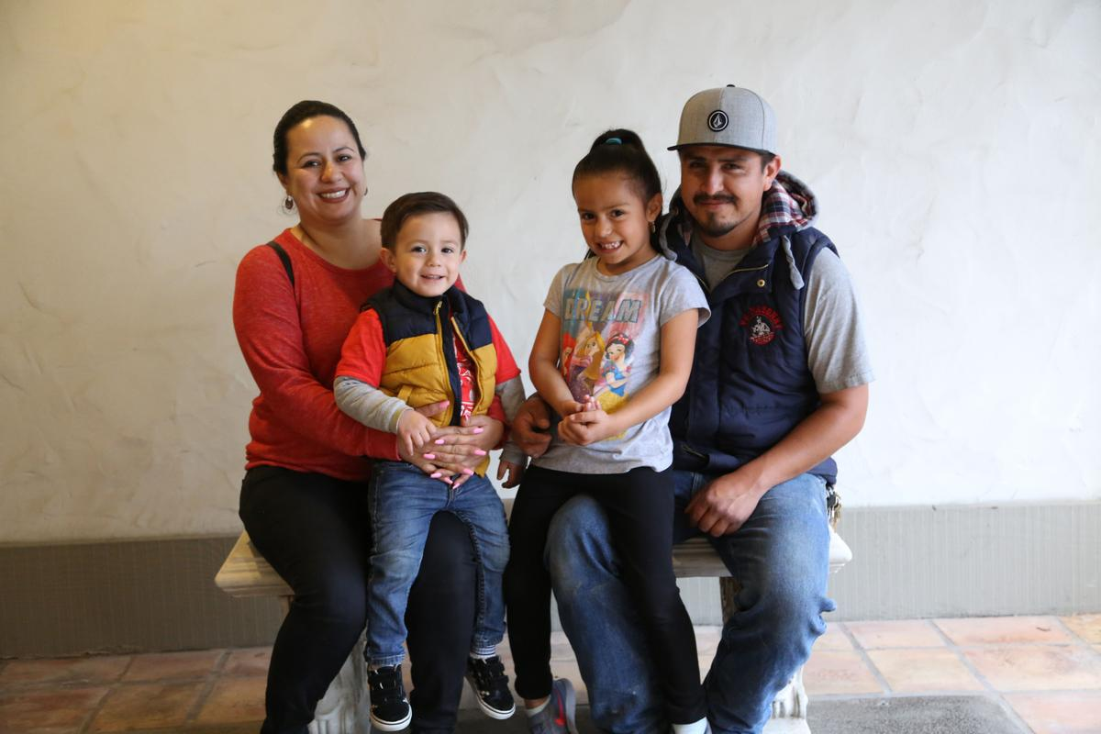
2. Create a network of support
Think about the resources at your disposal to ensure that your child can use his or her potential without barriers.
Create a community around you that can support you as your neighbors, other parents of children with disabilities, and support groups for parents and people with disabilities.
With a strong support network that understands the services present in the community and the accessibility of those services for people with disabilities, you will better understand how to take advantage of the opportunities for your child.
Family photo of a newly enrolled family at the Harbor Regional Center in Torrence, CA.
Notes:
2. Create a network of support
It is common to feel alone when you face the educational system. What are the resources at your disposal to ensure that your daughter or son can use his or her potential without barriers?
Create a community around you that can support you as your neighbors, other parents of children with disabilities, and support groups for parents and people with disabilities.
With a strong support network that understands the services present in the community and the accessibility of those services for people with disabilities, you will understand better how to take advantage of the opportunities for your daughter or son.

Slide 19
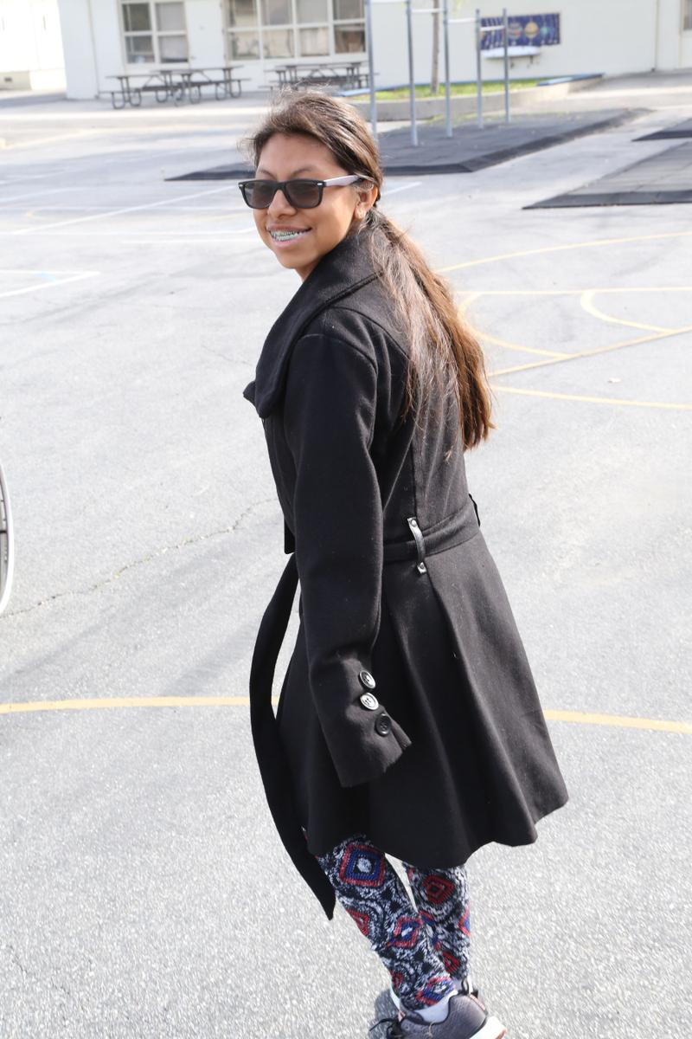
3. Promote your child’s independence
By leaning in the community and using technology, you can help strengthen their independence without fully disconnecting from you.
Talk with your child to understand their wishes and interests. Support their independence and help them find and form their own identity.
If your child requires personal assistance, reach out to your community and other experts to get more information about programs and support services for independent living
This student smiles wide while walking outside of her school.
Notes:
3. Promote your child’s independence
The time will come when your daughter or son will grow up and want to form their own life. By leaning in the community and using technology, you can help strengthen your independence without fully disconnecting from you.
To start, talk with your daughter or son to understand their wishes and interests. Support their independence and help them find and form their own identity.
If your son or daughter requires personal assistance, talk to your community and other experts to get more information about programs and support services for independent living.
It is possible that these programs provide a personal assistant, and the cost of this support is borne by the state where you live. The assistant represents a resource so that your daughter or son can find his own way without feeling overprotected or stifled. For more information about personal assistance, reach out to local organizations or talk to people in your community including the people who know or support your daughter or son at school.

Slide 20
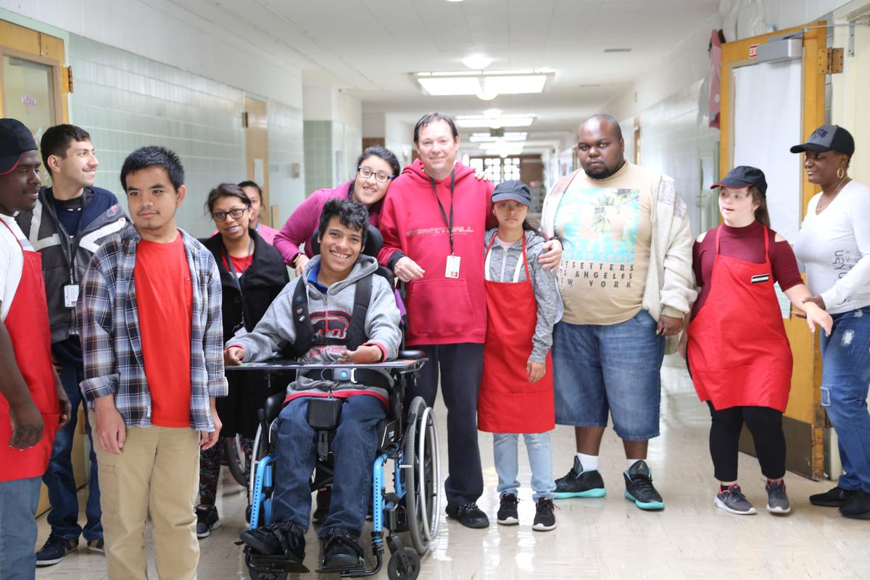
4. Meet with teachers to create a success plan for your child
Teachers and student counselors can be great advocates and resources for the success of your child.
Have a relationship with the teachers in the school, to support your child.
Together, with your child, you can create an educational success plan.
Students with disabilities pose for a group photo in the hallway of a Long Beach Unified School District high school.
Notes:
Teachers and student counselors can be great advocates and resources for the success of your daughter or son.
It is important to create a relationship with the teachers in the school, to support your daughter or son. They should know your child’s skills and interests.
Together, with your daughter or son, you can create a plan for personal growth and academic success. .

Slide 21
5. Be involved in your child’s learning
Keep up with your child's curriculum and school activities to identify opportunities for more school achievements.
Talk with your child about their studies to see if they have any difficulty participating in their class.
Talk to the teachers so that they are aware of the way your child learns best.
Review schoolwork with your child or find out if there is a tutor or program at school who can work with your son or daughter to review what they have learned during the day
A young student with a disability poses in front of a Yellow School Bus.
Notes:
It is important to keep up with your child's curriculum and school activities to identify opportunities for more school achievements. Talk with your daughter or son about their studies to see if they have any difficulty participating in their class.
In addition, you should talk to the teachers so that they are aware of the way your daughter or son learns best.
You can also review your child’s homework or find out if there is a additional free help such as a tutor who can work with your son or daughter to review what they have learned during the day.

Slide 22
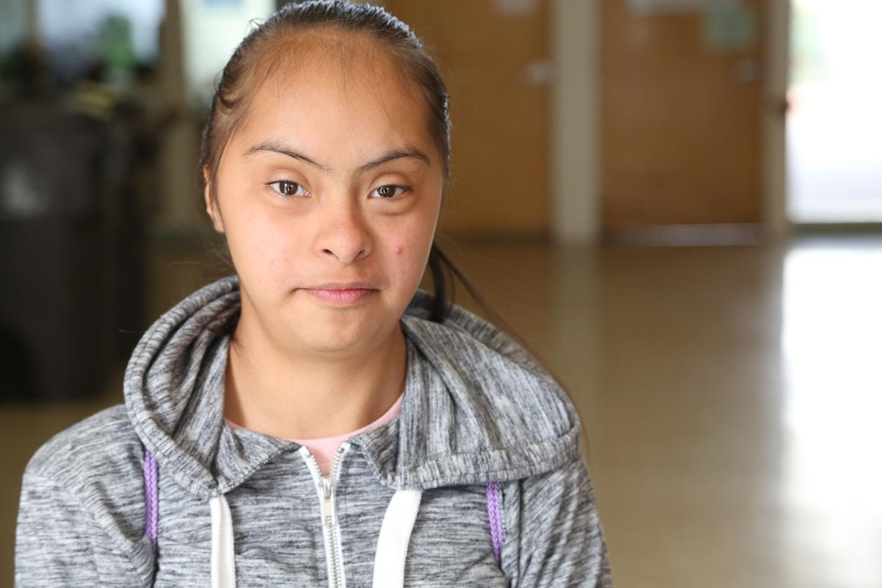
6. Know your rights and fight for them
There are three important laws that protect students with disabilities.
    1) The Individuals with Disabilities Education Act (IDEA)
    2) The American Rehabilitation Act
    3) Americans with Disabilities Act.
IDEA requires schools to support students with disabilities and helps your children get the support they need.
The Americans with Disabilities Act and the Rehabilitation Act prohibit discrimination against people with disabilities.
A slight smile from this Long Beach student with a disability.
Notes:
There are three important laws that protect students with disabilities. 1) The Individuals with Disabilities Education Act (IDEA) 2) The American Rehabilitation Act 3) Americans with Disabilities Act.
IDEA is a National Law that obliges schools to support certain students with disabilities, and it is a tool that defends the rights of your children in the educational system. The Americans with Disabilities Act and the Rehabilitation Act prohibit discrimination against people with disabilities and create a plan to ensure that students with disabilities will have access to the school environment and its services.
You do not need to read all these documents, just understand what is covered and the rights that are protected. It is important to know that your daughter or son will have to be evaluated by the school to be considered as an individual with a disability. This evaluation is the responsibility of the school, with no expense on your part. Remember to keep a record of all the paperwork about your child organized in a file, this includes their medical and educational records.

Slide 23
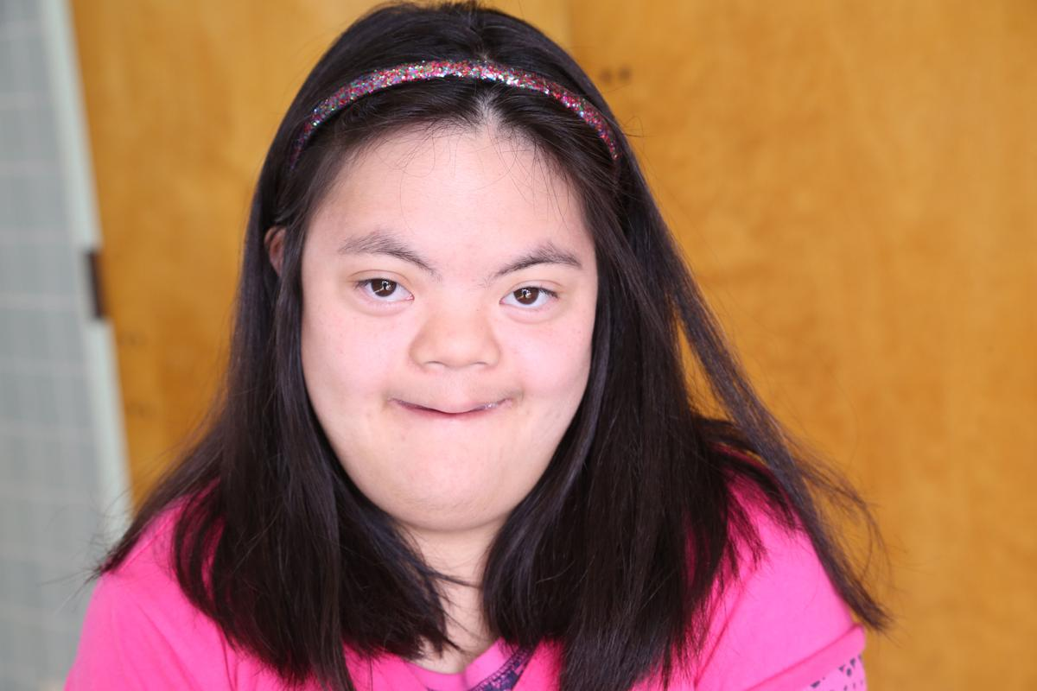
Know Your Rights-IDEA, IEP & 504
Know your rights contd.
Learn the differences between IEP and 504 plans and which would be right for your child.
IEP: a blueprint or plan for a child’s special education experience at school.
  Includes only 13 specific disabilities listed in IDEA.
  The disability must affect the child’s educational performance and/or ability to learn and benefit from the general education curriculum, leading to the need for specialized instruction.
504: a plan for access needs at school
  A child has a disability - not restricted.
  The disability must substantially limit one or more basic life activities, such as learning.
This student smiles at the camera in a school hallway.

Slide 24
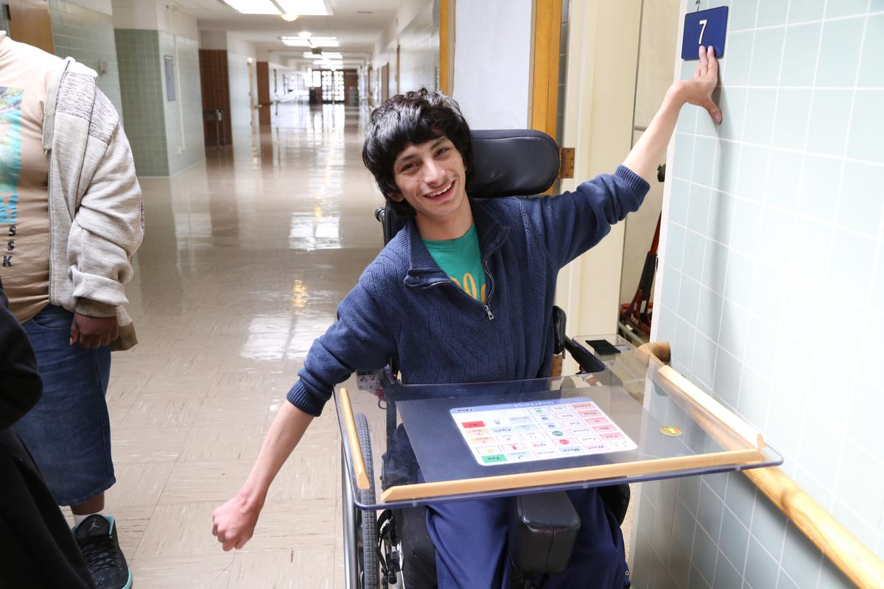
7. Learn more about the resources and experts that can support your child
Find experts such as child psychologists, therapists, and personal assistants in your community. Speak with and maintain a relationship with these experts, who can help you identify solutions and support your child in school.
They will know how to advise you about the resources that exist for your child in the school environment.
Remember the phrase: "Nothing About Us Without Us!" This is the motto of the disability community. Talk to your child about the resources you have found - their perspective is the most important.
This student with a disability rolls down his high school’s hallway delivering mail and practicing job skills.
Notes:
7. Learn more about the resources and experts that can support your daughter or son
It is important to know and look for available resources to support full participation in the community of your daughter or son. These resources include experts such as child psychologists, therapists, and personal assistants. Speak and maintain a relationship with these experts, who can help you identify solutions for the support of your daughter or son in school.
They will know how to advise you about the resources that exist for your daughter or son in the school environment.
Remember the phrase: "Nothing About Us Without Us!" This is the motto of the disability community. Talk to your daughter or son about the resources you have found. Their perspective is the most important.

Slide 25
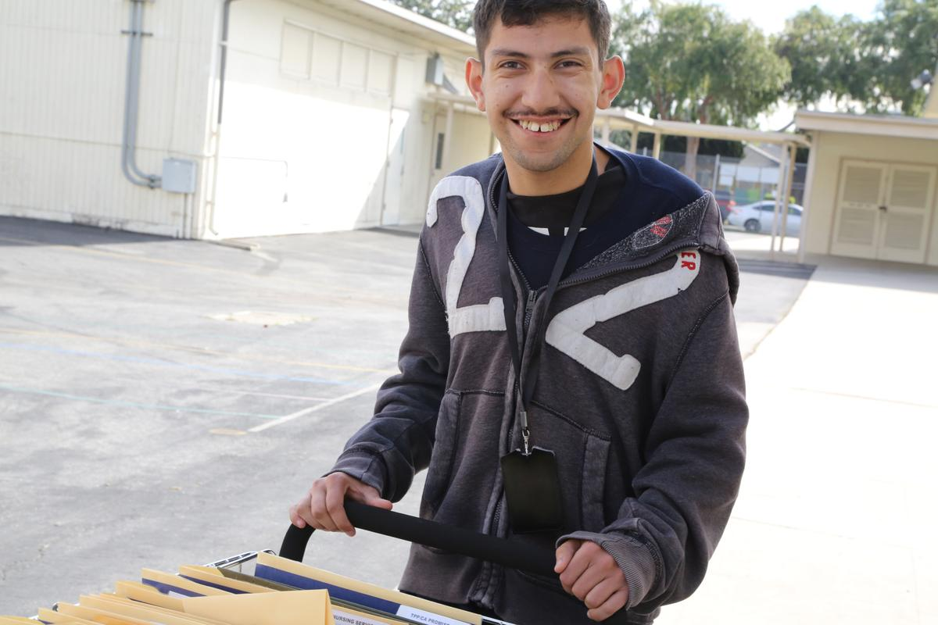
8. Be involved in your child’s extracurricular activities
It is important that you are present so that you learn more about the interests of your child and the network of people with whom they have placed their trust.
Your presence does not have to be and should not be one that watches everything. Your child has to have a space to grow and learn without always having you stuck by his or her side.
Do not worry - your children, although they will not always tell you, want to feel that you support them and that you are present in their life.
This student with a disability is out in the sun, doing work on the sunlit campus of his Long Beach, CA high school.
Notes:
School and extracurricular activities make up a large part of your son's or daughter's life. They are critical spaces where they form new experiences including achievements and challenges. It is also where your daughter or son begins to create their own identity and friendships.
It is important that you are present so that you learn more about the interests of your daughter or son and the network of people with whom they have placed their trust.
Your presence does not have to be and should not be one of constant vigilance. Your daughter or son has to have space to grow and learn without always having you stuck by their side. This space gives you the time to learn and know that you are independent and capable.
Do not worry - your children, although they may not always tell you, want to feel that you support them unconditionally and that you are present in their life.

Slide 26
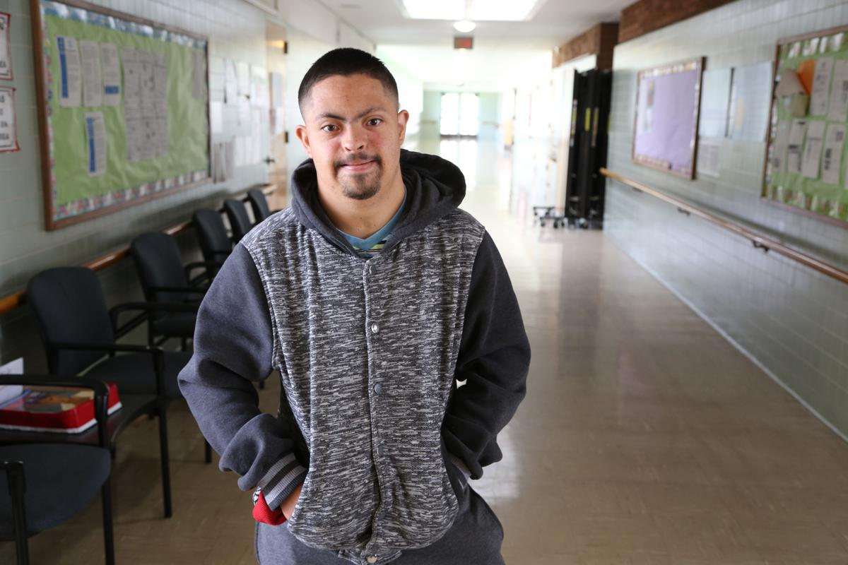
9. Nurture a positive disability identity
Find mentors, and exemplary people in your community who can be role models for your child..
Look for positive stories from leaders of people with disabilities. Your child can learn that they are part of a strong community and can continue to create a better world for everyone, including people with disabilities. Learn more about activists like Judy Heumann and other activists that fought for the passage of the Americans with Disabilities Act (ADA) in 1990.
This energetic young man with Down Syndrome is framed in the cooly lit hallway of his Long Beach high school.
Notes:
There are many people with disabilities who have achieved great success in their personal and professional lives. There are many who have also improved their community. Find mentors, and positive examples in your community who can be role models for your son or daughter.
Examples of Latinos with disabilities that have been successful include actress Salma Hayek and urban planner Dr. Victor Pineda.
Look for positive stories from leaders with disabilities. Your daughter or son can learn that they are part of a strong community and that they could continue to create a better world for everyone, including people with disabilities. Learn more about activists like Judy Heumann and other activists that fought for the passage of the Americans with Disabilities Act (ADA) in 1990.

Slide 27
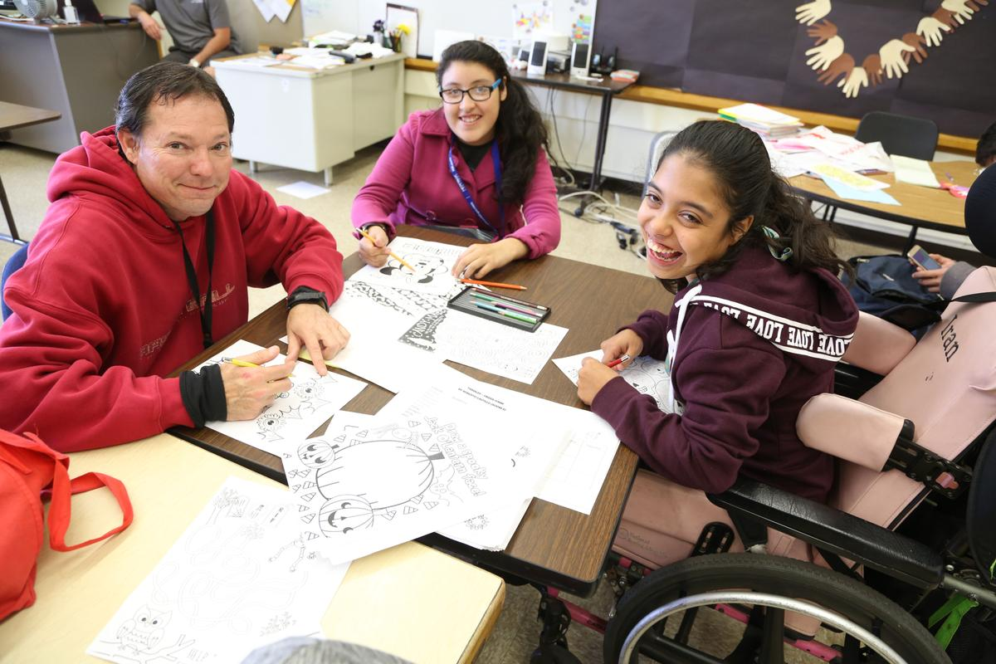
10. Recognize challenges and celebrate successes
Recognize the challenges not simply as barriers, but rather as opportunities to be creative and to change things.
Work with a support team to find solutions and remove the barriers that limit or exclude the full participation of your child in their school and family community.
Each achievement is a step forward. Success comes step by step.
These Long Beach high school students sit down with their job coach to talk about applying for summer jobs in the community.
Notes:
It is not easy to raise a daughter or a son, and it is more difficult when you try to raise it in an environment that is full of barriers.
We must recognize the challenges not simply as barriers, but rather as opportunities to be creative and to change things. Work with a support team to find solutions and remove barriers that limit or exclude the full participation of your daughter or son in their school, family, or community.
The most beautiful and important thing to remember is that your child will have many experiences and reach new milestones. Each achievement is step forward.

Slide 28
Resources / Contact Info
National Rehabilitation Information Center - https://www.naric.com/?q=en/content/spanish-language-resources
Learning Disabilities online http://www.ldonline.org/espanol?lang=en
Web Accessibility and Disability Resources in Spanish - http://www.icdri.org/hispanic/Hispanic.htm
Pacer Center Spanish Resources http://www.pacer.org/publications/spanish.asp
Colorin Colorado - http://www.colorincolorado.org/
Understood.org - https://www.understood.org/es-mx
Recursos para personas con discapacidades - https://www.benefits.gov/es/newsroom/news-and-updates/article/238
Discapnet El Portal de las Personas con Discapacidad - https://www.discapnet.es/
ADA Guide Spanish - https://www.ada.gov/cguide_spanish.htm
Servicio de Información sobre Discapacidad - http://sid.usal.es/default.aspx
FESOCE Federación Española de Sordoceguera - https://fesoce.org/
Center for Parent Information and Resources - https://www.parentcenterhub.org/recursos-en-espanol/
Fundación CADAH TDAH: Guías para educadores - https://www.fundacioncadah.org/web/articulo/tdah-guias-para-educadores.html
Fundación CADAH TDAH: Guías para padres y educadores - https://www.fundacioncadah.org/web/articulo/tdah-guias-para-padres-y-educadores.html
World Enabled - http://worldenabled.org/
Fiesta Educativa - http://fiestaeducativa.org/
Coca-Cola Foundation - ttps://www.coca-colacompany.com/our-company/the-coca-cola-foundation

