Slide 1

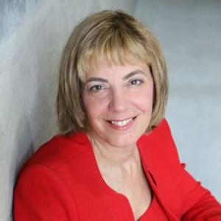
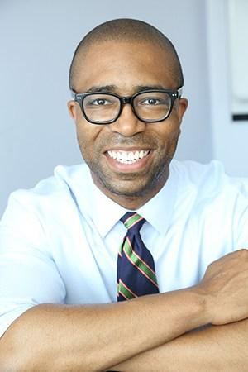
Inclusion Branding –Debra Ruh
July 10th, 2018 – Employment and Advocacy Webinar
Jennifer Laszlo Mizrahi, President, RespectAbility
Calvin Harris, Chairman, Respect Ability
Contact: JenniferM@RespectAbility.org
202-517-6272

Slide 2

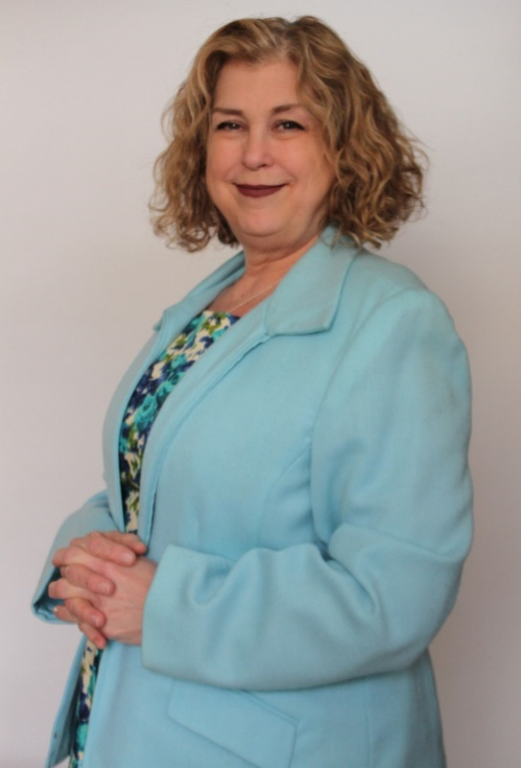
Inclusion Branding
Presented by:
Debra Ruh

Slide 3
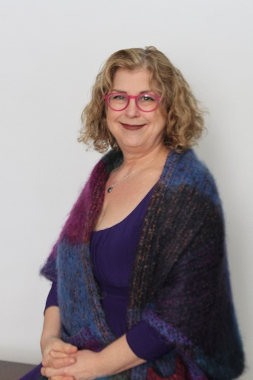
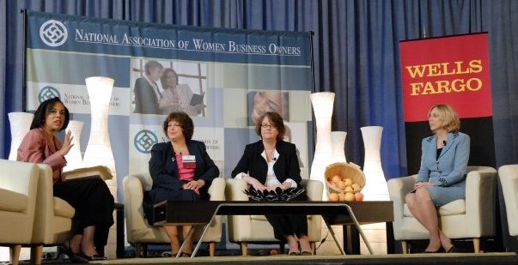

Introduction
Ruh Global Communications is a Global Marketing and Strategic Consultancy. We provide strategic disability inclusion and accessibility that leverage positive corporate branding, competitive differentiation, and ROI.
Host of ‘Human Potential at Work’ – audience in 80+ countries. Co-Founder #AXSChat one of the largest tweet chats in the world. Consultant for UN ILO GBDN. Member of G3ict Expert Panel and Advisory Board.
Debra Ruh, CEO of Ruh Global Communications
Founded TecAccess in 2001 merged with SSB in 2011. TecAccess was a US based multi-million dollar firm focused on ICT Accessibility. Over 80% of the team were technologists with disabilities.
Author of three books. Inclusion Branding, Tapping into Hidden Human Capital and Finding Your Voice Using Social Media.
Market Influencer on Social Media with over 175,000 followers on Twitter. KLOUT score of 82+ and ranked in the top 0.1% of people on social media.
Mother of a child with Down syndrome.
Debra Ruh at the National Association of Women Business Owners Receiving the Trailblazer Award, 2007
2

Slide 4
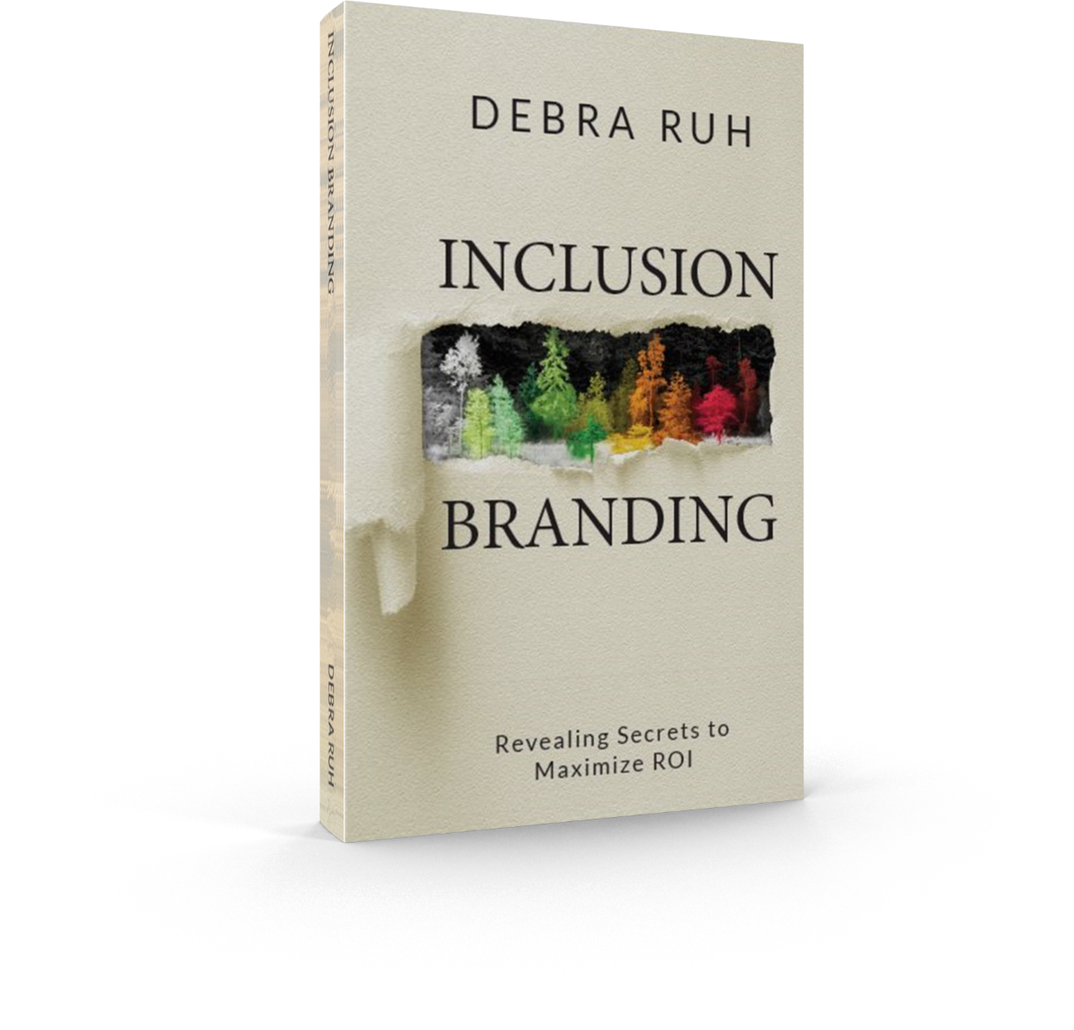


INCLUSION BRANDING: REVEALING SECRETS TO MAXIMIZE ROI
How Brands Can Learn to Engage with the Community of Persons with Disabilities and other minorities to Create Solid ROI and Positive Social Impact. This book is essential for every CEO and entrepreneur.
Get free additional content at:
www.RuhGlobal.com/Inclusion-Branding/

Slide 5
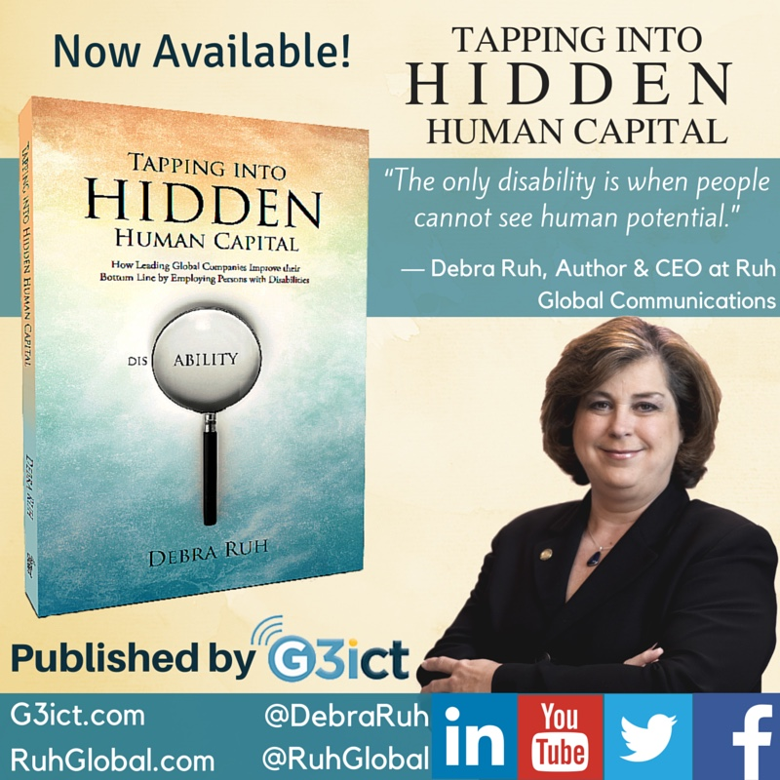
Tapping into Hidden Human Capital:
How Leading Corporations Leverage Multiple Abilities in Their Workforce

Slide 6
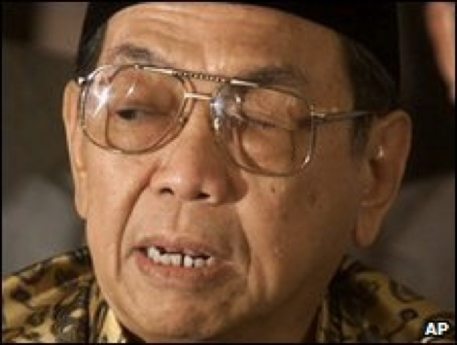


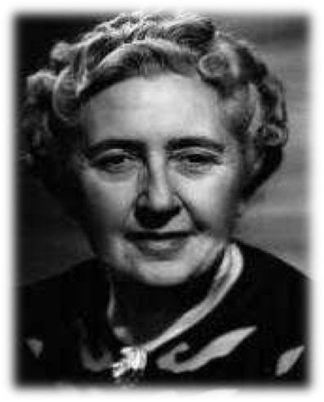


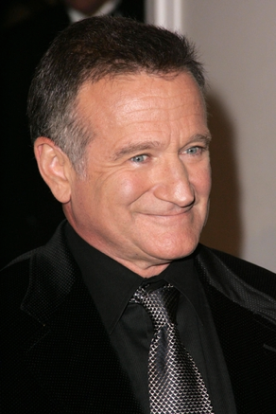
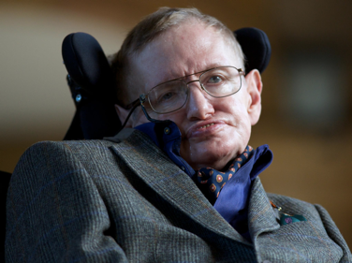

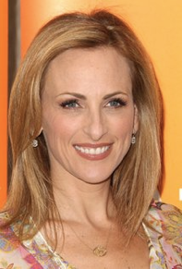

What do they have in common?

Slide 7
What do they have in common? Part 2
Agatha Christie: Dysgraphia
Robin Williams: Bipolar & ADHD
Sudha Chandran: Amputee
Steven Hawkins: ALS
Former Indonesian President Abdurrahman Wahid: Blind
Deepika Padukone: Depression
Michael J. Fox: Parkinson
Marlee Matlin: Deaf
Sir Richard Branson: Dyslexia
Stevie Wonder: Blind
Beethoven: Deaf

Slide 8

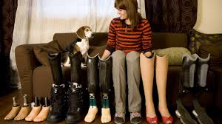




The World Has Changed
Numbers of Persons with Disabilities are on the rise!
Globalization
Medical Advancements
Technology
CRPD
Digital Divide
CSR
Notes:
The number of people with disabilities is on the rise due to many factors.
Technological advances
Globalization
Countries are taking major steps to ensure the rights of people with disabilities.
UN Convention on the Rights of Persons with Disabilities. (CRPD)
Reduction of Digital Divide
Corporate Social Responsibilities

Slide 9


ROI & Shareholder Value vs. Charity
Corporate engagement with our community is now about ROI and increased shareholder value. Time to move away from charity or only Corporate Social Responsibility (CSR).
Improvements pursued by a corporation to streamline their process for improved accessibility and inclusion within its workforce are providing differentiators for brands.
Brands must realize that these efforts provide increased productivity for its employees and better solutions for their customers (with and without disabilities). Equating to positive ROI. Resulting in competitive advantages and larger returns to the Shareholders.

Slide 10




How ADA, United States and ICT Accessibility is supporting Global Change!
Legislation
Social Media
Litigation
Brand
Notes:
ICT Accessibility efforts provide increased opportunities in social inclusion, employment, and education for persons with
disabilities.
Legislation and Litigation: Countries legislation and Litigation in countries like the US Accessibility everyone is benefiting from those efforts.
New Technology: IOT, Smart Cities, Robotics, 3D Printing and Wearables are changing the world for everyone. These technologies hold special promise for community of persons with disabilities.
Social Media: Persons with Disabilities and the ICT Accessibility communities are eagerly engaging via social media to assure access for all. #AXSChat – 2nd largest tweet chat in the world, Human Potential At Work Facebook Group and Human Potential at Work Podcast on iTunes, Stitcher, & IHeartRadio are a few examples.

Slide 11
Global Disability Stats
More than one billion people, or about 15% of the world's population live with disabilities – that’s 1 in 7 people. 1 in 5 people identify as having a disability in the United States
Russia
13 to 15 Million
Canada
3.8 million
Europe
39 Million
China
60 million
130M+ over 60
United States
60 Million and 1 in 3 households impacted
UK
8.6 Million
Japan
5 million and 127.8 are elderly
Middle East
50 Million
Africa
80 Million
India
40 to 80 Million
Latin America & Caribbean
50 Million
Australia
1 in 5 people or 4 million
Statistics Source: World Health Organization
3
Notes:
Measuring disabilities because of census
US Stats source: U.S. Census Bureau; The percentage of people with disabilities is larger than any single ethnic, racial, or cultural group. In the US at 19.3%, the number of people with disabilities exceeds the next largest group – Hispanic people (14.9%) – by a fairly wide margin.
In the UK, the numbers are equally as large. For example — CSR Europe, a European business network of Corporate Social Responsibility, estimates that 8.6 million people (aged 16 and over) self-identify as having a disability, which translates into 15% of the population.
14% of working age population has a disability
58% of people with disabilities of working age are non-working
Source: European Community Household Panel Study, 1996
The over sixty-five population is anticipated to rise from 15.5% of the EU population in 1995 to 22.4% by 2025.
Those over 50 years of age currently account for one fifth of the UK population, and they own more than 80 percent of the country’s asset wealth and are the group most likely to vote in general elections. Surprising to some, 33% of 50-60 year olds now have a disability.
Many think of disabilities in extreme terms such as blindness and deafness, but it also includes many others with visual or hearing impairments that are increasingly common in our aging population, and other challenges such motor and cognitive impairment.
According to the National Organization on Disabilities, 1 out of 3 households in the U.S. are impacted by disabilities.
According to the 2010 Census Bureau, the US population of Persons with Disabilities is 56.7 million, demographically described as being 5 years of age or older and non-institutionalized. This equates to 19% of the entire US population.
Europe estimates that 39 million people have a disability.
http://www.ada.gov/buisstat.htm date accessed 02/22/2015
http://g3ict.org/resource_center/newsletter/news/p/id_273 date accessed 02/22/2015
http://www.boston-ia.org/library/presentations/gribbons_presentation_2005.html date accessed 02/22/2015
http://www.slideshare.net/NordeaBank/nordea-csr-report-2013 date accessed 02/22/2015
http://serviceandinclusion.org/index.php?page=basic date accessed 02/22/2015
http://www.disabled-world.com/disability/statistics/us-disability-stats.php date accessed 02/22/2015
https://euobserver.com/disability/118249 date accessed 02/22/2015
Japan 65% of people with disabilities of working age are non-working Source: Ministry of Health and Welfare
Australia, 18% of working age population has a disability, Source: Australian Bureau of Statistics, 2001

Slide 12


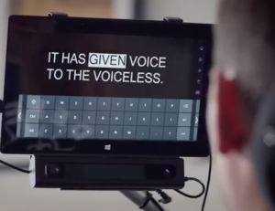


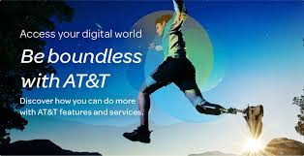

Market Opportunity
5

Slide 13

Disruption: Mainstream Technology & Globalization
6

Slide 14
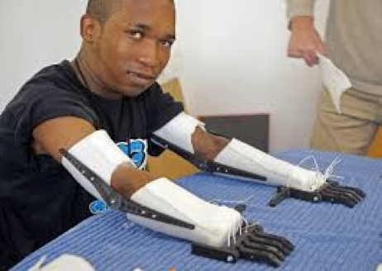
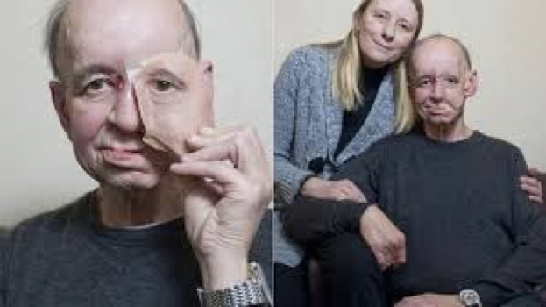

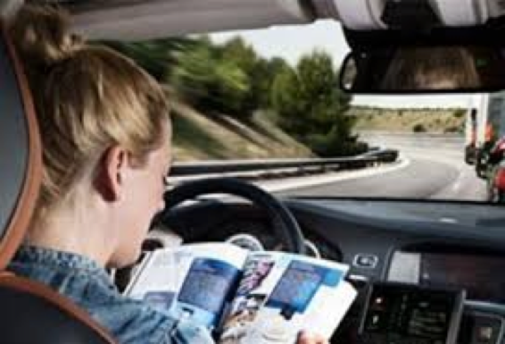
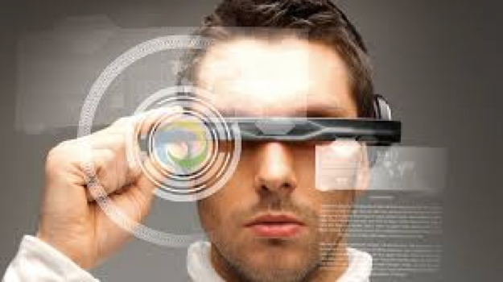
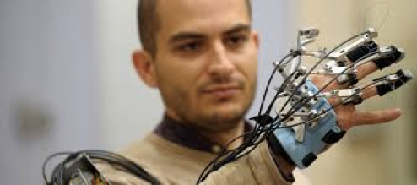

ICT is Changing the World for PwD
≈
7

Slide 15
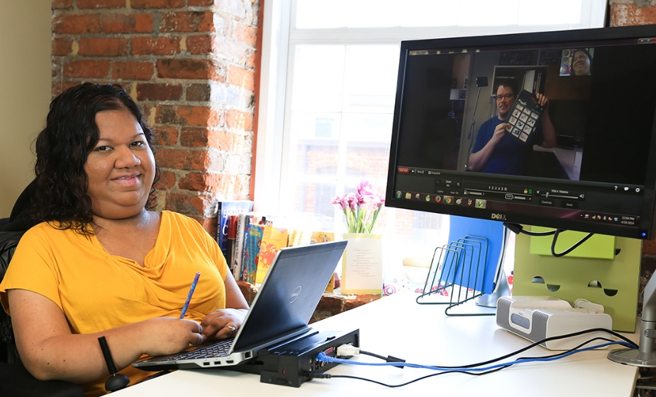
Inclusive Workforce Features
What are the features of an Inclusive Workplace?
  Policies and Procedures
  Accessibility
  Universal Design
  Inclusion
  Accommodations
  Training
  Future of Work
Liz, AMAC employee working at her accessible computer desk Photo from AMAC Accessibility Solutions

Slide 16
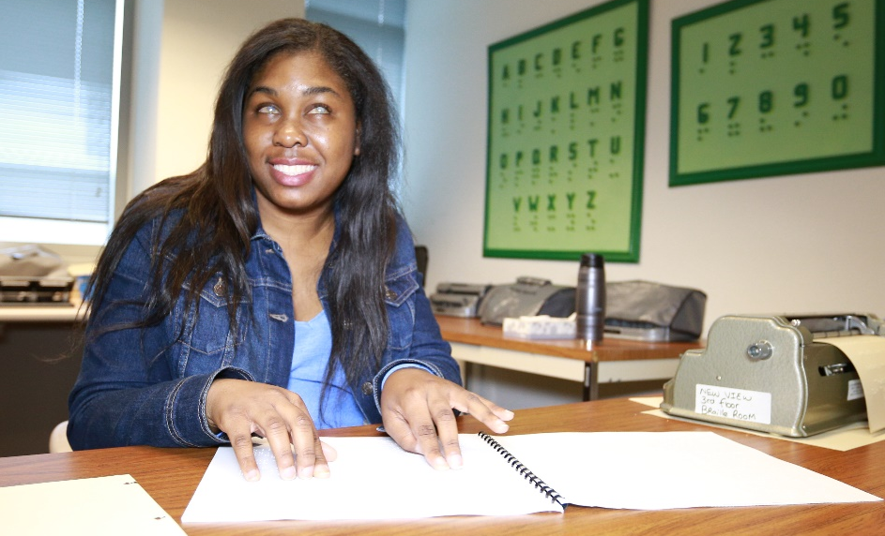
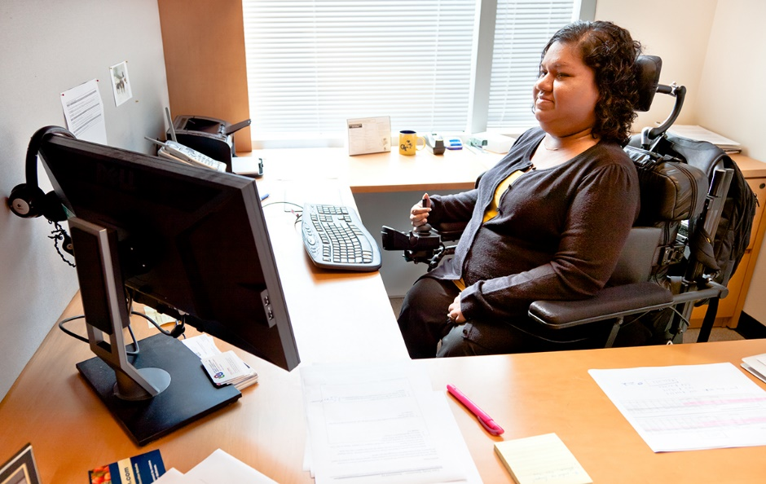
Myths about Employment of PwD
Myth: People with disabilities do not have the talent and skills needed in business
Fact: People with disabilities have been among the greatest leaders and contributors to business, science, the arts, and society. 11% of this year’s college graduates have disabilities!
Myth: People with disabilities leave jobs more frequently than workers without disabilities
Fact: Employees with disabilities in most sectors stay on the job longer, resulting in up to a 6% turnover rate improvement.
Myth: People with disabilities have a higher than average absentee rate and your worker’s comp claims will increase
Fact: In fact, people with disabilities who are employed have less overall absenteeism and the number of compensation claims are no different.
Lakeisha Holmes reading Braille. Photo from AMAC Accessibility Solutions
AMAC employee, Liz working at her desk. Photo from AMAC Accessibility Solutions

Slide 17
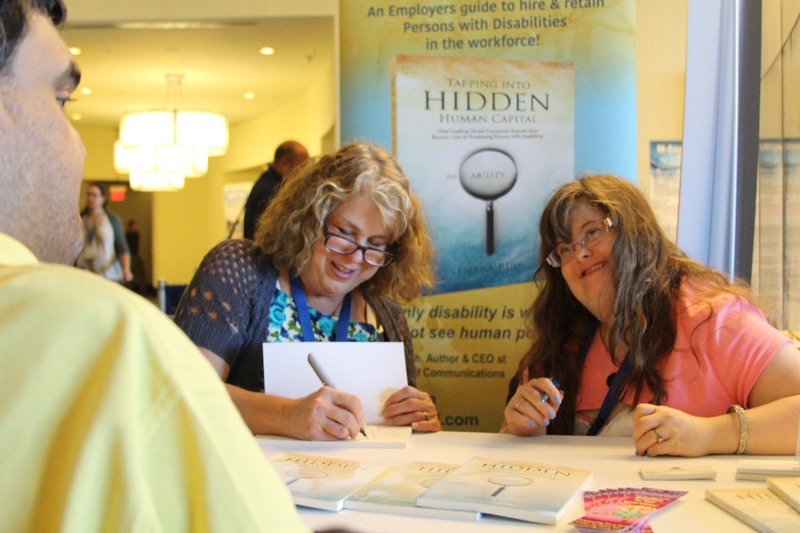
Seamless Integration
Integrating persons with disabilities into an organization’s workplace, marketing/branding efforts, and accessibility of products and services.
These efforts are good for the bottom-line and the brand’s image.
Societies function better when everyone is giving the opportunity to contribute and participate.
Debra and Sara Ruh at a Book Signing

Slide 18

Direct Path to the Community
Advance technology has created a new model that has broken down barriers to this Global Community of PwD’s, family and friends. The community is active, engaged, and is a strong purchasing power.
A direct bidirectional path to consumers with disabilities.
Model that is Business to Consumer and Consumer direct to Business.
This is due in great part to the advancements with Social media being a critical global marketing platform.

Slide 19

Employers who hire PwD

Slide 20
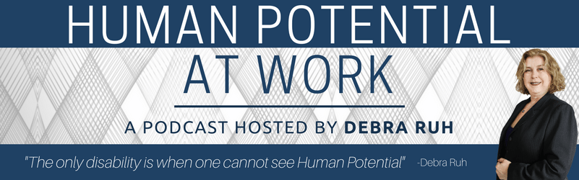
Human Potential at Work
Filmed live on Facebook, Captioned, Audio becomes Podcast and Radio Program on over 25 channels. Global Audience in 83 countries and 113 regions.
Social Impact, Inclusion, and Empowerment of everyone including Persons with Disabilities. How do we bring out the potential in all people, including those with disabilities? Get ready to be inspired, hear success stories and learn tips and principles for bringing out the best in everyone.
Please subscribe and give us a review: http://www.ruhglobal.com/podcasthuman-potential-work/

Slide 21
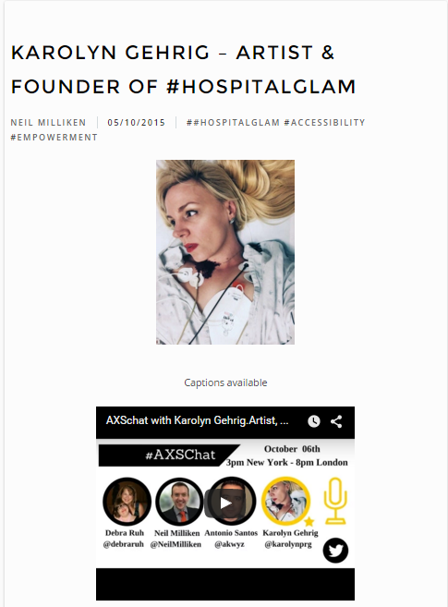
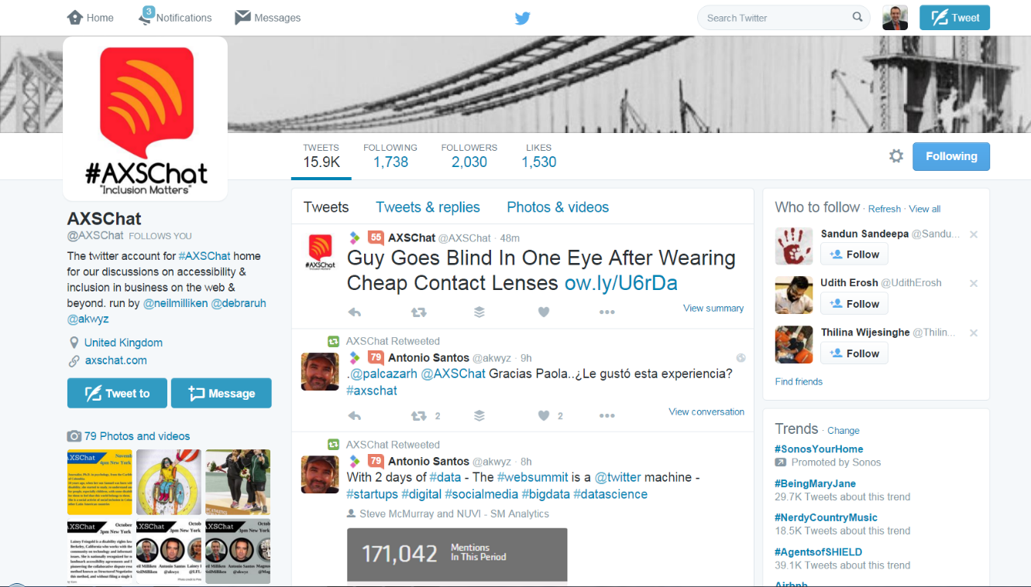
#AXSChat TweetChat on
Disability Inclusion & Accessibility
One of the World’s largest tweet chat on Twitter
Hosts: Debra Ruh, Neil Milliken and Antonio Santos
www.AXSChat.com

Slide 22




In Summary…
The business case is clear
Technology is redefining the workforce
Corporations are leading the change
All of us must be agents of this change
Notes:
Equality, Performance, Brand, Societal Good
Integrating and accommodating employees with disabilities into an organization’s workplace, marketing efforts, and assuring your products and services are accessible to your customers are critical to your brand and bottom-line.
People with disabilities have been among the greatest leaders and contributors to business, science, the arts, and society.
There is no significant difference between the productivity of employees with disabilities and employees without disabilities, particularly in knowledge-related business.
Societies function better when everyone is giving the opportunity to contribute and participate.

Slide 23
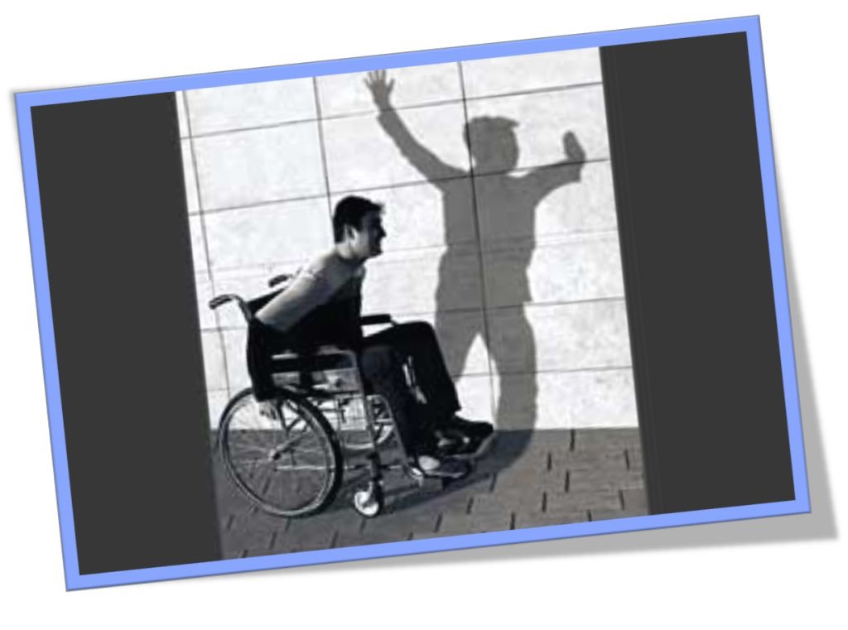
QUESTIONS ???

Slide 24
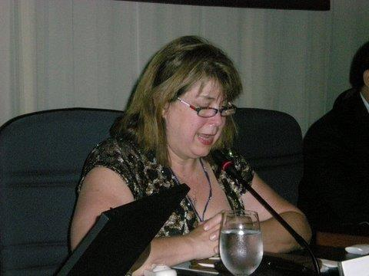
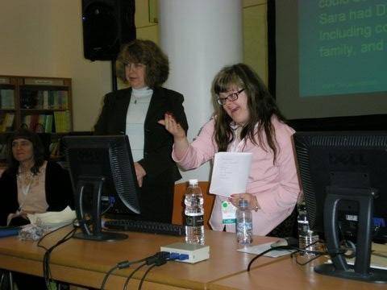


Contact Data
Debra Ruh
CEO, Ruh Global Communications
AXSChat Co-Founder
Ph: +01 (804) 986-4500
Email: Debra@RuhGlobal.com
Web: www.RuhGlobal.com
Twitter: @debraruh
Program: goo.gl/mLRMPk

