Slide 1

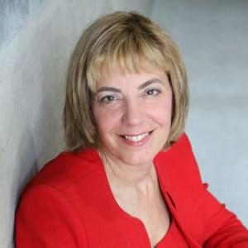
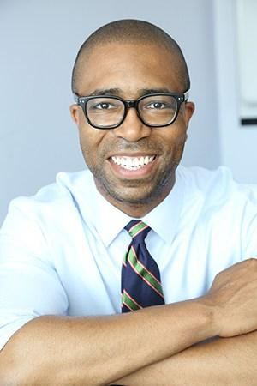
Introduction
Advancing Jobs for People with Disabilities
June 20^{th,} 2018: RespectAbility Volunteer Training
Jennifer Laszlo Mizrahi, President, RespectAbility
Calvin Harris, Chairman, Respect Ability
Contact: JenniferM@RespectAbility.org
202-517-6272

Slide 2
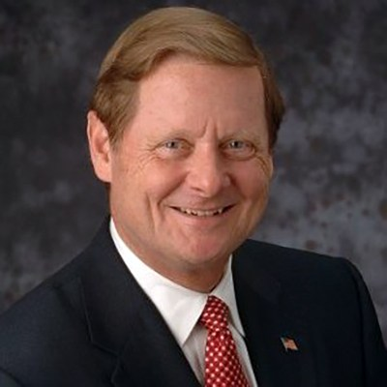
Intro to Speakers 1
Steve Bartlett
Vice Chair,
Board of Directors
The Honorable Representative Bartlett, Vice Chair of RespectAbility’s Board of Directors, previously served as a member of Congress for eight years, authoring 18 major pieces of legislation. Most notably, Bartlett was the President and CEO of the Financial Services Roundtable in Washington, D.C., the Mayor of Dallas, and a board member of several for-profit and non-profit organizations. Currently, he is a Senior Advisor with Treliant Risk Advisors.

Slide 3
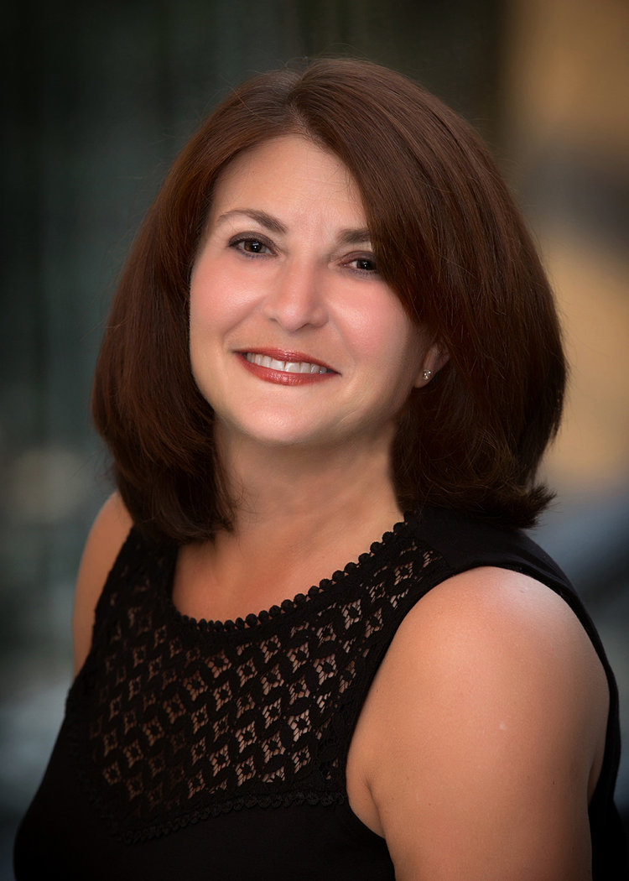
Intro to Speakers 2
Donna Meltzer
Board of Advisors
Meltzer serves as the CEO of the National Association of Councils on Developmental Disabilities (NACDD), a national nonprofit organization that supports the nation’s
56 governor-appointed Developmental Disabilities Council. She is a past chairwoman for the Consortium for Citizens with Disabilities and the National Health Council Government Relations Affinity Group.

Slide 4
Advocacy 101
The Importance of Advocacy

Slide 5
Self-Advocacy and Systems Change
It is critically important for people with disabilities to advocate for themselves. Often that is referred to as self-advocacy
The Developmental Disabilities Assistance and Bill of Rights Act of 2000 (P.L. 106-402) includes a mandate that the Councils on Developmental (a.k.a. the DD Councils) “support opportunities for individuals with developmental disabilities who are considered leaders to provide leadership training to individuals with DD who may become leaders”
Self-Advocacy happens in different ways and at different levels
  Advocating for your own needs
  Advocating for yourself and for others
  Advocating to change larger systems and creating policy change

Slide 6
What is a DD Council?
DD Councils are established in law and appointed by Governors
There is one in every state and territory of the US – by law the Council must be 60% people with developmental disabilities or family members
DD Councils work through public policy and advocacy to make communities more welcoming and accessible for people with disabilities to live, learn, work and play
DD Council educate and inform policymakers at all levels about the needs of people with intellectual and developmental disabilities and look for innovative solutions to problems

Slide 7
Innovative Solutions
Florida needed to solve a transportation problem –
The DD Council brought together a team of people from the Council, from the Florida Department of Transportation and private transportation companies to assess the problem, the wants and needs of people with disabilities, and came up with a plan
After the plan was enacted an evaluation was conducted to see how effective the solution was

Slide 8
How do I participate?
Those serve on the DD Council are appointed by the Governor so not everyone can join the Council. But there are other ways to be involved and meetings are open to all to attend and listen
DD Councils host community programs and forums on various topics
DD Councils often hold Capitol Days where advocates can come and join a team of people who go to the legislators’ offices to talk about their needs and concerns
DD Councils visit regularly with their Governor and Lt. Governor to share information

Slide 9
What Else Do DD Councils Do?
Many DD Councils support (with staff, with funding, or other means) statewide and local self-advocacy organizations – these organizations work to develop an advocacy agenda and work to educate local boards, committees, and policymakers about important issues such as housing, healthcare, education and transportation. Self-advocacy organizations teach leadership skills and help advocates to be effective and authentic voices in their communities and showcase that people with disabilities can and must be part of the planning in their community.

Slide 10
Advocacy Training
Many DD Councils sponsor advocacy training programs. Some are for adults with disabilities and family members and professionals. Some are for teenagers or young adults
These advocacy training programs teach the history of disability policy, the skills of advocacy, and help people with disabilities learn how to be engaged in local advocacy work
Many DD Councils also help make sure that people with disabilities know their rights and responsibilities in their civic communities including in the election process

Slide 11
What NACDD Offers
NACDD is the national non-profit, non-partisan membership organization for the 56 DD Councils
NACDD launched in 2015. It is a website for people who startyourjourney.org want to advocate whether they are experienced long-time advocates or brand new. The website includes a handbook called, The Art of Impact: A Handbook for Living a Self-Determined Life.
NACDD works with a lot of other organizations to ensure that people with disabilities are part of the election process,
NACDD developed the website onevotenow.org which is a curated site of information for people who want to know important information about upcoming elections and how they can participate.

Slide 12
Want to Learn More?
If you are not familiar with your state or territory’s DD Council, you can find out more on-line at nacdd.org
Your local Council can help you identify ways to get involved locally or find a training
DD Councils post all information on their websites about meetings, events, and advocacy days
Get Involved!!!!

Slide 13
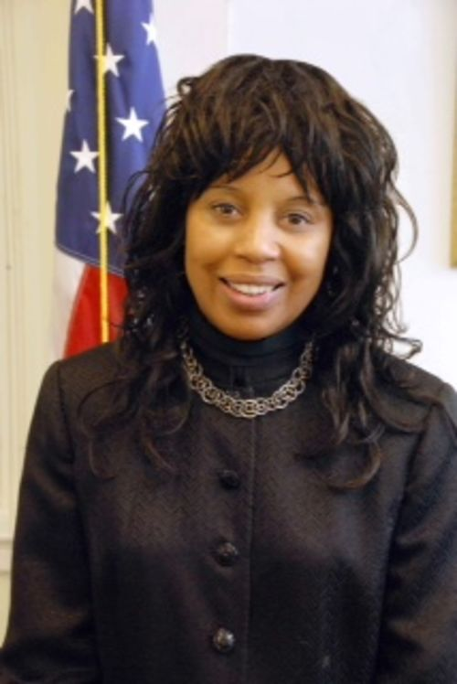
Intro to Speakers 3
Janet LaBreck
Board of Directors
LaBreck served as the Former Commissioner for the Rehabilitation Services Admin-istration (RSA) under the Obama administration, resulting in the most substantive regulation changes to the vocational rehabilitation program in over
15 years. In 2017, the New England College of Optometry honored her by naming its rehabilitation clinic the Janet L. LaBreck Center for Low Vision Rehabilitation.
Most recently, she established the Janet L. LaBreck Consulting LLC and became a partner for Synergy Consulting Partners.

Slide 14
Workforce Innovation
& Opportunity Act (WIOA)
Obama Administration:
Passed on July 22, 2014
  Creates a more diverse and inclusive workforce;
  Unites organizations to streamline job driven services to job seekers;
  Gives Americans the opportunity to improve outcomes in terms of competitive, integrated employment for people with disabilities.
RespectAbility:
The only disability organization in the nation to have reviewed and commented on all 50 state WIOA plans;
RespectAbility’s testimony, data, and feedback have already been directly integrated in the state plans for CA, CO, HI, ID, NV, OK, OR and WY.

Slide 15
Op-eds: The Goal
What are Op-eds?
  An opportunity to get your voice heard;
  A chance to educate the public through facts and personal experiences;
  An opportunity to change public opinion and improve legislation.
What should Op-eds say?
  Most people with disabilities want to work;
  Nearly three-quarters of people with disabilities want jobs and independence more than benefits;
  Hiring people with disabilities can increase company profitability and save taxpayers money.

Slide 16
Op-eds: The Message
Equality: Our nation was founded on the principle that anyone who works hard should be able to get ahead in life. People with disabilities deserve the same opportunities.
Successful Employees: Companies
(like EY, JPMC and Coke-a-Cola)
have shown that employees with
disabilities can be loyal, successful,
and help them make more money.
If we find the right jobs,
it can and does increase the
bottom line of companies.
Changing Legislation:
Studies show the most people with disabilities want to work. Public policies
that help people with
disabilities get and keep
jobs enable people with disabilities
the dignity and financial benefits of work,
grow our economy,
and save taxpayer money.

Slide 17
State by State Testimony
Alabama: Download the PDF here. Download the PPT here
Alaska: Download the PDF here. Download the PPT here
Arizona: Download the PDF here. Download the PPT here
Arkansas: Download the PDF here. Download the PPT here
California: Download the PDF here. Download the PPT here
Colorado: Download the PDF here. Download the PPT here
Connecticut: Download the PDF here. Download the PPT here
DC: Download the PDF here. Download the PPT here
Delaware: Download the PDF here. Download the PPT here
Florida: Download the PDF here. Download the PPT here
Georgia: Download the PDF here. Download the PPT here
Hawaii: Download the PDF here. Download the PPT here
Idaho: Download the PDF here. Download the PPT here
Illinois: Download the PDF here. Download the PPT here
Indiana: Download the PDF here. Download the PPT here
Iowa: Download the PDF here. Download the PPT here
Kansas: Download the PDF here. Download the PPT here
Kentucky: Download the PDF here. Download the PPT here
Louisiana: Download the PDF here. Download the PPT here
Maine: Download the PDF here. Download the PPT here
Maryland: Download the PDF here. Download the PPT here
Massachusetts: Download the PDF here. Download the PPT here
Michigan: Download the PDF here. Download the PPT here
Minnesota: Download the PDF here. Download the PPT here
Mississippi: Download the PDF here. Download the PPT here
Missouri: Download the PDF here. Download the PPT here
Montana: Download the PDF here. Download the PPT here
Nebraska: Download the PDF here. Download the PPT here
Nevada: Download the PDF here. Download the PPT here
New Hampshire: Download the PDF here. Download the PPT here
New Jersey: Download the PDF here. Download the PPT here
New Mexico: Download the PDF here. Download the PPT here
New York: Download the PDF here. Download the PPT here
North Carolina: Download the PDF here. Download the PPT here
North Dakota: Download the PDF here. Download the PPT here
Ohio: Download the PDF here. Download the PPT here
Oklahoma: Download the PDF here. Download the PPT here
Oregon: Download the PDF here. Download the PPT here
Pennsylvania: Download the PDF here. Download the PPT here
Rhode Island: Download the PDF here. Download the PPT here
South Carolina: Download the PDF here. Download the PPT here
South Dakota: Download the PDF here. Download the PPT here
Tennessee: Download the PDF here. Download the PPT here
Texas: Download the PDF here. Download the PPT here
Utah: Download the PDF here. Download the PPT here
Vermont: Download the PDF here. Download the PPT here
Virginia: Download the PDF here. Download the PPT here
Washington: Download the PDF here. Download the PPT here
West Virginia: Download the PDF here. Download the PPT here
Wisconsin: Download the PDF here. Download the PPT here
Wyoming: Download the PDF here. Download the PPT here

Slide 18
Op-eds: How-To
Keep it simple and straightforward Do not use jargon.
Use your personal experiences – You are in a unique position to shape the public image for people with disabilities
Use facts and doublecheck for accuracy
Use “people-first” language –terms that respect people with disabilities Ex: a person who is blind vs. a blind person
Introduce your topic and argument in first paragraph
Give 3-6 facts that support your argument
Ensure each paragraph supports your argument
Be your own critic
Typically, stick to a 500-700 word length

Slide 19
Op-eds: Where to Go
Decide where you want to get press and publish your op-ed
  Who best covers disability issues?
Consider any personal, local, or regional ties
  Who do you know?
If possible, send by email with a short note to introduce yourself, your topic, and its relevance.
  Include your full name, telephone number, and email in correspondence.

Slide 20
Op-eds: Examples
False Stereotypes of People With Disabilities Hold Employers Back
By Jennifer Laszlo Mizrahi, President of RespectAbilityUSA Huffington Post, May 22, 2014 http://www.huffingtonpost.com/jennifer-laszlo-mizrahi/false-stereotypes-of-peop_b_5353818.html
A Better Bottom Line: Employing Individuals With Disabilities
By Jack Markell, Gov. of Delaware Huffington Post, Aug. 13, 2013
http://www.huffingtonpost.com/gov-jack-markell/a-better-bottom-lineempl_b_3749414.html
Disability advocates laud governors' jobs focus
By Cindy Bentley, Daniel Bier, Joan Karan, Lisa Pugh And Beth Swedeen Journal Sentinel (Milwaukee), Aug. 1, 2013 http://www.jsonline.com/news/opinion/disability-advocates-laud-governors-jobs-focus-b9966299z1-217983671.html
People with disabilities are rapidly joining the workforce. That's a hopeful trend.
By Fmr. Gov. Jack Markell (D-DE). USA Today, February 22, 2018 https://www.usatoday.com/story/opinion/2018/02/22/people-disabilities-rapidly-joining-workforce-parallel-tv-trend-jack-markell-column/355728002/
Ford’s Push on Disability Rights Should Be a Model for Philanthropy
By Steve Bartlett and Tony Coelho
https://www.philanthropy.com/article/Opinion-Ford-s-Push-on/237762

Slide 21
State-Level Work:
Governors are Partners
The nation’s governors are critical partners in the continuing effort to advance job opportunities for millions of people with disabilities.
Governors drive policy, prioritize programs, and bring attention to what people with disabilities can accomplish if and when given a fair chance.
Contact their offices to learn about public events!
RespectAbility met with 44 governors to discuss disability employment and to advocate for best practices.
  A nonpartisan endeavor, connecting all governors to promote the idea that people with disabilities deserve the opportunity to work and achieve independence.

Slide 22
State-Level Work:
Governors and NDEAM
A Better Bottom Line: Employing People with Disabilities
  National Governors Association Initiative 2012-2013
  Sparked a 8.6% increase of employment among people with disabilities in Delaware
Governors came together in 2017 to celebrate National Disability Awareness Month (NDEAM)
  26 governors showed support through public proclamations, executive orders and press statements.
  Gov. Terry McAuliffe of VA: “Career Pathways for Individuals with Disabilities (CPID)” to “close the skills gaps and create a pipeline of young adults, including those with disabilities” to go into advance careers in science and technology.
  Gov. Larry Hogan of MD: Employment is “the most direct and cost-effective means to empower people with disabilities to achieve independence” and highlighted self-employment “as a growing and viable option for many with disabilities.”

Slide 23
Local Workforce Systems
Want to help further? Contact your local:
Workforce Development Boards, that:
  Direct federal, state, and local funding to workforce development programs;
  Oversee the American Job Centers, where job seekers can find employment information, career training, and other programs in their localities.
Youth Councils, that:
  Connect and guide local youth programs and policy.
For more information:
  The Career One Stop: https://www.careeronestop.org/LocalHelp/WorkforceDevelopment/workforce-development.aspx

Slide 24
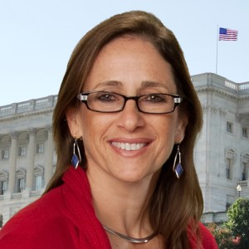
Contact Information
Debbie Fink
Director, Community Outreach & Impact
DebbieF@RespectAbility.org
11333 Woodglen Drive, Suite 102
Rockville, MD 20852
Office: (202) 517-6272
Cell: (301) 518-1715
www.RespectAbility.org

