Slide 1

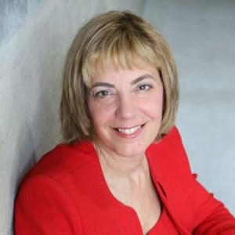
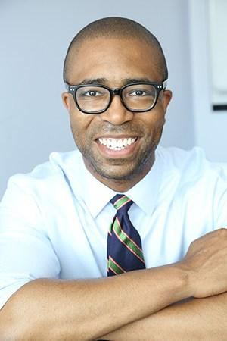
Education and Skills Building for People with Disabilities
June 29^{th,} 2018: RespectAbility Volunteer Training
Jennifer Laszlo Mizrahi, President, RespectAbility
Calvin Harris, Chairman, Respect Ability
Contact: JenniferM@RespectAbility.org
202-517-6272

Slide 2
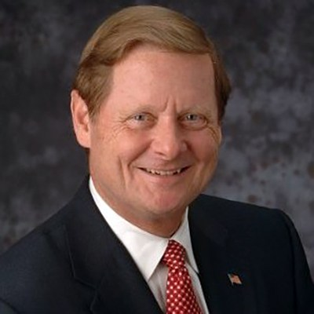
Speakers #1
Steve Bartlett
Vice Chair,
Board of Directors
The Honorable Representative Bartlett, Vice Chair of RespectAbility’s Board of Directors, previously served as a member of Congress for eight years, authoring 18 major pieces of legislation. Most notably, Bartlett was the President and CEO of the Financial Services Roundtable in Washington, D.C., the Mayor of Dallas, and a board member of several for-profit and non-profit organizations. Currently, he is a Senior Advisor with Treliant Risk Advisors.

Slide 3
Civic Engagement Etiquette
In meetings with a public audience, remember to:
Arrive 15 – 30 minutes early.
Sit in the 2nd or 3rd row.
Ask a 15-30 second question in a friendly, respectful way.
    * Don’t ask the first question; try to ask the 2nd – 5th question.
Listen intently to answer.
Write down notes.
Afterwards, connect with others from different organizations.

Slide 4
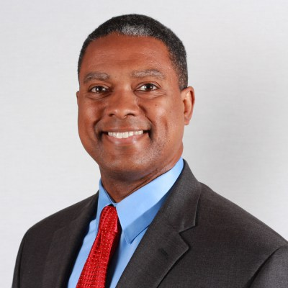
Speakers #2
Gerard Robinson
Board of Directors
Gerard Robinson is the executive director of the Center for Advancing Opportunity (CAO), and a resident fellow at the American Enterprise Institute (AEI). His research areas include parental choice in the public and private schools, regulatory development and implementation of K-12 standards, to name a few. His previous positions include Commissioner of Education for the State of Florida, Secretary of Education for the Commonwealth of Virginia, and President of the Black Alliance for Educational Options.

Slide 5
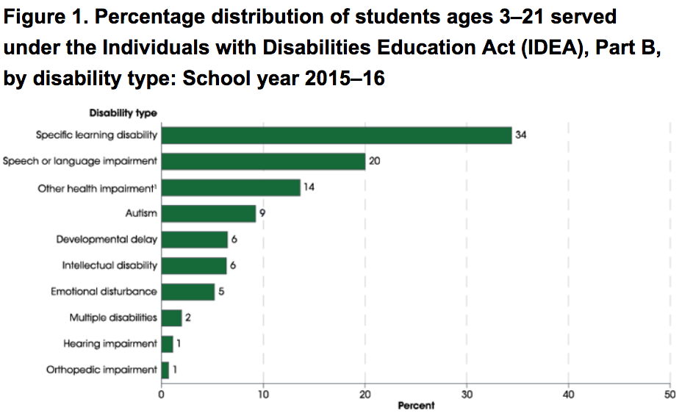
Individuals with Disabilities Education Act (IDEA)
Students Under IDEA
“In 2015-16, the number of students ages 3-21 receiving special education services was 6.7 million, or
13 percent of all public school students. Among students receiving special education services, 34 percent had specific learning disabilities.”
Source: NCES The Condition of Education: Children and Youth with Disabilities
Notes:
https://nces.ed.gov/programs/coe/indicator_cgg.asp#f1

Slide 6
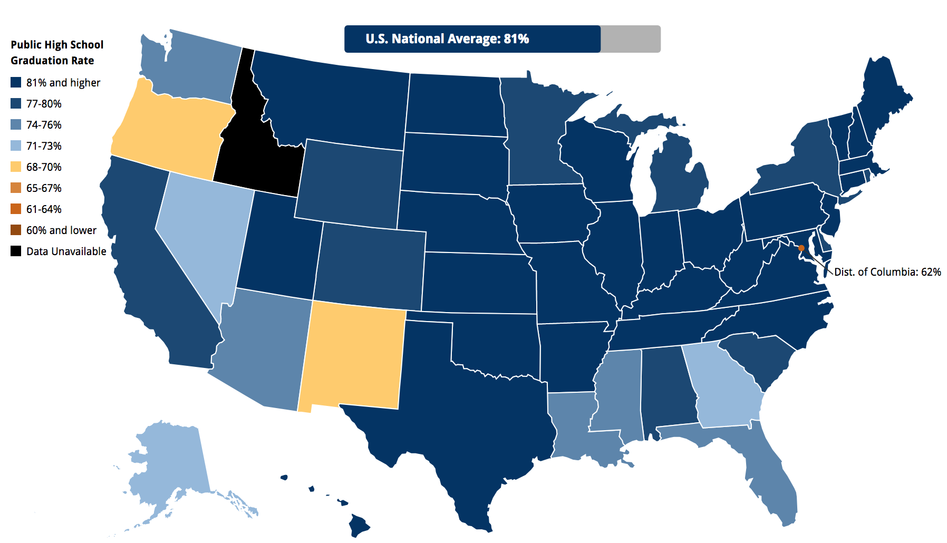
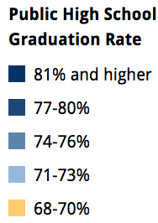
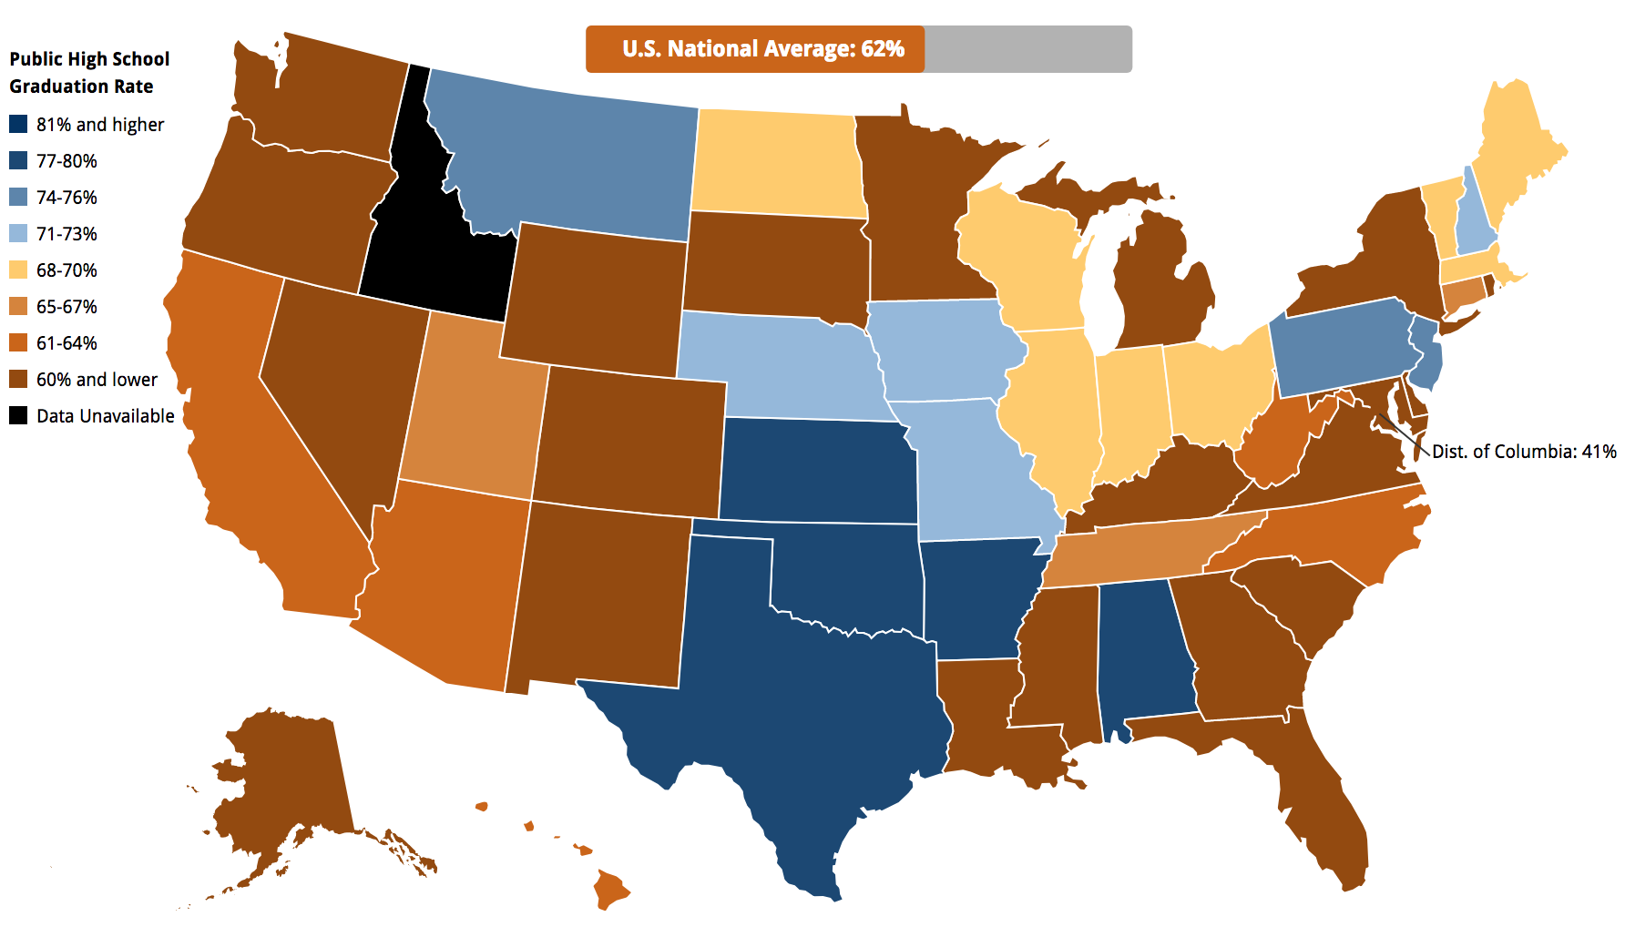



Graduation Disparities (2012-2013)
Total National Public High School Graduation Average:
81%
National Public High School Graduation Average for Students with Disabilities : 62%
FACT: Students with disabilities have lower graduation rates than students without disabilities. This gap has increased in recent years.
Notes:
Fact source: https://nces.ed.gov/ccd/tables/ACGR_RE_and_characteristics_2013-14.asp

Slide 7
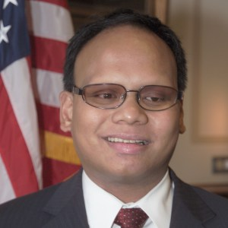
Speakers #3
Ollie Cantos
Board of Advisors
Ollie Cantos is the Special Assistant to the Acting Assistant Secretary for Civil Rights at the U.S. Department of Education and Member of the President’s Committee for People with Intellectual Disabilities (PCPID). He is also the Chairman of the Board of Advisors for Scholarships for Eagles, Board Member of the Virginia Organization of Parents of Blind Children, Attorney Mentor for the American Bar Association Commission on Disability Rights, and Member of the United States Coast Guard Auxiliary. Ollie is most grateful for his adoption of three blind triplet boys—Leo, Nick, and Steven.

Slide 8

Civil Rights Data Collection (CRDC)
What is CRDC?
  The CRDC is an online tool that collects and presents data on education and civil rights issues.
It can be found at: https://ocrdata.ed.gov/

Slide 9
How to Get Involved
Become an advocate:
  Write op-ed pieces for your local newspaper.
  Attend school board meetings:
    Amplify the voice for students with disabilities.
    Ask the board what resources they are providing for their students.
  Connect with RespectAbility for more opportunities
  on how to contribute to our work.
Always exercise Respect and assume Good Will!

Slide 10
Op-eds: The Goal
What are Op-eds?
  An opportunity to get your voice heard;
  A chance to educate the public through facts and personal experiences;
  An opportunity to change public opinion and improve legislation.
What should Op-eds say?
  Most people with disabilities want to work;
  Nearly three-quarters of people with disabilities want jobs and independence more than benefits;
  Hiring people with disabilities can increase company profitability and save taxpayers money.

Slide 11
Op-eds: The Message
Equality: Our nation was founded on the principle that anyone who works hard should be able to get ahead in life. People with disabilities deserve the same opportunities.
Successful Employees: Companies
(like EY, JPMC and Coke-a-Cola)
have shown that employees with
disabilities can be loyal, successful,
and help them make more money.
If we find the right jobs,
it can and does increase the
bottom line of companies.
Changing Legislation:
Studies show the most people with disabilities want to work. Public policies
that help people with
disabilities get and keep
jobs enable people with disabilities
the dignity and financial benefits of work,
grow our economy,
and save taxpayer money.

Slide 12
State by State Testimony
Alabama: Download the PDF here. Download the PPT here
Alaska: Download the PDF here. Download the PPT here
Arizona: Download the PDF here. Download the PPT here
Arkansas: Download the PDF here. Download the PPT here
California: Download the PDF here. Download the PPT here
Colorado: Download the PDF here. Download the PPT here
Connecticut: Download the PDF here. Download the PPT here
DC: Download the PDF here. Download the PPT here
Delaware: Download the PDF here. Download the PPT here
Florida: Download the PDF here. Download the PPT here
Georgia: Download the PDF here. Download the PPT here
Hawaii: Download the PDF here. Download the PPT here
Idaho: Download the PDF here. Download the PPT here
Illinois: Download the PDF here. Download the PPT here
Indiana: Download the PDF here. Download the PPT here
Iowa: Download the PDF here. Download the PPT here
Kansas: Download the PDF here. Download the PPT here
Kentucky: Download the PDF here. Download the PPT here
Louisiana: Download the PDF here. Download the PPT here
Maine: Download the PDF here. Download the PPT here
Maryland: Download the PDF here. Download the PPT here
Massachusetts: Download the PDF here. Download the PPT here
Michigan: Download the PDF here. Download the PPT here
Minnesota: Download the PDF here. Download the PPT here
Mississippi: Download the PDF here. Download the PPT here
Missouri: Download the PDF here. Download the PPT here
Montana: Download the PDF here. Download the PPT here
Nebraska: Download the PDF here. Download the PPT here
Nevada: Download the PDF here. Download the PPT here
New Hampshire: Download the PDF here. Download the PPT here
New Jersey: Download the PDF here. Download the PPT here
New Mexico: Download the PDF here. Download the PPT here
New York: Download the PDF here. Download the PPT here
North Carolina: Download the PDF here. Download the PPT here
North Dakota: Download the PDF here. Download the PPT here
Ohio: Download the PDF here. Download the PPT here
Oklahoma: Download the PDF here. Download the PPT here
Oregon: Download the PDF here. Download the PPT here
Pennsylvania: Download the PDF here. Download the PPT here
Rhode Island: Download the PDF here. Download the PPT here
South Carolina: Download the PDF here. Download the PPT here
South Dakota: Download the PDF here. Download the PPT here
Tennessee: Download the PDF here. Download the PPT here
Texas: Download the PDF here. Download the PPT here
Utah: Download the PDF here. Download the PPT here
Vermont: Download the PDF here. Download the PPT here
Virginia: Download the PDF here. Download the PPT here
Washington: Download the PDF here. Download the PPT here
West Virginia: Download the PDF here. Download the PPT here
Wisconsin: Download the PDF here. Download the PPT here
Wyoming: Download the PDF here. Download the PPT here

Slide 13
Op-eds: How-To
Keep it simple and straightforward
  Do not use jargon an/or technical terms
Share your personal experiences
  You are in a unique position to shape the public image for people with disabilities
Include facts and doublecheck for accuracy
Use “people-first” language: terms that respect people with disabilities
  Ex: a person who is blind vs. a blind person
Introduce your topic and argument in first paragraph
Give 3-6 facts that support your argument
Ensure each paragraph supports your argument
Be your own critic:
                “Why is this important?”
                “Why should others care?”
Typically, stick to a 500-700 word length

Slide 14
Op-eds: Where to Go
Decide where you want to get press and publish your op-ed
  Who best covers disability issues?
Consider any personal, local, or regional ties
  Who do you know?
If possible, send by email with a short note to introduce yourself, your topic, and its relevance.
  Include your full name, telephone number, and email in correspondence.

Slide 15
Op-eds: Examples
False Stereotypes of People With Disabilities Hold Employers Back
By Jennifer Laszlo Mizrahi, President of RespectAbilityUSA Huffington Post, May 22, 2014 http://www.huffingtonpost.com/jennifer-laszlo-mizrahi/false-stereotypes-of-peop_b_5353818.html
A Better Bottom Line: Employing Individuals With Disabilities
By Jack Markell, Gov. of Delaware Huffington Post, Aug. 13, 2013
http://www.huffingtonpost.com/gov-jack-markell/a-better-bottom-lineempl_b_3749414.html
Disability advocates laud governors' jobs focus
By Cindy Bentley, Daniel Bier, Joan Karan, Lisa Pugh And Beth Swedeen Journal Sentinel (Milwaukee), Aug. 1, 2013 http://www.jsonline.com/news/opinion/disability-advocates-laud-governors-jobs-focus-b9966299z1-217983671.html
People with disabilities are rapidly joining the workforce. That's a hopeful trend.
By Fmr. Gov. Jack Markell (D-DE). USA Today, February 22, 2018 https://www.usatoday.com/story/opinion/2018/02/22/people-disabilities-rapidly-joining-workforce-parallel-tv-trend-jack-markell-column/355728002/
Ford’s Push on Disability Rights Should Be a Model for Philanthropy
By Steve Bartlett and Tony Coelho
https://www.philanthropy.com/article/Opinion-Ford-s-Push-on/237762

Slide 16
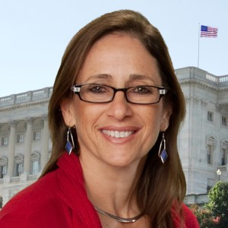
Contact Information
Debbie Fink
Director, Community Outreach & Impact
DebbieF@RespectAbility.org
11333 Woodglen Drive, Suite 102
Rockville, MD 20852
Office: (202) 517-6272
www.RespectAbility.org

